Slide 1
Basic Docker CLIs
Here’s the list of the basic Docker commands that works on both Docker Desktop as well as Docker Engine:

Slide 2
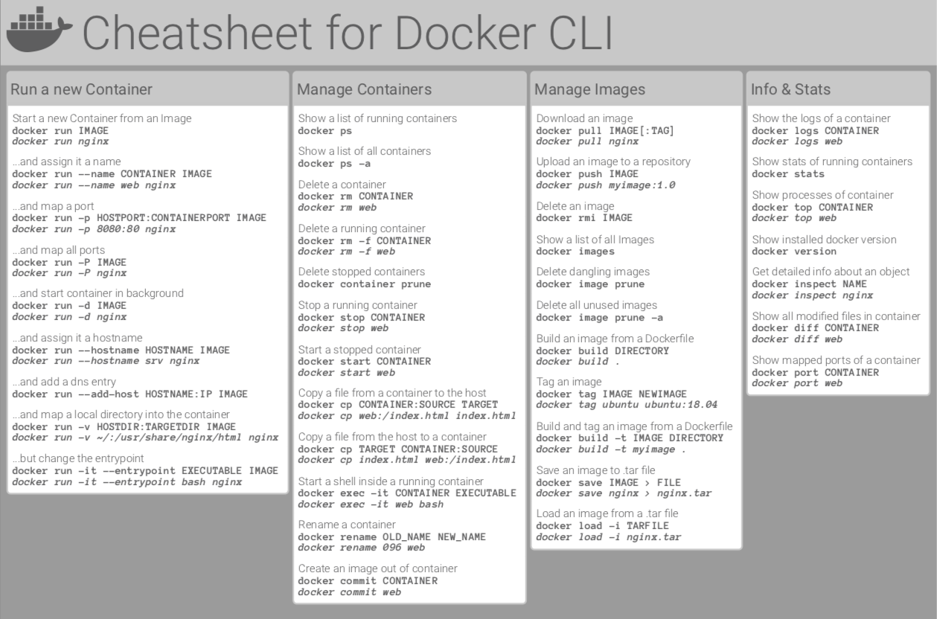

Slide 3
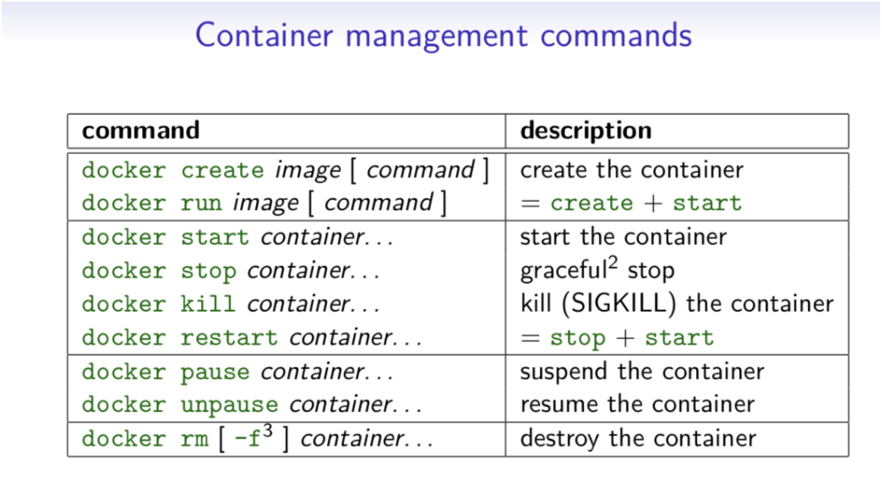
Container Management CLIs
Here’s the list of the Docker commands that manages Docker images and containers flawlessly:

Slide 4
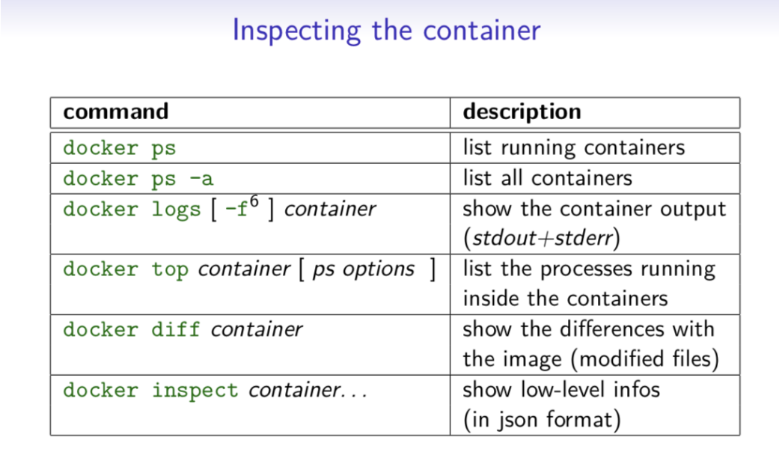
Inspecting The Container
Here’s the list of the basic Docker commands that helps you inspect the containers seamlessly:

Slide 5
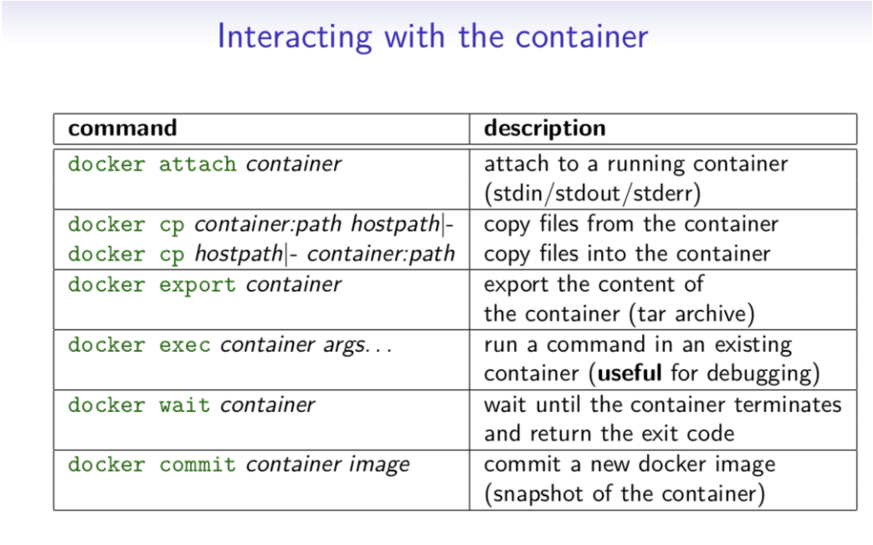
Interacting with Container
Do you want to know how to access the containers? Check out these fundamental commands:

Slide 6
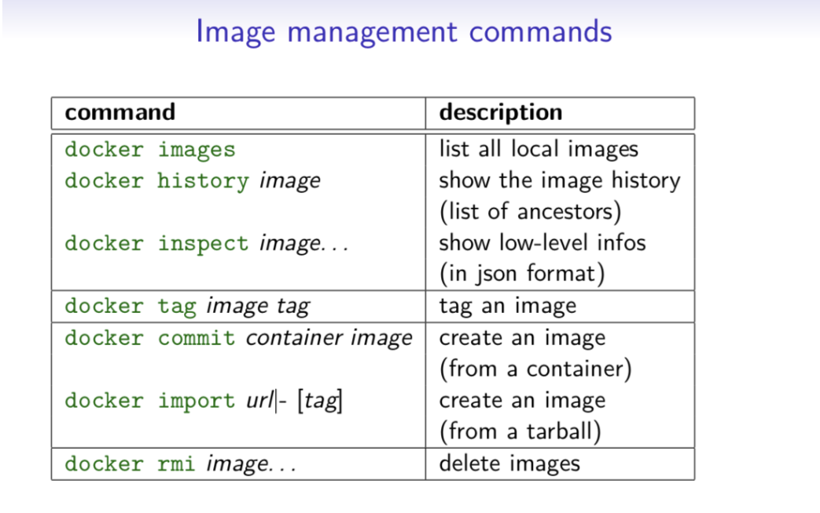
Image Management Commands
Here’s the list of Docker commands that helps you manage the Docker Images:

Slide 7
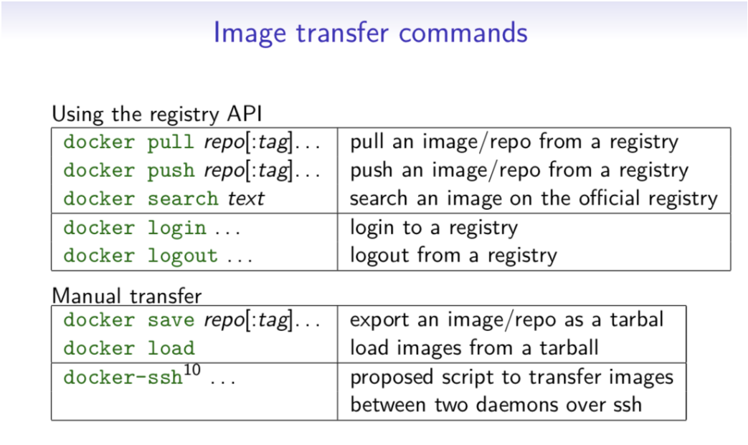
Image Transfer Commands
Here’s the list of Docker image transfer commands:

Slide 8
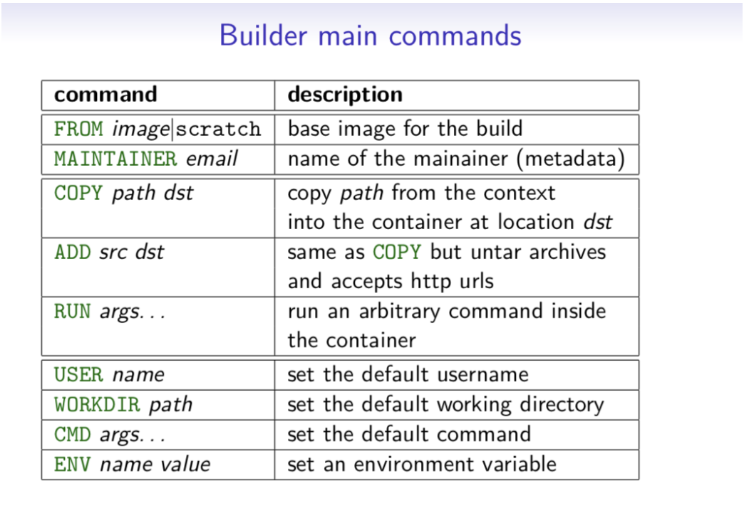
Builder Main Commands
Want to know how to build Docker Image? Do check out the list of Image Build Commands:

