Slide 1
NATURAL LANGUAGE PROCESSING
DS 250: Data Analytics and visualisation
G Sai Sudarshan

Slide 2
NATURAL LANGUAGE
PROCESSING(Telugu)

Slide 3
NATURAL LANGUAGE
PROCESSING(Telugu)
For students who primarily speak and understand Telugu, reading texts in their native language can be a more convenient and efficient way to learn.

Slide 4
NATURAL LANGUAGE
PROCESSING(Telugu)
For students who primarily speak and understand Telugu, reading texts in their native language can be a more convenient and efficient way to learn.
However, often, educational resources are predominantly available in English, making it challenging for Telugu-speaking students to comprehend and engage with the content

Slide 5
NATURAL LANGUAGE PROCESSING(Telugu)
For students who primarily speak and understand Telugu, reading texts in their native language can be a more convenient and efficient way to learn.
However, often, educational resources are predominantly available in English, making it challenging for Telugu-speaking students to comprehend and engage with the content
Language barriers can hinder an individual's ability to access information and expand their knowledge.

Slide 6
Aim :
1)Data Extraction of Raw Telugu Subtitles.
2)Formality Classifier for Telugu Text using Data Analysis methods

Slide 7
Problem Statement
Enhancing Linguistic Accessibility: A Transliteration Tool for Telugu Students
In the realm of language learning and digital communication, Telugu-speaking students frequently encounter significant barriers due to the lack of efficient transliteration tools. This problem is particularly acute in educational settings where resources are primarily available in English or other non-Telugu languages. The existing tools for transliteration either fail to accurately capture the nuances of the Telugu language or are not user-friendly for students, especially those in primary and secondary education levels.

Slide 8
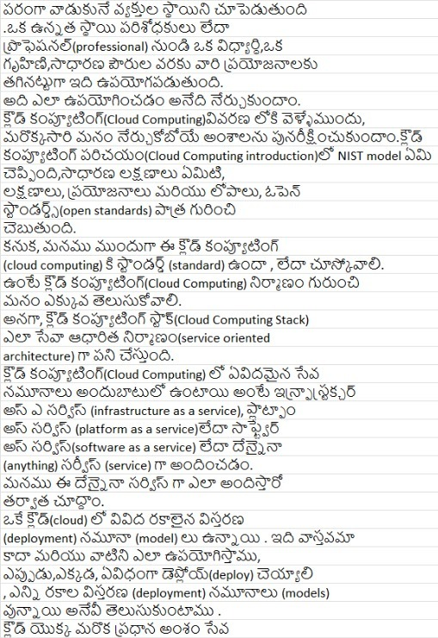
Caption

Slide 9
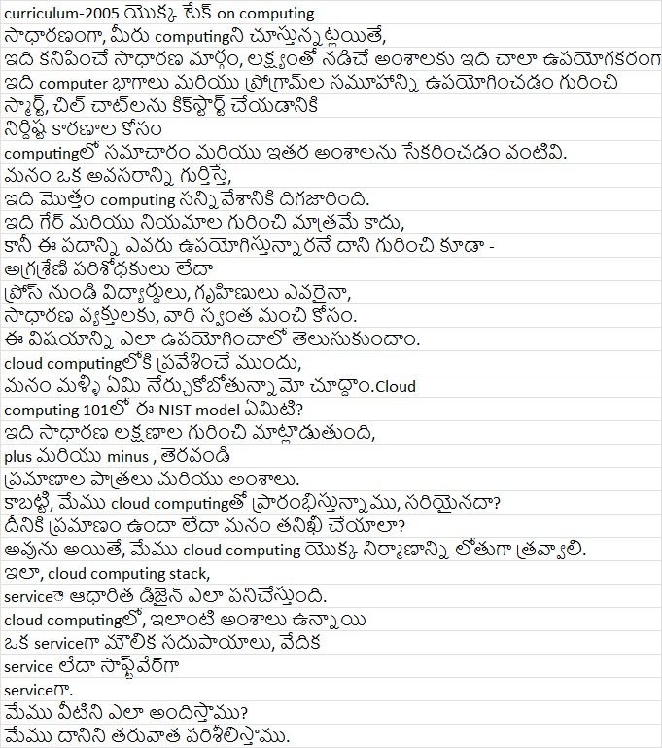
Caption
Caption

Slide 10
Raw Sentence

Slide 11
Rawsentence
Cleaning
Telugu Sentence

Slide 12
Rawsentence
Cleaning
Telugu Sentence
Find Required Elements
(Forming a dictionary)

Slide 13
Rawsentence
Cleaning
Telugu Sentence
Find Required Elements
(Forming a dictionary)
Required formal sentence

Slide 14
Rawsentence
Cleaning
Telugu Sentence
Find Required Elements
(Forming a dictionary)
Required formal sentence
Changing Verbal Sentence
Informal sentence

Slide 15
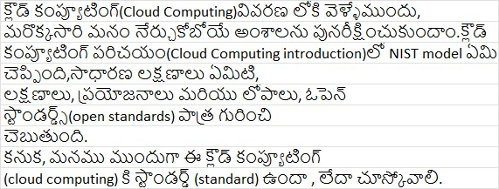
Raw Data

Slide 16
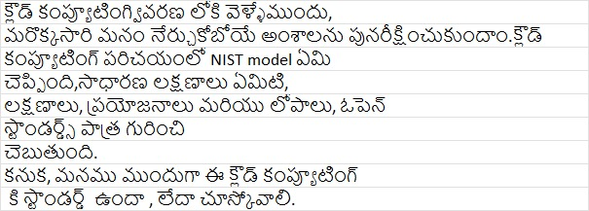
Raw Data
Telugu Sentence

Slide 17
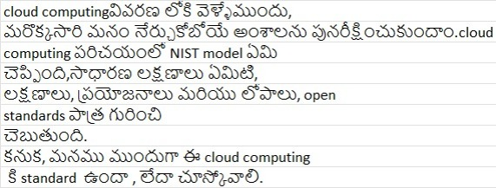
Transliterated Telugu Sentence(Formal)

Slide 18
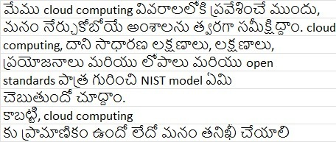
Transliterated Telugu Sentence(Formal)
Transliterated Telugu Sentence(Informal)

Slide 19
Formality Classifier for Telugu Text using Data Analysis methods
Introduction :
This project introduces an innovative approach to Natural Language
Processing in the Telugu language, leveraging the power of Support Vector Machines (SVM). Our system specializes in analyzing Telugu sentences and accurately predicting whether the tone is formal or informal.
Objective :
The primary goal of this project is to enhance language processing capabilities for Telugu, a language spoken by millions but often underrepresented in the digital domain. By focusing on the formality aspect, we aim to provide tools for better communication analysis, automated moderation, and educational purposes.

Slide 20
Methodology :

Slide 21
Methodology :
DATA COLLECTION :
For Data Collection I have taken a government open Source (NPTEL Website)
So I have collected Around 20,000 sentences to prepare a data set.

Slide 22
Methodology :
DATA COLLECTION :
For Data Collection I have taken a government open Source (NPTEL Website)
So I have collected Around 20,000 sentences to prepare a data set.
PREPROCESSING :
The data underwent rigorous preprocessing, including tokenization, normalization, and part-of-speech tagging, to prepare it for machine learning algorithms.

Slide 23
Methodology :
DATA COLLECTION :
For Data Collection I have taken a government open Source (NPTEL Website)
So I have collected Around 20,000 sentences to prepare a data set.
PREPROCESSING :
The data underwent rigorous preprocessing, including tokenization, normalization, and part-of-speech tagging, to prepare it for machine learning algorithms.
SVM IMPLEMENTATION :
We employed the Support Vector Machine algorithm for its effectiveness in classification tasks. The SVM model was trained to distinguish between formal and informal tones based on linguistic features inherent in the Telugu language.

Slide 24
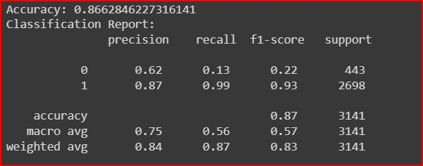
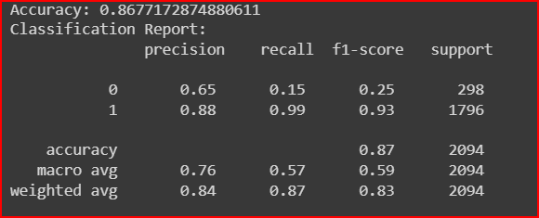
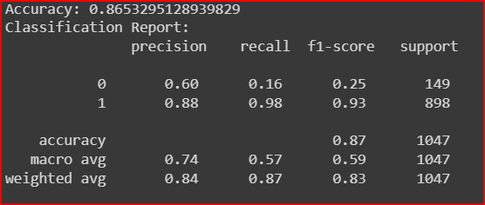
Results :
Our SVM model achieved a high accuracy rate in classifying Telugu
sentences into formal and informal categories. The system showed
remarkable proficiency in understanding nuances and contextual cues.
30% test size
20% test size
10% test size

