Slide 1

[ NORTHLINE FC-01 · LOGISTICS COMMAND ]
WarehouseIQ Flow Command
Intelligent fulfillment architecture replaces passive warehouse tracking with proactive operational decisions.
[ MANUS AI · HACKATHON SOLUTION · 2026 ]

Slide 2

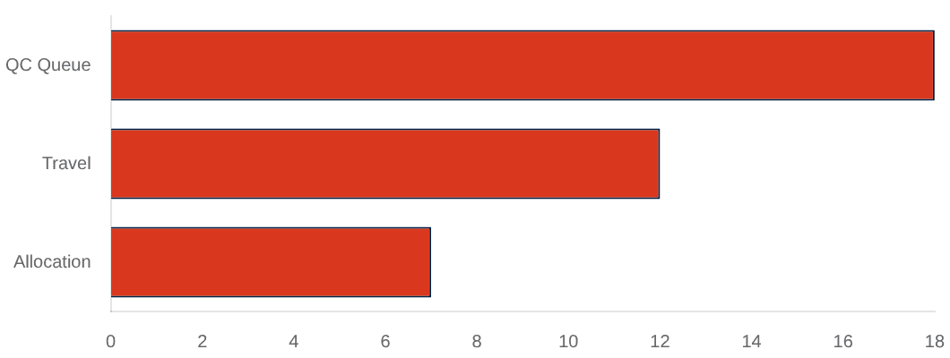
[ LOGISTICS EXCEPTION REPORT · 01 ]
Fragmented inventory visibility and priority clashes cause costly SLA breaches
DISRUPTION TYPE
OPERATIONAL IMPACT
INVENTORY BLIND SPOTS
Disconnected stock counts between available, reserved, and inbound deliveries lead to hidden stockouts during peak hours.
Stockout Deficit
Missed carrier cut-off (16:00)
Route Overlap
+126m duplicate travel distance
PRIORITY CLASHES
Queue Stalling
37m recoverable dwell time
Urgent orders frequently clash with standard queues, forcing fulfillment leads to pause operations while searching for inventory.
Priority Exception
SLA breach on urgent retail orders
PICKING INEFFICIENCIES
Unmanaged quality-check queues and unoptimized picking routes accumulate minutes of avoidable dwell time per shift.

Slide 3

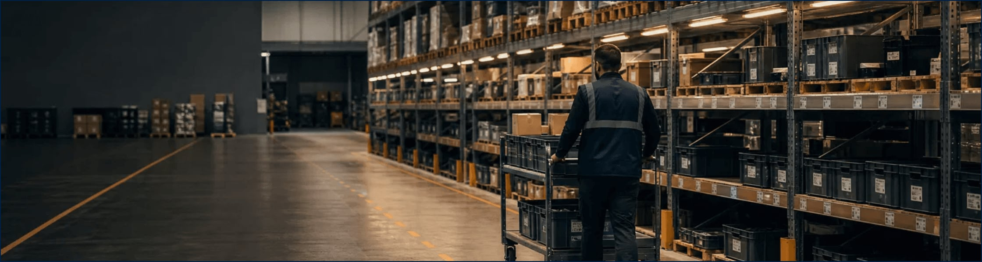
[ SOLUTION ARCHITECTURE · 02 ]
WarehouseIQ establishes a unified control room that protects shift promises
CONTROL ROOM VISIBILITY
PERSISTENT OPERATIONS RAIL
LIVE TELEMETRY
Instant visibility into active orders, pick accuracy, floor capacity, and bottleneck recovery time from a single desk.
Anchor shift tracking, facility location, and lead profile management across every operational module.
Connect executive metrics directly to floor-level task execution without unnecessary tab switching or data silos.

Slide 4

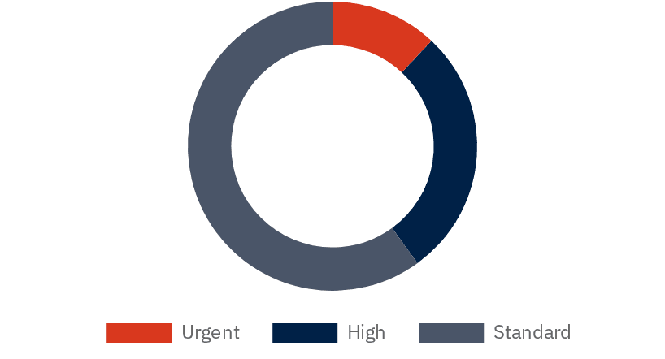
[ FULFILLMENT LOGIC · 03 ]
Multi-tier prioritization and promise-date ranking safeguard urgent customer commitments
DYNAMIC TIERING
[ ACTIVE PRIORITY QUEUE ]
Orders are automatically categorized into Urgent, High, and Standard tiers based on promise dates and carrier cut-offs.
CUSTOMER / ORDER
PRIORITY
UNITS
CUT-OFF
10
16:00
Nova Retail
URGENT
SO-48219
6
16:30
SLA RISK FLAGGING
Swell & Co.
HIGH
SO-48207
Live indicators highlight potential delivery failures before they impact customers, allowing for proactive intervention.
5
Tomorrow
Marlowe Market
HIGH
SO-48196
2
Tomorrow
Aster House
STD
CONTEXTUAL DETAIL
SO-48183
Interactive drawers provide visibility into item allocations, picking zones, and fulfillment-chain steps for every order.

Slide 5
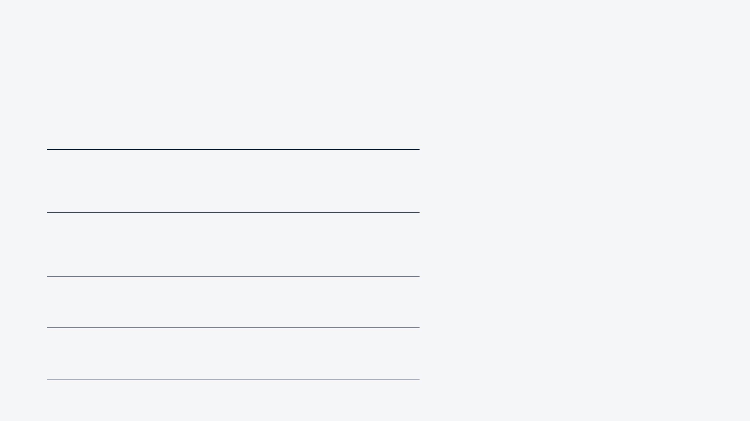
[ OPERATIONAL LOGIC · 04 ]
Proactive split-allocation logic transforms inventory exceptions into guided operator resolutions
01
DETECTION
[ CASE STUDY: SO-48219 ]
Identifies stock deficits and flags SLA risks before they impact the floor rhythm.
"Nova Retail required 10 units of LUMA-200 with only 7 available. The system proposed allocating 7 immediate units, linking 3 from an inbound delivery, and shifting a lower-priority reservation."
02
ANALYSIS
Evaluates inbound replenishment and lower-priority reservations for potential re-allocation.
[14:32] EXCEPTION DETECTED [14:33] SPLIT PROPOSED [14:35] LEAD APPROVED [14:35] WAVE RELEASED
03
RESOLUTION
Proposes split-allocation recommendations to protect urgent carrier cut-offs.
04
ACTION
Updates allocation state and logs the audit trail instantly upon lead approval.

Slide 6

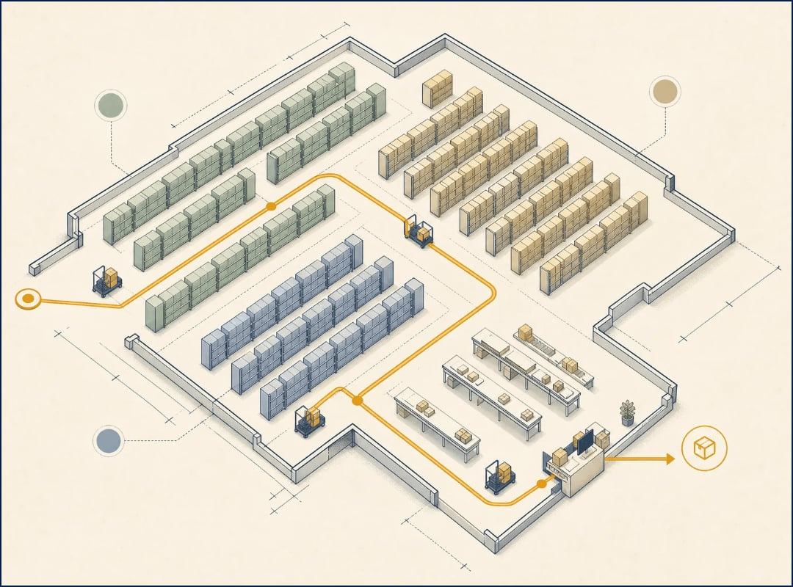
[ FLOOR EXECUTION · 05 ]
Zone-based picking sequences eliminate duplicate aisle travel
OPTIMIZED SEQUENCING
Floor execution routes sequence items by zone and carrier cut-off to keep warehouse walkers highly productive.
TRAVEL DISTANCE REDUCTION
Recommended pick waves bundle urgent allocations with nearby orders, removing 126 meters of duplicate travel per run.
METRIC
WAVE W-26
STANDARD
Travel Distance
412m
538m
Pick Velocity
84 units/hr
62 units/hr
Zone Density
High (A/C)
Fragmented
[ FIG 05.1: ISOMETRIC ROUTE MAPPING · ZONE A ]

Slide 7

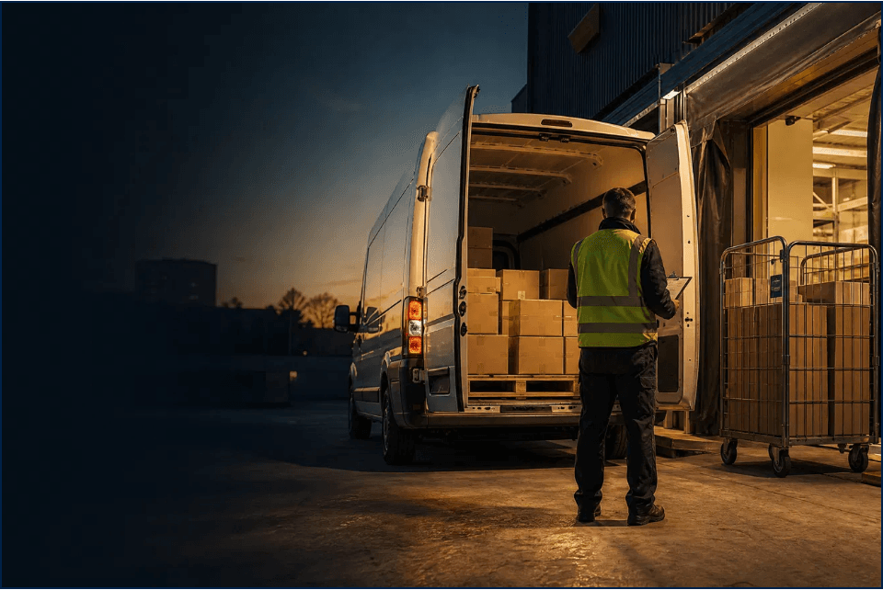
[ OUTBOUND CONTROL · 07 ]
Integrated dispatch tracking aligns dock bay capacity and quality checks with strict carrier cut-offs
MANIFEST
CARRIER
DOCK
CUT-OFF
STATUS
EXP-2148
Express
D-02
15:30
LOADING
PRIO-602
Priority
D-01
16:00
STAGED
GRD-071
Ground
D-03
17:45
OPEN
QUALITY CHECKS
DOCK CAPACITY
CARRIER CONFIDENCE
6 Pending
2 Spaces
92%
Outbound control boards join express, priority, and ground manifests with dock assignments and loading statuses to prevent missed shipping deadlines.

Slide 8

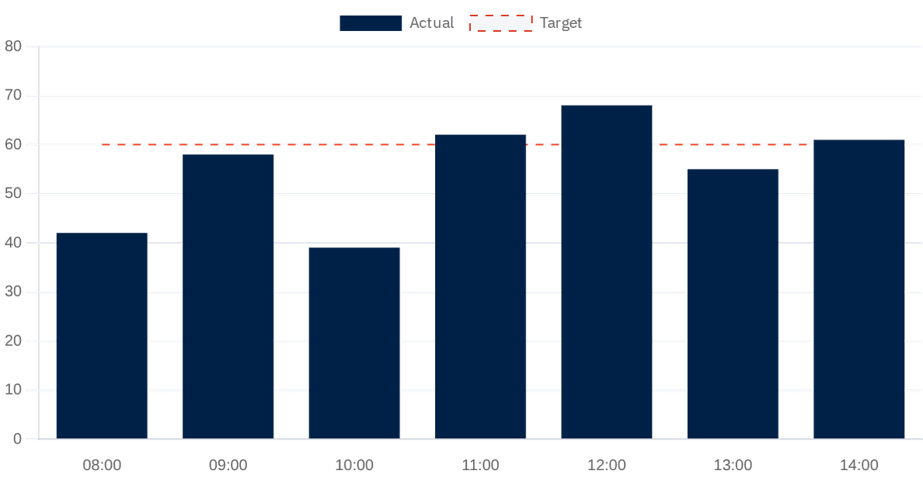
[ OPERATIONAL INTELLIGENCE · 08 ]
Actionable operational intelligence isolates recoverable minutes and measures true throughput
ORDERS CLEARED PER HOUR VS. TARGET
BOTTLENECK WATCH
18m
QUALITY-CHECK QUEUE
6 orders pending; QC-01 station at peak load.
12m
DUPLICATE AISLE TRAVEL
Route W-26 optimization removes 126m per run.
07m
ALLOCATION DECISION
Priority stock exception pending lead approval.
03
Pick Accuracy
Pack Dwell Time
ACTIVE INTERVENTIONS
99.3% (+0.4)
6.2m (-1.1)
Required to protect today's 16:00 cut-off.

Slide 9


[ SYSTEM ARCHITECTURE · 09 ]
A robust modern tech stack delivers high-performance reliability with an editorial signal-room aesthetic
CORE STACK
DESIGN ETHOS
BRAND IDENTITY
Framework
React 19
Signal Room Aesthetic
Warm paper surfaces and deep ink rails evoke traditional logistics ledgers.
Language
TypeScript
Styling
Tailwind 4
Editorial Hierarchy
DM Serif Display headers provide authoritative clarity for shift leads.
Primitives
shadcn/ui
WarehouseIQ Flow Command
Semantic Amber
Intelligent fulfillment architecture for modern warehouse operations.
Charts
Recharts
Color is reserved strictly for operational exceptions and SLA risks.
[ AUTHOR: MANUS AI ] [ LICENSE: MIT ] [ REPO: Smart-Warehouse-Operations ]

