Slide 1

INDIAN FOOD CLASSIFICATION
Team Number: D8
Sl. Num. | Student Name | USN | Roll Num. | Division
1 | Manoj Kumar | 01fe21bcs291 | 408 | D
2 | Srivathsa A | 01fe21bcs083 | 414 | D
3 | P Sai Sudheer | 01fe21bcs096 | 417 | D
4 | Praneet Mane | 01fe21bcs104 | 418 | D
Under the guidance of
Prof. Sunil V.G

Slide 2
Introduction
India's culinary landscape is rich with vibrant flavors and regional specialties, reflecting the country's diverse cultural heritage. Our project focuses on harnessing the power of Machine Learning, specifically Convolutional Neural Networks (CNNs), to accurately classify and categorize Indian cuisine. In an era where smartphone usage is widespread, the ability to instantly recognize and identify dishes becomes crucial, especially for tourists and individuals with dietary restrictions. Traditional image recognition methods often struggle with the complexities of food classification due to subtle variations in appearance and cooking techniques. However, with advancements in deep learning, CNNs offer a promising solution by effectively distinguishing between similar dishes and improving the accuracy of classification tasks.

Slide 3
Literature Survey
1] Food Image Recognition by Using Convolutional Neural Networks (CNNs) :
MobileNetV3, an advancement over MobileNetV1 and MobileNetV2, innovatively utilized reinforcement learning methods like MnasNet and NetAdapt to automatically search and optimize its architecture. MnasNet optimized the global structure of the network blocks, while NetAdapt fine-tuned each layer sequentially. By integrating squeeze-and-excite mechanisms within residual blocks, MobileNetV3 improved accuracy while reducing parameter count. The final stage of the network underwent manual optimization to trim computational time and parameters without sacrificing accuracy.
2] NU-InNet: Thai Food Image Recognition Using Convolutional Neural Networks:
The original Thai cuisine image recognition article, published in 2017, introduced THFOOD50, the first and largest dataset of Thai cuisine images. They proposed NUInNet1.1, a novel network utilizing Inception modules with optimized depth to balance accuracy, processing time, and model size. NUInNet1.1 surpassed GoogleNet, achieving 69.8% accuracy in 18.16 ms. Further enhancements stacking adjusted inception modules yielded 80.34% accuracy. Evolution to NU-ResNet1.1 Depth 4 with residual layers achieved 83.07% accuracy in 44.60 ms, the most precise model for THFOOD-50. Additionally, they introduced a dataset of 3,961 images divided into 11 groups, improving GoogLeNet to achieve 88.33% accuracy.

Slide 4
Literature Survey
3] Automated Food image Classification using Deep Learning approach:
A food recognition program categorized Thai cuisine photos into 13 types. They achieved 82.00% accuracy using transfer learning with a VGG19 network on their 7,632-photo dataset. Due to VGG19's large size, predictions were executed on a server and relayed to client devices. Earlier efforts highlighted the importance of neural network training for cutting-edge results and the effectiveness of transfer learning on smaller datasets. However, there hasn't been an in-depth exploration of Transfer Learning on the largest Thai food dataset, THFOOD-50. This study aims to compare Transfer Learning outcomes across different networks, training methods, and augmentations for THFOOD-50.
4] Indian Food Image Recognition with MobileNetV2:
MobileNetV3, the latest enhancement in MobileNets, took a different approach from its manually designed predecessors, V1 and V2. It utilized reinforcement learning techniques like MnasNet and NetAdapt to autonomously discover its architecture. Initially, MnasNet optimized the overall block structure, followed by NetAdapt fine-tuning each layer systematically. Moreover, by integrating squeeze-and-excite mechanisms into residual blocks, it enhanced accuracy with fewer parameters. Finally, manual adjustments in the last stage aimed to reduce computational load and parameters without compromising accuracy.

Slide 5
Problem Statement
The goal is to examine in-depth the impact of training methods, and the accuracy of image classification on the precision of Indian food image classification.

Slide 6
Objectives
• To classify images of food since we intended to make a program that could be used in dietary assessment applications.
• To analyze images so that computers can understand them and group comparable images into the same class.
• To compare accuracy amongst different algorithms.
• To decide the best and most accurate model for classifying the input.

Slide 7
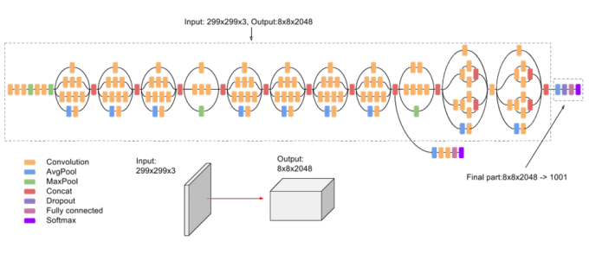
Model Architecture
Google's InceptionV3 is a powerful convolutional neural network renowned for its balance between accuracy and complexity. It utilizes the Inception module, capturing characteristics at various scales with multiple convolutional filters within a layer. This design enables better performance and wider property extraction. InceptionV3 has excelled in image recognition tasks and is suitable for your "Indian food classification" project due to its ability to discern subtle nuances and diverse attributes. Its multi-scale feature extraction can help overcome the challenges of categorizing Indian cuisine. Leveraging InceptionV3 provides access to a proven pre-trained model, enhancing the precision and resilience of your classification system.

Slide 8
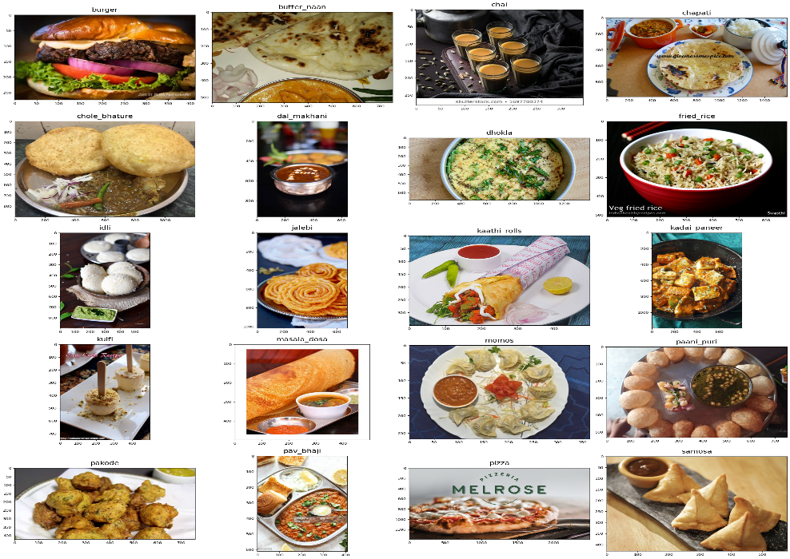
Methodology
A. Dataset Description:
The Food20 dataset comprises 4018 training shots and 1250 validation images covering 20 significant areas of Indian cuisine, providing researchers with a comprehensive resource for photo classification in kitchen contexts. The dataset is meticulously organized into train, validation, and test folders to facilitate structured model construction and assessment. It uniquely emphasizes the complexity of Indian cuisine, influenced by geographical, climatic, and historical elements. With features like multiple dishes on one plate and identical sides for each item, models must make sophisticated selections across diverse food types. Additionally, researchers have access to a pre-trained Inception v3 model for baseline performance, with opportunities for architecture refinement.

Slide 9
Methodology
B. Preprocessing and Augmentation:
Different strategies were utilized to increase the quality and variety of the dataset, supporting the training of a robust convolutional neural network (CNN). The issues addressed included cleansing the dataset owing to misspelled labels and an excessive amount of raw photos not connected to any class. To acquire insights into the data and undertake early analysis, a picture was imported, and pixel intensity distributions were shown in the RGB color space. Additionally, clustering methods, such as K-means clustering, were applied to find patterns in the picture data.
Exploratory Data Analysis (EDA) was undertaken to show the distribution of training instances for each food item. It indicated class inequalities, with two classes, Pani puri and Kulfi, having less training examples. To alleviate this problem and increase model generalization, data augmentation approaches were employed employing offline augmentation. Randomly picked photographs from each class were displayed to offer an overview of the dataset.

Slide 10
Methodology
C. Model Training:
Model training commenced with selecting the InceptionV3 model pre-trained on the ImageNet dataset as the base model for transfer learning. Additional layers were added to tailor the architecture for identifying Indian food, including global average pooling, dense layers for feature learning, and dropout for regularization. Training utilized a large dataset augmented with real-time data augmentation techniques.
The Stochastic Gradient Descent (SGD) optimizer was employed with specified parameters, and categorical cross-entropy served as the loss function. Monitoring mechanisms like checkpoints and CSV logging were used to track training progress and select the best-performing model. After 20 epochs, the model demonstrated convergence, capturing underlying patterns within the dataset. Testing on a separate test set confirmed the model's generalization capabilities, achieving an excellent test accuracy of 0.897. Prediction functions were established for individual images and batch predictions, showcasing the model's ability to accurately identify various Indian cuisine products.

Slide 11
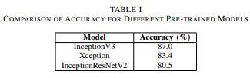
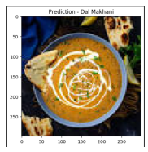
Results And Discussion
In our Indian food classification study, we evaluated three pre-trained models: Xception, InceptionResNetV2, and InceptionV3. InceptionV3 excelled with an accuracy of 0.87, showcasing its ability to capture complex patterns crucial for diverse Indian cuisines. Xception achieved 0.834 accuracy, while InceptionResNetV2 scored slightly lower at 0.805, indicating variations in their effectiveness for detailed food categorization.
The model's value was proven through prediction tests using both individual pictures and batch methods. It accurately identified food items in single photos and performed well across different food groups in batch predictions.

Slide 12
Conclusion And Future Scope
Utilizing the InceptionV3 deep learning model yielded a remarkable accuracy of 0.87 in automating the identification and categorization of diverse Indian food specialties, underscoring its effectiveness in computer vision applications within the food sector.
Comparative analysis with other pre-trained models, such as Xception and InceptionResNetV2, demonstrated the superior performance of InceptionV3, emphasizing the significance of appropriate model selection in achieving high accuracy in complex tasks like Indian cuisine categorization.
This research not only expands the understanding of deep learning applications in image classification but also underscores the importance of model refinement and data preprocessing techniques for enhancing accuracy.
Future endeavors may focus on fine-tuning, exploring ensemble techniques, and enlarging datasets to further improve the model's generalization capabilities.

Slide 13
References
[1] Lu, Yuzhen. ”Food image recognition by using convolutional neural networks (cnns).” arXiv preprint arXiv:1612.00983 (2016).
[2] Kaur, P., Sikka, K., Wang, W., Belongie, S., Divakaran, A. (2019). Foodx-251: a dataset for fine-grained food classification. arXiv preprint arXiv:1907.06167.
[3] Termritthikun, Chakkrit, Paisarn Muneesawang, and Surachet Kanprachar. ”NU-InNet: Thai food image recognition using convolutional neural networks on smartphone.” Journal of Telecommunication, Electronic and Computer Engineering (JTEC) 9.2-6 (2017): 63-67.
[4] ttisoponpisan, Sirawit, et al. ”Pushing the Accuracy of Thai Food Image Classification with Transfer Learning.” Engineering Journal 26.10 (2022): 57-71.
[5] Hnoohom, Narit, and Sumeth Yuenyong. ”Thai fast food image classification using deep learning.” 2018 International ECTI northern section conference on electrical, electronics, computer and telecommunications engineering (ECTINCON). IEEE, 2018.

