Slide 1
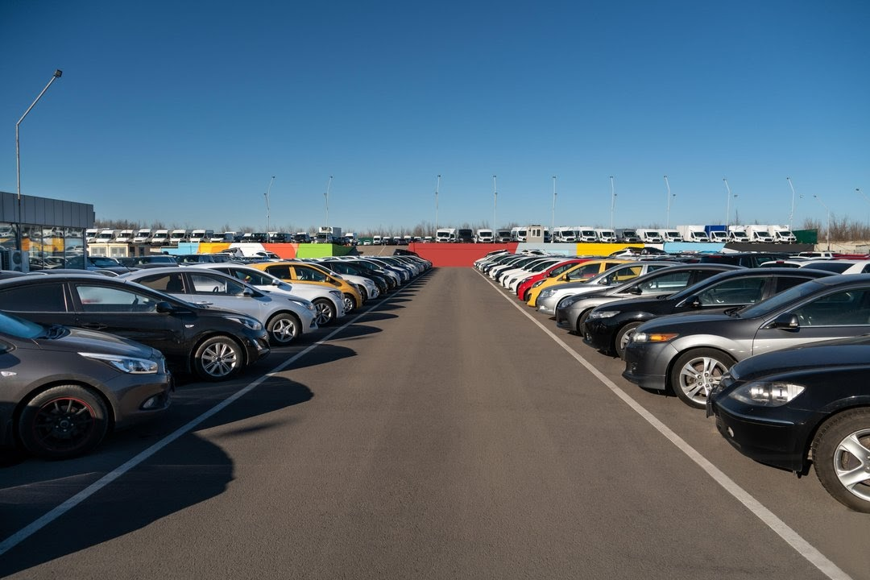
Predicting the price of the Pre-Owned cars
Group-9
Madhavi Palutla (1002070463)
Naga Prasad Yalamarthi (1002070464)
Sai Sumana Adurugatla (1002073766)
Sweta Veerabhadra (1002049852)
Bhargav Tanneeru (1002076799)

Slide 2
Project Name: Predicting the price of pre-owned cars | Champion Project Leader: Sai Samana
Business or Process Owner | Project Goal: To get a better understanding and chalking out a plan of action for the solution of consumers to create a system to assist them in choosing a resale cars at well estimated price. Our goal is to outperform prediction score of existing price estimation websites.
Problem Statement: To predict the price of used cars using the various Machine Learning (ML) model. This can enable the customers to make decisions based on different inputs or factors | Project Scope: Determining whether the listed price of a used car is a challenging task, due to the many factors that drive a used vehicle's price on the market. The focus of this project is developing machine learning models that can accurately predict the price of a used car based on its features, in order to make informed purchases. We implement and evaluate Linear regression on a dataset consisting of the sale prices of different makes and models across the United States.
Business Case: It is required to apply some data science techniques. That should help the management to understand how exactly the prices vary with the independent variables. They can accordingly manipulate the design of the cars, the business strategy etc., to meet certain price levels. | Benefits: Help in decision making to buy or sell car Attract customers and maximize sales Informed business decisions
Team Members: Madhavi Palutla Naga Prasad Yalamarthi Sai Sumana Adurugatla Sweta Veerabhadra Bhargav Tanneeru | Timeline: The following are milestones for our project: Problem Identification-09/15/20222 Model Development- 10/15/20222 Analysis-10/27/2022 Final Report-12/01/2022

Slide 3
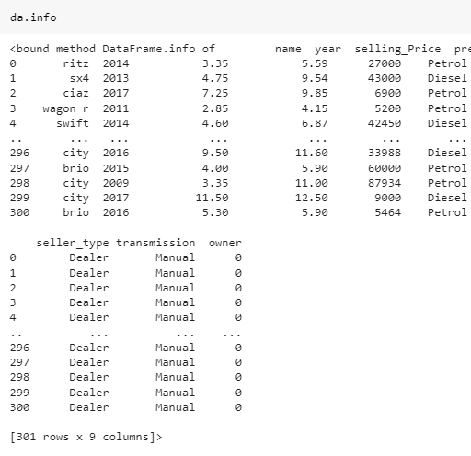
DATASET SELECTION
The data set was taken from Kaggle.
It has 9 columns and 301 rows.

Slide 4
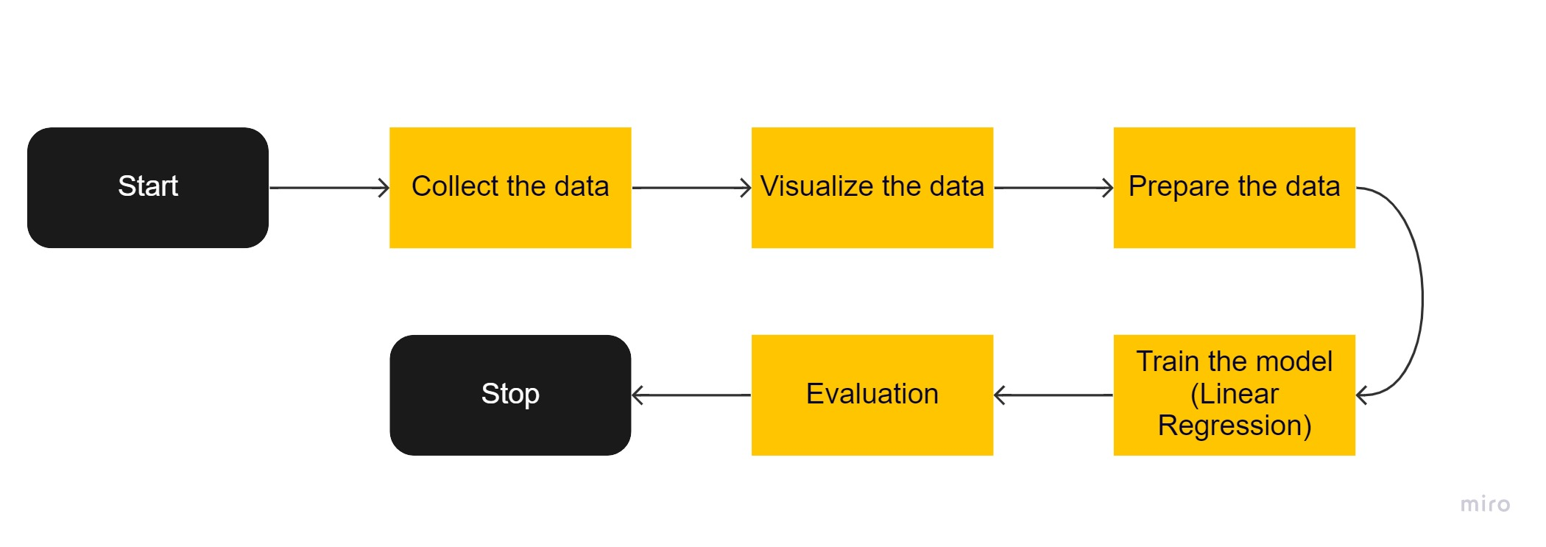
FLOWCHART
Collect the Data: The collection of car parameters to help predicting the price of pre-owned cars.
Prepare the data: Data cleaning, Data reduction, Data Transformation.
Visualize the data: Can be done using some plots
Training Data: About 80% of data is used for training the model.
Testing Data: About 20% of data is used for testing the model.
Model: Linear Regression model to predict price of preowned cars.
Evaluation: Analysis of the accuracy of the algorithm using metrics.

Slide 5
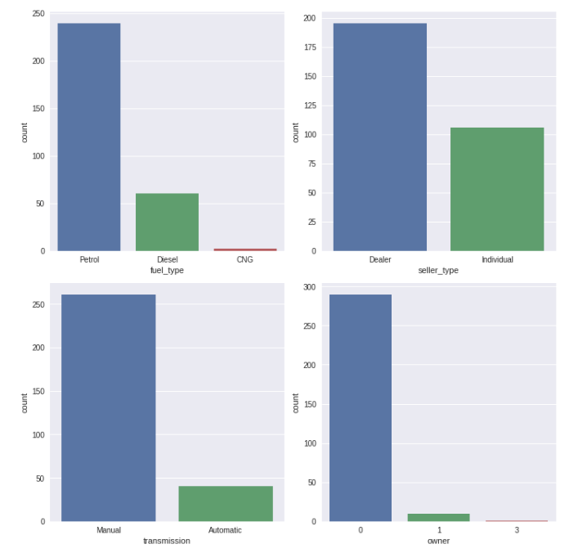
DATA VISUALIZATION
To count the total number of categorial data, we’re using “count plot”. A count plot can be thought of as a histogram across a categorical, instead of quantitative, variable.

Slide 6
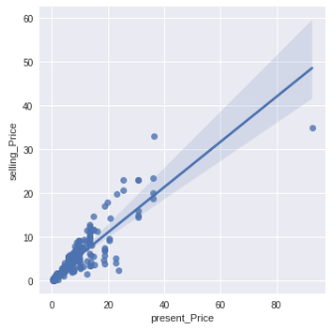
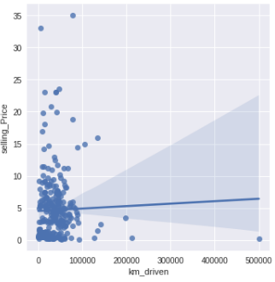
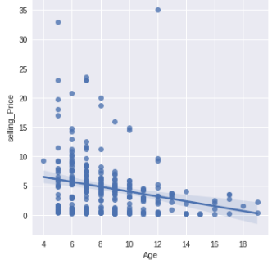
DATA VISUALIZATION
To visualize the relation between selling price and the numerical columns, we’ve used “lm plot”. The lm plot plot shows the line along with datapoints on the 2d space.

Slide 7
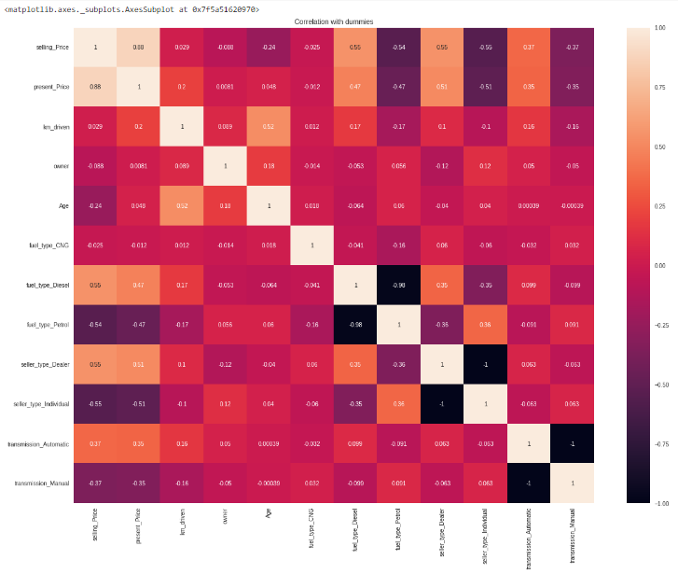
DATA PRE-PROCESSING
As there are no null values in the dataset, we haven’t deleted any rows.
We’ve added some dummy values for quantifying our categorical data to be used in ML model.
The below are the dummy values added in our code
fuel_type_CNG, fuel_type_Diesel, fuel_type_Petrol
seller_type_Dealer, seller_type_Individual
transmission_Automatic, transmission_Manual

Slide 8
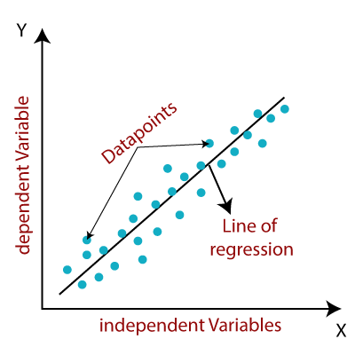
MODEL SELECTION
We used Linear regression, because it makes predictions for continuous/real or numeric variables such as sales, salary, age, product price, etc.
Linear regression shows the linear relationship, which means it finds how the value of the dependent variable is changing according to the value of the independent variable.

Slide 9
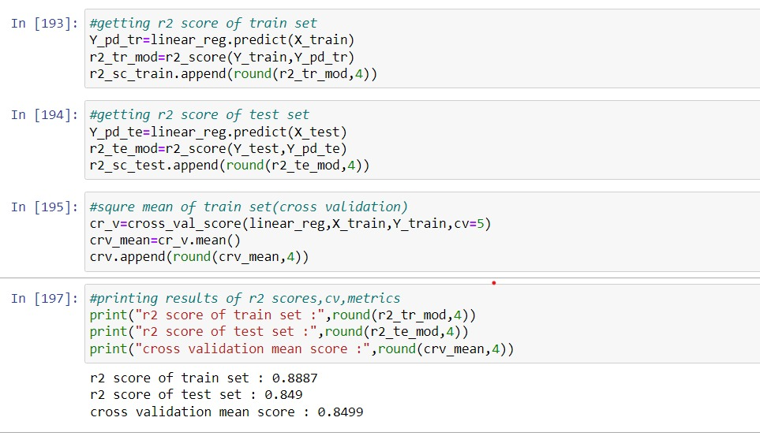
MODEL ANALYSIS
We’ve used Linear Regression algorithm for training.
80%of the data is used for training and 20% of the data is used for testing.
The results are as follow.

Slide 10
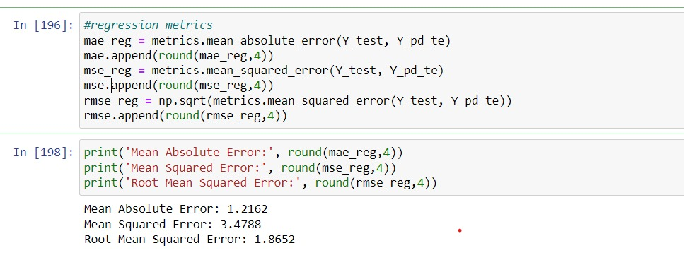
Contd..
The values of MAE, MSE, RMSE for our model are 1.21,3.4, 1.86.
So , we can say that the difference between predicted data and the real data is very less.

Slide 11
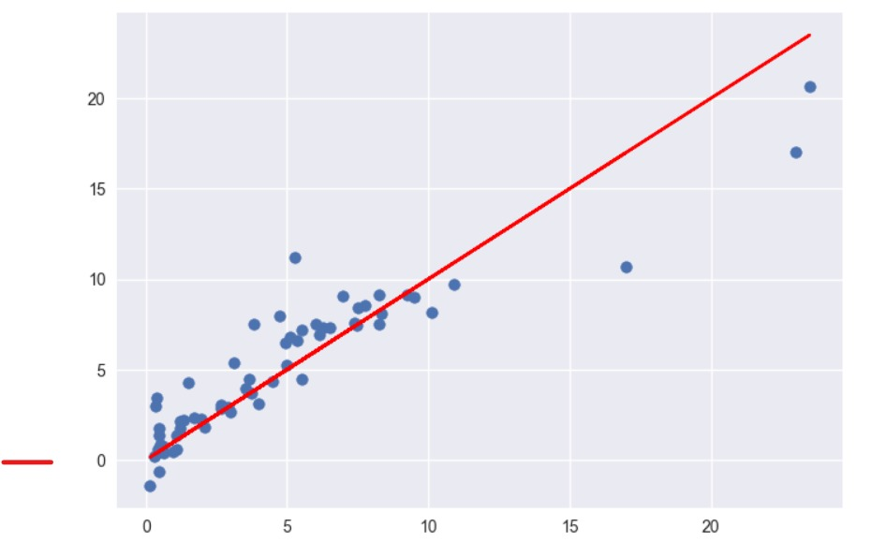
Line of Best Fit

Slide 12
CONCLUSIONS AND RECOMMENDATIONS
Our project obtained an accuracy of 84% using Linear Regression algorithm.
In future, we can use other machine learning algorithms like Lassos Regression, Gradient Regression to check if they are better than Linear Regression.
This model can be extended by adding it to a front-end and help in decision making to buy pre-owned cars.

Slide 13


