Slide 1

ENHANCING SECURITY SYSTEM OF IOT DEVICES WITH MACHINE LEARNING ALGORITHMS
R.V. R. & J. C. College of Engineering
Batch Number –Y22CD/20
Under the Guidance of
Mr. P.A.V.Krishna Rao
Assistant professor
Dept. of CSD
Kodali Karthik | Y22CD071
Nalluri Sai Sumanth Babu | Y22CD113
Palle Jacob Abhraham Jane | Y22CD122

Slide 2
Contents
Abstract
Problem Statement
Literature Survey
Existing Work
Proposed Work
IoT-based security framework
Types of Security Attacks in IOT
Architecture Diagram for Hybrid-Ensemble ML Model
Results for Hybrid-Ensemble ML Model
Dataset
Methodology
Results Comparison
Conclusion & Future Scope
References

Slide 3
Abstract
The Internet of Things (IoT) is a rapidly growing technology that connects smart devices to improve automation and decision-making. However, ensuring security and accurate traffic classification in IoT networks remains a challenge. This research proposes an efficient approach using advanced Machine Learning techniques, including Light Gradient Boosting Machine (LightGBM), CatBoost, and an ensemble of Random Forest and LightGBM, to detect malicious activities. Using the UNSW-NB15 dataset, the proposed models achieve a high accuracy of 99.9%, outperforming traditional algorithms. This work enhances IoT network security and contributes to building intelligent and reliable IoT systems.

Slide 4
Problem Statement
The rapid growth of IoT devices has increased automation but also led to serious security threats and malicious attacks. Traditional Machine Learning models struggle to detect these threats accurately. Hence, an advanced system is needed to classify network traffic and enhance IoT security effectively.

Slide 5
Literature Survey
Research Title | Problem Statement | Proposed Methodology | Results
[1] Anomaly-Based Intrusion Detection System for IoT Networks Using Machine Learning [2023] | IoT devices are highly vulnerable to cyber threats such as unauthorized access, malware, and denial-of-service (DoS) attacks. This study proposes an intrusion detection system (IDS) to detect anomalous behavior in IoT networks. | Machine Learning (Random Forest, SVM), Feature Selection using PCA, Network Traffic Analysis | Accuracy – 94.2% Precision – 0.91 Recall – 0.93 F1-Score – 0.92
[2] A Lightweight Deep Learning Model for IoT Malware Detection [2022] | Deep Learning (CNN-LSTM Hybrid), Static and Dynamic Malware Analysis, Lightweight Model Optimization | Deep Learning (CNN-LSTM Hybrid), Static and Dynamic Malware Analysis, Lightweight Model Optimization | Accuracy – 96.5% Precision – 0.94 Recall – 0.95 F1-Score – 0.94

Slide 6
Existing Work
The existing work focuses on using traditional Machine Learning models such as Decision Trees, Naïve Bayes, and Backpropagation Neural Networks for detecting attacks in IoT networks. These approaches rely on analyzing network traffic patterns and identifying malicious behaviors using static models. Although ensemble methods like Random Forest and boosting techniques such as AdaBoost and XGBoost have been applied to improve accuracy, they still struggle with issues like high false positives and poor detection of sophisticated attacks. Moreover, handling large, imbalanced datasets remains a challenge, limiting the overall effectiveness of these methods in real-world IoT environments.

Slide 7
Proposed Work
Hybrid-Ensemble Approach
The proposed approach for detecting IoT network attacks involves multiple steps. First, the UNSW-NB15 dataset is preprocessed by handling missing values and scaling the features for better model performance. Then, advanced Machine Learning models like LightGBM and CatBoost are introduced to replace traditional models such as Backpropagation Neural Networks and Naïve Bayes for higher accuracy and better handling of large, imbalanced data. Ensemble methods combining Random Forest and LightGBM are used to enhance detection performance. Finally, these models are trained to classify network traffic and detect malicious activities with high accuracy, aiming to provide a robust and scalable solution for IoT security.

Slide 8
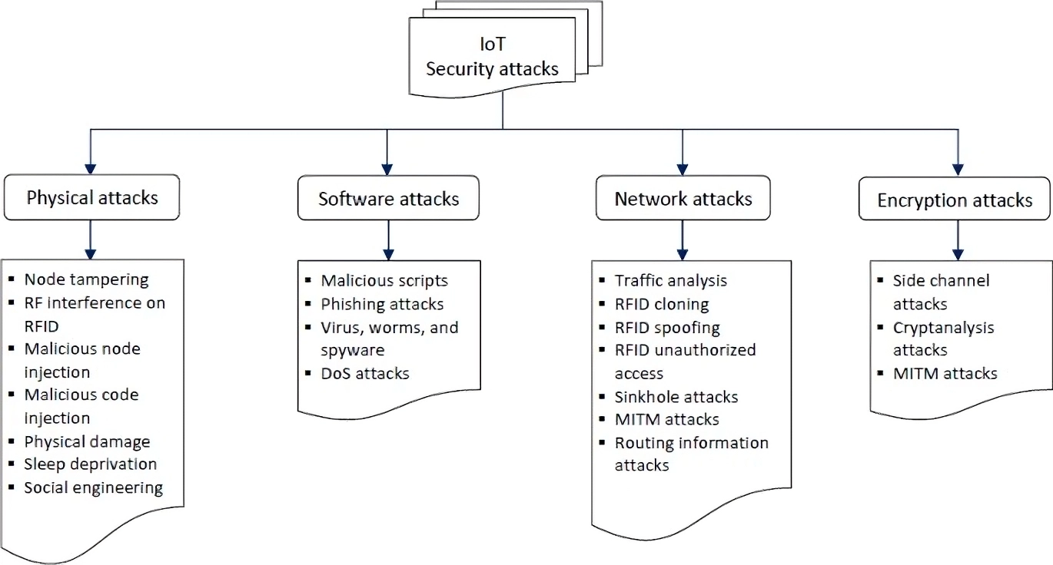
Types of Security Attacks in IOT

Slide 9
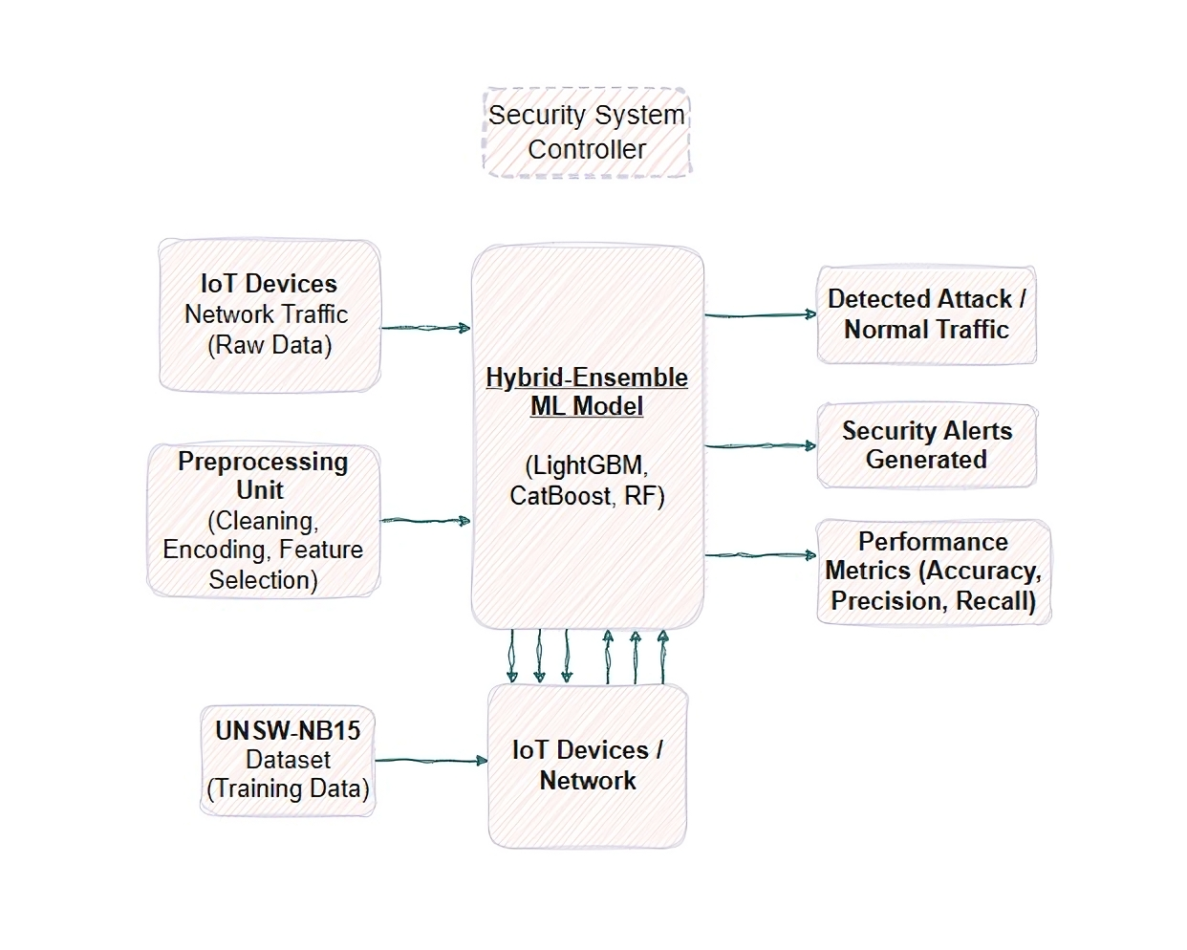
Architecture Diagram for Hybrid-Ensemble ML Model (LightGBM, CatBoost, RF)

Slide 10
Results for Hybrid-Ensemble ML Model
Parameters | Values
Accuracy | 99.9%
Precision | 0.99
Recall | 0.98
F1 Score | 0.985

Slide 11
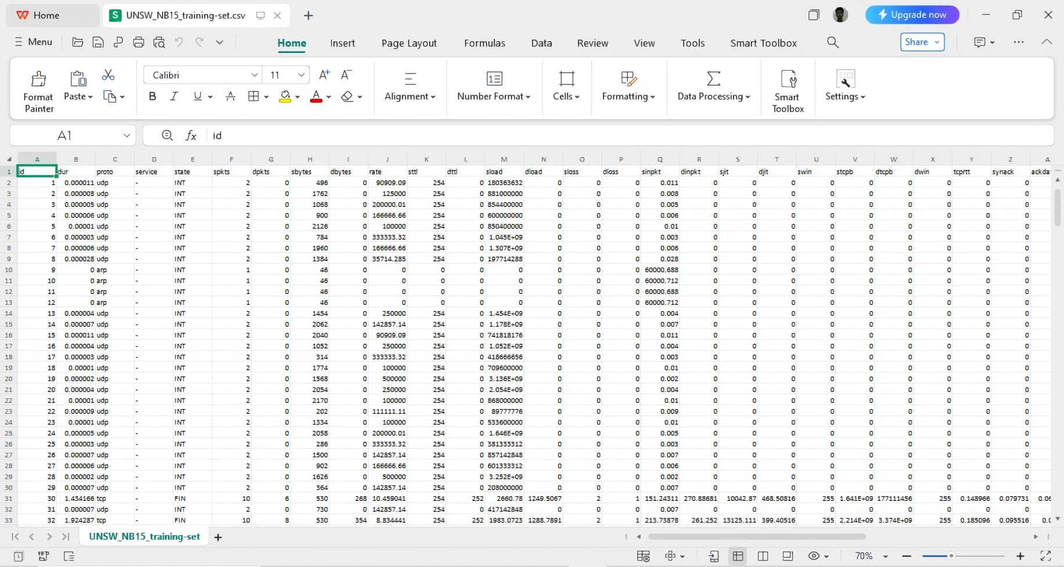
Dataset
Dataset – UNSW-NB15
It contains normal and
malicious iot network traffic.
It is used for training and
evaluating ML models.
It contains modern attack types
suitable for real-world iot
scenarios

Slide 12
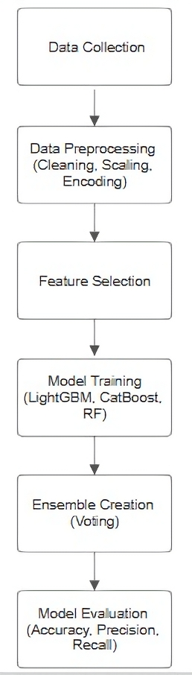
Methodology
Data Collection (UNSW-NB15)
Data Preprocessing (Cleaning, Scaling, Encoding):
Clean missing values, scale features, and encode
categorical data for model compatibility.
Feature Selection
Model Training (LightGBM, CatBoost, RF):Train individual
machine learning models to learn patterns of IoT attacks.
Ensemble Creation (Voting)
Model Evaluation (Accuracy, Precision, Recall):Evaluate
the ensemble model using performance metrics
like accuracy, precision, and recall

Slide 13
Results Comparison Table
Model | Accuracy | Precision | Recall | F1 Score
Existing Models | 95.3% | 0.81 | 0.83 | 0.82
Proposed Model | 99.9% | 0.95 | 0.97 | 0.96

Slide 15
Conclusion & Future Scope
The proposed Hybrid-Ensemble Approach, combining LightGBM, CatBoost, and Random Forest, has achieved 99.9% accuracy in detecting IoT network attacks. This model outperforms existing models by reducing false positives and improving detection rates. The ensemble method effectively handles imbalanced datasets and enhances IoT network security.
Future Scope:
Deploying the model in real-time IoT environments for practical evaluation.
Exploring Deep Learning models (CNN, LSTM) for better attack classification.
Expanding the model to work with other IoT datasets for more generalized performance.
Integrating real-time data streams and adaptive learning for continuous model improvement.

Slide 16
References
[1] https://ieeexplore.ieee.org/stamp/stamp.jsp?arnumber=9775571
[2] https://academic.oup.com/bioinformatics/article/39/1/btad006/6992646
[3] https://pubmed.ncbi.nlm.nih.gov/36516131/
[4] https://www.sciencedirect.com/science/article/pii/S2667237522002557
[5] https://www.sciencedirect.com/science/article/abs/pii/S0957417424002112
[6] https://pubmed.ncbi.nlm.nih.gov/33472571/
[7] https://bmcbioinformatics.biomedcentral.com/articles/10.1186/s12859-015-0774-y
[8] https://www.researchgate.net/publication/315845346_DrugClust_A_machine_learning_app
[9] https://www.hindawi.com/journals/cmmm/2020/1573543/
[10] https://www.nature.com/articles/s41467-020-18305-y
[11] https://www.nature.com/articles/s41598-024-62861-y

Slide 17
Thank You

