Slide 1
PROJECT 35 • DATABASE MANAGEMENT SYSTEM
Internship Application &
Progress Monitoring System
REVIEW 2 | Database Implementation, Normalization & Working Prototype
B.Tech CSE • Woxsen University
INTERNSHIP APPLICATION & PROGRESS MONITORING SYSTEM • 01

Slide 2
PROJECT 35 • REVIEW 2
Review 2 — Implementation Focus
Moving from conceptual design to a working, constrained relational database and prototype.
01
NORMALIZATION
02
DATABASE
3NF structure and functional dependencies
DDL, keys, constraints and realistic data
03
QUERIES
04
APPLICATION
JOINs, aggregation, reports and views
Flask + MySQL integration and authentication
Implementation status: core database + student-facing workflow + admin reporting are integrated.
INTERNSHIP APPLICATION & PROGRESS MONITORING SYSTEM • 02

Slide 3
PROJECT 35 • REVIEW 2
System Architecture
Three layers connect the user interface, application logic and relational database.
PRESENTATION LAYER
HTML • CSS • JavaScript
Home, login, registration, internships, applications, progress, results
↓ data flow
APPLICATION LAYER
Python • Flask
Routes, sessions, validation, password hashing, business workflow
↓ data flow
DATA LAYER
MySQL 8
12 relational tables, PK/FK constraints, checks, unique rules, SQL views
INTERNSHIP APPLICATION & PROGRESS MONITORING SYSTEM • 03

Slide 4
PROJECT 35 • REVIEW 2
Implemented Relational Schema
The final database contains 12 normalized tables linked through primary and foreign keys.
STUDENT
student_id PK
COMPANY_SUPERVISOR
supervisor_id PK • organization_id FK
ORGANIZATION
organization_id PK
ASSIGNMENT
assignment_id PK • application_id FK • mentor_id FK • supervisor_id FK
OPPORTUNITY
opportunity_id PK • organization_id FK
WEEKLY_LOG
log_id PK • assignment_id FK
APPLICATION
application_id PK • student_id FK • opportunity_id FK
EVALUATION
evaluation_id PK • assignment_id FK
APPROVAL
approval_id PK • application_id FK
CERTIFICATE
certificate_id PK • assignment_id FK
FACULTY_MENTOR
mentor_id PK
FEEDBACK
feedback_id PK • assignment_id FK
INTERNSHIP APPLICATION & PROGRESS MONITORING SYSTEM • 04

Slide 5
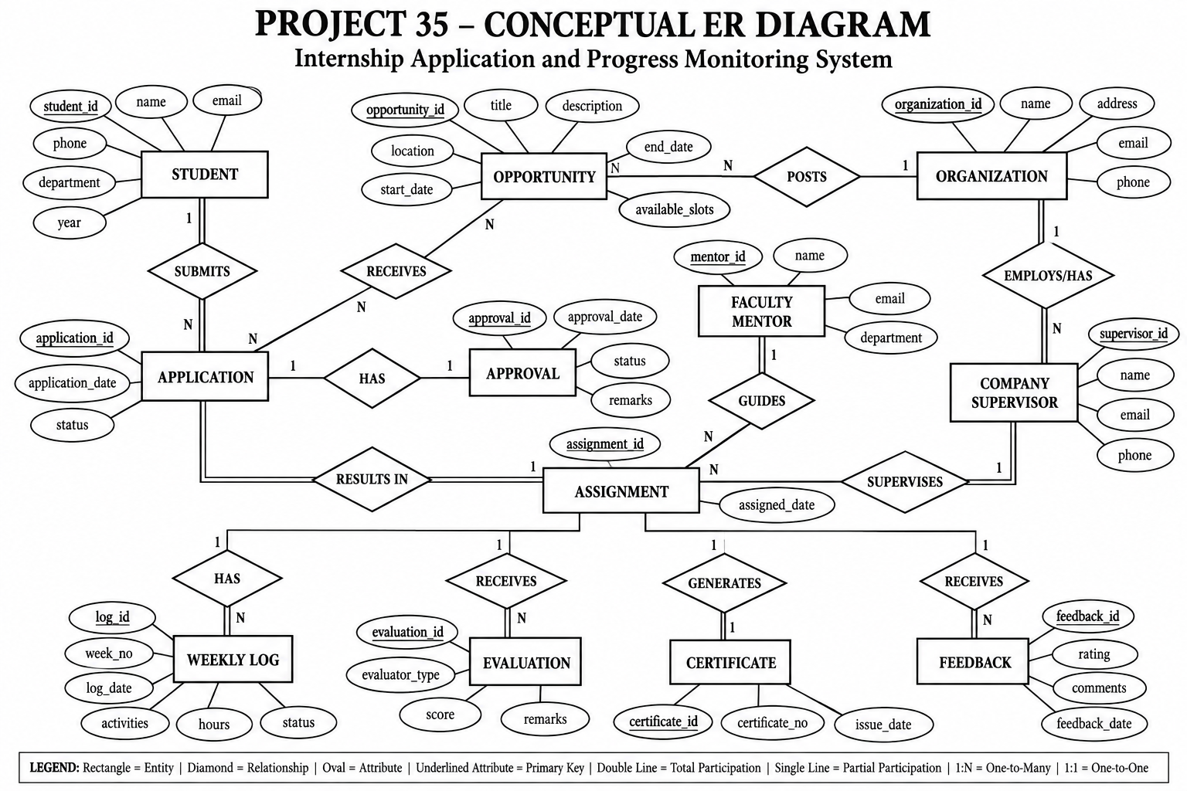
PROJECT 35 • REVIEW 2
Conceptual ER Model
INTERNSHIP APPLICATION & PROGRESS MONITORING SYSTEM • 05

Slide 6
PROJECT 35 • REVIEW 2
Normalization — 3NF
The design separates independent facts and keeps non-key attributes dependent on the appropriate key.
1NF
2NF
3NF
Atomic attributes
No repeating groups
Full dependency on key
No transitive dependency
Each table stores one value per attribute.
Non-key attributes depend on the whole candidate key.
Non-key attributes do not depend on another non-key attribute.
Example: APPLICATION stores student_id and opportunity_id as foreign keys rather than repeating student or organization details. ORGANIZATION details remain in ORGANIZATION and internship details remain in OPPORTUNITY.
INTERNSHIP APPLICATION & PROGRESS MONITORING SYSTEM • 06

Slide 7
PROJECT 35 • REVIEW 2
Functional Dependencies
Representative dependencies used to reason about keys and normalization.
RELATION
FUNCTIONAL DEPENDENCY
STUDENT
student_id → name, email, phone, department, year, password_hash
ORGANIZATION
organization_id → name, address, email, phone
OPPORTUNITY
opportunity_id → organization_id, title, description, location, start_date, end_date, available_slots
APPLICATION
application_id → student_id, opportunity_id, application_date, status
APPROVAL
approval_id → application_id, approval_date, status, remarks
ASSIGNMENT
assignment_id → application_id, mentor_id, supervisor_id, assigned_date
WEEKLY_LOG
log_id → assignment_id, week_no, log_date, activities, hours, status
EVALUATION
evaluation_id → assignment_id, evaluator_type, score, remarks
CERTIFICATE
certificate_id → assignment_id, certificate_no, issue_date
FEEDBACK
feedback_id → assignment_id, rating, comments, feedback_date
Unique constraints also establish alternate keys, e.g. (student_id, opportunity_id) in APPLICATION and application_id in APPROVAL/ASSIGNMENT.
INTERNSHIP APPLICATION & PROGRESS MONITORING SYSTEM • 07

Slide 8
PROJECT 35 • REVIEW 2
DDL, Keys & Integrity Constraints
Constraints are enforced in MySQL rather than relying only on application-side validation.
PRIMARY KEY
Uniquely identifies each row; AUTO_INCREMENT used for identifiers.
FOREIGN KEY
Maintains valid links between students, opportunities, applications and internship records.
UNIQUE
Prevents duplicate student-opportunity applications and duplicate one-to-one records.
CHECK
Validates year, dates, slots, application status, scores, hours and ratings.
NOT NULL
Requires essential student, opportunity, application and progress fields.
DEFAULT
Application status defaults to 'Applied'; weekly log status defaults to 'Submitted'.
INTERNSHIP APPLICATION & PROGRESS MONITORING SYSTEM • 08

Slide 9
PROJECT 35 • REVIEW 2
Data Dictionary — Core Tables
Key attributes and their roles in the implemented schema.
TABLE
KEYS
IMPORTANT ATTRIBUTES
STUDENT
PK student_id
name, email, phone, department, year, password_hash
ORGANIZATION
PK organization_id
name, address, email, phone
OPPORTUNITY
PK opportunity_id; FK organization_id
title, description, location, start/end dates, available_slots
APPLICATION
PK application_id; FK student_id, opportunity_id
application_date, status
APPROVAL
PK approval_id; FK application_id
approval_date, status, remarks
FACULTY_MENTOR
PK mentor_id
name, email, department
INTERNSHIP APPLICATION & PROGRESS MONITORING SYSTEM • 09

Slide 10
PROJECT 35 • REVIEW 2
Data Dictionary — Internship Tracking Tables
Tables that manage supervision, progress, assessment and completion.
TABLE
KEYS
IMPORTANT ATTRIBUTES
COMPANY_SUPERVISOR
PK supervisor_id; FK organization_id
name, email, phone
ASSIGNMENT
PK assignment_id; FK application_id, mentor_id, supervisor_id
assigned_date
WEEKLY_LOG
PK log_id; FK assignment_id
week_no, log_date, activities, hours, status
EVALUATION
PK evaluation_id; FK assignment_id
evaluator_type, score, remarks
CERTIFICATE
PK certificate_id; FK assignment_id
certificate_no, issue_date
FEEDBACK
PK feedback_id; FK assignment_id
rating, comments, feedback_date
INTERNSHIP APPLICATION & PROGRESS MONITORING SYSTEM • 10

Slide 11
PROJECT 35 • REVIEW 2
SQL Queries, Views & Reports
The database supports operational queries and consolidated reporting for the internship lifecycle.
JOIN
Student applications with internship title and organization
FILTER
Approved internships / application status / progress status
AGGREGATION
Average evaluation score and applications per organization
REPORT
Assignment report combining student, organization, internship, mentor and supervisor
VIEW
internship_assignment_report
SELECT s.name, op.title, org.name FROM application ap JOIN student s ON ap.student_id=s.student_id JOIN opportunity op ON ap.opportunity_id=op.opportunity_id JOIN organization org ON op.organization_id=org.organization_id;
INTERNSHIP APPLICATION & PROGRESS MONITORING SYSTEM • 11

Slide 12
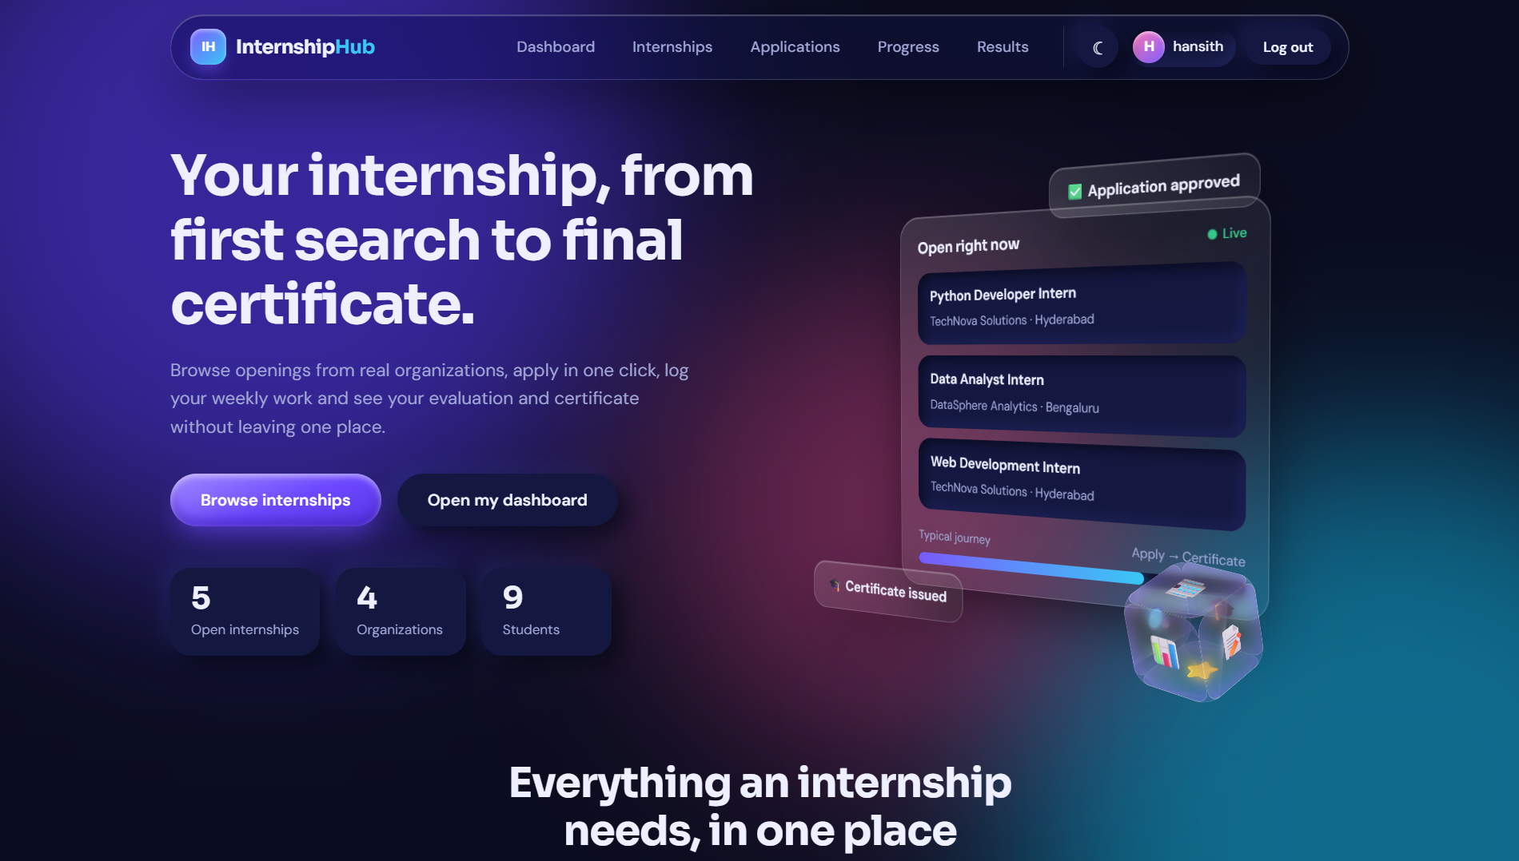
PROJECT 35 • REVIEW 2
Working Prototype — Internship Discovery
Actual project UI connected to the MySQL data. Search/filter behavior is visible in the running prototype.
Prototype screen: internship listings with organization, slots, location, dates and application action.
INTERNSHIP APPLICATION & PROGRESS MONITORING SYSTEM • 12

Slide 13
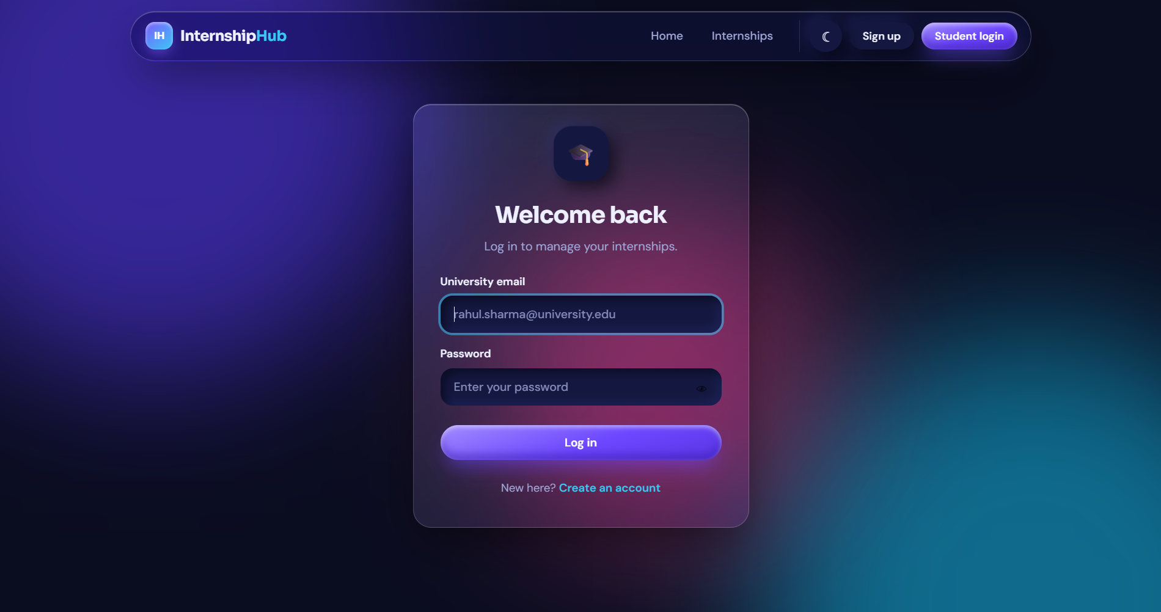
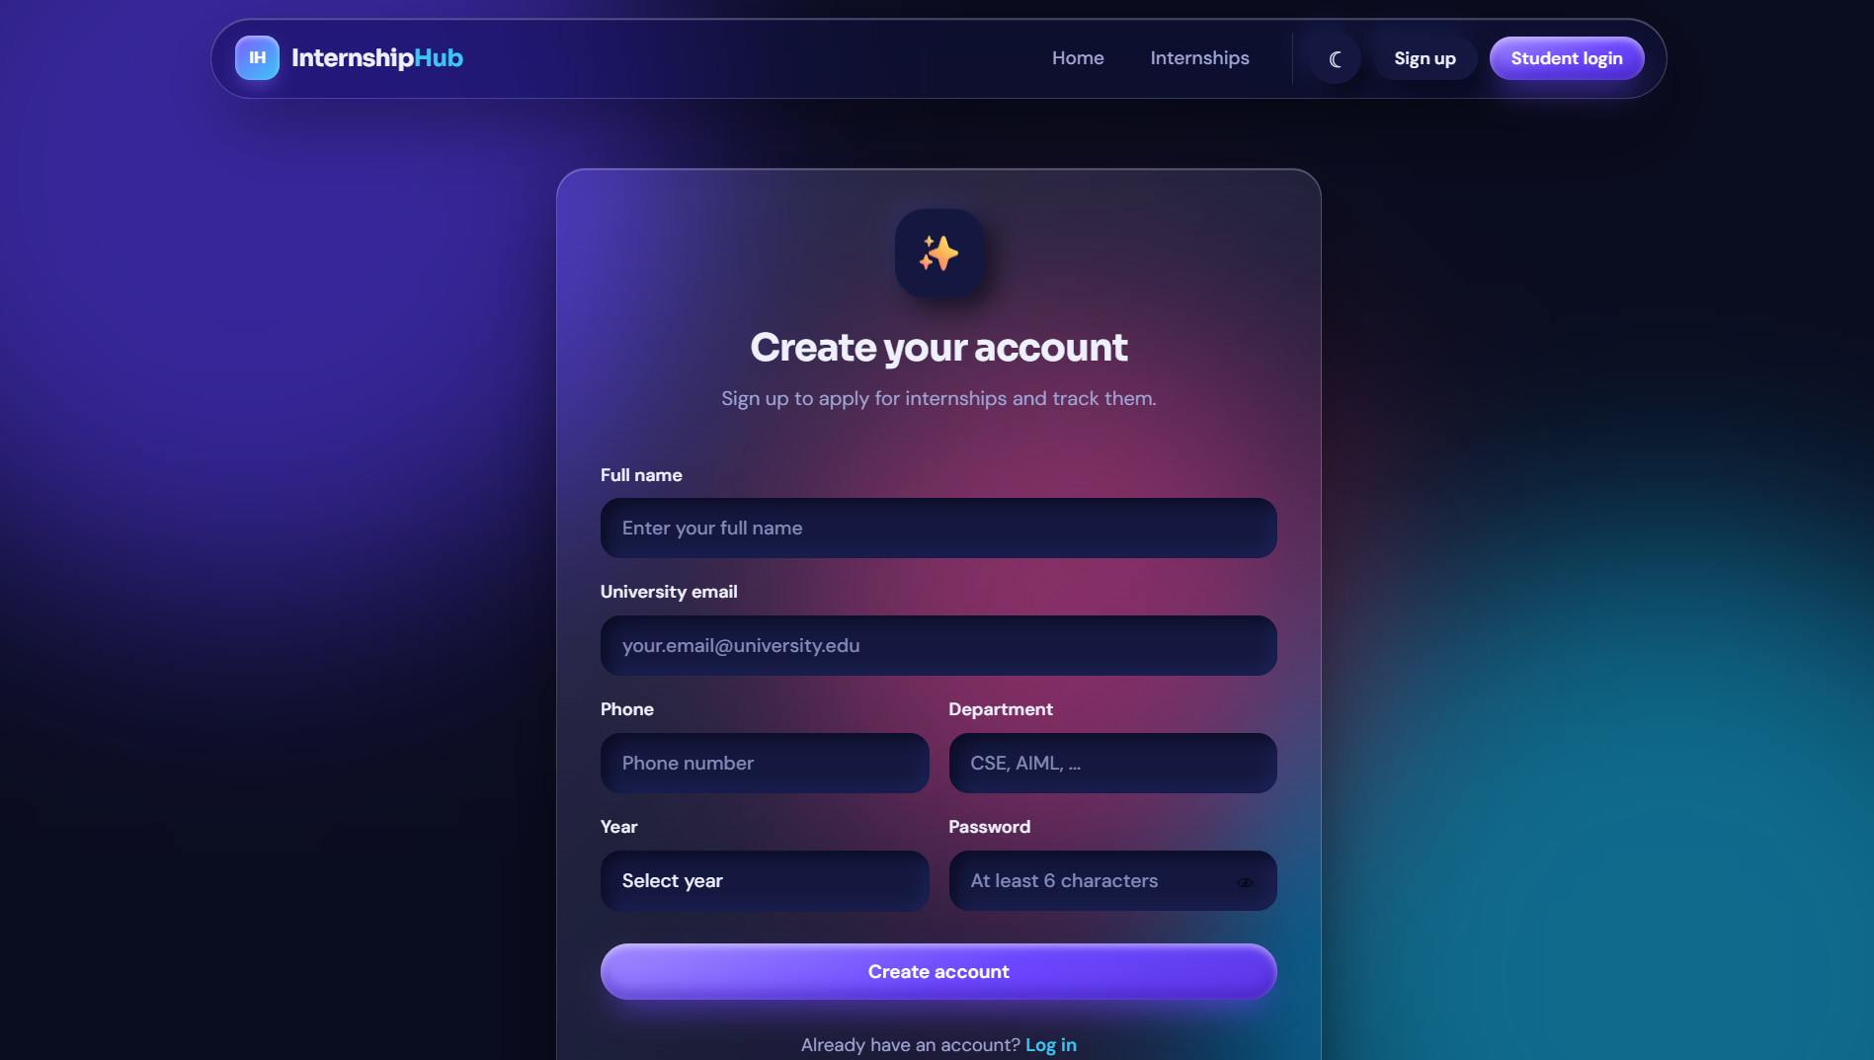
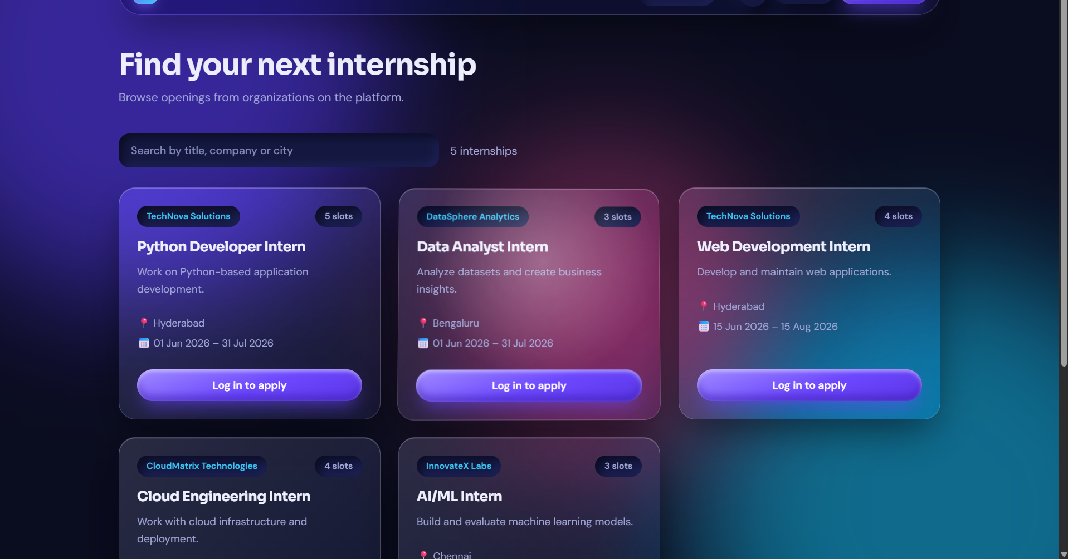
PROJECT 35 • REVIEW 2
Working Prototype — Authentication & Student Dashboard
Registration, secure password hashing, login sessions and student-specific navigation are integrated.
Login
Registration
Logged-in dashboard
INTERNSHIP APPLICATION & PROGRESS MONITORING SYSTEM • 13

Slide 14
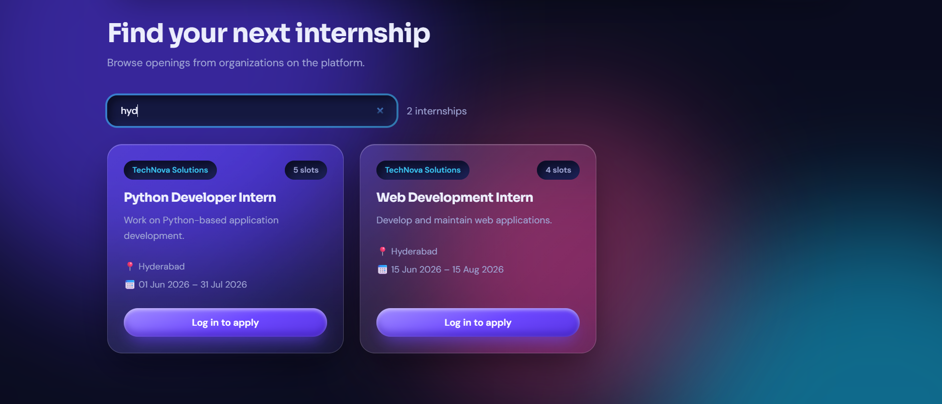
PROJECT 35 • REVIEW 2
Working Prototype — Logged-in Internship Experience
The student workflow continues from discovery to applications and progress/results.
Internship search / filtering
Internship catalogue
Implemented routes include dashboard, opportunities, applications, progress, results and admin reporting.
INTERNSHIP APPLICATION & PROGRESS MONITORING SYSTEM • 14

Slide 15
PROJECT 35 • REVIEW 2
Review 2 Outcome & Next Stage
The database is implemented and connected to a working web prototype.
• 12-table MySQL relational schema implemented
• Primary/foreign keys, UNIQUE, CHECK, NOT NULL and DEFAULT constraints
• Normalization and functional dependencies documented through 3NF
• Sample records, SQL queries and reporting view implemented
• Flask application integrated with MySQL
• Student registration, authentication and internship workflow demonstrated
• Database exported as internship_management.sql for reproducibility
NEXT STAGE
Review 3
• Final application polish
• Testing & validation
• Documentation
• Final demo / viva
Deliverables prepared:
Source code • SQL dump • requirements.txt • prototype screens
Thank you
INTERNSHIP APPLICATION & PROGRESS MONITORING SYSTEM • 15

