Slide 1
PROJECT 35 • DATABASE MANAGEMENT SYSTEM
Internship Application &
Progress Monitoring System
REVIEW 3 | Final Application • Testing • CRUD • Reporting
Final implementation and demonstration
INTERNSHIP APPLICATION & PROGRESS MONITORING SYSTEM • 01

Slide 2
PROJECT 35 • REVIEW 3
Review 3 Requirements
Final deliverables mapped directly to the project brief.
APPLICATION
FINAL DEMO
Python application connected to the designed MySQL database.
CRUD operations, search, validation, reports and error handling.
SOURCE
EVIDENCE
Source code, database script and test data.
Output screens, project report and viva-voce preparation.
INTERNSHIP APPLICATION & PROGRESS MONITORING SYSTEM • 02

Slide 3
PROJECT 35 • REVIEW 3
Final System Architecture
Working application connected to the implemented relational database.
USER INTERFACE
HTML / CSS / JavaScript
Home • Login • Register • Dashboard • Internships • Applications • Progress • Results
APPLICATION
Python + Flask
Routing • sessions • password hashing • validation • CRUD workflow
DATABASE
MySQL 8
12 tables • PK/FK • UNIQUE • CHECK • NOT NULL • DEFAULT • SQL view
INTERNSHIP APPLICATION & PROGRESS MONITORING SYSTEM • 03

Slide 4
PROJECT 35 • REVIEW 3
Implemented Application Modules
Final prototype covers the student workflow plus administration.
Authentication
Registration, password hashing, login, session and logout
Internships
Browse, search/filter, organization, location, dates and slots
Applications
Apply, prevent duplicate application, view application status
Progress
Display weekly internship logs and activity status
Results
Display evaluations and certificate information
Administration
System statistics + internship opportunity CRUD
INTERNSHIP APPLICATION & PROGRESS MONITORING SYSTEM • 04

Slide 5
PROJECT 35 • REVIEW 3
CRUD Operations
Final administration module demonstrates Create, Read, Update and Delete against the MySQL database.
CREATE
Add a new internship opportunity using an HTML form → INSERT
READ
Display opportunities and system counts → SELECT / JOIN
UPDATE
Edit internship title, description, location and slots → UPDATE
DELETE
Remove an internship opportunity → DELETE
CRUD scope: internship opportunity administration. Student application workflow remains database-backed.
INTERNSHIP APPLICATION & PROGRESS MONITORING SYSTEM • 05

Slide 6
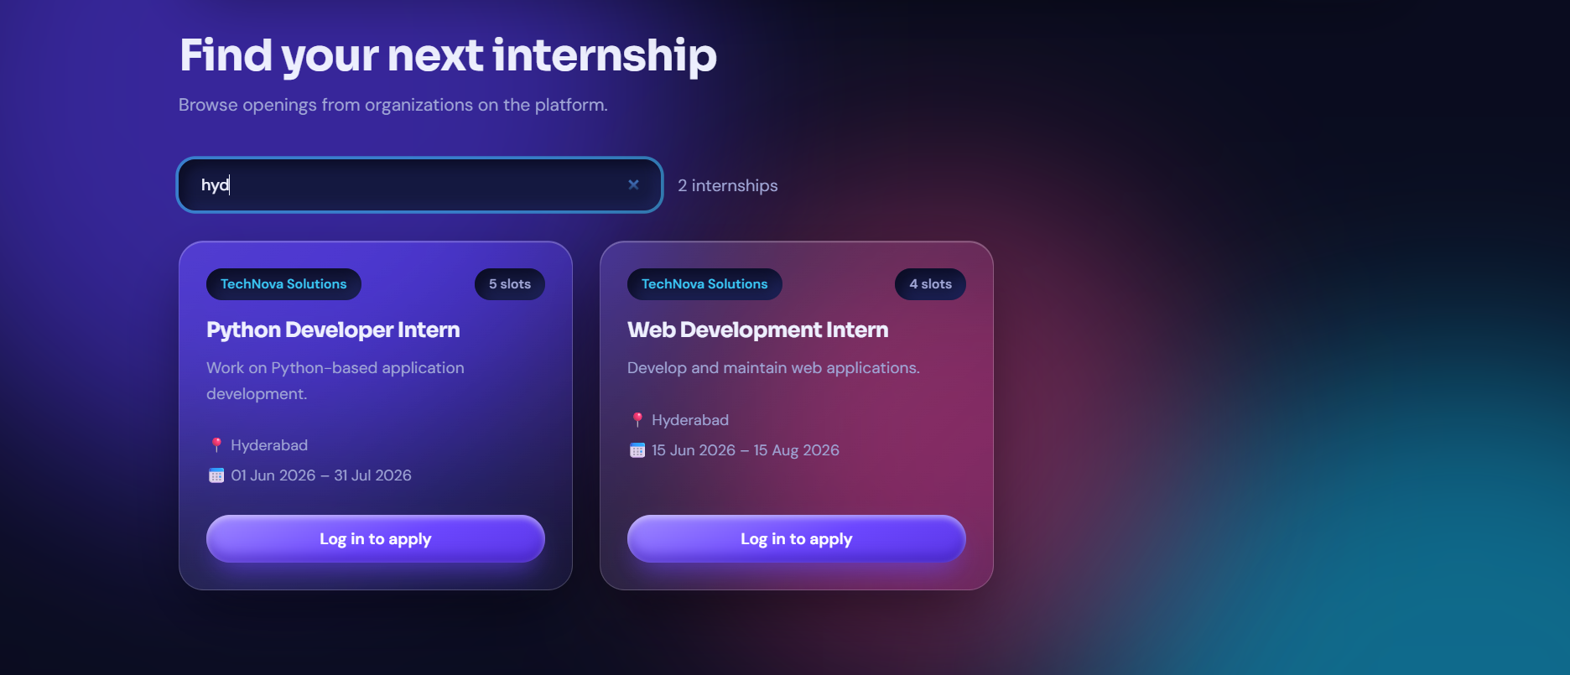
PROJECT 35 • REVIEW 3
Search & Filtering
Students can search the internship catalogue by title, organization or city.
Prototype evidence: search reduces the displayed internship set based on the entered term.
INTERNSHIP APPLICATION & PROGRESS MONITORING SYSTEM • 06

Slide 7
PROJECT 35 • REVIEW 3
Validation & Error Handling
Validation is enforced at both the application and database levels where applicable.
REGISTRATION
Duplicate email is checked before INSERT; password is hashed.
LOGIN
Invalid credentials return an error instead of opening the dashboard.
APPLICATION
Student must be logged in; duplicate student-opportunity application is prevented by UNIQUE constraint.
DATABASE
PK/FK, CHECK, NOT NULL and date/slot/score/rating constraints reject invalid records.
SESSION
Protected pages redirect unauthenticated users to login.
INTERNSHIP APPLICATION & PROGRESS MONITORING SYSTEM • 07

Slide 8
PROJECT 35 • REVIEW 3
Reports & Database Queries
The implementation supports joins, aggregation and a consolidated assignment report.
Applications
Student + opportunity + organization
Approved internships
Applications filtered by Approved status
Weekly progress
Assignment + weekly_log + opportunity
Evaluation report
Student + internship + evaluator + score
Assignment report
internship_assignment_report view
Admin statistics
Counts of students, organizations, opportunities, applications and assignments
INTERNSHIP APPLICATION & PROGRESS MONITORING SYSTEM • 08

Slide 9
PROJECT 35 • REVIEW 3
System Testing
Representative test cases prepared for the final demonstration.
TEST CASE
EXPECTED RESULT
STATUS
New student registration
Account created and dashboard session established
PASS
Duplicate email
Registration blocked with message
PASS
Valid login
Dashboard opens
PASS
Invalid login
Login error shown
PASS
Search internship
Matching internships displayed
PASS
Apply for internship
Application stored in MySQL
PASS
Duplicate application
UNIQUE rule prevents duplicate
PASS
Protected page without login
Redirected to login
PASS
Admin create/update/delete opportunity
Database record changes accordingly
PASS
INTERNSHIP APPLICATION & PROGRESS MONITORING SYSTEM • 09

Slide 10
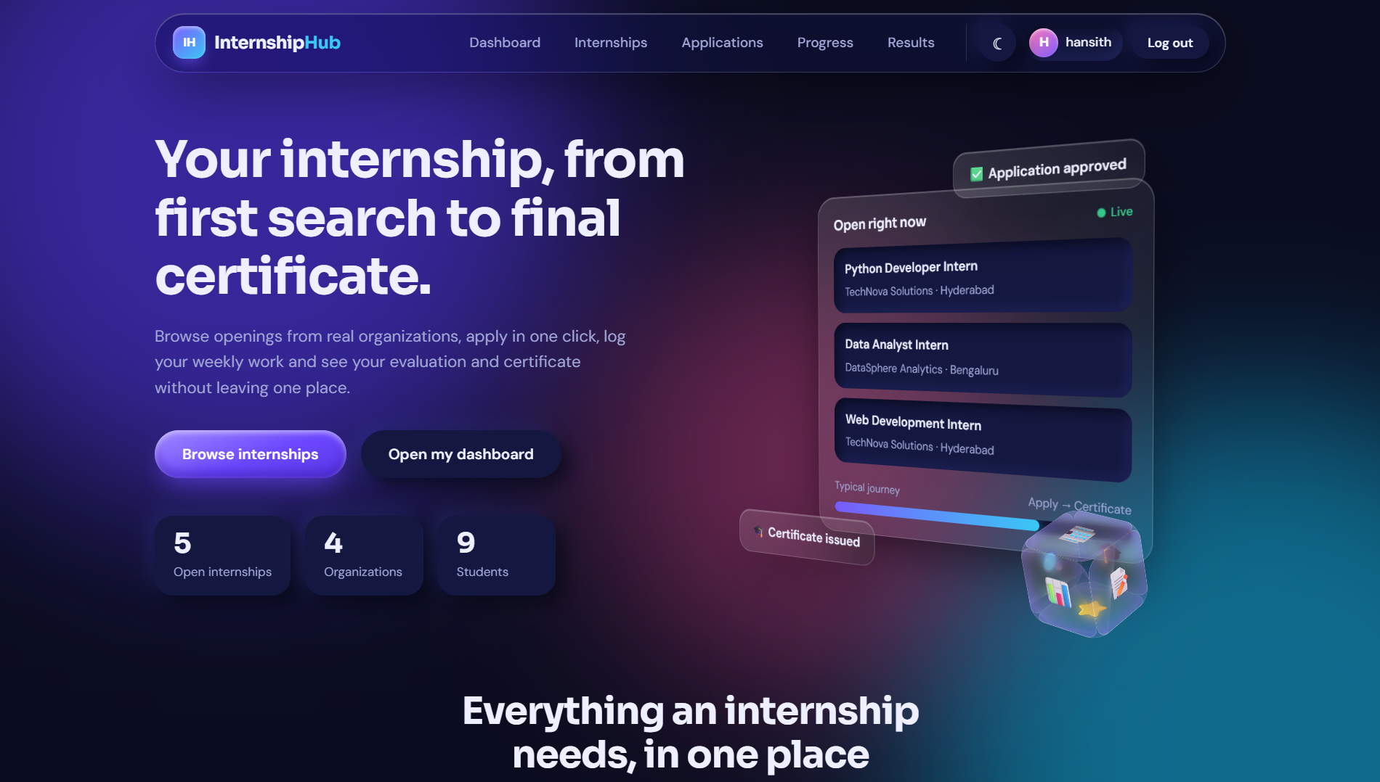
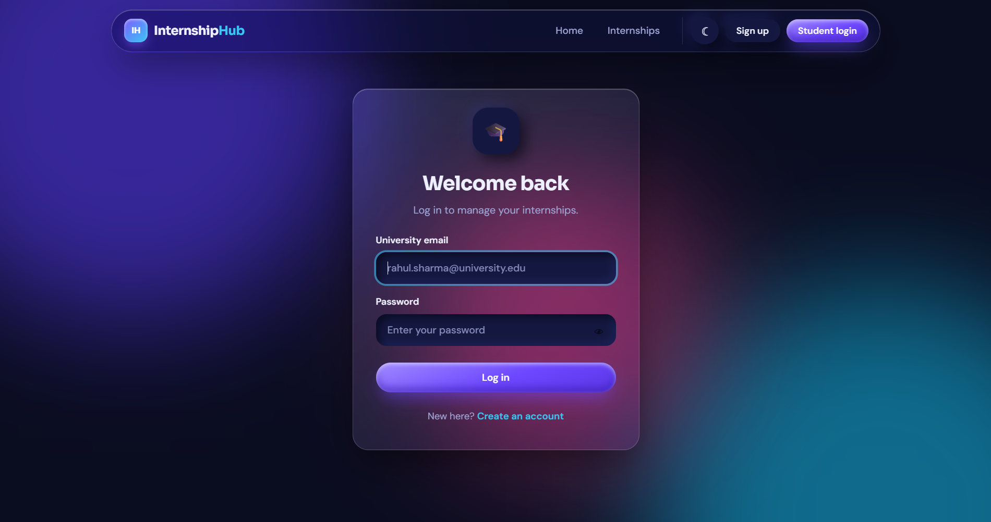
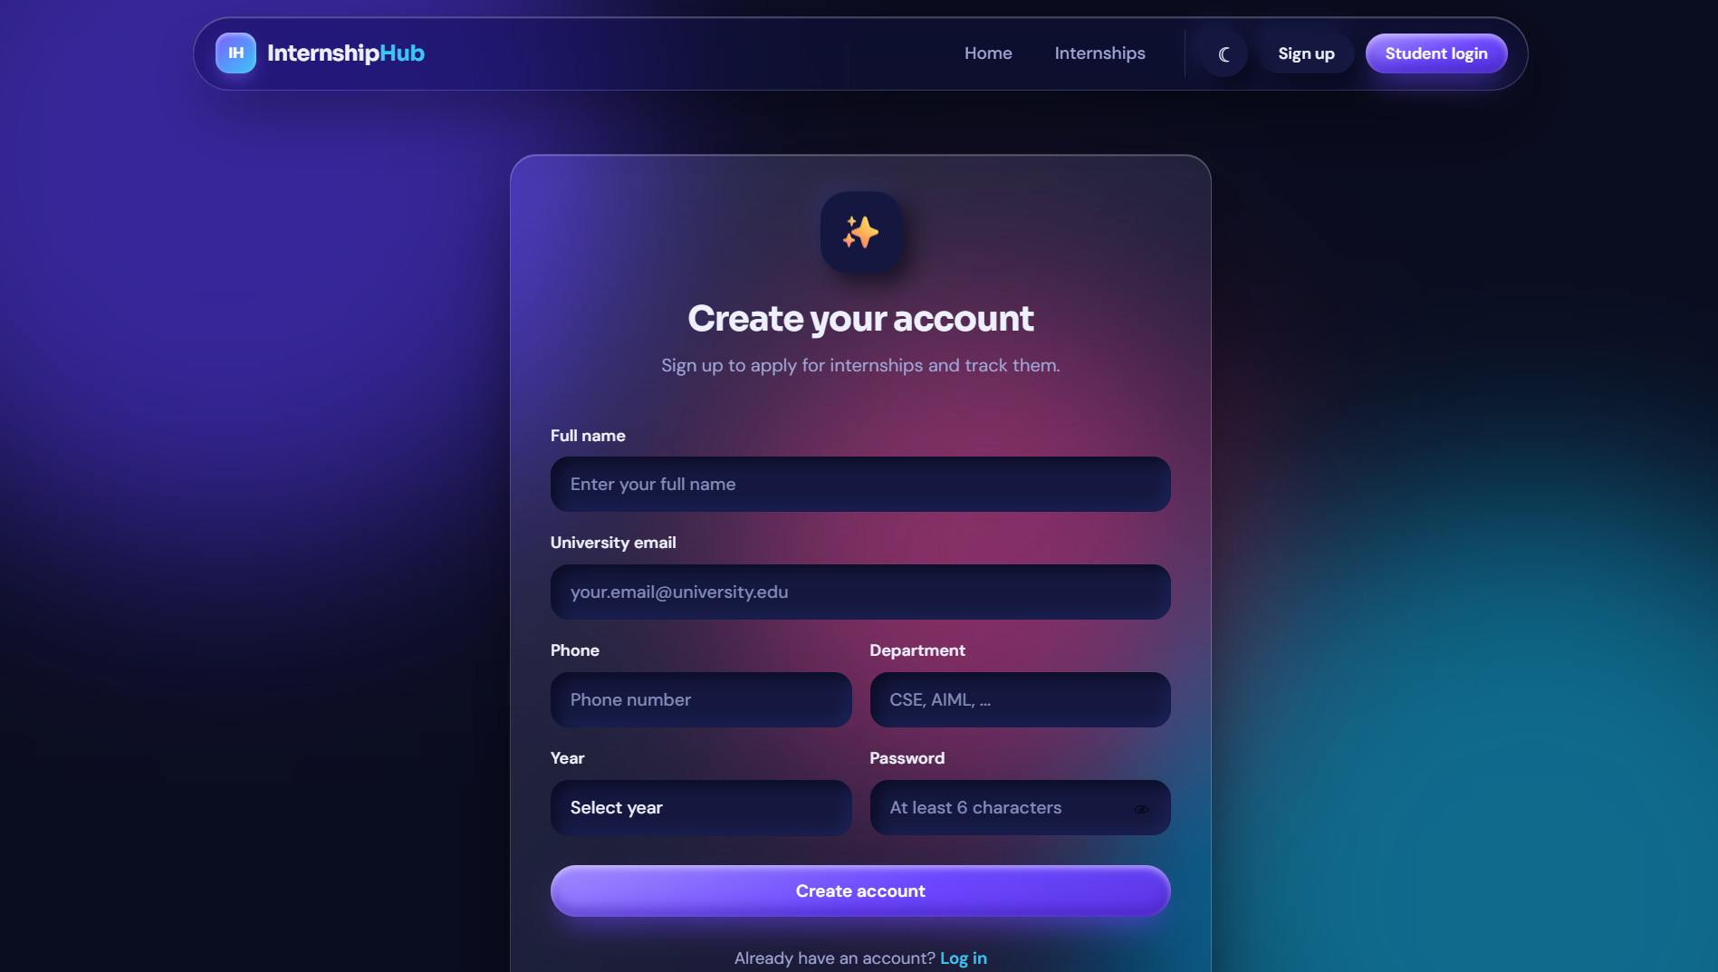
PROJECT 35 • REVIEW 3
Final Output Screens
Evidence of the completed user-facing prototype.
Internship catalogue
Login
Registration
INTERNSHIP APPLICATION & PROGRESS MONITORING SYSTEM • 10

Slide 11
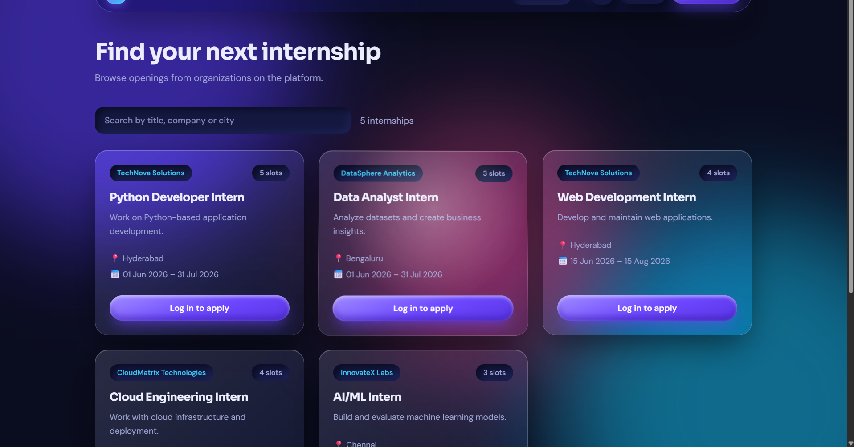
PROJECT 35 • REVIEW 3
Authenticated Student Experience
After login, the navigation exposes dashboard, applications, progress and results.
Logged-in navigation and student-specific workflow.
INTERNSHIP APPLICATION & PROGRESS MONITORING SYSTEM • 11

