Slide 1

A
Mini Project
On
A Model for Object Detection and Analysis
(Submitted in partial fulfilment of the requirements for the award of Degree)
BACHELOR OF TECHNOLOGY
In
COMPUTER SCIENCE AND ENGINEERING
By
M SAI SURYA (197R1A05N2)
A HRUTHIK KUMAR (197R1A05J4)
A NAVYA (197R1A05J1)
Under the Guidance of
NUTHANAKANTI BHASKAR
(Associate Professor)

Slide 2
ABSTRACT
In this work, we proposed a methodologies for detecting the object in the given image/real time and specify the name and note the count of each object respectively. The variety of object counting problems is considerable, each having their own characteristics and challenges. The difficulty of the problem depends on many factors: contrast between object and background, degree of object clustering, object texture and its variation, object size and its variation, complexity of the objects, among others. With the help of YOLOV3 algorithm from which we had trained COCO data set and preform pre-processing to detect the each object and classifies them using YOLO algorithms, which will detect the object and give the count as the result.
Key points: YOLOV3, COCO Data Set.

Slide 3
EXISTING SYSTEM
In recent years, with the progress of more and more innovative and powerful Convolutional Neural Networks (CNNs) based object detection systems have been proposed, the object detection problem has been one of the fastest moving areas in computer vision In addition to increased accuracy in predictions and a better Intersection over Union in bounding boxes (compared to real-time object detectors), YOLO has the inherent advantage of speed.
YOLO is a much faster algorithm than its counterparts, running at as high as 45 FPS. Here’s how YOLO works in practice. While algorithms like Faster RCNN work by detecting possible regions of interest using the Region Proposal Network and then perform recognition on those regions separately, YOLO performs all of its predictions with the help of a single fully connected layer.
Methods that use Region Proposal Networks thus end up performing multiple iterations for the same image, while YOLO gets away with a single iteration.
DISADVANTAGES:
Comparatively low recall and more localization error.
Struggles to detect close objects because each grid can propose only 2 bounding boxes.
Struggles to detect small objects.

Slide 4
PROPOSED SYSTEM
In this we used COCO data set and perform pre-processing on the data set to detect each object and each object is classified in the respective manner. To do detection and classification YOLO algorithm is used.
This is an algorithm that detects and recognizes various objects in a picture (in real-time). Object detection in YOLO is done as a regression problem and provides the class probabilities of the detected images.
The algorithm requires only a single forward propagation through a neural network to detect objects. This means that prediction in the entire image is done in a single algorithm run. The objects are detected and specify the object by name and count.
ADVANTAGES:
Process frames at the rate of 45 fps (larger network) to 150 fps (smaller network) which is better than real-time.
The network is able to generalize the image better.
Speed: This algorithm improves the speed of detection because it can predict objects in real-time.
High accuracy: YOLO is a predictive technique that provides accurate results with minimal background errors.
Learning capabilities: The algorithm has excellent learning capabilities that enable it to learn the representations of objects and apply them in object detection.

Slide 5
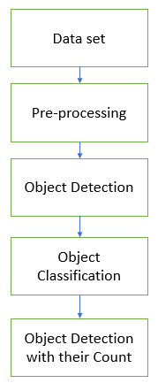
PROPOSED SYSTEM…

Slide 6
HARDWARE REQUIREMENTS:
System : Platinum IV (or) above.
Hard Disk : 40 GB.
Ram : 500 Mb.
SOFTWARE REQUIREMENTS:
Operating System : Windows 7 or higher, Linux, Mac OS
Coding Language : Python.
Tools used : Visual Studio Code,

Slide 7
NOVELITY:
A growing number of routine and research activities, Most of the cases the count of the objects is done manually which consume time and energy. This project is used to detect the object and specify the object by the name and count in real time. For example: In a crowded area, In a library, In laboratory, etc.
This model take the picture to anticipate what are those object, where objects are available and count of the objects. A single convolutional network at the same time predicts numerous bounding.
Every lattice cell predicts just a single object. This model is very quick at test time and it requires single network assessment and performs feature extraction, bounding box predict, non max suppression, and contextual reasoning all simultaneously.

Slide 8
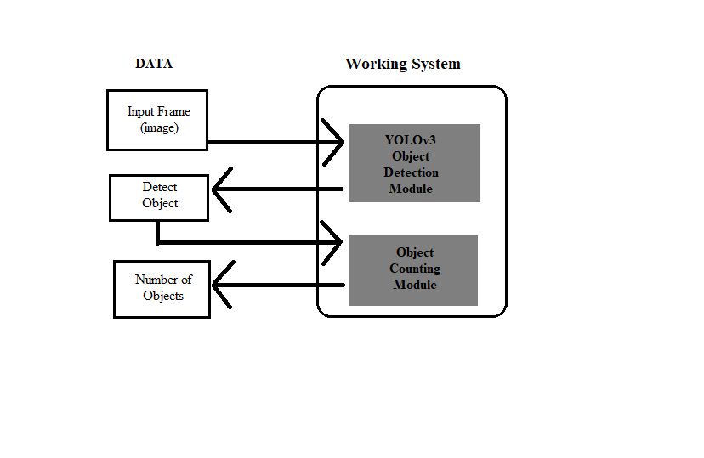
Architecture:
Objects

Slide 9
Modules:
1. Data Analysis
2. Data Preprocessing
3. Machine Learning Algorithm for Prediction
4. Prediction analysis and result

Slide 10
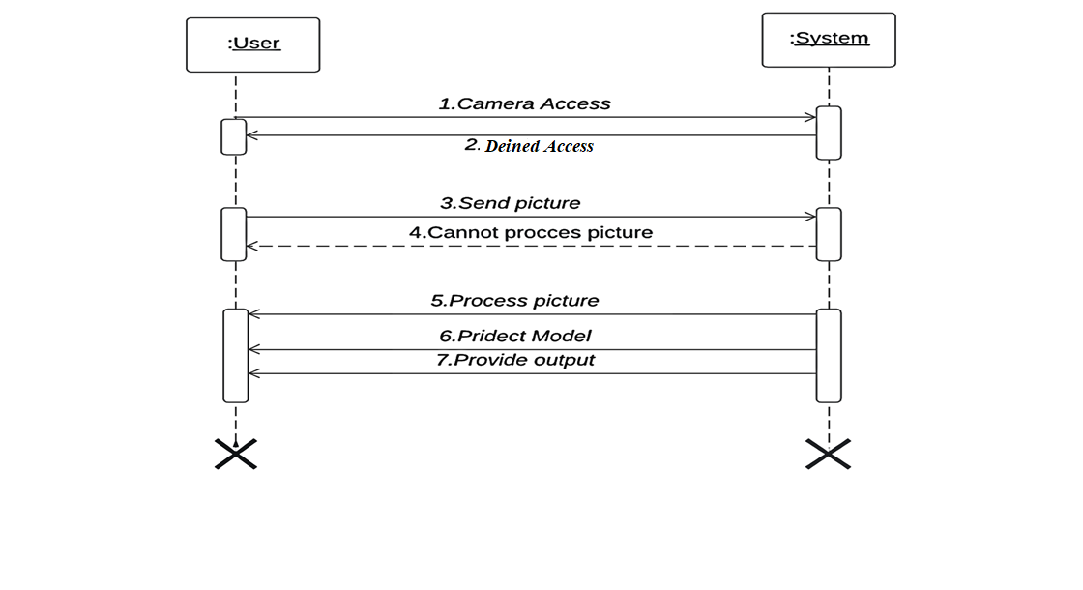
UML
1. Sequence diagram

Slide 11
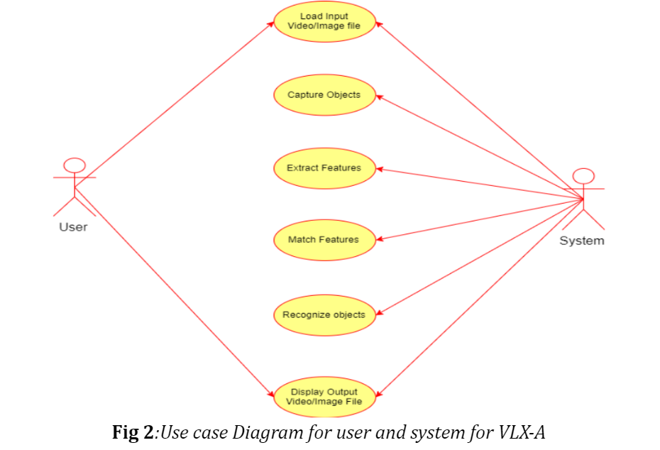
2. Use case Diagram

Slide 12
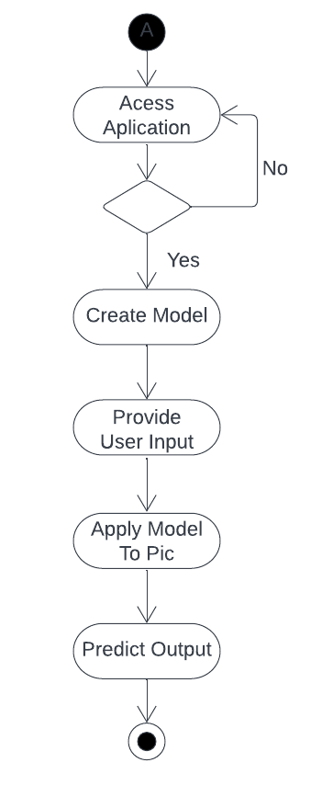
3. Activity diagram

Slide 13
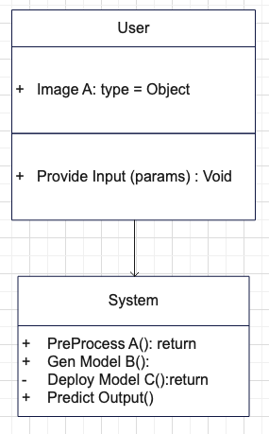
4. Class diagram

Slide 14
SAMPLE CODE:
import cv2
import numpy as np
net=cv2.dnn.readNet(r"C:\Users\Public\yolov3.weights",r"C:\Users\Public\yolov3.cfg")
classes=[]
with open('coco.names','r') as f:
classes=f.read().splitlines()
redundant=[]
countlists=[]
size=len(track)
i=0
while i<size:
redundantsize=len(redundant)
if (redundantsize==0):
totalobject=countobject(track,track[i])
redundant.append(track[i])
countlists.append(totalobject)
i+=1

Slide 15
SAMPLE CODE…
else:
rslt=numOfsameIndex(redundant,track[i])
if(rslt==0):
totalobject=countobject(track,track[i])
redundant.append(track[i])
countlists.append(totalobject)
i+=1
else:
i+=1

Slide 16
RESULT:

Slide 17
CONCLUSION:
In this proposed work we applied YOLOv3 algorithm on COCO dataset. The object detection and classification is done and the recognized objects are specified by there name and the count of the object. This work high accuracy and efficiency.

Slide 18
FUTURE ENHANCEMENT:
In this research work, the object Identification and Visual Tracking has been done through the use of ordinary camera. The concept is well extendable in applications like Intelligent Robots, Automatic Guided Vehicles, Enhancement of Security Systems to detect the suspicious behavior along with detection of weapons, identify the suspicious movements of enemies on boarders with the help of night vision cameras and many such applications.
object identification task with motion estimation needs to be fast enough to be implemented for the real time system. Still there is a scope for developing faster algorithms for object identification. Such algorithms can be implemented using FPGA or CPLD for fast execution.

Slide 19
REFERENCES:
Agarwal, S., Awan, A., and Roth, D. (2004). Learning to detect objects in images via a sparse ,part-based representation. IEEE Trans. Pattern Anal. Mach. Intell. 26,1475–1490.doi:10.1109/TPAMI.2004.108
Alexe , B., Deselaers , T., and Ferrari, V. (2010). “What is an object?,” in Computer Vision and Pattern Recognition (CVPR), 2010 IEEE Conference on (San Francisco , CA: IEEE), 73–80.doi:10.1109/CVPR.2010.5540226
A. Kamal, “YOLO, YOLOv2 and YOLOv3: All You want to know”(2019) Available at: https://medium.com/@amrokamal_47691/yolo-yolov2-and-yolov3-all-you-want-toknow-7e3e92dc4899 [Assessed: 04/10/20]

Slide 20
GITHUB LINK:
https://github.com/saisurya21/A-Model-for-Object-Detection-and-Analysis

Slide 21
THANK YOU

Slide 22
PAPER PUBLICATION:

