Slide 1

Name: Konakalla Sai Surya Pavan Kumar
Roll no: 21471A05G7
College: Narasaraopeta Engineering College

Slide 2
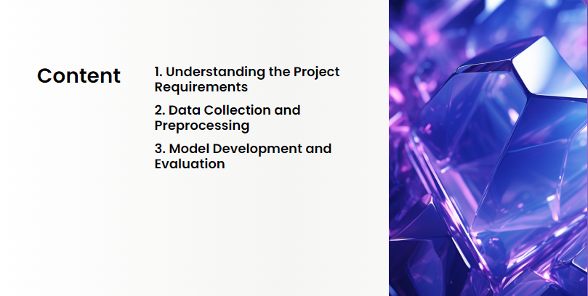

Slide 3


Slide 4


Slide 5



Slide 6


Slide 7


Slide 8


Slide 9


Slide 10


Slide 11
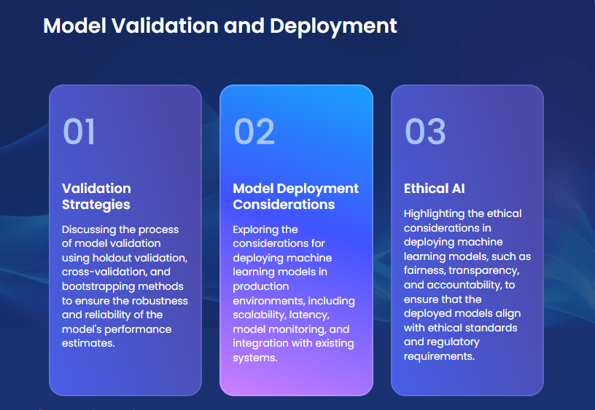

Slide 12
THANK YOU

