Slide 1


Social Buzz content Analysis

Slide 2


Today's agenda
Project recap
Problem
The Analytics team
Process
Insights

Slide 3

Social Buzz is a rapidly expanding technology unicorn that is scaling globally. In order to keep up with this growth, the company needs to adapt quickly. That's why Accenture has taken up a 3-month proof-of-concept project to help Social Buzz achieve its goals.
1. An audit of social buzz big data practice
2. Recommendations for a successful IPO
3. Analysis to find social Buzz's top 5 most popular categories of content.
Project Recap

Slide 4


Problem
Over 100000 posts per day
36,500,000 pieces of content per year!
But how to capitalize on it when there is so much?
Analysis to find Social Buzz’s top 5 most popular categories of content

Slide 5


Andrew Fleming
Chief Technical Architect
The Analytics team
Marcus Rompton
Senior Principle
Gatta Venkata Sai Surya Chandra Prasad
Data Analyst

Slide 6
Process
1
Data Understanding
2
Data Cleaning
3
Data Modelling
4
Data Analysis
5
Uncover Insights

Slide 7
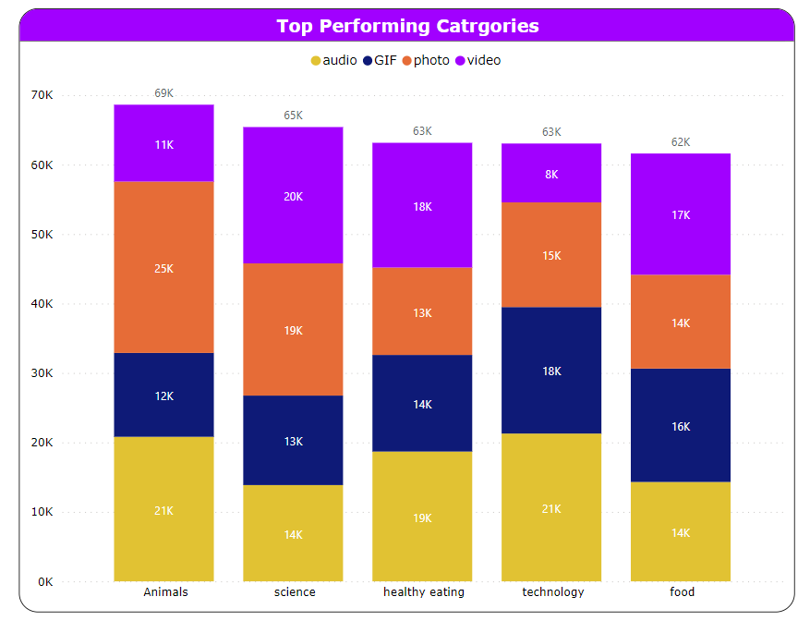
Insights

Slide 8
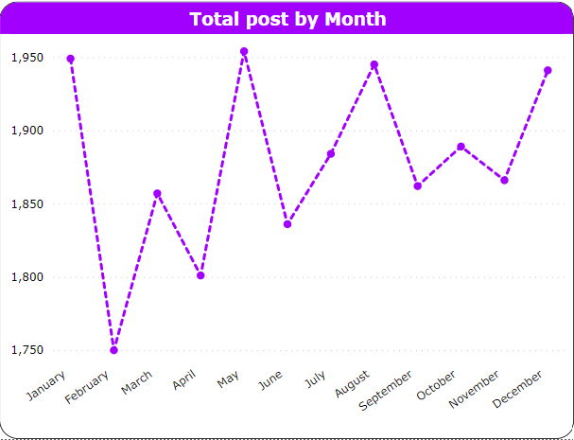
Insights

Slide 9

Thank you!
ANY QUESTIONS?

