Slide 1

Bio-Gen Eco System

Slide 2
Problem statement
Bio-Gen eco-system is a Java swing application which integrates data coming from all areas of healthcare value system to do analytics on data of the healthcare value chain from chemical compounds to all the way to patient’s treatment and recovery. Bio-Gen eco-system maintains statistical data of an active chemical compound effective in targeting a certain gene in a disease and provides a chemical compound to the test the effectiveness in targeting other diseases that share the same gene. We believe that adopting a common global data standard and upgrading healthcare value system would benefit Bio-Gen eco-system in further improvements of patient care.

Slide 3
Approach
To help Bio-Gen integrate data coming from different sources of healthcare system.
To provide a common platform for global biotechnology company like Bio-Gen to focus on the development and marketing of new drugs for the treatment of disease in healthcare patients anywhere in the world.
Drug enterprise keeps tracks of the gene and their targeting chemical compound. This way, a drug manufacturer can create a new drug in the future when a new disease is occurred by combination of existing genes to avoid any delays in manufacturing a new drug.

Slide 4
Areas To FOCUS
THE APPLICATION FOCUSES TO DO ANALYSIS ON DATA BIOGEN OWNS IN ALL PHASES OF HEALTHCARE VALUE CHAIN FROM CHEMICAL COMPOUNDS TO ALL THE WAY TO PATIENT’S TREATMENT AND RECOVERY.
DATA MANAGEMENT
PROCUREMENT – PROVIDING A METHOD FOR INVENTORY TRACKING
INFORMATION SHARING & COLLABORATION- SENDING THE DISEASE-RELATED INFORMATION FROM THE HOSPITAL TO THE LAB AND LAB TO THE DRUG COMPANY FROM THERE TO CHEMICAL ENTERPRISE.
INVOLVING PATIENTS FOR CLINICAL TRIALS.
PROVIDE A DASHBOARD FOR BIOGEN TO VIEW SALES OF MEDCINE, PREDOMIDANT GENE IN ALL DISEASES AND COMMON DISEASE IN A NETWORK.

Slide 5
Hierarchy structure
BIOGEN
BOSTON
DALLAS
CALIFORNIA
HOSPITAL
PHARMACY
DRUG SUPPLIER
CHEMICAL

Slide 6
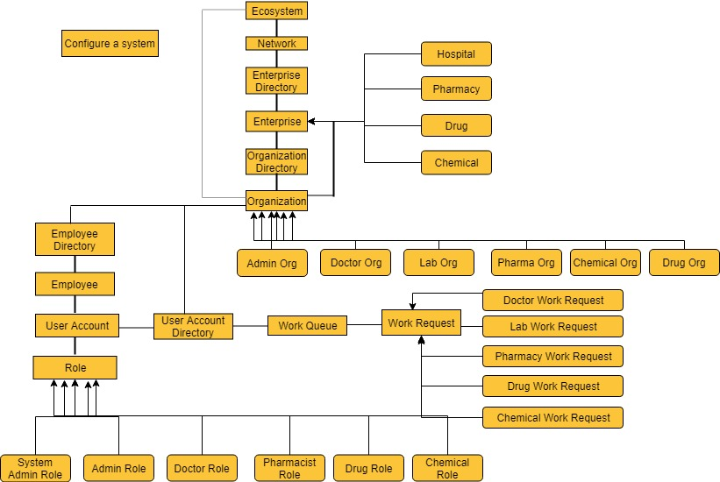
Architecture diagram

Slide 7
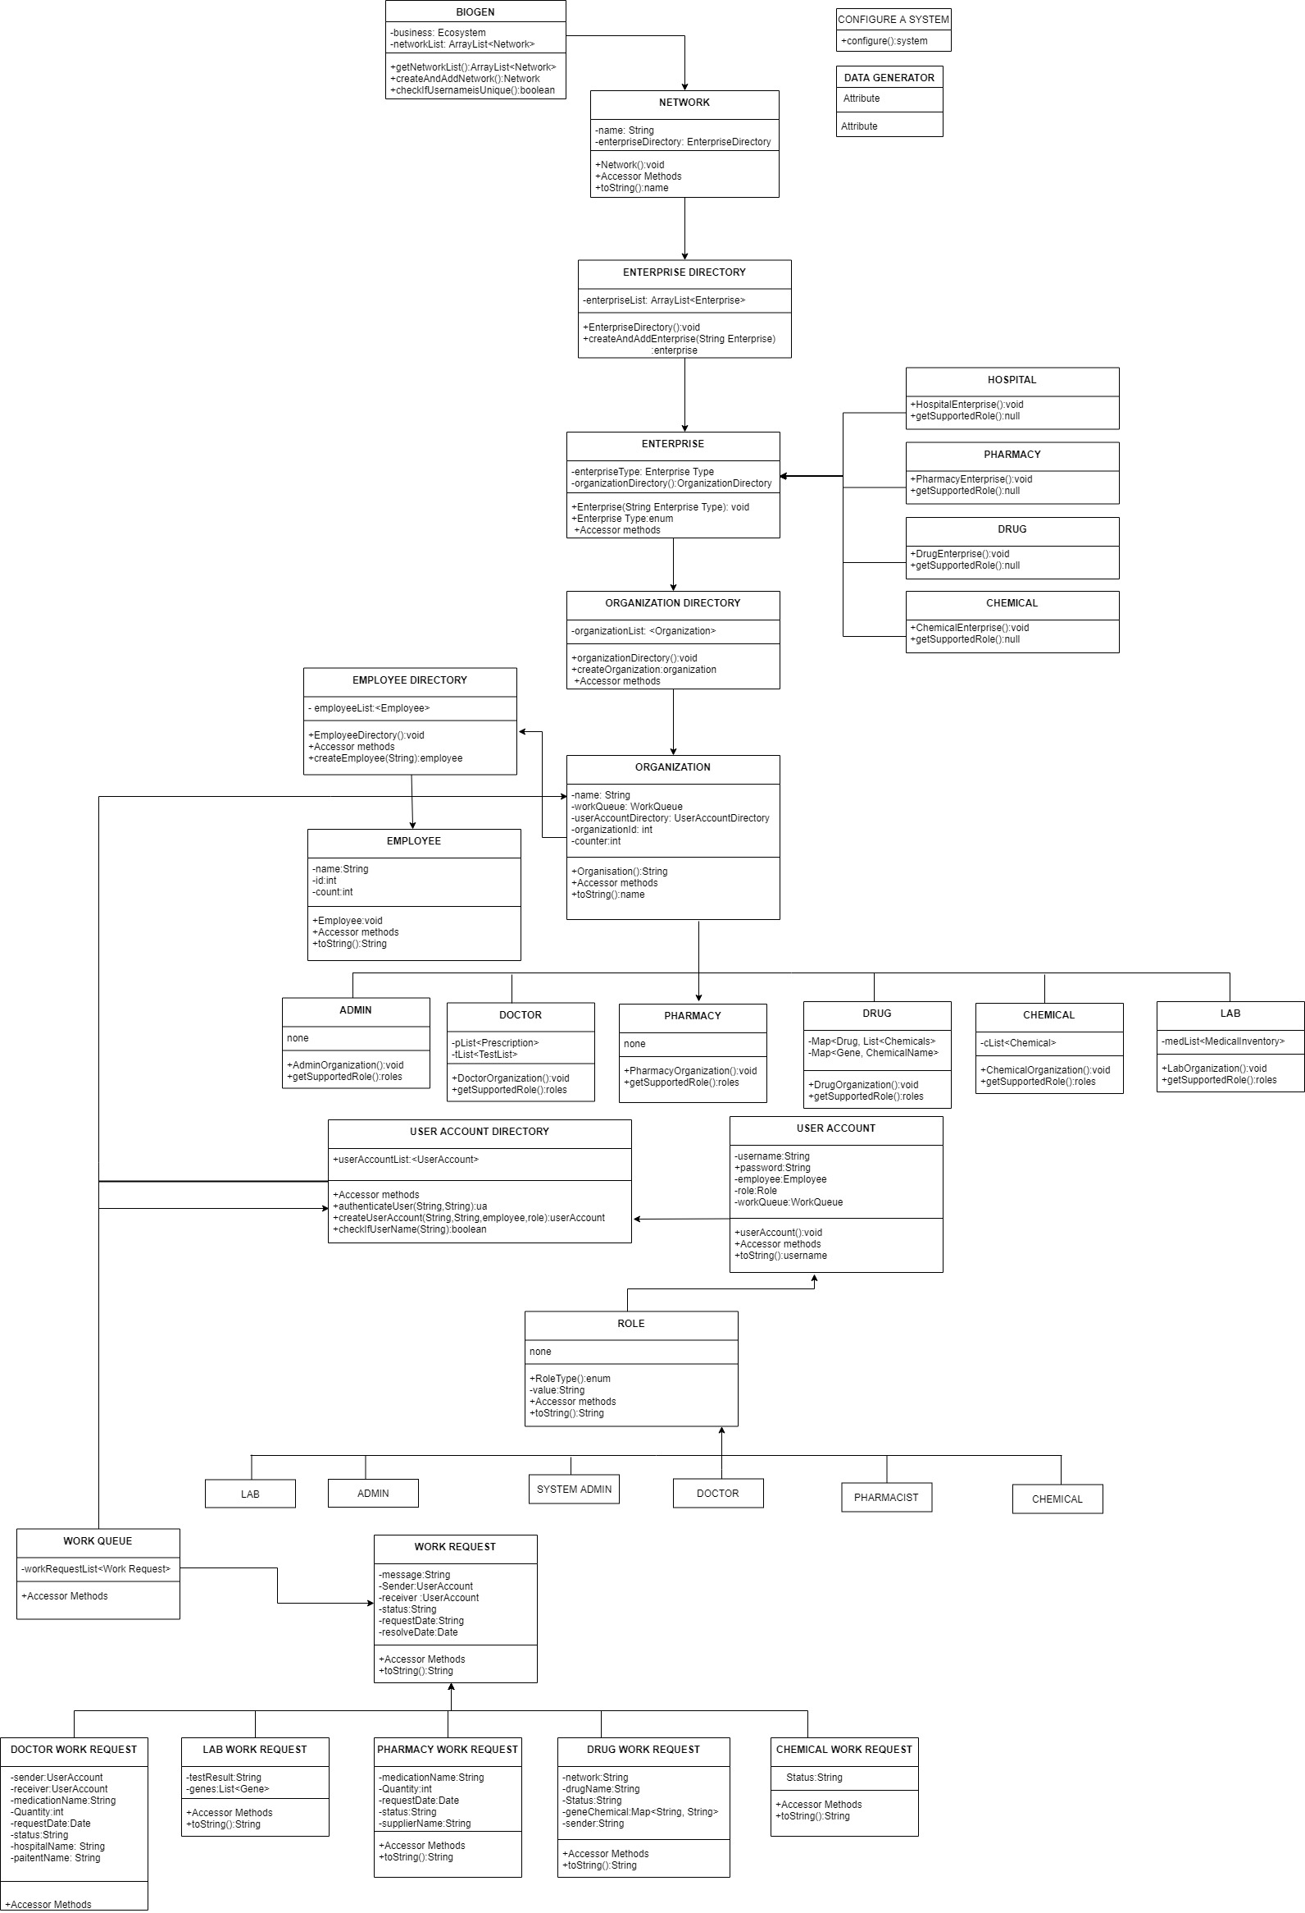
Object Model

Slide 8
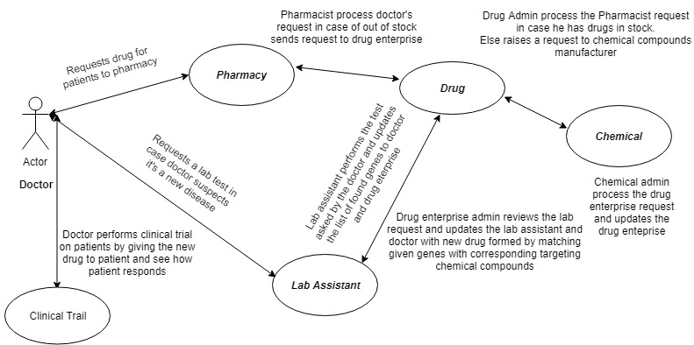
Use cases

Slide 9
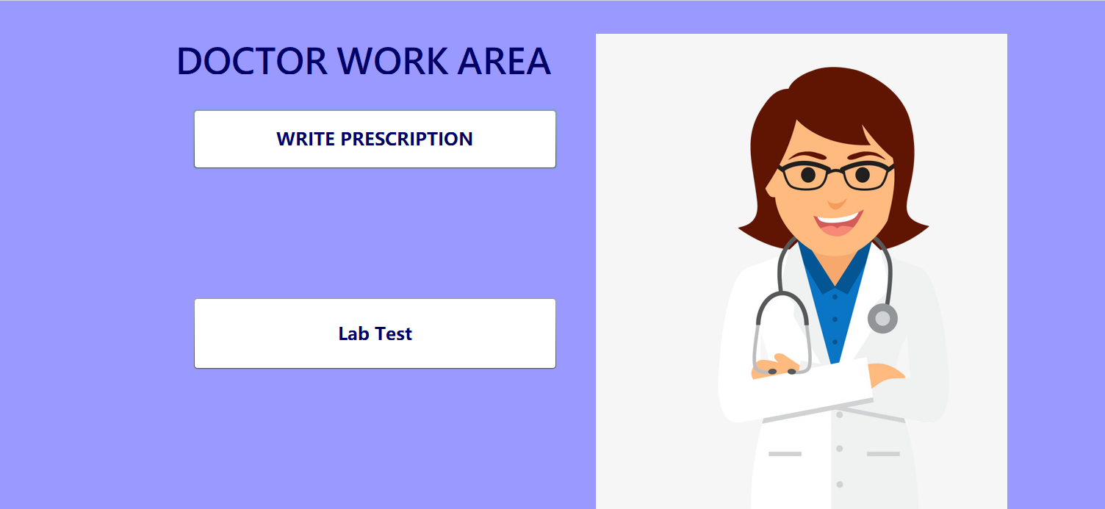

Slide 10
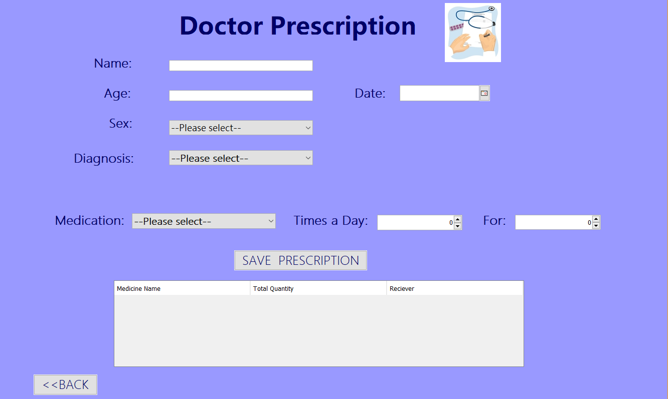

Slide 11
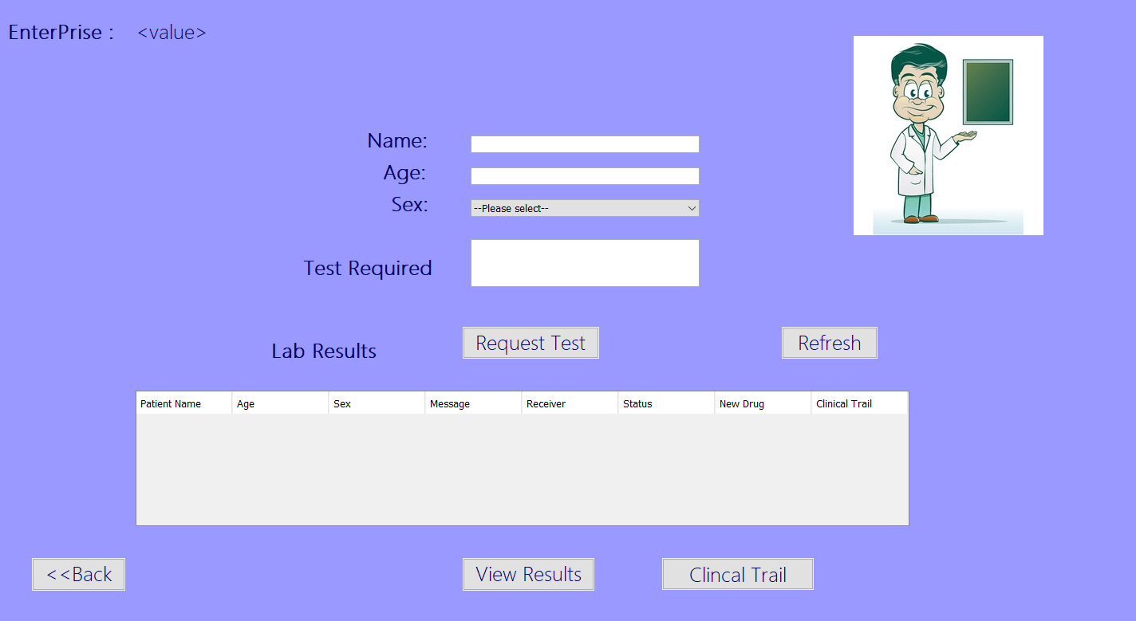

Slide 12
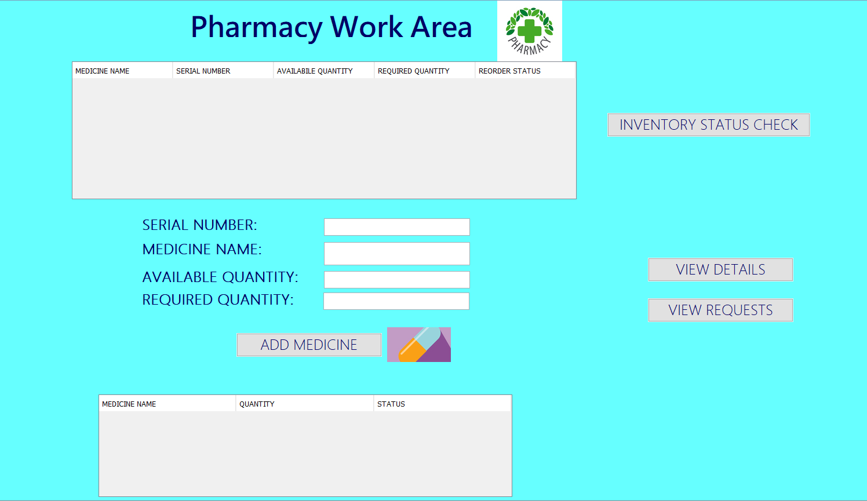

Slide 13
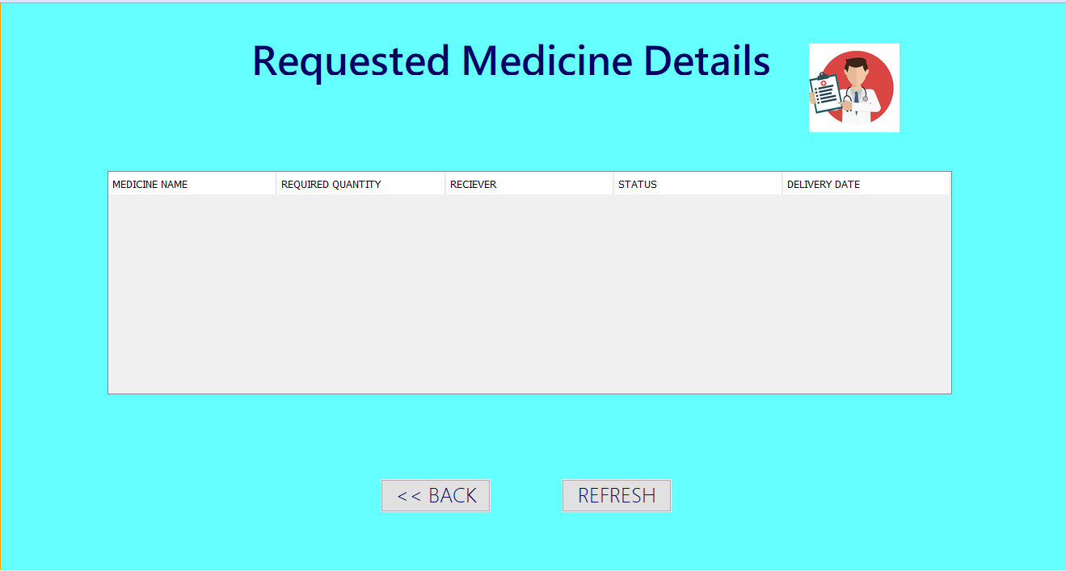

Slide 14
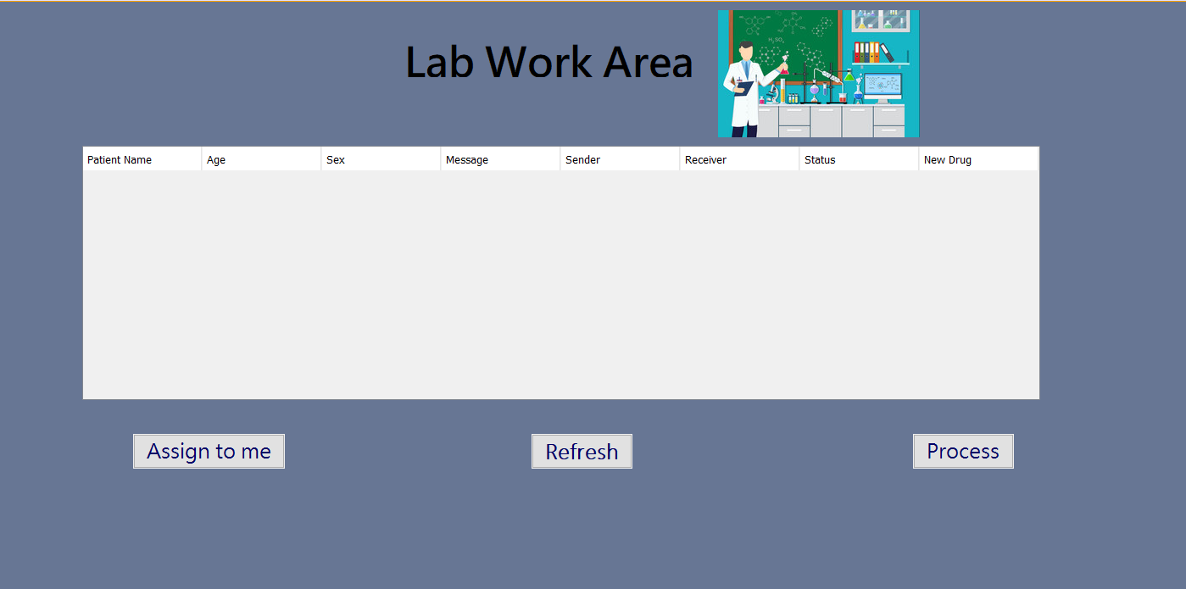

Slide 15
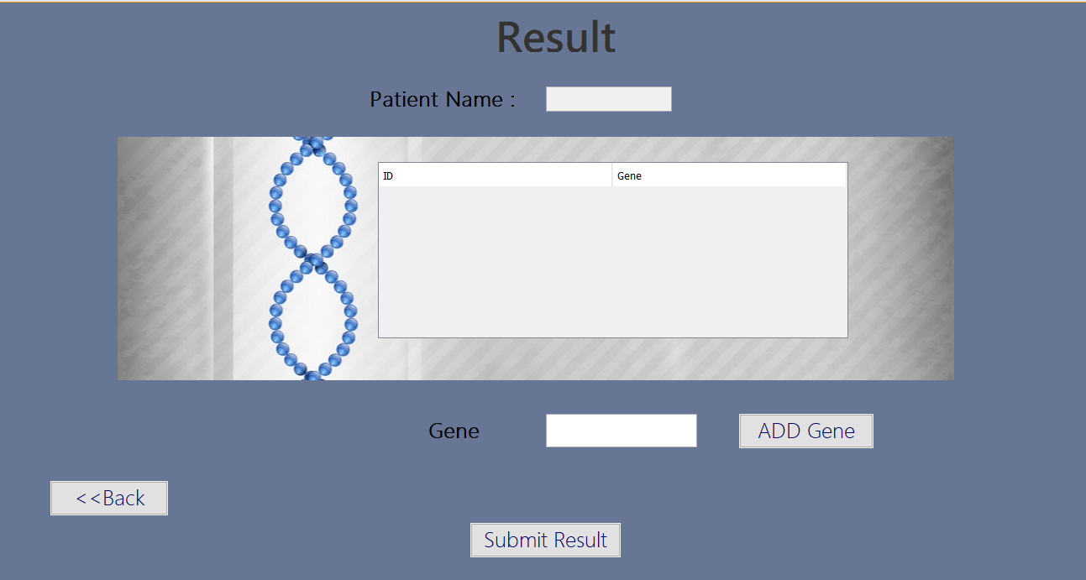

Slide 16
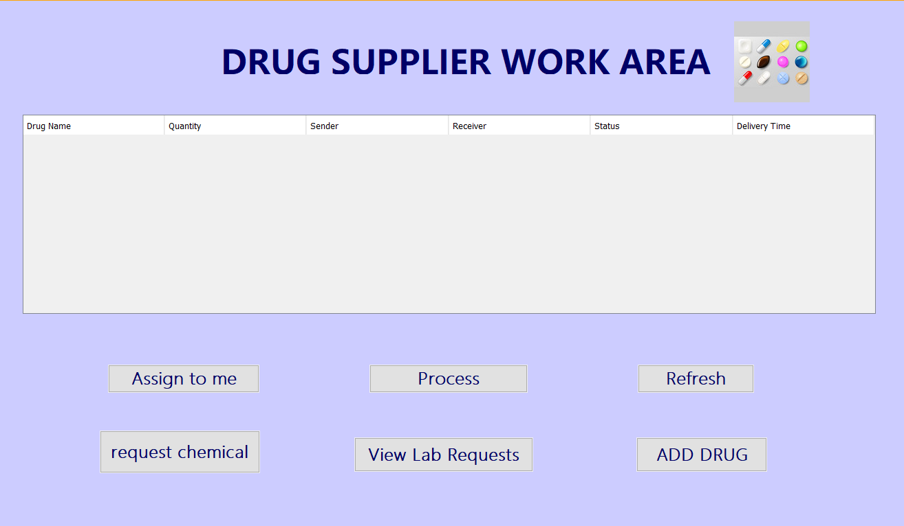

Slide 17
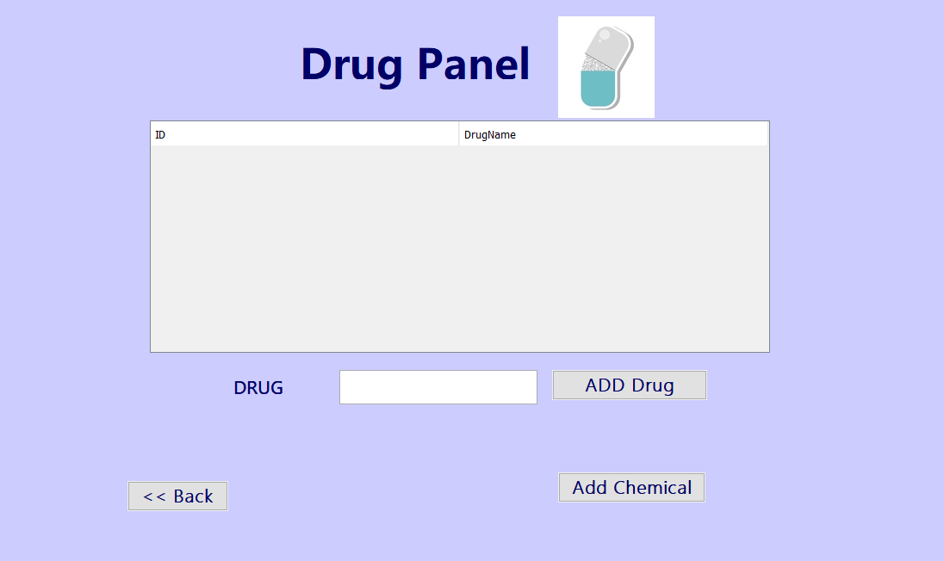

Slide 18
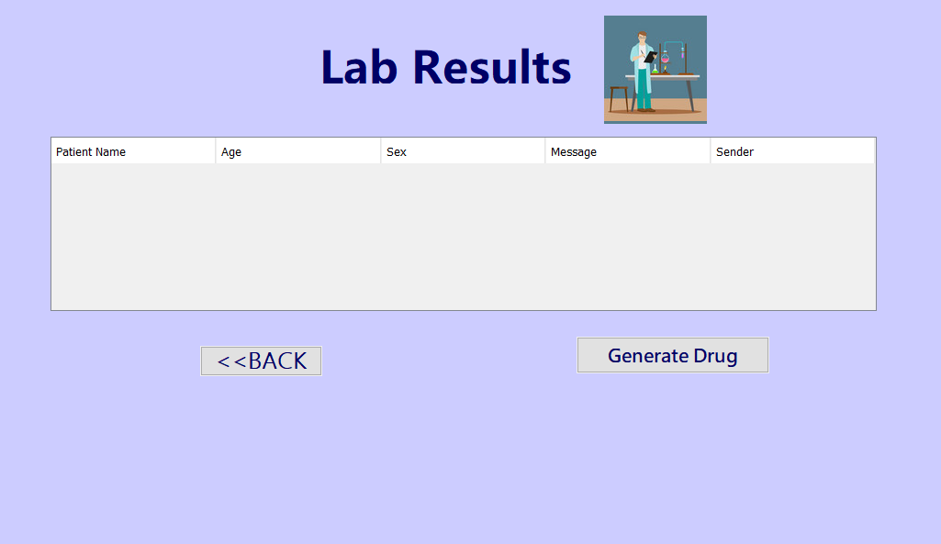

Slide 19
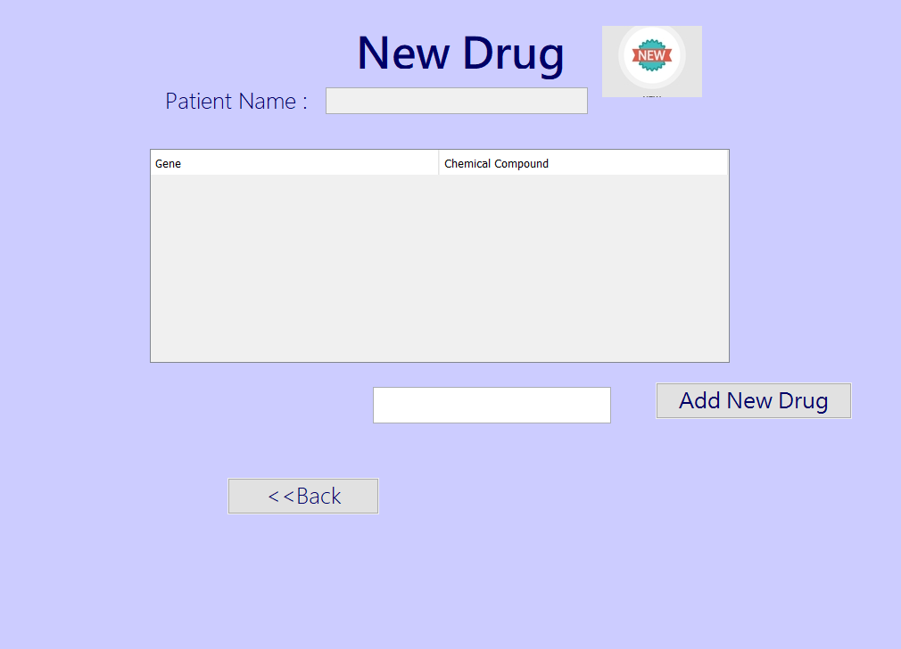

Slide 20
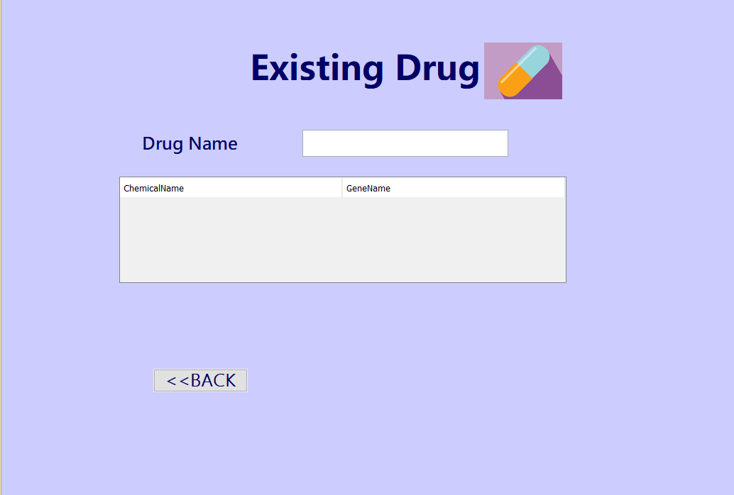

Slide 21
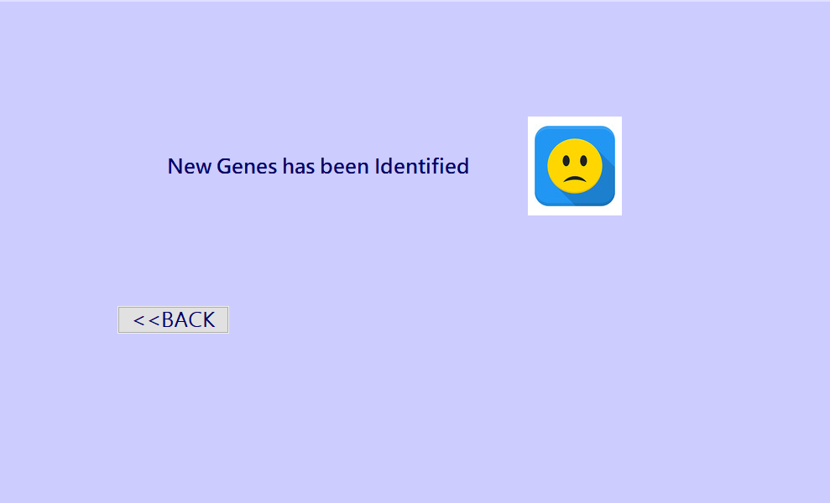

Slide 22
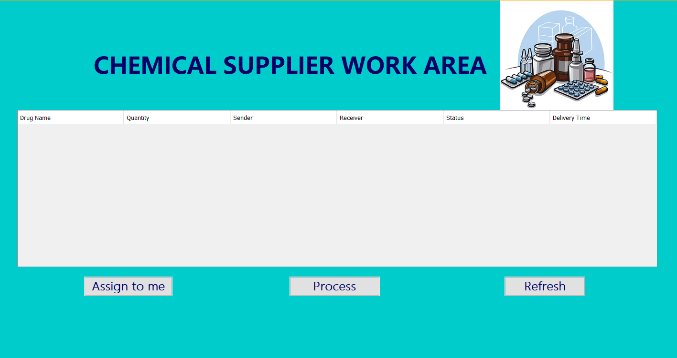

Slide 23
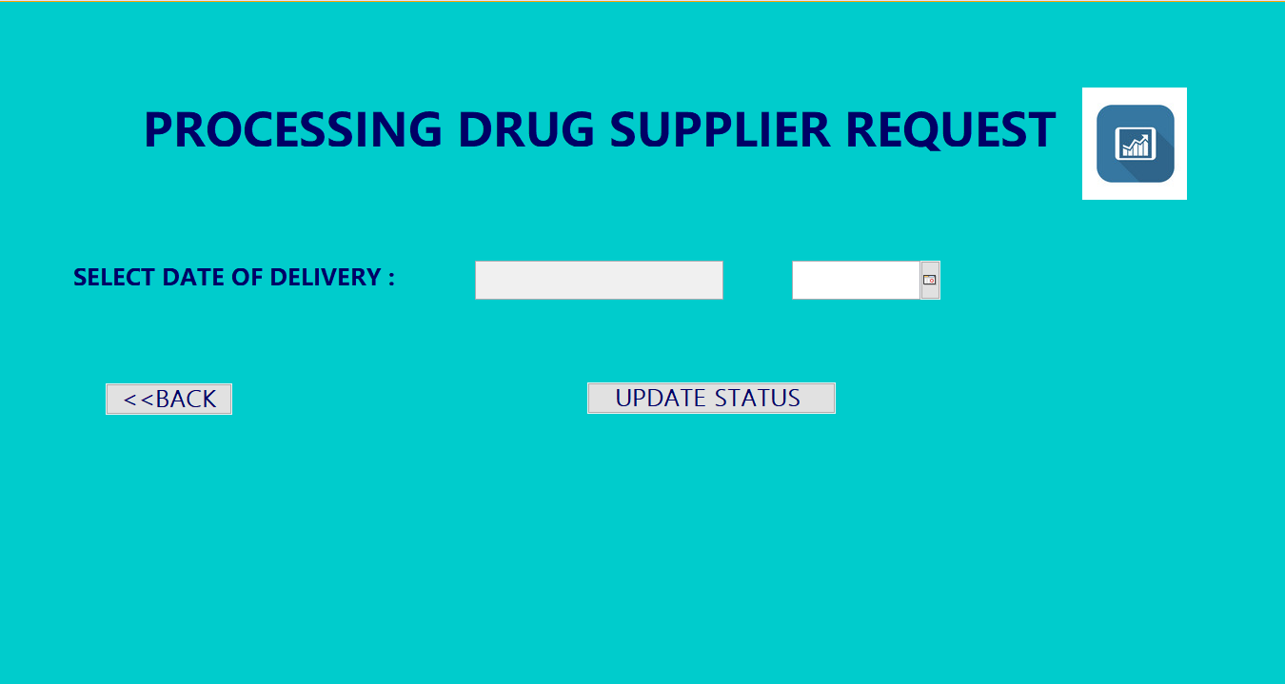

Slide 24

ANALYSIS

Slide 25
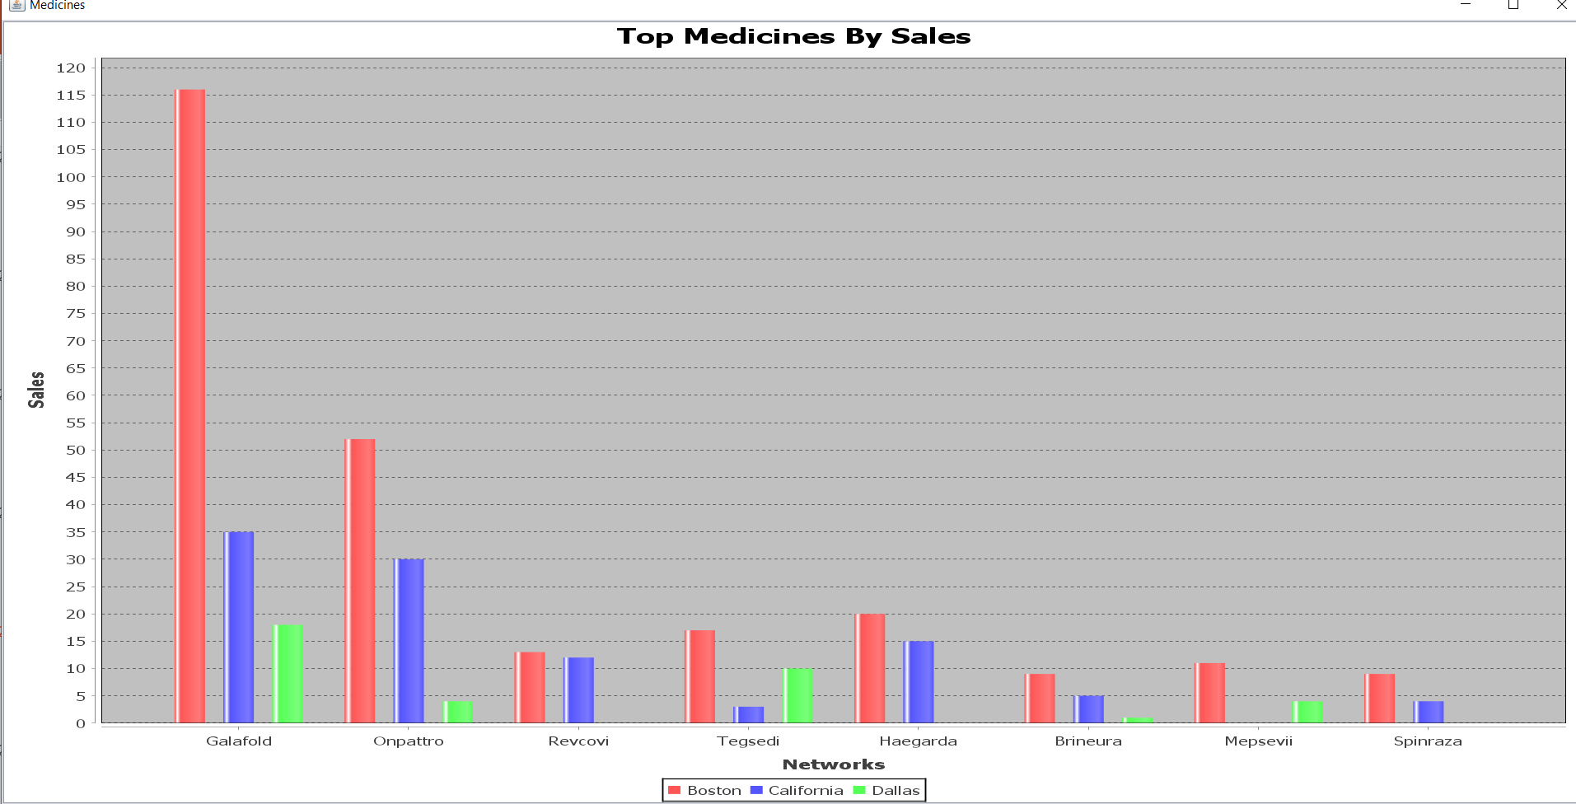

Slide 26
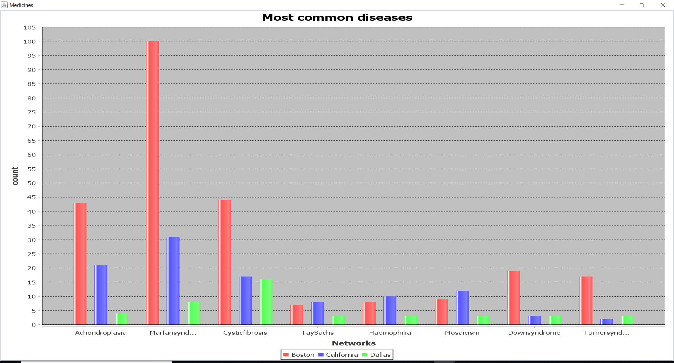

Slide 27
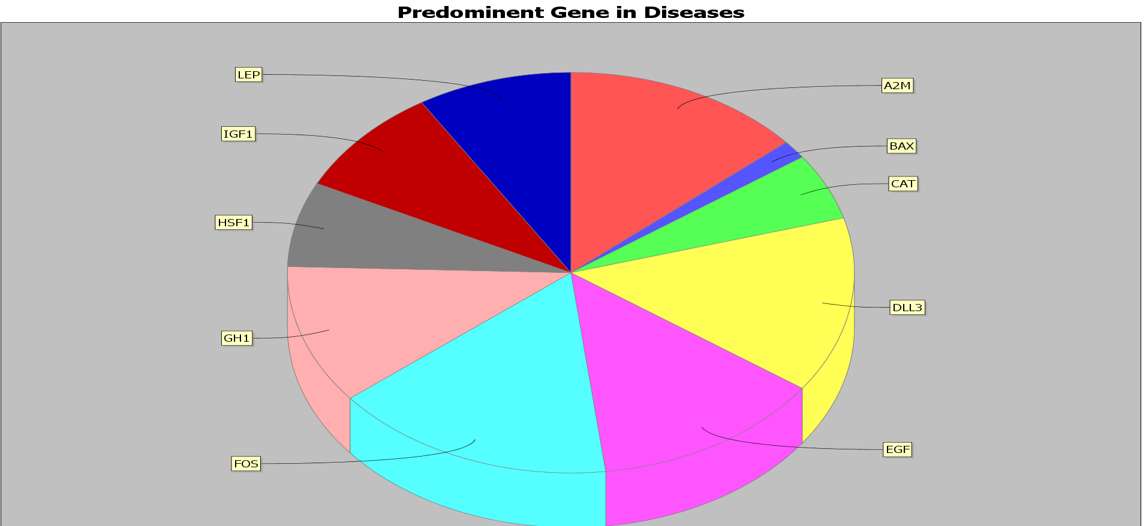

Slide 28
BENEFITS
We believe that adopting a common global data standard and upgrading healthcare value system would benefit Bio-Gen eco-system in further improvements of patient care.
Also, safer and cost effective healthcare can be provided to millions of patients across the country.
Keeping track of inventory across multiple enterprises helps in faster deliver of medicines to patients.

Slide 29

Thank you
By ,
Sai Swagath
Goutham Reddy
Venu Gopal

