Slide 1

AMRITA SCHOOL OF ARTIFICIAL INTELLIGENCE, BENGALURU
B. Tech in Artificial Intelligence and Data Science (AID)
Third Semester, Section F, Academic Year: 2024-25
END-TERM PROJECT
on
CHURN PROBABILITY PREDICTION IN BANKING
Mathematics For Intelligent Systems 3(23MAT204)
Presented by Group No. 05
B. NITHIN KUMAR (BL.EN.U4AID23007)
T. SAI SWAROOP (BL.EN.U4AID23051)
P. SAI(BL.EN.U4AID23063)
Mentor : Dr . Sarada Jayan

Slide 2
CHURN PROBABILITY PREDICTION IN BANKING
Leveraging Machine Learning for Enhanced Customer Retention

Slide 3
Introduction
The Banking sector is evolving rapidly and is very well influenced by technological advancements, changing consumer preferences and a competitive market.
Customer churn , which is the phenomenon of customers discontinuing their relationship with a bank, poses unique challenges and opportunities .
Machine Learning, with its predictive capabilities, offers a transformative approach to understand the challenges posed by a customer.

Slide 4
Dataset Information
Number of records : The dataset consists of 10000 records. Each record represents a unique entry , contributing to the analysis.
Features/Columns : The dataset contains 18 features consisting of both numerical and categorical features.

Slide 5
Exploratory Data analysis(eda)
Exploring the dataset allowed us to gain a comprehensive overview of the data’s structure.
It uncovered potential patterns, helped us to identify key trends and to find essential insights from the dataset.
Visualization also played a crucial role in providing a clear representation of the data.

Slide 6
Exploratory Data analysis(eda)
First, we made sure that there were no Null and Duplicate values in the dataset. Our dataset was clean .
We found out that the columns like “Row Number”, “ Customer ID”, “Surname” and “Complain” weren’t contributing much to the prediction.
Converted categorical columns like “Geography”, “Gender” and “Card type” into numerical format .
We used Standard Scaler to ensure consistency for the numerical features.

Slide 7
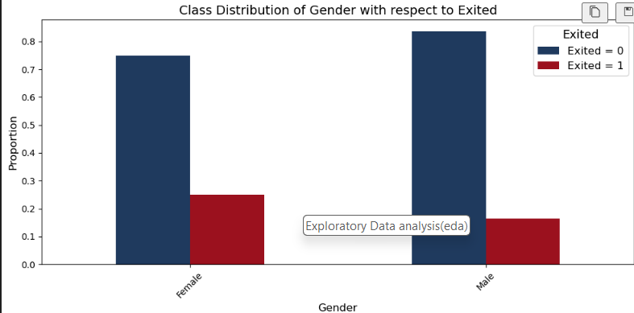
The dataset contains more Male entries than the Female entries

Slide 8
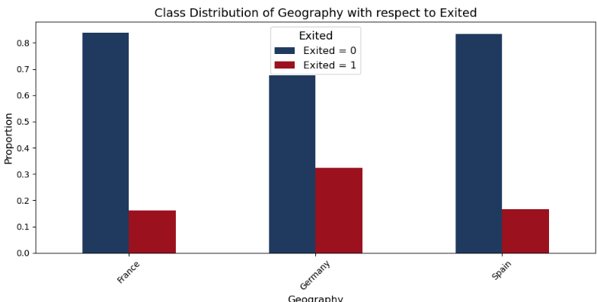
The above plot reveals a substantial customer presence in France compared to other regions

Slide 9
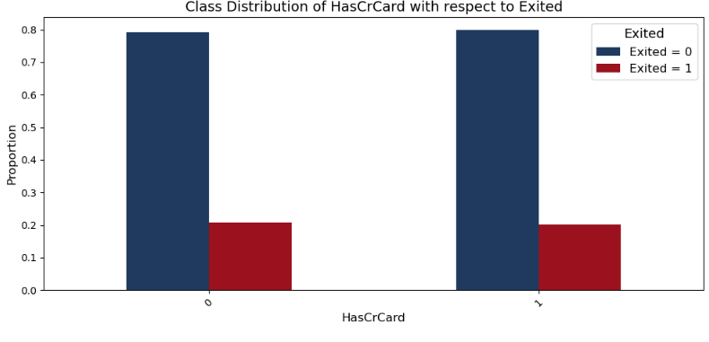

Slide 10
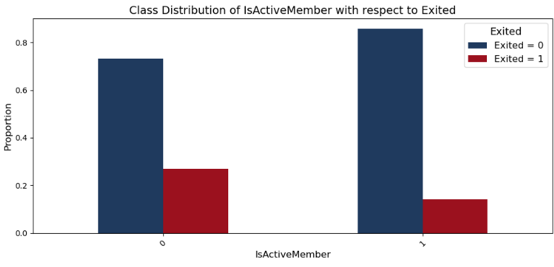
From the above plot we can interpret that Inactive members have a higher Churn rate than Active

Slide 11
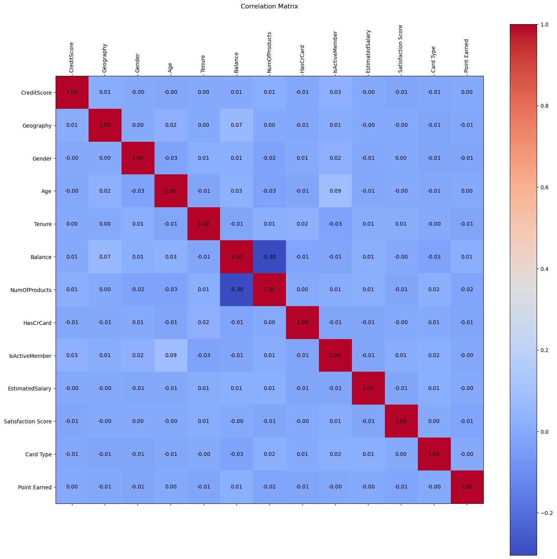
Upon inspection we can see that there is no significant correlation observed among the columns.

Slide 12
Preprocessing
We used a technique called SMOTE ENN to balance our data before splitting.
Dropped the features which were not contributing much for the prediction.
Splitting the Data
We partitioned the dataset into two components : X and y.
X consists of all independent features and y consist of the dependent feature or the target variable(Exited).

Slide 13
Train – Test Split
We split the dataset into training data and testing data.
We did an 80:20 split, meaning 80% of the data is used for training and 20% for testing.
We took random state as 42. This ensures the reproducibility of our result across different runs.

Slide 14
Sampling with SMOTE ENN
We had data imbalance within our target variable . We evaluated our model’s accuracy in the presence pf this imbalance.
To rectify the issue of imbalance we implemented Synthetic Minority Over Sampling Technique and Edited Nearest Neighbours.
Distribution of y_train before sampling:
Distribution of y_train after sampling:
Not Churned(0) | Churned(1)
7962 | 2038
Not Churned(0) | Churned(1)
7286 | 4976

Slide 15
Applying Machine Learning Algorithms
Models used:
Support Vector Machine(SVM) : This technique is used for classification task, especially where there’s a need for clear separation between classes. In this context it draws a distinct boundaries between churned customers.
Random Forest : It builds multiple decision trees on random subsets of data and features and predicts based on majority voting for classification tasks.
Naïve Bayes : It is a probabilistic classification algorithm where it assumes that features are independent making calculations easier. It is often used when simplicity and speed are crucial.
Logistic Regression: It is very good at modelling the probability of an event occurring . It is suitable for scenarios where understanding the likelihood of customers churning is essential.

Slide 16
NAÏVE BAYES ANALYSIS
P(A|B) = P(B|A) . P(A)
P(B)
The posterior probability is equal to the conditional probability of event B given A multiplied by the prior probability of A, all divided by the probability of B.
It is used when the attributes that describe instances are conditionally independent given classification.

Slide 17
Logistic Regression Analysis

Slide 18
Evaluation Metrics
MODEL | F1- Class 0 | SCORE Class 1 | ACCURACY
Logistic Regression | 0.78 | 0.79 | 0.79
SVM | 0.90 | 0.93 | 0.92
Naïve Bayes | 0.78 | 0.86 | 0.83
Random Forest | 0.93 | 0.95 | 0.94

Slide 19
Conclusion
With the help of several insights, patterns and trends in our data, we’ve used Machine Learning to address the intricate challenge of predicting Customer Churn.
By predicting the potential churners, banks can adopt strategies to retain valuable customers.
Mitigating customer churn contributes directly to revenue optimization.
This helps bank to streamline operations, reduce marketing costs and to improve efficiency.

Slide 20
THANK YOU

