Slide 1

AMRITA SCHOOL OF ARTIFICIAL INTELLIGENCE, BENGALURU
B. Tech in Artificial Intelligence and Data Science (AID)
Third Semester, Section F, Academic Year: 2024-25
END-TERM PROJECT
on
Machine Learning for Bank Loan Assessment : Enhancing Predictive Accuracy
INTRODUCTION TO AI AND MACHINE LEARNING (23AID205)
Presented by Group No. 05
B. NITHIN KUMAR (BL.EN.U4AID23007)
T. SAI SWAROOP (BL.EN.U4AID23051)
P. SAI(BL.EN.U4AID23063)
Mentor : Dr . Manju Venugopalan

Slide 2
Motivation
Credit risk assessment is one of the most critical challenges for modern financial institutions.
Making profits with minimal risk calculations to ensure repayment.
Traditional methods often relied on standard parameters like income, credit scores and employment status.
These often miss certain indicators of creditworthiness hidden in the complex data.
Emergence of machine learning introduces objectivity and consistency , minimizing biases in lending decisions.[1]

Slide 3
Problem Statement
How can we use historical data to predict the likelihood of loan defaults and also to mitigate financial risks?
Limited scope of standardized parameters such as income, credit scores and employment status
Difficulty in capturing real world factors affecting the credit risk rating.

Slide 4
Literature Survey

Slide 5
Year of Completion | Title | Dataset (or) Domain | Methods | Results | Challenges
2024 | Credit Risk Assessment and Financial Decision Support Using Explainable Artificial Intelligence[2] | Yahoo Finance | Decision Tree, Random Forest | Accuracy, F1 score – 0.90, 0.93 | Privacy, security, integrity. It is difficult for XAI to discriminate what details of the customer can be utilized for explanation and what details are to be kept private.
2023 (journal) | Machine Learning Approaches for Credit Risk Assessment in Banking and Insurance[3] |  | Logistic Regression, Decision Tree, Random Forests, SVM, Neural Networks |  | Data quality and pre-processing, model interpretability, Regulatory Compliance, Ethical considerations
2020 | Credit Risk Assessment Using Learning Algorithms for Feature Selection[4] | https://www.kaggle.com/dansbecker/aer-credit-card-data | KNN, FKNN, Decision Tree, Random Forest, Support Vector Machine | KNN – 98.88 FKNN-97.56 RF – 99.02 DT – 98.93 SVM -98.5 | No potential conflict of interest was reported by the authors.

Slide 6
Year of Completion | Title | Dataset (or) Domain | Methods | Results | Challenges
2020 | Credit Risk Assessment Models of Retail Microfinancing: The Case of a Malaysian National Savings Bank’s Branch [5] | Data was collected through personally administered questionnaires | Logistic Regression | Accuracy,– 0.86 | Collection of dataset. Restricted scope of data to only borrowers that operate their businesses within five (5) km radius of the location.
2023 | A Logistic Regression Based Credit Risk Assessment Using WoE Bining and Enhanced Feature Engineering Approach ANOVA and Chi-Square[6] | https://www.kaggle.com/datasets?search=Lending+club | Logistic Regression | The AUROC on the test set came 0.87 with a Gini of 0.73 | No challenges were mentioned
2022 | Assessing credit risk of commercial customers using hybrid machine learning algorithms[7] | This study explored the financial data set provided by a North American commercial bank | Ensemble model (US+S): k-means, DBSCAN, Adaboost, Gradient Boosting, Decision Tree, Random Forest, uppost Vector machine and Artificial Neural Networks | Accuracy : 0.99

Slide 7
Year of Completion | Title | Dataset (or) Domain | Methods | Results | Challenges
2024 | A machine learning‑based credit risk prediction engine system using a stacked classifer and a flter‑based feature selection method[8] | http://archive.ics.uci.edu/ml/datas ets/statlog+(australian+credit+approval) | RF, DB, XGB, KNN, ANN, DT, Stacked | Accuracy of RF– 87.68 | No potential challenges were mentioned
2021 | Financial Inclusion in Emerging Economies: The Application of Machine Learning and Artificial Intelligence in Credit Risk Assessment[9] |  | Explained about impact of AI and ML on credit risk analysis |  | No challenges were mentioned

Slide 8
Dataset Statistics
Shape : 15000 rows x 20 columns
Numerical Features : Age , Income, Credit Score, Loan Amount, Assets Value, Debt-to-Income Ratio
Categorical Features : Gender (Male, Female and Non-Binary), Education Level (Bachelor’s, Phd, Master’s, High School) , Martial Status (Married, Widowed, Single, Divorced), Risk Rating (Low, Medium, High), Employment Status ( Unemployed and Employed), Loan Purpose, Payment History(Poor, Fair, Excellent),City , State, Country
Missing Values : Income, Credit Score, Loan Amount, Assets Value, Number of Dependents, Previous Defaults( all 2250 missing values).

Slide 9
Proposed Methodologies
Data Collection : Sourced from Kaggle datasets(financial_risk_assessment)
Preprocessing :
Data Cleaning
1) Found missing values in features like Income, Credit Score, Loan Amount, Assets Value, Number of Dependents, Previous Defaults( all 2250 missing values).
2) Handled missing values using mean for numerical features and mode for categorical features.
Handling Categorical Values
Categorical values in the dataset are converted into numerical using Ordinal Encoding
We used this technique as the categorical variables have meaningful ranking or order.
Data Transformation
Used Z- Score normalization to scale data between -1 and 1 for consistency.
Feature Engineering
Created new features like Income stability, Credit Utilization, Dependents to Income ratio, Employment Duration Category, Debt-to-Income ratio.

Slide 10
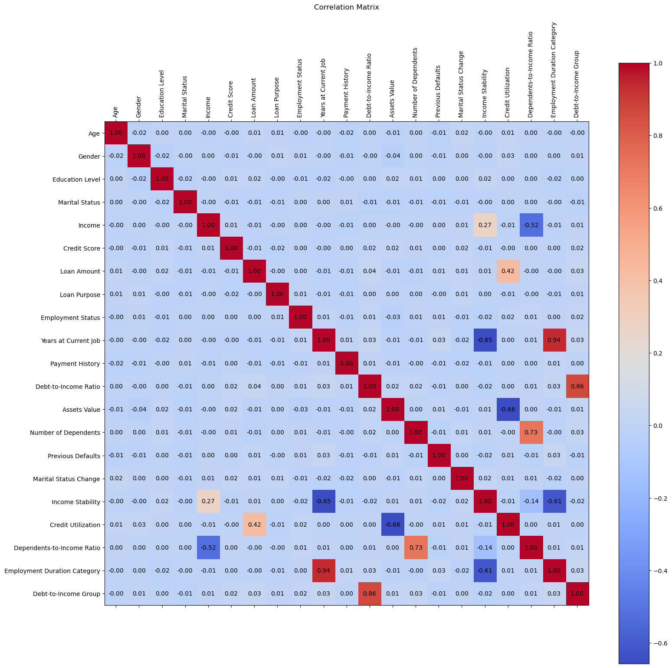
Correlation Matrix after feature engineering:

Slide 11
Detecting Outliers : There are no potential outliers
Sampling Techniques :
1) 9000 instances of Low, 4500 instances of Medium and 1500 instances of high.
2) These three categories are balanced using SMOTE which resulted in 9000 instances in each category.
Exploratory Data Analysis:
Used Histograms to show the distribution of values of every single feature. The height of each bar
indicates the number of objects and shape indicates the number of bins
Feature Ranking :
Found the feature importance scores using Random Forest in order to find the most contributing features
on the target column.
Feature Selection :
By using the ranks found in the feature ranking we used feature selection algorithms like Select-K-Best
and Recursive Feature Elimination to create a data frame with best features.

Slide 12
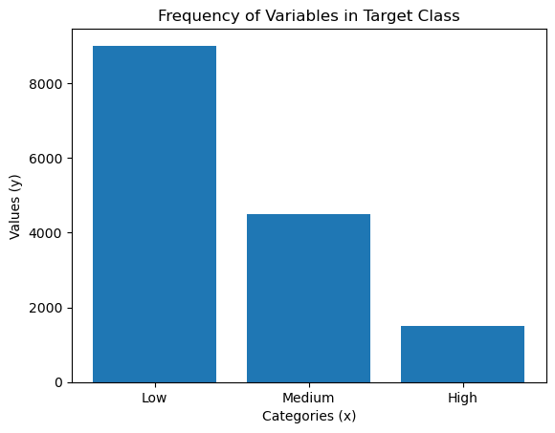
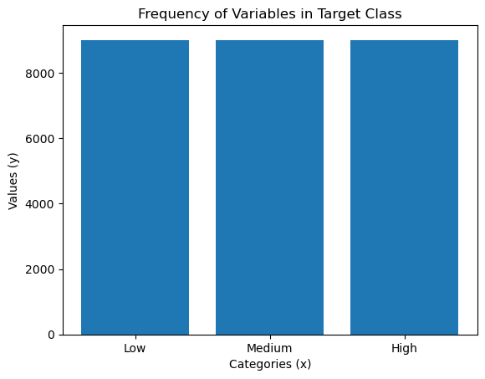
Before and after sampling techniques:

Slide 13
Feature Reduction:
We used algorithms like PCA and TSNE to create a new feature reduced data frame , where
we used TSNE for 2-dimensional visualization.
Splitting Data :
Created 3 different splits for original , feature selected and feature reduced datasets in ideal ratio of 70:30.
Model Training :
We trained our 3 different data frames on five classifiers like Logistic Regression, Random
Forest, SVM and K-Nearest Neighbours.
Model Testing :
1) Created two new functions to evaluate the classifiers and also to plot the accuracy and f1-score .
2) The above mentioned 5 models are tested on original , feature selected and feature reduced
dataset in order to find the dataset which could be used for better prediction.

Slide 14
Ensemble Models:
1) Boosting: Used two classifiers XGBoost and Gradient Boost on original dataset to make
predictions.
2) Bagging: We used RF as the base estimator to make predictions in bagging
3) Stacking: Used our three best classifiers KNN, RF and DT as weak learners and Logistic Regression
as meta learner.
Deep Learning Models:
1) ANN: input layer - 21 features with 64 nodes , hidden layer -32 nodes and output layer – 3 classes
(low, medium and high). Optimizer – adam, activation function used are relu and softmax.
2) MLP : hidden layer sizes – (64, 32) and activation function –relu.

Slide 15
Explainable Artificial Intelligence
Used XAI model called LIME (Local Interpretable Model-Agnostic Explanation) to explain the prediction
made by the a stacking classifier for a specific test instance.
The specific instance chosen was 6th row in the test dataset.
The explanation is instance – specific , showing how individual features influenced the prediction for a single
test case.

Slide 16
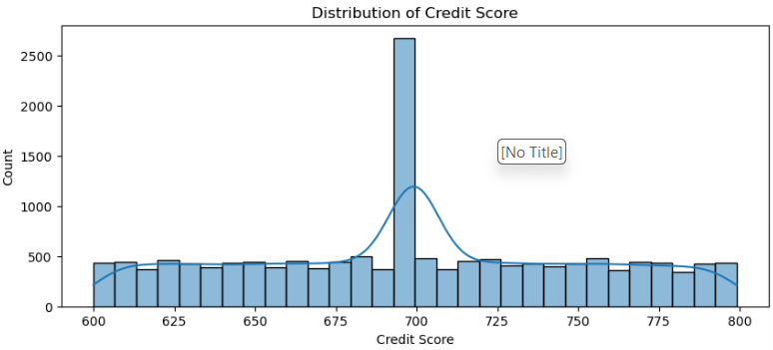
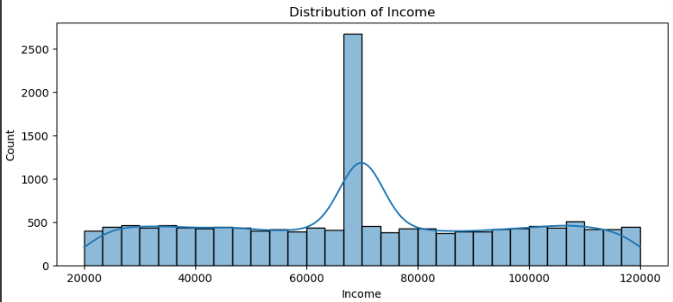
Exploratory Data Analysis

Slide 17
Results
Model | Original F1-Score | Dataset Accuracy | Selected F1-Score | Dataset Accuracy | Reduced F1-Score | Dataset Accuracy
Logistic Regression | 0.35 | 0.36 | 0.35 | 0.36 | 0.35 | 0.35
Decision Tree | 0.56 | 0.57 | 0.56 | 0.56 | 0.55 | 0.55
Random Forest | 0.73 | 0.75 | 0.72 | 0.73 | 0.76 | 0.76
SVM | 0.53 | 0.54 | 0.52 | 0.53 | 0.56 | 0.56
KNN | 0.63 | 0.66 | 0.64 | 0.66 | 0.64 | 0.66

Slide 18
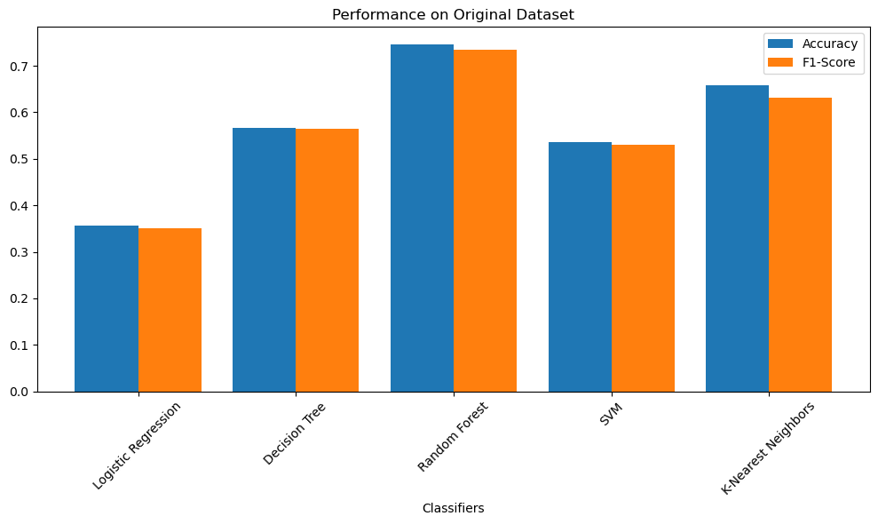

Slide 19
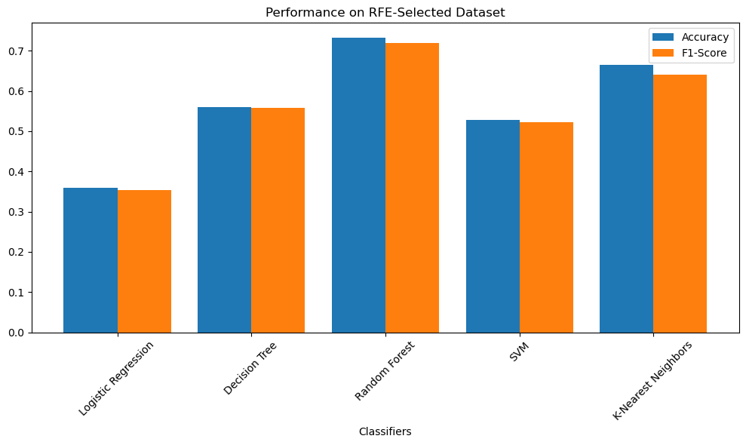

Slide 20
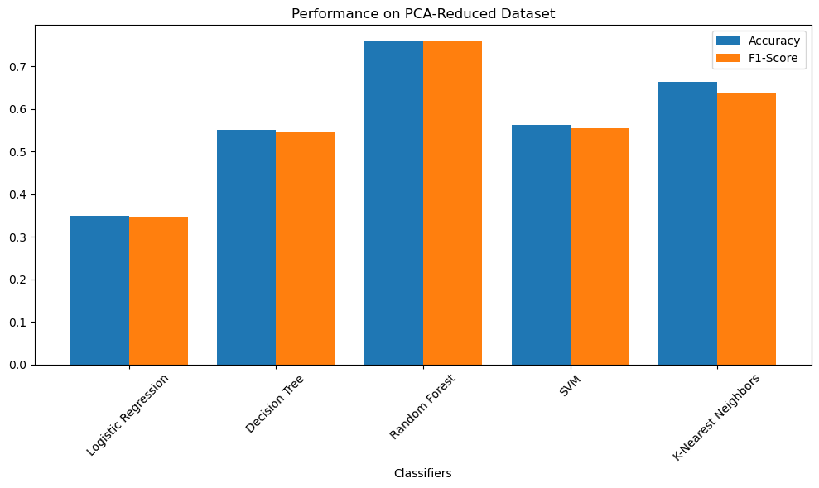

Slide 21
Results of Ensemble and Deep Learning Models
Model | Accuracy
Bagging(RF) | 0.75
Gradient Boost | 0.62
XGBoost | 0.70
Stacking(weak – RF,KNN, DT and meta – Logistic Regression) | 0.81
ANN | 0.55
MLP | 0.60

Slide 22
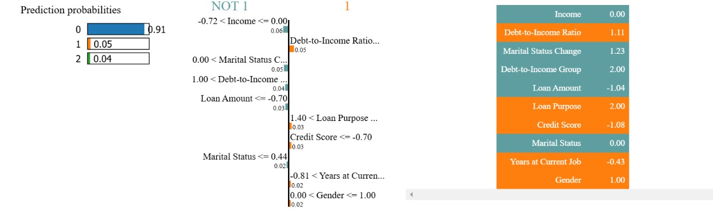
Results of Explainable Artificial Intelligence

Slide 23
Conclusion:
Risk rating evaluation plays a vital role in banks to decide whether to grant the loans or not.
Machine Learning algorithms can predict at higher accuracy while traditional techniques require essential assumptions.
In our analysis we found out that in stacking, Logistic Regression as meta classifier predicted better on dataset.
Future Works :
ADASYN or advanced SMOTE variations to handle extreme class imbalances without overfitting
Develop models capable of real-time risk prediction by integrating streaming data analysis techniques and event-based systems​.
By applying Deep Learning architectures to capture complex relation in data for better predictions.

Slide 24
References :
Bello, Oluwabusayo Adijat. "Machine learning algorithms for credit risk assessment: an economic and financial analysis." International Journal of Management 10.1 (2023): 109-133.
Nallakaruppan, M. K., Chaturvedi, H., Grover, V., Balusamy, B., Jaraut, P., Bahadur, J., Meena, V. P., & Hameed, I. A. (2024). Credit Risk Assessment and Financial Decision Support Using Explainable Artificial Intelligence. Risks, 12(10), 164. https://doi.org/10.3390/risks12100164
P. Zanke, “Machine Learning Approaches for Credit Risk Assessment in Banking and Insurance”, IoT and Edge Comp. J, vol. 3, no. 1, pp. 29–47, Jun. 2023.
Hassani, Zeinab & Meybodi, Mohsen & Hajihashemi, Vahid. (2021). Credit Risk Assessment Using Learning Algorithms for Feature Selection. Fuzzy Information and Engineering. 12. 1-16. 10.1080/16168658.2021.1925021.
Abdullah, Mazni & Ahmad, Azlina & Nayan, Nor & Azhar, Zubir & Ahmad, Abd-Razak. (2020). Credit Risk Assessment Models of Retail Microfinancing: The Case of a Malaysian National Savings Bank’s Branch. International Journal of Financial Research. 11. 73. 10.5430/ijfr.v11n3p73.
V. Sharma, A. Singh, A. K. Saxena and V. Saxena, "A Logistic Regression Based Credit Risk Assessment Using WoE Bining and Enhanced Feature Engineering Approach ANOVA and Chi-Square," 2023 12th International Conference on System Modeling & Advancement in Research Trends (SMART), Moradabad, India, 2023, pp. 499-507, doi: 10.1109/SMART59791.2023.10428399.

Slide 25
7. Marcos Roberto Machado, Salma Karray, Assessing credit risk of commercial customers using hybrid machine learning algorithms,Expert Systems with Applications,Volume 200,2022,116889,ISSN 0957-4174,
https://doi.org/10.1016/j.eswa.2022.116889.
8. Emmanuel, I., Sun, Y. & Wang, Z. A machine learning-based credit risk prediction engine system using a stacked classifier and a filter-based feature selection method. J Big Data 11, 23 (2024). https://doi.org/10.1186/s40537-024-00882-0
9. Mhlanga, D. (2021). Financial Inclusion in Emerging Economies: The Application of Machine Learning and Artificial Intelligence in Credit Risk Assessment. International Journal of Financial Studies, 9(3), 39. https://doi.org/10.3390/ijfs9030039

