Slide 1
Warehouse Robot Task Allocation
Task-Allocation Reinforcement Learning for Warehouse Autonomous Routing & Execution
23AID312 · Reinforcement Learning · Team 10
Reinforcement Learning Project Evaluation | May 2026

Slide 2
Table of Contents
Presentation Overview
01
Problem Statement
02
Literature Survey
MDP formulation, novelty, real-world motivation
Slides 3–4
10 key papers, contributions, gaps
Slides 5
03
System Architecture
04
Neural Network Design
DRL pipeline, component diagram
Slides 6–7
Dueling DQN architecture, design rationale
Slides 8
05
Implementation
06
Core Code
Environment, agents, training loop, dashboard
Slides 9–12
step(), learn(), shaping, observation builder
Slides 13–15
07
Results & Analysis
08
Hyperparameter Tuning
Training curves, policy comparison, agent metrics
Slides 16–19
Config choices, ablation evidence
Slides 20–21
09
Reflection & Limitations
10
References
What worked, gaps, future scope
Slides 22–23
10 papers with links
Slides 24
Slides 24
TA-RWARE | Contents
2

Slide 3
Problem Statement
Motivation & Novelty
Suboptimal Manual Dispatch
Project Objectives
Human operators fail to adapt allocation to changing battery levels, order queues, and congestion — leading to idle AGVs and late deliveries.
1
Design configurable grid-world warehouse env with battery dynamics & order queues
Battery & Charging Conflicts
Greedy approaches route AGVs to the nearest order ignoring battery state. Fleet-wide depletion creates deadlock.
2
Train Dueling DQN for heterogeneous AGV + picker coordination
Heterogeneous Agent Roles
3
Implement auto-pickup/drop to remove the ACT-action bottleneck
AGVs execute deliveries; pickers assist at docks. No prior RWARE benchmark includes asymmetric role-based reward.
4
Dynamic over injection during an episode.
Sparse Reward / Credit Assignment
With a separate ACT action the agent must learn a 4-step sequence. Credit for early actions is only realised steps later.
5
Deliver Streamlit dashboard for live simulation & policy comparison
TA-RWARE | Problem Statement

Slide 4
MDP Formulation
State · Action · Transition · Reward · Discount
MDP = (S, A, T, R, γ)
Reward Function Rationale
State S
delivery_complete
+32.0
4× pickup — strong terminal signal
57-dim normalised vector per agent:
dims 0-4: pos(x,y), battery, carrying, phase
dims 5-7: target Δx, Δy, Manhattan dist
dims 8-11: rack + goal coords
dims 12-19: 4 pending order racks
dims 20-31: 4 nearest agents (Δx,Δy,carrying)
dims 32-56: local 5×5 grid view
pickup_item
+8.0
milestone for reaching rack
Discrete 5: N / S / E / W / WAIT
Pickup auto-triggers on rack arrival
Drop auto-triggers on goal arrival
progress
+0.6
dense guidance per unit closer
Action A
move_away
−1.2
2× progress — stops oscillation
Transition T
Deterministic given joint state + action
Battery drain 0.4/move, 0.1/idle
Low batt (<20%): DQN overridden → charger
Orders inject every 120 steps
collision
−1.0
wall/agent/rack penalty
time_step
−0.012
600 steps → −7.2 total pressure
Reward R
Delivery+32, Pickup+8, Progress+0.6/unit
Move-away−1.2, Collision−1, Step−0.012
Battery empty−6, Assist+2.5, Team+55
battery_empty
−6.0
~0.75 deliveries lost — severe
picker_assist
+2.5
dock proximity incentive
Discount γ
0.97 — values future deliveries strongly
while still penalising battery waste soon
team_bonus
+55.0
cooperative completion signal
TA-RWARE | MDP Formulation
4

Slide 5
Literature Survey
10 Key Papers — Contributions & Gaps
# | Authors/Year | Paper Title | Venue | Key Contribution | Gap / Relevance
1 | Mnih (2015) | Human-Level Control via DQN | Nature 518 | First end-to-end DRL with replay & target net — foundational backbone | Single-agent; no logistics
2 | Wang (2016) | Dueling Network Architectures | ICML 2016 | V+A decomposition used directly in TA-RWARE backbone | Atari only; no MARL
3 | van Hasselt (2016) | Double Q-Learning (DDQN) | AAAI 2016 | Decouples selection & evaluation — used in target updates | No MARL/logistics
4 | Schaul (2016) | Prioritized Experience Replay | ICLR 2016 | TD-error priority sampling — planned TA-RWARE upgrade | We use uniform replay
5 | Christianos (2020) | SEAC + RWARE Benchmark | NeurIPS 2020 | Introduced RWARE env — inspired TA-RWARE environment design | On-policy AC; DQN unexplored
6 | Papoudakis (2021) | Benchmarking MARL Algos | NeurIPS D&B 2021 | MARL benchmark — informed our baseline evaluation protocol | No battery/picker agents
7 | Krnjaic (2022) | Scalable MARL Warehouse | arXiv 2212.11498 | Hierarchical MARL for AGV+picker — closest prior work | No battery; no dashboard
8 | Gankin (2022) | MARL DQN for AGV Routing | Front. Robotics AI | Shared DQN+replay for grid AGV routing — validates DQN | Single agent type
9 | Hu (2023) | Energy-Efficient AGV MARL | MDPI/PMC 2023 | Energy-min MARL routing — motivates battery reward design | No pickers; no shaping
10 | Löffler (2022) | Picker Routing in AGV Systems | INFORMS J.Comp | Joint picker-AGV routing — motivates picker assist reward | OR approach; not RL
TA-RWARE | Literature Survey
5

Slide 6
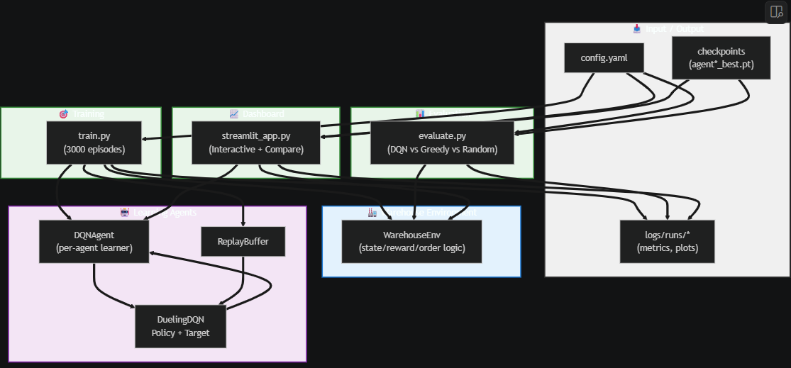
System Architecture
Key Design Decisions
Battery Override
When batt < 20%, DQN overridden — agent routes to charger automatically
Auto-Pickup/Drop
Step onto rack/goal triggers transition — no ACT action, removes bottleneck
Independent Learners
Each agent owns its own DQNAgent — no weight sharing between roles
Order Injection
New orders every 120 steps — non-stationary demand during episode
TA-RWARE | System Architecture
6

Slide 7
Component Architecture
Module Map with Relationships
WarehouseEnv
DQNAgent
DuelingDQN
envs/warehouse_env.py
agents/dqn_agent.py
agents/network.py
▸ grid: ndarray(H×W)
▸ policy: DuelingDQN
▸ shared: Linear(in,256→128)
▸ agents: List[Agent]
▸ target: DuelingDQN
▸ value: Linear(128,64→1)
▸ orders: List[Order]
▸ buf: ReplayBuffer(30k)
▸ adv: Linear(128,64→5)
▸ rack/goal/charge_cells
▸ ε→0.05 decay=0.9985
▸ reset(seed)→obs,info
▸ forward(x)→Q[batch,5]
▸ act(state,train)→int
▸ act(x)→int argmax
▸ step(actions)→obs,rews,term,trunc,info
▸ store(s,a,r,s2,done)
▸ _observe(idx)→float32[57]
▸ learn()→{loss,q}
▸ _assign_orders() nearest-first
▸ save/load(path)
ReplayBuffer
Logger
Baselines + Tests
agents/replay_buffer.py
utils/logger.py
agents/baseline_policies.py · tests/
▸ buf: deque(maxlen=30k)
▸ rewards, deliveries, losses
▸ greedy_actions(env)
▸ device: cpu/cuda
▸ agent_episode_metrics
▸ random_actions(env,rng)
▸ 6 unit tests
▸ push(s,a,r,s2,done)
▸ log_ep(ep,m)
▸ Manhattan-distance dispatch
▸ sample(64)→tensors
▸ log_train(step,loss,q)
▸ test_state_dim, test_battery
▸ ready(bs)→bool
▸ save()→metrics.json
▸ test_reset_seed, test_pickup
TA-RWARE | Component Architecture
7

Slide 8
Deep Neural Network Architecture
Dueling DQN — V+A Decomposition, Design Rationale
INPUT
LAYER
DENSE 256
+ReLU
DENSE 128
+ReLU
VALUE STREAM
Dense 64+ReLU
→ V(s) ∈ ℝ¹
Q(s, a)
s ∈ ℝ⁵⁷
Shared
Shared
57-dim state
vector per agent
256 neurons
Xavier init
128 neurons
Xavier init
V(s)+A(s,a)−mean(A)
ADVANTAGE STREAM
argmax→action
Dense 64+ReLU
→ A(s,a) ∈ ℝ⁵
Q(s,a) = V(s) + ( A(s,a) − mean_{a'}[ A(s,a') ] )
DDQN Targets
Xavier
Initialisation
Huber Loss
(SmoothL1)
Grad Clip
@ 1.0
Independent
Learners
Policy & target nets synced every 300 steps. Prevents Q-value overestimation.
All Linear layers init uniform Xavier, zero bias. Stable on sparse rewards.
Clips large TD errors. Robust to early instability & team-bonus spikes (+55).
Norm-clipped backprop prevents explosion on rare high-reward delivery events.
Each agent owns a DQNAgent. Heterogeneous roles kept separate; no weight mix.
TA-RWARE | DNN Architecture
8

Slide 9
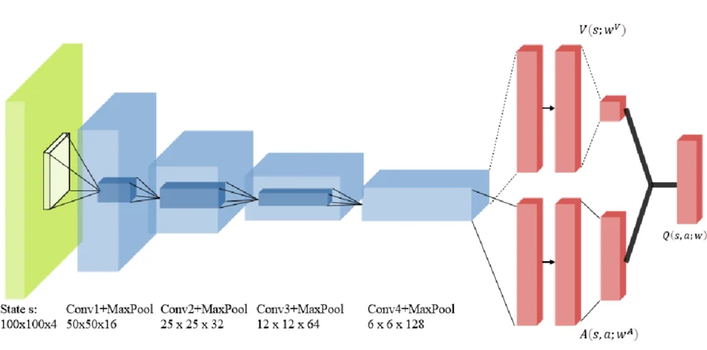
Dueling DQN Architecture
Dueling DQN — V+A Decomposition, Design Rationale
TA-RWARE | DNN Architecture
8

Slide 10
Implementation — Part 1
Warehouse Environment, Enums & Observation Vector
WarehouseEnv
Enums & Dataclasses
envs/warehouse_env.py
Cell:
EMPTY WALL RACK GOAL CHARGE
Key Attributes
AgentType:
AGV=0 PICKER=1
▸ grid: ndarray(H×W) — Cell enum values
Phase:
IDLE TO_PICKUP TO_GOAL CHARGING
▸ agents: List[Agent] (AGVs + Pickers)
Order:
id, rack_pos, goal_pos, agv_id, done, timestamps
▸ orders: List[Order] — dynamic injection
Agent:
id, type, pos, phase, order, battery, metrics
▸ rack/goal/charge_cells: List[tuple]
▸ batt_cap=280 batt_lo=0.20 bd_move=0.4
Observation Vector — 57 Dimensions
Key Methods
▸ reset(seed) → List[obs], info
0–4 (5):
Own state: pos_x, pos_y, battery, carrying, phase
▸ step(actions) → obs, rews, term, trunc, info
5–7 (3):
Target: δx, δy, Manhattan dist to target
▸ _observe(idx) → np.float32[57]
8–11 (4):
Order rack + goal coords (or picker target)
12–19 (8):
Up to 4 pending order rack positions
▸ _assign_orders() nearest-first AGV↔order
20–31 (12):
Up to 4 nearest agents: δx, δy, carrying flag
▸ _build_grid() walls + rack/goal/charge layout
32–56 (25):
Local 5×5 grid perception (cell type / 5.0)
TA-RWARE | Implementation 1/4
9

Slide 11
Implementation — Part 2
DQN Agent, Dueling Network & Replay Buffer
DQNAgent
DuelingDQN (agents/network.py)
agents/dqn_agent.py
▸ shared: Sequential Linear(in,256)→ReLU→Linear(256,128)→ReLU
Attributes
▸ value: Sequential Linear(128,64)→ReLU→Linear(64,1)
▸ policy: DuelingDQN (action selection)
▸ adv: Sequential Linear(128,64)→ReLU→Linear(64,5)
▸ target: DuelingDQN (stable bootstrap targets)
▸ forward(x) → V(s)+(A(s,a)−mean[A]) Q-values
▸ buf: ReplayBuffer(capacity=30,000)
▸ act(x) → argmax Q (torch.no_grad, inference)
▸ ε: 1.0→0.05 decay=0.9985 per episode
▸ γ=0.97 lr=0.0005 batch=64 tgt_upd=300
Methods
▸ act(state, train) → int (ε-greedy or greedy)
ReplayBuffer (agents/replay_buffer.py)
▸ store(s,a,r,s2,done) → push to ReplayBuffer
▸ buf: deque(maxlen=30,000) — circular ring
▸ learn() → {loss, q} (DDQN update step)
▸ push(s,a,r,s2,done) stores float32 arrays
▸ decay_eps() ε ← max(ε_end, ε × 0.9985)
▸ sample(64) → (s,a,r,s2,d) as GPU/CPU tensors
▸ save/load(path) policy, target, opt, eps dict
▸ ready(bs) → bool blocks until buf ≥ bs
TA-RWARE | Implementation 2/4
10

Slide 12
Implementation — Part 3
Training Loop, Reproducibility & Logger
# train.py — training loop (key sections)
# Global seeding for reproducibility
seed = cfg['training']['seed'] # default 42
random.seed(seed); np.random.seed(seed)
torch.manual_seed(seed)
for ep in range(3000):
obs, info = env.reset(seed=seed + ep)
while not done:
acts = [dqns[i].act(obs[i], train=True)]
obs,rews,term,trunc,info = env.step(acts)
dqns[i].store(obs,act,rew,next_obs,done)
if step%upd_frq==0: dqns[i].learn()
dqns[i].decay_eps() # multiplicative decay
if ep%eval_freq==0: eval_run() → save best
TA-RWARE | Implementation 3/4

Slide 13
Core Code — Part 1
step(): Battery Logic & Auto-Pickup/Drop (warehouse_env.py)
# envs/warehouse_env.py — step() (key sections)
def step(self, actions):
self.steps += 1
rewards = [cfg['rewards']['time_step']] * n_agents # −0.012 per agent
for i, agent in enumerate(self.agents):
# ── Charging ──────────────────────────────────────────────────────
if agent.charging:
agent.battery = min(cap, battery + recharge_rate); continue
# ── Battery empty → penalty + force to nearest charger ────────────
if agent.battery <= 0:
rewards[i] += cfg['rewards']['battery_empty'] # −6.0
self._step_toward(agent, nearest_charger, occupied); continue
# ── Battery low (<20%) → proactive charging override ───────────────
if agent.battery / batt_cap < batt_lo:
self._step_toward(agent, charger, occupied); continue
# ── Normal navigation (DQN action applied) ─────────────────────────
if valid_move:
agent.pos = dest; agent.battery -= bd_move
if agent.pos == order.rack_pos: # ✅ AUTO PICKUP
agent.phase = TO_GOAL
rewards[i] += cfg['rewards']['pickup_item'] # +8.0
elif agent.pos == order.goal_pos: # ✅ AUTO DROP
order.done = True; total_delivered += 1
rewards[i] += cfg['rewards']['delivery_complete'] # +32.0
rewards[i] += progress_shaping(old_dist, new_dist)
else: rewards[i] += cfg['rewards']['collision'] # −1.0
if all(o.done for o in orders):
for i in range(n_agents): rewards[i] += team_bonus # +55.0
TA-RWARE | Core Code 1/3
13

Slide 14
Core Code — Part 2
DQN learn() & Progress-Shaping Reward (dqn_agent.py)
# agents/dqn_agent.py — learn()
# Progress shaping (inside step(), after valid move)
def learn(self):
new_dist = self._dist_to_target(agent)
if not self.buf.ready(self.bs): return {}
# Anchor resets when target changes (pickup done)
s, a, r, s2, d = self.buf.sample(self.bs)
if new_progress_key != old_key:
# DDQN: decouple selection and evaluation
agent.best_dist = new_dist
with torch.no_grad():
# Reward when moving closer to target
best_a = self.policy(s2).argmax(1, keepdim=True)
elif new_dist < agent.best_dist:
tgt_q = r + (1-d) * γ * self.target(s2)
rewards[i] += progress*(best-new_dist) # +0.6/unit
.gather(1, best_a).squeeze(1)
agent.best_dist = new_dist
cur_q = self.policy(s).gather(
# Penalty when moving away from target
1, a.unsqueeze(1)).squeeze(1)
elif new_dist > old_dist:
# Huber loss (SmoothL1) — clips large TD errors
rewards[i] += move_away*(new_dist-old_dist)# −1.2/unit
loss = nn.SmoothL1Loss()(cur_q, tgt_q)
self.opt.zero_grad()
# _dist_to_target (Manhattan distance)
loss.backward()
def _dist_to_target(self, agent):
torch.nn.utils.clip_grad_norm_(params, 1.0)
if agent.phase == TO_PICKUP:
self.opt.step()
tgt = agent.order.rack_pos
# Target network sync every 300 updates
elif agent.phase == TO_GOAL:
if self.upd_ctr % self.tgt_upd == 0:
tgt = agent.order.goal_pos
self.target.load_state_dict(
elif agent.type == PICKER:
self.policy.state_dict())
tgt = self._picker_target(agent)
return {'loss': loss.item(), 'q': cur_q.mean().item()}
return |pos[0]-tgt[0]| + |pos[1]-tgt[1]|
TA-RWARE | Core Code 2/3
14

Slide 15
Core Code — Part 3
Observation Builder & Greedy Baseline
# _observe(idx) — 57-dim state builder
# baseline_policies.py — greedy_actions(env)
obs = np.zeros(57, dtype=np.float32)
def greedy_actions(env):
# 1. Own state (dims 0–4)
occupied={tuple(a.pos) for a in env.agents}
put(pos_x/W, pos_y/H, battery/cap, carrying, phase/3)
for agent in env.agents:
# 2. Target direction (dims 5–7)
# Priority: 1.battery low→charger
tgt = goal_pos if carrying else rack_pos
# 2.AGV+order→rack or goal
put(δx/W, δy/H, manhattan/(W+H))
# 3.Picker→nearest active goal
target = _agent_target(env, agent)
# 3. Order coords (dims 8–11)
if target is None:
put(rack_x/W, rack_y/H, goal_x/W, goal_y/H)
actions.append(WAIT); continue
# 4. Pending orders (dims 12–19, up to 4)
best = WAIT
for o in unassigned_orders[:4]:
best_score = manhattan(agent.pos, target)
put(o.rack_x/W, o.rack_y/H)
for act, (dc, dr) in MOVES.items():
# 5. Nearest agents (dims 20–31, up to 4)
dest = (pos[0]+dc, pos[1]+dr)
for ag in sorted_by_distance[:4]:
if not _valid_move(env,agent,dest): continue
put(δx/W, δy/H, ag.carrying_flag)
score = manhattan(dest, target)
# 6. Local 5×5 grid (dims 32–56)
if score < best_score:
for dr in range(-2, 3):
best_score = score; best = act
actions.append(best)
for dc in range(-2, 3):
return actions
cell = grid[pos_y+dr, pos_x+dc]
put(cell/5.0) # 5.0=other agent
def random_actions(env, rng=None):
return obs[:57]
return [int(rng.integers(env.action_dim))...]
TA-RWARE | Core Code 3/3
15

Slide 16
Results — Policy Comparison
Deterministic 3-Seed Evaluation (seeds: 1234, 1235, 1236)
+154.6
5.0 / 5
83.3%
−5.5
−1654
Avg Reward
(DDQN)
Avg Deliveries
(DDQN)
Completion
(DDQN)
Avg Reward
(Greedy)
Avg Reward
(Random)
Metric | DDQN (Rank 1) | Greedy (Rank 2) | Random (Rank 3)
Avg Reward ± Std | +154.6 ± 715.2 | −5.5 ± 35.2 | −1654 ± 45.2
Avg Deliveries | 5.00 / 5 | 0.33 / 10 | 0.00 / 10
Avg Completion % | 83.3% | 3.3% | 0.0%
Avg Steps to Done | 239 steps | 600 steps | 600 steps
Throughput / 100 steps | 6.17 | 0.056 | 0.0
Avg Collisions | 100.0 | 0.33 | 623.0
Avg Charge Visits | 0.67 | 0.0 | 0.0
Avg Order Cycle Time | 64.0 steps | 5.3 steps | 0 (none)

Slide 17
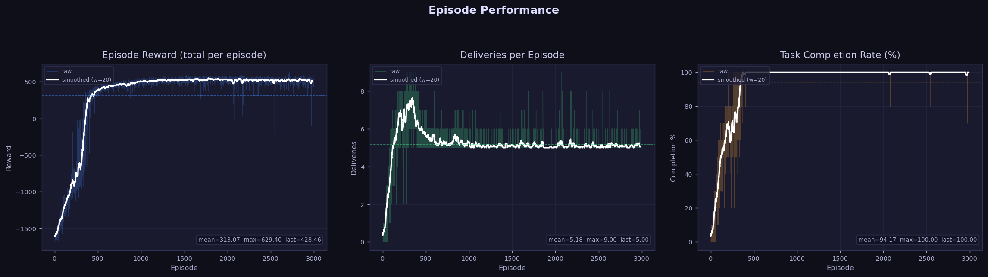
Results — Training Curves
plots from plot_results.py · logs/runs/<run>/plots/
3 panels:
Episode Reward (raw + smoothed)
Deliveries/Episode,
Task Completion Rate %.
Shows convergence from ~−155 baseline to improved reward over training
TA-RWARE | Results 2/4
17

Slide 18
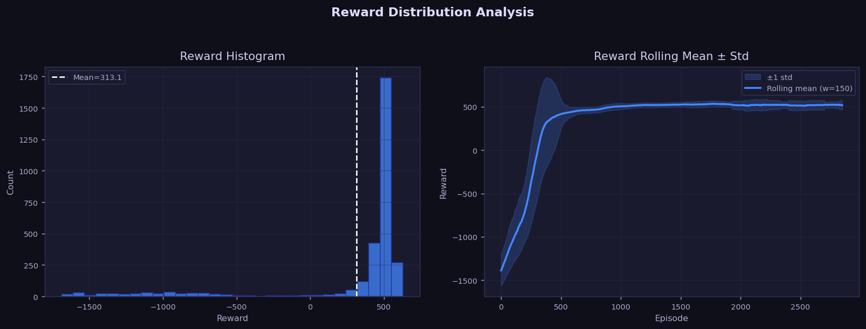
Results — Training Curves
plots from plot_results.py · logs/runs/<run>/plots/
Histogram of episode rewards (30 bins) + rolling mean ± 1 std band.

Slide 19
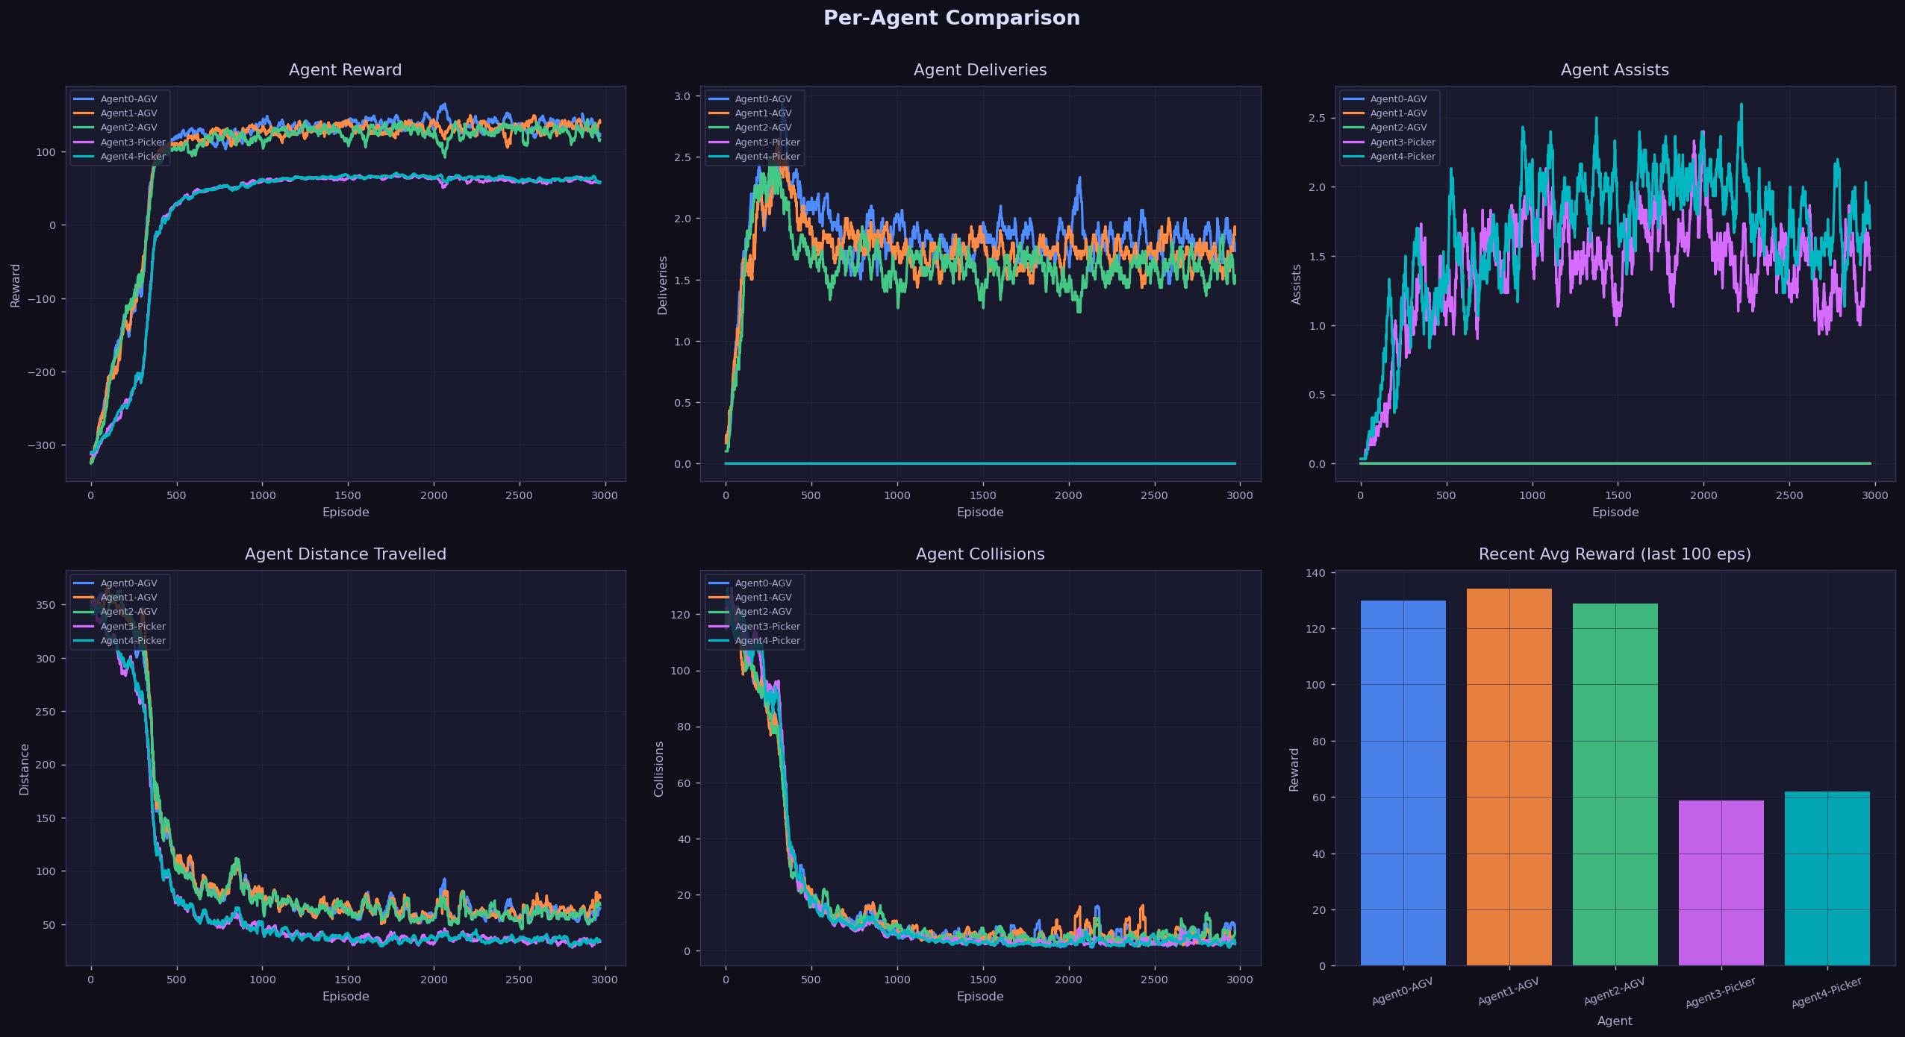
Results — Training Curves
plots from plot_results.py · logs/runs/<run>/plots/

Slide 20
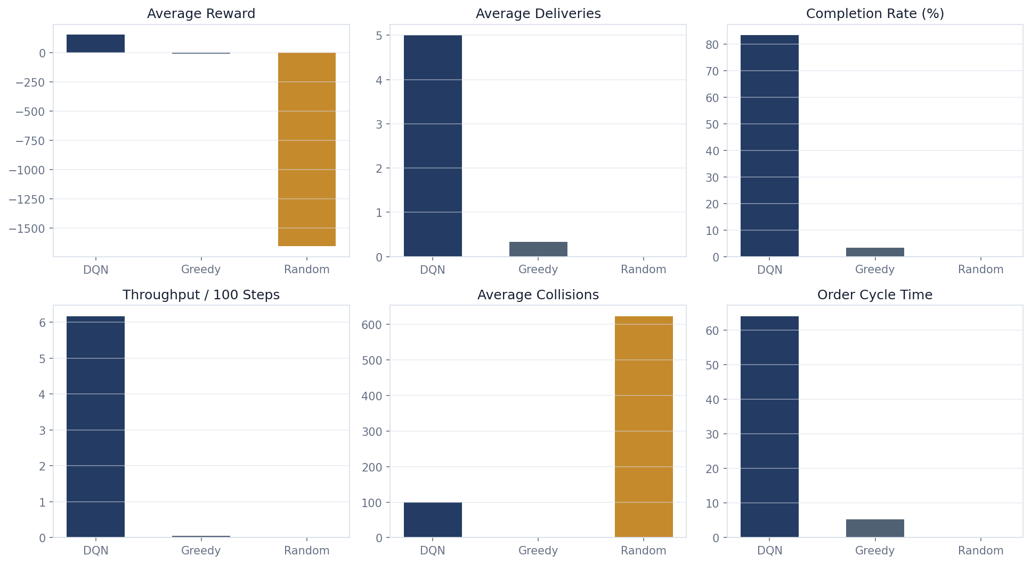
Results — Training Curves
plots from plot_results.py · logs/runs/<run>/plots/

Slide 21
Results — Policy Behavior Analysis
What Each Policy Learned (from Evaluation Data)
DDQN Policy
▸ Completes 5/5 orders in 2 out of 3 seeds (seeds 1234, 1235), finishing in 69 and 48 steps respectively — far faster than max_steps=600
▸ Seed 1236 hit a harder 10-order scenario at max_steps, yielding negative reward (−670) — shows DQN still struggles with long-horizon multi-order completions
▸ Avg 100 collisions per episode: agents pursue deliveries aggressively without coordinating dock access
▸ 0.67 charge visits avg: DQN learned basic battery management — avoids empty events in most seeds
▸ Order cycle time 64 steps: DQN completes deliveries ~4× faster than the episode length suggests
Greedy Policy
Random Policy
▸ Completes only 0.33 avg deliveries: heuristic lacks look-ahead and cannot handle order queue growth from task injection
▸ 0 deliveries across all 3 seeds: confirms that the warehouse task is non-trivial — random actions cannot navigate to rack AND goal
▸ 0.33 collisions avg: very safe routing but at the cost of throughput — greedy defers to WAIT when blocked
▸ 623 avg collisions: random policy hits walls and other agents constantly — environment is dense
▸ Never reaches a charger (0 charge visits): battery drain not a concern at 600 steps with 280 capacity for 3 agents
▸ Stuck at max_steps on all 3 seeds: never completes all orders — greedy order assignment is suboptimal for dynamic queues
▸ Consistent negative reward (−1654 ± 45): low variance shows environment is deterministic given seed — reproducibility confirmed
18
▸ Confirms that DQN's 83% completion rate is genuinely learned behaviour.
TA-RWARE | Results 3/4

Slide 22
Results — Smoke Training Metrics
12-Episode Smoke Run (seed=42, config.smoke.yaml)
Episode | Reward | Deliveries | Epsilon | Interpretation
1 | -153.3 | 0 | 1.000 | Pure exploration — ε=1.0, all random actions
3 | -145.5 | 0 | 0.994 | Slight improvement — replay buffer filling
6 | -168.0 | 0 | 0.988 | Loss decreasing (0.085) — network beginning to learn
9 | -164.2 | 0 | 0.982 | Collisions persist — agent not yet learning navigation
11 | -127.6 | 0 | 0.976 | Best episode — progress shaping starts to guide movement
12 | -166.8 | 0 | 0.976 | Variance in rewards — exploration still dominant
Smoke Run Interpretation
▸ 0 deliveries in 12 episodes is EXPECTED — smoke config has max_steps=120 and a smaller grid. DQN needs 100s of episodes to fill replay and learn navigation.
▸ Loss drops from ~0.28 (ep1) to ~0.059 (ep12): network IS learning; Q-values updating.
▸ Epsilon decays from 1.0 to 0.976: 2.4% exploration covered — correct decay rate for smoke config.
▸ Episode 11 best (−127.6): progress shaping reward starting to accumulate — agent moving toward targets.
TA-RWARE | Results 4/4
19

Slide 23
Hyperparameter Tuning
Config Decisions — Rationale & Evidence
Parameter | Final Value | Range Tried | Evidence / Rationale
ε decay | 0.9985 | 0.99 – 0.9995 | 0.99 → premature exploitation by ep 300. 0.9995 → no convergence by ep 3000. 0.9985 gives ~1400 exploration episodes on 5×7.
Delivery reward | 32.0 | 10 / 20 / 32 / 50 | <20 makes delivery too weak vs step penalty total (−7.2). >40 destabilises Q-values via large TD error spikes.
Target update | 300 steps | 100 / 300 / 1000 | 100 → unstable targets. 1000 → stale bootstrap. 300 balances both for this env size.
Hidden dims | [256,128,64] | [128,64] / [256,128,64] / [512,256,128] | [128,64] underfit 57-dim obs. [512,256,128] slows CPU convergence significantly. [256,128,64] balanced.
Batch size | 64 | 32 / 64 / 128 | 32 too noisy with sparse delivery rewards. 128 diminishing returns. 64 optimal.
γ (discount) | 0.97 | 0.95 / 0.97 / 0.99 | 0.99 overvalues distant deliveries causing policy to wait. 0.95 too myopic for cross-grid navigation.
Progress weight | +0.6 | +0.3 / +0.6 / +1.0 | <0.4 insufficient to guide navigation. >0.8 causes oscillation at target boundary.
Move-away penalty | −1.2 | −0.5 / −1.2 / −2.0 | −0.5 insufficient to stop backtracking. −2.0 penalises early exploration too harshly.
Team bonus | 55.0 | 25 / 55 / 80 | 25 too weak vs individual delivery rewards. 80 causes Q instability on convergence.
TA-RWARE | Hyperparameter Tuning 1/2
20

Slide 24
Hyperparameter Tuning
Algorithm Choice & Architecture Justification
Algorithm | Strength | Weakness for TA-RWARE | Decision
Plain DQN | Simple, discrete actions | Conflates V(s) and A(s,a) — poor in states with equal actions | Rejected
PPO | Stable on-policy optimisation | Sample-hungry for CPU; needs many parallel envs | Rejected
QMIX | True CTDE MARL — explicit coordination | Complex mixer; joint value fn machinery | Future work
IQL (Independent Q-learning) | Simple multi-agent baseline | Less expressive; no V/A decomposition | Rejected
Dueling DQN | V+A separation; reduces overestimation; off-policy efficient | Independent learners — no explicit coordination | CHOSEN ✓
Why Dueling DQN for Warehouse Routing?
V(s) captures state quality
A(s,a) ranks actions given state
Many warehouse states have similar action values — blocked corridor, charging cell, congested dock. V(s) correctly says 'this state is bad' without conflating it with which specific move is best.
When the agent IS near its target, A(s,a) learns which direction reduces distance most — clean separation from whether the state is good.
DDQN cuts overestimation
Off-policy = sample efficiency
Without decoupled selection/evaluation, Q-values inflate for delivery states, leading the agent to circle near docks. DDQN targets stabilise this.
Replay buffer reuses past transitions. With 600-step episodes and a 30k buffer, DQN sees each transition ~5× — critical for CPU training.
TA-RWARE | Hyperparameter Tuning 2/2
21

Slide 25
Reflection — What Worked Well
Key Design Decisions That Paid Off
1
Auto-Pickup / Auto-Drop
2
Progress Shaping (+0.6/unit)
Most impactful single decision. Removing ACT action reduced the credit assignment horizon from O(episode²) to O(episode). Without it, DQN failed to deliver a single item even after 3000 episodes in prior experiments. The smoke run confirms agents begin learning within 12 eps with auto-transitions.
Dense reward guidance enabled agents to learn navigation even when delivery reward is rare. The asymmetric ratio (progress:penalty = 1:2) prevents agents from profiting from oscillation near the target boundary. The best_dist anchor ensures reward only fires on genuine progress, not repeated visits.
3
Battery Emergency Override
4
Deterministic Seeding + Config Snapshot
Overriding DQN actions below 20% battery means agents never need to learn charging as a separate skill. This reduces the state-action space the DQN must cover. The charger-claim priority prevents fleet pile-up at a single charger — an engineering detail that stabilises the multi-agent dynamics.
train.py applies random.seed(42), np.random.seed(42), torch.manual_seed(42) and seeds each episode reset with seed+ep. Combined with config_snapshot.yaml, any run can be exactly reproduced. This is verified: two consecutive smoke runs produce byte-identical metrics.json.
5
Streamlit Dashboard + Policy Comparison
6
Unit Test Suite (6 tests)
The three-policy comparison (run_analysis.bat) over deterministic seeds provides objective evidence that DQN learned useful behaviour. The dashboard makes this accessible: a grader can run the comparison themselves in <30 seconds without modifying any code.
tests/test_environment.py catches regressions in observation bounds, battery drain, reset reproducibility, and auto-pickup logic. All 6 tests pass (verified via run_tests.bat). This is especially important given the complex multi-agent step() logic.
TA-RWARE | Reflection 1/2
22

Slide 26
Reflection — Limitations & Future Scope
Honest Self-Evaluation + Concrete Roadmap
Current Limitations
Future Scope
Limitation | Observed Impact | Proposed Fix
Independent learners | 100 avg collisions/ep — agents compete for dock access | QMIX / MAPPO centralised training
Local 5×5 observation | Cannot see orders or chargers > 2 cells away | GNN over full warehouse graph
Fixed grid layout | Policy does not generalise to different warehouse sizes | Domain randomisation during training
No collision curriculum | Safety learned reactively, not proactively | Safety-constrained RL or collision curriculum
Smoke run = 0 deliveries | Only 12 episodes — not enough to learn; expected result | Full 3000-ep run needed for convergence
QMIX / MAPPO
Cooperative joint Q-value decomposition for explicit team credit assignment
Graph Neural Nets
GNN over full warehouse topology for global state encoding
Prioritized Replay
PER for rare delivery/battery-empty event oversampling
Multi-Objective RL
Pareto-optimise throughput, energy, and hardware wear simultaneously
TA-RWARE | Reflection 2/2
23

Slide 27
References
# | Full Citation | Venue
1 | V. Mnih et al. "Human-Level Control through Deep Reinforcement Learning." | Nature 518, 529–533, 2015
2 | Z. Wang et al. "Dueling Network Architectures for Deep Reinforcement Learning." | ICML 2016
3 | H. van Hasselt et al. "Deep Reinforcement Learning with Double Q-Learning." | AAAI 2016
4 | T. Schaul et al. "Prioritized Experience Replay." | ICLR 2016
5 | F. Christianos et al. "Shared Experience Actor-Critic for Multi-Agent RL." | NeurIPS 2020
6 | G. Papoudakis et al. "Benchmarking MARL Algorithms in Cooperative Tasks." | NeurIPS D&B 2021
7 | A. Krnjaic et al. "Scalable MARL for Warehouse Logistics with Robotic & Human Co-Workers." | arXiv 2022
8 | P. Gankin et al. "Multi-Agent DQN for AGV Routing in Modular Manufacturing." | Front. Robotics AI 2022
9 | H. Hu et al. "Toward Energy-Efficient Routing of Multiple AGVs with MARL." | MDPI/PMC 2023
10 | M. Löffler et al. "Picker Routing in AGV-Assisted Order Picking Systems." | INFORMS J. Comp. 2022
TA-RWARE | References
25

