Slide 1
PROJECT PRESENTATION · JAVA CONCEPTS
Online Store
Cart and Order Pipeline
A structured path from product selection to order confirmation.
PREPARED BY
PREPARED BY
Swaroopa
Nagasri

Slide 2
ABSTRACT
Project Overview
The Online Store Cart and Order Pipeline models how a customer selects a product, enters quantity, calculates the amount, applies a discount, and confirms an order. The project demonstrates basic Java concepts through one complete shopping-cart process.
Purpose
Create a simple and structured path from product selection to successful order confirmation.
Pipeline
Product selection → quantity → total calculation → discount → order status.

Slide 3

INTRODUCTION
Online Store Cart and Order Pipeline
What is the project?
A Java program that lets a customer choose a product, enter quantity, calculate the total price and receive an order status.
Main inputs
Product number and quantity are taken using the Scanner class.
Main output
The program displays price, total amount, discount, final amount and Premium/Normal Order status.

Slide 4
EXISTING SYSTEM
Basic Shopping-Cart Process
Limitations
• Cart actions may be handled as separate steps.
• Validation and calculations can be less structured.
• Repeated order behavior is harder to organize.
• Product data may not be stored in an ordered collection.
Need: a clear and structured order pipeline.

Slide 5
PROPOSED SYSTEM
Java-Based Order Pipeline
Input & Data
Scanner + variables + 1D arrays store the selected product, price and quantity.
Processing
Operators calculate the total; if-else applies discount and decides the order status.
Reusable Behavior
Method overloading provides two versions of displayOrder(), keeping the program reusable.
Result
The program produces the final amount and Premium/Normal Order status.
Proposed flow: Input → Calculate → Validate → Discount → Order Status

Slide 6
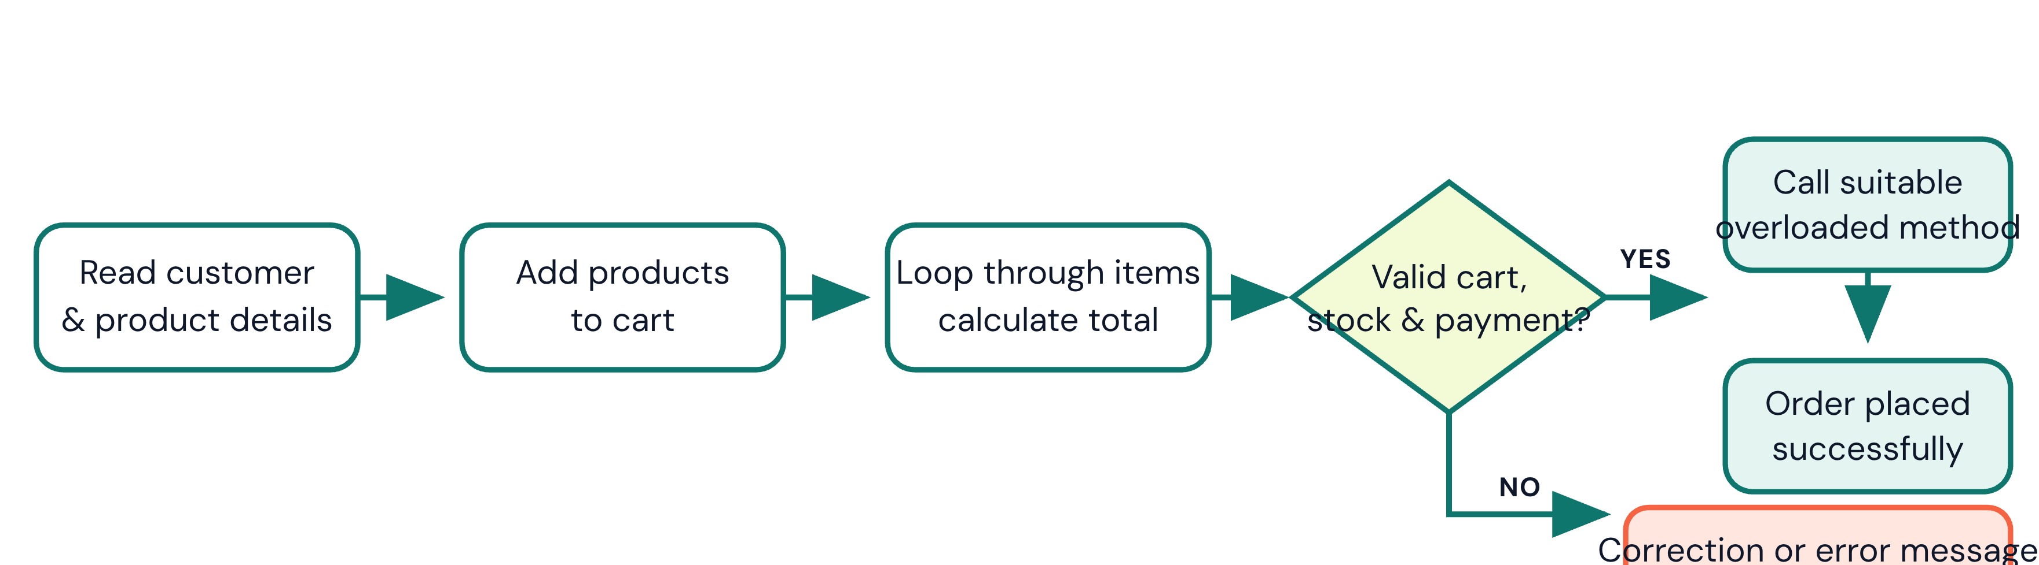
CO ATTAINMENTS
Java Concepts Used in the Project
CO1
Scanner class – takes product number and quantity.
Variables – store choice, quantity, price, total and discount.
Operators – +, -, *, >=, && for calculations and conditions.
CO2
If-else – validates the product and applies discount/order status.
For loop – displays the available products from the 1D arrays.
CO3
Method overloading – two displayOrder() methods with different parameters.
1D array – stores product names and prices.
All three COs are integrated into one end-to-end order process.

Slide 7
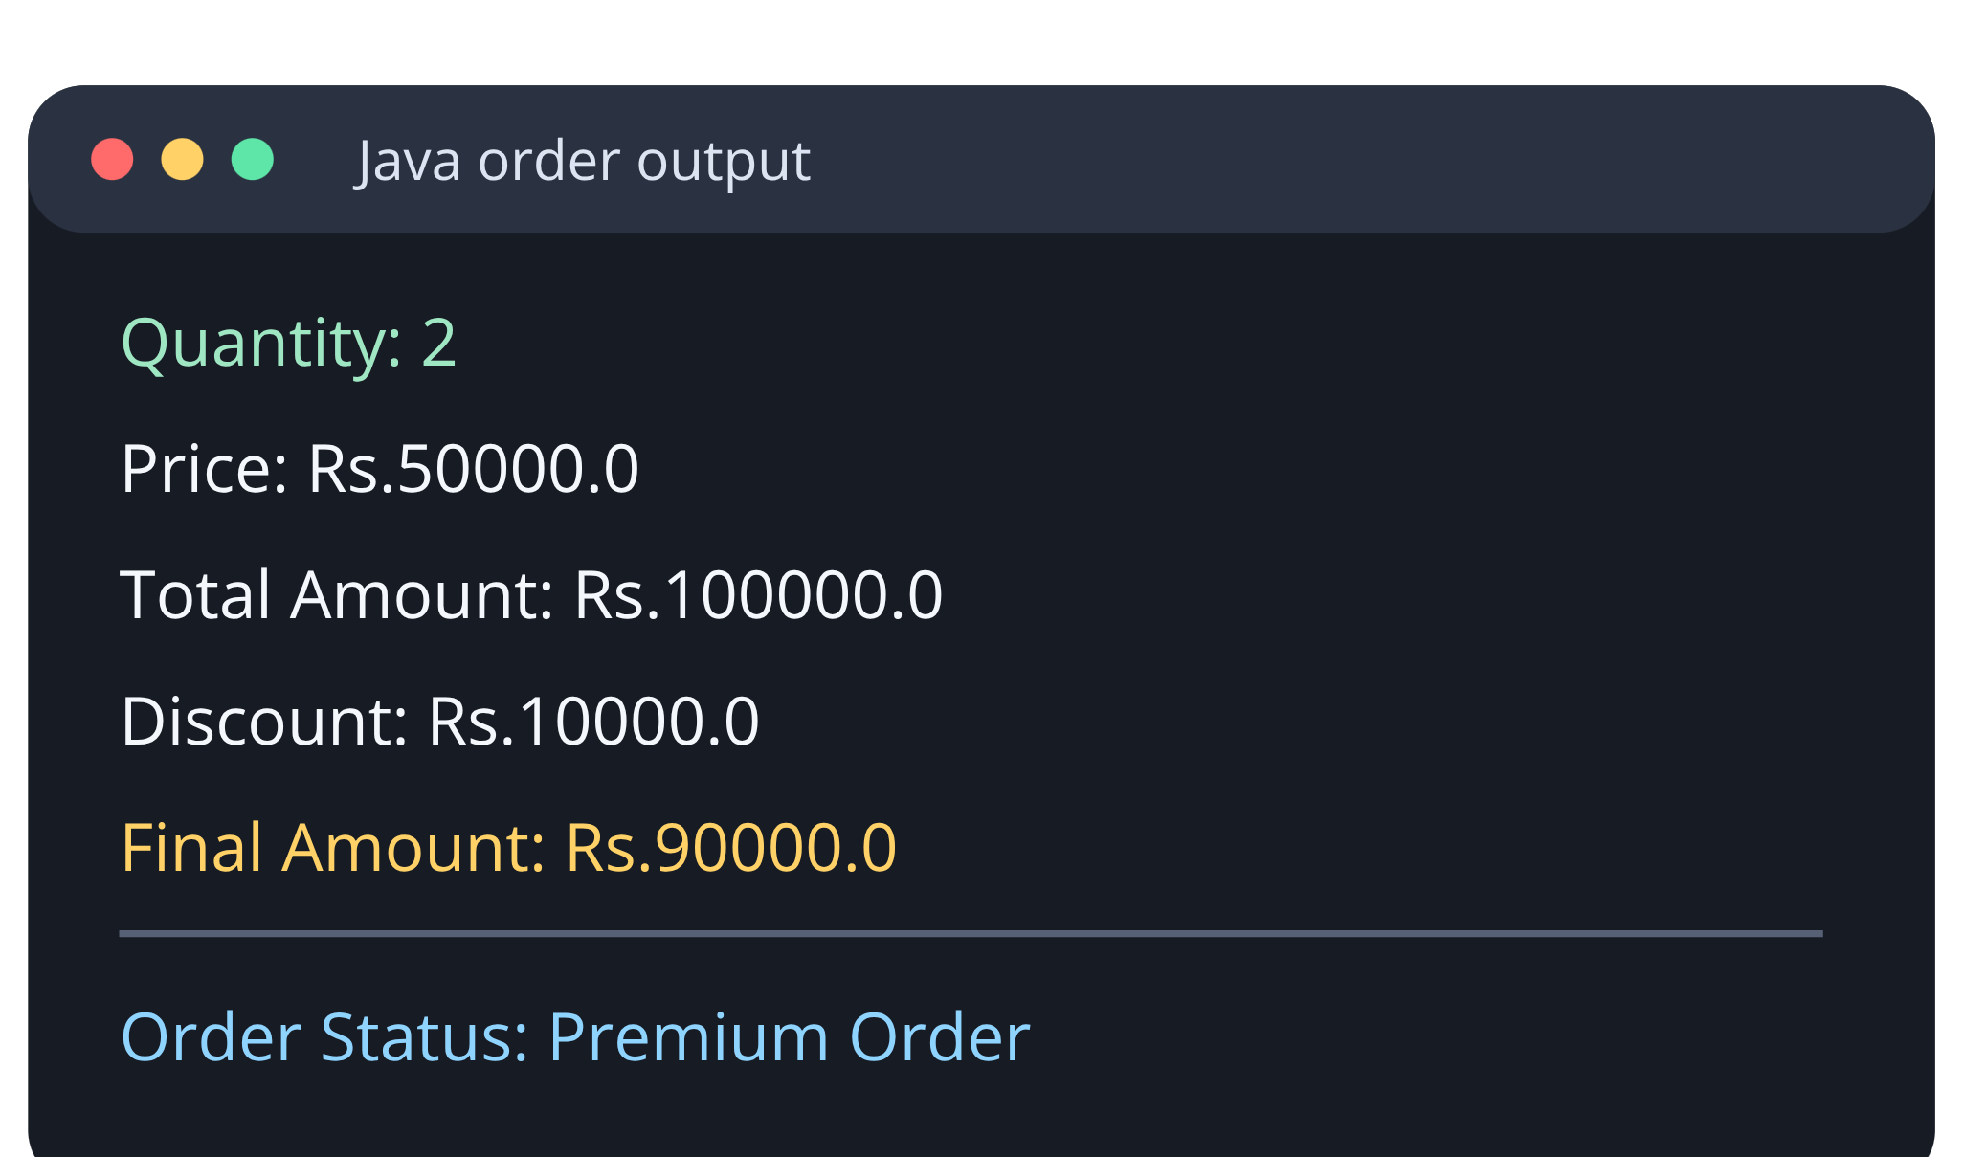

FLOWCHART
End-to-End Order Pipeline
The original flowchart is retained to show the complete movement from product selection to order confirmation.

Slide 8
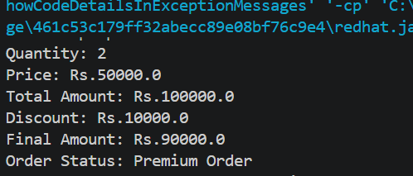
RESULT SCREENSHOT
Java Program Output
Sample result: Quantity = 2 | Total = Rs.100000 | Discount = Rs.10000 | Final Amount = Rs.90000 | Premium Order

Slide 9
THANK YOU
Online Store Cart and Order Pipeline
Questions?

