Slide 1
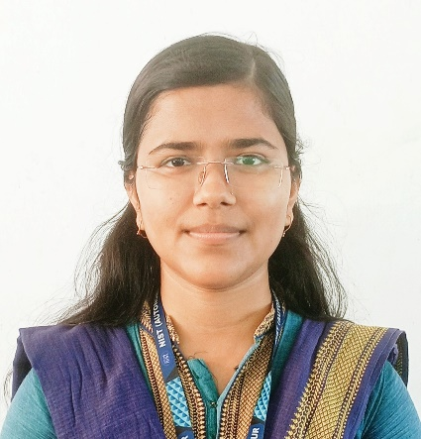


Design of Control and Status Registers (CSR) with APB interface
Project ID: 26441
By
Student 1: Deepika Adhikary Roll No: ECE201911579
Student 2: Sai Swarup Patnaik
Roll No: ECE201910057
Under the guidance of
Prof. Rajesh Kumar Dash
Notes:
B-TECH PROJECT MID-SEM PRESENTATION 2011
BY KHUSHBU KHAN & ISAN SAHOO
B-TECH PROJECT MID-SEM PRESENTATION 2011
BY KHUSHBU KHAN & ISAN SAHOO

Slide 2
CONTENT
Abstract
Objective
Working Diagram
Methodology
SoC
Control and Status Register
APB
RW Register Schematic
RW Register Simulation
APB-CSR
Conclusion
Reference
Notes:
B-TECH PROJECT MID-SEM PRESENTATION 2011
BY KHUSHBU KHAN & ISAN SAHOO
B-TECH PROJECT MID-SEM PRESENTATION 2011
BY KHUSHBU KHAN & ISAN SAHOO

Slide 3
Abstract
Design of Control and Status Registers (CSR) with APB interface for IPs and SoCs.
Notes:
B-TECH PROJECT MID-SEM PRESENTATION 2011
BY KHUSHBU KHAN & ISAN SAHOO
B-TECH PROJECT MID-SEM PRESENTATION 2011
BY KHUSHBU KHAN & ISAN SAHOO

Slide 4
OBJECTIVE
Approch-1 : Using the external pin for each signal which needs to be controlled or observed.
  Increases pin count drastically.
  Becomes difficult to integrate IPs in SoC.
  Increases the cost of SoC.
Approch-2 :To control and observe internal signals inside an IP using a standard interface like APB.
  Only a few pins are used.
  Becomes easy to integrate in SoCs.
Notes:
B-TECH PROJECT MID-SEM PRESENTATION 2011
BY KHUSHBU KHAN & ISAN SAHOO
B-TECH PROJECT MID-SEM PRESENTATION 2011
BY KHUSHBU KHAN & ISAN SAHOO

Slide 5
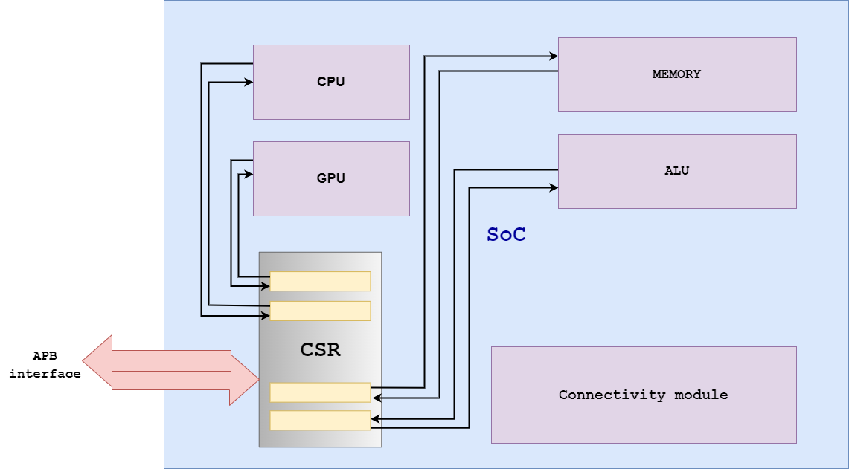
WORKING DIAGRAM
Notes:
B-TECH PROJECT MID-SEM PRESENTATION 2011
BY KHUSHBU KHAN & ISAN SAHOO
B-TECH PROJECT MID-SEM PRESENTATION 2011
BY KHUSHBU KHAN & ISAN SAHOO

Slide 6
Steps for Implementation
Implementation of RW(Read-Write) register.
Reading and Writing into the registers.
Understand and Implement APB protocol as an interface to CSR.
Synthesis and place and route.
Notes:
B-TECH PROJECT MID-SEM PRESENTATION 2011
BY KHUSHBU KHAN & ISAN SAHOO
B-TECH PROJECT MID-SEM PRESENTATION 2011
BY KHUSHBU KHAN & ISAN SAHOO

Slide 7
Types of Register Support
Registers are the smaller and the fastest accessible memory units.
It can hold instructions, address location, or operands.
Sometimes, the instruction has register as a part of itself.
REGISTER
READ ONLY (RO) REGISTER
READ-WRITE (RW) REGISTER
Notes:
B-TECH PROJECT MID-SEM PRESENTATION 2011
BY KHUSHBU KHAN & ISAN SAHOO
B-TECH PROJECT MID-SEM PRESENTATION 2011
BY KHUSHBU KHAN & ISAN SAHOO

Slide 8
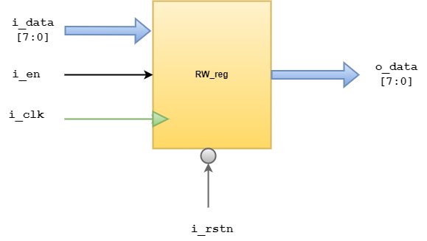
RW Register
We can both Read and Write through APB interface into this registers.
Notes:
B-TECH PROJECT MID-SEM PRESENTATION 2011
BY KHUSHBU KHAN & ISAN SAHOO
B-TECH PROJECT MID-SEM PRESENTATION 2011
BY KHUSHBU KHAN & ISAN SAHOO

Slide 9
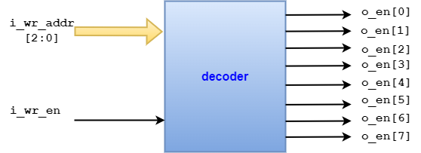
Address Decoder
Address Decoder decodes the address input and enables the required register for reading and writing.
Notes:
B-TECH PROJECT MID-SEM PRESENTATION 2011
BY KHUSHBU KHAN & ISAN SAHOO
B-TECH PROJECT MID-SEM PRESENTATION 2011
BY KHUSHBU KHAN & ISAN SAHOO

Slide 10
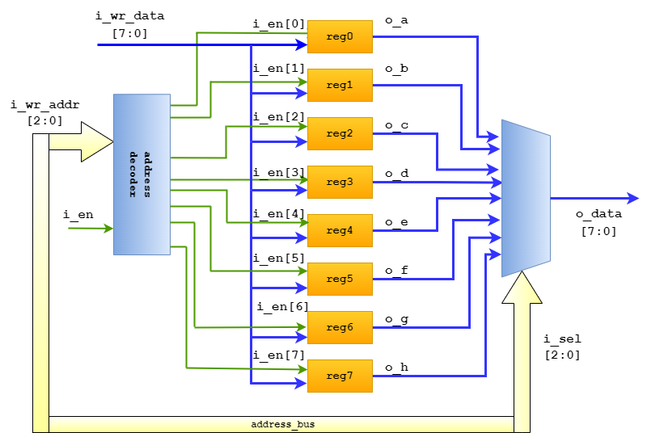
Architecture of CSR
Notes:
B-TECH PROJECT MID-SEM PRESENTATION 2011
BY KHUSHBU KHAN & ISAN SAHOO
B-TECH PROJECT MID-SEM PRESENTATION 2011
BY KHUSHBU KHAN & ISAN SAHOO

Slide 11
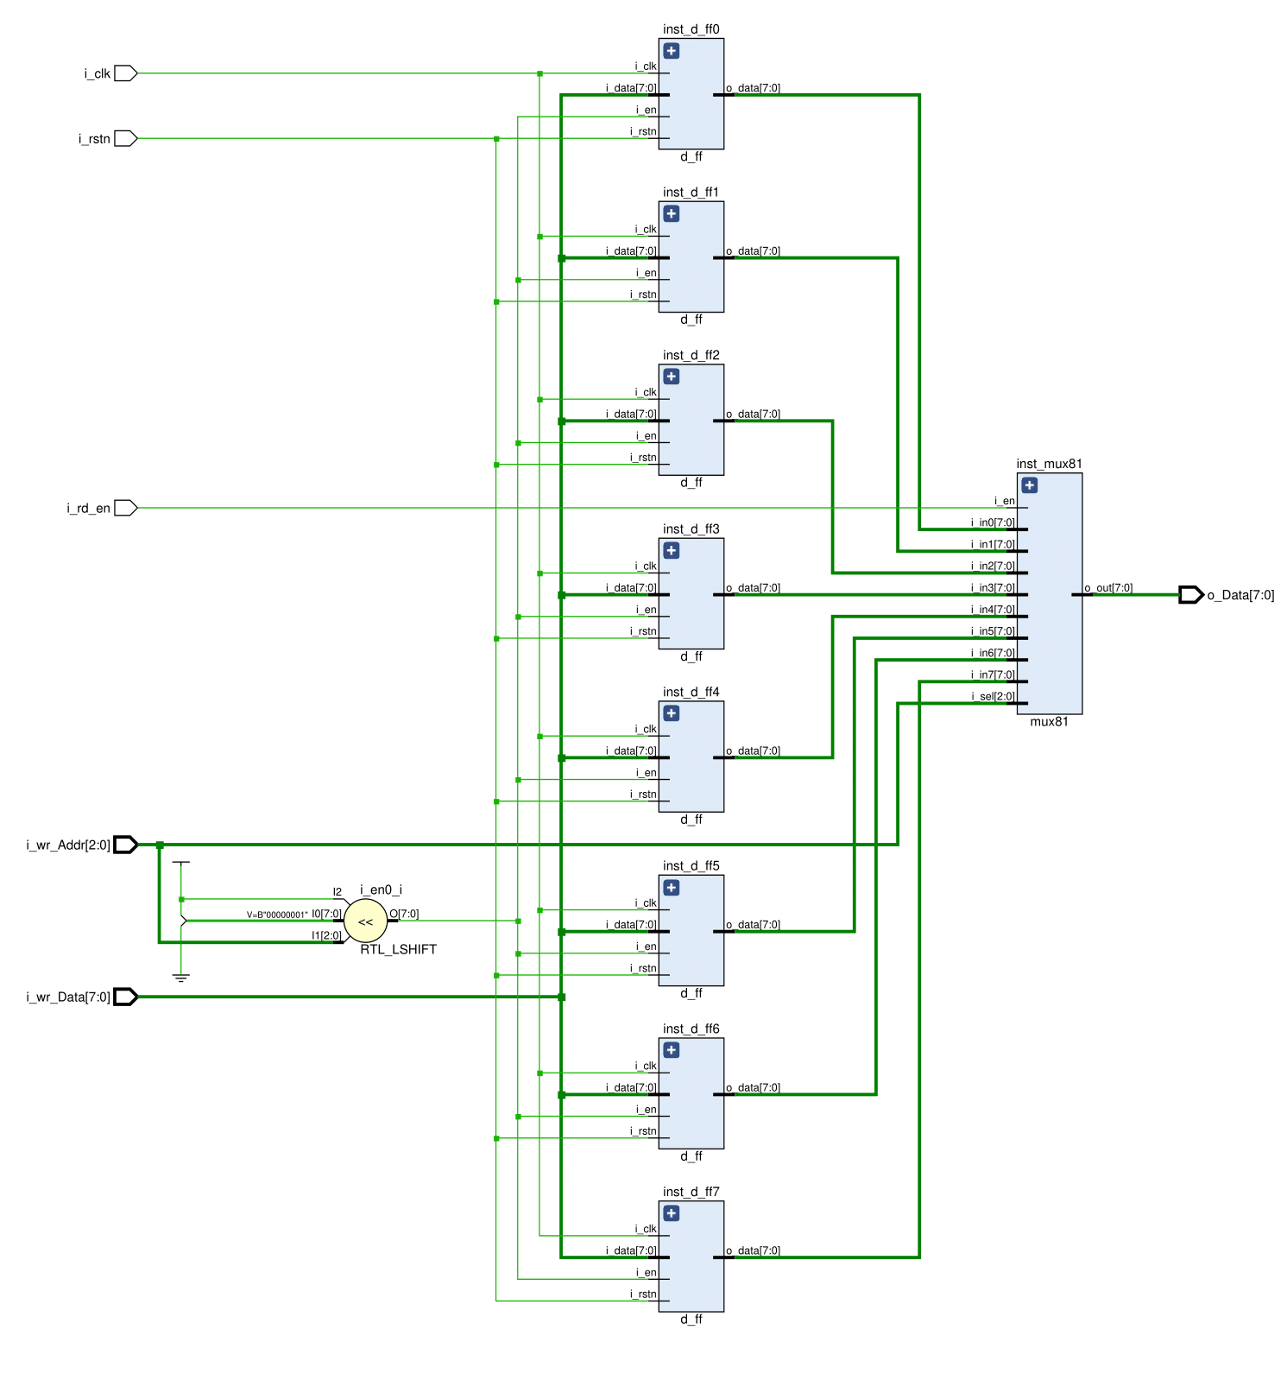
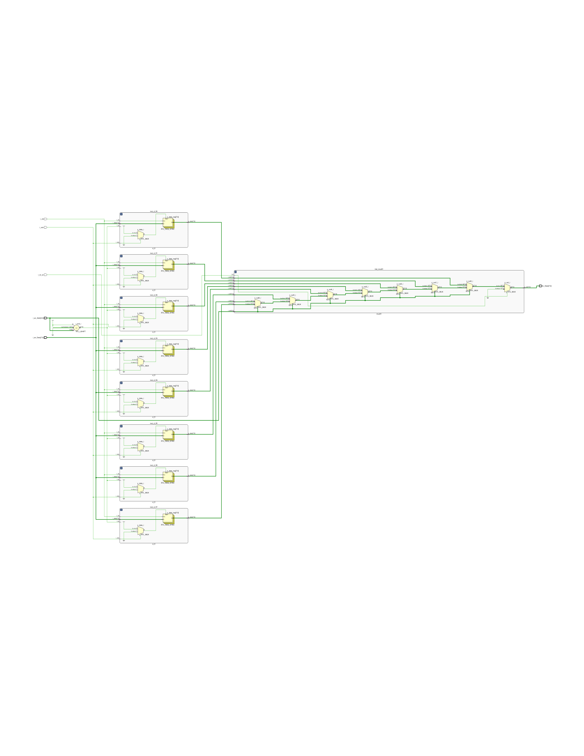
CSR Schematic
Notes:
B-TECH PROJECT MID-SEM PRESENTATION 2011
BY KHUSHBU KHAN & ISAN SAHOO
B-TECH PROJECT MID-SEM PRESENTATION 2011
BY KHUSHBU KHAN & ISAN SAHOO

Slide 12
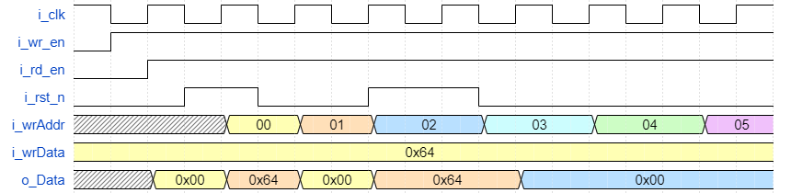
Simulation Waveform
Notes:
B-TECH PROJECT MID-SEM PRESENTATION 2011
BY KHUSHBU KHAN & ISAN SAHOO
B-TECH PROJECT MID-SEM PRESENTATION 2011
BY KHUSHBU KHAN & ISAN SAHOO

Slide 13
Advance Peripheral Bus (APB)
The Advanced Peripheral Bus (APB) is part of the Advanced Microcontroller Bus Architecture (AMBA) protocol.
It defines a low-cost interface.
The APB protocol is Non-pipelined.
The APB protocol relates a signal transition to the rising edge of the clock.
Every transfer takes at least two cycles.
Low power and Low-complexity.
Low-bandwidth.
Ideal for peripherals.
Notes:
B-TECH PROJECT MID-SEM PRESENTATION 2011
BY KHUSHBU KHAN & ISAN SAHOO
B-TECH PROJECT MID-SEM PRESENTATION 2011
BY KHUSHBU KHAN & ISAN SAHOO

Slide 14
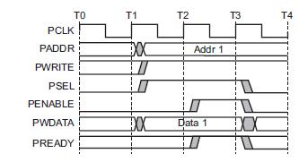
APB Bus Signals
PCLK
    Clock
PADDR
    Address on bus
PWRITE
    1=Write, 0=Read
PWDATA
    Data written to the I/O device. Supplied by the bus master/processor.
Notes:
B-TECH PROJECT MID-SEM PRESENTATION 2011
BY KHUSHBU KHAN & ISAN SAHOO
B-TECH PROJECT MID-SEM PRESENTATION 2011
BY KHUSHBU KHAN & ISAN SAHOO

Slide 15
APB Bus Signal
PSEL
  Asserted if the current bus transaction is targeted to this device.
PENABLE
  High during entire transaction other than the first cycle.
PREADY
  Driven by target.
  Each target has it’s own PREADY
Notes:
B-TECH PROJECT MID-SEM PRESENTATION 2011
BY KHUSHBU KHAN & ISAN SAHOO
B-TECH PROJECT MID-SEM PRESENTATION 2011
BY KHUSHBU KHAN & ISAN SAHOO

Slide 16
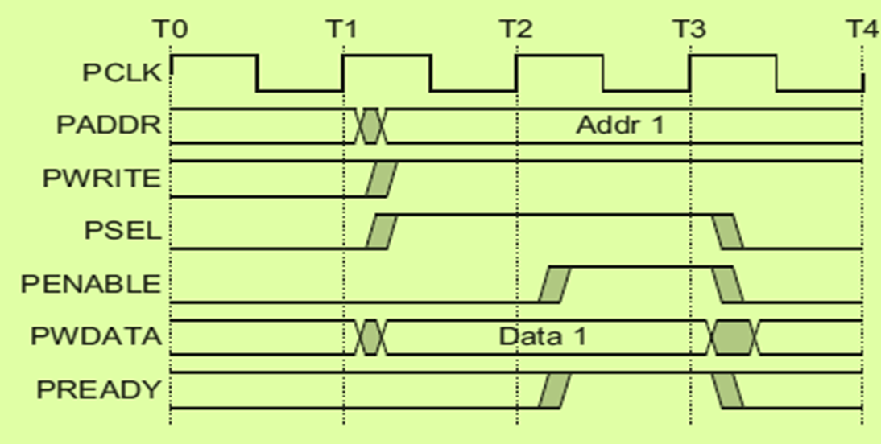
APB Bus State Machine
Setup phase begins
with this rising edge
IDLE
SETUP
ACCESS
Setup
Phase
Access
Phase
Notes:
B-TECH PROJECT MID-SEM PRESENTATION 2011
BY KHUSHBU KHAN & ISAN SAHOO
B-TECH PROJECT MID-SEM PRESENTATION 2011
BY KHUSHBU KHAN & ISAN SAHOO

Slide 17
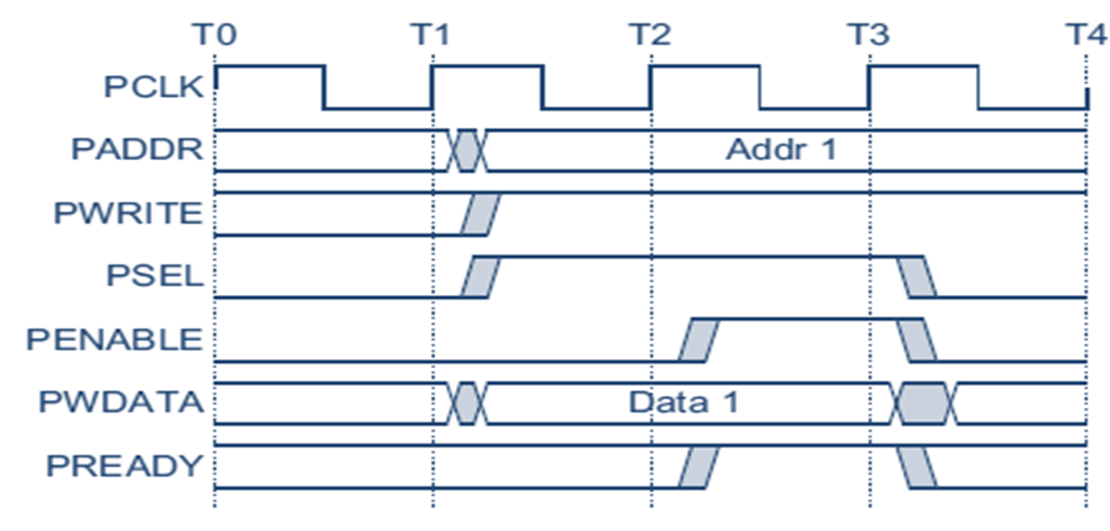
Write Transfer State
Setup phase begins
with this rising edge
Setup
Phase
Access
Phase

Slide 18
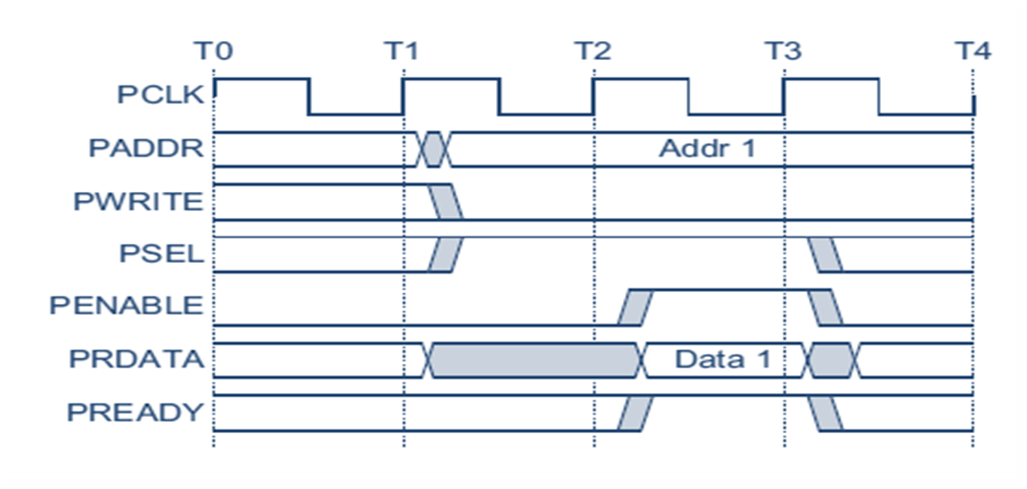
Read Transfer State
Setup phase begins
with this rising edge
Setup
Phase
Access
Phase

Slide 19
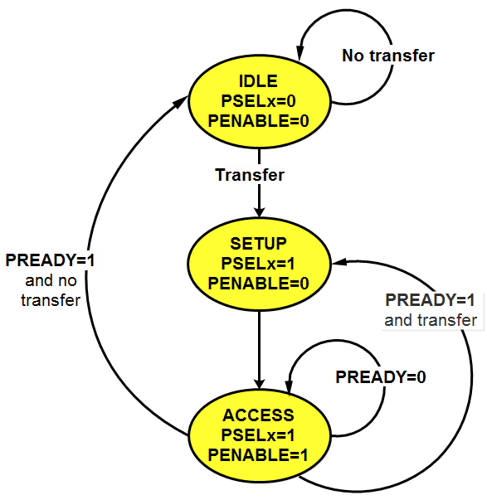
Operating State Diagram

Slide 20
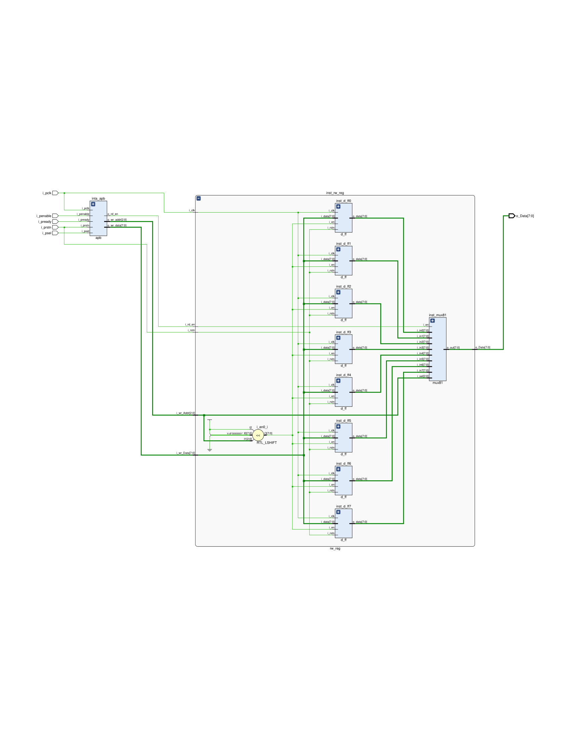
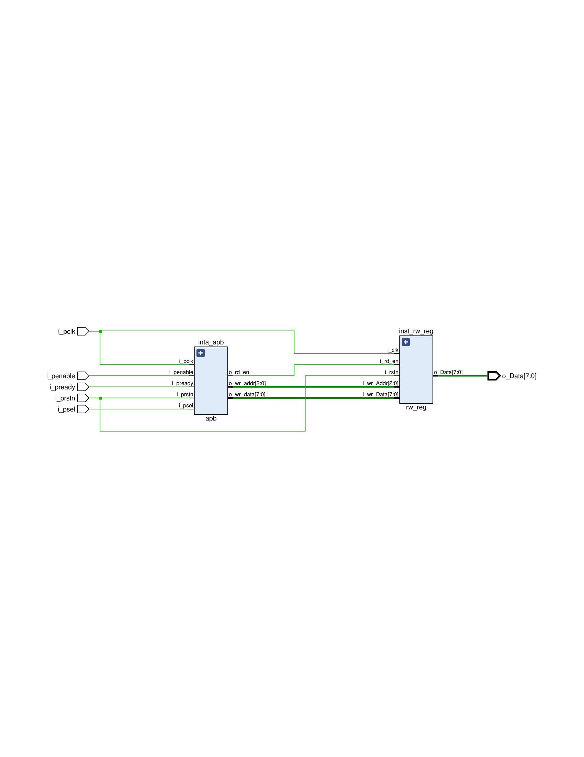
APB – CSR Schematic

Slide 21
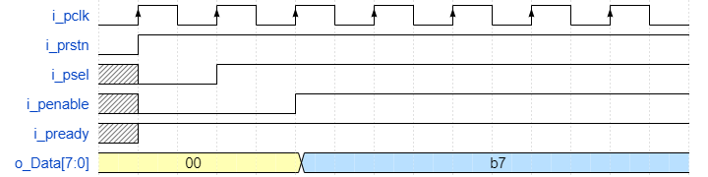
APB – CSR waveform

Slide 22
Conclusion
To add Configurability and Observability
To reduce the Pin count in an IP/SoC.
Hardware complexity will be reduced.

Slide 23
Reference
http://ijecce.org/administrator/components/com_jresearch/files/publications/IJECCE_3416_Final.pdf
https://electrobinary.blogspot.com/p/verilog.html?m=1
https://electrobinary.blogspot.com/2020/06/control-and-status-registers-csr.html?m=1
https://binaryterms.com/register-organization.html
https://en.wikipedia.org/wiki/Control/Status_Register
https://www.researchgate.net/publication/318431852_Digital_Logic_for_Computing
https://www.youtube.com/watch?v=-W5zE-pVTzA
https://link.springer.com/chapter/10.1007/978-3-319-56839-3_13
https://esrd2014.blogspot.com/
https://jindongpu.wordpress.com/2012/03/07/register-file/

Slide 24
Thank You
Notes:
B-TECH PROJECT MID-SEM PRESENTATION 2011
BY KHUSHBU KHAN & ISAN SAHOO

