Slide 1
Less is More: CLIPBERT for Video-and-Language Learning
Hasan Sait Arslan

Slide 2
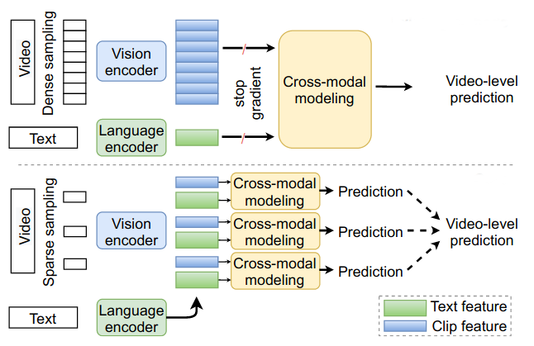
Motivation
Baseline Networks
CLIPBert

Slide 3
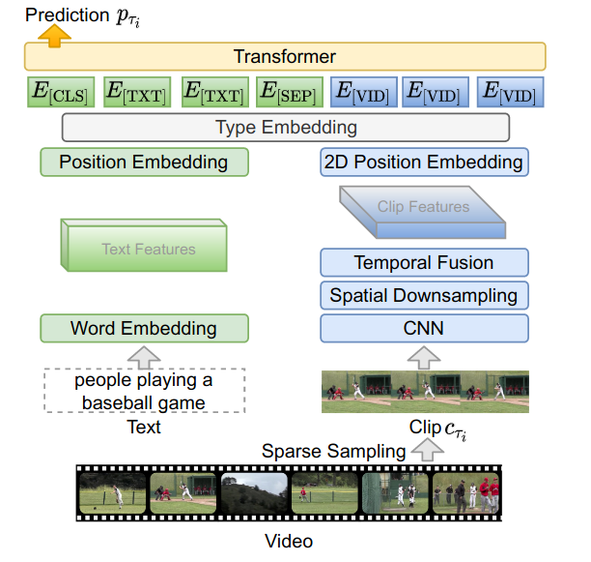
CLIPBert

Slide 4
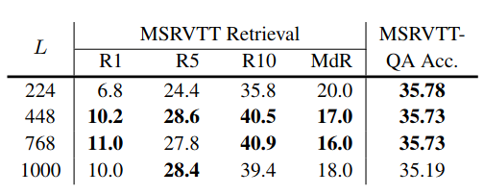
Impact of Input Image Size
MSVRT: Dataset of YouTube Videos
R(1/5/10): Average Recall within (1/15/10) most confident predictions
MdR: Median Rank
QA Acc: Question Answering Accuracy

Slide 5
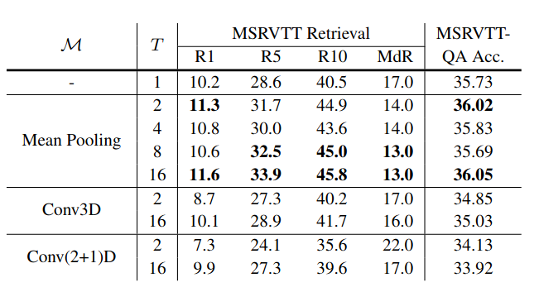
Impact of Number of Frames and Temporal Fusion Function
M: Temporal Fusion Function
T: Number of Frames

Slide 6
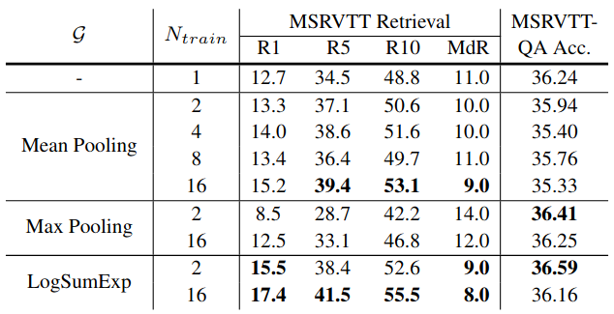
Impact of Number of Training Clips and Score Aggregation Function
G: Score aggregation function

Slide 7
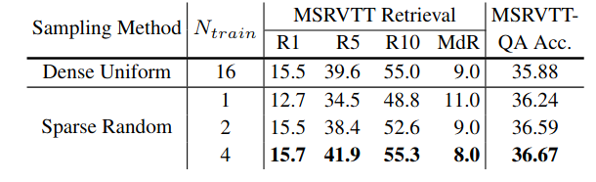
Sparse Random Sampling vs. Uniform Sampling

Slide 8
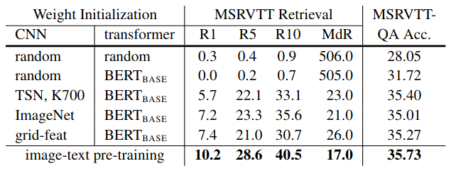
Impact of Weight Initialization Method

Slide 9
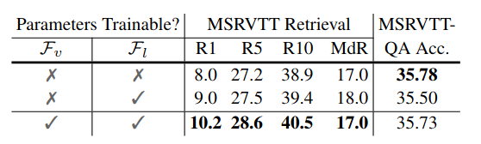
Impact of End-to-End Training

Slide 10
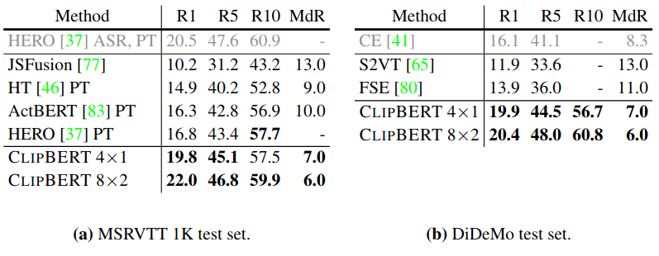
Comparison with SOTA on Text-to-Video Retrieval

Slide 11
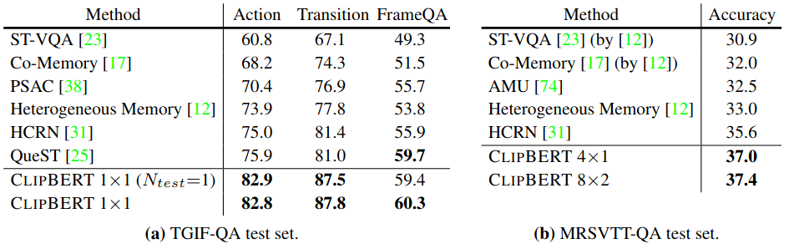
Comparison with SOTA on Video Question Answering

Slide 12
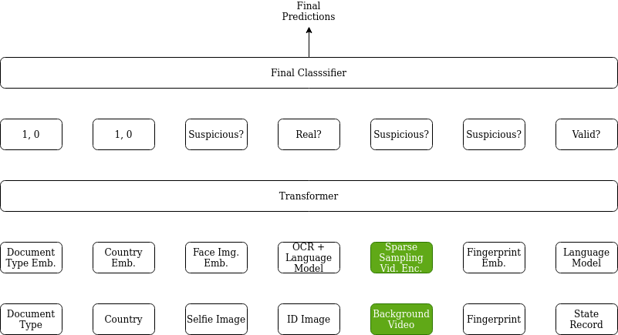
Possible Usage Within Veriff Identity Verification Platform

Slide 13
Q & A
Thank you for listening!

