Slide 1

BeltApp skin conductance data cleaning manual
durgun.s@buas.nl
The Experience Lab

Slide 2
BeltApp skin conductance data cleaning manual
Content List
SC/EDA basics and key signal parameters
Tonic vs. phasic components
How to identify artifacts (the "1-3 second rule")
Complete BeltApp setup workflow
Step-by-step cleaning process
The three replacement methods and when to use each
Critical save behavior warning
durgun.s@buas.nl
The Experience Lab
Notes:
Authority, intuition, common sense, experience, belief…

Slide 3
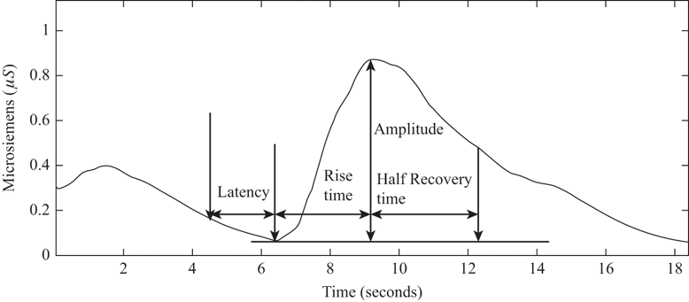
Understanding What You’re Cleaning
Skin Conductance (SC) — also known as Electrodermal Activity (EDA) — measures changes in sweat gland activity linked to sympathetic arousal.
Figure: Example of a typical Skin Conductance Response (SCR). After a stimulus, skin conductance shows a delayed increase (latency), a sharp rise to peak amplitude (rise time), and a gradual decay (half-recovery time). The amplitude reflects the intensity of sympathetic arousal.
durgun.s@buas.nl

Slide 4
Understanding What You’re Cleaning
Key Phases Explained
Parameter | Description | Typical Range
Latency | The delay between the stimulus onset and the beginning of the SCR rise. It reflects the time it takes for the sympathetic nervous system to activate sweat glands. | 1–4 seconds
Rise Time | The time from the onset of the response to the peak amplitude. It reflects how quickly the arousal develops. | 1–3 seconds
Amplitude | The height of the response, measured as the difference in microsiemens (µS) between the baseline and the peak. It indicates the strength of physiological arousal. | ≥ 0.05 µS (significant response)
Half-Recovery Time | The time it takes for the signal to drop to half of its peak value after reaching the maximum. It shows how quickly the arousal subsides. | 2–10 seconds
Fig. 1. A Typical GSR Response
durgun.s@buas.nl

Slide 5
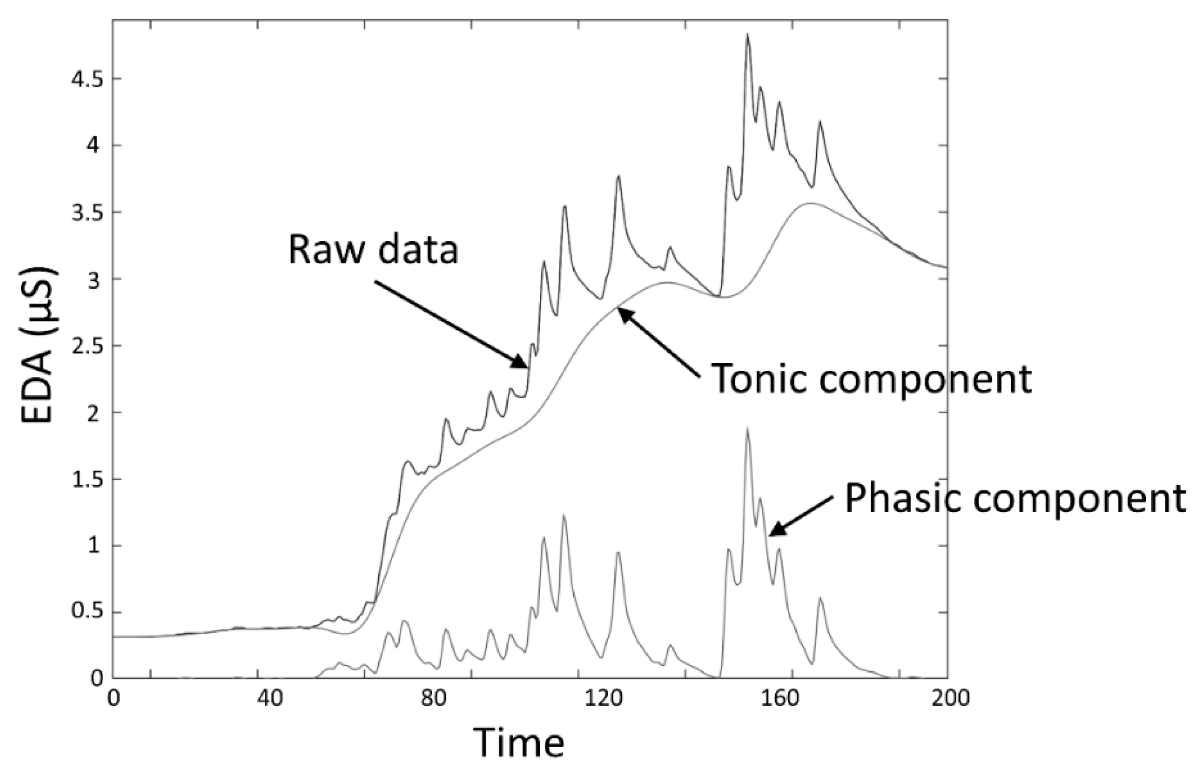
Understanding What You’re Cleaning
In real life, SCR signals don’t happen one at a time. If someone experiences several emotional or attention-grabbing moments close together, the skin keeps reacting before the previous response has fully faded.
SCR signal shows a moment of arousal — but because our body often reacts several times in a row, the responses overlap, making the raw signal look complex and noisy.
Tonic Component: This is the slow, steady part of the signal — like the “baseline”. It changes gradually over time depending on general factors such as temperature.
Phasic Component: In the raw data, the quick spikes (actual SCRs) are not always clear because they overlap with the slow tonic changes. When several reactions happen close together, their peaks merge and become difficult to separate visually.
Therefore, BeltApp uses a deconvolution method to separate the tonic and phasic components mathematically. This allows you to see the true arousal responses more clearly — as will be shown in the next steps.
Figure. This is an example raw signal recorded from the skin. It includes two mixed components: a slow tonic trend and fast phasic spikes. In the raw signal, you don’t clearly see this separation — both are combined.
durgun.s@buas.nl

Slide 6
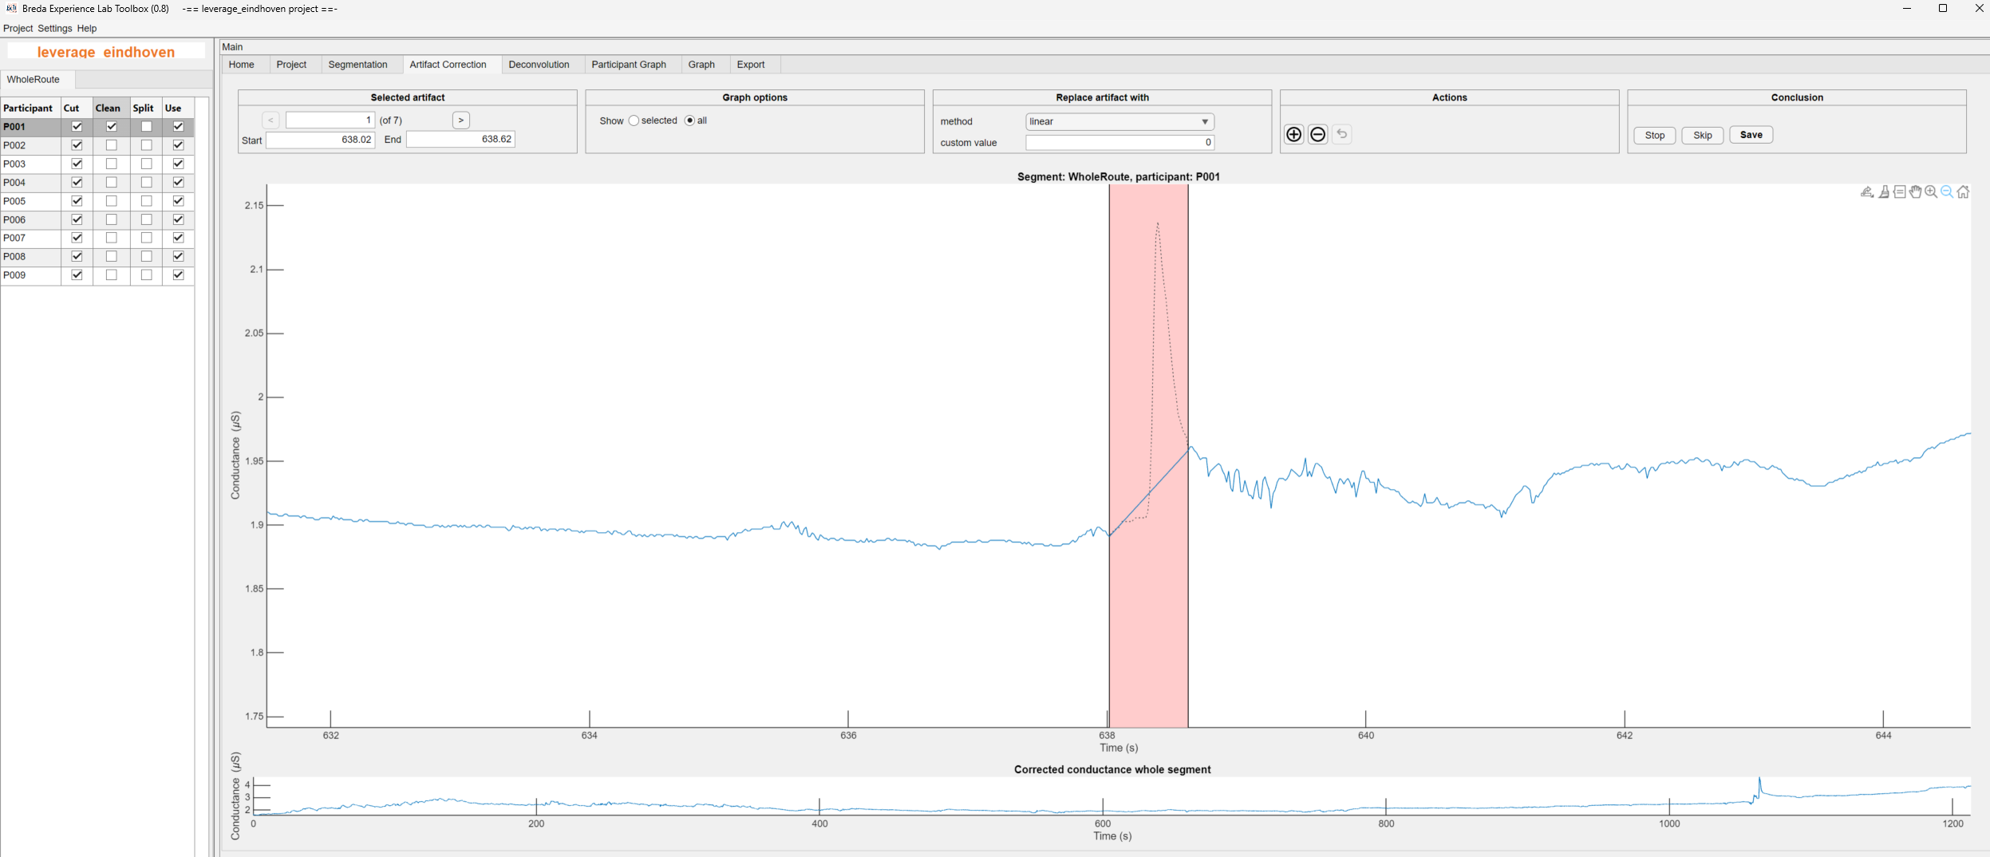
What Is an Artifact in EDA Data?
An artifact is a change in the SCR signal that does not come from the body's physiological response, but instead from external disturbances. Artifacts distort the data and can look like sudden jumps, drops, or noise that does not match normal skin conductance behavior.
Artifacts happen because SCR sensors are very sensitive to movement, pressure, sweat, and contact quality.
Common Causes of Artifacts
Hand or body movement (sudden jumps in the signal)
Electrode shifting or poor contact
Sweat accumulation or drying
Cable pulling or vibration
Device interference or signal dropouts
In this fig. you can see a very sharp, steep rise followed by an immediate drop — this is not a normal physiological SCR.
A true SCR develops gradually: it rises over 1–3 seconds and decays slowly. However, this spike happens almost instantly, which indicates movement or electrode disturbance rather than real arousal.
durgun.s@buas.nl

Slide 7
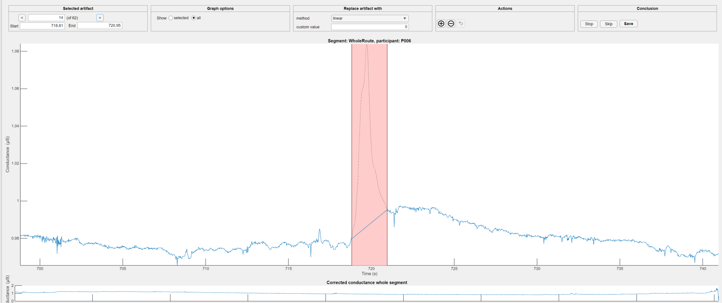
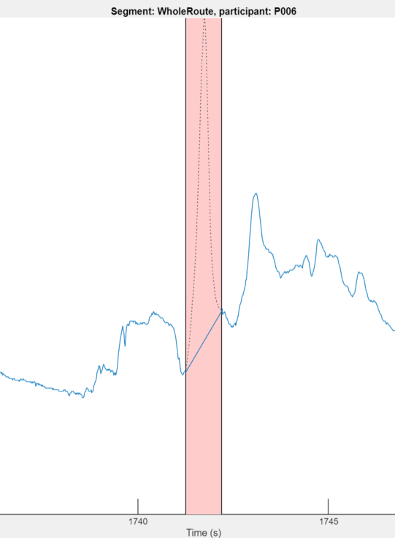
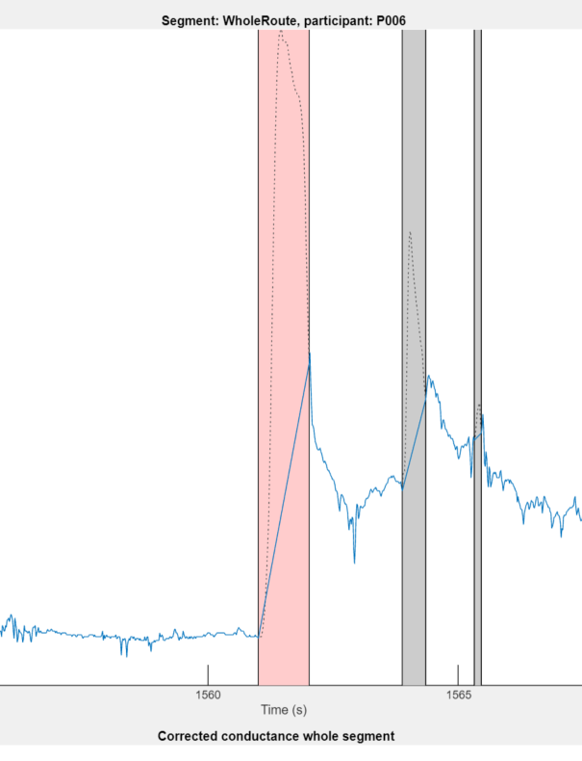
How to Spot Artifacts
Look for unnatural changes in the signal. Typical artifact patterns include:
Artifact Patterns
Sharp vertical jumps or drops (instant rise/fall)
Flat zero line or sudden drop to 0 µS
Very noisy or jagged segments
Sudden signal spikes that do not follow SCR shape
Clipped/constant max value
Quick Rule of Thumb
If a change happens faster than the body can react, it is an artifact.
SCRs rise over 1–3 seconds but an artifact looks instant.
durgun.s@buas.nl

Slide 8
Cleaning Skin Conductance Data and Identifying Artifacts in BeltApp
Now you are ready to open the BeltApp
Please note that when you start BeltApp, it may take a little while to open.
This delay is completely normal; BeltApp runs on top of MATLAB, which needs to load several background components before the interface appears.
And this delay is also a good opportunity to think about the opportunity cost; all the things that you could do with your life rather than cleaning artifacts..
durgun.s@buas.nl

Slide 9
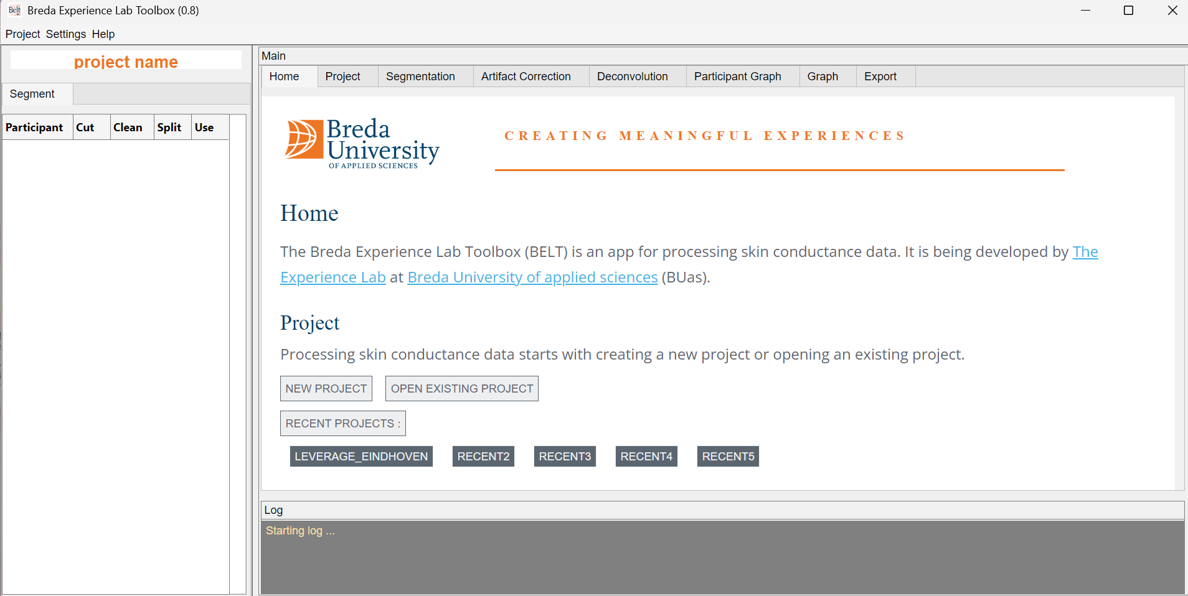
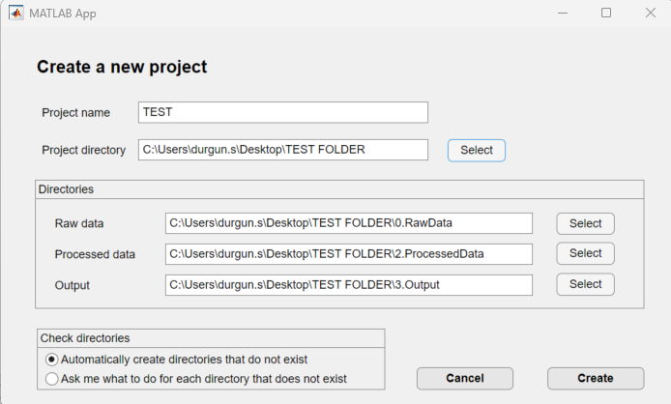
Then you see this pop-up window.
2. Name the project and set the directory
1. Click here
3. Click here
durgun.s@buas.nl

Slide 10
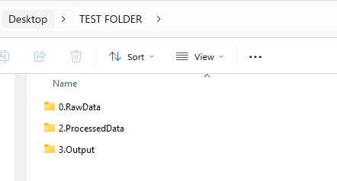
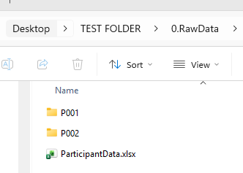
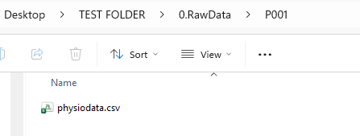

3. Raw data inside the participant’s folder must be named as “physiodata”
BELTapp creates those folders automatically
Move your data into RawData folder.
Make sure that you named each participant folder as per on the screenshot
4. Create the “ParticipantData” file based on the right format here>
Note: if you do not have exact start&end time you can always write “startfile” and “endfile” here
durgun.s@buas.nl

Slide 11
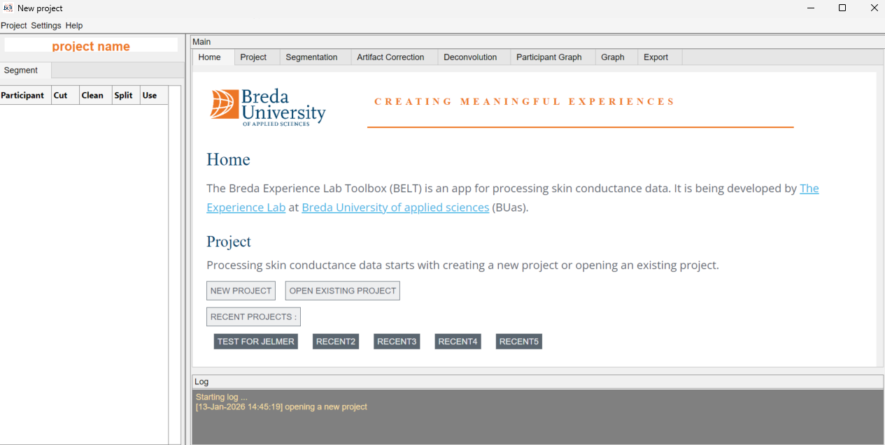
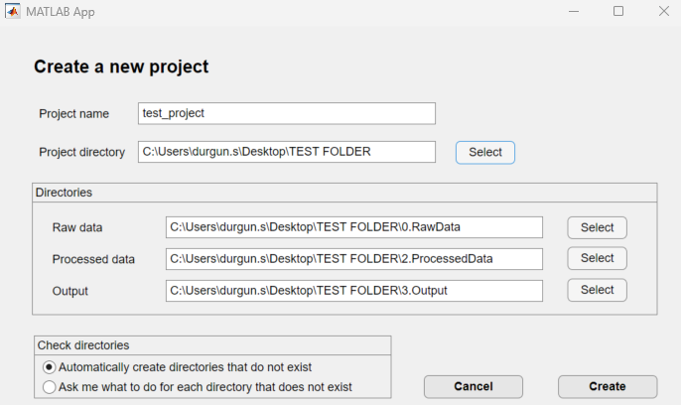
Once you create the right layout of the folders\file with right formats:
2. Name the project and select the folder location we just generated.
3. Click create
1. Click “new project” again
durgun.s@buas.nl

Slide 12
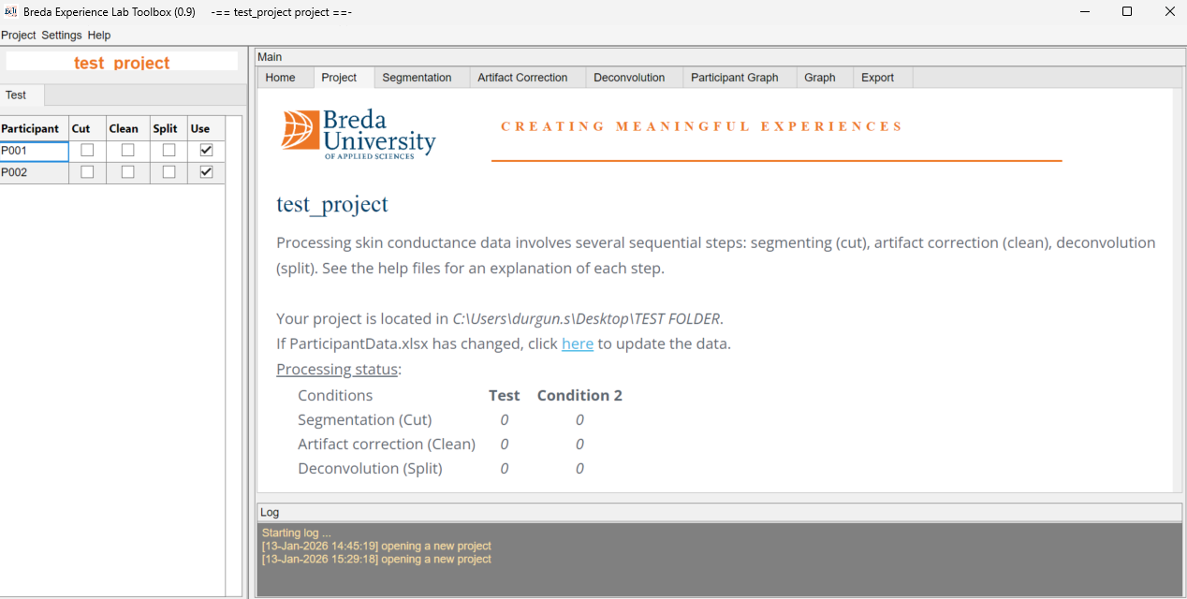
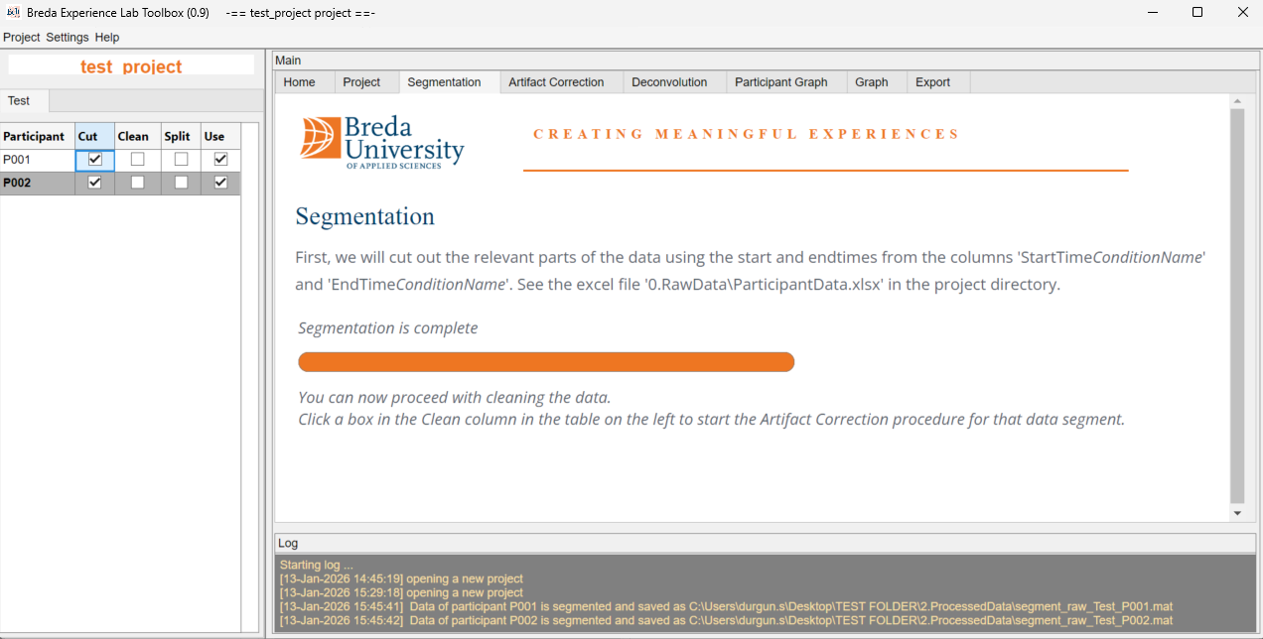
1. Click here for the segmentation of all data.
Beltapp cuts all the data and segments them based on the onset and offset time you entered into ParticipantData file.
The data are now ready for cleaning! From this point onward, the data-cleaning steps are demonstrated using a different dataset.
durgun.s@buas.nl

Slide 13
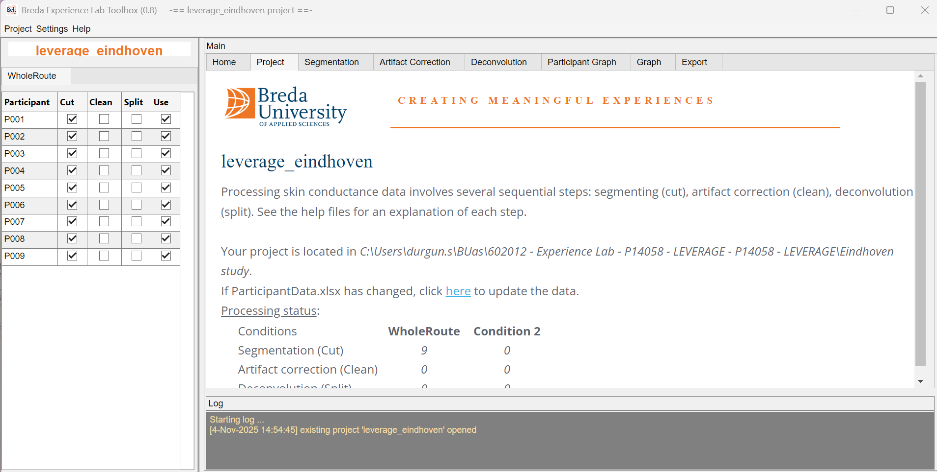
Make sure all the data are here, and they are selected like this
durgun.s@buas.nl

Slide 14
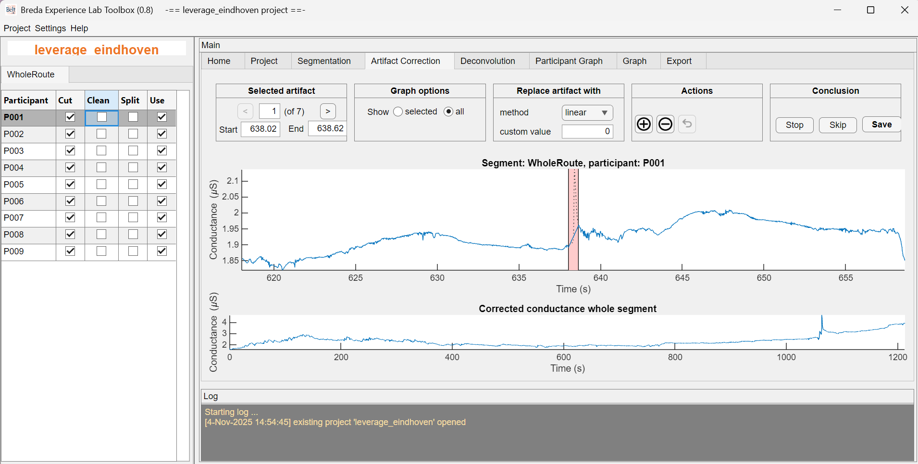
Click here and wait for the participants data to show up on the right side like this
durgun.s@buas.nl

Slide 15
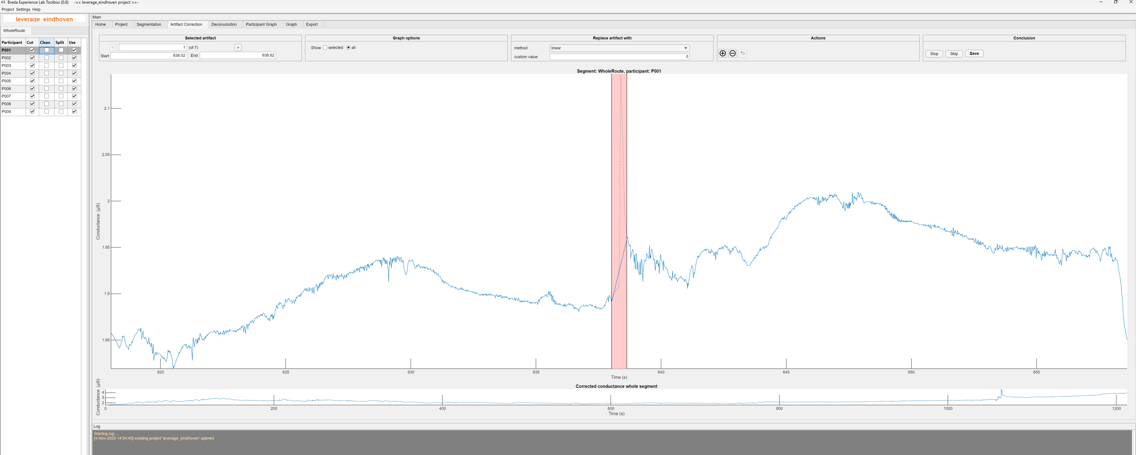
When you select full screen, it looks like this
The BeltApp automatically marks suspicious segments with red boxes.
In this case, it’s detected 7 potential artifacts
You can check them by clicking right/left arrows.
!! But it does not detect all the artifacts and sometimes it detects the normal arousal as an artifact. So, we still need to go through the data and remove the artifacts one by one.
durgun.s@buas.nl

Slide 16
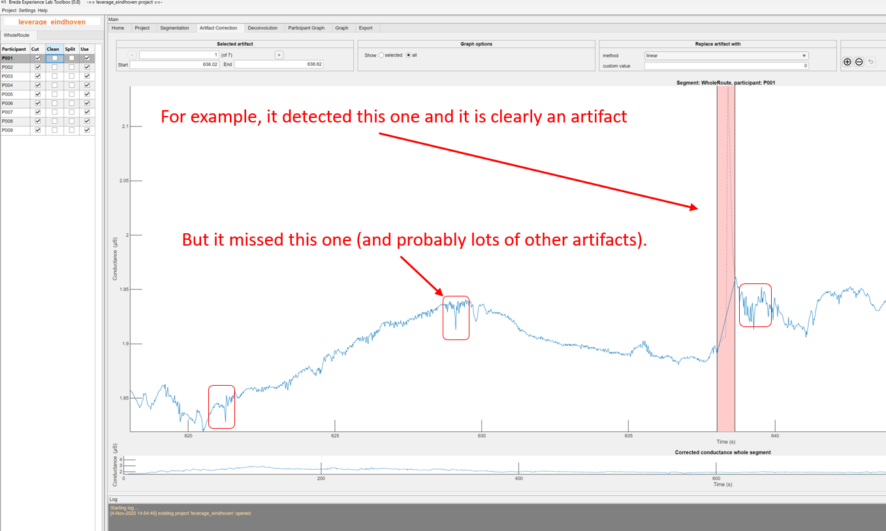
Visual Inspection - Manual Review
Now comes the critical part: YOU must review each flagged segment AND look for missed artifacts.
🔴 Example 1: Correctly Detected Artifact
The large red box on the right shows a sharp, sudden drop followed by erratic fluctuations:
Shape: Unnatural spike and steep decline, not a smooth physiological curve
Action: ✓ Keep this flagged - definitely an artifact
🔴 Example 2: MISSED Artifact (little 3 red boxes)
BeltApp failed to detect these clear artifacts:
What you see: A small, irregular bump with sharp edges
Why it's an artifact:
Too sharp/angular (real SCRs are smooth and rounded)
Irregular shape - doesn't follow typical rise/recovery pattern
No smooth exponential decay
Appears as "noise on noise" rather than a clear response
Action: ✗ You must MANUALLY mark this as an artifact
durgun.s@buas.nl

Slide 17
Review Auto-Detected Artifacts
If it IS an artifact (TRUE positive):
Simply click the right arrow (→) button to move to the next detected artifact
The red box stays marked for later removal
Move on to review the next flagged segment
If it is NOT an artifact (FALSE positive):
In the Action Panel (right side), click the minus (−) button
This removes the red box from this segment
The algorithm incorrectly flagged valid data - you're correcting it
Click the right arrow (→) to continue to the next artifact
🔄 Repeat this process until you've reviewed all auto-detected artifacts.
durgun.s@buas.nl

Slide 18

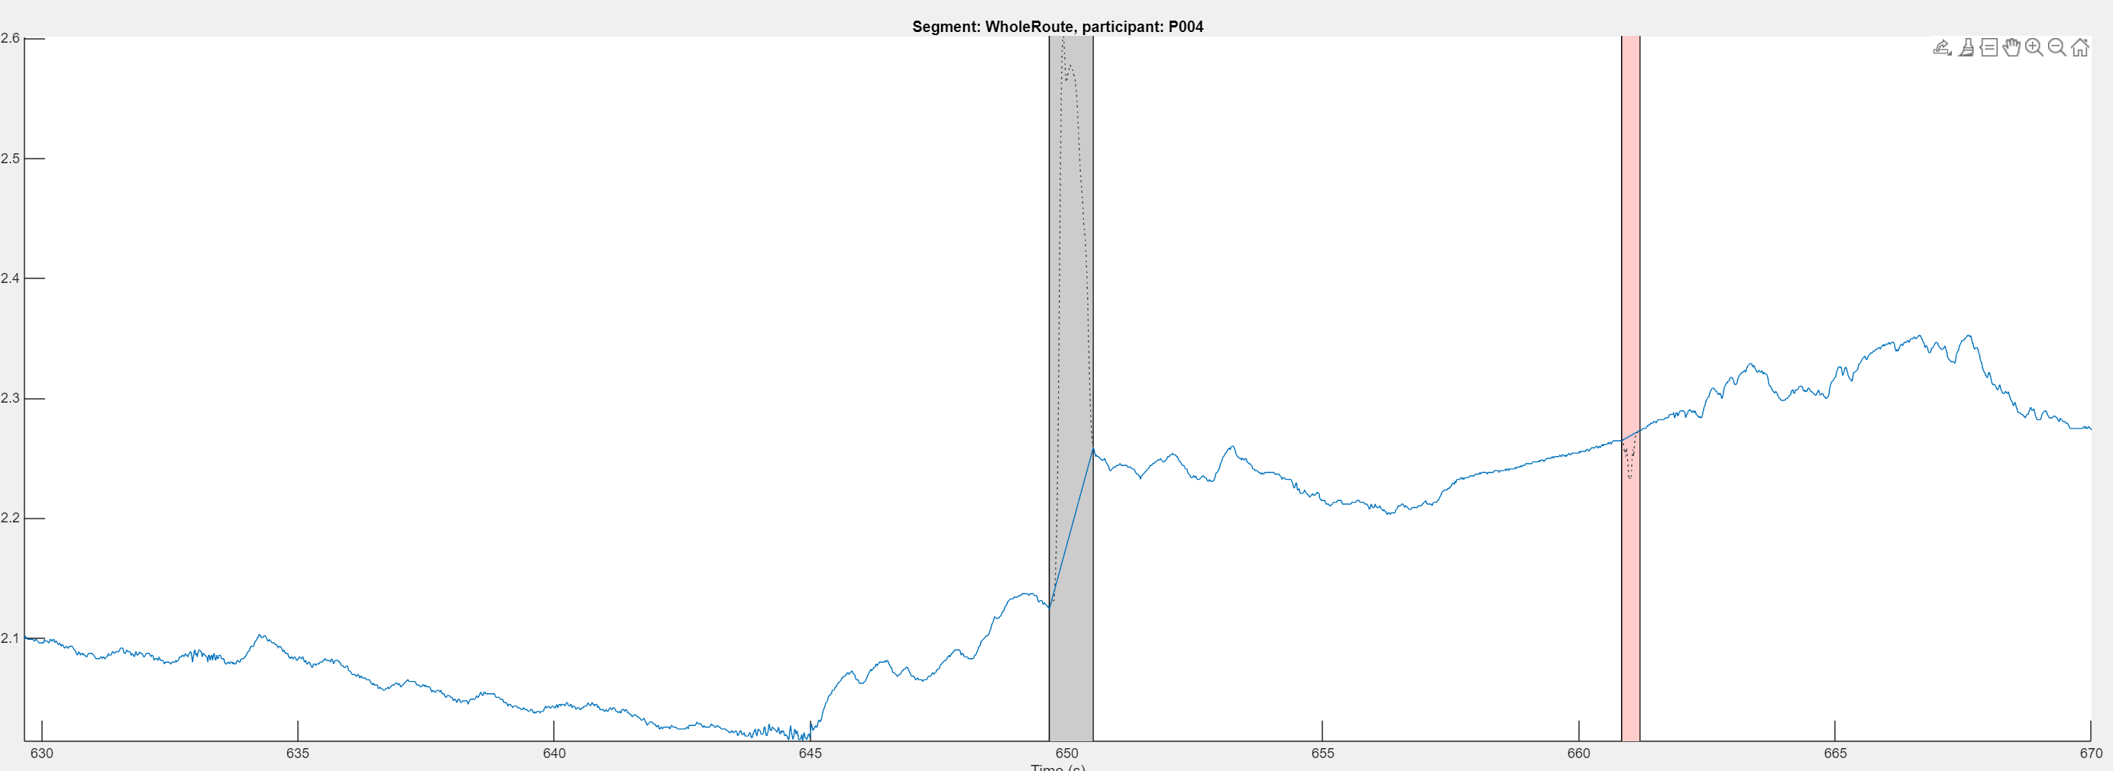
Manual Artifact Detection
⚠️ Critical: The automated detection WILL miss artifacts (as shown in your example). You must now manually scan the entire dataset.
Reset Your View to the Beginning
Navigate to data start:
Use the navigation tools (top right of the data visualization panel)
Available tools: Brush, Zoom in/out, Hand, Home
Click Home or drag the timeline back to 0 seconds
Set optimal zoom level for artifact detection:
Horizontal (X-axis/Time): Zoom to show ~5 second intervals of data on screen
Why 5 seconds? This resolution allows you to see:
SCR rise times (1-3 sec)
Recovery phases (2-10 sec)
Small artifacts that appear as brief disturbances
Vertical (Y-axis): Adjust so you can see full signal range without clipping
Example of 5sec intervals
durgun.s@buas.nl

Slide 19
Manual Artifact Detection
When you identify an artifact that BeltApp missed:
Click the Brush icon
Select the artifact boundaries:
Click at the START of the artifact (where signal becomes abnormal)
Drag to the END of the artifact (where signal returns to normal pattern)
OR: Click start point, then click end point (depends on BeltApp version)
The selected region should now be highlighted
⚠️ Selection Tips:
Include the entire disturbance - from where it deviates to where it normalizes
Don't over-select - only mark the truly problematic portion
Check both sides - ensure you're connecting clean data points
🔑 CRITICAL DECISION: How you fill in the artifact gap determines data quality.
Once selected, choose your replacement method in the "Replace artifact with" panel:
LINEAR: Stable and similar baselines on both sides
SPLINE: Where data shows clear upward/downward trends
NaN: When you cannot reliably predict what the signal should be
⚠️ Use sparingly! NaN removes data entirely. Only use when interpolation would be misleading.
durgun.s@buas.nl

Slide 20
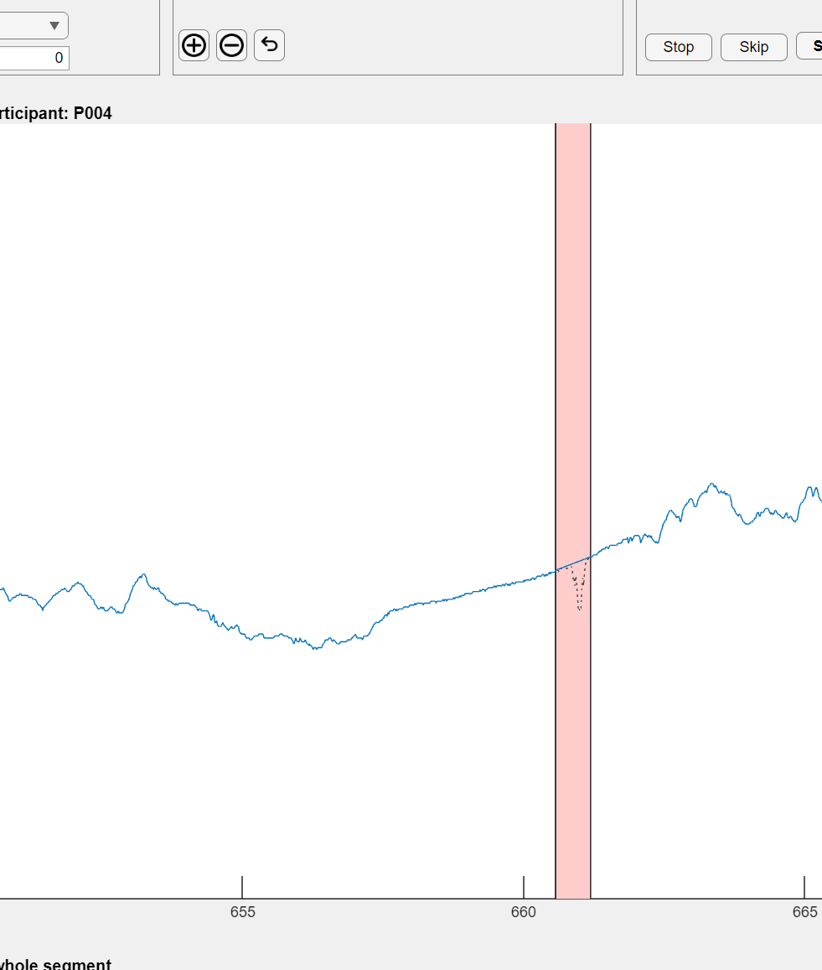
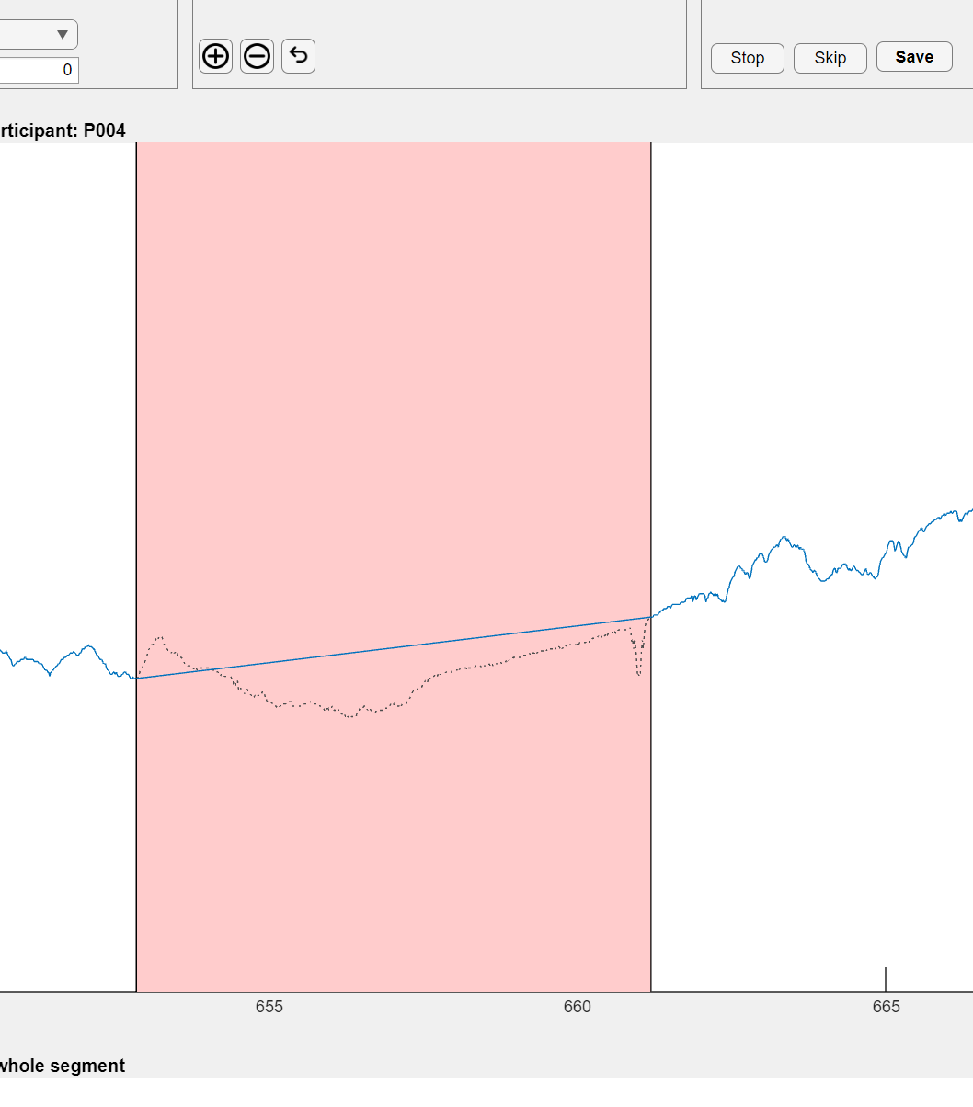
Manual Artifact Detection
Apply and Continue
After selecting your method (Linear/Spline/NaN), click Apply or OK
The artifact is now corrected - red box disappears, replaced by your interpolation
Visually verify the correction looks natural
Continue scanning - pan to the next 5-second window
Repeat Steps 5-7 until you reach the end of the recording
As you can see once you select the artifact you can drag the red box and adjust the size of the correction.
durgun.s@buas.nl

Slide 21
Manual Artifact Detection
⚠️ CRITICAL: Save Only When Fully Complete
BeltApp does NOT auto-save or save partial work.
If you close the program or switch participants before clicking "Save," all your cleaning work will be lost.
Correct workflow:
✅ Finish cleaning the entire participant (all phases complete)
✅ Click "Save"
✅ Only then move to next participant or close BeltApp
→ One participant = One complete cleaning session = One save
Once you've completed cleaning for one participant:
Click "Save"
BeltApp will automatically:
Save all your artifact corrections
Close the current participant's data
Load the NEXT participant automatically
You'll see the next participant's data appear on screen
Repeat the steps for this new participant
Final Save
After completing the last participant:
Click "Save" one final time
This ensures the last participant's corrections are stored
durgun.s@buas.nl

Slide 22
That’s all!
For any inquires please contact:
Sait Durgun (Ph.D.) durgun.s@buas.nl
durgun.s@buas.nl

