Slide 1

Scraping & Analyzing Nykaa Products:
Trends in Health, Baby & Beauty Segments

Slide 2
About Us
Team Members
  Teemara Sai
  Lokesh
Background (B-tech )
Why you want to learn Data Science
Any work experience
Share your linkedin and github profile urls

Slide 3
Contents:
1. Introduction
2.Process of Web Scraping
3.Project Objectives
4. Summary of the Data
5. Data Cleaning Steps
6. Data Manipulation Steps
7. Univariate Analysis Steps
  Product Count Per Category
  Stock Status Distribution
  Distribution of Original Price and Final Price
8. Bivariate Analysis Steps
  Average Final Price by Category
  Average Reviews per Category
  Offer Percentage vs Final Price
9. Conclusion
10. Experience and Challenges

Slide 4
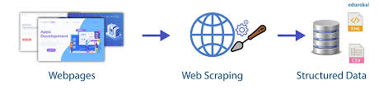
Introduction
Website scraping refers to the automated process of extracting data from websites.
With the rise of the internet and the increasing amount of data available online, website scraping has become an essential tool for businesses and organizations to gather valuable insights and make data-driven decisions
Dynamic website scraping refers to the process of extracting data from websites that use client-side scripting and asynchronous communication. Dynamic website scraping requires specialized tools and techniques to bypass the dynamic nature of websites and extract data effectively.
Static website scraping refers to the process of extracting data from websites where the content is fixed and does not change dynamically.

Slide 5
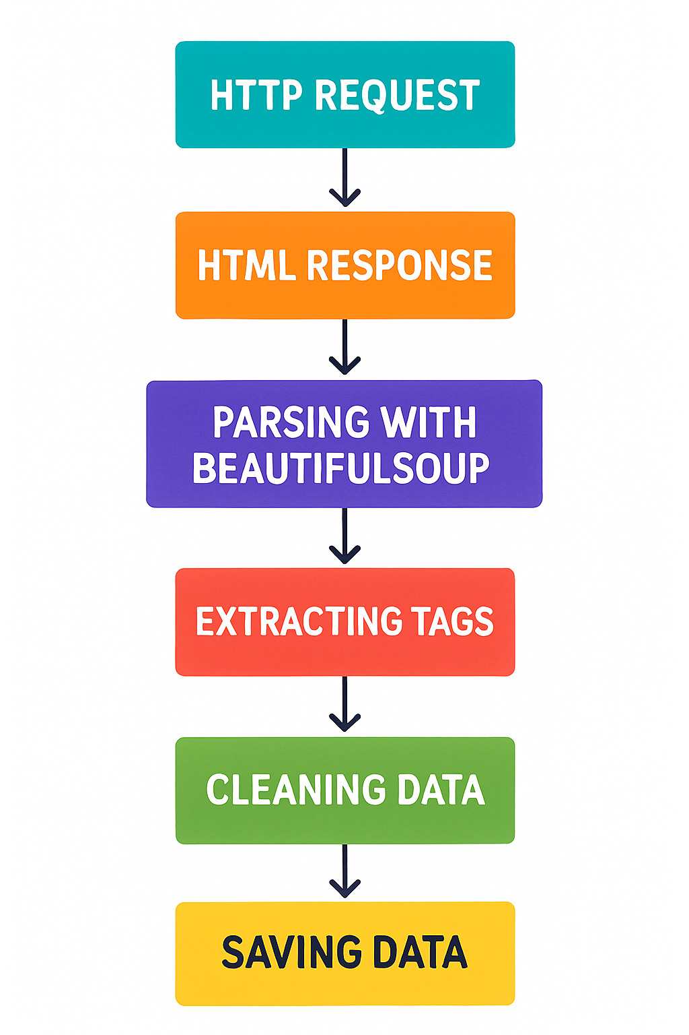
Process of Web Scraping
HTTP Request : A program makes an HTTP request to the target website’s server, similar to how a browser requests a webpage. If permission is granted, the server responds with the page’s HTML content.
Get HTML Response : The server sends back an HTML document containing the website’s structure and content. This document includes tags, elements, and data needed for extraction.
Parse HTML with Beautiful Soup : The raw HTML is passed to Beautiful Soup a Python library that converts it into a structured parse tree. The parser allows easy navigation, search, and modification of the HTML elements.
Locate Tags & Extract Data : Using Beautiful Soup, the program searches for specific HTML tags, classes, or IDs containing the desired information.
Store Data : The dataset is saved to a CSV file

Slide 6
Project Objective
Our primary objective is to scrape, clean, and analyze product data from Nykaa to derive actionable business insights. This involves:
Structured Database
Creating a Clean and well –structured dataset by scraping raw product details and preprocessing for analysis.
Meaningful Analysis
Applying Exploratory Data Analysis (EDA) to uncover insights into pricing strategies, customer engagement, product demand, and cross-category comparisons.
Visualized Insights
Transforming product data into actionable visualizations to support data-driven decisions, optimize marketing strategies, and identify top-performing products.

Slide 7
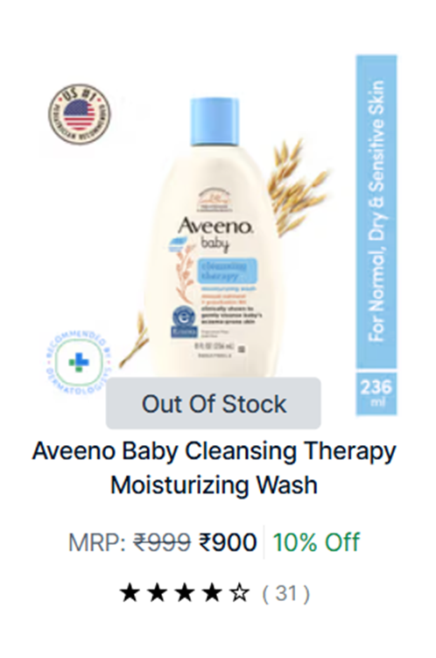
📊 Summary of the Data
Total Products : 3,400+ items
Categories Covered :
  🧴 Beauty Products
  👶 Baby Products
  💪 Health Products
Key Columns :
  Product_Name → Product details
  Original_Price → Listed price
  Final_Price → Discounted price
  Offer_Percentage → Discount offered
  Reviews → Customer engagement
  Tags → Labels like AD, BESTSELLER, Unknown
  Sizes → Variants/shades count
  Stock → Availability (In Stock / Out Of Stock)
  Category → Dataset grouping (added by us)

Slide 8
🧹 Data Cleaning Steps
Removed unwanted symbols (₹, %, MRP:) from price & discount columns.
Converted Original_Price, Final_Price, Offer_Percentage, Sizes into numeric values.
Added a new column Category (Health, Baby, Beauty).
Ensured consistent datatypes for all columns.
Filled missing values:
  Reviews → filled with 0.
  0-fill: Distribution looks natural → most products have very few reviews, some have very high (long tail).
  Offer_Percentage → filled with 0.
  Sizes → filled with 1 (default).
  Tags → filled with "Unknown".

Slide 9
Data Manipulation Steps
Merged 3 datasets (Health, Baby, Beauty) into a single dataframe.
Added a new column Category to identify product type.
Created summary tables using groupby & aggregation (mean, min, max).
Sorted data to identify Top/Bottom products (based on Reviews, Discounts, Prices).
Prepared subsets of data for analysis:
  Top 10 In-Stock products by reviews
  Top 10 Out-of-Stock products by reviews
  Products with maximum price per category

Slide 10
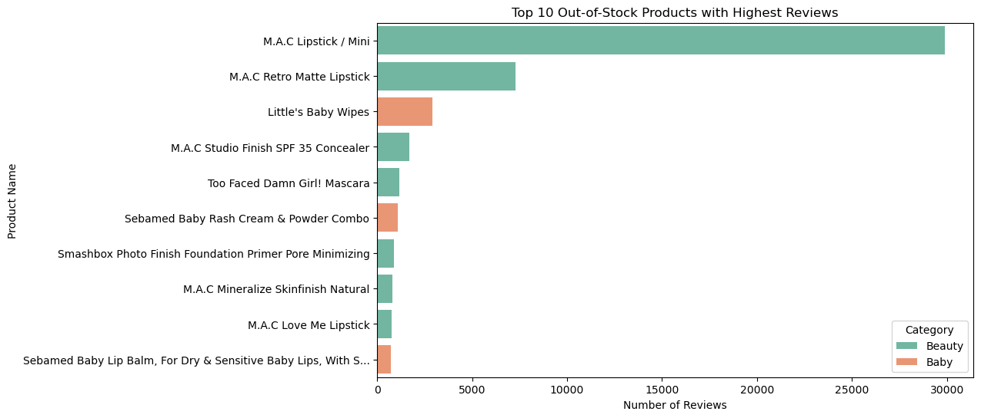
Top 10 Out-of-Stock products by reviews
products that customers want but cannot buy right now.

Slide 11
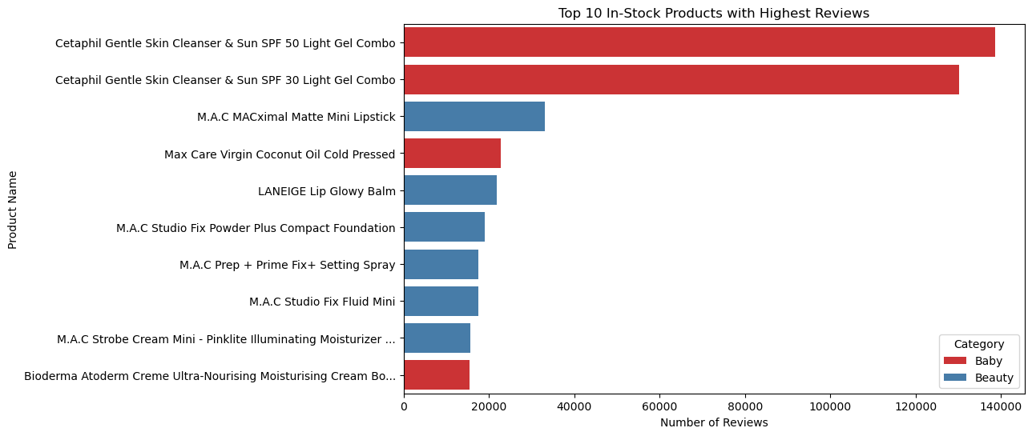
Top 10 In-Stock products by reviews

Slide 12
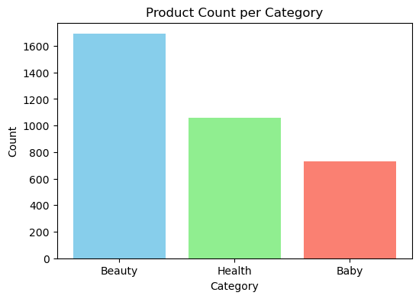
Univariate Analysis Steps
Count how many products belong to each category.
Beauty category has the highest number of products (~1700), indicating a strong market focus.

Slide 13
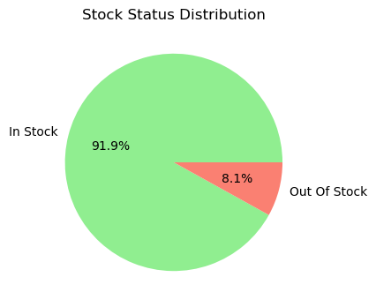
Stock Status Distribution
In Stock vs Out of Stock distribution.
Green slice (91.9%) → In Stock
  The vast majority of products are available.
Red slice (8.1%) → Out of Stock
  A small portion of products are unavailable.
Insights
  Out of Stock (8.1%) → Still notable; could indicate:
    High demand for certain products.
    Supply chain/stocking issues.
    Seasonal trends.

Slide 14
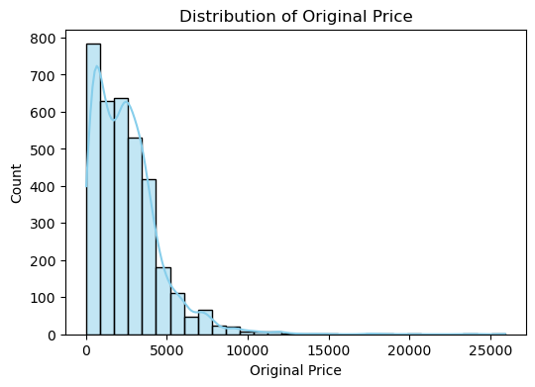
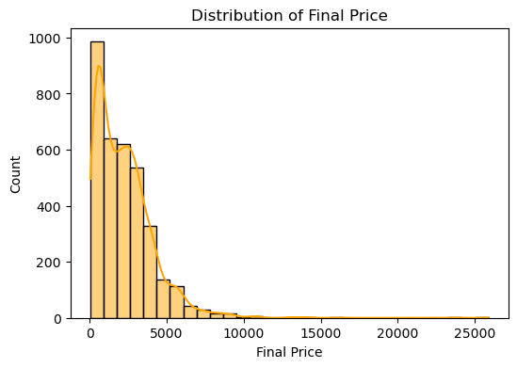
Distribution of Original Price and Final Price
Most products are priced between 0 and 5,000.
Very few products have prices above 10,000, and almost none near 25,000.
The distribution is right-skewed (positively skewed):
  Long tail to the right → a few very expensive items pull the scale higher.
  That’s why the curve slopes down as the price increases.

Slide 15
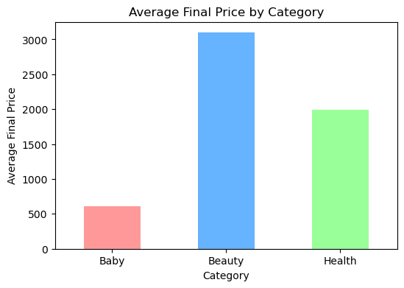
Bivariate Analysis Steps
Average Final Price by Category
This shows which category (Beauty, Baby, Health) is costlier on average.
Baby Category (~600)
  Lowest average final price.
Beauty Category (~3100)
  Highest average final price.
Health Category (~2000)
Summary:
  Baby → Cheapest (mass-market).
  Beauty → Most expensive (premium).
  Health → Middle range (balanced).

Slide 16
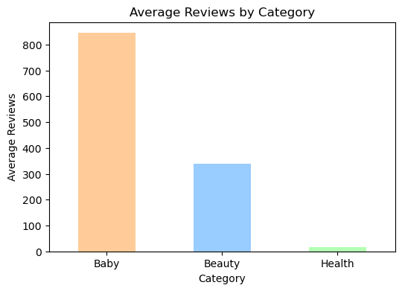
Average Reviews per Category
This will show which category customers engage with most (in terms of reviews).
The Baby category has the highest average reviews, with a count over 800.
The Beauty category is in the middle, with an average
review count around 350.
The Health category has the lowest, with an average
review count close to 20.
This may indicate greater customer engagement and
popularity in the Baby category, or that Baby products
are purchased and reviewed more frequently than those
in the other two categories.

Slide 17
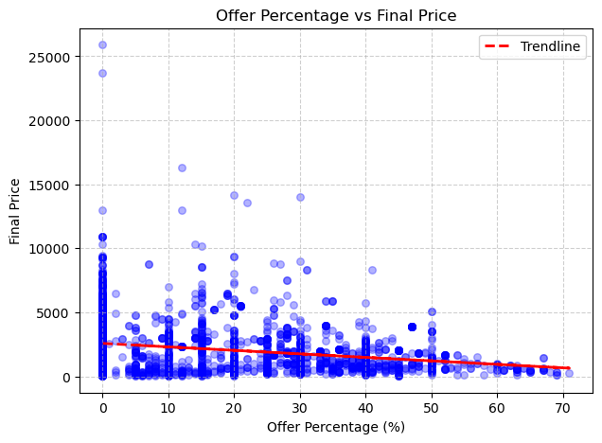
Offer Percentage vs Final Price
Most products cluster at lower offer percentages (0-20%) and lower final prices (below 5,000)
Some products with very high prices have low offer percentages, while high offer percentages almost never result in high prices.
Most products are concentrated at lower discounts
and lower final prices.
Outliers (high price at low discount) are easily
identified using trendline.
The trendline helps to visualize and understand the
negative correlation between discounts and product
prices more clearly.

Slide 18
Conclusion
Majority of products belong to a beauty category.
Discounts significantly impact final prices, showing a strong negative correlation.
Categories differ in average, minimum, and maximum prices → indicating diverse pricing strategies.
Some categories have more out-of-stock products, hinting at higher demand or supply issues.
Products with high reviews often align with popular and trusted brands.
Key Finding:
  Customer demand, pricing, and stock availability are strongly linked to category and discount strategies.

Slide 19
Experience and Challenges
Experience :
  Gained hands-on exposure to web scraping techniques using BeautifulSoup/Requests.
  Understood how to clean and preprocess real-world data (handling missing values, duplicates, inconsistent formats).
  Learned to perform univariate, bivariate, and multivariate analysis to derive business insights.
  Improved skills in visualization (Matplotlib, Seaborn) to present findings effectively.
  Understood the importance of data-driven decision-making through analysis.
Challenges :
  Handling dynamic websites where content loads via JavaScript (needed extra tools/logic).
  Had to deal with data cleaning complexities like removing symbols (₹, %, NaN).
  Encountered inconsistent product information (e.g., missing prices, unknown tags).
  Choosing the right type of visualizations to clearly communicate insights.

Slide 20

THANK YOU

