Slide 1
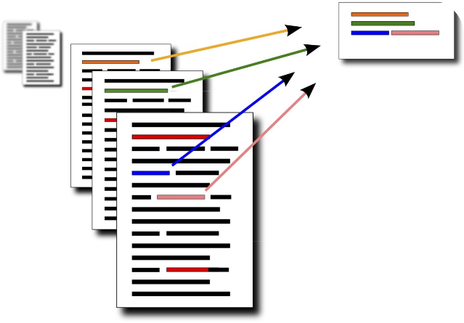

Text Summarizer
Team-1 : Text Summarizer under the guidance of
NARENDRA KUMAR SIR

Slide 2

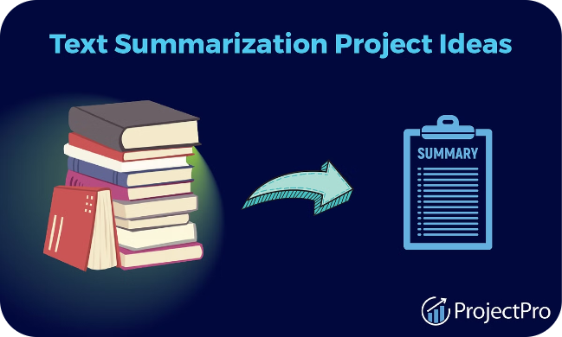
key points:
Team
2. Introduction
3. Dataset
4. Model
5. Approach
6. Preprocessing
7. Extractive Model
8. Rough Scores-Extractive
9. Abstractive Model
10. Rough Scores-Abstractive
11. Interface-Demo
12. Github Repo

Slide 3
Team-1
DHARMAVARAPU SANTHI KUMARI
SAI TEJA ANKAM
HETU PATEL
AVANIGADDA SIVAYYA
VIVEK SADASIVAN

Slide 4


Text summarization is the process of condensing a lengthy
text into a concise and informative summary, capturing the
key points and main ideas. It is a crucial task in natural
language processing with applications in various domains,
from news articles to research papers.Text summarization is
the creation of a short, accurate, and fluent summary of a
longer text document. Automatic text summarization methods
are greatly needed to address the ever-growing amount of text
data available online. This could help to discover relevant
information and to consume relevant information faster.

Slide 5

Dataset
Research:
Considering many datasets and working on them for better
understanding we consider two datasets for model.
Xsum.csv
For Abstractive model we choose Xsum.csv dataset
from Hugging face
train.csv
For Extractive model we choose train.csv dataset from
Cnn/Daily mails

Slide 6
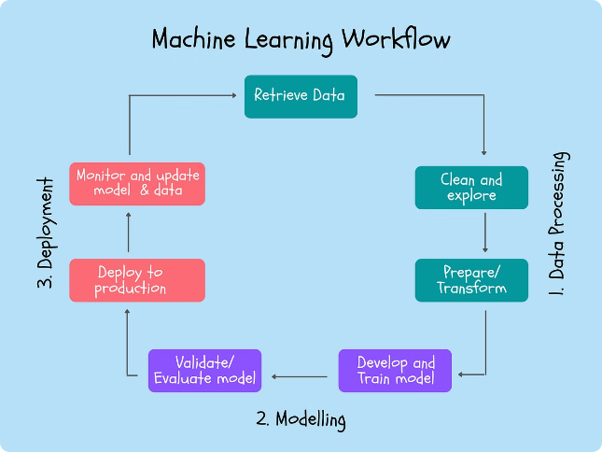
Overview of T5 Model
1.Transformers
The T5 model is built upon the Transformer
architecture,which has revolutionized language understanding and generating tasks.
2.Text-to-Text
T5 is a unified text-to-text model,capable of handling a wide range of natural language processing tasks,including summarization.
3.Pre-training
T5 is pre-trained on a massive corpus of text data,providing it with a strong foundation for fine-tuning on specific tasks.

Slide 7
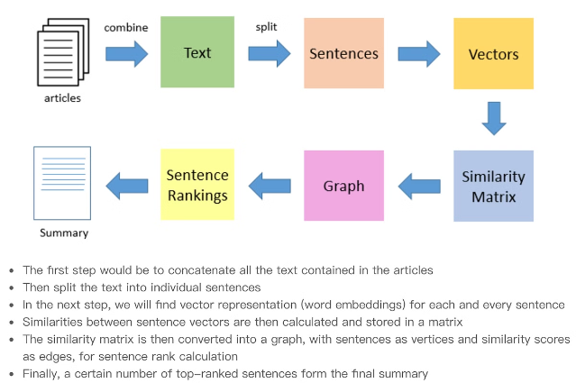
Approach
1
Extract
Our model identifies the
most essential information
in the source text.
2
Compress
The extracted content is
intelligently compressed
to create a concise
summary.
3
Refine
The summary is polished to ensure
coherence, clarity, and readability.

Slide 8

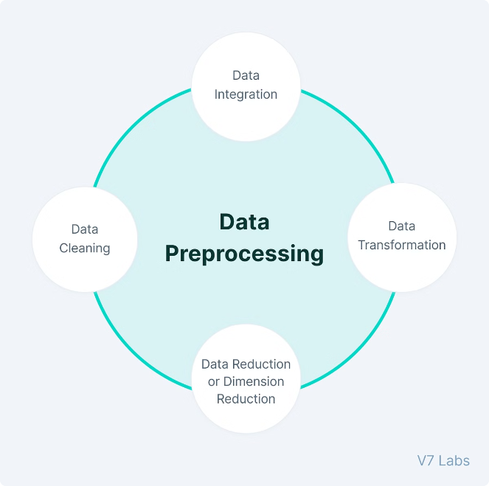



Preprocessing
Cleaning
Removing noise, formatting, and irrelevant content
from the source text.
Tokenization
Breaking down the text into individual words, sentences,
and paragraphs.
Analysis
Applying natural language processing techniques
to understand the text structure and meaning.
Encoding
Converting the preprocessed text into a format suitable
for the summarization model.

Slide 9
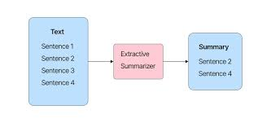
Extractive Summarization
Key Idea:
Extractive summarization selects the most important
sentences or phrases from the original text and
concatenates them to form the summary.
Advantages:
Extractive summaries are typically more faithful to
the original text and easier to generate.
Limitations:
Extractive methods can struggle to capture the
overall meaning and coherence of the text, leading
to less informative summaries

Slide 10
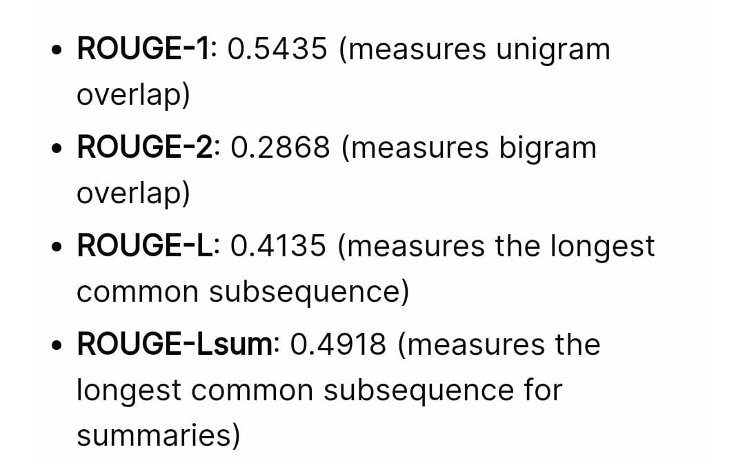
Rough Scores
Rough scores for extractive model

Slide 11
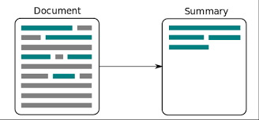
Abstractive Summarization
Generating New Text:Abstractive Summarization
generates new text that captures the main ideas and essence
of the original document,rather than just extracting existing
sentences
Deeper Understanding:Abstractive models require a
deeper understanding of the text to rephrase the content in
a concise and coherent manner.
Challenges:Abstractive summarization is more complex and
prone to generating inaccurate or irrelevant information if
not properly trained.
Potential:Abstractive summarization has the potential to
produce more informative and human-like summaries that
better capture the essence of the original text.
Abstractive Summarizer

Slide 12

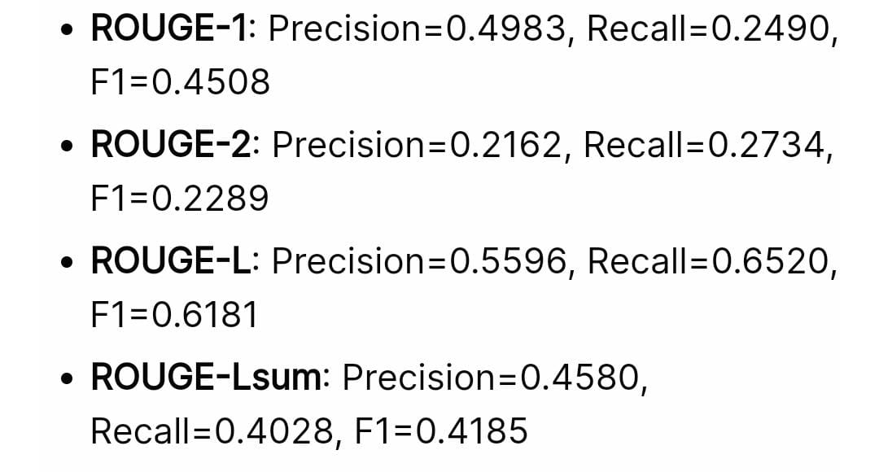
Rough scores
Rough scores of abstractive model

Slide 13
c
Interface
User-Friendly Design
Developing an intuitive and visually appealing interface that makes it easy
for users to input text and view the generated summaries.
Interactive Features
Incorporating interactive elements, such as sliders or dropdown menus, to allow users
to customize the summarization settings and preferences.
Real-Time Summarization
Implementing the text summarization models to provide instant summaries as
users type or upload their input text.

Slide 14
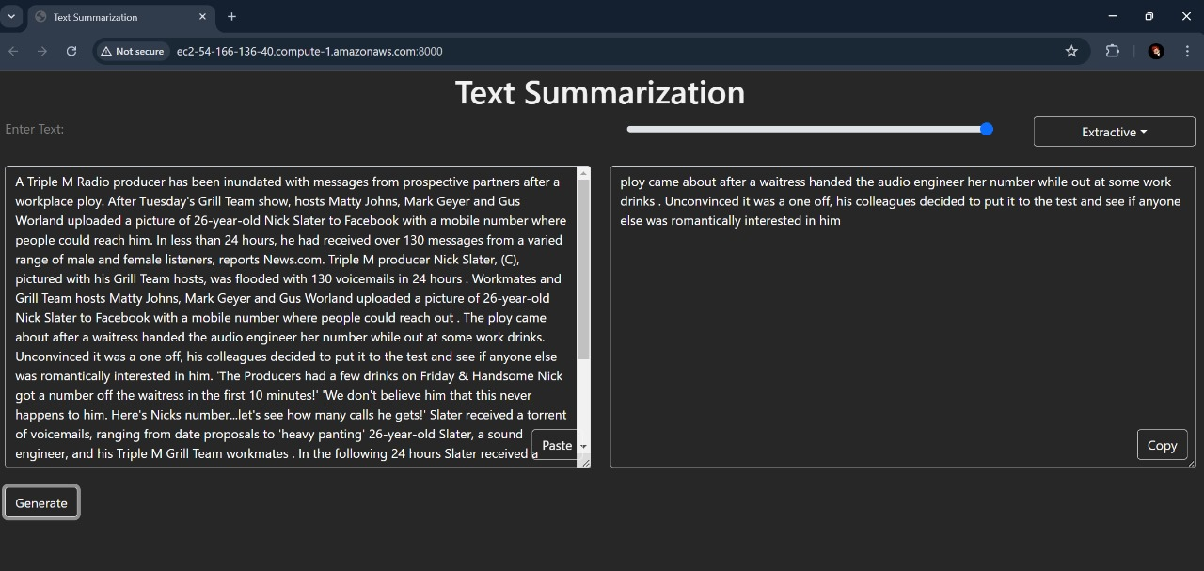

Slide 15
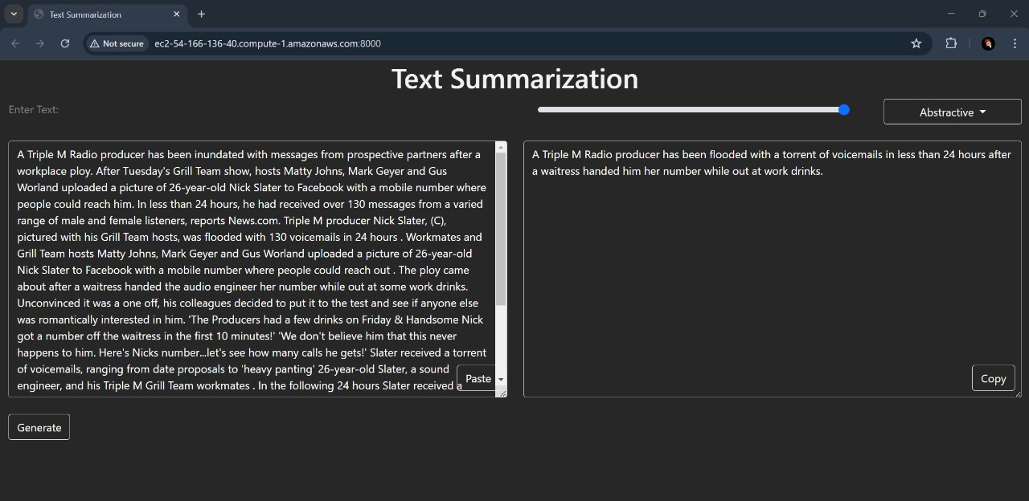

Slide 16


Conclusion
In conclusion, this project has explored
the potential of the T5 model for both
extractive and abstractive text
summarization.
The results demonstrate the strengths and
limitations of each approach,
highlighting the importance of tailoring
the summarization method to the
specific needs of the task and the target
audience.

Slide 17
Github Link
https://github.com/saitej-a/Infosys_text_summarizer

Slide 18
Thank you

