Slide 1

DIGITAL TRIBAL TOURISM PORTAL
TRIBAL TOURISM
A Digital Tribal Tourism & Cultural Discovery Website for Alluri Sitharama Raju District, Andhra Pradesh
PROJECT TEAM MEMBERS
• Rohinilavanya
• Mounika
• Himagiri
• Ruthin Sai
• Udaykiran

Slide 2

01. Project Overview
A modern web platform dedicated to discovering Araku tribal tourism, rich indigenous heritage, local authentic foods, and immersive travel experiences.

Slide 3



Problem Statement
Scattered Info
Low Digital Visibility
Guide Navigation
Details about tourist places, Araku tribal heritage, food, and transport in ASR district are hard to find in a single place.
Authentic cultural experiences like traditional Dhimsa tribal dances and local foods lack dynamic online presence.
Visitors struggle to navigate local tourist spots or easily connect with authorized tribal tour guides online.

Slide 4

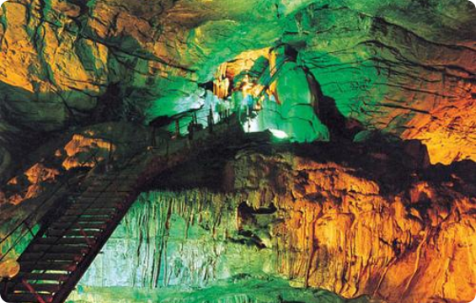
Proposed Solution
Unified Tribal Tourism Portal
A single interactive platform combining tourist spot content, Google Maps, and video highlights.
Interactive booking requests for verified local tribal guides in Araku Valley.
Glassmorphism UI design with smooth navigation and dynamic place cards.
Promotes sustainable ecotourism benefiting local indigenous communities.

Slide 5
Technology Stack Used
Technology / API | Role in Tribal Tourism Platform
HTML | Semantic structure, navigation sidebar, forms, and interactive content containers.
CSS | Glassmorphism visual effects, responsive layout grid, animations, and custom theme.
JavaScript | Dynamic card rendering, destination search logic, form validation, and updates.
Google Maps API | Direct spot search and verified location opening in interactive external tabs.
Media Integration | Embedded video links for tribal dances (Dhimsa), foods, and scenic highlights.

Slide 6
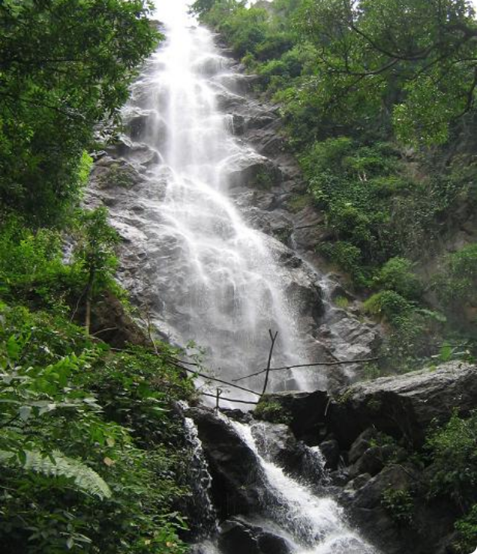
Tourist Destinations
Exploring Scenic Wonders
Dynamic destination cards allow travelers to explore iconic spots across Alluri Sitharama Raju District including Borra Caves, Araku Valley, Ananthagiri Plantations, and Katiki Waterfalls.
Each destination card provides high-resolution visuals, key location highlights, and instant Google Maps directions.

Slide 7
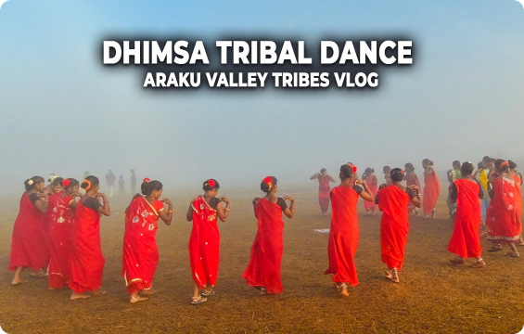
Tribal Culture & Dance
Preserving Indigenous Heritage
Dedicated cultural section showcasing traditional Dhimsa Folk Dance.
Highlights community rituals, tribal musical instruments, and traditional attire.
Integrated video links for immersive digital viewing of community celebrations.
Promotes authentic cultural appreciation for indigenous Eastern Ghats tribes.

Slide 8

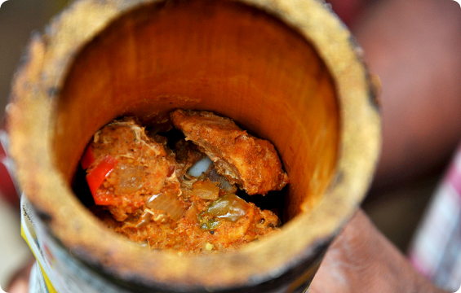
Authentic Tribal Delicacies
Local Culinary Discovery
Features famous local delicacies including organic Araku Bamboo Chicken.
Promotes healthy millet-based traditional tribal recipes and dishes.
Highlights globally renowned organic Araku hill coffee plantations and products.
Connects visitors directly to local tribal food hubs and authentic culinary spots.

Slide 9
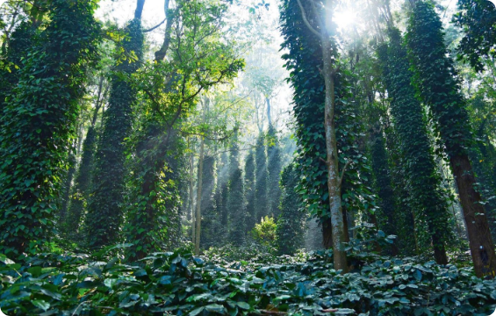
Coffee & Ecotourism
Araku Organic Coffee Heritage
Showcases organic coffee plantations cultivated by indigenous tribal farmers.
Provides location guidance for visiting coffee museums and tasting centers.
Supports local tribal economy through direct sustainable ecotourism promotion.
Integrates eco-friendly travel tips and conservation awareness for visitors.

Slide 10
“Explore nature. Experience culture. Discover Araku tribal tourism.”
Conclusion
Adivasi Tribal Trails successfully transforms tourism information into an interactive, modern digital portal—empowering local tribal communities and guiding tourists effortlessly.
Alluri Sitharama Raju District • Digital Tribal Tourism Project 2026
THANK YOU
CLICK HERE

Slide 11





Image Sources
https://www.trawell.in/admin/images/upload/249844919BorraCaves_Main.jpg
Source: www.trawell.in
http://www.trawell.in/admin/images/upload/249844317KatikiFalls_Main.jpg
Source: www.trawell.in
https://i.ytimg.com/vi/rqPjSvMX9uQ/maxresdefault.jpg
Source: www.youtube.com
http://desitraveler.com/wp-content/uploads/2013/06/Bamboo-Chicken-Araku-in-the-Bamboo.jpg
Source: desitraveler.com
https://images.travelandleisureasia.com/wp-content/uploads/sites/2/2023/05/15224353/Featured-Inside-21-1600x900.jpg
Source: www.travelandleisureasia.com

