Slide 1

Used Car Market Analysis Using Web Scraping & Exploratory Data Analysis

Slide 2

ABOUT ME
NAME : GOLLAPALLI SAI TEJA
BATCH : DS-541
Enrollment ID : 81010517526
PROJECT : CARS24 USED CAR MARKET ANALYSIS
LINKEDIN : https://www.linkedin.com/in/sai-teja-gollapalli/
GITHUB: https://github.com/saiteja-0518

Slide 3
OBJECTIVE OF THE PROJECT
To collect used-car listing data from Cars24 Hyderabad using web scraping techniques.
To build a structured dataset from dynamically loaded website content.
To clean missing, inconsistent and text-formatted values before analysis.
To study brand, fuel type, transmission, year, KM driven and price.
To identify patterns and relationships between price and vehicle attributes.
To summarize findings using visualizations and pivot tables.

Slide 4
TECHNOLOGIES USED
Python — programming and scripting.
Requests — sending HTTP requests
BeautifulSoup — parsing HTML content.
Pandas — data cleaning and analysis.
NumPy — numerical operations.
Matplotlib and Seaborn — data visualization.

Slide 5
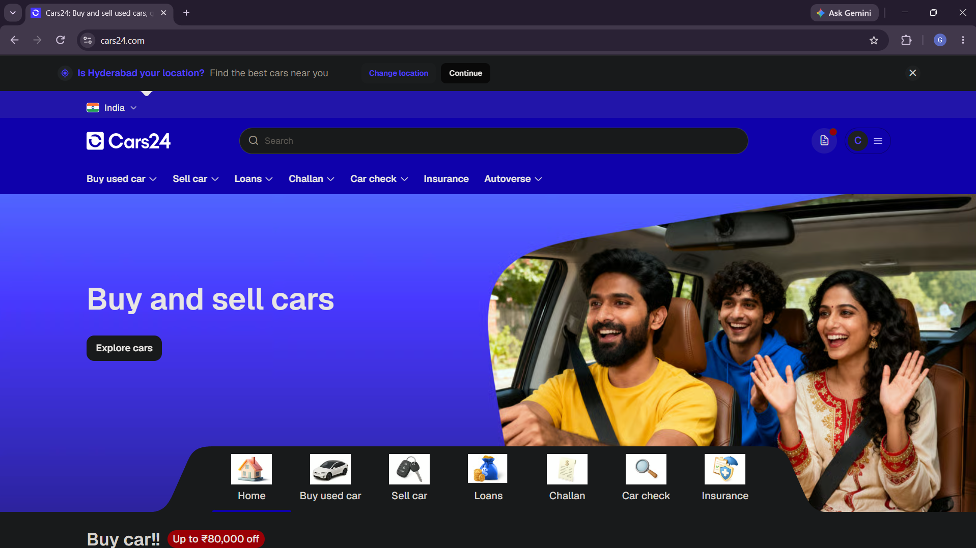

DATA COLLECTION
Source: Cars24 used-car listings for Hyderabad.
Requests and BeautifulSoup were used for HTML parsing.
Since the listings are dynamically loaded, Selenium was
used to load and scroll through the page.
Extracted values were organized into lists and converted
into a Pandas Data Frame.
The collected data was saved for cleaning and analysis.

Slide 6
DATASET OVERVIEW
Initial scraped records: 211
Final cleaned records: 187
Total features: 10
Location: Hyderabad
Columns: Car Name, Year, Brand, Model, Variant, KM Driven, Fuel Type, Transmission, Registration and Price

Slide 7
DATASET FEATURES
• Car Name, Brand, Model and Variant describe the vehicle.
• Year represents the vehicle year.
• KM Driven represents distance travelled.
• Fuel Type and Transmission describe vehicle configuration.
• Registration contains the registration information captured from the listing.
• Price is the listed selling price.
• This is an EDA project, so there is no machine-learning target variable.

Slide 8
DATA CLEANING
• Year had 23 missing values and Model had 13 missing values.
• Rows missing Year or Model were removed because these fields are important for analysis.
• KM Driven values were cleaned by removing commas and converted to integer.
• Price values such as '1.33 lakh' were converted into rupee values.
• Data types were checked before EDA.
• Final dataset: 187 rows × 10 columns.

Slide 9
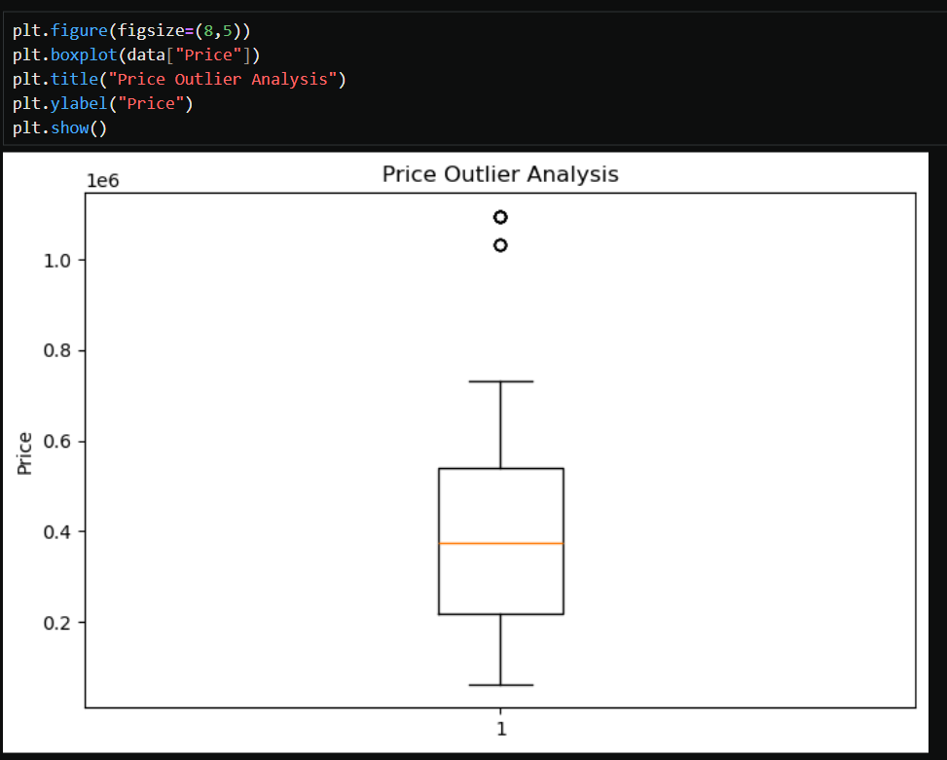
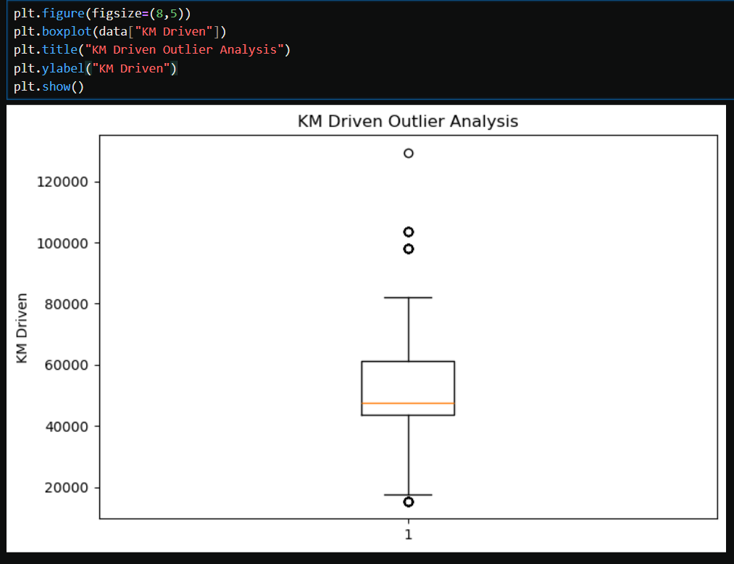
OUTLIER DETECTION
• Potential outliers were examined mainly for Price and KM Driven.
• The IQR method was used to identify extreme observations.
• Boxplots were used to visually inspect the spread.
• Extreme values were interpreted in the context of real used-car listings rather than automatically treating every extreme value as an error.

Slide 10
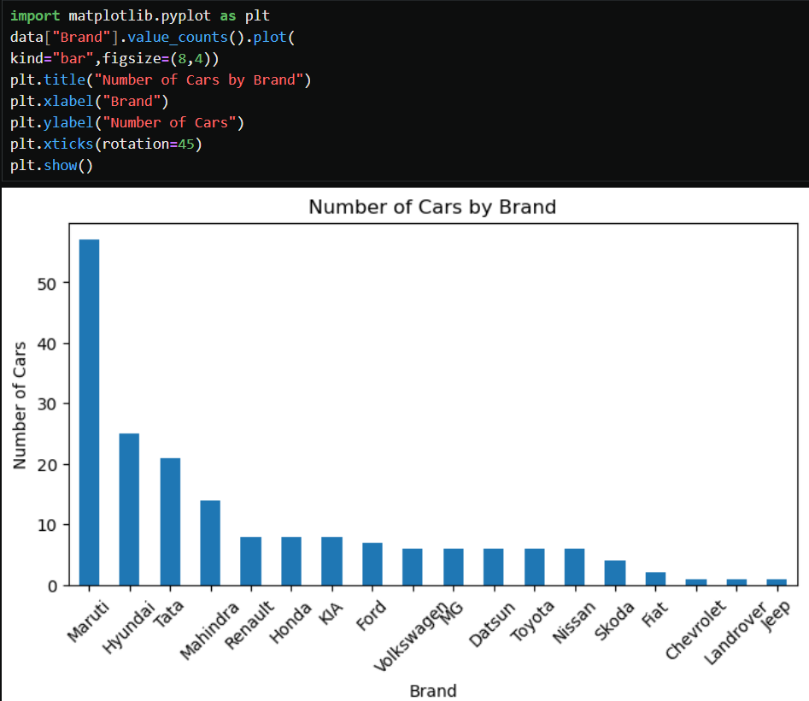
UNIVARIATE ANALYSIS — BRAND
Which brands have the highest representation in the scraped listings?
Maruti has the highest number of listings, followed by Hyundai and Tata. The remaining brands have comparatively fewer listings in the collected dataset.

Slide 11
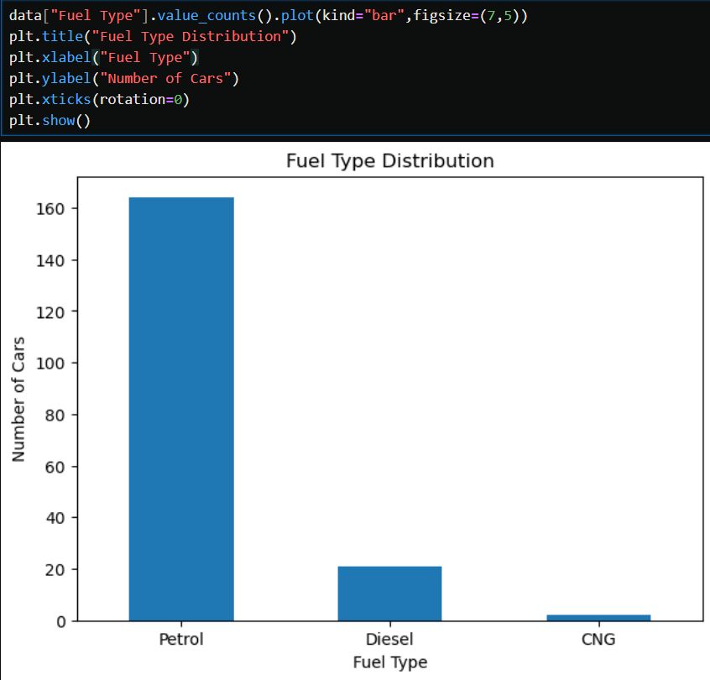
UNIVARIATE ANALYSIS — FUEL TYPE
How are the listings distributed across fuel types?
Petrol cars make up the majority of the listings, followed by Diesel, while CNG cars have very
few listings in the collected dataset.

Slide 12
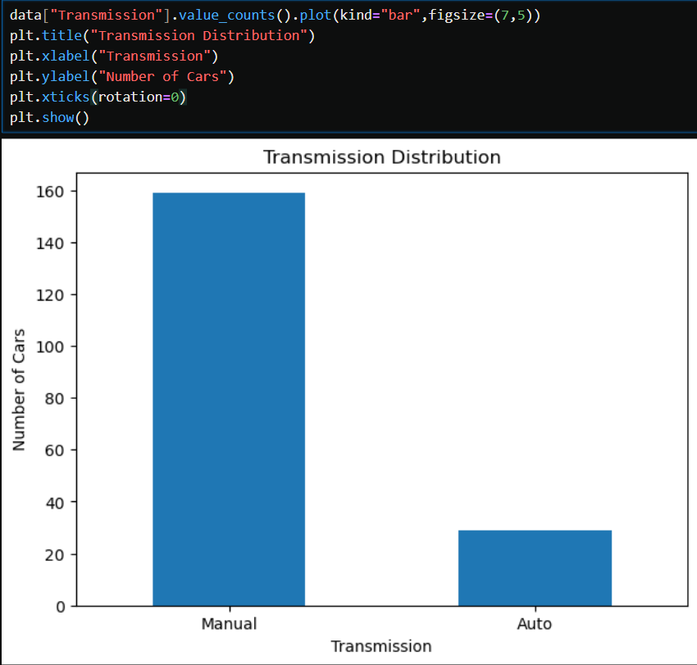
UNIVARIATE ANALYSIS — TRANSMISSION
How are the cars distributed by transmission type?
Manual transmission cars form the majority of the listings, while automatic cars represent a smaller portion of the dataset.

Slide 13
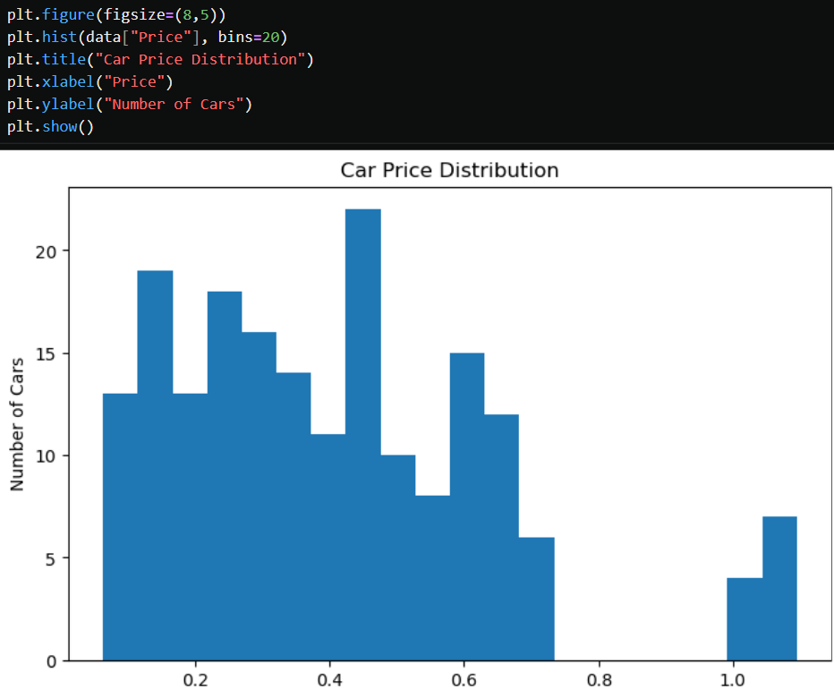
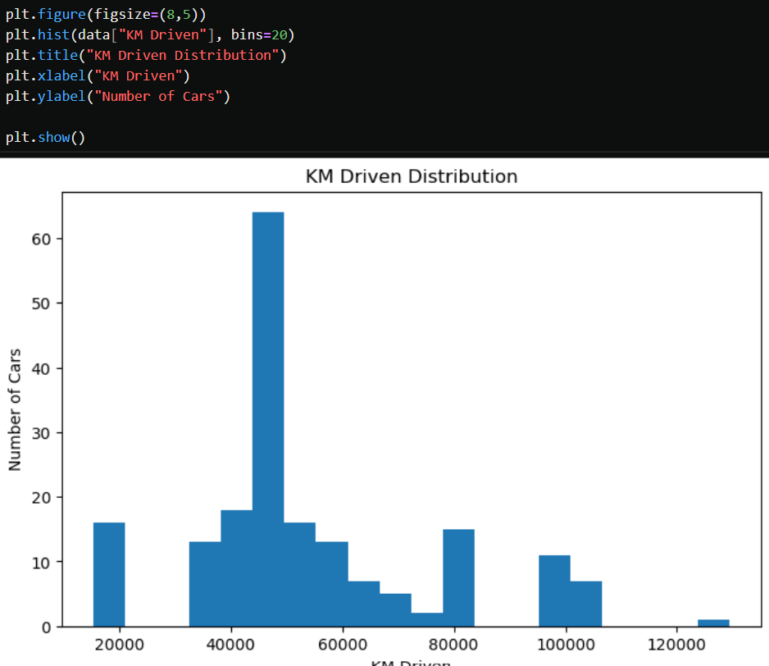
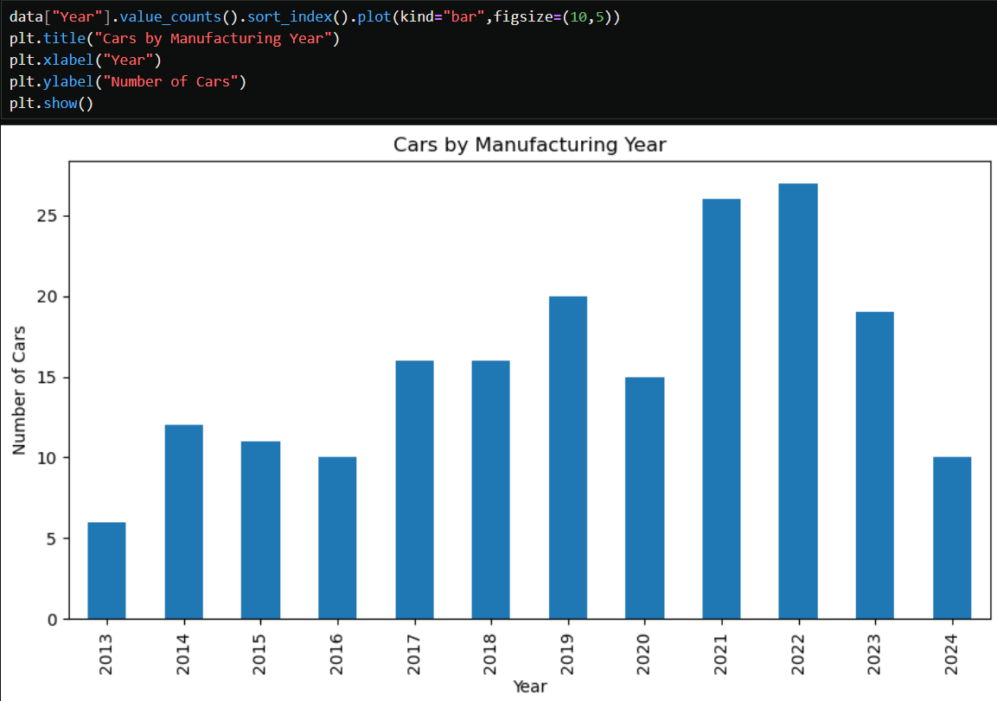
UNIVARIATE ANALYSIS — PRICE, KM & YEAR
How are the main numerical variables distributed?
The price and KM Driven distributions show variation across the listings, while the year-wise chart shows
that the number of listings varies across manufacturing years.

Slide 14
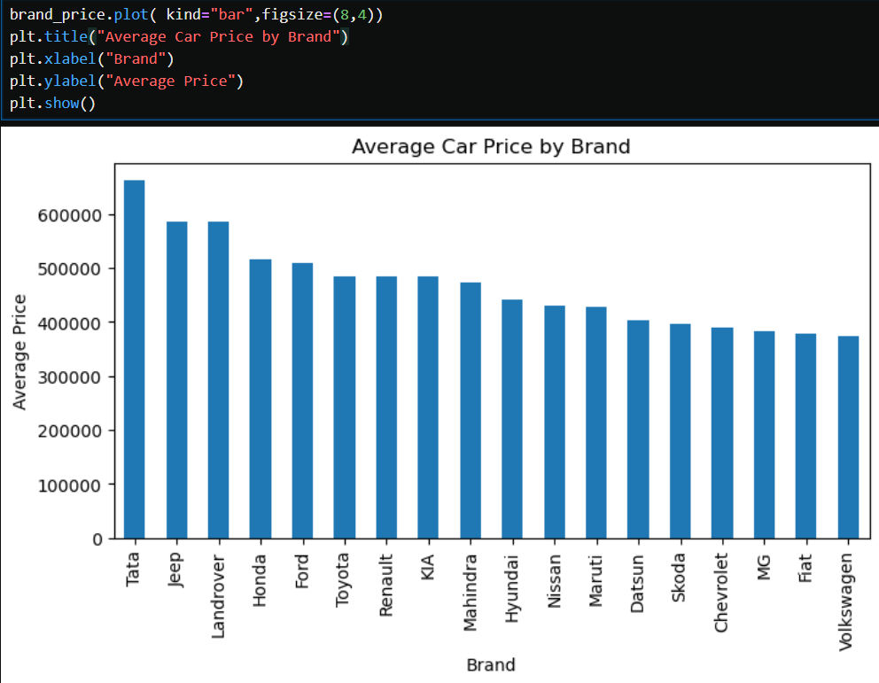
BIVARIATE ANALYSIS — AVERAGE PRICE BY BRAND
How does the average listed price vary across different brands?
The average listed price varies across brands. Tata has the highest average price in the dataset, while Volkswagen has the lowest among the brands shown.

Slide 15
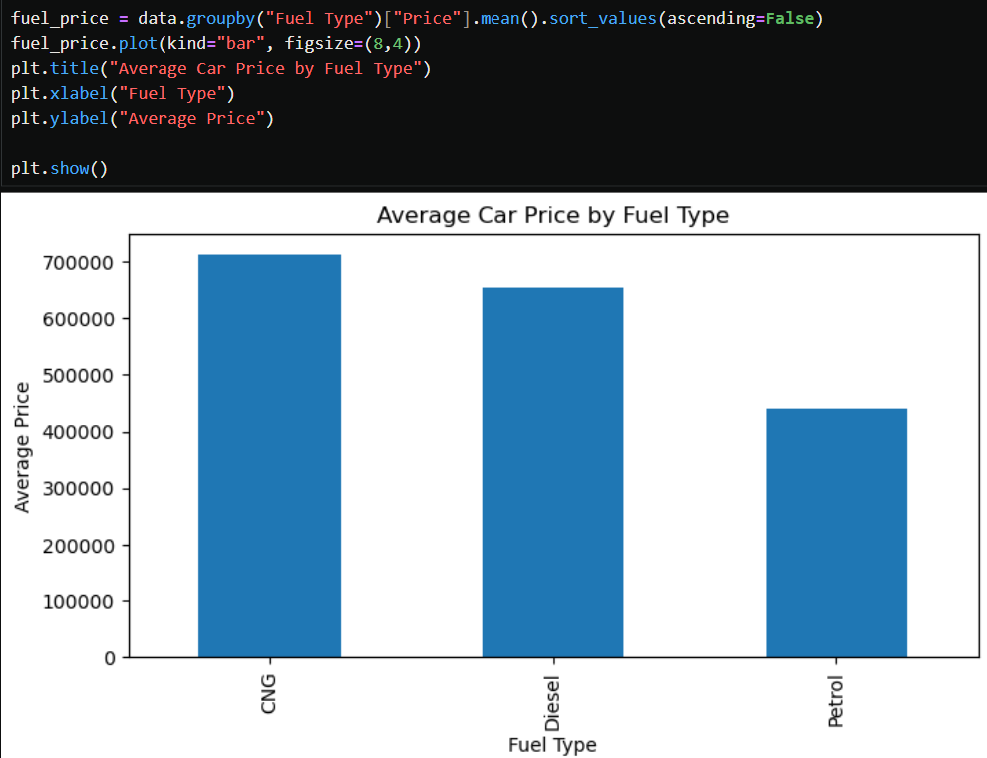
BIVARIATE ANALYSIS — PRICE BY FUEL TYPE
How does average price vary across different fuel types?
The average listed price varies across the different fuel types, with [highest fuel type] having the highest average price and [lowest fuel type] having the lowest average price in the dataset.

Slide 16
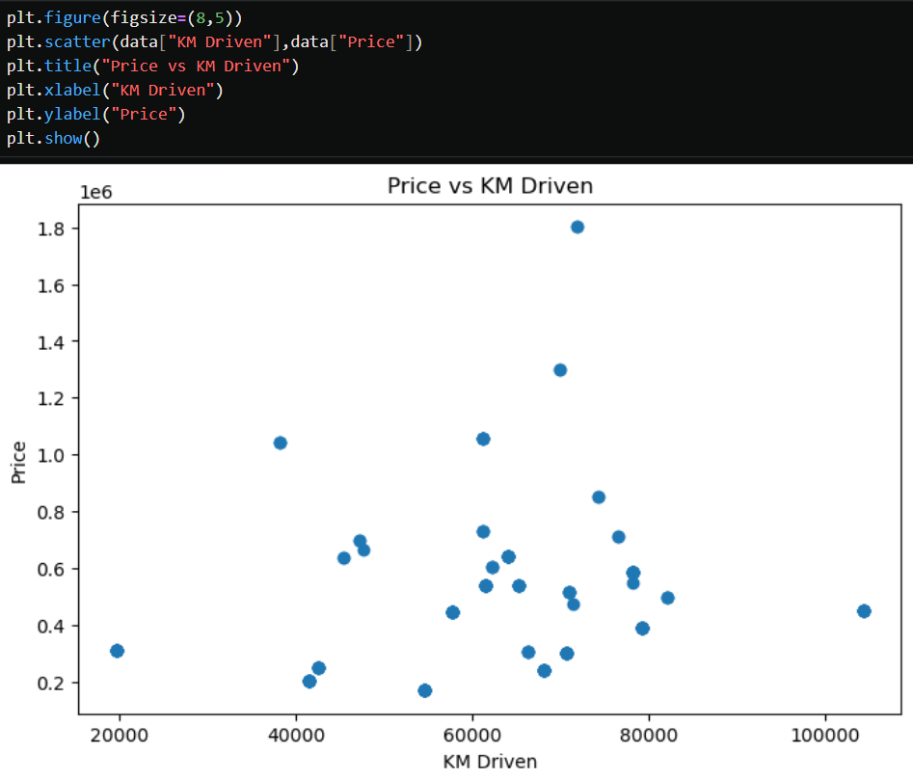
BIVARIATE ANALYSIS — PRICE VS KM DRIVEN
Is there a visible relationship between kilometers driven and listed price?
The scatter plot shows no clear linear relationship between KM Driven and listed Price. Price varies considerably across different levels of kilometers driven.

Slide 17
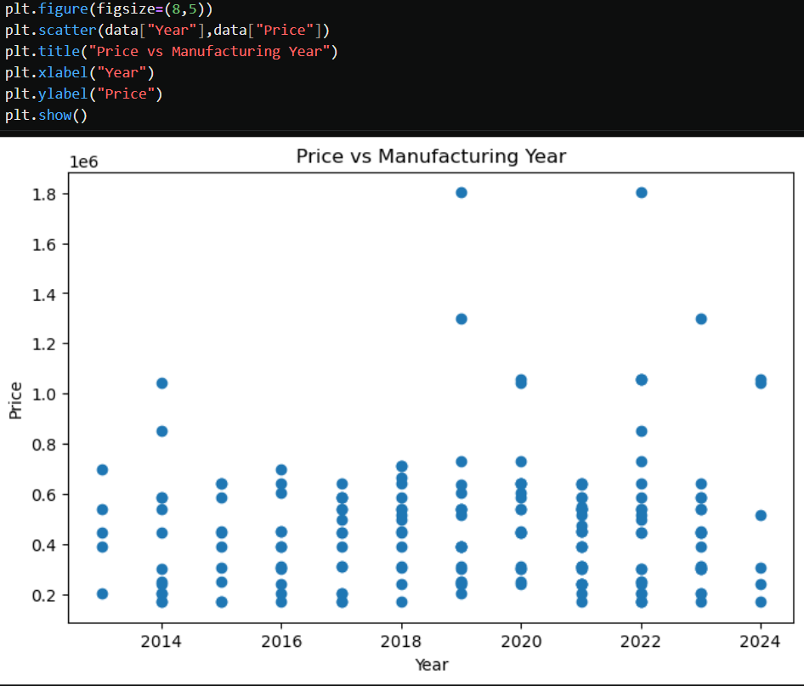
BIVARIATE ANALYSIS — PRICE VS YEAR
How does price vary across vehicle years?
Prices vary considerably across different manufacturing years. Newer vehicles generally show a wider range of prices, while older vehicles are mostly concentrated in the lower price range.

Slide 18
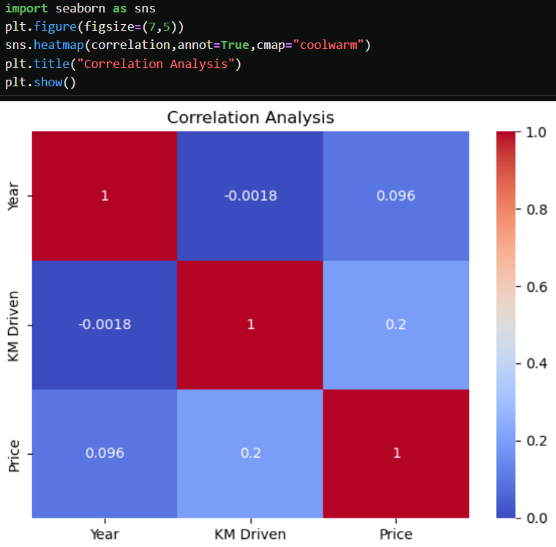
MULTIVARIATE ANALYSIS — CORRELATION HEATMAP
What relationships can be observed among the numerical variables?
Year and KM Driven show almost no correlation (-0.0018).
Year and Price show a very weak positive correlation (0.096).
KM Driven and Price show a weak positive correlation (0.2).

Slide 19
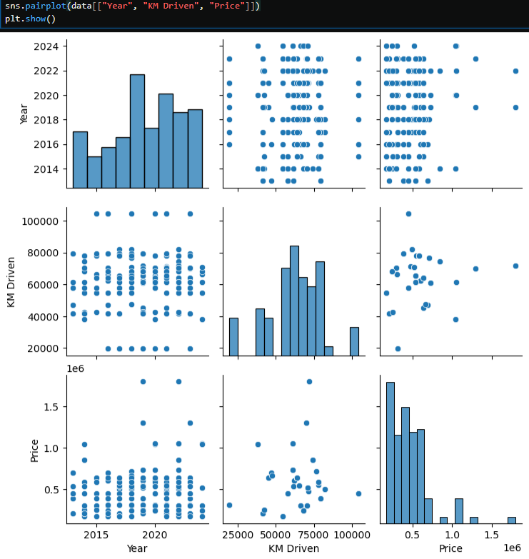
MULTIVARIATE ANALYSIS — COMBINED RELATIONSHIPS
How do price, usage and vehicle categories interact when viewed together?
The pairplot shows the relationships among Year, KM Driven, and Price together.
The Year–Price and Year–KM Driven relationships appear relatively weak.
KM Driven and Price also show considerable scatter, with no strong linear pattern.

Slide 20
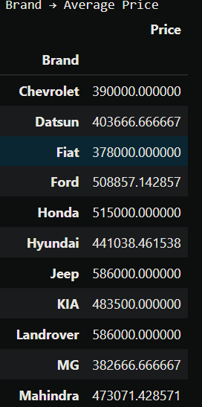
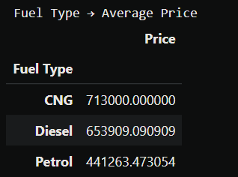
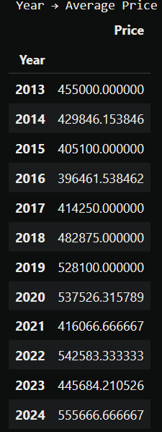
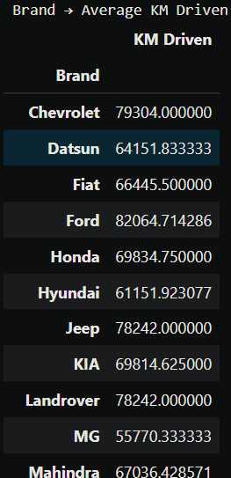
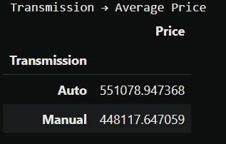
PIVOT TABLES & KEY INSIGHTS
Brand → Average Price
Fuel Type → Average Price
Transmission → Average Price
Year → Average Price
Brand → Average KM Driven
Pivot tables provide category-level summaries that make it easier to compare average prices and average KM driven across different vehicle categories.

Slide 21
KEY FINDINGS
The scraped dataset contained 211 initial listings and 187 records after cleaning.
Brand, fuel type and transmission show different distributions within the collected sample.
Average price varies across brands, fuel types and transmission categories.
Price can be examined against KM Driven and vehicle Year to understand pricing patterns.
Correlation and multivariate analysis provide a broader view of relationships among numerical variables.
All findings should be interpreted as patterns within the Cars24 Hyderabad sample.

Slide 22
CHALLENGES FACED
Web Scraping — Cars24 listings were dynamically rendered, so basic requests did not expose the complete set of visible listings.
Dynamic Content — Selenium was used to load and scroll through the page to collect additional records.
Missing Values — Some scraped records had missing Year or Model values.
Data Cleaning — KM Driven and Price were captured in text formats and required conversion.
Visualization — Different chart types were selected based on the variable type and analysis objective.

Slide 23
CONCLUSION
The project successfully collected used-car listing data from Cars24 Hyderabad using web scraping.
The scraped data was cleaned and transformed into a structured dataset suitable for analysis.
Univariate, bivariate and multivariate analysis were performed to understand data distributions and relationships.
The project provided practical experience in web scraping, Pandas, data cleaning and exploratory data analysis.
Future work can include collecting more listings, comparing additional locations, and building a price-prediction model.
THANK YOU

