Slide 1

Semantic elements of HTML in React

Slide 2

HTML5 Semantics.?
HTML5 Semantics refers to the use of specific tags like <header>, <footer>, <nav>, <article>, <section>, etc., to provide clearer structure and meaning to web content. This improves accessibility, and SEO, and facilitates better understanding by both humans and machines.

Slide 3

Semantic elements
<article>
<aside>
<figcaption>
<figure>
<footer>
<header>
<main>
<nav>
<section>
Semantic elements have meaningful names that tell about the type of content. For example header, footer, table, … etc. HTML5 introduces many semantic elements as mentioned below which make the code easier to write and understand for the developer as well as instruct the browser on how to treat them.

Slide 4

The <article> tag specifies independent, self-contained content. An article should make sense on its own and it should be possible to distribute it independently from the rest of the site.
The <aside> tag defines some content aside from the content it is placed in. The aside content should be indirectly related to the surrounding content.
The <figcaption> tag defines a caption for a <figure> element.
The <figure> tag specifies self-contained content, like illustrations, diagrams, photos, code listings, etc.

Slide 5
The <footer> tag is an essential element for structuring the footer section of an HTML document. It helps organize content like author information, copyright notices, and contact details.
The <header> element represents a container for introductory content or a set of navigational links. A <header> element typically contains: one or more heading elements (<h1> - <h6>) logo or icon. authorship information.
The HTML <main> Tag defines a document’s main content, which should be unique.

Slide 6
The Section tag defines the section of documents such as chapters, headers, footers, or any other sections. The section tag divides the content into sections and subsections.
The HTML <main> Tag defines a document’s main content, which should be unique. It excludes content like sidebars, navigation, logos, and copyright info, ensuring unique document-specific material within.

Slide 7

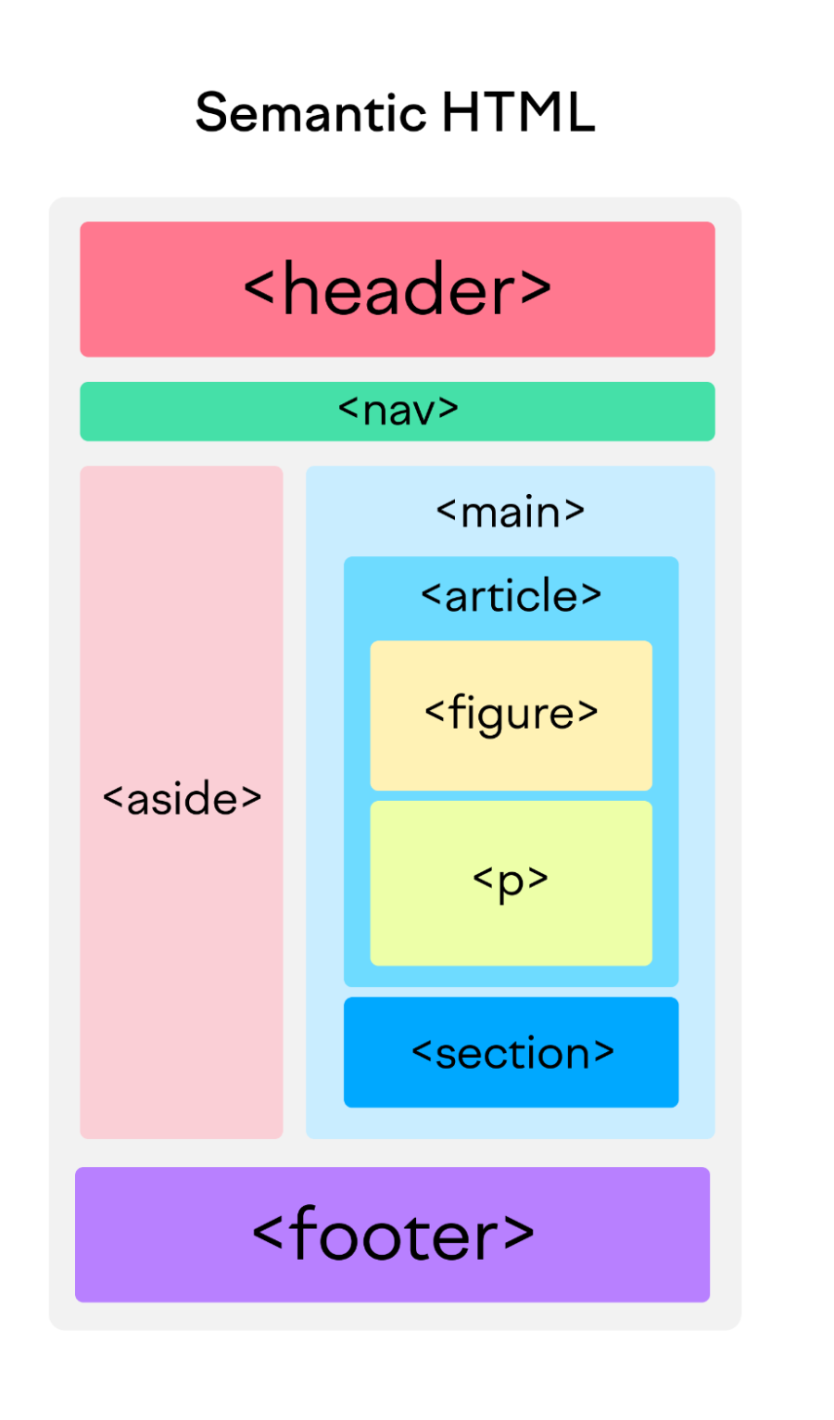

Slide 8
Advantages
Improved Accessibility: Semantic elements provide meaningful information to assistive technologies like screen readers. For example, using <header>, <nav>, and <main> tags helps screen readers understand the structure of the page, making the content more accessible to users with disabilities.
Better SEO: Search engines use semantic tags to understand the content and structure of a webpage. Elements like <article>, <section>, and <aside> help search engines categorize and prioritize content, potentially improving the page's ranking.
Enhanced Readability and Maintainability: Code that uses semantic elements is easier to read and understand, making it simpler for developers to work on and maintain. This is especially useful when collaborating with others or revisiting code after some time.
Consistent Structure: Semantic elements promote a consistent structure across web pages, leading to a more predictable and user-friendly experience. This consistency also helps in applying styles uniformly across different sections of a site.

Slide 9

Thank you.!

