Slide 1


AI-BASED FRAUD MANAGEMENT SYSTEM FOR UID AADHAAR
AN AI-POWERED FRAUD DETECTION SYSTEM DESIGNED TO ENHANCE THE SECURITY OF THE UID AADHAAR VERIFICATION PROCESS
Presented by: Interns Team

Slide 2

OVERVIEW OF THE PROJECT
Developed an advanced fraud detection system leveraging OCR technology. Integrated classification, detection, and OCR models to identify fraudulent Aadhaar documents with high accuracy. The system automates document verification, ensuring security and efficiency in identity validation.
A team of interns developing an OCR-based fraud detection system for UID Aadhaar, integrating classification and detection models for secure and efficient identity verification.

Slide 3




IMPORTANCE OF FRAUD DETECTION IN AADHAAR VERIFICATION
01
Protection Against Identity Theft
Effective fraud detection mechanisms safeguard individuals from unauthorized access to their personal information and prevent identity theft in the Aadhaar system.
02
Maintaining Public Trust
Robust fraud detection enhances public confidence in the Aadhaar system, ensuring that citizens feel secure in sharing their biometric data for essential services.
03
Compliance with Regulations
Implementing fraud detection aligns with legal and ethical standards, ensuring that personal data is handled responsibly and in accordance with privacy laws.

Slide 4


GOALS AND OBJECTIVES
PROBLEM STATEMENT
Our goal is to enhance the security and reliability of UID Aadhaar verification by developing an advanced fraud detection system. Using OCR, classification, and detection models, we aim to automate document verification, prevent identity fraud, and ensure a seamless and trustworthy authentication process.
Fraudulent UID Aadhaar documents pose security risks, and manual verification is slow and error-prone. An AI-driven solution is needed to automate detection, classification, and verification, ensuring accurate and efficient fraud prevention

Slide 5




AI Models
SOLUTIONS
An AI-powered fraud detection system for UID Aadhaar using OCR, classification, and detection models. This system automates document verification, accurately identifying fraudulent documents to enhance security, reduce manual effort, and improve the efficiency of identity authentication.
Efficiency
Convenient Security

Slide 6
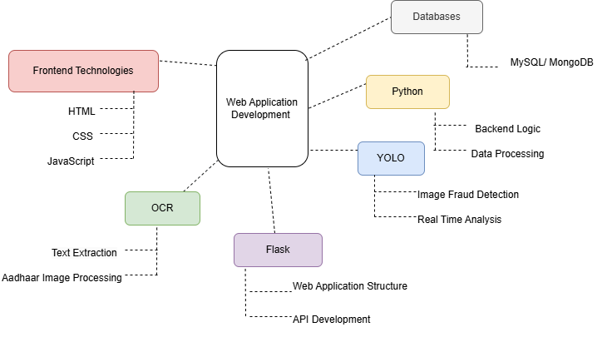
TECH STACK USED

Slide 7
Generating output from input has the following steps:
01
Document Classification
The model identifies whether the document is an Aadhaar card. If it's not, the process ends; if it is, it moves to the next step.
02
Image Detection
PROJECT
WORKFLOW
The detection model scans the Aadhaar document for any signs of tampering or anomalies.
03
OCR Processing
Text is extracted from the document using OCR for comparison and verification.
04
Matching & Output
The extracted data is compared to verify authenticity, and the results, including matching scores, are provided in an Excel file.

Slide 8



UPLOADING FILES
Users provide a ZIP file with Aadhaar images and an Excel file with metadata. The system classifies the images, detects tampering, and extracts text via OCR. It compares the extracted data with the metadata and generates an output Excel file with matching scores and fraud detection results.
ZIP Files
Excel Files

Slide 9
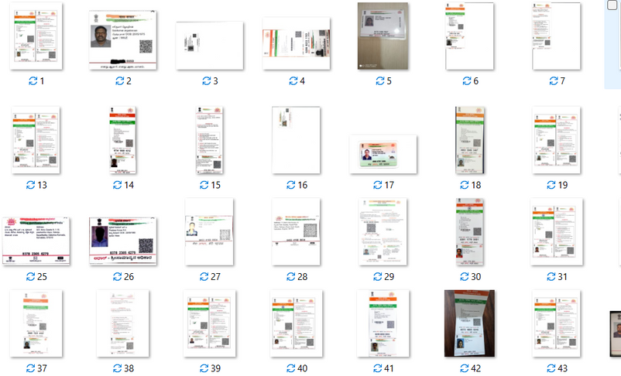
DATASET USED FOR TRAINING THE MODELS
The unstructured data containing blurry, low-resolution, distorted, poorly lit aadhar and non-aadhar images is converted into structured data by applying image preprocessing steps such as resizing, grayscaling, normalization, contrast enhancement, etc.
The structured data is then used to train the classification, detection and the OCR model.
Img: Sample dataset of Structured data

Slide 10

PROCESSING AADHAAR DATA
Image Upload
Users upload Aadhar images for processing
OCR technology extracts key details (Name, UID, DOB, Address) from uploaded Aadhaar images
OCR Extraction
Data Matching
Extracted details are compared with metadata from the Excel database
Any mismatch or discrepancy is flagged for verification
Fraud Detection

Slide 11

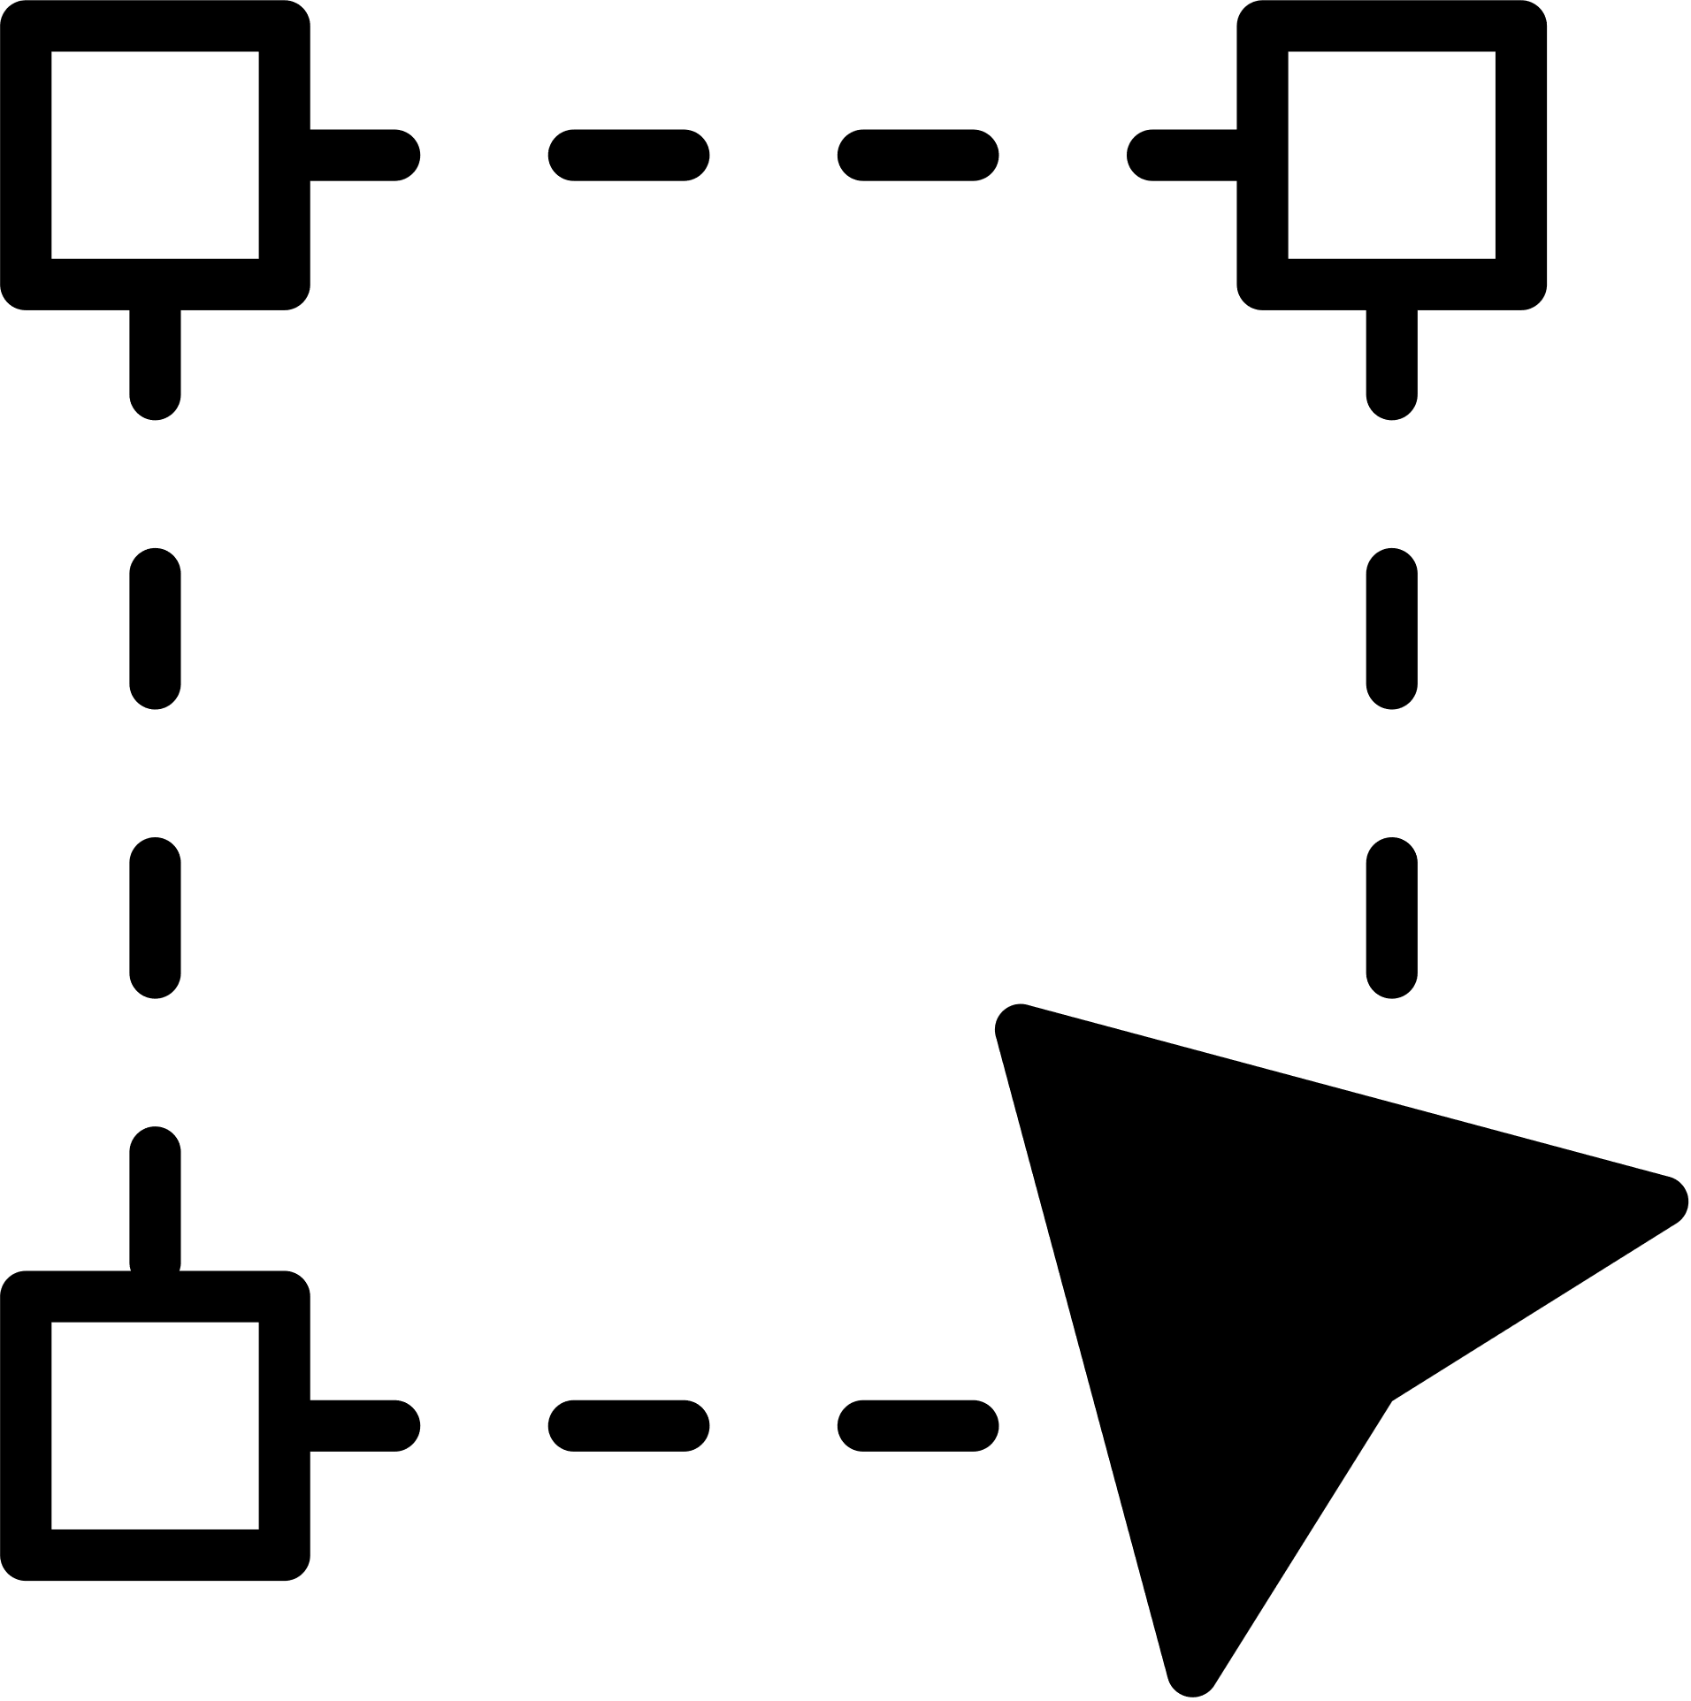


FRAUD DETECTION USING YOLO
DETECT TAMPERED AREAS
HIGHLIGHT FORGED REGIONS
IDENTIFY FRAUD
ENHANCE SECURITY
YOLO model detects tampered areas on Aadhaar images.
YOLO model highlights forged or altered regions for detailed analysis.
YOLO model identifies fraud by analyzing and manipulation patterns.
YOLO model enhances security and accuracy in Aadhaar verification.

Slide 12



DISPLAYING RESULTS
The user uploads Aadhaar images and an Excel file, which are processed using classification, detection, and OCR models to extract and verify details. The backend compares the data, generates match scores, provides JSON results for the frontend, and allows users to download the final results.xlsx file.
Processing Aadhaar Data
The user uploads Aadhaar images and an Excel file, which are processed using classification, detection, and OCR models to extract and verify details.
Generate Results
Extracted data is compared with the Excel file, match scores are calculated, and a `results.xlsx` file is created with remarks like "All matched" or "UID mismatch."
Displaying Results
The backend returns JSON results for the frontend to display, and users can download the full results via the `/download` endpoint.

Slide 13

CHALLENGES FACED
Data Collection: Limited publicly available Aadhaar datasets.
Model Optimization: Fine-tuning YOLO for precise fraud detection.
OCR Accuracy: Managing variations in font styles and text clarity.

Slide 14


FUTURE ENHANCEMENTS
Enhanced OCR Accuracy & Multilingual Support
Web-Based Data Visualisation
Web-Based Dashboard
API & Security Enhancements
AI-Driven Data Validation & Fraud Detection
Real Time Alert System
Cloud Integration & Secure Storage
Deep Learning-Based Forgery Detection

Slide 15

Government Agencies – A graphic of Aadhaar authentication or a government security system.
Banking & Financial Sector – A digital payment authentication image or a fraud detection alert in banking.
INTEGRATION POSSIBILITES
E-KYC Providers – A verification process illustration with Aadhaar integration.
Corporate HR Systems – An employee ID verification process image, possibly showing Aadhaar-based authentication.

Slide 16
THANK YOU

