Slide 1

CS5200 - Database Theory and Application
Title : Homegrown Grocery System

Slide 2
Team Members
Praneeth Teja Jikalapally
700765534 - Venkata Sai Teja Mothukuri
700781569 - Shashank Reddy Dasari
700761015 - Sai Revanth Arigela
700777009 - Srinivas Reddy Pittu

Slide 3
PURPOSE OF THE DATABASE
The purpose of the database is to serve as the backbone of the grocery inventory management system.
It ensures real time data management, avoiding redundancy, and facilitates accurate inventory tracking and transaction management.
The database is essential for maintaining consistency and operational efficiency.

Slide 4
DATABASE OBJECTIVES
- Manage user authentication and authorization.
- Store and update product information.
- Track orders and order details.
- Support concurrent operations ensuring data integrity.

Slide 5
IDENTIFYING THE USERS AND THEIR NEEDS
Users:
1. Admins: Full access to manage inventory, orders, and users.
2. Staff: Limited access for viewing products and assisting customers.
Functions:
- Admins manage products, orders, and user roles.
- Staff view product information and assist in operations.

Slide 6
Tech Stack
PHP
A widely-used open-source scripting language, especially suited for web development.
Handles server-side logic, processing user input, interacting with the database, and generating HTML.
performance improvements, type hinting, and other modern features.
The platform likely uses PHP frameworks or libraries to structure the code, promote reusability, and enhance security (though not specified, this is a common practice).
MySQL
A relational database management system (RDBMS) used to store and manage the application's data.Stores information about users, products, orders, categoriesetc.. which includes performance enhancements, JSON support, and security updates.
The database schema (defined in nestco_homegrown.sql) ensures data integrity and efficient data retrieval.
Apache
A popular web server that processes HTTP requests and delivers web pages to users.
Acts as the interface between the user's browser and the PHP application.
Handles routing requests to the appropriate PHP scripts.
Configuration files determine how the server handles requests, manages virtual hosts, and applies security settings.
XAMPP/WAMP/MAMP
These are local development environments that bundle Apache, MySQL, and PHP into a single package.
XAMPP (Cross-Platform), WAMP (Windows), and MAMP (macOS) provide an easy way to set up a local server for testing and development.
They include tools like phpMyAdmin for database management.

Slide 7
INPUT DATA & STORED INFORMATION
Input Data:
- User credentials and roles.
- Product details: Name, category, price, stock.
- Orders and order items.
Stored Information:
- User details.
- Product inventory.
- Transaction and order data.

Slide 8
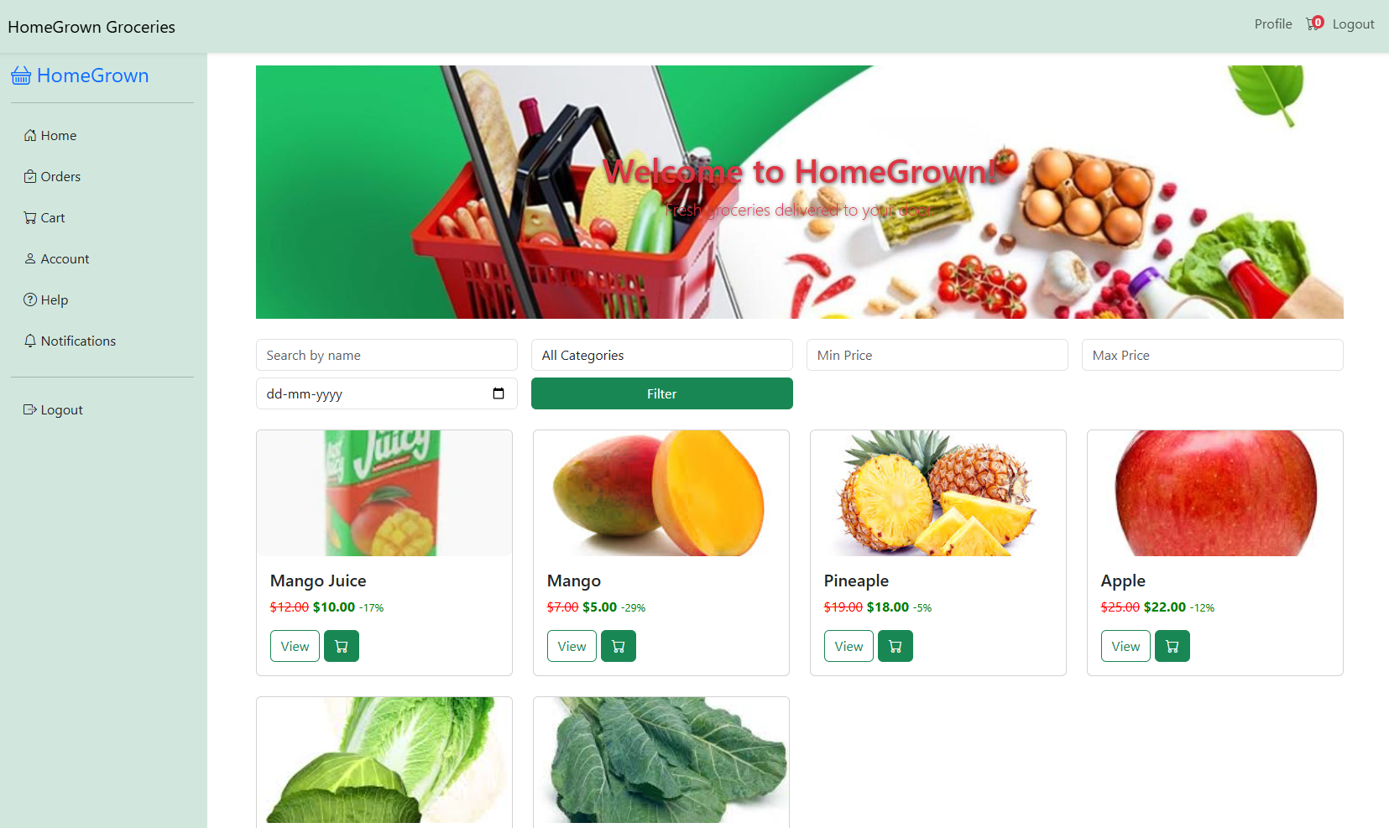
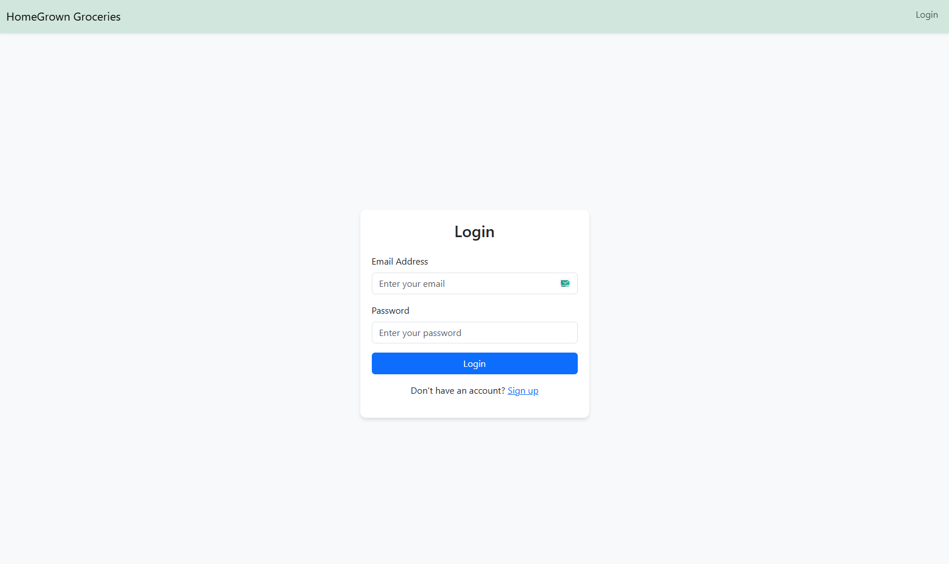
User Interface

Slide 9
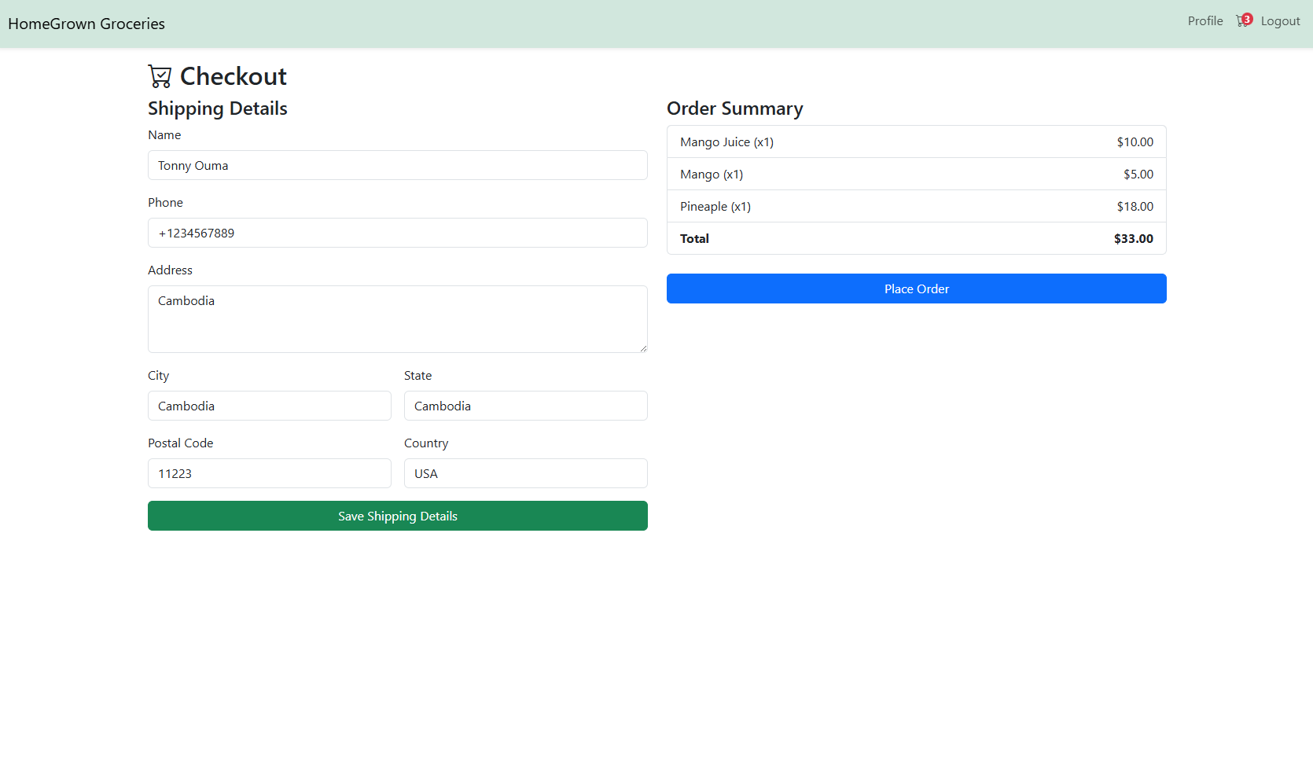
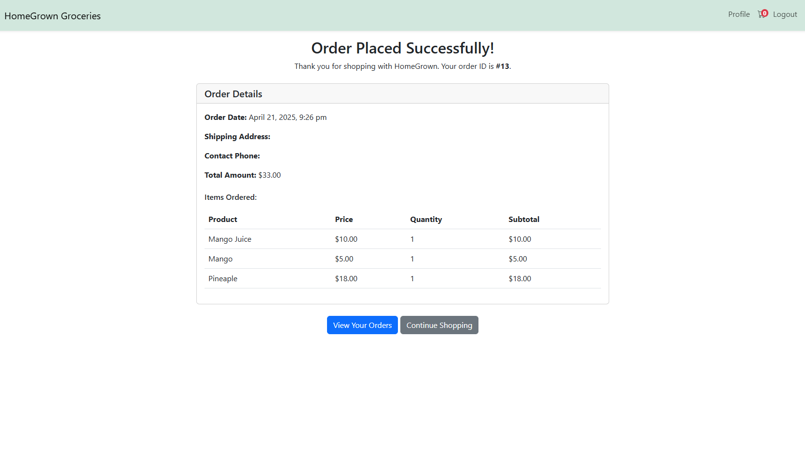

Slide 10
Database Tables
Users
Stores user information and authentication details
Manages user roles (admin/customer)
Products
Contains product information
Manages inventory and pricing
Orders
Tracks customer orders
Maintains order status and total amount
Links to user and shipping information
OrderDetails
Stores individual items in each order
Links products to orders
Maintains quantity and price information
HelpTickets
Manages customer support tickets
Links tickets to orders and users
Tracks ticket status and responses
Categories
Organizes products into categories
Enables efficient product browsing

Slide 11
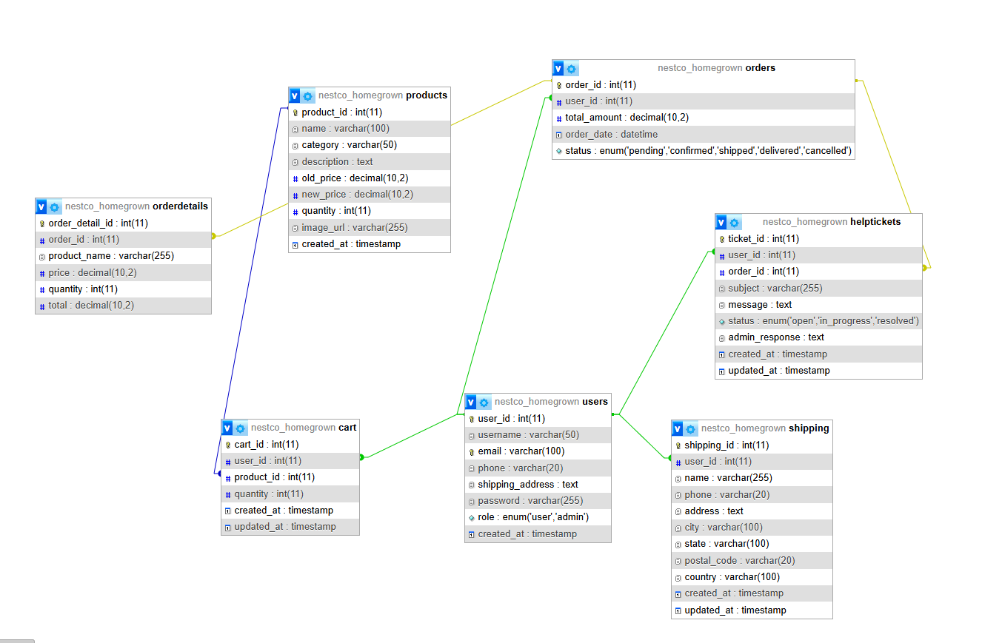
DATABASE DESGIN

Slide 12
ROLES FOR GROUP MEMBERS
1. Schema Designer: Creates The Database Schema And Er Diagram.
2. Backend Developer: Implements Crud Operations And Transaction Management.
3. Frontend Developer: Designs The Gui With Bootstrap.
4. Security Specialist: Ensures Secure Password Hashing And Role-Based Access.
5. Tester: Tests Concurrency And System Functionality.

Slide 13
CRUD OPERATIONS
- CREATE: add new products and orders.
- READ: view products and order details.
- UPDATE: modify product or order details
- DELETE: remove obsolete data.
- Crud Operations Are Restricted To Admins For Security

Slide 14
SECURITY MEASURES
Password Hashing: Secure Storage Using Hashing Algorithms
Role-Based Access Control: Limits Sensitive Actions To Admins
Input Validation: Prevents Sql Injection And Other Attacks.
Session Management: Maintains Secure User Sessions.
.

Slide 15



