Slide 1
Prediction of Spam Email using Machine Learning Classification Algorithm Domain : Machine Learning & Deep Learning
Group Members
P.SAI TEJA (177R1A05M2)
CH.AMITH (177R1A05K3)
Under the guidance of:
Dr.K.SRUJAN RAJU
-Professor & HOD
(Department of CSE)

Slide 2
Agenda
Abstract
Existing System
Disadvantages/Limitations of Existing System
Proposed System
Advantages of Proposed System
Hardware & Software Requirements
Project Architecture
Modules
UML Diagrams
Output(Screenshot)
Execution
Conclusion

Slide 3
Abstract
In recent times, unwanted commercial bulk emails called spam has become a huge problem on the internet. Spam prevents the user from making full and good use of time, storage capacity and network bandwidth. So,this problem can be solved by using Machine learning methods which can successfully detect and filter spam emails. We present a systematic review of some of the popular machine learning based email spam filtering approaches. Our review covers survey of the important concepts, attempts, efficiency, and the research trend in spam filtering. Our review compares the strengths and drawbacks of existing machine learning approaches and the open research problems in spam filtering.

Slide 4
Existing System
The person sending the spam messages is referred to as the spammer. Such a person gathers email addresses from different websites, chatrooms, and viruses. Spam prevents the user from making full and good use of time, storage capacity and network bandwidth. The huge volume of spam mails flowing through the computer networks have destructive effects on the memory space of email servers, communication bandwidth, CPU power and user time. In all existing systems does not find the spam mails effectively. It is also resulted to untold financial loss to many users.

Slide 5
Disadvantages/Limitations of Existing System
Test and Prediction accuracy is low.
Less Secure
Loss of data

Slide 6
Proposed System
In this project we are giving brief review on various machine learning algorithms such as SVM, Random Forest, Decision Tree, CNN, KNN, MLP to predict spam emails. There are various SPAM datasets such as SPAM ARCHIVE, SPAMBASE, LINGSPAM, PU1 to perform this experiment. We are using SPAMBASE dataset to evaluate performance of above algorithms in terms of accuracy, precision and recall.

Slide 7
SVM: It refers to support vector machine.It is basically a hyperplane which classifies data into classes.
Decision Tree: It uses tree representation to solve the problem in which leaf node corresponds to a class label and attributes are represented as internal nodes.
Adaboost: It is short for Adaptive Boosting and is a very popular boosting technique which combines multiple weak classifiers into single strong classifier.
KNN: It refers to k-nearest neighbor.It is a simple algorithm which performs classification based on similarity measure.
Naïve Bayes: It is a supervised learning algorithm,which is based on Bayes theorem which is a probablistic classifier .

Slide 8
MLP: It refers to multi layer perceptron.It is formed from multiple layers of perceptron.It consists of three layers input,hidden and output layers.
Random Forest: It is a classifier that contains a number of decision trees on various subsets of given dataset and takes the average to improve the predictive accuracy of that dataset.
CNN: It refers to convolutional neural network.It is similar to MLP but is more effective .It has much deeper layers and are sparsely connected rather than fully connected.

Slide 9
IMPORTANT TERMS:
Accuracy: It refers to number of correct instances divided by total number of instances.
Accuracy=(TP+TN)/(TP+TN+FP+FN)
Precision: It refers to the percentage of results which are relevant.
Precision=TP/(TP+FP)
Recall: It refers to percentage of total relevant results correctly classified by algorithm.
Recall=TP/(TP+FN)
where TP=true positive,FP=false positive,
FN=false negative,TN=true negative.

Slide 10
Advantages of Proposed System
The performance classification of spam email is further improved.
Different machine learning algorithms having high accuracy of the result: In comparison to other methodologies considered, the right machine learning algorithm can aptly increase the efficiency of the results that are expected out of the predictive system.
Security is more compared to existing systems.
Accuracy is more.

Slide 11
Hardware and Software Requirements
HARDWARE REQUIREMENTS
Processor : Intel Core 2 Duo Processor
RAM : 2GB and Above.
Hard disk : 6GB and Above.
Operating System:
Windows 10
SOFTWARE REQUIREMENTS
Language : Python 3.8
IDE : PyCharm

Slide 12
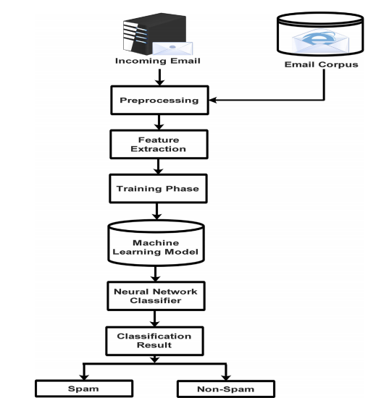
Project Architecture

Slide 13
Project Modules
1. Upload Spam Base Dataset
2.Preprocess Dataset
3. Run KNN, Naive Bayes & Multilayer Perceptron Algorithm
4.Run SVM, Decision Tree & AdaBoost Algorithm
5.Run Random Forest & CNN Algorithm
6. Accuracy Comparison Graph
7.Recall Comparison Graph
8.Precision Comparison Graph

Slide 14
UML Diagrams
Use Case Diagram
Class Diagram
Sequence Diagram
Activity Diagram

Slide 15
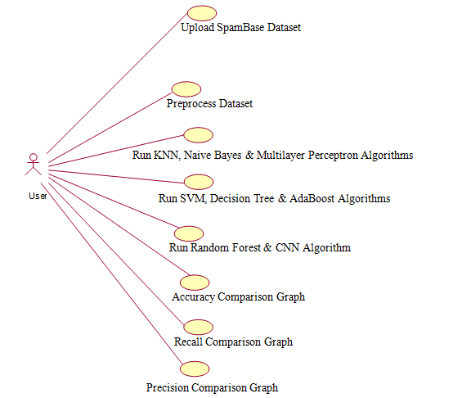
Use Case Diagram
A use case diagram at its simplest is a representation of a user's interaction with the system and depicting the specifications of a use case.

Slide 16
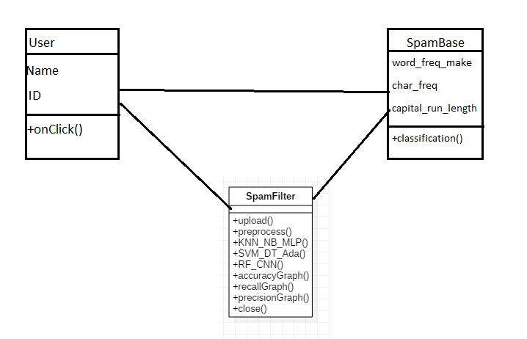
Class Diagram
The class diagram is the main building block of object oriented modeling. It is used both for general conceptual modeling of the systematic application, and for detailed modeling translating the models into programming code. Class diagrams can also be used for data modeling. The classes in a class diagram represent both the main objects, interactions in the application and the classes to be programmed.

Slide 17
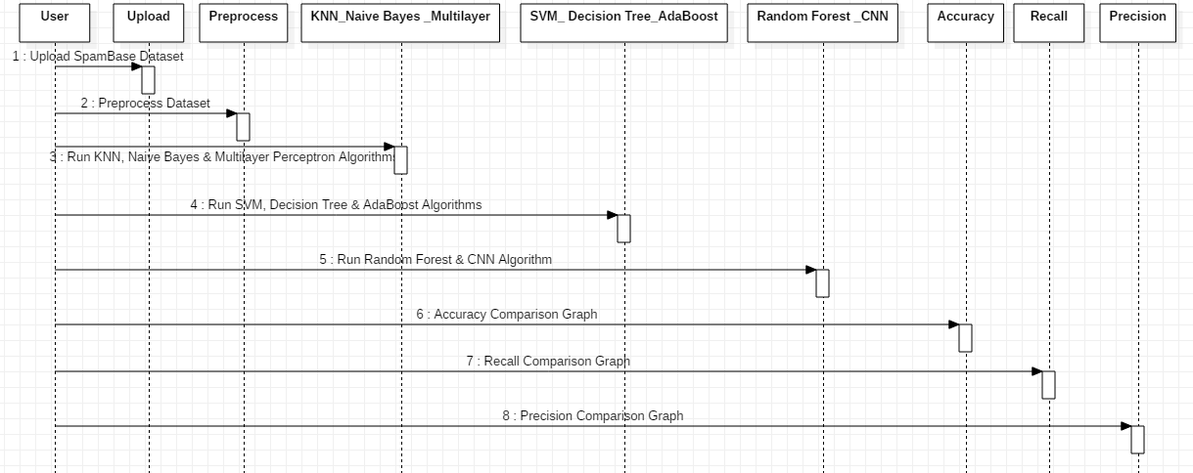
Sequence Diagram
A sequence diagram is a kind of interaction diagram that shows how processes operate with one another and in what order. It shows object interactions arranged in time sequence. Sequence diagrams are sometimes called event diagrams, event scenarios, and timing diagrams.

Slide 18
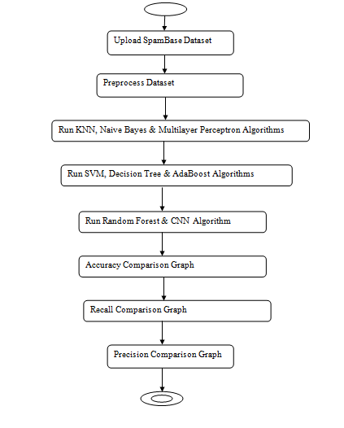
Activity Diagram
Activity Diagram is basically a flow chart to represent the flow form one activity to another activity. It can be described as an operation of the system such that the control flow is drawn from one operation to another. This flow can be sequential, branched or concurrent.

Slide 19
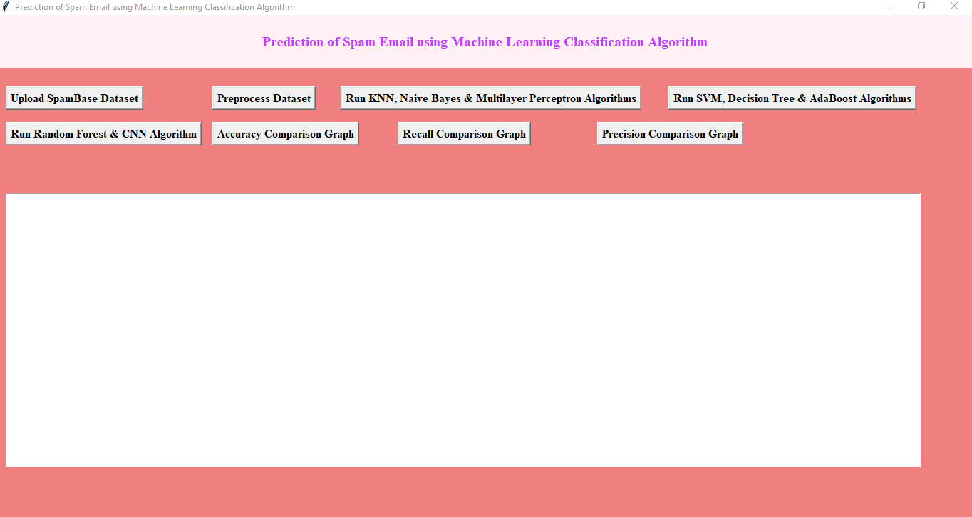
Output(Screenshot)
In the above screen click on ‘Upload SpamBase Dataset’ and upload dataset.

Slide 20
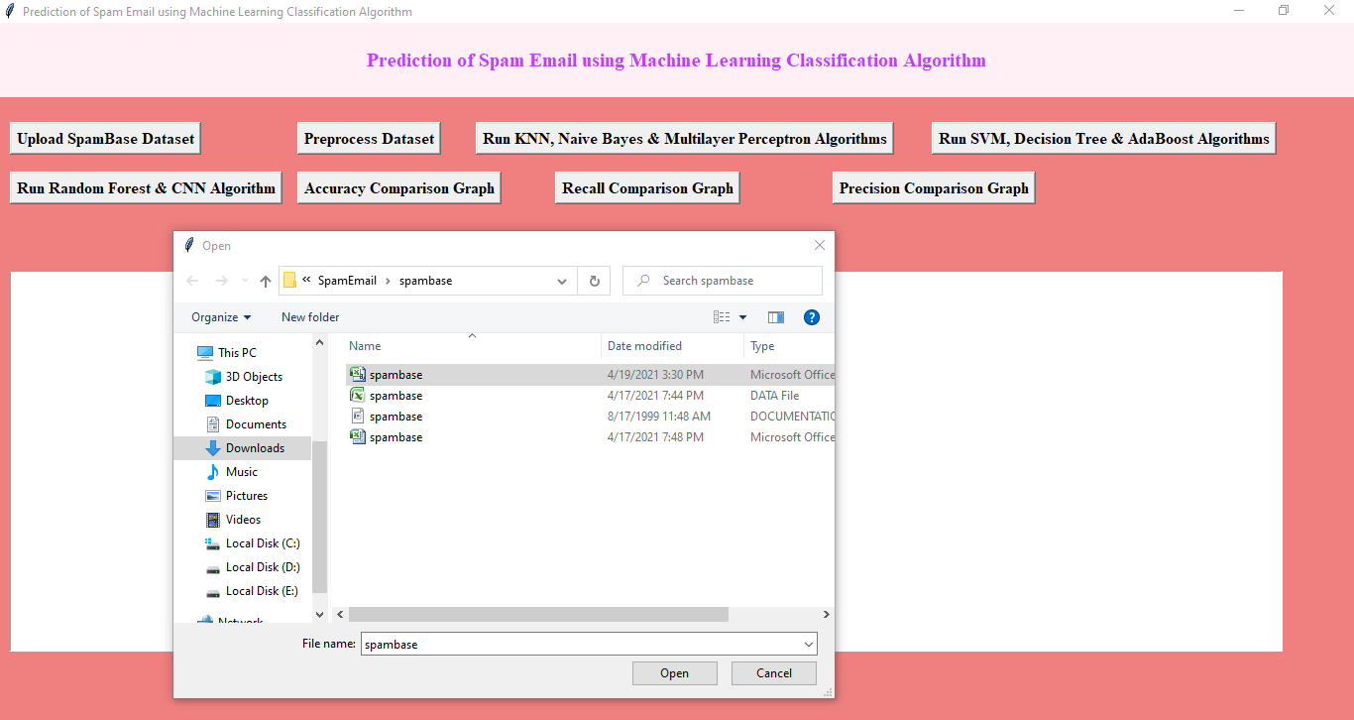
In above screen selecting and uploading ‘spambase.csv’ dataset and then click on ‘Open’ button to load dataset and to get below screen.

Slide 21
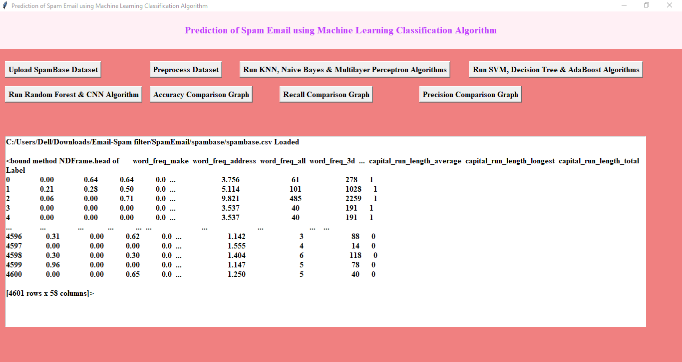

Slide 22
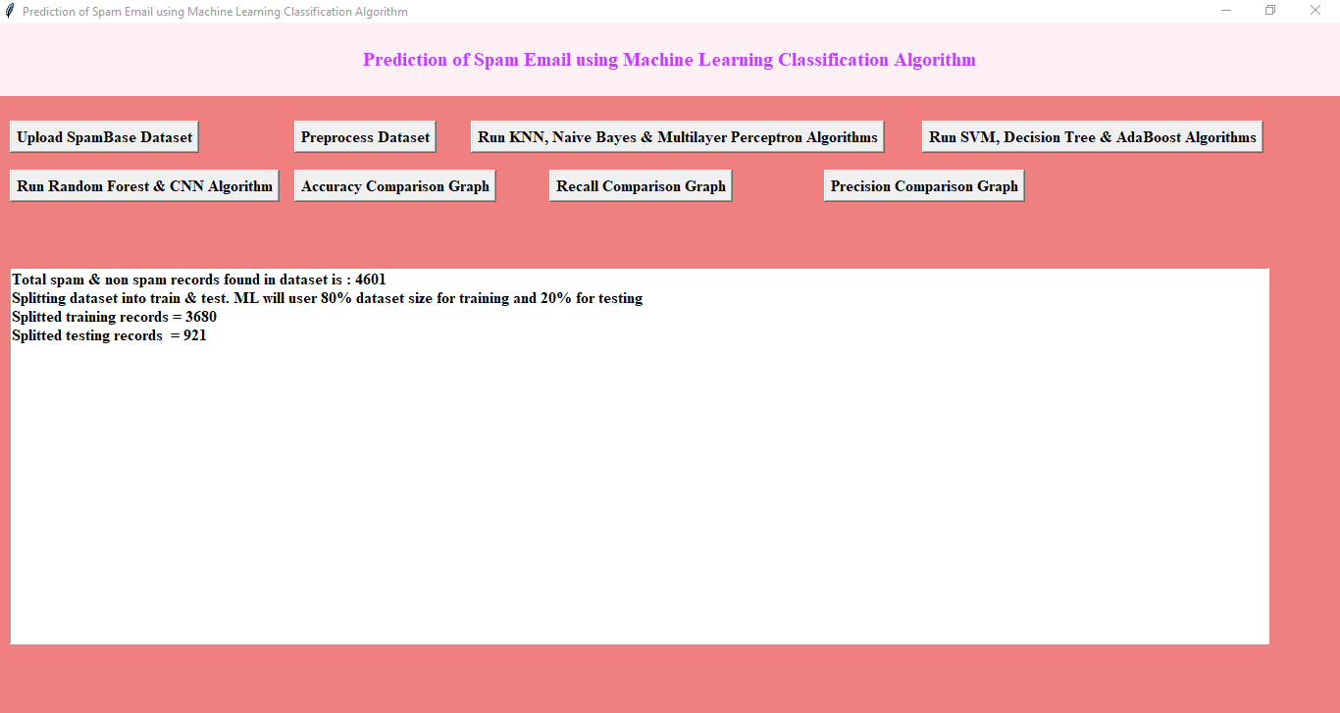
Click on ‘Preprocess Dataset’ button to read all values from dataset and then split data into train and test part where application used 80% dataset for training and 20% dataset for testing.
In above screen we can see dataset contains 4601 records and application using 3680 for training and 921 records for testing and now dataset is ready.

Slide 23
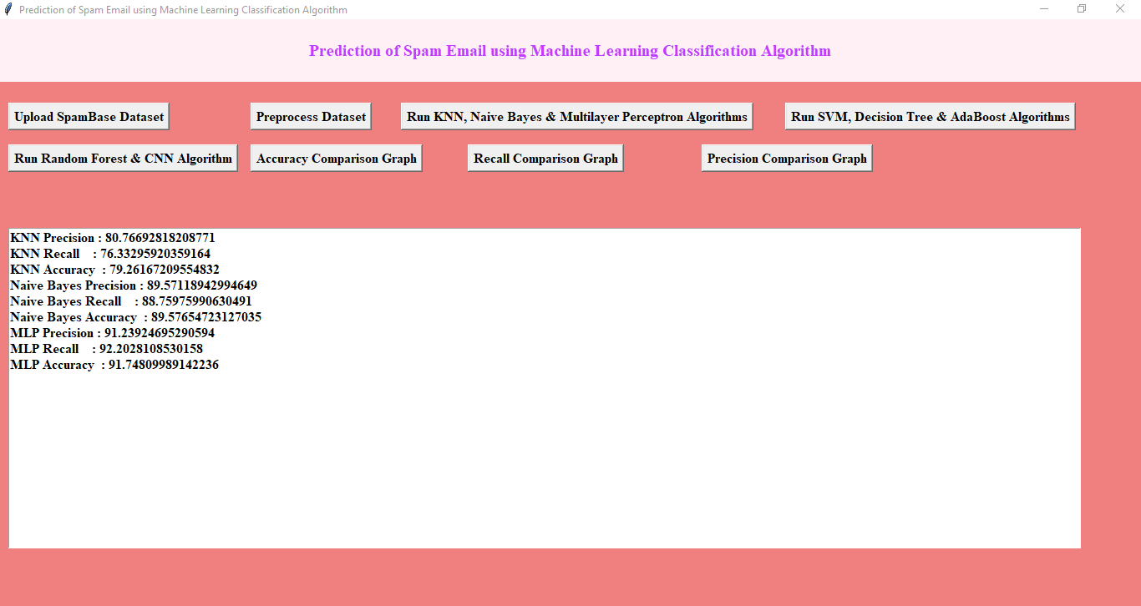
Click on ‘Run KNN, Naive Bayes & Multilayer Perceptron Algorithms’ button to run all 3 algorithms and get there prediction metrics.

Slide 24
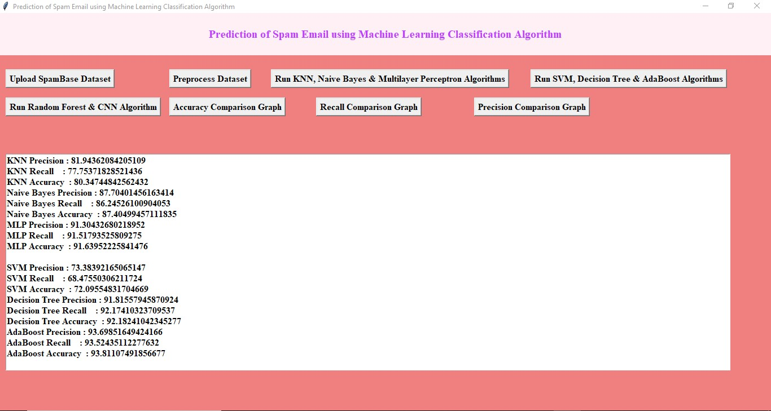
Click on ‘Run SVM, Decision Tree & AdaBoost Algorithms’ button to run these 3 algorithms.

Slide 25
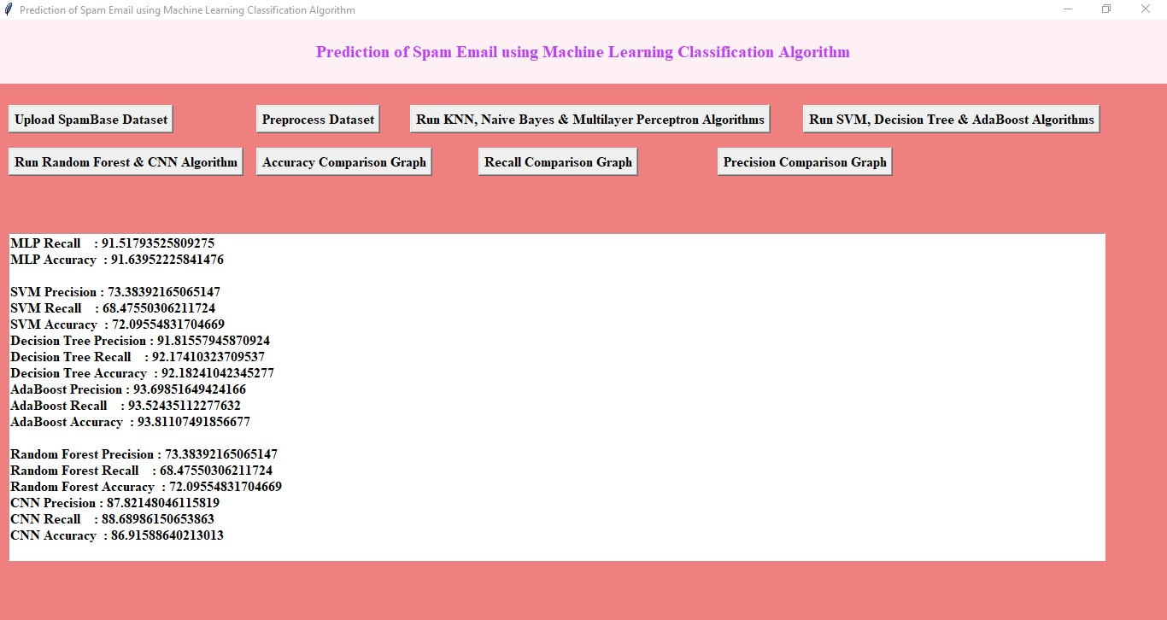
Click on ‘Run Random Forest & CNN Algorithm’ button to run both algorithms.

Slide 26
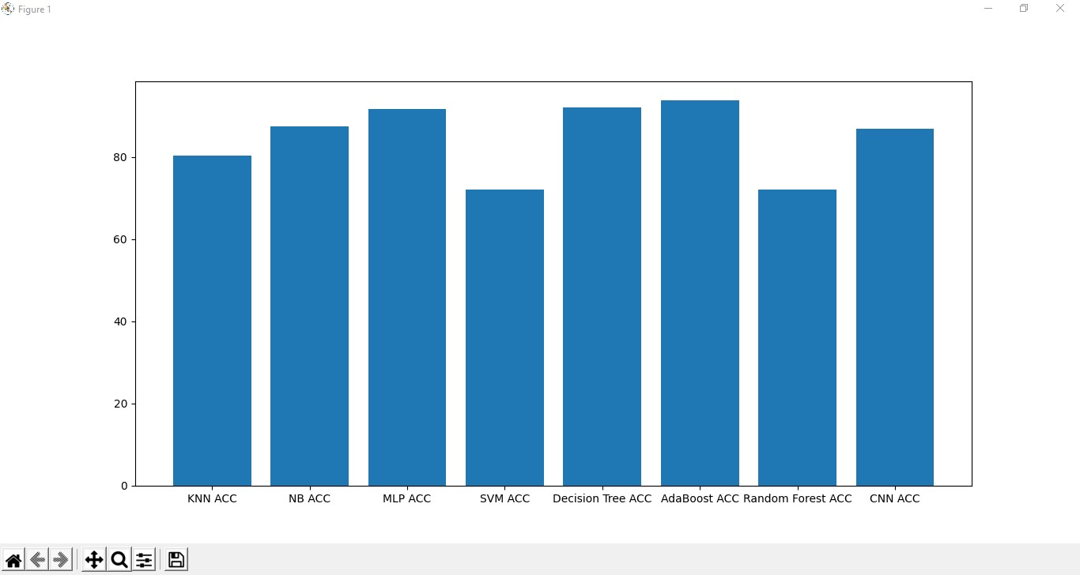
Click on ‘Accuracy Comparison Graph’ button to get below accuracy comparison between all algorithms.

Slide 27
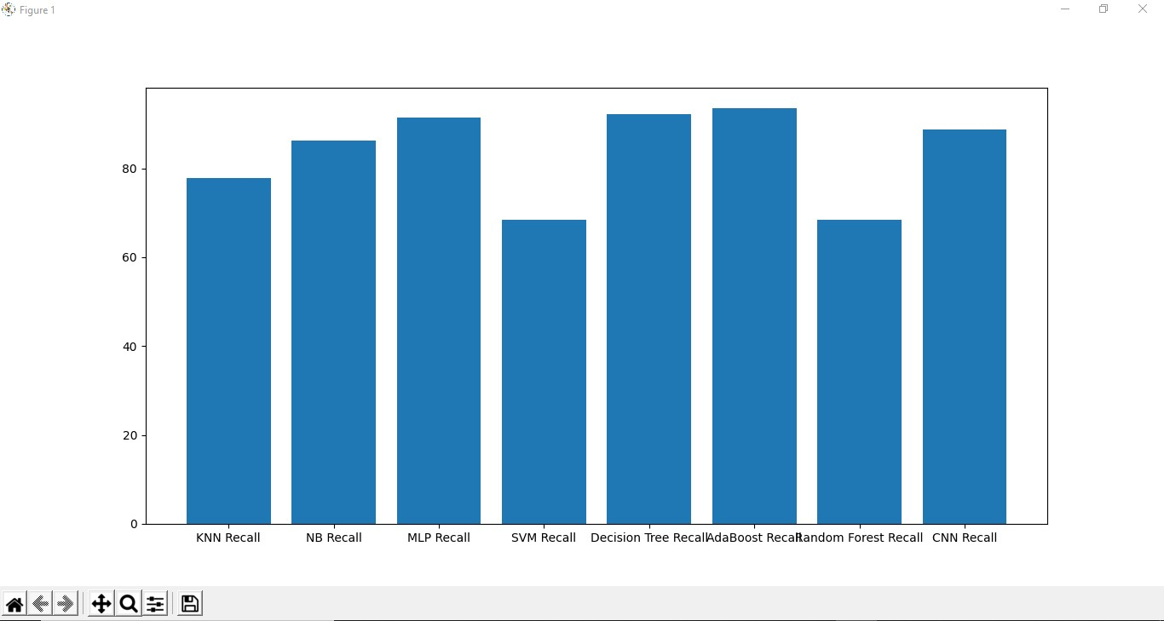
Click on ‘Recall Comparison Graph’ button to get below recall graph.

Slide 28

Click on ‘Precision Comparison Graph’ button to get below precision graph.
In all, MLP, Decision Tree and AdaBoost algorithm provide better results in terms of accuracy,precision and recall when we compare all the algorithms.

Slide 29
Conclusion
In this study, we reviewed machine learning approaches and their application to the ﬁeld of spam ﬁltering.
The challenges of the machine learning algorithms in efﬁciently handling the menace of spam and comparative studies of the machine learning techniques in terms of Precision ,Accuracy and Recall is being done.

Slide 30
THANK YOU

