Slide 1

Building Information Classification using Street View Images
Team: Bits and Bots
Members:
Bhargav Petla (18070)
Sai Teja Gilukara (18210)
Ajay Choudhury (18018)

Slide 2
Motivation
1. Urban Development
Monitoring urban development on large scale.
2. Land Use Classification
Land use classification at a level of individual building is not a trivial task.
3. Density Mapping and Utility Planning
Classification map based on individual buildings is much more informative.

Slide 3
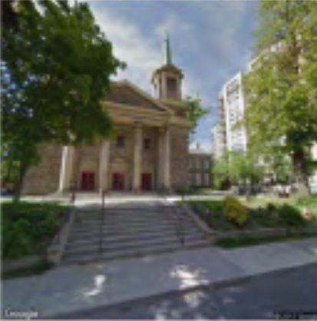
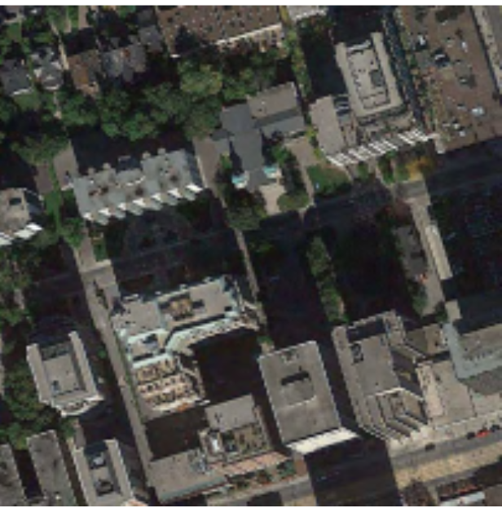
Research Gaps
Remote sensed data lack height information for buildings.
Physical factors like volume, alignment, etc. from remote sensed/satellite data can be inefficient.
Analysis of individual building instances can give better results.
Only considering the top-view data can give subtle results.
Street view images can solve this issue of individual building classification and efficient land usage pattern detection.
Church
Fig. 1: Commercial area

Slide 4
Objective
01
Collecting Data
02
Pre Processing
Building instance classification by the CNN trained on our benchmark dataset
03

Slide 5
Methodology
Data reading and pre-processing.
CNN network using different layers.
Training CNN with dataset and saving the best model based on accuracy.
Dataset Collection | PyTorch | Resize | Random Horizontal Flip
We used various stock image sources (6 classes). | We use pytorch with cuda to train fast. | We will resize images to 150,150. | To add variation to our data and for unique images.

Slide 6
Pre Processing
1. NumPy to Tensor
Transform pixel ranges from 0-22 to 0-1 and change datatype from NumPy to
Tensor because of PyTorch uses Tensor datatype.
2. Normalization
Will change the range from 0-1 to -1-1. In the input 2x3 matrix column RGB
channel, rows represent mean and deviation and any new pixels will be calculated
using the formula (x - mean) / std
3. Data Loader
Helps in reading the data and helps for training into batches.

Slide 7
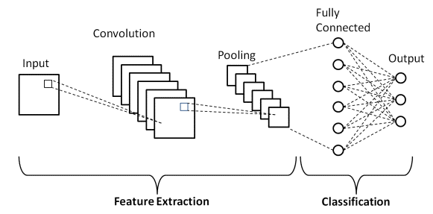
Layers in CNN
Input shape
In_channel and Out_channel
Normalization
ReLu function
MaxPool
Fig. 2: Layers in CNN

Slide 8
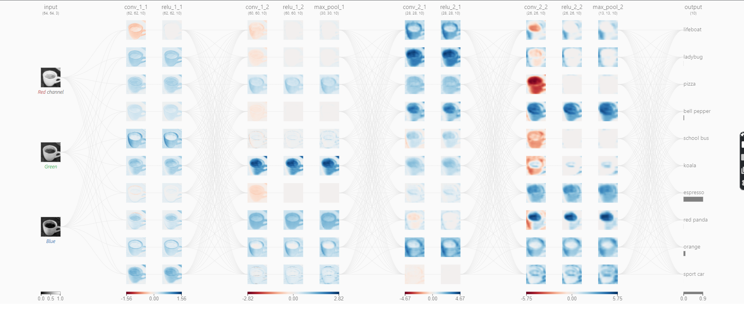
Methodology (CNN)

Slide 9
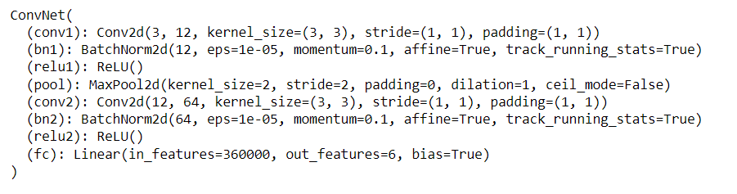
Results
Neural Network
Best Accuracy

Slide 10
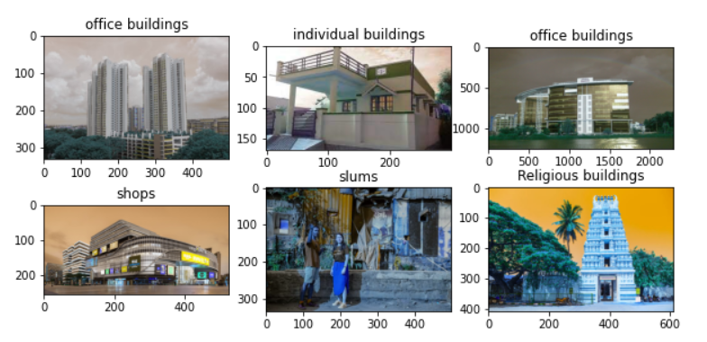
Results
Prediction

Slide 11
Conclusion and Future Recommendations
Ideology and framework for individual building instance classification.
Land usage pattern can be studied with a new dimension added on.
A dataset with images of various kinds of buildings is prepared which can be expanded for various other studies.
Using CNN, we have attained a prediction of around 60% in predicting the category of individual buildings.
Geo-tagging of building instance data can lead to better land planning.
For future work, other information can be incorporated to improve efficiency and accuracy of the model like location data, text descriptions, etc.
Study of building instance classification can be a support to various other studies.

Slide 12
Thank You

