Slide 1
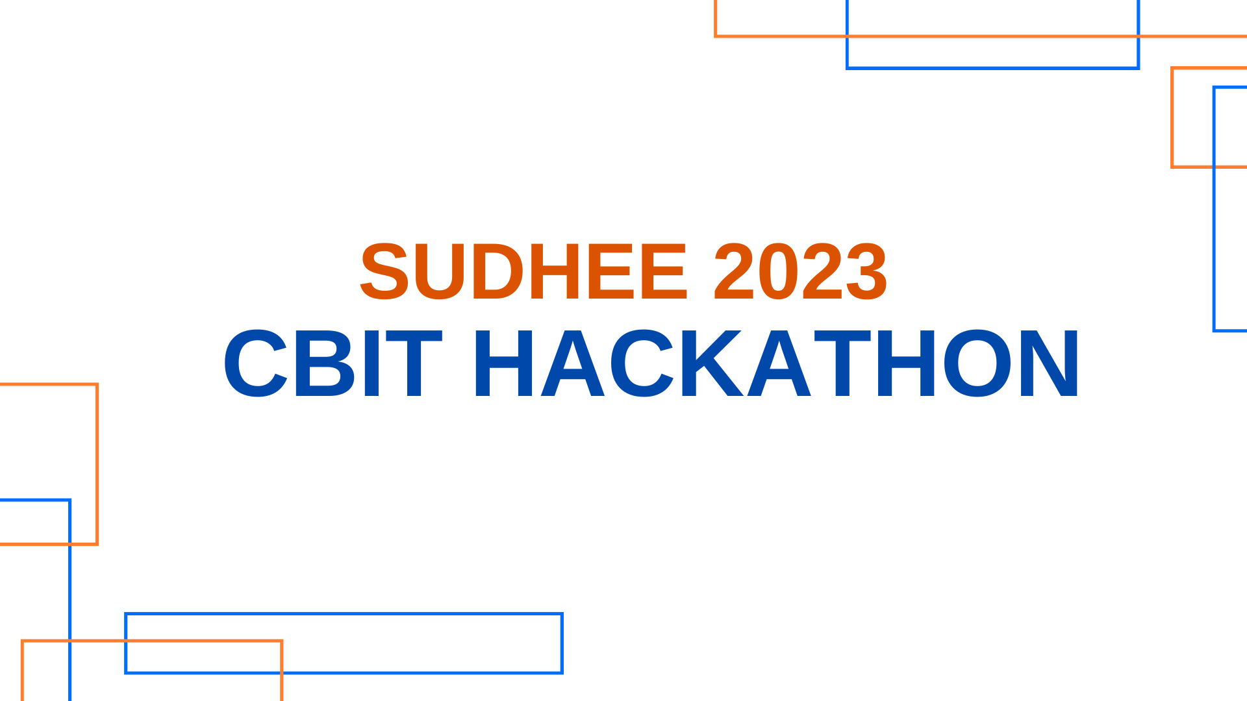

Slide 2
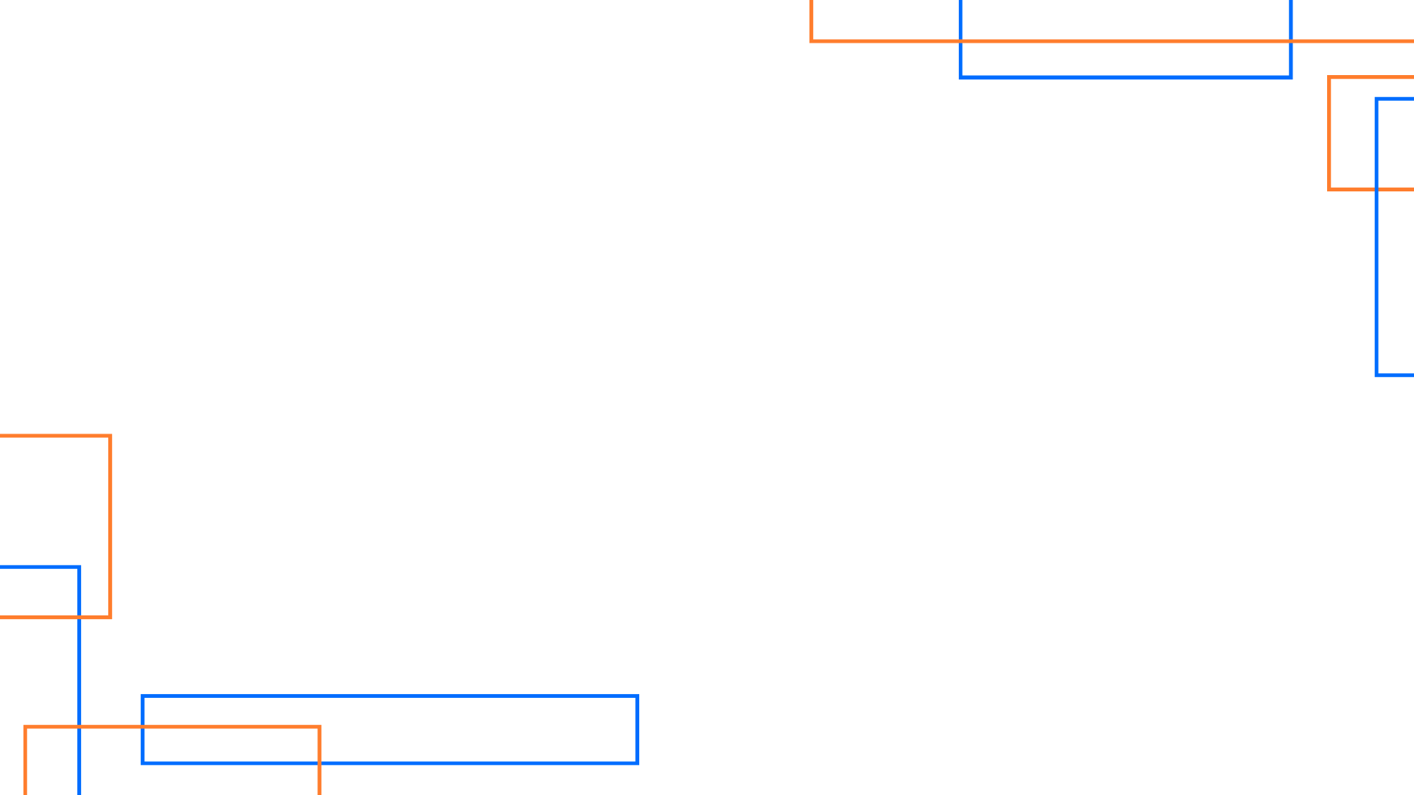
TEAM DETAILS
PROBLEM STATEMENT TITLE
Sai Teja
RVSS Surya Abhishek
K. Vaibhav Rao
Osman Irfan

Slide 3
PROBLEM STATEMENT
Description
Application through which students can order food and canteen staff can respond with self-service notifications

Slide 4
IMPLEMENTATION / METHODOLOGY
(approach to solve the problem)

Slide 5
TECH STACK
HyperText Markup Language
Cascading Style Sheets
JavaScript
Bootstrap
Smptjs API

Slide 6
RESULTS
Screenshots of Application

Slide 7
FUTURE SCOPE
This Project could be widely implemented in Universities, essentially making the lives of students much easier

Slide 8
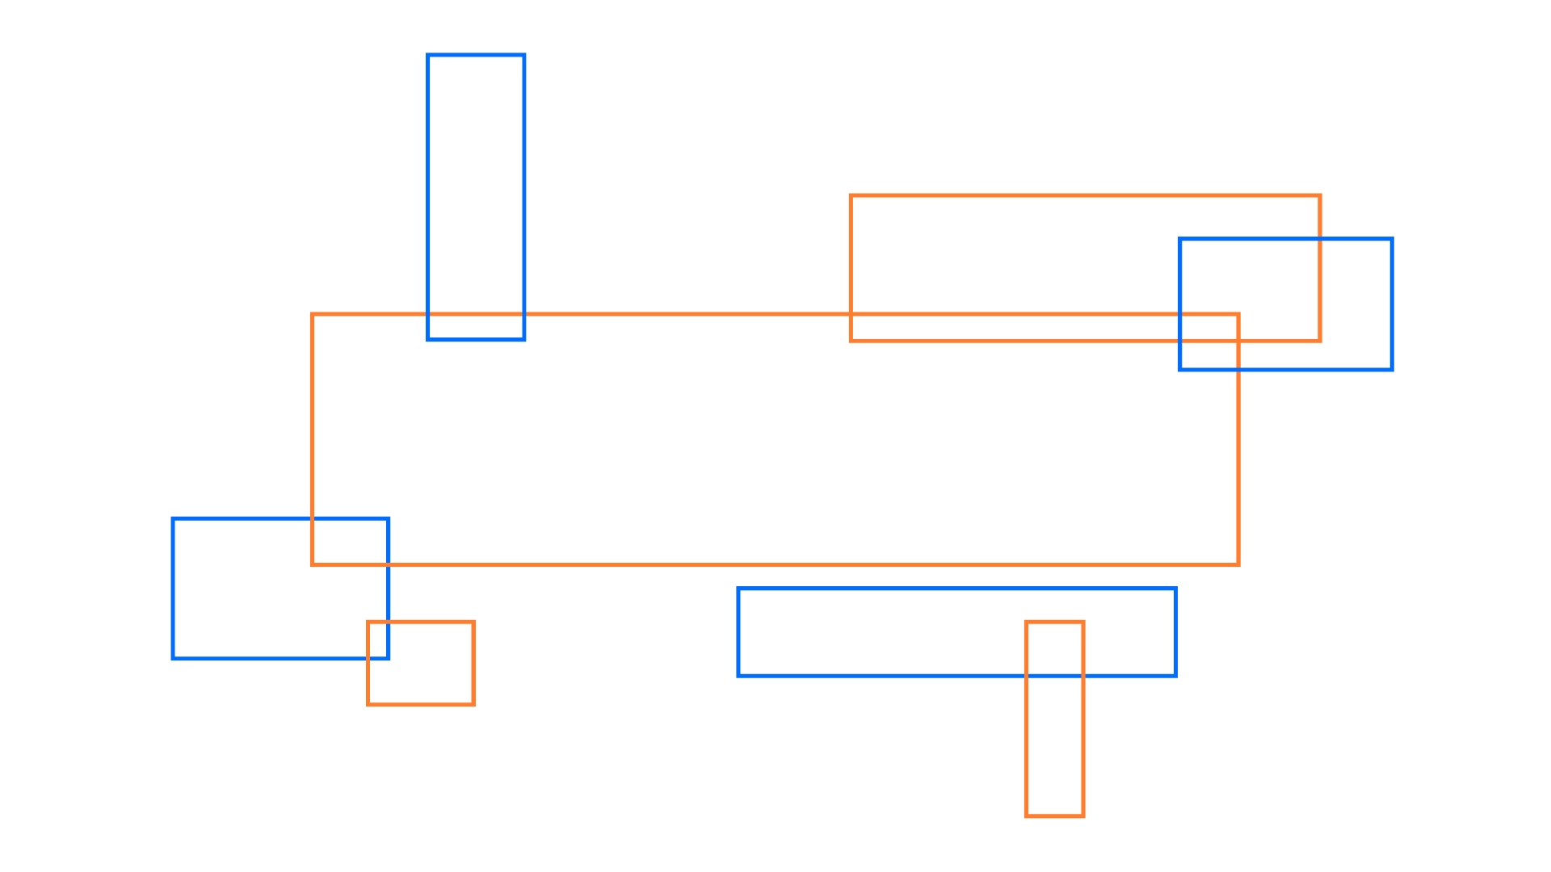
THANK YOU

