Slide 1

VCM Alerts & Monitoring - Action Plan
Mar 16, 2021

Slide 2
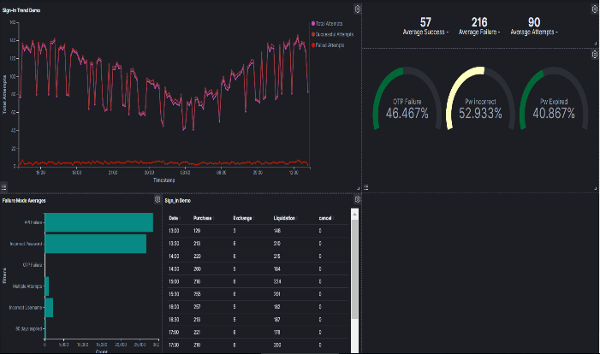
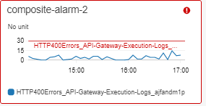
Alerts & Monitoring
Focus Area-1
30%
60%
85%
80%
Review the Existing alerts configured at the Infra level.
Configure the Missing alerts /modify the threshold.
Provide Infra and security related recommendations.
Focus Area-2
Review the existing alerts and threshold.
Configure the missing alerts for the Below components
User Management System (UMS)
Dashboard
Transactions
Account Options
Document Management
Batch
Focus
Area-4
SOP for all the Critical Alerts
Focus
Area-3
Building ELK Actionable Dashboard
Focus
Area-1
Infra Security and network Related Alerts
Focus
Area-2
Application related Alerts
Focus Area-3
Building actionable ELK Dashboard based on the CloudWatch Data. for Focus area 1 & 2 & along with Different KPI
Focus Area-4
For all the critical Alerts SOP needs to be created for to the L1.5 Team.
Review the SOP thoroughly before socializing the same with wider team.
Create the Action plan and escalation matrix and handing over to L1.5
Work in Progress(TBD)
Ongoing (Target Date 2/28)

Slide 3
Alarms Statistics
Key Actions
Analyze the Cloud watch log to capture the max value and number of occurrences.
Edit the Alarms with Correct Configuration.
Testing the Alarms in lower environment.

Slide 4
FIS 4XX and 5XX Analysis and Following up
Observed 500 and 504 issues in the last couple of weeks which led to couple of P1 issues.
Observed 417 response code from FIS with an overwhelming number. It was only observed after reconfiguring the missing Alarms.
FIS load balancer switch caused outage and around 109 member profile request failed on Feb 13th.
Impact
Opened QB tickets with FIS for every single incident and closely follow-up till closure.
FIS agreed to change the 417(data not found) to 200 which would make the Alarms system accurate.
Shared the detailed log with exact timeframe for further investigation.
Issues caused by FIS is coming into the surface and L1.5 team is able to isolate.

Slide 5



GIACT 5XX , USPS Errors
5XX stat for a weeks time
Corrective Action
Errors | Count
Invalid eMail address | 208
Invalid phone | 13
invalid SSN | 3
Invalid Zip | 15
Less than min length | 81
Grand Total | 320
Include Validation before Making a third-party API Invocation
Show exact functional Error message to the member around the reason validation failed.
Impact
Lower Cost by avoiding GIACT calls with invalid data
Improved member Experience by pinpointing the error reason
Reduce Call Volume

Slide 6
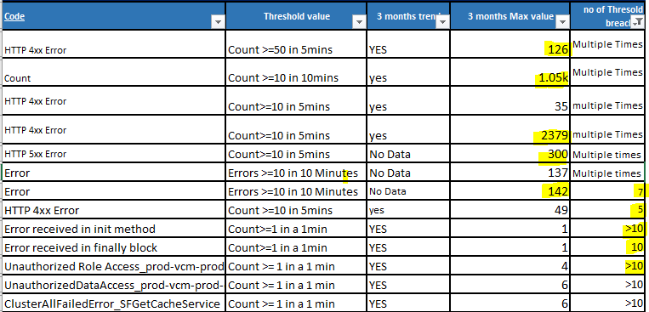
How to determine the threshold ?
Corrective Actions Taken
Detailed Log Analysis to figure out any Missing Alarms
Threshold determination based on Historical data and Incident Occurrence
Analysis of the Root cause for the current Threshold Breach.
Engage 3rd Party Partner System As needed .

Slide 7



Enablement of the Support Team L1.5
Functional & Technical Enablement
Functional KT has been provided about the B2C platform.
Team was enabled to log at the Cloud watch log to identify the component for which the ticket has been raised.
Drive deep into the log stream to pin point the exact error an share details before the L2 team joins the bridge.
SOP would help L1.5 team to do the due diligence while L2 team is coming into the Picture.
Ticket Statistics for last 3 weeks
Ticket Severity | Brief Description | Average Triage Time | Number of associate joined the bridge
1 – Critical , 6 Tickets | 4 Auto Tickets for 5XX errors in FIS Proxy & GIACT API Gateway 2 Auto tickets for High CPU utilization | Average – 1:27:29 | 6 Members (Including L1.5, L2 & Infra team)
2 – High , 7 Tickets | 2 Auto tickets for Try after 1 hr and Try after 24 hr error from Lamba 3 Auto tickets for Disk space, CPU utilization & Host Health 2 Auto tickets for 4xx/5xx errors in UMS API gateway | Average – 1:30:40 | 7 Members (Including L1.5, L2 & Infra team)
L1.5 Team Enablement
Cloudwatch Log
Dashboard
SOP

Slide 8
ELK Dashboard

Slide 9




















ELK Integration Architecture
Salesforce Cloud Logs
Splunk forwarder
Adobe Cloud Logs
Informatica Secure Logs
AWS Cloudwatch Metrics
Metric Beat Agents and Kafka queuing
Log Alerts via HTTPS
Logstash Input Plugins
Lambda pushes
data to ES
Infra and App Component Logs in S3, Cloudtrail and Cloudfront
JDBC Input Plugin
Lambda function to convert data to match mapping template
VPC Flow Logs
New Log events invoke lambda function through subscription filter
Application Lambda
Alfresco and AWS Cloudwatch Logs
Logs failed due to exceptions
Amazon S3 bucket

Slide 10
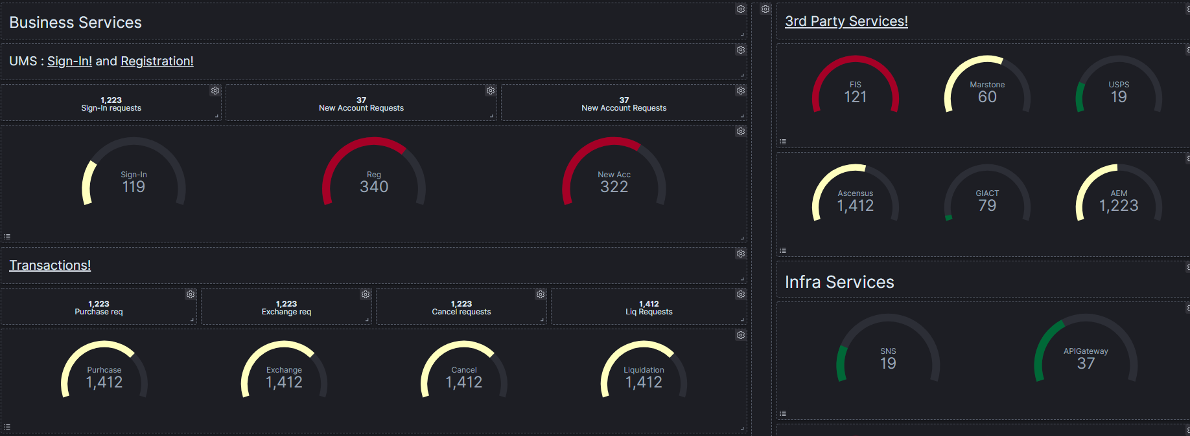
Victory Health Dashboard

Slide 11
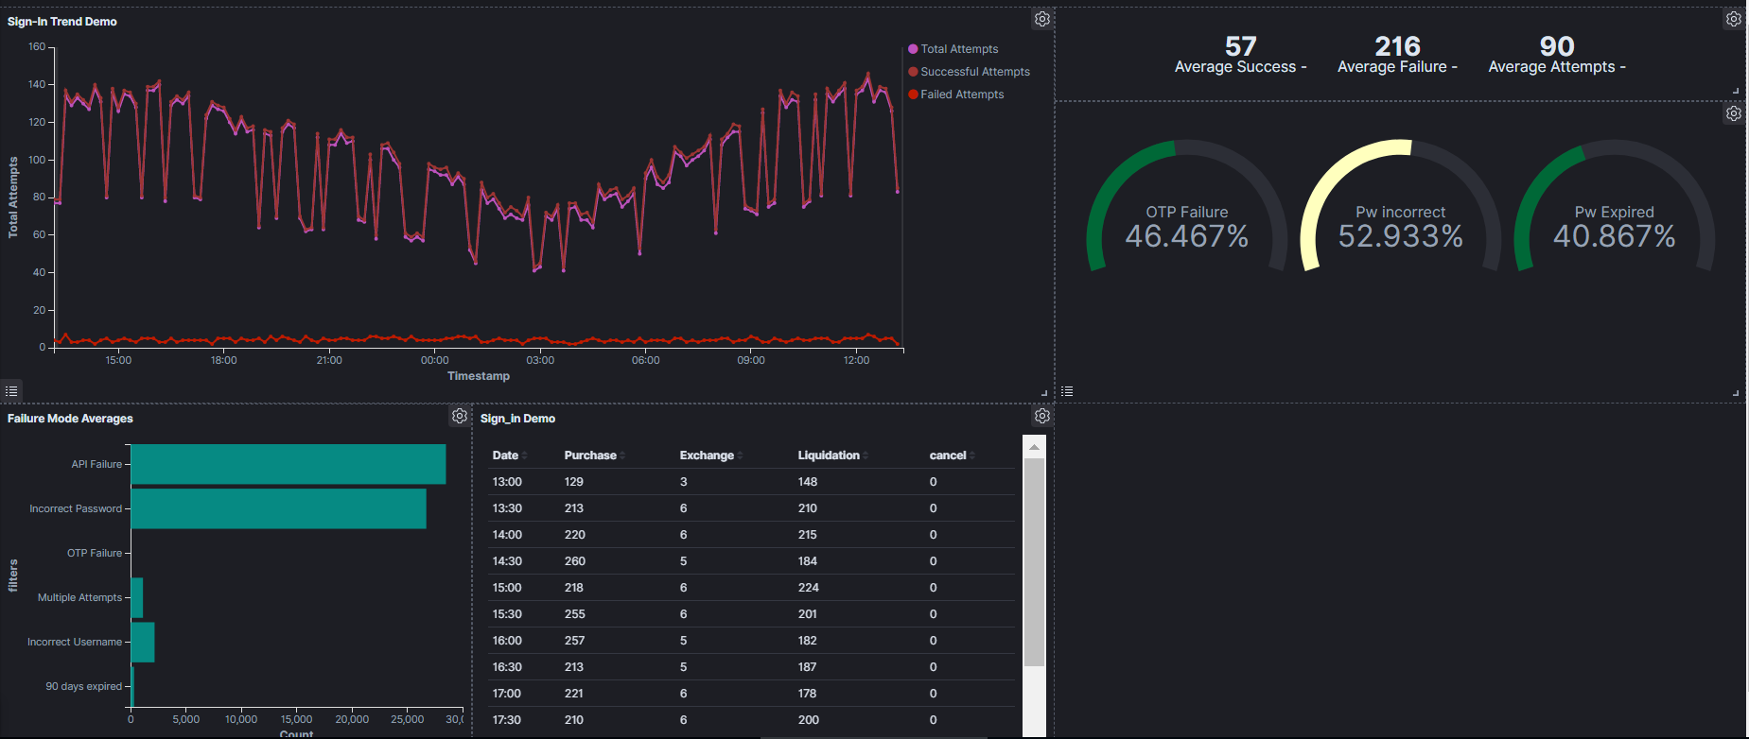
Sign in Dashboard

Slide 12
ELK Dashboard Wireframe

Slide 13
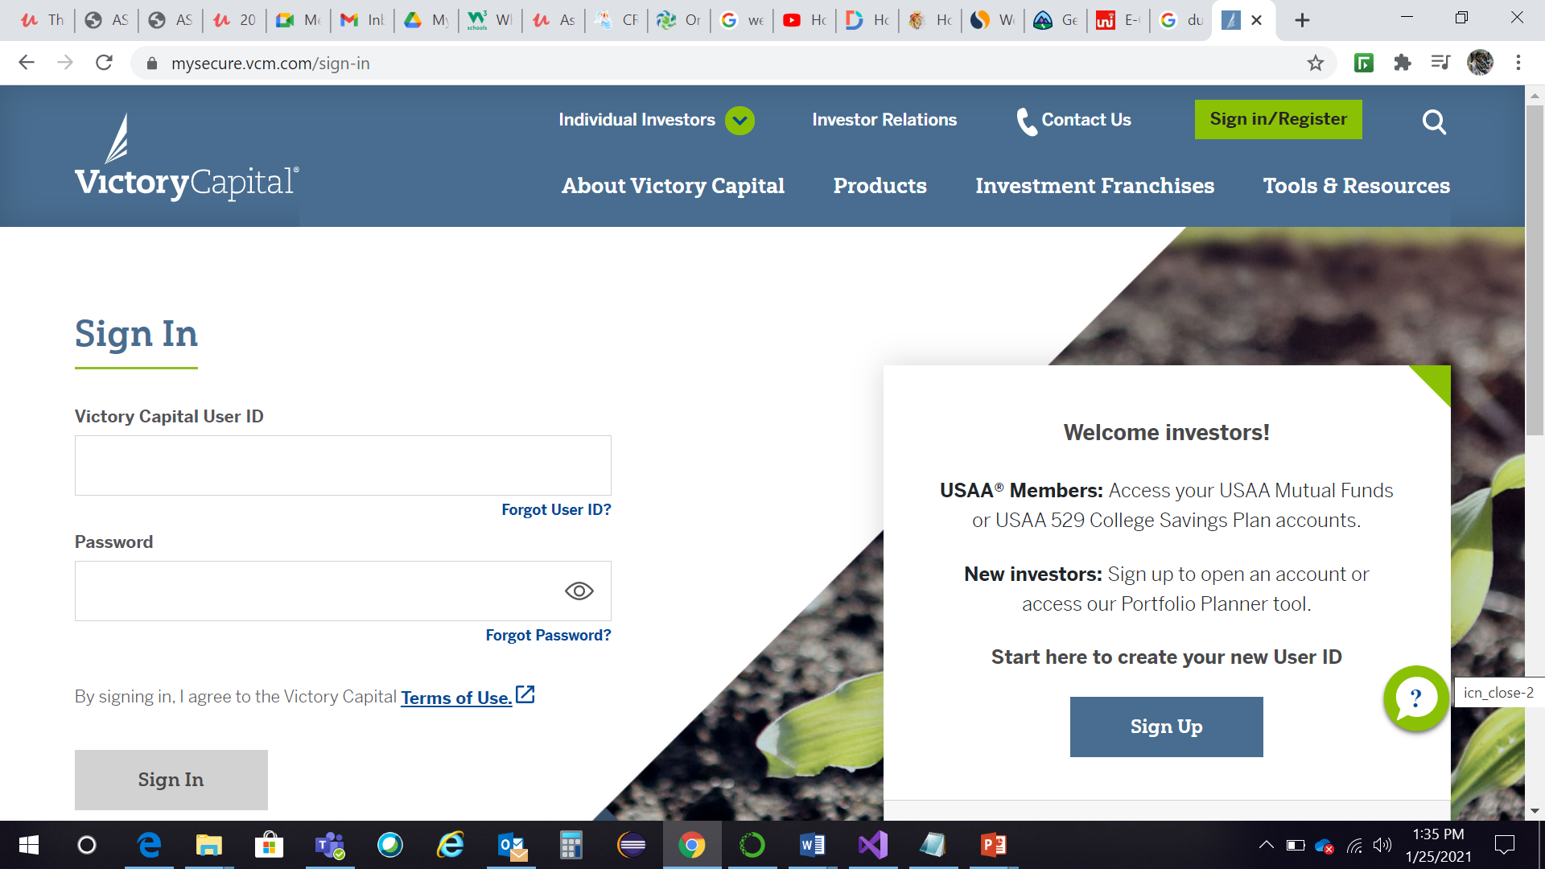




1
Admin
Log Out
Home
Search
Registration Details
Sign-In Details
30m
1hr
3hr
7D
6hr
12hr
24hr
5 day
Filter By
Wrong PW
Max Attempts
OTP Expired
API Failure
Wrong User Name

Slide 14
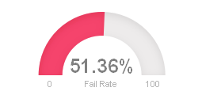
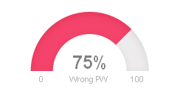
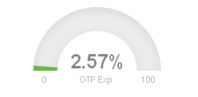
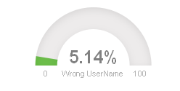
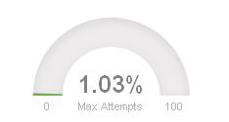
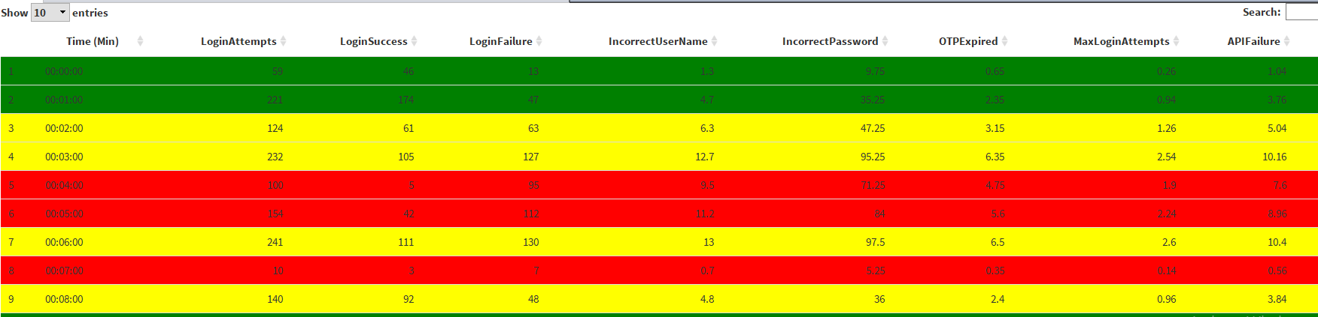
1
Admin
Log Out
Annotation
Home
Search
1
Registration Details
Sign-In Details
1
Dashboard will have a graphical representation on the registration as well as sign-in trends.
30m
1hr
3hr
3
Filter By
7D
6hr
12hr
24hr
5 day
2
Web - Chrome
Average Attempts – 2318.25
2
User can filter based on device/browser
Average Success – 1694
Average Fail – 624.25
3
User can filter the dashboard based on time horizon
5
4
This chart shows the different categories of issues faced while analyzing the trend
5
This chart shows live picture based on time horizon, with indicators when an alert is present
4

Slide 15
1
Admin
Log Out
Annotation
Home
Search
1
Registration Details
Sign-In Details
1
Dashboard will have a graphical representation on the registration as well as sign-in trends.
3
Filter By
30m
1hr
3hr
6hr
12hr
24hr
5 day
2
Web - Chrome
Average Attempts – 2318.25 (Guest 1000)
2
User can filter based on device/browser
Average Success – 1694 (Guest 600)
Average Fail – 624.25 (Guest 50)
3
User can filter the dashboard based on time horizon
5
4
This chart shows the different categories of issues faced while analyzing the trend
5
This chart shows live picture based on time horizon, with indicators when an alert is present
4

Slide 16
Transaction View
Annotation
Allow adjustment of time scale: recommendation is to allow by (30 min, 1 hr, 4hr, 12 hr, 24 hr, weekly, and monthly views)
Allow filtering by account type, demographics?
Allow view of failure reason?

Slide 17
Acct Services View
Annotation
Allow adjustment of time scale: recommendation is to allow by (30 min, 1 hr, 4hr, 12 hr, 24 hr, weekly, and monthly views)
Allow filtering by account type, demographics?
Allow view of failure reason?

Slide 18
Acct Opening View
Annotation
Allow adjustment of time scale: recommendation is to allow by (30 min, 1 hr, 4hr, 12 hr, 24 hr, weekly, and monthly views)
Allow filtering by account type, demographics?
Allow view of failure reason?

Slide 19
Thank You

