Slide 1

AI IS MOVING FROM EXPERIMENT TO OPERATING ADVANTAGE
261FB04001
Notes:
Open by framing the inflection point: early exploratory pilots proved technological feasibility, but durable enterprise value requires embedding AI directly into production operating systems.

Slide 2


02
OPERATING CRITERIA · VALUE CAPTURE
AI CREATES VALUE WHERE WORK IS REPETITIVE, INFORMATION-RICH, AND MEASURABLE
AUTOMATE ROUTINE WORK
Remove high-frequency administrative drag across billing, documentation, and compliance triage; cycle time and straight-through processing are quantifiable.
AUGMENT EXPERT DECISIONS
Equip underwriters, engineers, and clinicians with context-aware synthesis of unstructured archival knowledge for instantaneous risk and pricing recommendations.
PERSONALIZE CUSTOMER EXPERIENCES
Deliver tailored interactions and adaptive service at zero marginal distribution cost; drive retention through responsive, intent-aware workflows.
261FB04001
Notes:
Emphasize that successful deployments meet all three criteria: repetitive tasks provide volume, dense data feeds models, and clear unit economics prove operational ROI.

Slide 3
03
SYSTEM ARCHITECTURE · CORE CAPABILITIES
THREE AI PATTERNS COVER MOST BUSINESS OPPORTUNITIES
01
02
03
PATTERN 01 · DETECTION
PATTERN 02 · CREATION
PATTERN 03 · EXECUTION
PREDICT: SPOT SIGNALS IN DATA
GENERATE: CREATE USEFUL FIRST DRAFTS
ACT: CONNECT INSIGHT TO WORKFLOW
Isolate anomalies, forecast churn, and anticipate operational bottlenecks before escalation. Predictive engines ingest historical volume to surface leading indicators for leadership action.
Accelerate creative and analytical throughput across communications, code synthesis, and structured summaries. Human domain specialists edit and verify rather than composing from scratch.
Trigger governed downstream handoffs across internal systems, enterprise ERPs, and customer portals. Operational leverage compounds when synthesis initiates direct execution.
261FB04001
Notes:
Walk through the three-part continuum: prediction uncovers what is happening, generation accelerates synthesis, and autonomous action completes the loop inside standard operating procedure.

Slide 4
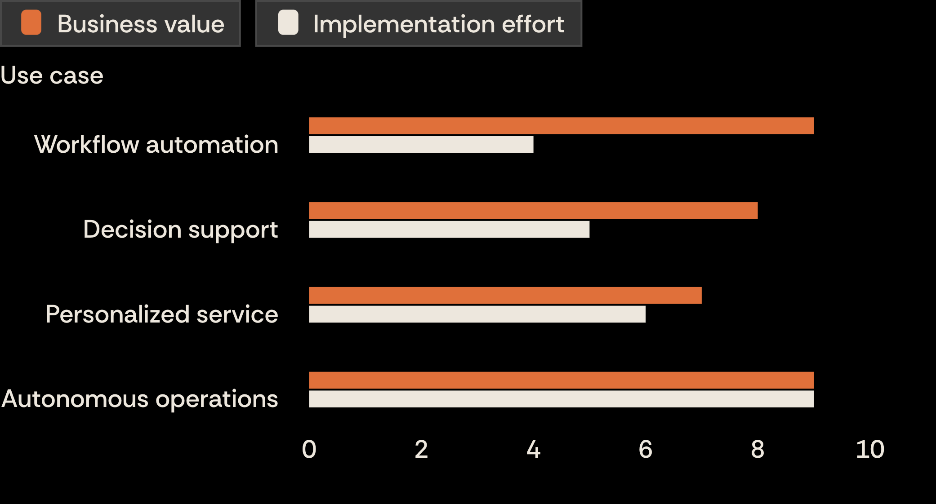
04
PORTFOLIO PRIORITIZATION · PILOT MATRIX
START WITH HIGH-VALUE USE CASES, NOT THE LOUDEST DEMOS
TARGET THE HIGH-LEVERAGE WEDGE
Workflow automation yields top-tier business value (9) at modest execution complexity (4), delivering immediate payback without architectural upheaval.
AVOID EARLY AUTONOMOUS TRAPS
Autonomous operations promise equal impact (9) but demand extreme engineering overhead (9). Defer full autonomy until frontline data foundations mature.
Illustrative AI use-case prioritization · Directional evaluation matrix (scale 1–10)
261FB04001
Notes:
State clearly that scores are illustrative and directional. Point out the clear takeaway: prioritize workflow automation and decision support early, avoiding complex autonomous bets until foundations are solid.

Slide 5




EXECUTION DISCIPLINE · OPERATING CADENCE
THE WINNING MOVE IS A FOCUSED LOOP: CHOOSE, TEST, LEARN, SCALE
CHOOSE
TEST
One measurable business problem with unambiguous unit economics.
Directly alongside frontline operators who live the daily workflow.
LEARN
SCALE
Real-time telemetry on output accuracy, adoption velocity, and edge failures.
Institutionalize systems that earn operator trust and compound margin.
261FB04001
Notes:
Summarize the closing mandate: enterprise winners avoid open-ended research initiatives by treating AI adoption as an iterative operating rhythm centered on frontline trust.

