Slide 1

AI TECHNOLOGY
AI technology is becoming a new kind of computer
Foundation models can perceive, generate, reason, and act—turning language, images, and code into an interface for software and machines.
A field guide to models, systems, capabilities, and limits
Notes:
Open with the core idea: AI is not one feature or chatbot. It is a technology stack—data, models, compute, tools, and interfaces—that can turn unstructured information into predictions, content, and actions.

Slide 2

THE TECHNOLOGY STACK
AI systems combine models, data, and tools
THE MODEL LAYER
THE SYSTEM LAYER
Foundation Models
Tools & Feedback
Large models learn statistical structure from text, images, audio, video, and code—then generate a response from context.
Production systems add retrieval, APIs, memory, evaluation, and permissions so a model can use current knowledge and take bounded actions.
Scale comes from pretraining, specialized fine-tuning, and inference.
The interface is conversational; the architecture underneath is software.
Notes:
Explain the stack from bottom to top: data and compute enable models; models provide general capability; tools, retrieval, and evaluation turn that capability into a dependable system.

Slide 3
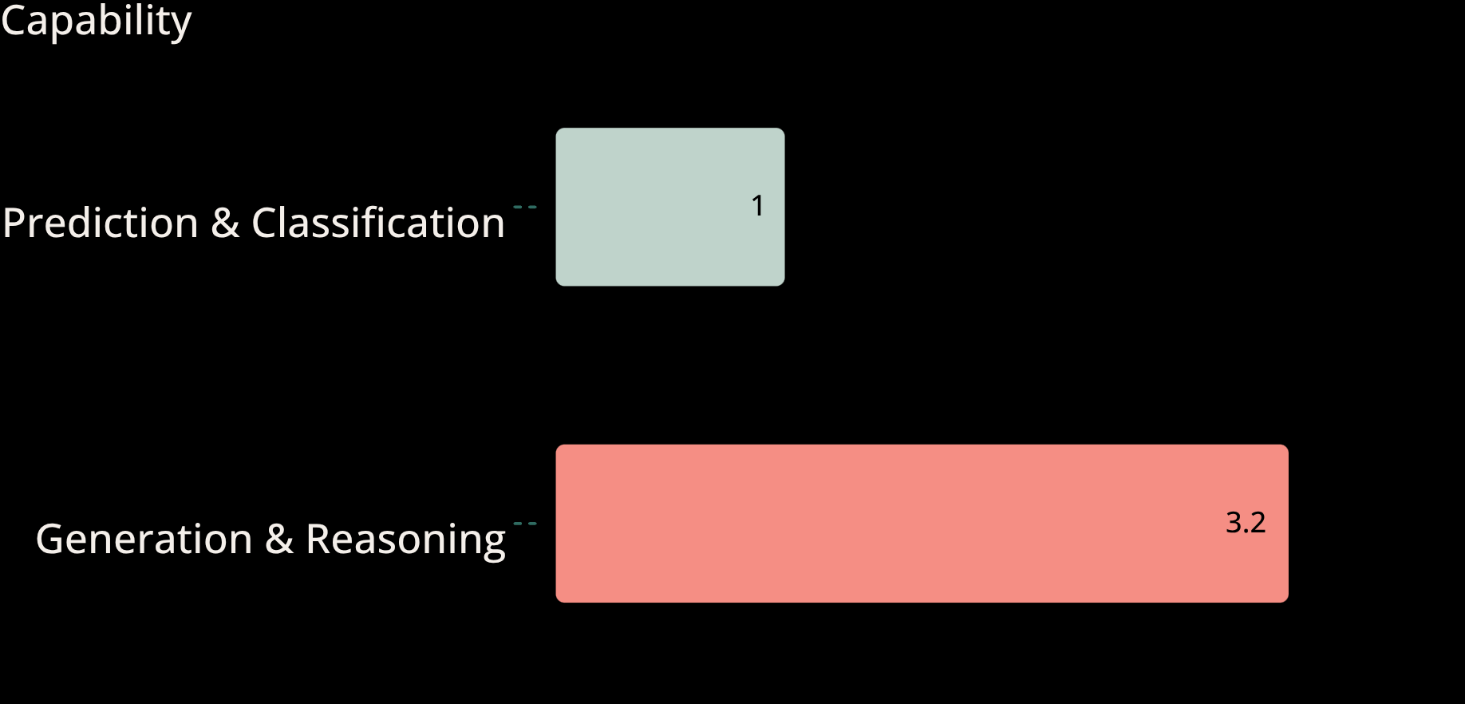

CORE CAPABILITIES
AI expands what software can understand and produce
4
capability families: perceive, predict, generate, and act.
The leap is not one clever prompt. It is connecting models to context, tools, and feedback so outputs become useful, testable, and repeatable.
Illustrative capability map: modern AI systems move from recognizing patterns to generating and transforming information.
Notes:
Use the chart as a capability ladder: AI starts with prediction and classification, then expands into generation, reasoning, and action when connected to tools and feedback.

Slide 4

HOW IT WORKS
Every AI response is a probabilistic prediction
01
02
03
Pretraining: learn statistical patterns from enormous datasets.
Inference: generate the next token, pixel, action, or prediction from context.
Grounding: retrieve evidence and call tools to improve relevance and control.
The output is powerful—but confidence is not the same as correctness.
Notes:
Walk through the pipeline: pretraining builds broad capability, inference produces an answer, and grounding adds current evidence or actions. The system remains probabilistic at every step.

Slide 5



LIMITS & RISKS
AI is powerful precisely where its limits matter
Models can be fluent, fast, and wrong. Reliability depends on the data, the prompt, the evaluation method, and the controls around deployment.
Hallucination & Uncertainty
1
Generated content can sound certain without being supported by evidence.
Bias, Privacy & Security
2
Training data and system access can reproduce bias, leak sensitive information, or widen attack surfaces.
Notes:
Make the limits visible: test against real tasks, cite sources where possible, restrict permissions, monitor drift, and keep accountable review for high-impact decisions.

Slide 6


FROM MODEL TO PRODUCT
The gap is no longer the model—it is the system around it
A foundation model is a starting point. Production value appears when the model is connected to data, tools, interfaces, and evaluation.
The engineering challenge is integration: retrieval quality, latency, cost, permissions, observability, and graceful failure.
30% Foundation model
70% Application system
A useful mental model: model + context + tools + evaluation = AI product
Notes:
Emphasize that the model is only one layer. The product experience depends on retrieval, tool use, evaluation, security, and operations wrapped around it.

Slide 7


APPLICATION PATTERNS
The next wave connects AI to the real world
AI applications are moving from answering questions to perceiving environments, coordinating steps, and operating within boundaries.
1
2
3
Copilots
Agents
Embodied AI
Assist people inside the tools they already use: draft, search, summarize, explain, and recommend.
Plan and execute multi-step tasks by calling tools, checking state, and adapting to results.
Bring perception and reasoning into robots, vehicles, labs, and edge devices where latency and safety are physical constraints.
Notes:
Use the three patterns to show the trajectory: copilots augment a person, agents coordinate software, and embodied systems act in the physical world. Each step raises the stakes for evaluation and safety.

Slide 8

THE AI TECHNOLOGY AGENDA
Build an AI stack that is useful, testable, and safe
Map the stack: data, model, context, tools, interface, and evaluation
1
Test capabilities on real tasks: accuracy, latency, cost, robustness, and failure modes
2
Design for control: least-privilege access, monitoring, human review, and clear rollback
3
Notes:
Close on a practical thesis: the winning AI technology is not merely the largest model. It is the system that combines capability with evidence, tools, evaluation, and control.

