Slide 1
[SYS.INIT] RUNTIME_V4
WORLD_STATE: ACTIVE
MANIFEST.TXT
Paradigm shift: Static scripts → living loops
Core capability: Continuous environmental response
Industry impact: Dynamic retention and player agency
AI is turning
games into
living systems
INDUSTRY BRIEF · NEXT-GENERATION INTERACTIVE ARCHITECTURE
Notes:
Open the presentation by setting the core thesis: games are moving away from static, pre-authored branching trees and transforming into reactive, continuous ecosystems that learn and adapt.

Slide 2





[LAB.ENV] SYNTHETIC_SIMULATION
Why gaming is the ideal proving ground for AI
Games provide self-contained, high-fidelity sandboxes where digital agents face human unpredictability under strict, measurable rules.
SYSTEM_PROPERTIES.LOG
Rich worlds
Human intent
Closed feedback
Boundless spatial complexity with clean telemetry.
Millions of real-time decisions and edge cases daily.
Clear objective functions with instant outcome scoring.
SIMULATED ENVIRONMENTS VALIDATE COMPLEX MODELS BEFORE REAL-WORLD DEPLOYMENT.
Notes:
Explain why gaming leads artificial intelligence research: it offers deep complexity paired with clean telemetry and instant feedback loops, making it the perfect stress test for reinforcement learning and generative agents.

Slide 3



[ARCH.V1] CORE_STACK
Three layers power game AI
A UNIFIED PIPELINE LINKING RAW TELEMETRY TO REAL-TIME GENERATIVE OUTPUT
LAYER 03
LAYER 02
Generation
LAYER 01
Decision
Synthesizes on-demand dialogue, custom animations, tactical encounters, and local procedural terrain on the fly.
Perception
Arbitrates tactical utility, narrative pacing, and objective prioritization to determine what the world should do next.
Ingests real-time inputs, spatial context, controller telemetry, and social cues to build an active model of player state.
PERCEPTION TRANSLATES STATE · DECISION SELECTS STRATEGY · GENERATION CREATES VISIBLE REALITY
Notes:
Walk through the three modular layers. Emphasize that generative tools only succeed when anchored by robust perception and strategic decision systems.

Slide 4
[DIFF.MATRIX] SCRIPT_VS_AGENT
From scripted behavior to adaptive worlds
PARADIGM_COMPARISON.CSV
Dimension | Legacy Scripted Engine | Adaptive Living System
Logic model | Hardcoded decision trees and triggers | Utility scoring and goal-oriented action planning
Player reaction | Predictable spatial exploits and cheese loops | Learns style, adjusts flanks, and counters habits
World state | Resets on checkpoint reload | Persistent episodic memory and emergent faction state
Pacing curve | Static designer-tuned difficulty spikes | Continuous tension monitoring matching player mastery
THE TRANSITION REPLACES LINEAR EXECUTION GRAPHS WITH OPEN-ENDED SYSTEMIC AGENCY.
Notes:
Contrast static state machines against agentic systems. Explain how moving away from brittle IF-THEN triggers creates games that surprise both players and developers.

Slide 5

[NPC.COGNITION] AUTONOMOUS_ENTITIES
AGENT_SPECIMEN_09.IMG
AI can make characters feel more alive
NPCs move beyond stationary quest dispensers: purposeful actors with memory, intent, and contextual voice.
AGENT_CAPABILITIES.TXT
Persistent episodic memory — Recall encounters, betrayal, and tactical preferences across sessions.
Goal-driven planning — Agents balance competing survival needs rather than repeating loop animations.
Unscripted dialogue delivery — Small-footprint language models ground spoken responses in lore and immediate spatial peril.
Notes:
Focus on character believability: persistent memory creates genuine emotional stakes, while goal planning prevents NPCs from standing idly when combat breaks out nearby.

Slide 6

[PIPELINE.OPT] PRODUCTION_VELOCITY
MESH_GENERATION.IMG
Generative AI expands the content pipeline
Studio bottlenecks shift from brute-force asset production to high-level curation, orchestration, and creative direction.
PROTOTYPE
ITERATION
Rapid world-building
Dynamic audio & mocap
Instant generation of quest drafts, environmental variations, and blockout geometry accelerates pre-production.
Procedural scratch voices, reactive ambient scores, and motion blending eliminate placeholder stagnation.
HUMAN DESIGNERS RETAIN AUTHORSHIP BY DEFINING ART BIBLES, LOGIC GUARDRAILS, AND FINAL POLISH.
Notes:
Emphasize that generative tools remove the friction of early asset blockouts without removing creative oversight. The human designer acts as the creative director.

Slide 7
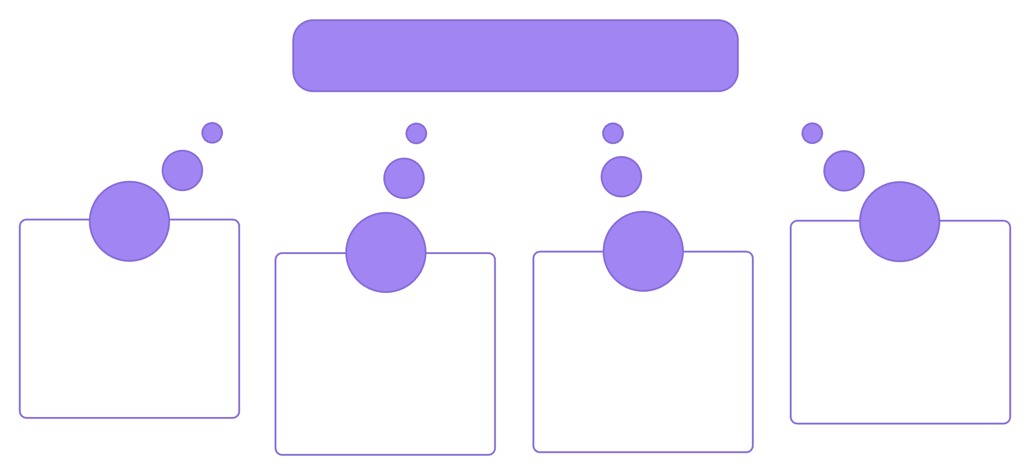

[UX.VECTOR] MULTI_PATH_DELIVERY
Personalization turns one game into many experiences
A SINGLE CODEBASE ADAPTS ITS RECOMMENDATIONS, PACING, NARRATIVE FOCUS, AND CHALLENGE TO INDIVIDUAL PLAY STYLES
Player State
Real-time telemetry
Adaptive challenge
Assistive controls
Dynamic pacing
Tailored narrative
Micro-calibrated tension.
Autonomous ergonomics.
Rest intervals matching stamina.
Quests reflecting choices.
RETENTION IMPROVES WHEN THE SYSTEM DYNAMICALLY MEETS THE PLAYER AT THEIR EDGE OF MASTERY.
Notes:
Explain how personalization creates distinct experiences from identical assets. Highlight that dynamic difficulty and tailored narrative pacing dramatically reduce churn.

Slide 8

WORKBENCH.IMG
[WORKFLOW.LEVERAGE] COGNITIVE_AMPLIFICATION
Developers gain leverage, not a magic button
AI automates tedious mechanical toil so teams spend disproportionate time on high-conviction creative choices.
WORK_REALLOCATION.LOG
Repetitive tasks offloaded
Collision mesh debugging, automated localization checks, and edge-case QA pass to background workers.
Multiplied creative judgment
Level designers direct algorithmic layout sweeps in hours instead of manually placing foliage for months.
Accelerated experimentation
Prototyping unusual mechanics happens in days, lowering the cost of bold gameplay bets.
Notes:
Clarify developer sentiment: generative tools are not replacing creative craft, but removing the soul-crushing repetitive work of manual asset propagation and regression testing.

Slide 9








[TELEMETRY.LOOP] AUTONOMOUS_OPS
Live-service games can learn from every session
CONTINUOUS LIVE TELEMETRY FEEDS AUTOMATIC BALANCING, TUNING, AND CONTENT INTERVENTIONS
Observe
Detect
Collect gameplay logs, churn points, and heatmaps.
Identify weapon imbalance, exploits, or player drop-off.
Measure
Intervene
Verify engagement recovery and adjust algorithmic weights.
Deploy localized balance patches or dynamic events.
GAMES SHIFT FROM STATIC SOFTWARE RELEASES INTO CONTINUOUSLY CALIBRATED ORGANIC SERVICES.
Notes:
Walk through the four steps of the live-service learning flywheel. Illustrate how automated data loops can stabilize meta shifts and retain players before frustration sets in.

Slide 10
[RISK.AUDIT] BOUNDARY_CONDITIONS
The hard problems are trust, control, and cost
Building sustainable autonomous game systems requires solving three severe engineering and economic constraints.
TRUST
CONTROL
COST
Creative coherence
Safety & moderation
Inference economics
Unguarded generative systems drift into nonsensical dialogue and game-breaking lore violations without tight semantic rails.
Real-time player-facing generation requires sub-second content filtering, copyright protection, and defensive boundaries.
Running continuous LLMs and diffusion passes per concurrent player destroys server unit margins without edge deployment.
STRATEGIC IMPERATIVE: THE WINNERS WILL BE STUDIOS THAT BUILD ROBUST CONTAINMENT ARCHITECTURES AROUND THEIR MODELS.
Notes:
Conclude with the reality check: trust, control, and unit economics determine which AI features survive beyond tech demos into commercially viable titles.

