Slide 1
Sales & Financial Dashboard
Interactive Dashboard for Business Insights
Saiteja | Tableau | Task 4

Slide 2
Objective
Build an interactive dashboard for business stakeholders.
Track KPIs like Sales, Profit, and Growth.
Provide time-series and regional/category analysis.
Enable interactivity with slicers and filters.

Slide 3
Key KPIs Tracked
KPI | Description
Total Sales | Overall revenue
Total Profit | Revenue minus cost
Profit Margin | Profit ÷ Sales
Sales Growth (%) | % increase in sales over time
Orders Count | Total transactions/orders

Slide 4
Dashboard Features
✅ Slicers: Region, Category, Date
✅ Summary Cards: Sales, Profit, Growth
✅ Time-Series Charts: Monthly/Quarterly trends
✅ Category/Region Analysis (Bar/Map visuals)
✅ Consistent Color Theme + Clean UI
✅ Drill-down Interactivity + Tooltips

Slide 5
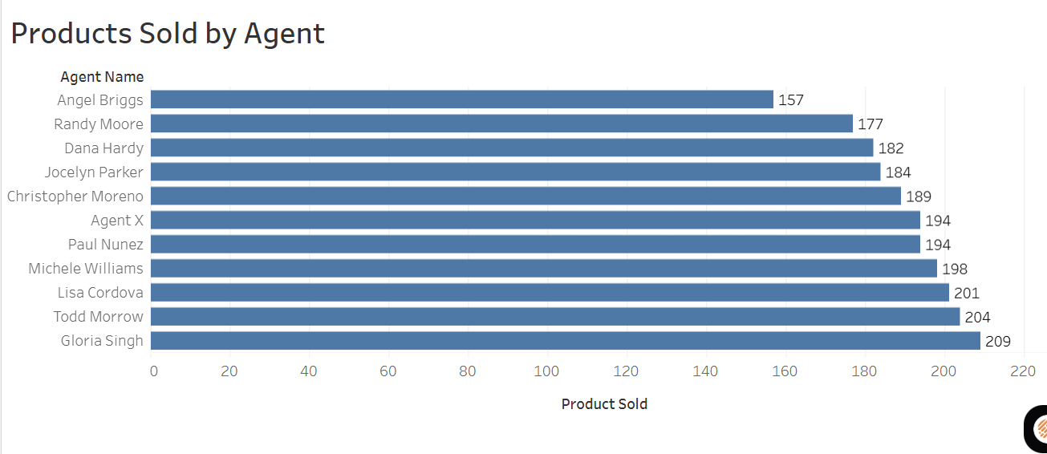

Slide 6
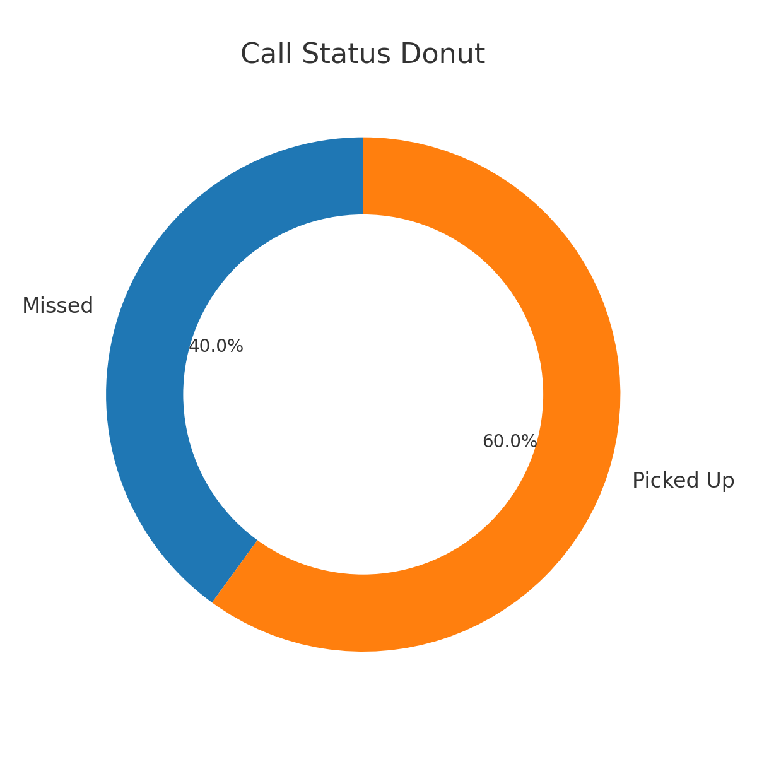

Slide 7
Key Insights
Region A has the highest profit margin (24%).
Category X saw a 30% sales growth QoQ.
Sales dip in Q2 across multiple regions.
Product Line Y underperformed consistently.

Slide 8
Tools & Techniques
Tools Used: Tableau, CSV
Techniques: Data Modeling, Time Intelligence
Drill-down Hierarchies, Interactive Filters

Slide 9
Learnings & Challenges
Learned dashboard design & time-series analysis.
Faced data inconsistencies and filter optimization issues.
Improved visual storytelling and interactivity.

