Slide 1
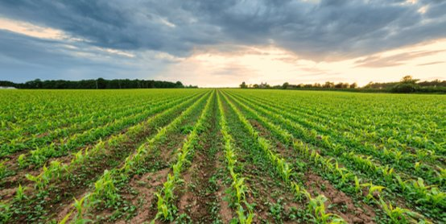
Crop Yield Analysis : ETL Pipeline and Data Visualization
Team Members :
K.Ram Shashank Reddy
B.Pranay
Harshit
Sai Teja
Ashutosh

Slide 2
Presentation Outline
01
02
Project Overview & Importance
ETL Architecture
Understanding the business value of crop yield analysis
Silver and Gold layer implementation strategy
03
04
Technical Implementation
Data Visualization Strategy
PostgreSQL integration and code optimization
Power BI dashboard design and anomaly detection
05
06
Challenges & Solutions
Future Roadmap
Obstacles encountered and mitigation strategies
Machine learning integration and advanced analytics

Slide 3
Why Crop Yield Analysis Matters
Optimize Resource Allocation
Predict Market Trends
Identify Performance Gaps
Efficient use of water, fertilizers, and labor based on historical yield patterns and environmental factors
Forecast supply dynamics to support strategic planning and reduce waste in the agricultural supply chain
Detect underperforming regions and crops to implement targeted interventions and improve overall productivity
Data-driven insights enable stakeholders to make informed decisions that directly impact profitability, sustainability, and food security.

Slide 4


Medallion Architecture: A Layered Approach to Data Excellence
The Medallion Architecture organizes data into three progressive quality layers, transforming raw inputs into business-ready insights through systematic refinement.
Gold Layer: Business-Ready Analytics
Silver Layer: Cleansed & Standardized
Bronze Layer: Raw Data Foundation
Delivers refined, aggregated data products optimized for specific use cases. Powers executive dashboards, KPI tracking, machine learning models, and strategic business intelligence.
Applies data quality rules, deduplication, and schema conformance. Creates validated, consistent datasets ready for analytical workloads and advanced data science applications.
Ingests and preserves raw, unprocessed data in its original form. Serves as the immutable historical archive and single source of truth for all downstream processes.
This progressive refinement ensures data quality improves at each stage, enabling both data governance and rapid time-to-insight for business users.

Slide 5










Bronze Layer: Raw Data Ingestion
Unprocessed Collection
Rainfall Data
Pesticide Records
Raw CSV files ingested using a flexible loader that detects delimiters and preserves original schema for traceability.
Raw precipitation measurements from weather stations and sensors across crop regions
Pesticide usage across the various countries over the years .
Yield Measurements
Temperature Readings
Unprocessed crop yield data collected directly from harvesting operations and field assessments
Raw temperature data from environmental sensors monitoring daily fluctuations and patterns
Historical Preservation
Maintains complete historical records ensuring full traceability and enabling audit capabilities when needed
Country names are standardized later for consistency across all datasets.

Slide 6



Silver Layer: Cleaned and Conformed Data
Data Cleaning
Standardization
Validation
Handles null values, trims whitespace, enforces correct data types, removes duplicates, and validates numeric ranges.
Aligns rainfall, pesticide, yield, and temperature data into unified formats with consistent column naming and canonical country keys.
Applies year-based filtering (1990–2013) and ensures data integrity for downstream analytics
Enterprise-Wide Consistency
Self-Service Analytics Ready
Creates a single source of truth by conforming data from multiple sources into a unified, reliable dataset that maintains granular detail while ensuring consistency across the organization.
Provides "just enough" transformation to enable data scientists and analysts to perform exploratory analysis and build accurate models without requiring extensive preprocessing.
Unified data schemas and naming conventions
Optimized for model training and testing
Consistent measurement units and time zones
Accessible for data science teams
Cross-validated data relationships
Supports ad-hoc querying and exploration

Slide 7
Gold Layer: Curated and Analytics-Ready Data
Regional Aggregations
Pesticide Impact Analysis
Climate Correlations
Aggregates yield and climate metrics by country and year for strategic planning and resource allocation.
Combines pesticide usage with crop yield data to uncover correlations and optimize application strategies.
Integrates rainfall and temperature trends with yield performance for predictive insights.
Executive Dashboards
Predictive Modeling
Actionable Intelligence
Provides clean, structured datasets optimized for machine learning and forecasting future crop performance
Structured datasets optimized for forecasting crop yields, identifying risk factors, and planning future seasons
Delivers analytics-ready data for dashboards, decision-making, and operational improvements.

Slide 8
Data Loading & Power BI Integration
PostgreSQL Integration
Raw crop yield data DF is written in the csv format which is ready for loading
CSV files are imported into PostgreSQL database by establishing JDBC connection
Ensures structured, centralized, and reliable data storage
Power BI Integration
The power BI is then connected to our database
Now all the tables are loaded which are ready for the visualization
Outcome
Efficient data processing and faster analysis
Scalable setup for large agricultural datasets
Accurate insights for crop yield trends and patterns

Slide 9
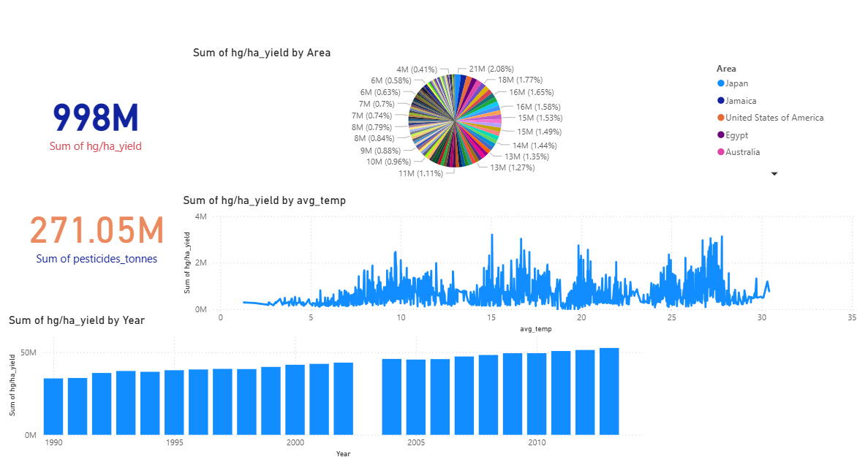
Cumulative Analysis

Slide 10
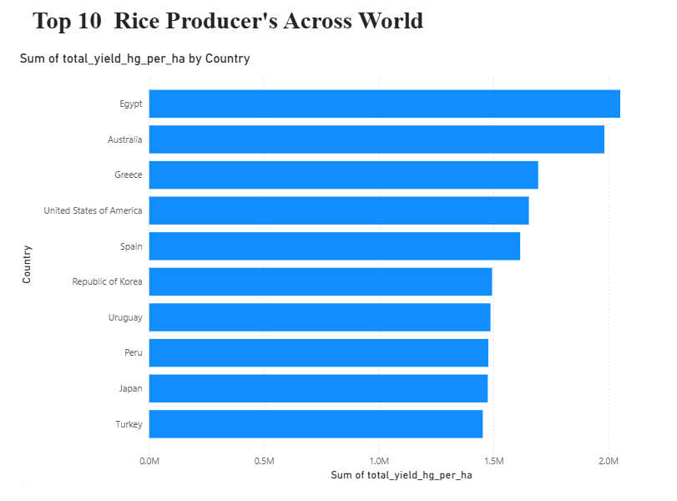
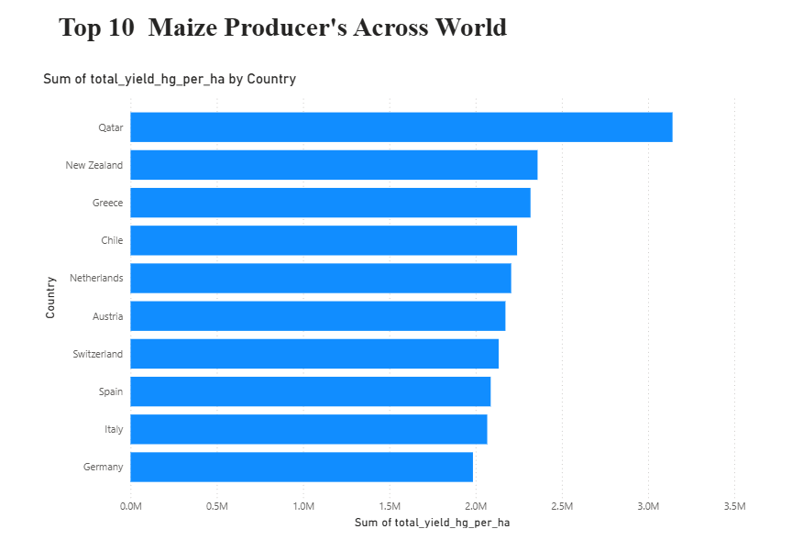
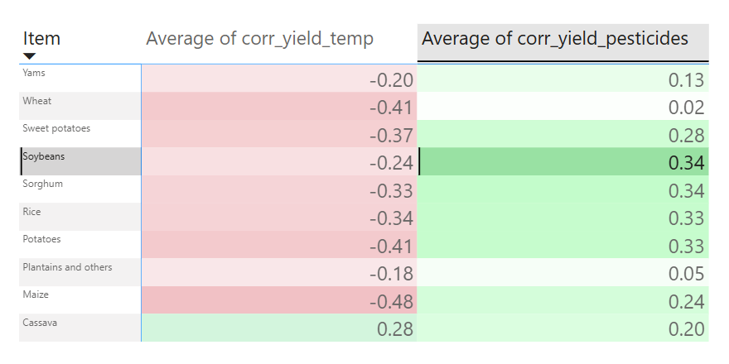
Global Crop Yield Correlations (Temperature ,Pesticides)

Slide 11
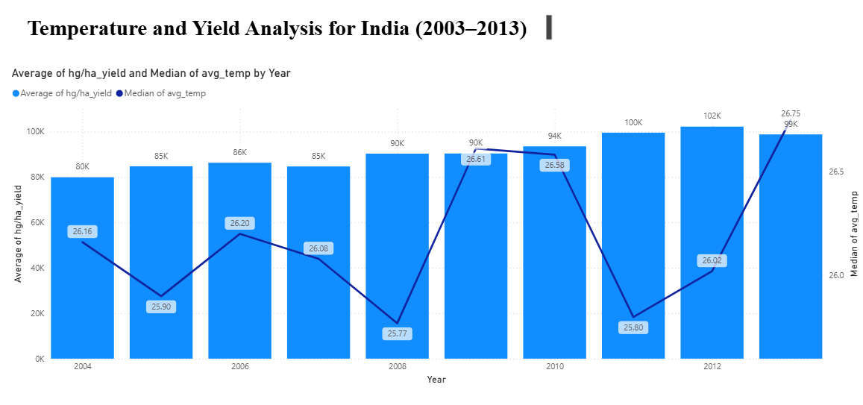
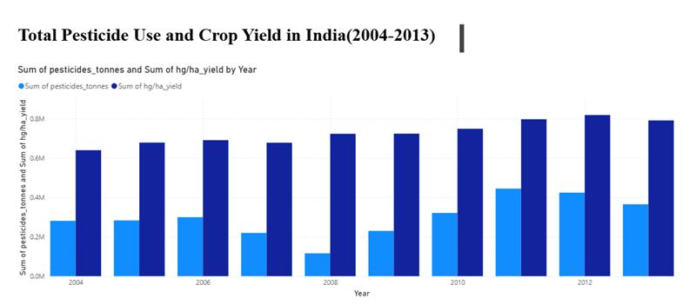
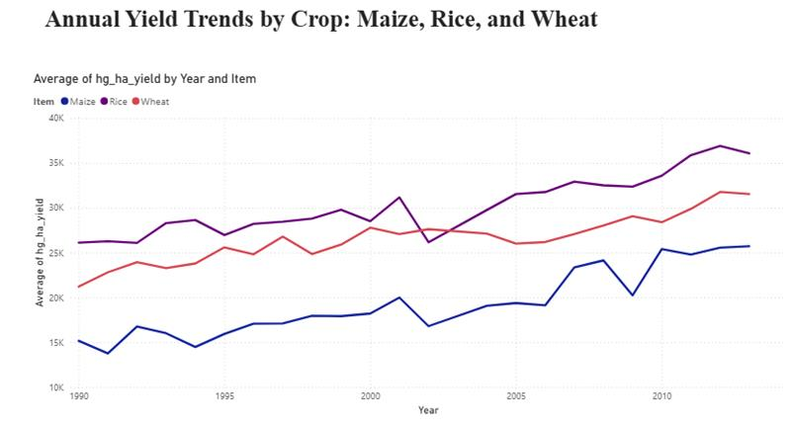

Slide 12
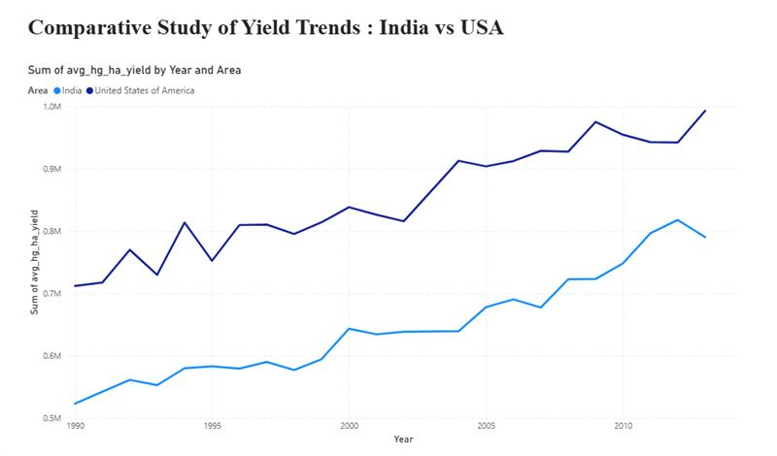
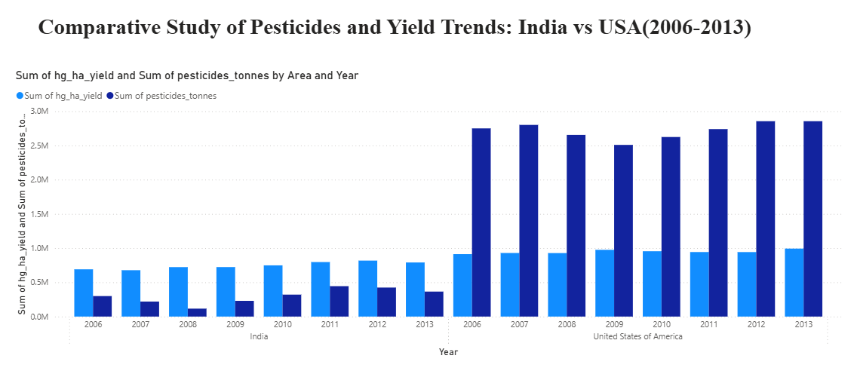
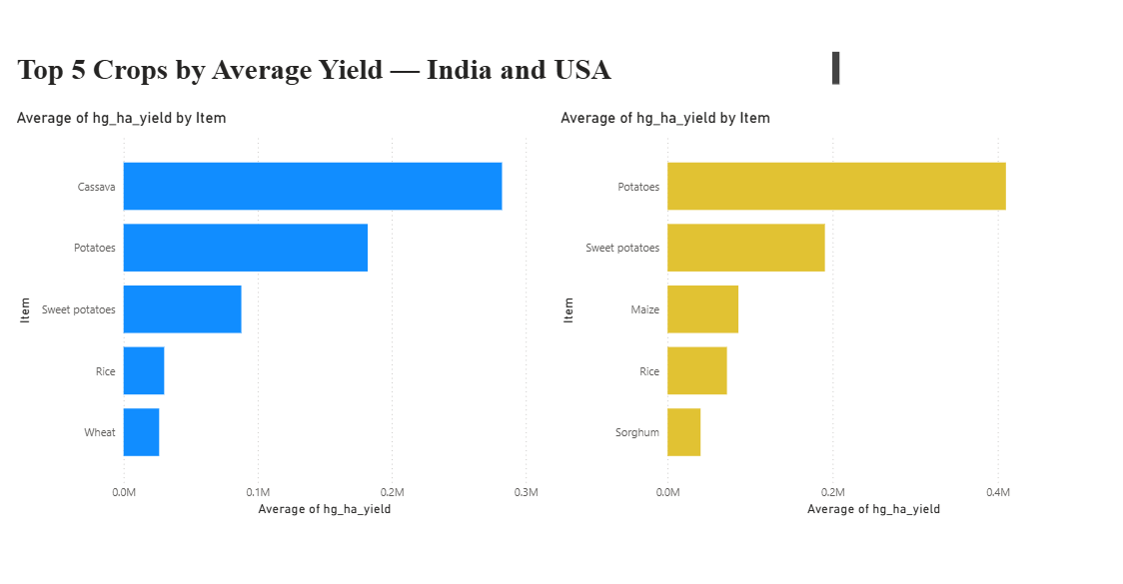
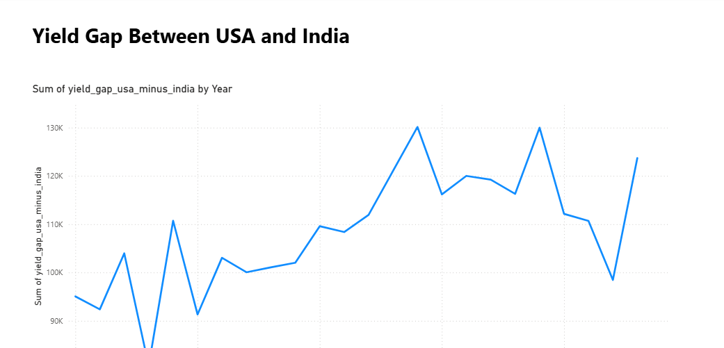

Slide 13




Power BI Analytics & Impact
Yield Trends
Anomaly Detection
Interactive dashboards reveal seasonal patterns and multi-year trends across different crop types and geographic regions, enabling proactive planning.
Automated identification of unexpected yield deviations, highlighting potential issues like pest infestations, irrigation problems, or weather impacts.
Regional Insights
Comparative Analysis
Geospatial analysis comparing performance across farms and regions, identifying best practices and optimization opportunities.
Benchmarking current yields against historical averages and industry standards to measure effectiveness of agricultural interventions.

Slide 14
Challenges
Project Challenges
Data Integration Issues
  Difficulty in merging rainfall, temperature, pesticides, and yield datasets
  Inconsistent data formats and missing values during ingestion
ETL & Environment Setup
  Challenges in configuring Spark and JDBC connections
  Loading transformed data into PostgreSQL efficiently
Tool Integration
  Effort required to connect PostgreSQL with Power BI
  Ensuring stable data refresh and query performance
Business Challenges
Unified Data View
  Need to integrate multiple agricultural data sources into one structure
Scalability & Performance
  Requirement for a scalable ETL pipeline to handle large datasets
Accurate Insights
  Ensuring reliable crop yield analysis under changing weather conditions

Slide 15



Future Scope: Advanced Analytics
Advanced Anomaly Detection
Real-Time Data Streaming
Machine Learning Integration
Utilize unsupervised learning algorithms to automatically identify irrigation failures, pest outbreaks, and equipment malfunctions before they impact yield.
Implement Apache Kafka or Azure Event Hubs for live IoT sensor data processing, enabling immediate responses to changing field conditions.
Deploy predictive models for yield forecasting using historical data, weather patterns, and soil conditions to enable proactive decision-making.
These enhancements will transform our system from descriptive analytics to prescriptive intelligence, driving measurable improvements in agricultural outcomes.

Slide 16
Conclusion & Key Takeaways
Integrated Crop Yield Analysis
Strategic Decision Support
Combined rainfall,temperature,Pesticide,and yield data to provide holistic insights for agricultural performance.
Enabled farmers and policymakers to make data-driven decisions for crop planning and resource allocation
Scalable Data Infrastructure
Agricultural Sustainability Impact
Built a robust ETL pipeline with PostgreSQL and Power BI for efficient data storage,processing, and visualization at scale.
Contributed to improved productivity,optimized resource usage, and promoted sustainable farming practices.

Slide 17
-----------Thank You-----------

