Slide 1

NYPD Shooting Incident and Park Crime Data Analysis
Group Members:
Aditya Bhavsar
Bhargav Balabadrapathruni
Sai Teja Bainapalepu

Slide 2
AGENDA
Objectives
Dataset information
Data preprocessing
SQL queries
Analysis and visualizations
Key insights
Challenges and solutions
Conclusion
future scope

Slide 3
OBJECTIVES:
Analyze crime rates across different boroughs in NYC.
Identify patterns and trends within crime data.
Provide a detailed assessment of data preprocessing steps.
DATASETS:
Dataset : New York Shooting Incident
https://data.cityofnewyork.us/Public-Safety/NYPD-Shooting-Incident-Data-Historic-/833y-fsy8/about_data
Dataset : New York Park Crime
https://data.cityofnewyork.us/Public-Safety/NYC-Park-Crime-Data/ezds-sqp6/about_data
Dataset : https://data.cityofnewyork.us/Public-Safety/NYPD-Shooting-Incident-Data-Year-To-Date-/5ucz-vwe8/about_data

Slide 4
Data Preprocessing
Handling Missing Values: Removed specific columns, replaced missing values with modes for categorical data.
Outlier Treatment: Replaced values in age group and location data with appropriate modes.
DateConversion: Converted OCCUR_DATE and OCCUR_TIME to datetime format and extracted monthly data.

Slide 5
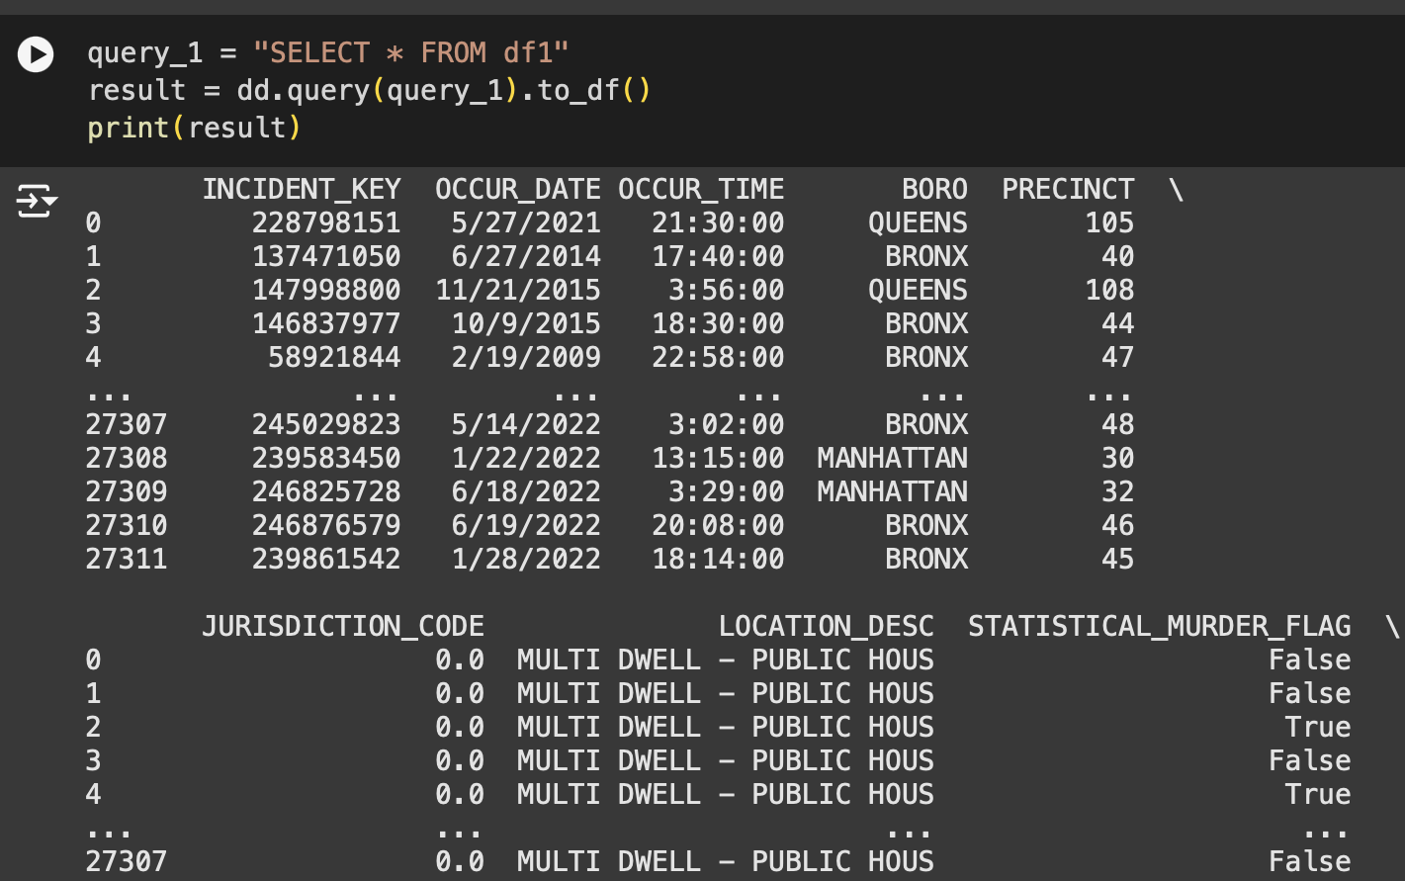
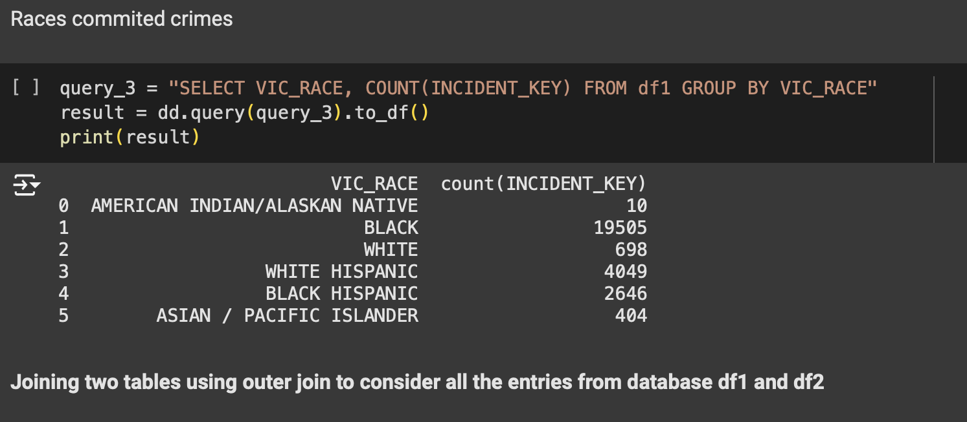
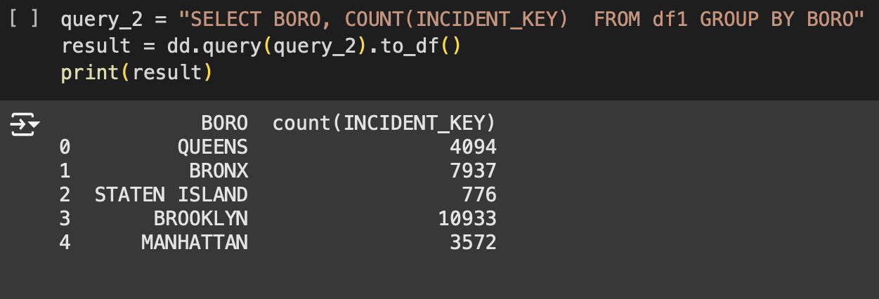
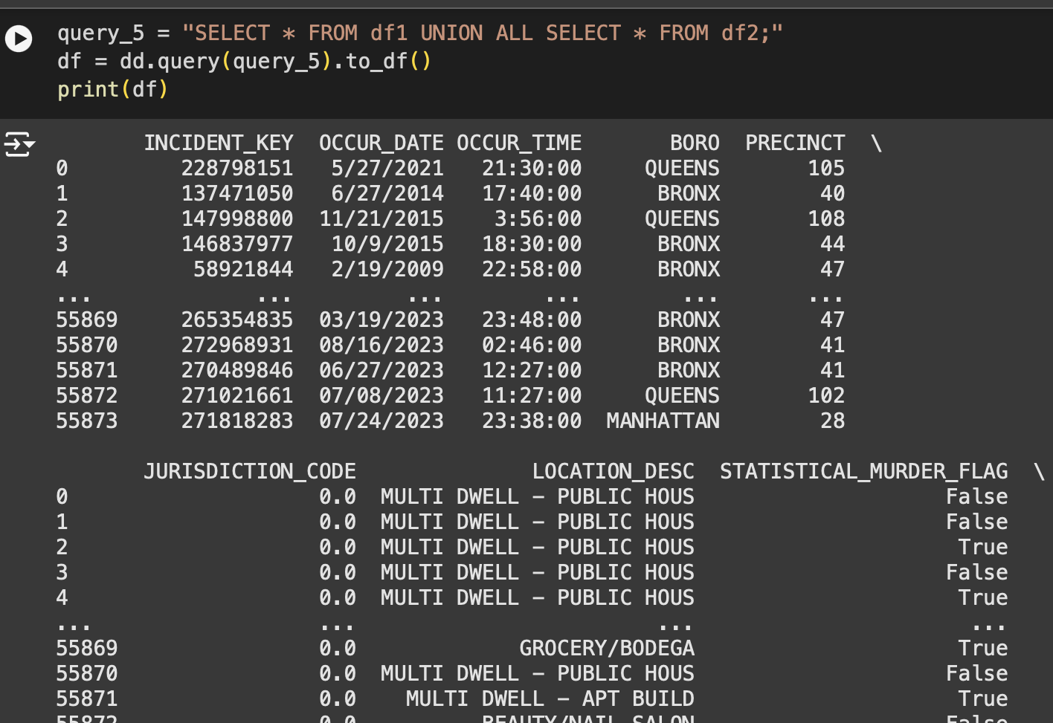
Notes:
Screenshot 2024-11-12 at 7.07.18 PM

Slide 6
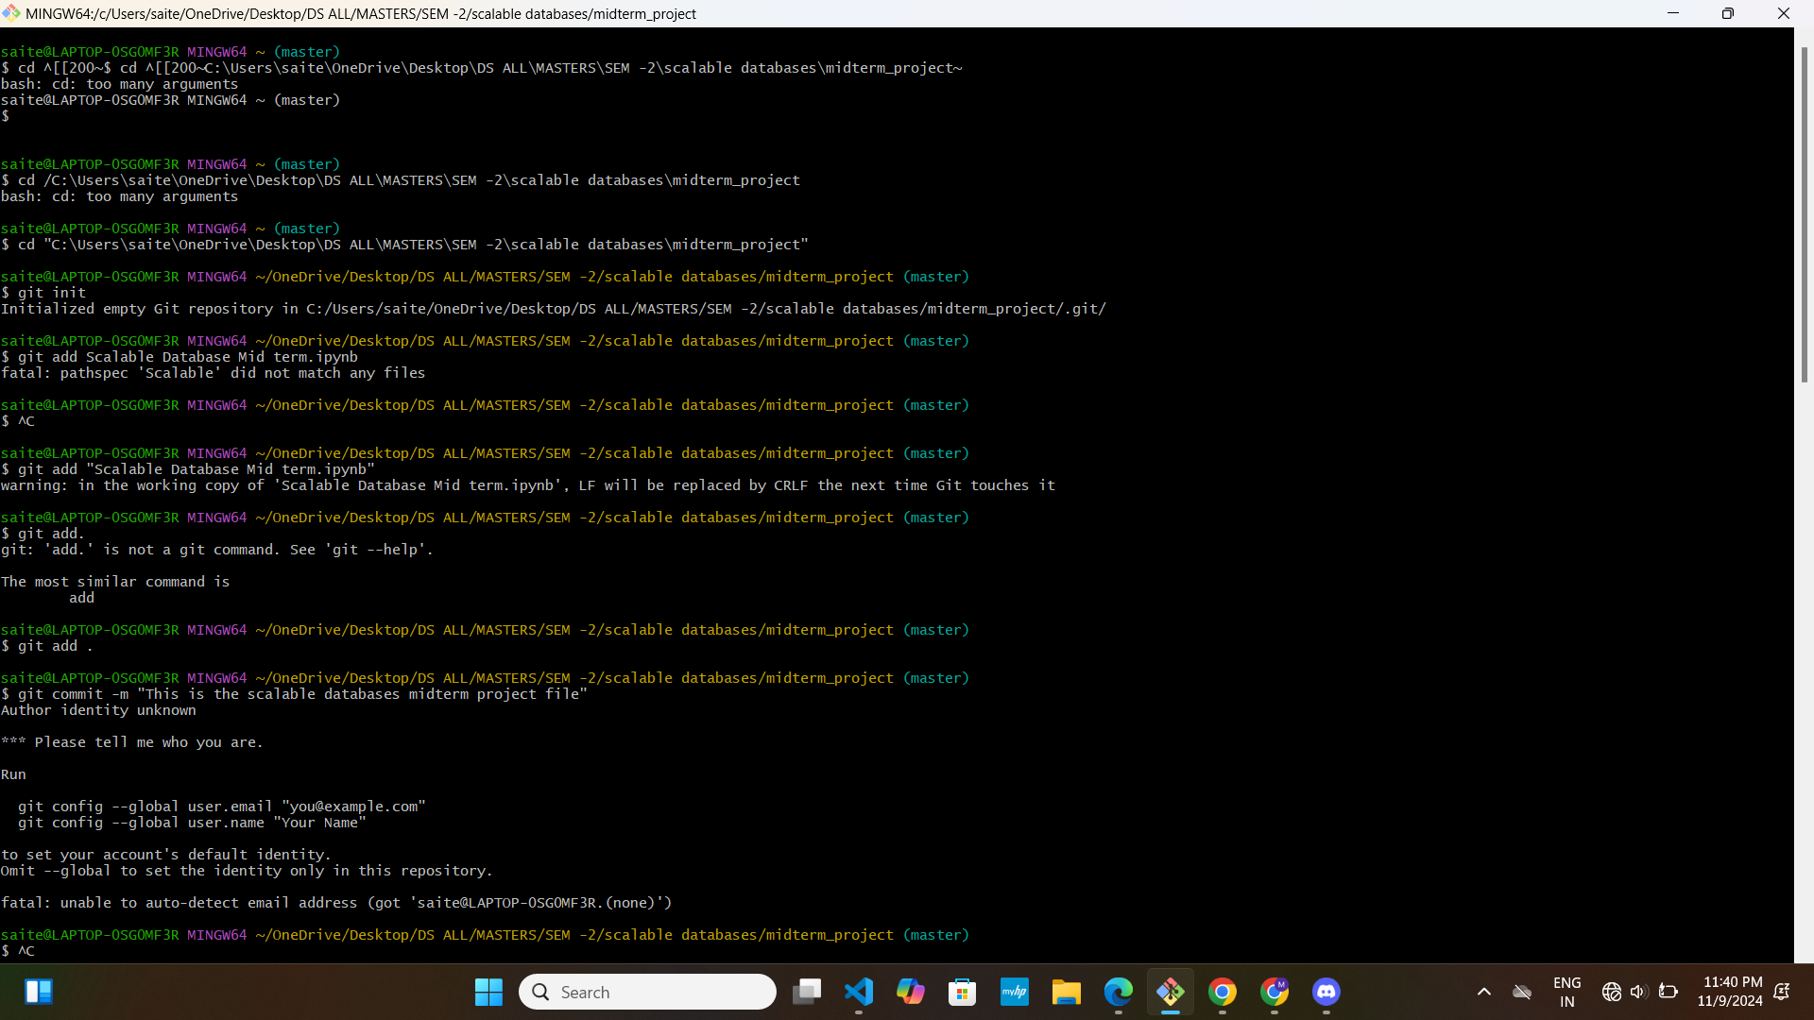
GITHUB VERSION CONTROL

Slide 7
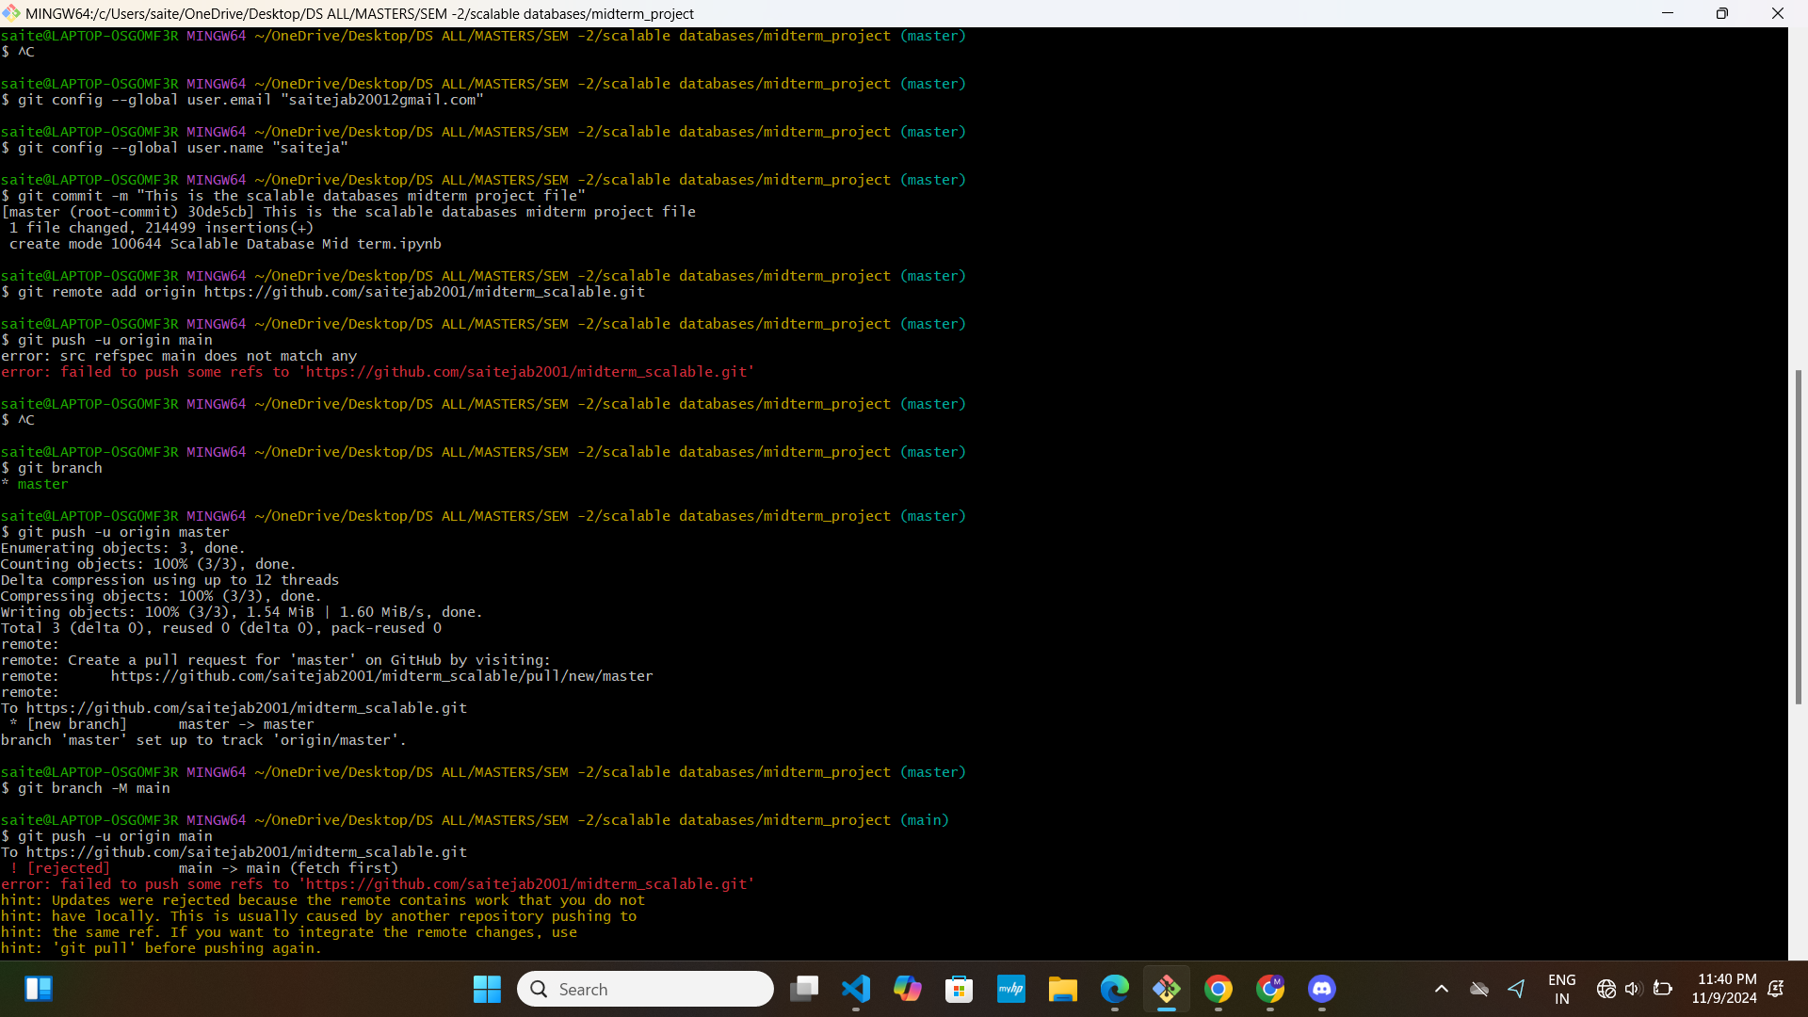

Slide 8
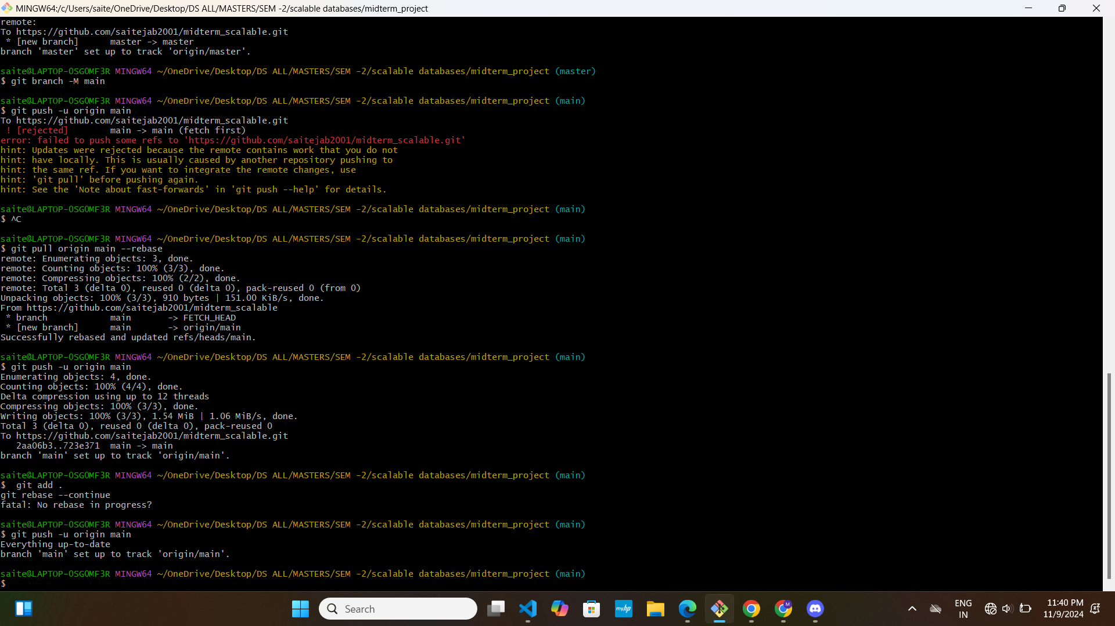

Slide 9
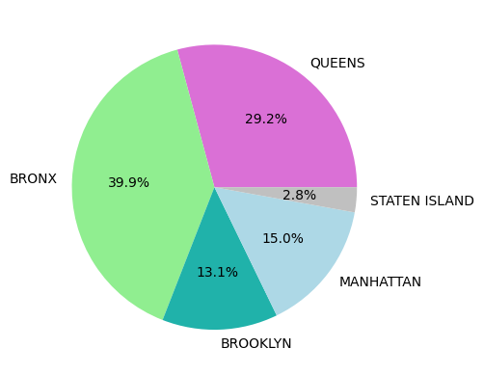
DATA ANALYSIS AND VISUALIZATION
colors_req = ['orchid', 'lightgreen', 'lightseagreen', 'lightblue', 'silver']
plt.pie(df_boro_size, labels=df_boro_unique, autopct='%1.1f%%', colors=colors_req)
INSIGHTS:
Bronx Has the Highest Crime Rate (39.9%): The Bronx accounts for the largest proportion of crime incidents, representing nearly 40% of the total. Queens and Manhattan Follow: Queens has the second-highest crime rate at 29.2%, while Manhattan follows with 15.0%.
Staten Island Has the Lowest Crime Rate (2.8%): Staten Island shows the smallest portion of crime incidents, making up only 2.8% of the total.

Slide 10
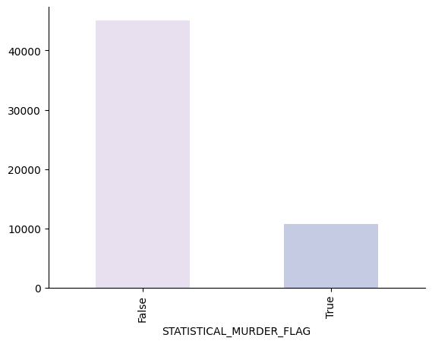
df_murderf_size = df.groupby('STATISTICAL_MURDER_FLAG').size()
df_murderf_size.plot(kind='bar', color=sns.palettes.mpl_palette('PuBuGn'))
plt.gca().spines[['top', 'right',]].set_visible(False)
INSIGHTS:
Majority of Incidents Are Non-Homicide: The bar for False under the STATISTICAL_MURDER_FLAG category is significantly higher than the bar for True, indicating that most incidents in the dataset are not homicides.
Homicide Cases Are a Small Fraction: The True bar is much shorter, showing that only a small percentage of the total recorded incidents involve homicides.
Clear Imbalance Between Categories: The disparity between the two bars suggests a notable imbalance in the types of incidents reported, with non-homicide incidents vastly outnumbering homicide cases.

Slide 11
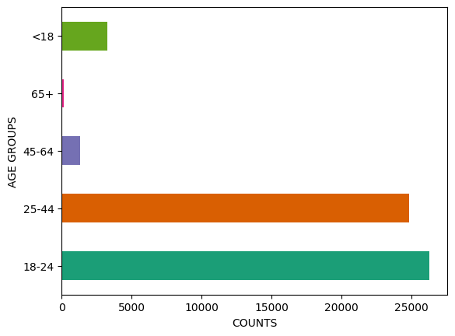
df_perpage_size which counts the values for different age groups
df_perpage_size = df.groupby('PERP_AGE_GROUP').size()
df_perpage_size.plot(kind='barh', color=sns.palettes.mpl_palette('Dark2'), xlabel="COUNTS", ylabel='AGE GROUPS')
INSIGHTS:
Age Groups:
The 18-24age group has the highest count of incidents, closely followed by the 25-44 age group.
Counts decrease significantly for the 45-64 and 65+ age groups, with the lowest counts in the 65+ group.
Juveniles (under 18) are also represented but in much smaller numbers than adults aged 18 and above.

Slide 12
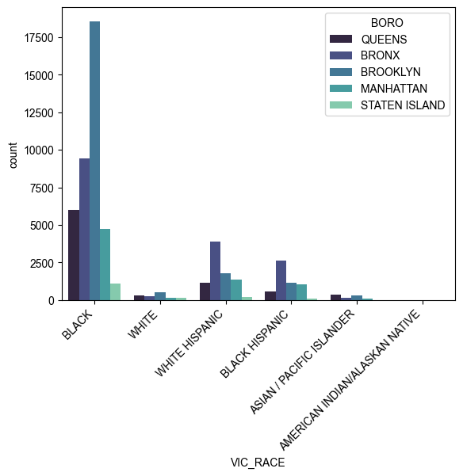
plt.xticks(rotation=45, ha='right', fontsize=10)
sns.countplot(x = "VIC_RACE", hue = "BORO", data=df, palette='mako' )
sns.set_theme(rc={'figure.figsize':(20,6)})
INSIGHTS:
Victim Race and Borough:
Black victims have the highest count across all boroughs, particularly in the Bronx.
White, White Hispanic, and Black Hispanic victims are represented at lower levels across boroughs.
Asian/Pacific Islander and American Indian/Alaskan Native victims have very low counts across all areas.

Slide 13
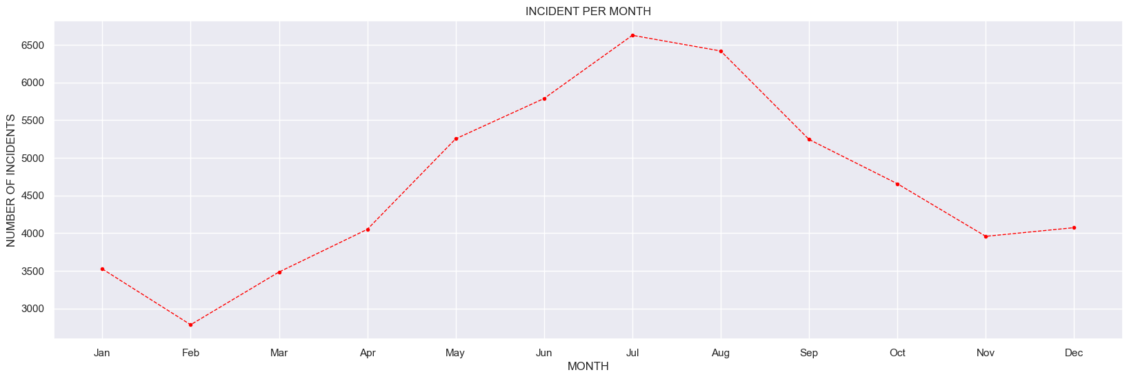
plt.plot(incident_month.index, incident_month, marker='.', color='red', linestyle='--', linewidth=1)
plt.title('INCIDENT PER MONTH')
plt.xticks(range(1, 13), ['Jan', 'Feb', 'Mar', 'Apr', 'May', 'Jun', 'Jul', 'Aug', 'Sep', 'Oct', 'Nov', 'Dec'])
plt.xlabel('MONTH')
plt.ylabel('NUMBER OF INCIDENTS')
plt.figure(figsize=(12, 6))
plt.show()
INSIGHTS:
Incident per Month:The number of incidents per month follows a cyclical pattern, peaking around mid-year and declining towards the end of the year.
There is a sharp increase in incidents around April-May, reaching the highest point in July.
After July, the number of incidents starts decreasing, with the lowest point being in December.

Slide 14
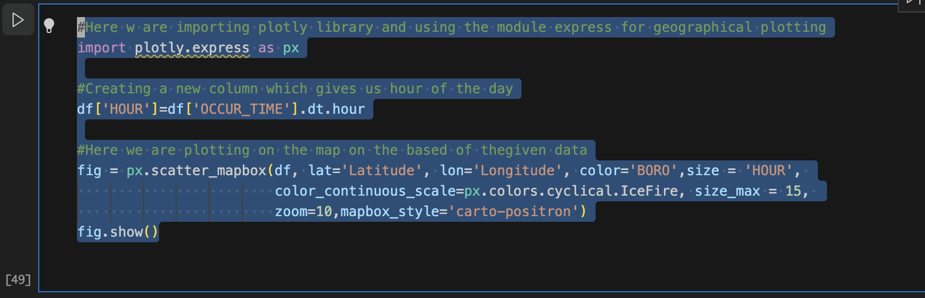
Plotly.express

Slide 15
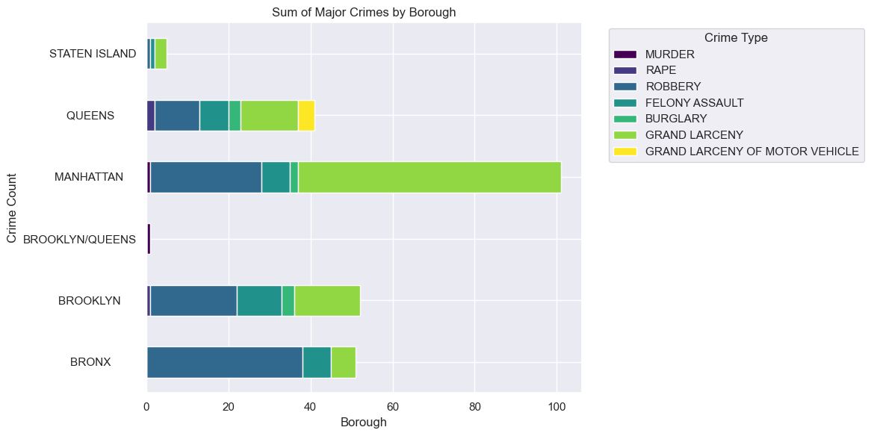
DATASET-2
INSIGHTS:
Sum of Major Crimes by Borough,Manhattan has the highest overall sum of major crimes, followed by the Brooklyn, bronx, and queens.
There is a significant difference in the total number of crimes between Manhattan and the other boroughs.

Slide 16
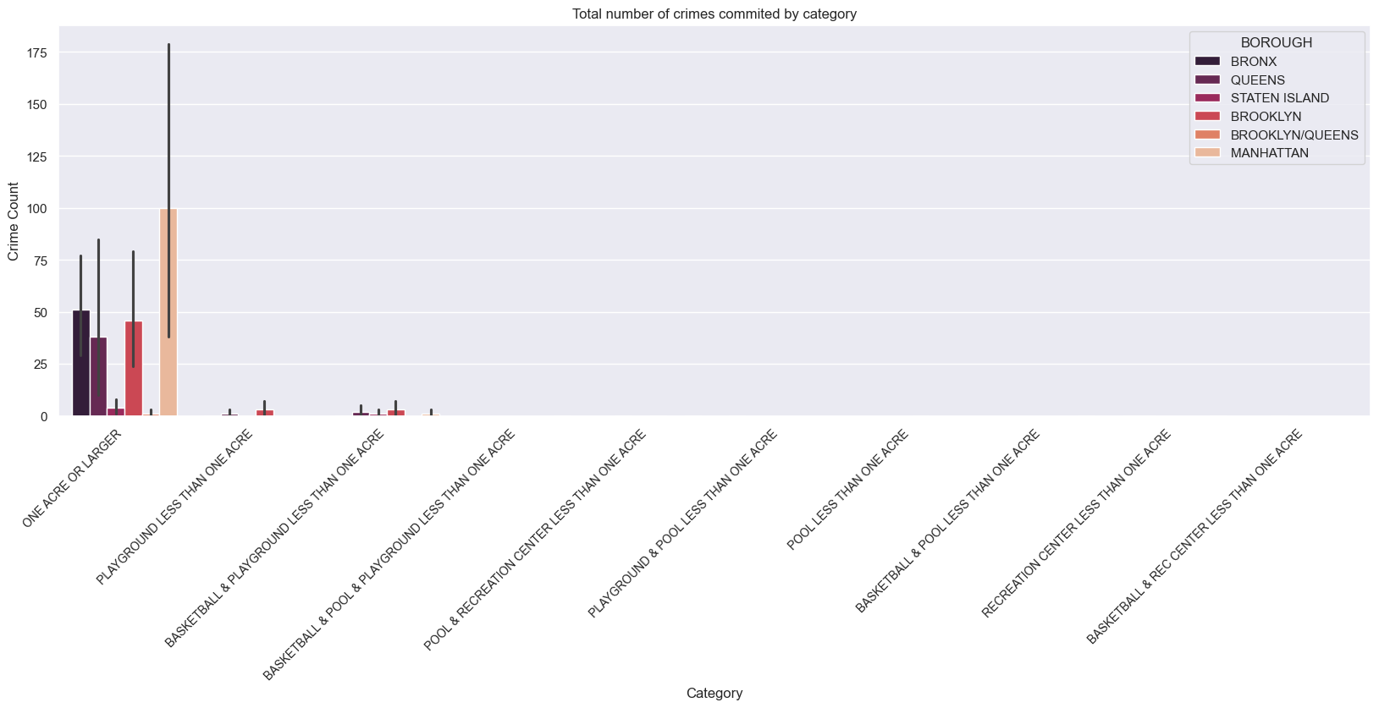
plt.xticks(rotation=45, ha='right', fontsize=10)
sns.barplot(data,x='CATEGORY', y='TOTAL', hue='BOROUGH', estimator='sum', palette='rocket')
plt.title('Total number of crimes commited by category')
plt.xlabel('Category')
plt.ylabel('Crime Count')
plt.show()
INSIGHTS:
Total Number of Crimes by Category:"Playground less than one acre" and "Basketball & Playground" have the highest total number of crimes across all boroughs.
Crimes related to "Recreation center less than one acre" and "Baseball & Recreation center" have relatively lower occurrences.

Slide 17
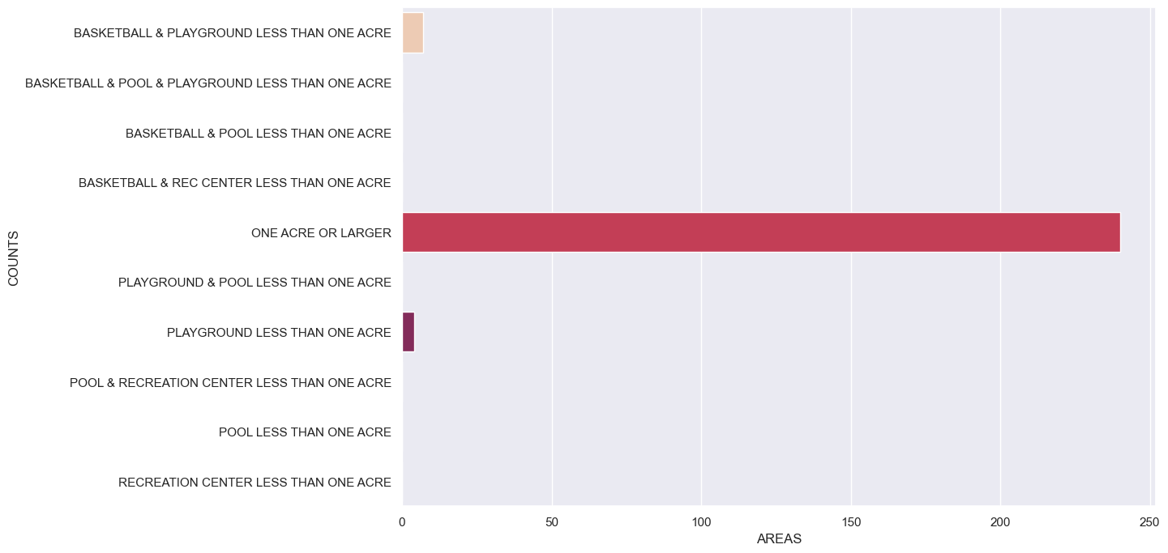
db_category = data.groupby('CATEGORY').sum()
db_category.head()
sns.set_theme(rc={'figure.figsize':(12,8)})
bar = sns.barplot(x='TOTAL', y='CATEGORY', data=db_category, palette='rocket_r')
bar.set(xlabel='AREAS',ylabel='COUNTS')
INSIGHTS:This chart shows different types of basketball and recreation facilities and their associated areas in square feet.The facilities range from "Basketball & Playground Less Than One Acre" to "One Acre or Larger".The chart indicates that larger facilities like "One Acre or Larger" take up significantly more area compared to smaller facilities like "Basketball & Playground Less Than One Acre".

Slide 18
Challenges and Solutions
Data Completeness: Missing values in key fields were filled with statistical imputations.
Outliers: Replaced improbable values for PERP_AGE_GROUP and other fields with more realistic figures.
Complex Joins: Merged datasets using SQL queries with DuckDB to unify records.

Slide 19
Conclusion:
Majority of crime committed among the five boroughs is Bronx.
Highest crime committed in Bronx were by Blacks and Hispanics people.
Age group fond of committing crime belongs to age group of 25-44.
The month with highest crime rate is July and the least crime rate is in February .
The percentage of arrests is higher for males across all races in NYC.

Slide 20
FUTURE SCOPE
Incorporate Predictive Analytics Future work could involve building predictive models to forecast crime trends in NYC based on factors like time of day, location, and historical crime data. This could help law enforcement proactively allocate resources to high-risk areas.
Expand Data Sources Integrate additional datasets, such as socioeconomic factors, weather conditions, and population density, to analyze how these variables may correlate with crime patterns and potentially influence crime rates in specific boroughs or neighborhoods.
Real-time Data Integration Explore integrating real-time data feeds, such as emergency service call logs or live crime reports, to enable dynamic and up-to-date crime analysis. This could support near real-time decision-making and improve response strategies.
Enhanced Geographic Analysis Use more detailed geographic mapping, such as block-level or street-level analysis, to pinpoint crime hotspots within boroughs. Combining this with demographic data can yield finer insights into specific areas with higher crime incidence.

