Slide 1
Sales Forecasting for
Small Basket
D L SAI TEJA
Emp-id:5026
Batch-121R

Slide 2

















Problem Statement
Small Basket is a huge online / mobile application-based grocery retailer in India, founded in 2011. Small Basket is trying to manage its supply chain and delivery partners and would like to accurately forecast the sales for the period starting from January of 2019 to August of 2019. They are looking for a model that can forecast sales accurately across various locations and product categories. This means they want to understand how their sales are affected by the location of the customers and the type of products they sell. They have provided some features that might help in analyzing their sales patterns and also given a few features that were developed by the Business Intelligence team, that might or might not provide additional information

Slide 3

Return of Investment (ROI)
The accurate sales forecast for the period starting from January 2019 to August 2019
It can help the company to take necessary strategies to increase profit and improve sales.
For example, if the sales forecast shows a higher demand for perishable items, the company can focus more on stocking up and promoting perishable items to meet the demand.
The analysis can also help to identify the business units belonging to which cluster will see the highest amount of sales in 2019.
Which products and locations are likely to have the highest sales, and use this information to optimize supply chain management and inventory control. Particular types of promotions or discounts that are more effective in driving sales.
If there are particular locations or types of stores that are more effective in converting transactions into sales. This could help to identify areas where additional marketing or sales training may be needed.
Based on this information, the company can allocate more resources and efforts to those units to maximize their sales and profit. Additionally, the top 10 selling items in this cluster can be identified, and the rate of purchase per week for these items can be calculated.
Information can help the company to optimize their inventory and supply chain management to meet the demand for these items.

Slide 4

Business Usecases
1.Inventory management: Accurate sales forecasting can help Small Basket manage its inventory better, ensuring that it has enough stock to meet demand while minimizing overstocking and wastage.
Resource allocation: Sales forecasting can help Small Basket allocate its resources effectively, including labor, delivery vehicles, and warehouse space. This can help optimize operations and reduce costs.
Revenue forecasting: Accurate sales forecasting can help Small Basket forecast its revenue more accurately, allowing it to make more informed decisions about investments and expansion plans.
Customer service: By accurately forecasting sales, Small Basket can better anticipate demand for certain products or categories, which can help it provide better customer service by ensuring that products are always in stock.
Marketing and promotions: Sales forecasting can also help Small Basket plan marketing and promotional activities more effectively, by identifying periods of high demand and creating targeted campaigns to drive sales during those periods.

Slide 5

Data
train
train_transactions
item_details
location_details
train.csv | Data type
date | datetime64[ns]
locationId | category
item_id | category
unit_sales | float32
Onpromotion | category
On which day sale happened
Location of sale dispatch
Ids of the sold items
Unit sales from x location on y date
Whether an item is on promotion or not
shape:(101688779, 5)
memory usage: 4.5 GB -> 1.5 GB

Slide 6
Data
slide4
train
train_transactions
item_details
location_details
train_transactions.csv | Data type
date | datetime64[ns]
locationId | category
transactions | category
Date during which the number of transactions are measured
Locations where the transactions were held
No.of transactions happened on that day
shape:(71391, 3 )
memory usage: 1.16 MB ->769.5 KB

Slide 7
Data
slide4
train
train_transactions
item_details
location_details
item_details.csv | Data type
item_id | category[ns]
category_of_item | category
class | category
perishable | category
item_details.csv | Data type
item_id | category[ns]
category_of_item | category
class | category
perishable | category
Ids of all items they have
Which category does the item belongs to
Which class the item belongs in business view
Whether item spoil or not over tie such as food
shape:(4100, 4 )
memory usage: 197.2 KB -> 95KB

Slide 8
Data
train
train_transactions
item_details
location_details
location_details.csv | Data type
locationId | category[ns]
city | category
state | category
type | category
cluster | category
Locations store/warehouse(unit)
City of unit
State of unit
Type of business unit
The cluster that the unit belong to (by business intelligence)
shape:(54, 5 )
memory usage: : 6KB -> 5.1 KB

Slide 9
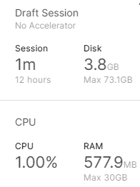
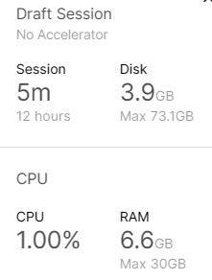
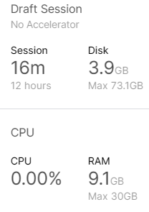
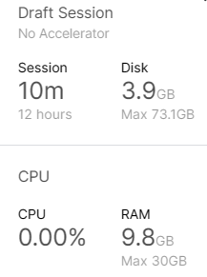
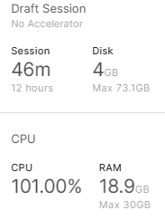
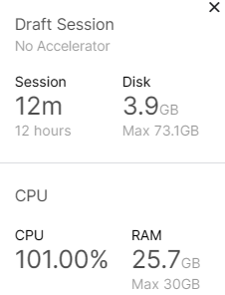
Initially
Data Handling
train_df | Data type
date | datetime64[ns]
locationId | category
item_id | category
unit_sales | float32
Onpromotion | category
transactions | Int 64
category_of_item | category
class | category
perishable | category
city | category
state | category
type | category
cluster | category
After loading datasets using reduce
After Merging
After EDA
After Visualisation
After Feature Engineering

Slide 10
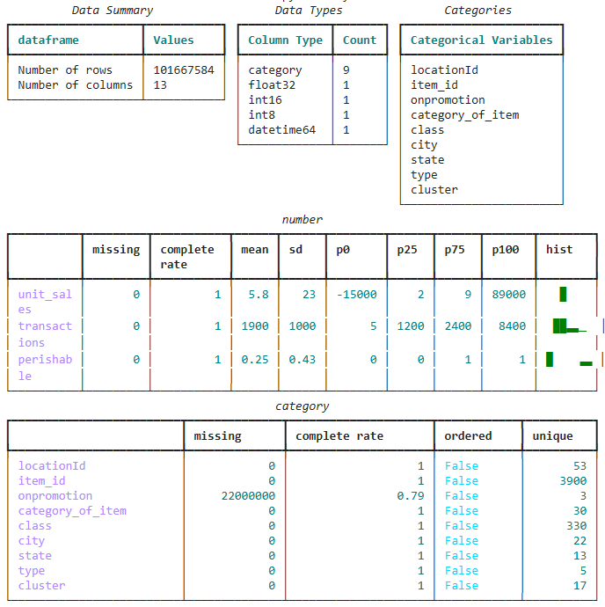
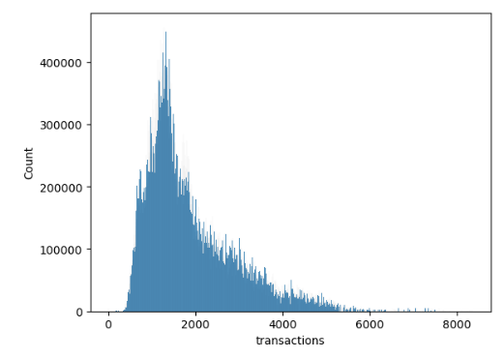
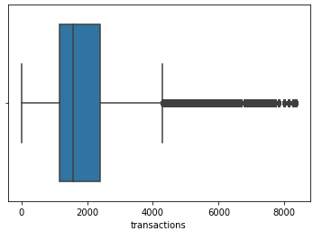
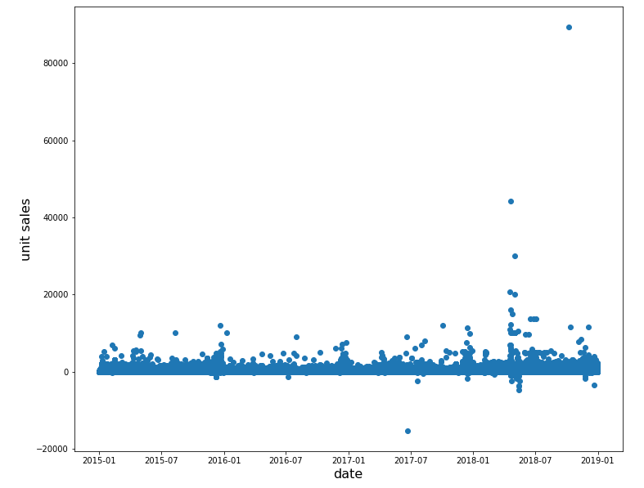
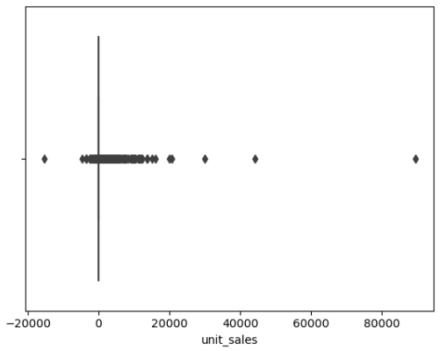
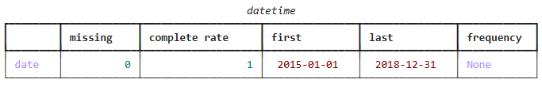
EDA & Data Visualisation

Slide 11
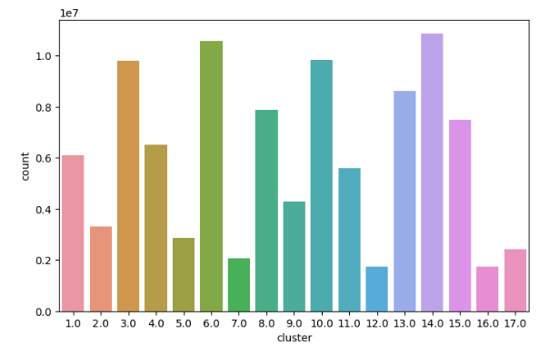
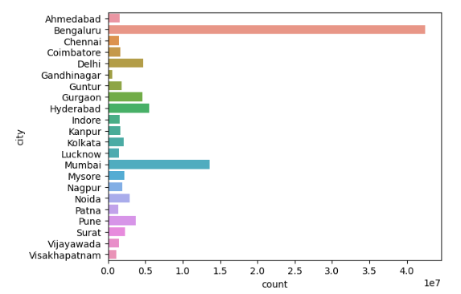
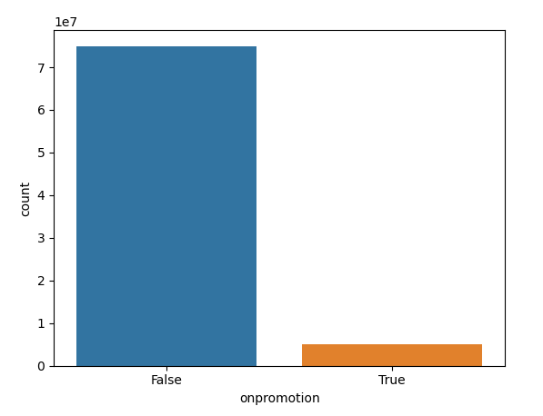
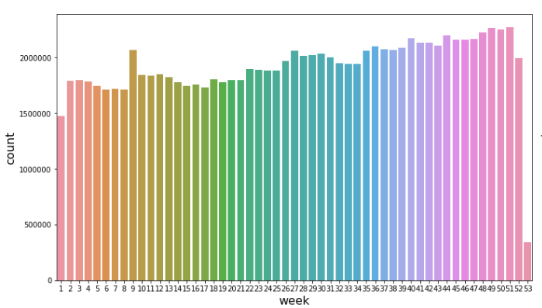
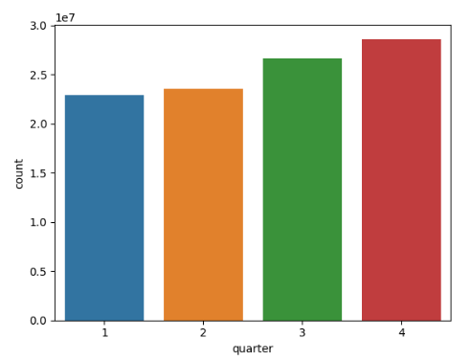
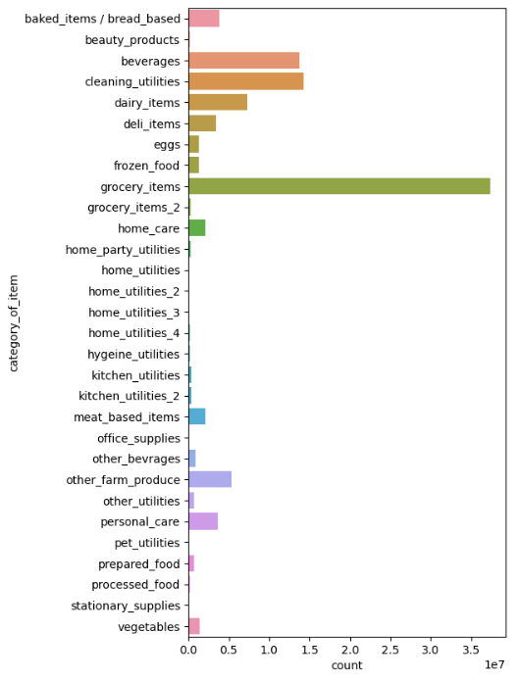
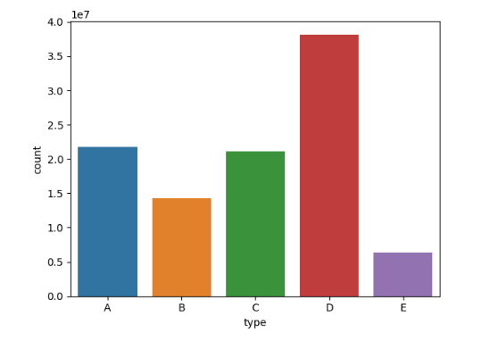
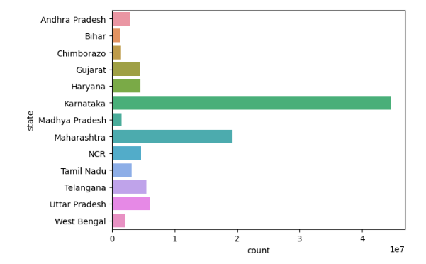
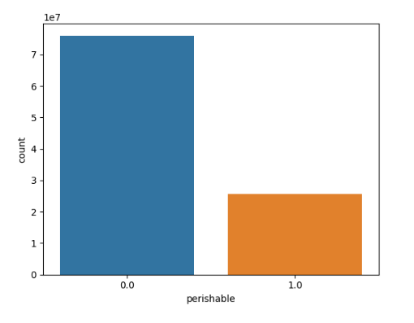
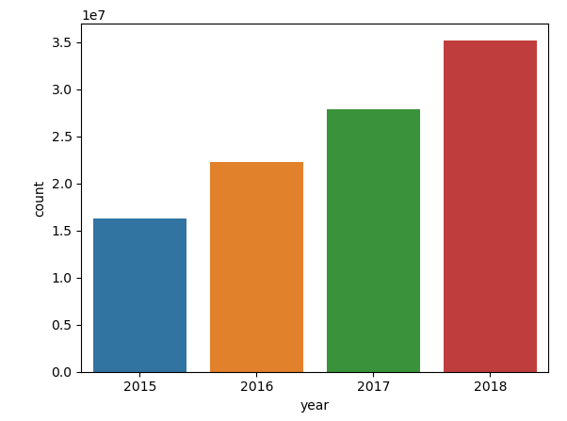
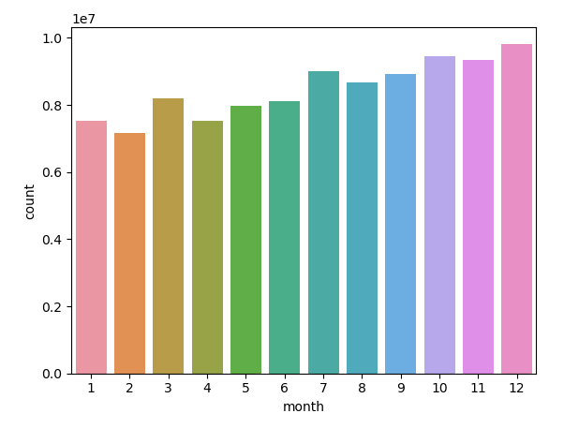
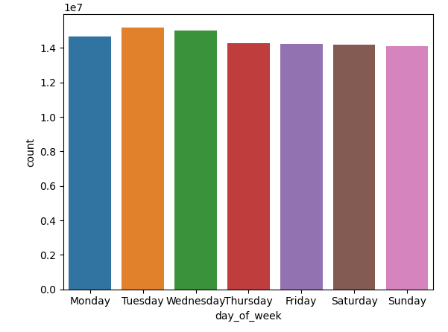
EDA & Data Visualisation

Slide 12
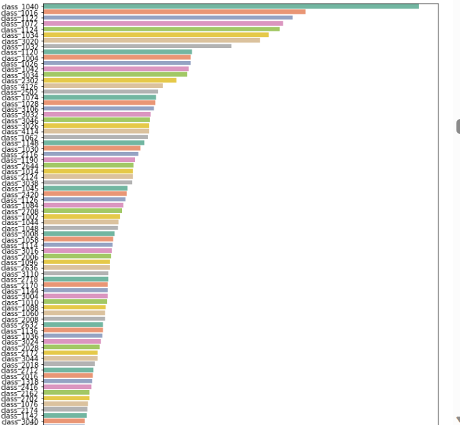
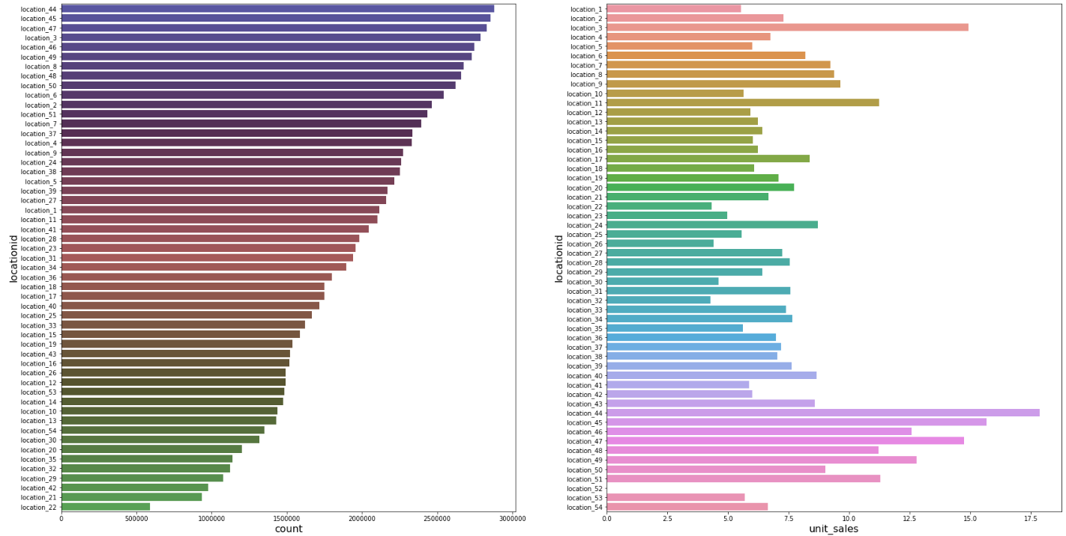
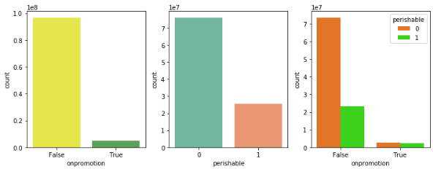
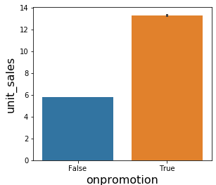
EDA & Data Visualisation
count

Slide 13
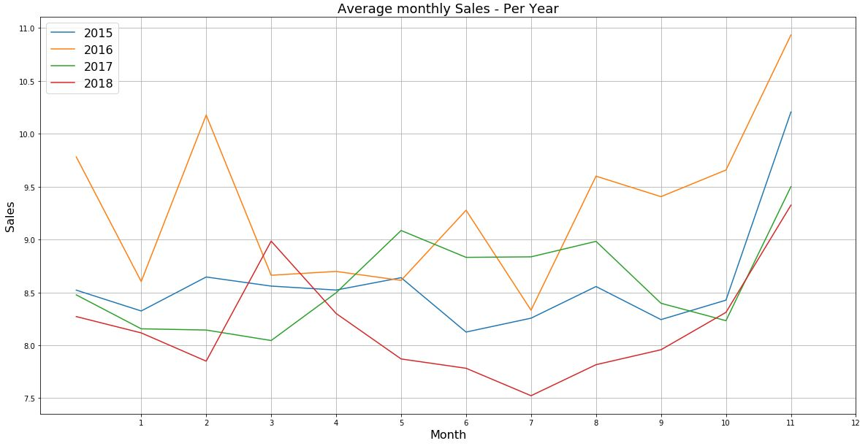
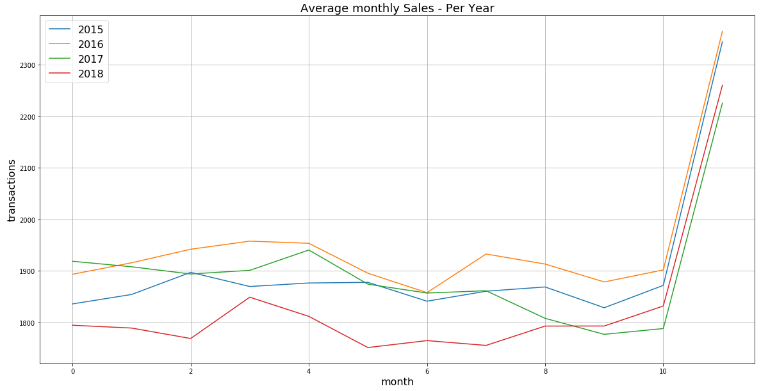
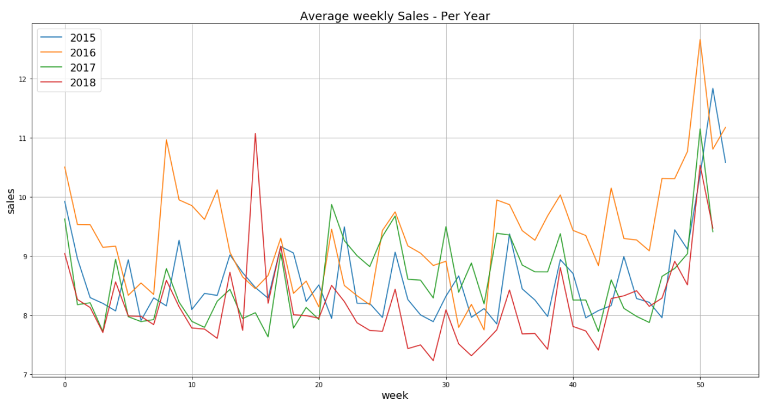
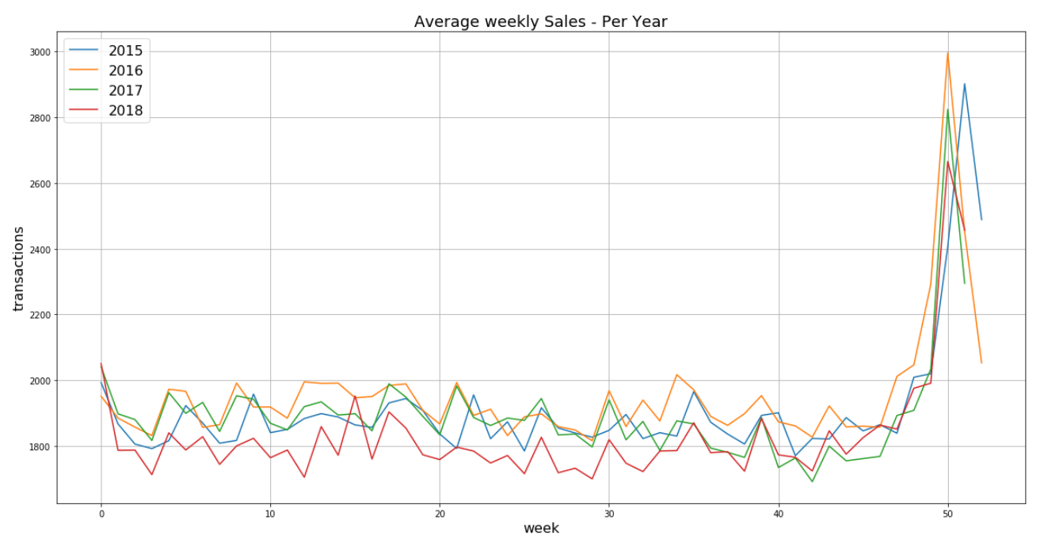
EDA & Data Visualisation

Slide 14

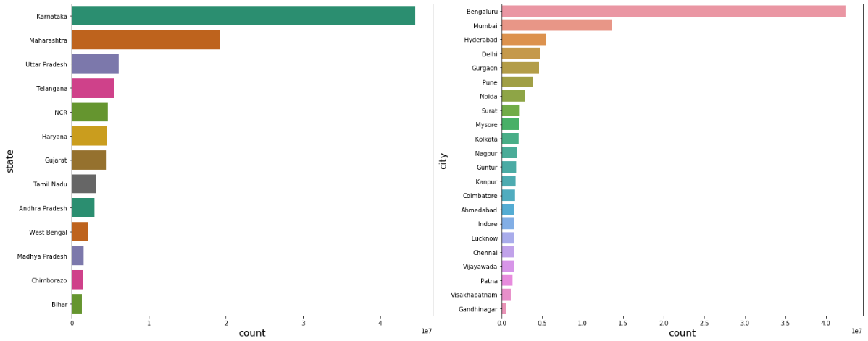
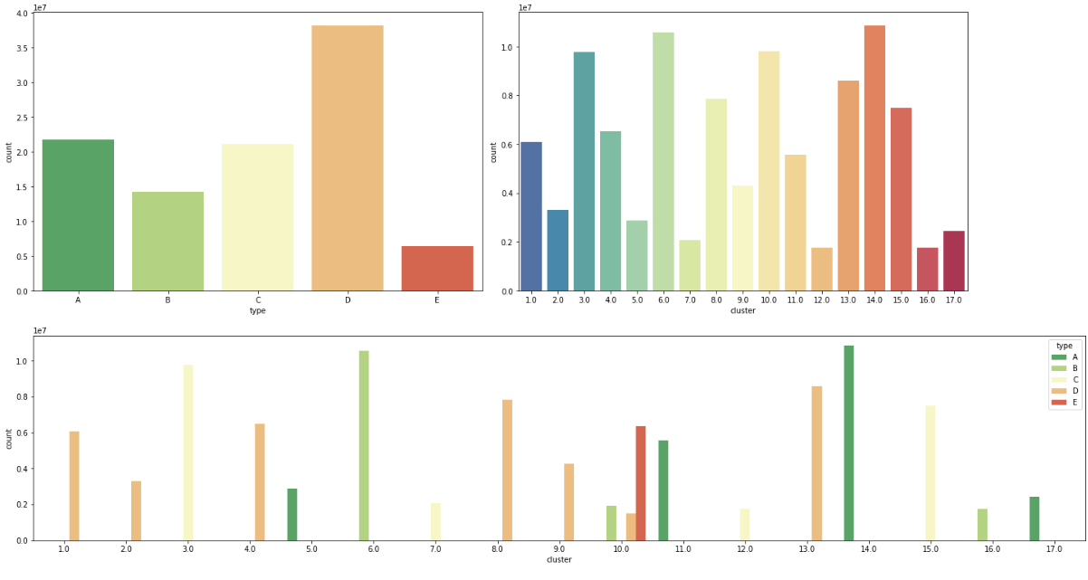
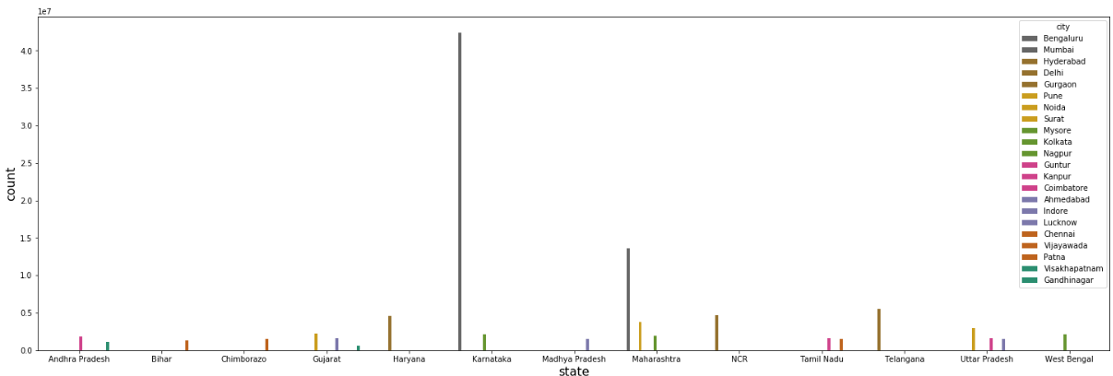
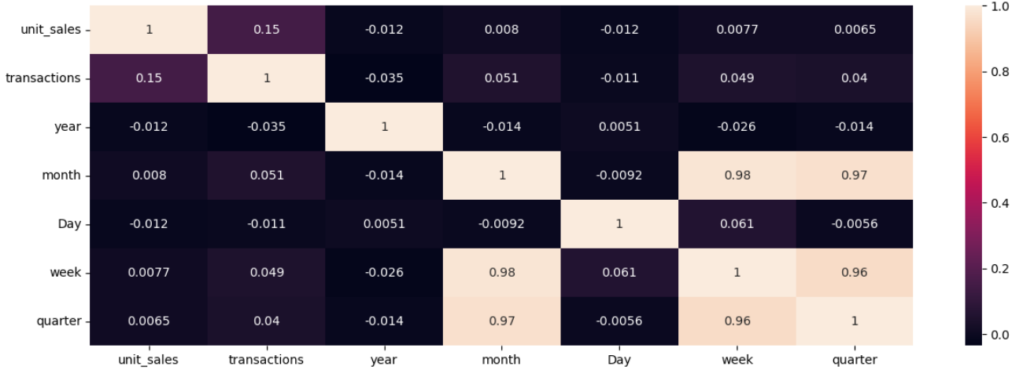
EDA & Data Visualisation

Slide 15
Preprocessing
Imputation
In ‘onpromotion’ column there are 21653354 null values.
replaced those null values with mode(True) of ‘onpromotion’ column.
Dropping unnecessary columns
After Feature engineering high cardinal columns ('date','locationId','item_id','state','class','week','quarter','day_of_week’) are dropped.
Dummification
After Feature engineering and dropping unnecessary columns all categorical columns are passed to dummification inorder convert to numerical data
Standardization
After Feature engineering and dropping unnecessary columns all numerical columns are standardized

Slide 16
Feature Engineering
Binning and Bucketing
'Karnataka’ : 'South_region',
'Telangana’ : 'South_region',
'Tamil Nadu’ : 'South_region',
'Andhra Pradesh’ : 'South_region',
'Maharashtra’ : 'West_region',
'Gujarat’ : 'West_region',
'Uttar Pradesh’ : 'NCR',
'Haryana’ : 'NCR',
'West Bengal’ : 'East_region',
'Bihar’ : 'East_region',
'Madhya Pradesh’ : 'Central_region'
Feature Extraction:
From Date column following columns are extracted
'date'
'year'
'month'
'Day'
'week'
'quarter'
'day_of_week'
Binned by frequency of values
If value are appeared more than 80% in category_of_items and 60% in city are considered as values all other values are binned to ‘others’ label to reduce the unique values of the respective columns.

Slide 17
Insights
location_2, location_3, location_6, location_8, location_44, location_45, location_46, location_47, location_48, location_49, location_50 appeared more in the given data
location_3, location_11, location_44, location_45, location_46, location_47, location_48, location_49, location_51 have the highest unit sales
The best item id are sell are: ['item_1976284', 'item_1239986', 'item_1503844', 'item_1084365', 'item_1463864’]
The least item id are sell are: ['item_2016619', 'item_1935459', 'item_1919674', 'item_2011934', 'item_1047793’]
In onpromotion Feature False class is having highest number of records than the true
In perishable Feature False class is having highest number of records than the true
More non-promotion products as well as non-perishable products and also in non-promotion products as well as in onpromotion data there are more number of non-perishable products are there
Hence non perishable products are being more promotioned(advertaised)
Large number of grocery_items, medium number of bevarages, cleaning_utilities, dairy items, deli_items, baked _items, other farm_produce and all remaining are less in the data
Large number of class_1040, class_1016, class_1122, class_1072, class_1124, class_1034, class_3020, class_1032, class_1120, class_1004,class_1026 are there in the given data
Large no.of sales are from
Banglore which is in karnataka
Mumbai in Maharashtra
Hyderabad in Telangana
There is high correlation between quarter and week and also high correlation between month and week ,quarter(this condition is multicollinearity). So I can drop any one of them
There is not much difference in type of business units across the 5 types of A, B and C,D,E. Type variable is having high counts of observations in Type D class.Means most of the records are belongs to Type D Class
Type A products in cluster 14,
Type C in cluster 3,
Type D in cluster 13having huge nuber of sales where
Type D in cluster 1,
cluster 4,
cluster 8have medium sales¶
Least no.of sales are from
cluater 7,
cluster 12,
cluater 16 and in type B, type E
In general, unit sales in an retail store cannot be negative since it represents the number of items sold, which is always a positive value.
However, if there is an error in the data or if the sales are being recorded as returns, the unit sales can be negative.
For example, if a customer returns 3 items, the unit sales for that item on that day would be recorded as -3. But in general, negative unit sales are not a common occurrence in an etail store
Observed gradualy decreasing the transactions at first month to second month in every year but transactions are increasing at every end of the year
observed gradualy decreasing the sales at first month to second month in every year but sales are increasing at every end of the year
In the year 2018 monthly sales are very less comapare to other years

Slide 18
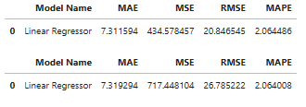
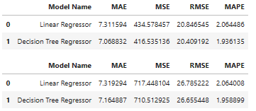
Model Building
Linear Regression
Train
Test
Decision Tree
Train
Test

Slide 19


Model Evaluation
Train
Train
Train
Linear Regression
Decision Tree
Test
Test
Test
Mean Absolute Percentage Error (MAPE) is a good evaluation metric to use. This is because MAPE provides a percentage error of the forecasted values, which is more meaningful for small basket sales forecasting as it helps to understand the magnitude of the errors in terms of the actual values.
MAPE is calculated as follows:
MAPE = (1/n) * ∑(|actual - forecasted|/actual) * 100
where n is the number of observations, actual is the actual value, and forecasted is the predicted value. The lower the MAPE, the better the model's performance in predicting sales.

Slide 20
Challenges
Data Handing
Data Size
Data Shape
Merging
Merging Huge data of 4 datasets with each other using common columns
Computation power
Ram
Disk space
High Cardinality
Item_id, location_id have high cardinality
IDLE Platform
Colab
Kaggle
I-lab

Slide 21
Conclusion
Business units which are belonging cluster number 17 will see the highest amount of sales in 2019
In cluster 17 the top 10 selling items are
'other_farm_produce'
'beverages'
'processed_food'
'vegetables'
'meat_based_items'
'eggs'
'deli_items',
'baked_items / bread_based'
'prepared_food'
'dairy_items'

