Slide 1
Secure data hiding in image using steganography
CAPSTONE PROJECT
Presented By : Saiteja
Student Name : Saiteja Darapureddi
College Name : Sir CR Reddy College Of Engineering
Department : Electronics And Communication Engineering

Slide 2
OUTLINE
Problem Statement
Technology used
Wow factor
End users
Result
Conclusion
Git-hub Link
Future scope

Slide 3
Problem Statement
With the rise in digital communication, The need for secure transmission of sensitive data has become critical. Traditional encryption methods often leave patterns that can be detected by malicious entities, exposing the data. This project aims to explore steganography, where sensitive information can be hidden within digital images, making it nearly undetectable to unauthorized users.

Slide 4
Technology used
The primary technology used in secure data hiding with steganography involves image processing and cryptography.
least Significant Bit
Programming Language: Python
Libraries:
OpenCV (for image processing)
OS - Windows

Slide 5
Wow factors
Invisible Communication: The project allows messages to be hidden in plain sight within images, which can then be decoded by those who have the key, adding an element of intrigue and security.
Multilayered Security: Combining encryption with steganography ensures double protection, making it more difficult for attackers to intercept the original message.

Slide 6
End users
Private Individuals: Those who require secure communication.
Businesses: Particularly companies dealing with sensitive information (e.g., financial institutions, legal firms).
Government Agencies: Security organizations that need to send confidential messages.
Cybersecurity Enthusiasts: People interested in cryptography and steganography.

Slide 7
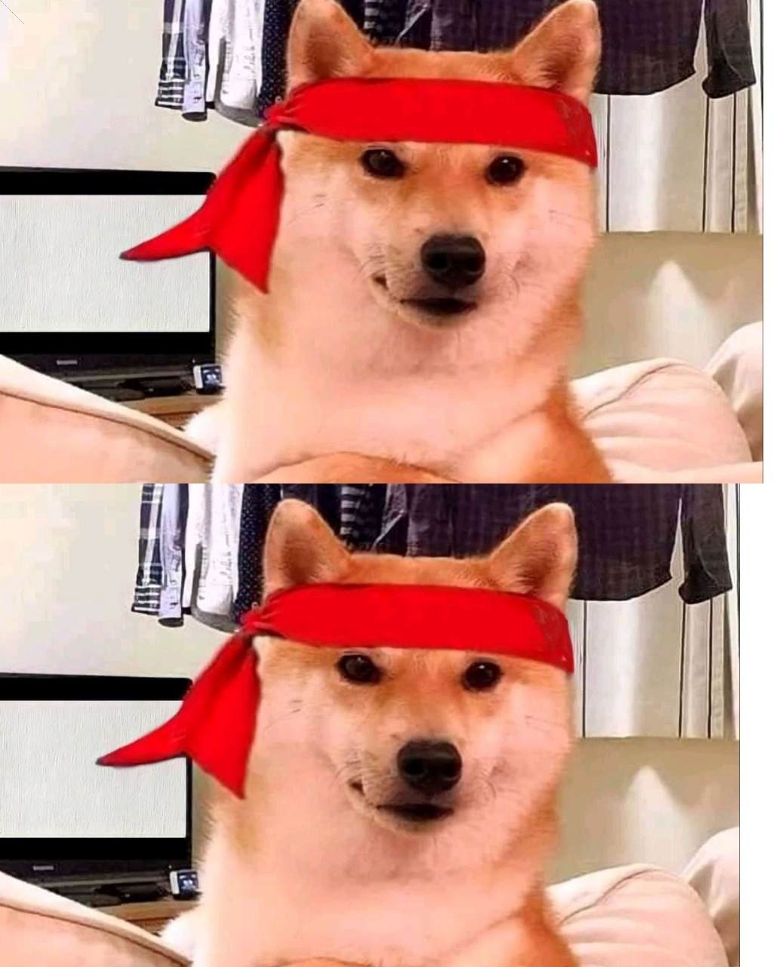
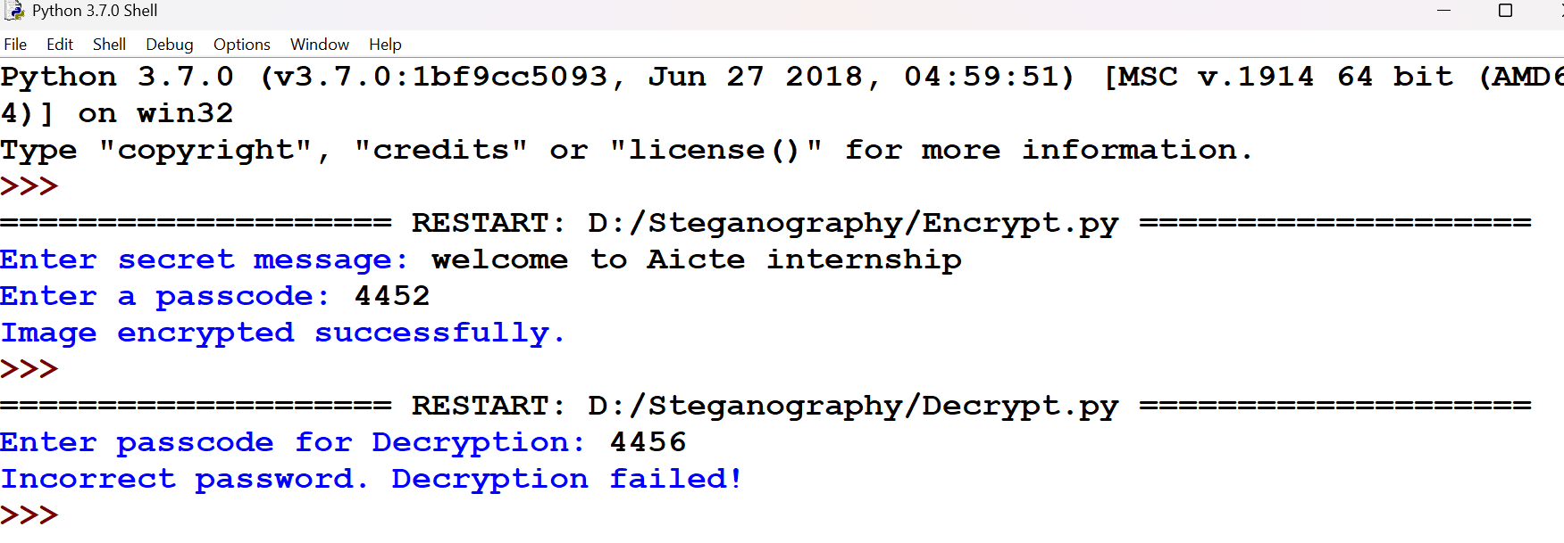
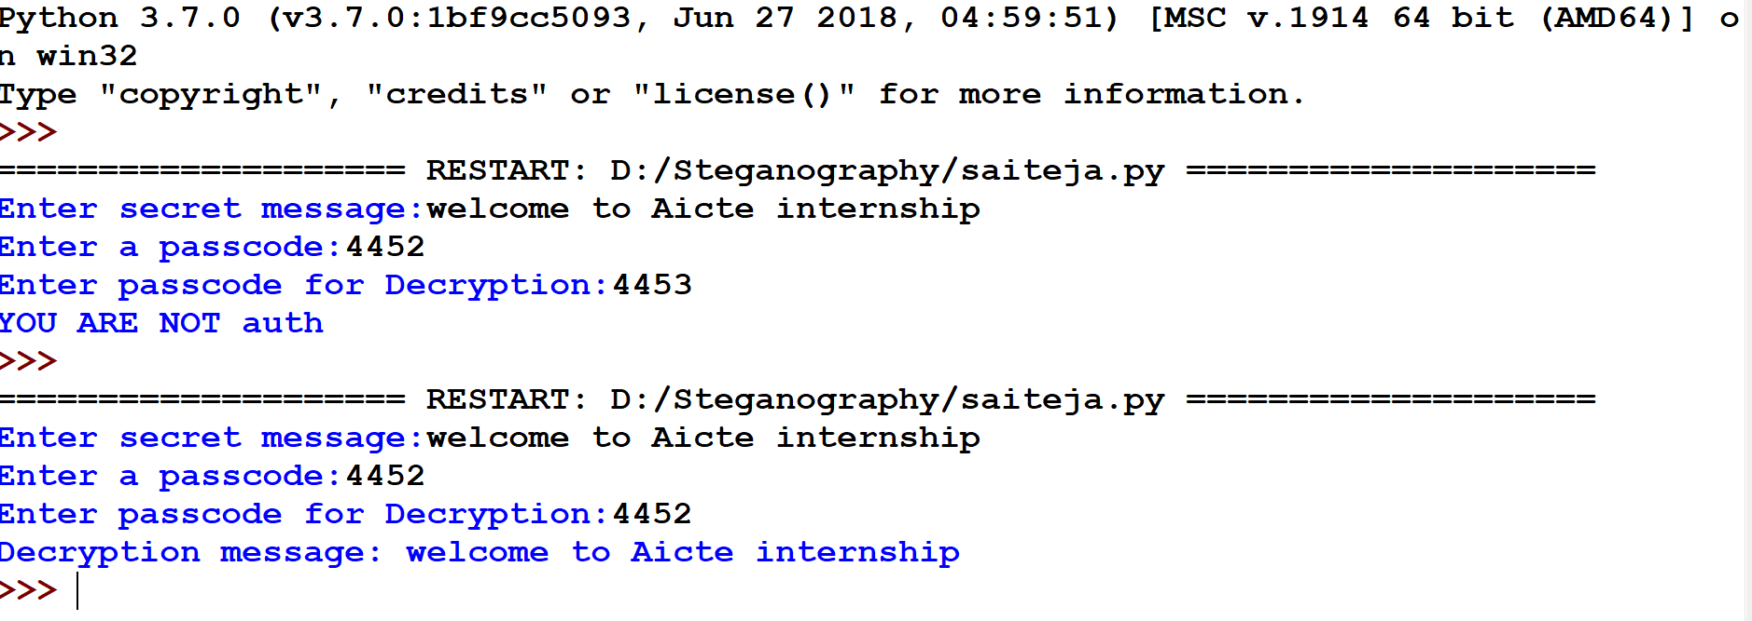
Results
Output 1
Output 2
Output Image

Slide 8
Conclusion
Steganography offers a secure and innovative way of communicating sensitive data by embedding it in images. By using this method in combination with encryption algorithms, the data becomes highly protected from unauthorized access. The project illustrates how combining cryptography and steganography can improve digital communication security.

Slide 9
GitHub Link
https://github.com/saitejadst444/Steganography.git

Slide 10
Future scope(optional)
Improved Algorithms:Research can focus on developing even more sophisticated methods of hiding data within images to make them less detectable.
Steganography in video$Audio:Explanding this concepct beyond images to videeo and audio files to increase the scope of secure data hiding.
Artifical Intelligence Integration: Incorporating AI to dynamically adjust embedding methods on image content and ensure higher capacity and imperceptibility.

Slide 11
THANK YOU

