Slide 1
Analysis of digital markers from MRI images using Deep Learning

Slide 2
TEAM NAME: MRI NU CIS TEAM SUPERVISOR:OSSAMA ALSHABRAWY LIST OF TEAM MEMBERS SAITEJA GAJE(PROJECT MANAGER) NARESH NALLURI(COMMUNICATION LEAD) VENKATA SAI MERUVA RAJESH CHITTIMALLA NIKHITHA THOKALA

Slide 3
Aim
To use machine learning techniques, especially Convolution Neural Networks, to classify MRI scans of the human brain to detect the presence of tumour, and in case of positive detection, classify the type of tumour.

Slide 4
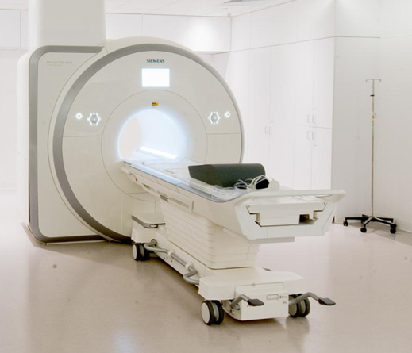
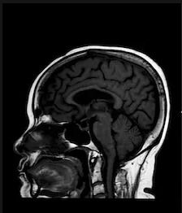
Background: What is MRI?
“Magnetic resonance imaging (MRI) is a type of scan that uses strong magnetic fields and radio waves to produce detailed images of the inside of the body.” - N.H.S.

Slide 5
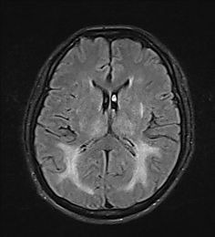
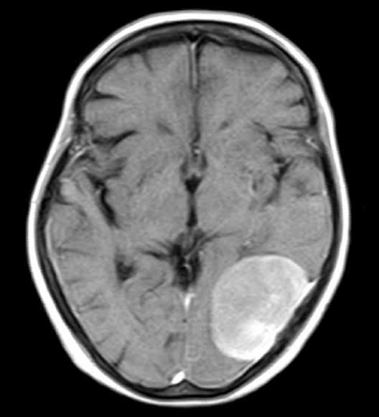
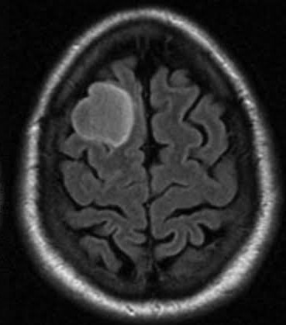
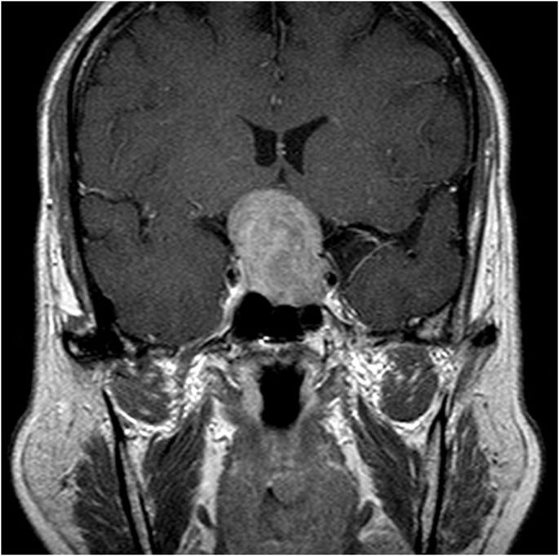
Background: MRI Use Case - Detecting Tumor
No tumor
Meningioma tumor
Glioma tumor
Pituitary tumor

Slide 6
Objective
Learn about state-of-the-arts models for image classification.
Apply state-of-the-arts models on the MRI classification dataset and compare what type of Convolution Neural Network (CNN) works best on the dataset.
Modify (tune hyperparameters) high-performance models to improve accuracy.

Slide 7
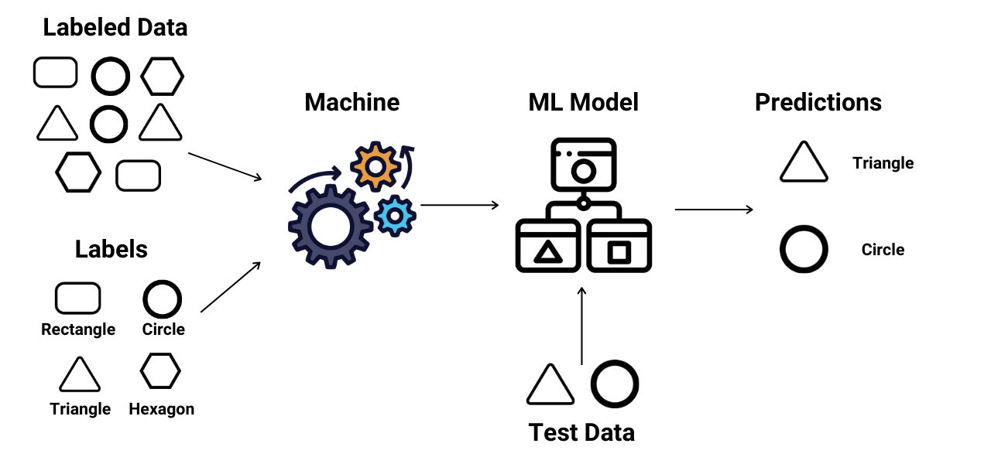
Methodology: Classification
In Machine Learning, Classification is the task of determining which of a set of predetermined classes an unknown sample belongs.
Examples are determining whether a given picture is a "cat" or a "dog" class, and determine whether the MRI of a patient detects a tumor.

Slide 8
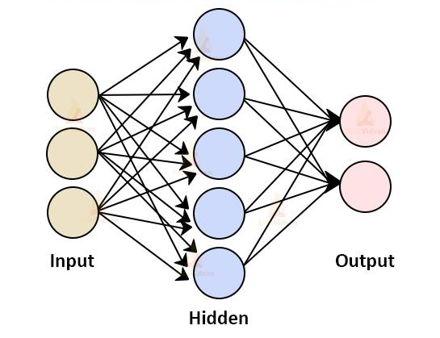
Methodology: Deep Neural Network
Artificial neural networks (ANNs) are machine learning models used for classification and regression that are inspired by the neural system of the animal brain. The ANN is comprised by a large network of neurons that are represented as problems in linear algebra and calculus.
A deep neural network (DNN) is an artificial neural network (ANN) with multiple layers between the input and output layers.

Slide 9
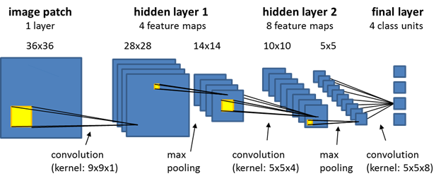
Methodology: Convolution Neural Network
A Convolution Neural Network (CNN) is a special type of neural network that is used widely for image classification. It uses a series of convolution and pooling layers for feature extraction before classifying using a fully-connected layer.

Slide 10
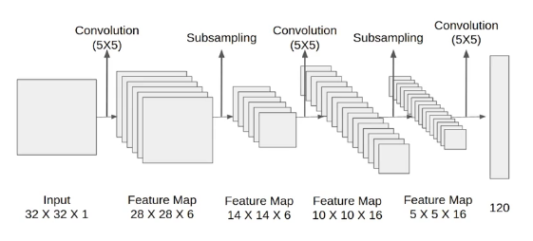
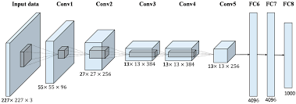
Methodology: State-of-the-arts
AlexNet
LeNet
ResNet
InceptionNet
VGG
CNN pipelines for two models
Above - LeNet
Below - AlexNet

Slide 11
Conclusion
We will use a publicly available dataset¹ to perform image classification on MRI images.
The classifications would be performed using state-of-the-art models such as AlexNet, LeNet, InceptionNet, etc.
We will compare the performance of different state-of-the-art models.
We will tune the hyperparameters of the best performing models to improve its performance.
¹Source of dataset: https://github.com/sartajbhuvaji/brain-tumor-classification-dataset

Slide 12
Thank You.

