Slide 1


Student Details
Name : GOLLA SAI TEJA
Skills build email id : saitejagolla22@gmail.com
College name : Lakireddy Bali reddy college of engineering.
College state : Andhra Pradesh
Internship domain : front end development
Internship start & end date : 5th June 2023 to 28th July 2023.
GITHUB LINK : https://github.com/saitejagolla22/Myportfolio

Slide 2
PROJECT TITLE/Problem Statement
MY PORTIFOLIO

Slide 3
AGENDA
Problem Statement/Project Topic
Project Overview
Who are the End Users
Your Solution and its Value Proposition
How did you customize the project and make it your own
Modelling
Results
Links

Slide 4
PROJECT OVERVIEW
The purpose of a portfolio website is to showcase an individual's or a company's work, skills, and achievements in a visually appealing and organized manner. It serves as an online representation of their professional identity and acts as a platform for potential clients, employers, or collaborators to explore their work and capabilities.
Focus on creating a positive user experience to ensure that visitors can easily navigate the website and find the desired information. The website should be intuitive, responsive, and accessible across different devices and screen sizes.

Slide 5
WHO ARE THE END USERS of this project?
The end users of a portfolio website can vary depending on the purpose and focus of the website. Here are some potential end users for a portfolio website:
Clients : These clients may be individuals, businesses, or organizations looking to hire a professional or engage in a business relationship.
Employers : A portfolio website can be valuable for job seekers, as it allows them to present their skills, experience, and projects to potential employers.
Recruiters: A portfolio website can attract the attention of recruiters who are looking for specific skills or talents.
Students : Your portfolio website can also inspire and provide guidance to students or individuals who are starting their careers in your field.

Slide 6
YOUR SOLUTION AND ITS VALUE PROPOSITION
The value proposition of a portfolio website lies in its ability to effectively showcase your skills, work, and achievements to a wide audience, including potential clients, employers, and collaborators.
Personal branding: Your portfolio website is an opportunity to build and showcase your personal brand. Through thoughtful design choices, content creation, and messaging, you can communicate your unique style, values, and strengths.

Slide 7
How did you customize the project and make it your own
Customizing a project portfolio website involves tailoring the design, content, and functionality to reflect your unique brand.
Consider incorporating your logo or a unique visual element to enhance brand recognition. Customize the navigation menu to reflect the sections and pages relevant to your projects.
Choose a color scheme, typography, and layout that align with your personal or professional aesthetics.

Slide 8
MODELLING
To model a portfolio website, you can follow a structured approach that includes defining the website's purpose, identifying key sections and pages, and organizing the content effectively.
Sections are Home, About, Portfolio, Services, Testimonials, Blog, and Contact.
Include your bio, background, skills, and experience. Highlight your unique selling points and what sets you apart from others in your field.

Slide 9
Results
The result of a portfolio website is a professional and visually appealing online presence that effectively showcases your skills, expertise, and accomplishments.
A well-designed and informative portfolio website enhances your credibility and professionalism.
A well-crafted portfolio website can lead to new opportunities. It can attract potential clients, employers, or collaborators who are impressed by your work and want to engage with you.

Slide 10
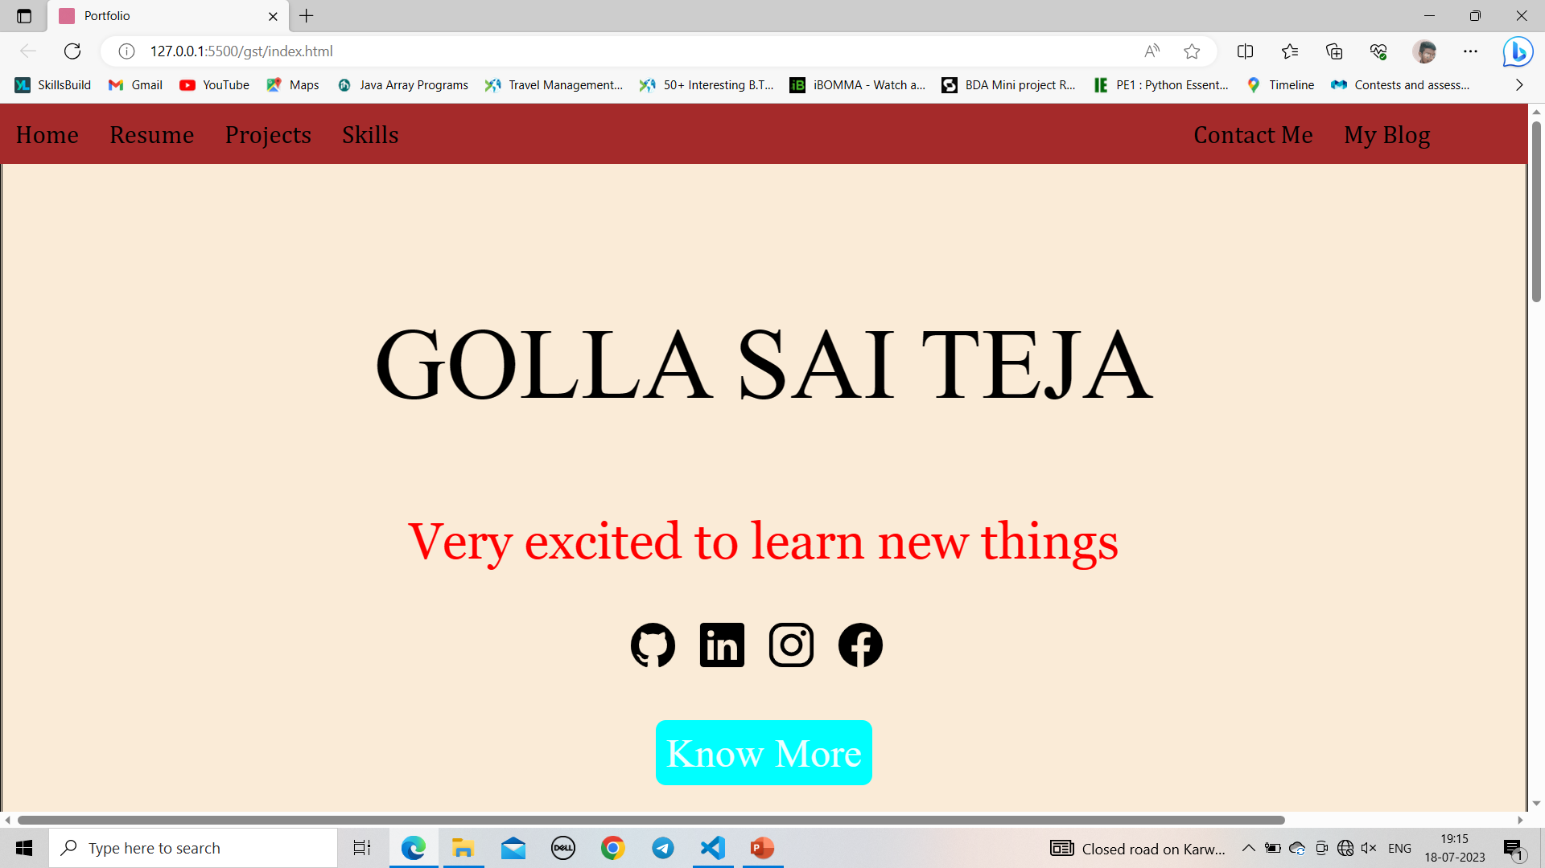
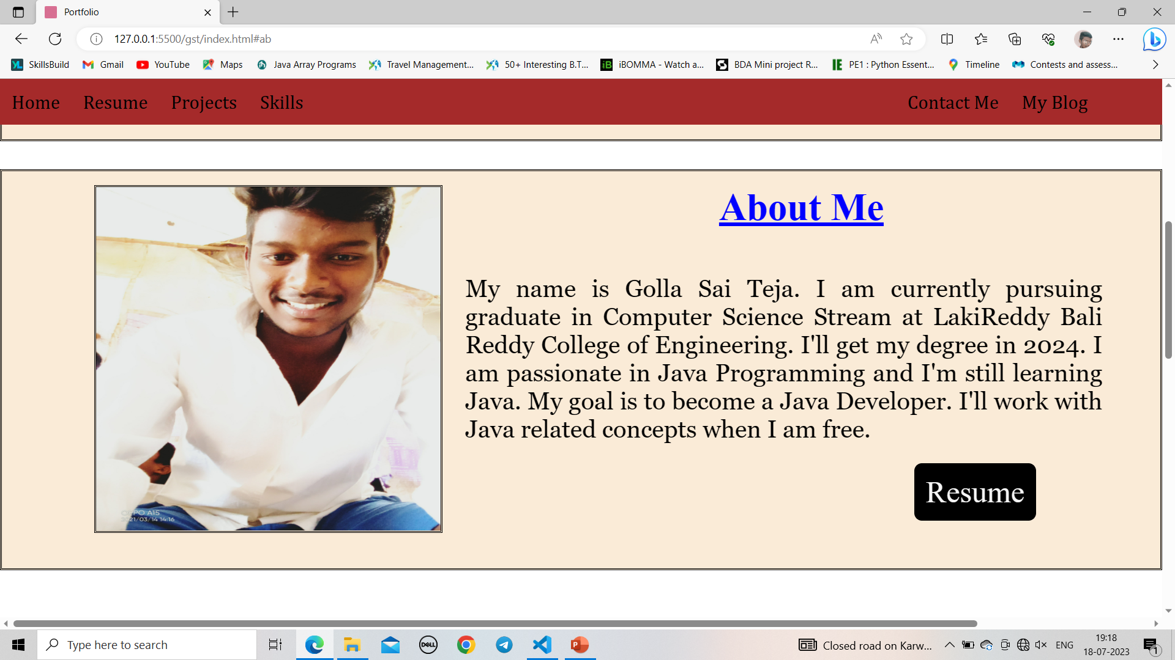

Slide 11
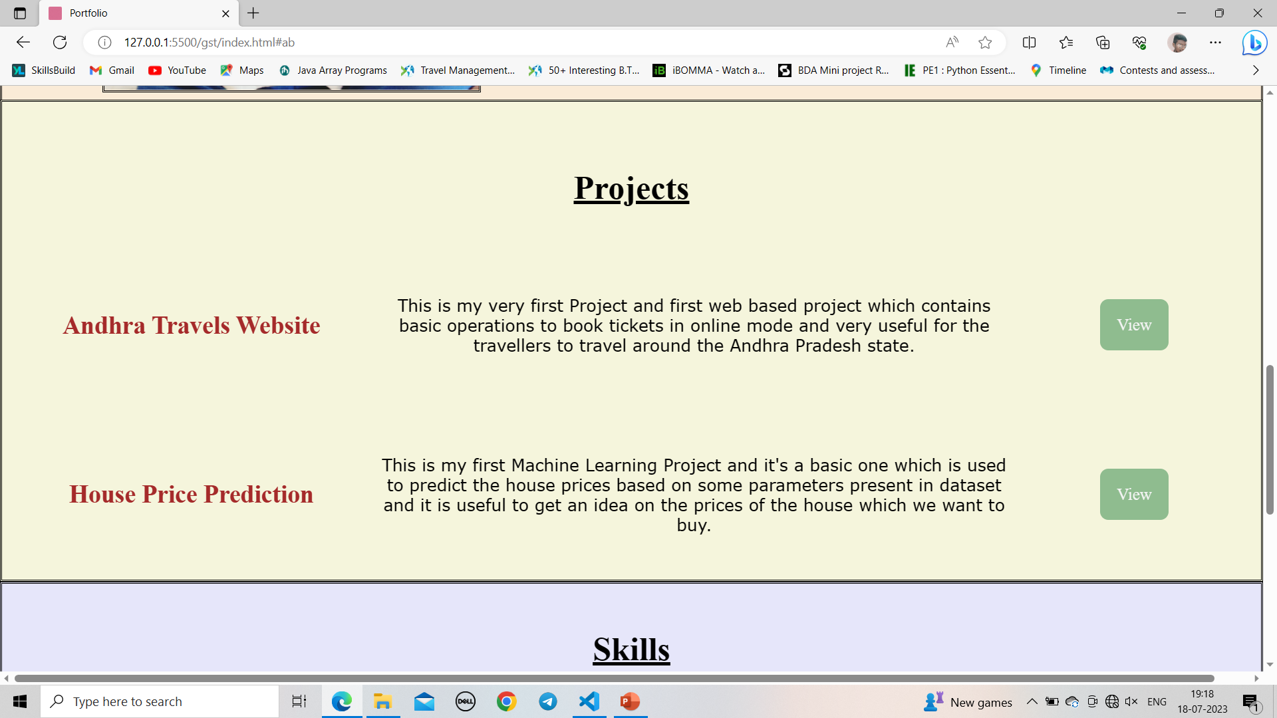
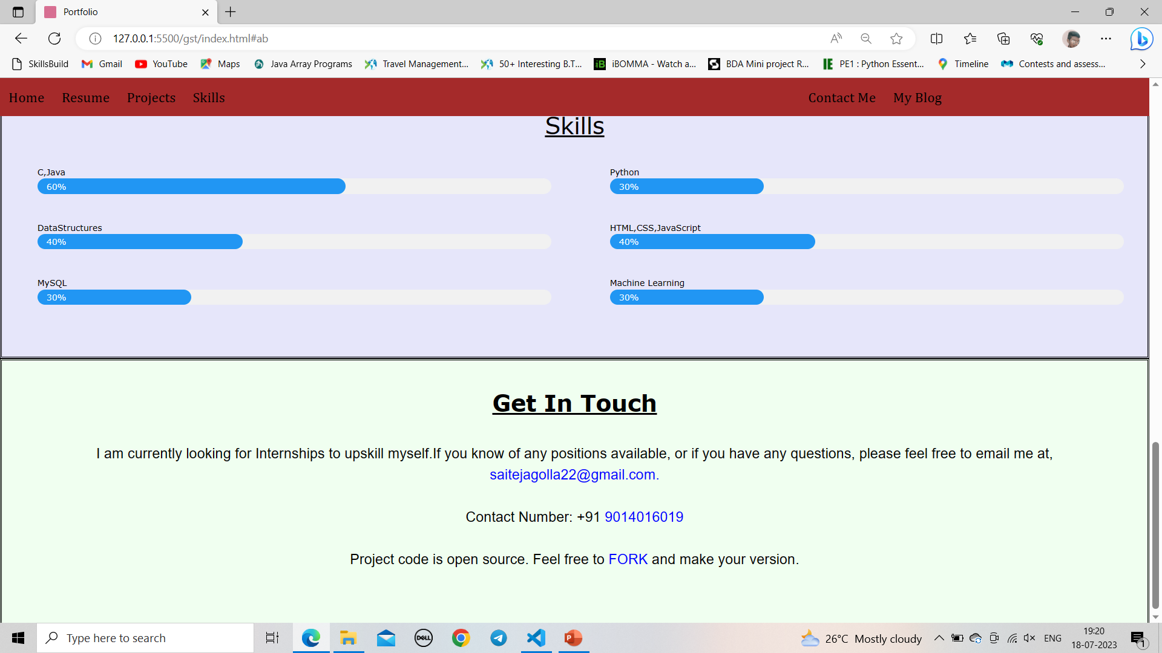

Slide 12
links
https://www.w3schools.com/html/default.asp
https://www.w3schools.com/html/html_css.asp
https;//skillsbuild.edunetworld.com/courses/fed/portfolio-site/

