Slide 1
Final Exam Review Midterm Notes
CMPE 200 Computer Architecture & Design
Haonan Wang

Slide 2
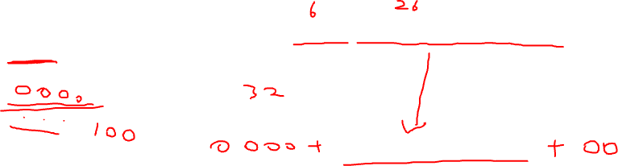
Midterm Questions
For the following instructions:
Loop: sll $t1, $s3, 2
....
j Loop
For the last line of code, its machine code is 000010 00000000000000110000100000 and address is 0x4000. Then what is the address of the first line of code?

Slide 3
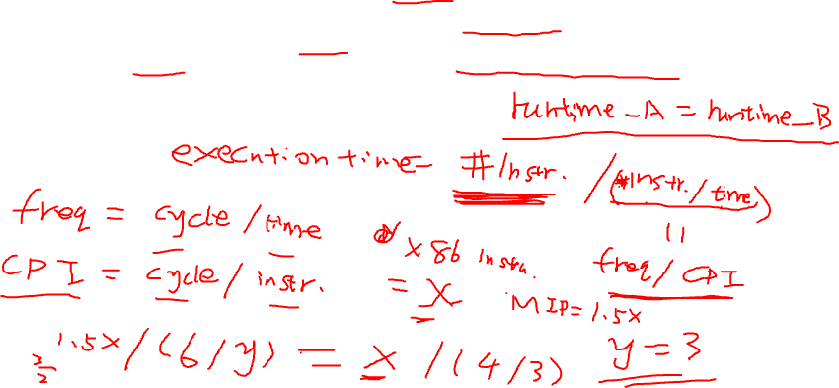
Midterm Questions
Computer A executes the MIPS ISA and computer B executes the x86 ISA. On average, programs execute 1.5 times as many MIPS instructions as x86 instructions. Computer A runs at 6GHz clock frequency and computer B runs at 4GHz clock frequency. If computer B has an average CPI of 3 for a program, what average CPI should computer A has for this program to run as fast as computer B?

Slide 4
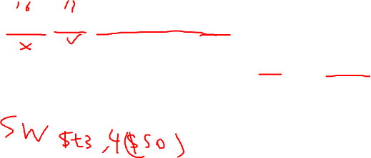
Midterm Questions
Here is the binary representation of an instruction:
101011 10000 01011 0000000000000100
What instruction does it represent? Note that $s0 is 16, $t0 is 8, and opcode for sw is 43.

Slide 5
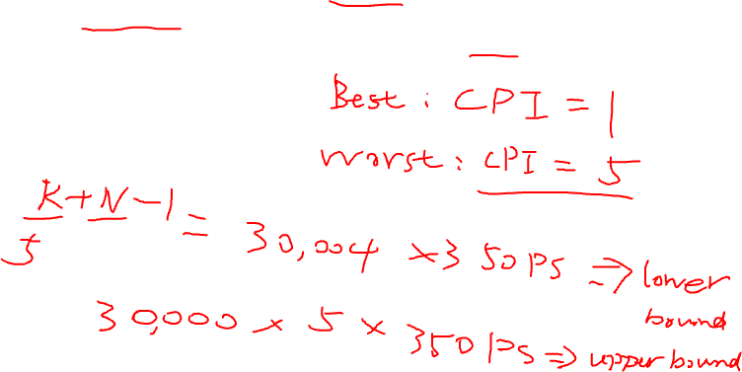
Midterm Questions
Assume a complete MIPS 5-stage pipeline machine has a clock cycle of 350 ps. Which of the following total execution times are absolutely impossible for this machine to complete 30,000 random instructions? (two possible answers)

Slide 6
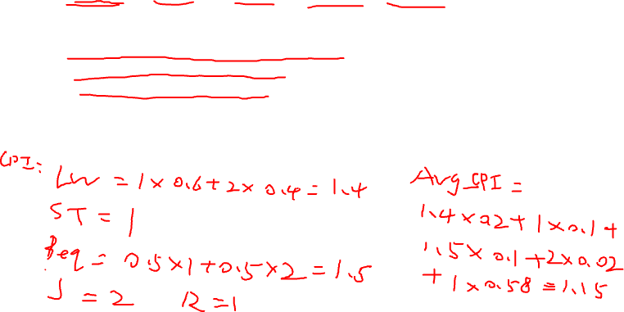
Midterm Questions
Assume the proportions of different instructions in a program is as follows:
20% loads, 10% stores, 10% branches, 2% jumps, 58% R-type
Also, assume the following conditions when executing this program:
40% of loads are used by the next instruction.
50% of branches are mispredicted.
All jumps flush next instruction.
For a MIPS 5-stage-pipeline machine with full data hazard and control hazard logic, what is the average CPI when executing this program? Please include the steps.

Slide 7
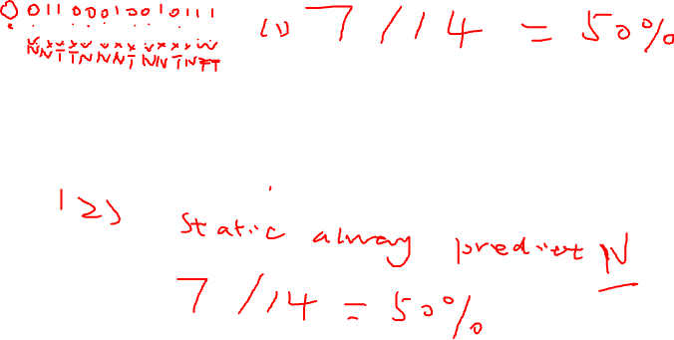
Midterm Questions
For a branch instruction, assume it has an exclusive prediction table entry and its actual outcome is as follows (T = Taken, N = Not Taken):
NTTNNNTNNTNTTT
1) Assuming the initial state is 0, what is the rate of correct prediction with a 1-bit dynamic branch predictor? (You should list all the prediction results. For example, if you think all predictions are Taken, you should write TTTTTTTTTTTTTT.)
2) Is the 1-bit dynamic predictor performing better than a static predictor in this case? Please explain.

Slide 8
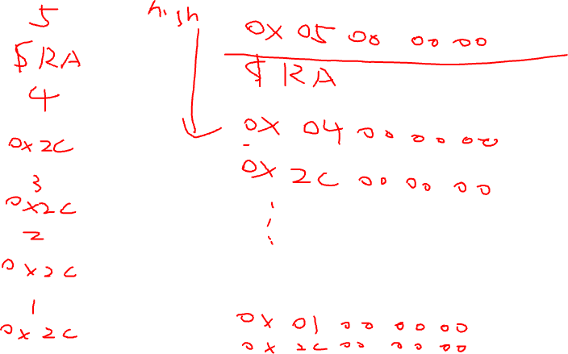
Midterm Questions
Bonus question

Slide 9


