Slide 1
Final Exam Review
CMPE 200 Computer Architecture & Design
Haonan Wang

Slide 2
Final Exam Composition
Multiple-choice Single-answer: 3 points * 10 = 30
Multiple-choice Multiple-answer: 4 points (wrong option -4, missing option -2) * 5 = 20
True or False: 2 points * 9 = 18
Questions & Answers: 8 points (steps 6 + answer 2) * 4 = 32
Bonus question: 10 points * 2 = 20
Total = 30 + 20 + 18 + 32 + 20 = 100 + 20
If you get more than 100 points, the excessive points will be used to improved your overall grade.
Exam settings:
Time: Thursday, Dec. 8th, 12:15 - 14:30 @ CLARK 222 with LockDown Browser
Closed book (but you can print out the MIPS data card and use it if needed)
Cheat sheet (handwritten): A4 paper * 2 allowed, pictures of all sides must be submitted before the exam
Use of calculator and scratch paper allowed
Double-check your laptop and turn off your cellphone before the exam
Submit your answers on time (otherwise score will not be counted)!

Slide 3
Processor Interface Mechanisms
Two ways for processors to access peripheral devices:
Port-mapped I/O (PMIO): isolated I/O, special I/O instructions, separate address spaces
Memory-mapped I/O (MMIO): one address space
MIPS processors use memory-mapped I/O
Use load and store instructions to communicate with peripheral devices
For a MIPS processor that only supports lw and sw, all data transfer will be 32 bits

Slide 4
Processor Interface Mechanisms
Two ways to communicate with CPU:
Polling: The CPU polls the device periodically
Interrupt: The I/O device calls the CPU actively
Two ways for data transfer between the memory and I/O:
CPU controlled
Direct Memory Access (DMA)

Slide 5
Why?
Two Types of Locality:
Temporal Locality (Locality in Time): If an address is referenced, it tends to be referenced again (e.g., loops, reuse)
Spatial Locality (Locality in Space): If an address is referenced, neighboring addresses tend to be referenced (e.g., array, stack, etc.)
On-chip
Off-chip

Slide 6
Cache Hit and Miss
Hit: Data appears in some block of the cache
Hit Rate: # hits / total accesses on the cache
Hit Time: Time to access the cache
Miss: Data needs to be retrieved from the lower level (and stored in cache)
Miss Rate: 1 - (Hit Rate)
Miss Penalty: Average delay in the processor caused by each miss
Miss
Lower Level Memory
(cache/main memory)
Cache
Can’t find!
read
read
From Processor
data block X
data block Y
Hit
Hit
To Processor

Slide 7
Reducing Penalty: Multi-Level Cache
1 cycle
10 cycles
Second
Level
Cache
20 cycles
300 cycles
First-level
Cache
Third
Level
Cache
Hit Time
Main
Memory
(DRAM)
L1
L2
On Processor Die
L3
AMAT in multi-level cache organization
= T_{hit}(L1) + Miss_rate(L1) x
[ T_{hit}(L2) + Miss_rate(L2) x
{ T_{hit}(L3) + Miss_rate(L3) x T(memory) } ]
Example:
Miss rate of L1, L2, L3 = 10%, 5%, 1%, respectively
AMAT = 1 + 0.1 x [ 10 + 0.05 x { 20 + 0.01 x 300 } ] = 2.115 cycles
Off-Chip
Vs. 31 cycles
14.7x speedup!

Slide 8
Measuring Performance with Caches
Assuming cache hit costs are included as part of the normal CPU execution cycle, then
CPU time = IC × CPI × CP
= IC × (CPI_{ideal} + Memory-stall cycles) × CP
Note: this is miss ratio with regard to all instructions
= read ratio * cache miss rate
CPI_{stall}
Memory-stall cycles come from cache misses (a sum of read-stalls and write-stalls)
Read-stall cycles = read miss ratio × read miss penalty
Write-stall cycles = write miss ratio × write miss penalty + write buffer stalls
For write-through caches, we can simplify this to
Memory-stall cycles = miss ratio × miss penalty

Slide 9
Impacts of Cache Performance
Relative cache penalty increases as processor performance improves (faster clock rate and/or lower CPI)
The memory speed is unlikely to improve as fast as processor cycle time. When calculating CPI_{stall}, the cache miss penalty is measured in processor clock cycles needed to handle a miss
The lower the CPI_{ideal}, the higher the impact of stalls
Example: A processor with a CPI_{ideal} of 2, a 100 cycle miss penalty, 36% load/store instructions, and 2% I$ and 4% D$ miss rates
Memory-stall cycles = 2% × 100 + 36% × 4% × 100 = 3.44
CPI_{stalls} = 2 + 3.44 = 5.44
What if the CPI_{ideal} is reduced to 1? Or the processor clock rate is doubled (doubling the miss penalty)?

Slide 10
Cache Types
N-way Set-Associative: Number of ways > 1 & Number of sets > 1
Slightly complex searching mechanism
Direct Mapped: Number of ways = 1
Fast indexing mechanism
Fully-Associative: Number of sets = 1
Extensive hardware resources required to search
Way 0
Way 1
…
Set 0
block 0
block 2
Set 1
block 1
block 3
…
Used for tag compare
Selects the set
Selects the word in the block
Tag
Index
Block offset
Byte offset
Assuming fixed sized cache:
Increasing associativity
Decreasing associativity
Fully associative (only one set)
Direct mapped (only one way)

Slide 11
Four-Way Set Associative Cache
31 30 . . . 11 10 9 . . . 2 1 0
Byte offset
Tag
22
8
Index
Index
V
Tag
Data
V
Tag
Data
V
Tag
Data
V
Tag
Data
0
1
2
.
.
.
253
254
255
0
1
2
.
.
.
253
254
255
0
1
2
.
.
.
253
254
255
0
1
2
.
.
.
253
254
255
32
4x1 select
Hit
Data

Slide 12
Cache Miss Classification: The 3 C’s
Compulsory (cold) Misses
On the 1st reference to a block
Related to # blocks accessed by a code, not related to the configuration of a cache
Capacity Misses
The program’s working set size exceeds the cache capacity
Conflict Misses
Multiple memory blocks map to the same set in set-associative caches

Slide 13
Cache Policies: Cases - Revisit
Allocation policy: do we allocate a block in cache for the missed data?
Read policies:
Read Hit: this is what we want. Only one data read from the cache.
Read Miss: needs to fetch from lower level, but just write to the register once after that
read-allocate (with replacement policy) vs. no-read-allocate (i.e., cache bypassing)
Write policies (only for the data cache): consistency & performance tradeoffs
Write Hit: behavior and number of writes depends on write policy
Write-through vs. write-back vs. write-evict
Write Miss: needs to first read from lower level, then apply write policies
Write-allocate (with replacement policy): Write-through vs. Write-back
No-write-allocate (bypassing): Write-evict
What else must be considered?
+ write policy of evicted data
+ write policy of evicted data

Slide 14
Cache Miss Behavior Analysis
Read miss:
+Write-through: evict victim block + fetch block from lower level
+Write-back: evict victim block + write back evicted block if dirty + fetch block from lower level
+No-write: find victim block + fetch block from lower level
Write miss:
Write-allocate:
+Write-through: evict victim block + fetch block from lower level + store word to block + store word to lower level
+Write-back: evict victim block + write back evicted block if dirty + fetch block from lower level + store word to block
No-write-allocate: +Write-evict: store word to lower level directly

Slide 15
Reduce Miss Rate (1): Code Optimization
Misses occur if sequentially accessed array elements come from different cache blocks
Code optimizations → No hardware change
Rely on programmers or compilers
Examples:
Loop interchange: In nested loops, outer loop becomes inner loop and vice versa
Loop blocking: partition large array into smaller blocks, thus fitting the accessed array elements into cache size

Slide 16
Reduce Miss Rate (2): Reduce the 3 C’s
Increase Cache Size
Reduce miss for: capacity miss, conflict miss
But has many limitations
Increase Associativity
Reduce miss for: conflict miss
But may increase access latency
Increase Cache Block Size
Reduce miss for: compulsory
But may increase miss penalty (more data will be evicted and fetched)
Very large blocks could increase miss rate

Slide 17
Reduce Miss Rate (4): Multi-level Caches
Having a unified L2 cache (i.e., it holds both instructions and data) and in some cases even a unified L3 cache
L1 cache should focus on minimizing hit time in support of a shorter clock cycle
Secondary cache(s) should focus on reducing miss rate to reduce the penalty of long main memory access times

Slide 18
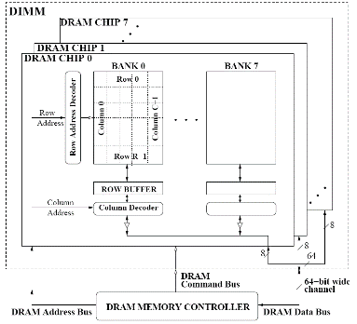
DRAM Subsystem Organization
Dram: Dynamic RAM
DRAM Organization:
Channel: Independent memory subsystem
E.g., 2 independent Channels:
Channel
DIMM
Rank
Chip
Bank
Row/Column

Slide 19
DRAM Design 2: Synchronous DRAMs
Like page mode DRAMs, synchronous DRAMs (SDRAMs) can transfer a burst of data from a series of sequential addresses in the same row
For words in the same burst, don’t have to provide the complete (row and column) addresses
The entire row is loaded into a row buffer (SRAM).
Specify the starting (row+column) address and the burst length (burst must be in the same row).
Data words in the burst are then accessed from that SRAM under control of a clock signal.

Slide 20
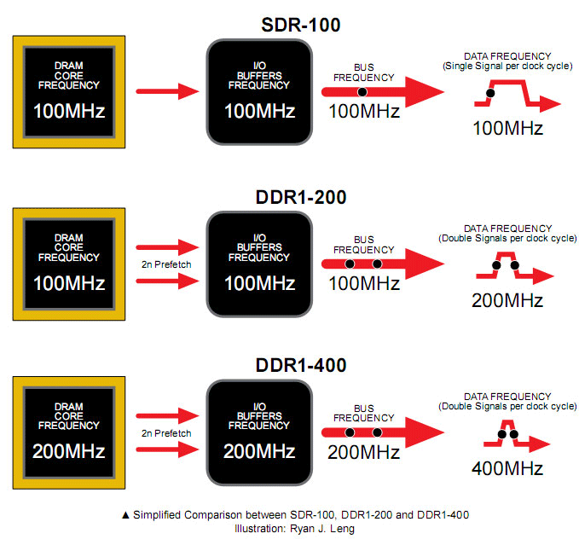
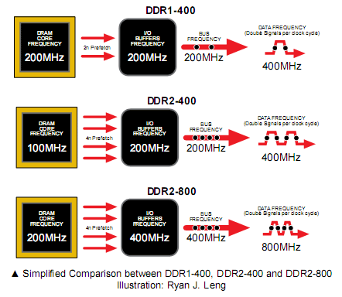
DDR (Double Data Rate) SDRAMs
DDR1 VS DDR1+:
DDR2 vs. QDR

Slide 21
Row Operations & Row Buffer Locality
Access Address: Row Operation:
Columns
(Row 0, Column 0)
Activation
RBL=2
(Row 0, Column 1)
No operation
RBL=1
(Row 1, Column 0)
Restore, Precharge, Activation
Row address 0
Row address 1
Row decoder
R1
R0
R0
Rows
Row Buffer
CONFLICT !
Row 1
HIT
Row 0
Empty
Column address 0
Column mux
Column address 0
Column address 1
Improving Row Buffer Locality (RBL) is the key to improve DRAM efficiency
Data
Credit: Onur Mutlu.

Slide 22
RBL & Memory Scheduling Schemes
Visible to the memory scheduler
In-order scheduling
(FIFO):
Activation Counter:
R1: Activation = 1
R5: Activation = 2
R1: Activation = 3
R5: Activation = 4
R5: Activation = 4
Avg RBL = 5 / 4 = 1.25
future
requests
requests currently
in the pending queue
oldest
request
Same
activation
Request Stream
……
……
R4
R3
R2
R5
R5
R1
R5
R1
Out-of-order scheduling
(FR-FCFS):
Activation Counter:
R1: Activation = 1
R1: Activation = 1
R5: Activation = 2
R5: Activation = 2
R5: Activation = 2
Avg RBL = 5 / 2 = 2.5
future
requests
requests currently
in the pending queue
Same
activation
oldest
request
Same
activation
Request Stream
……
……
R4
R3
R2
R5
R5
R1
R5
R1

Slide 23
Magnetic Disk Characteristic
Track
Seek time: position the head over the proper track
3 to 12/15 ms on average
Due to locality of disk references, the actual average seek time may be only 25% to 33% of the advertised number
Controller
+
Cache
Sector
Cylinder
Platter
Rotational latency: wait for the desired sector to rotate under the head
½ of 1/RPM converted to ms: 0.5R/5400RPM = 5.6ms to 0.5R/15000RPM = 2.0ms
Transfer time: transfer a block of bits (one or more sectors) under the head to the disk controller’s cache (70 to 125 MB/s are typical disk transfer rates)
the disk controller’s “cache” takes advantage of spatial locality in disk accesses
cache transfer rates are much faster (e.g., 375 MB/s)
Controller time: the overhead the disk controller imposes in performing a disk I/O access (typically < 0.2 ms)
Head

Slide 24
Typical Disk Access Time
The average time to read or write a 512B sector for a disk rotating at 15,000 RPM with average seek time of 4 ms, a 100MB/sec transfer rate, and a 0.2 ms controller overhead
Avg disk read/write
= 4.0 ms + 0.5/(15,000RPM/(60sec/min)) + 0.5KB/(100MB/sec) + 0.2 ms
= 4.0 + 2.0 + 0.005 + 0.2 = 6.2 ms
If the measured average seek time is 25% of the advertised average seek time, then
Avg disk read/write = 1.0 + 2.0 + 0.005 + 0.2 = 3.2 ms

Slide 25
Address Translation Mechanisms
Virtual page #
Offset
virtual address
Physical page #
physical address
Offset
Physical page
base addr
Main memory
V
1
1
1
1
1
1
0
1
0
1
0
Page table register
Page fault: a DRAM miss for the page
→ Page in disk
Page walk: Search (walk) the page table
Disk storage
Page Table (in main memory)

Slide 26
A TLB in the Memory Hierarchy
¼ t
hit
¾ t
VA
PA
miss
TLB
Lookup
Cache
Main
Memory
CPU
miss
hit
Trans-
lation
data
A TLB miss – is it a page fault or merely a TLB miss?
If the page is loaded into main memory, then the TLB miss can be handled by loading the translation information from the page table into the TLB (10’s of cycles )
If the page is not in main memory, then it’s a true page fault (1,000,000’s)
TLB misses are much more frequent than true page faults

Slide 27
TLB Event Combinations
TLB | Page Table | Cache | Possible? Under what circumstances?
Hit | Hit | Hit
Hit | Hit | Miss
Miss | Hit | Hit
Miss | Hit | Miss
Miss | Miss | Miss
Hit | Miss | Miss/ Hit
Miss | Miss | Hit
Yes – this is what we want!
Yes – although the page table is not
checked after the TLB hits
Yes – TLB missed, but PA is in page table and data is in cache
Yes – TLB missed, but PA is in page table, data not in cache
Yes – page fault
No – TLB translation is not possible if the page is not present in main memory
No – data is not allowed in the cache if the
page is not in memory

Slide 28
Memory Systems that Support Caches
on-chip
The off-chip interconnect and memory architecture can affect overall system performance in dramatic ways
CPU
Assume:
1 memory bus clock cycle to send the address
15 memory bus clock cycles to get the 1st word in the block from DRAM (row cycle time), 5 memory bus clock cycles for 2nd, 3rd, 4th words (column access time)
1 memory bus clock cycle to return a word of data
Memory-Bus to Cache bandwidth
number of bytes accessed from memory and transferred to cache/CPU per memory bus clock cycle
Cache
32-bit data
&
32-bit addr
per cycle
bus
DRAM
Memory
One word wide organization
(one word wide bus & memory)

Slide 29
One Word Wide Bus, One Word Blocks
on-chip
If the block size is one word, then for a cache miss, the pipeline will have to stall for:
memory bus clock cycle to send address
memory bus clock cycles to read DRAM
memory bus clock cycle to return data
total clock cycles miss penalty
Number of bytes transferred per clock cycle (bandwidth) for a single miss is
bytes per memory bus clock cycle
CPU
1
15
1
17
Cache
32-bit data
&
32-bit addr
per cycle
bus
DRAM
Memory
4 / 17 = 0.235
One word wide organization
(one word wide bus & memory)

Slide 30
One Word Wide Bus, Four Word Blocks
on-chip
What if the block size is four words and each word is in a different DRAM row?
cycle to send 1st address
cycles to read DRAM
cycles to return last data word
total clock cycles miss penalty
Number of bytes transferred per clock cycle (bandwidth) for a single miss is
bytes per memory bus clock cycle
CPU
1
4 x 15 = 60
1
62
Cache
32-bit data
&
32-bit addr
per cycle
bus
DRAM
Memory
(4 x 4) / 62 = 0.258
One word wide organization
(one word wide bus & memory)

Slide 31
One Word Wide Bus, Four Word Blocks
on-chip
What if the block size is four words and all words are in the same DRAM row?
cycle to send 1st address
cycles to read DRAM
cycles to return last data word
total clock cycles miss penalty
Number of bytes transferred per clock cycle (bandwidth) for a single miss is
bytes per memory bus clock cycle
CPU
1
15 + 3 x 5 = 30
1
32
Cache
32-bit data
&
32-bit addr
per cycle
bus
DRAM
Memory
(4 x 4) / 32 = 0.5
One word wide organization
(one word wide bus & memory)

Slide 32
Interleaved Memory, One Word Wide Bus
on-chip
For a block size of four words
cycle to send 1st address
cycles to read DRAM banks
cycles to return last data word
total clock cycles miss penalty
CPU
1
15
4 x 1 = 4
20
Cache
bus
DRAM
Memory
bank 0
DRAM
Memory
bank 1
DRAM
Memory
bank 2
DRAM
Memory
bank 3
Number of bytes transferred per clock cycle (bandwidth) for a single miss is
bytes per memory bus clock cycle
(4 x 4) / 20 = 0.8
What about interleaving channels?

Slide 33
Can We Do Better?
Latency vs. throughput
Levels of Parallelism:
Instruction-level Parallelism (ILP)
Executing independent instructions (in one thread) in parallel
Data-level Parallelism (DLP)
Executing the same instruction on different data subsets
Thread-level Parallelism (or Task-level Parallelism, TLP)
Executing independent computing tasks in parallel (on same or different data)

Slide 34
Dynamic Pipeline Scheduling
Challenges
All data hazards (memory and registers) must be resolved by hardware
Data Dependencies
RAW (Read After Write) : True dependency
Dynamic pipeline preserves only this dependency
WAR (Write After Read) & WAW (Write After Write) : False dependencies
Dynamic pipeline removes false dependencies by using register renaming

Slide 35
Dependencies Among Instructions
Mapping table status
Free list status
Logical | initial | lw | addu | sub | slti
l1 | t0 | P1 | P1 | P1 | P4
l2 | t1 | t1 | P2 | P2 | P2
l3 | t2 | t2 | t2 | t2 | t2
l4 | t3 | t3 | t3 | t3 | t3
l5 | s2 | s2 | s2 | P3 | P3
l6 | s4 | s4 | s4 | s4 | s4
initial | lw | addu | sub | slti
P1 | P2 | P3 | P4 | P5
P2 | P3 | P4 | P5 | …
P3 | P4 | P5 | …
P4 | P5 | …
P5 | …
P1
lw $t0, 20($s2) addu $t1, $t0, $t2 sub $s2, $s4, $t3 slti $t0, $s2, 20
P2
P1
lw P1, 20($s2) addu P2, P1, $t2 sub P3, $s4, $t3 slti P4, P3, 20
P3
P4
P3

Slide 36
How to Share Data?
Shared Memory multi-Processor (SMP)
Single address space shared by all cores
Cores coordinate/communicate through shared variables (via loads and stores)
Need synchronization primitives (e.g., locks)
Two styles
Uniform memory access (UMA): easier for programming
Non-uniform memory access (NUMA): more scalable & lower latency to local memory
Message Passing multi-Processors (MPP)
Each core has its own private address space
Cores share data by explicitly sending and receiving information (message passing)
Coordination is built into MP primitives (message send & message receive)

Slide 37
Cache Coherence Methods
Snooping-based protocol
Each processor’s cache controller constantly snoops on the bus
Processors observe other processors’ actions
E.g., processor A makes “read-exclusive” request for A on bus, processor B sees this and invalidates its own copy of A
P
P
P
P
...
$
invalidate X
$
invalidate X
$
$
X
X
X
Snooper
Snooper
Snooper
Snooper
I’m going to modify block X
Interconnection Network
Memory

Slide 38

Cache Coherence Methods
Directory-based protocol
Directory tracks ownership (sharer set) for each block (who has what)
A modified bit and multiple presence bits per cache block
Directory coordinates invalidation appropriately
E.g., processor A asks directory for “read-exclusive” copy, directory asks processor B to invalidate the requested copy, waits for ACK from processor B, then responds to processor A
P
P
P
P
...
X
X
$
X
$
$
$
I’m going to modify block X
Done
Done
Interconnection Network
Invalidate X
OK
Memory
Directory
0
Modified bit
Presence bits, one bit for each processor

Slide 39
Load Balancing
Load balancing is another important factor
E.g., a single core with twice the load of the others cuts the speedup almost in half
S = serial part, W = parallel part, N cores
Time on 1 processor is S + W
Suppose the workload is equally distributed and there is no extra overhead to accumulate partial results
Time on N processors is S + W/N
Suppose the workload is almost equally distributed (and still no overhead)
One core does 2(W/N), one does nothing, most do W/N
Time is S + max(2(W/N), 0, W/N) = S + 2(W/N) = S + W/(N/2)

Slide 40
Multi-core CPUs, Multiprocessors, and GPUs
Multi-core CPUs, Multiprocessors
Individual cores are fine-tuned for high ILP
Good for Task-level parallelism (TLP)
However, it is hard to employ hundreds of cores in one system
Cache coherence, control, power, cost …
For specific tasks, Graphics Processing Unit (GPU) can be an alternative solution
For tasks with high Data-Level parallelism
E.g., particle simulation, image/video processing, games, machine learning …
The usage of GPU is common now
Instruction & Data level parallelism combinations
SISD: Classical Von Neumann machine
MISD: NA
SIMD: GPU
MIMD: multi-core & multiprocessor

Slide 41
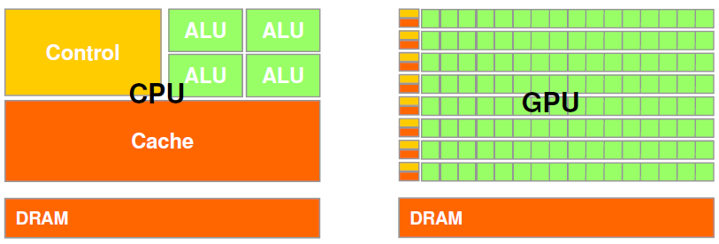
Why is GPU so Efficient?
GPU is specialized for compute-intensive, highly data parallel computation (owing to its graphics rendering origin)
More transistors can be devoted to data processing rather than caching and control
At peak performance GPU uses order of magnitude less energy per operation than CPU
Working with suitable applications: high arithmetic intensity (the ratio between arithmetic operations and memory operations), high DLP, not too sensitive to latency
Credit: Dan Negrut, ME964 UW-Madison

Slide 42
Classical GPGPU Architecture (Nvidia)
Warp contains 32 threads that execute the same instruction with different data - SIMD
SM/Core
SM/Core
Threads
PE
…
PE
…
PE
…
PE
W
W
W
W
W
W
warps
L1 Caches
Register File
L1 Caches
Register File
Interconnect
Warp Scheduler
L2 Cache
L2 Cache
L2 Cache
Memory Controller
Memory Controller
…
Memory Controller
DRAM
Module
DRAM
Module
DRAM
Module
Memory Array
Memory
Partition
Row open:
Activation
Row close:
Restore & Precharge
Row Buffer

Slide 43
Multicore Performance: Amdahl’s Law
Speedup due to enhancement E:
Exec time w/o E
Speedup w/ E = ----------------------
Exec time w/ E
Suppose that enhancement E accelerates a fraction F (F <1) of the task by a factor S (S>1) and the remainder of the task is unaffected:
ExTime w/ E = ExTime w/o E × ((1-F) + F/S)
Speedup w/ E = 1 / ((1-F) + F/S)

Slide 44
Example 1: Amdahl’s Law
Speedup w/ E = 1 / ((1-F) + F/S)
Consider an enhancement that runs 20 times faster but is only usable 25% of the time
Speedup w/ E = 1/(.75 + .25/20) = 1.31
What if its usable only 15% of the time?
Speedup w/ E = 1/(.85 + .15/20) = 1.17
Amdahl’s Law tells us that to achieve linear speedup with 100 cores, none of the original computation can be scalar!
To get a speedup of 90 from 100 cores, the percentage of the original program that could be scalar would have to be 0.1% or less
Speedup w/ E = 1/(.001 + .999/100) = 90.99

Slide 45
Example 2: Amdahl’s Law
Speedup w/ E = 1 / ((1-F) + F/S)
Consider summing 10 scalar variables and two 10 by 10 matrices on 10 cores
Speedup w/ E = 1/(.091 + .909/10) = 1/0.1819 = 5.5
What if there are 100 cores?
Speedup w/ E = 1/(.091 + .909/100) = 1/0.10009 = 10.0
What if the matrices are 100 by 100 (or 10,010 adds in total) on 10 cores?
Speedup w/ E = 1/(.001 + .999/10) = 1/0.1009 = 9.9
What if there are 100 cores?
Speedup w/ E = 1/(.001 + .999/100) = 1/0.01099 = 91

Slide 46
Other Important Points
Review the first half with midterm review slides and exam questions!
Processor review quiz
Extra review session (online): 15:00 – 16:15 PM, Sunday, Dec. 4th
Check announcements on Canvas
Extra Office hour (online): 15:00 – 16:15 PM, Wednesday, Dec. 7th
Check announcements on Canvas
You do not have to know everything in the textbook. However, any content covered in the lecture could appear in the exam. The review slides do not cover everything.
Do not leave it blank!

Slide 47
Good Luck!
I will be available for questions via Email/Canvas/Slack/Zoom
Interested in GPUs?
Spring 2023: CMPE214 GPU Architecture and Programming
Grader & Research opportunities
Yes, you are readily prepared!
Funded opportunity: RA position for outstanding students
MS Thesis & MS projects
Course Evaluation: Please participate before Dec 7, 2022
You should have received an E-mail, or you can find it on Canvas in the SOTE/SOLATE tab
Feel free to send me feedback directly!
Thank you!

Slide 48


