Slide 1
Midterm Review (1)
CMPE 200 Computer Architecture & Design
Haonan Wang

Slide 2
Midterm Exam Composition
Multiple-choice Single-answer: 4 points * 8 = 32
Multiple-choice Multiple-answer: 6 points (wrong or missing option -3) * 4 = 24
True or False: 3 points * 8 = 24
Questions & Answers: 10 points (steps 8 + answer 2) * 2 = 20
Bonus question: 10 points * 1 = 10
Total = 32 + 24 + 24 + 20 + 10 = 100 + 10
If you get more than 100 points, the excessive points will be used to improved your overall grade.
Exam settings:
Time: Monday, Oct 19, 15:00 - 16:15 @ Clark 222 with LockDown Browser
Closed book (but you can print out the MIPS data card and use it if needed)
Cheat sheet (handwritten): A4 paper * 1 allowed, pictures of both sides must be submitted before the exam
Use of calculator and scratch paper allowed
Double-check your laptop and turn off your cellphone before the exam

Slide 3
Relative Performance
Define Performance = 1/Execution Time
“X is n times faster than Y”
Example: time taken to run a program -- 10s on a computer A, 15s on computer B
Execution Time_{B} / Execution Time_{A} = 15s / 10s = 1.5
A is 1.5 times faster than B.

Slide 4
Example: Average CPI
Instruction Type | Integer | Floating point | Branch | Load/ Store
CPI for type | 1 | 2 | 4 | 3
Instruction Count in program A | 50 | 10 | 10 | 10
Instruction Count in program B | 20 | 0 | 10 | 10
Program A: Total Instructions = 80
Clock Cycles = 50×1 + 10×2 + 10×4 + 10x3 = 140
Avg. CPI = 140/80 = 1.75
CPU time (if Clock period = 100 ps)
= 1.75 x 80 x 100ps = 14000 ps = 14ns
Program B: Total Instructions = 40
Clock Cycles = 20×1 + 10×4 + 10×3 = 90
Avg. CPI = 90/40 = 2.25
CPU time (if Clock period = 100 ps)
= 2.25 x 40 x 100ps = 9000 ps = 9ns

Slide 5
Throughput
Throughput (T) = # of instructions executed / time
IPC = Instruction Per Cycle = 1 / CPI
For a large number of instructions, the IPC of a pipelined processor is 1 instruction per clock cycle
Only when we keep the pipeline full of instructions
Assume we execute N instructions using a K stage datapath
Pipeline IPC | N / (N+K-1)
Let n → ∞ (n = infinity) | 1

Slide 6
Byte-oriented vs. Word-oriented Memory
Most processors are byte-oriented
Can access a word from any byte address
MIPS: Word-oriented
Words must be aligned to multiples of 4
Not word-addressable!
Provides some simplicity in design
Logical views can be arranged in rows of 4-bytes for word-oriented memories
Proc
/
32
Mem
A
D
/
32
…
12
0x00002
F3
0x00001
3B
0x00000
Logical Byte-Oriented View of Mem
…
0x00008
8E
47
13
00
0x00004
7C
12
F3
3B
0x00000
Logical Word-Oriented View

Slide 7
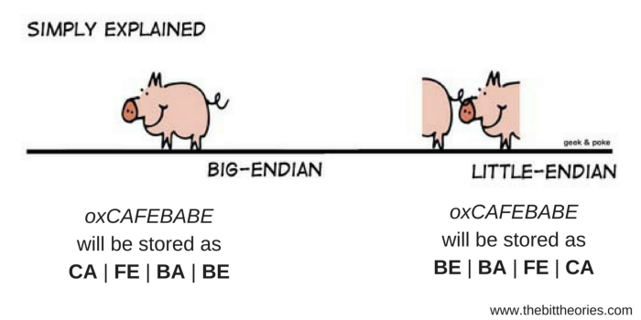
Tips to Remember Endianness
word value:
0 x 1 2 3 4 5 6 7 8
0x03
12
0x00
78
0x02
34
0x01
56
0x01
56
0x02
34
0x00
78
0x03
12
Little-Endian
…
0x00004
12
34
56
78
0x00000
Looks normal (same as writing order) when address is from low to high
Looks strange here
But same as writing order when address is from high to low
Logical Word-Oriented View

Slide 8
Signed vs. Unsigned Instructions
Other instructions also have unsigned versions
addu, addiu, subu, divu, multu, …
Example:
Assume that $2 = 0xFFFFFFFF, $3 = 0x00000001, what is $1?
slt $1, $2, $3 # signed set less than
# -1 < +1 ➔ $1 = 1
sltu $1, $2, $3 # unsigned set less than
# +4,294,967,295 > +1 ➔ $1 = 0

Slide 9
Instruction Formats
different ALU instructions
R-type
0
rs
rt
rd
shamt
funct
31:26
25:21
20:16
15:11
10:6
5:0
Load/ Store
(I-type)
35 or 43
rs
rt
address
31:26
25:21
20:16
15:0
Branch
(I-type)
4
rs
rt
address
31:26
25:21
20:16
15:0
opcode
always read
read, except for load
write for R-type and load
sign-extend and add

Slide 10
Branch Target Addressing
Why branch’s next instruction should be considered?
Because MIPS increments program counter (PC) by 4 before executing an instruction
This already incremented PC value is used for branch target address calculation
Branch Target Address Calculation
Target address = branch’s next instruction address + offset x 4
bne $t0, $s5, Exit
Exit (0x00080018) = addi address (0x00080010) + distance (2) x 4 byte/inst
b Loop
Loop (0x00080000) = Exit address (0x00080018) + distance (-6) x 4 byte/inst
80000 | Loop: sll $t1, $s3, 2
80004 | add $t1, $t1, $s6
80008 | lw $t0, 0($t1)
8000C | bne $t0, $s5, Exit
80010 | addi $s3, $s3, 1
80014 | b Loop
80018 | Exit: …

Slide 11
Loading an Immediate
What if you want to load an immediate value to a register?
If immediate (constant) is 16 bits or less
Use ori or addi instruction with $0 register
Examples : You want to load value 1 to $2
addi $2, $0, 1 // R[2] = 0 + 1 = 1
ori $2, $0, 0x1 // R[2] = 0 | 1 = 1
If immediate is more than 16 bits
Immediates limited to 16 bits so we must load constant with a 2-instruction sequence using the special LUI (Load Upper Immediate) instruction
To load $2 with 0x12345678
lui $2, 0x1234
ori $2, $2, 0x5678
LUI: the immediate value is loaded to the MSB 16 bits of the target register
R[2]
12340000
LUI
OR 00005678
R[2]
12345678
ORI

Slide 12
Jump Target Addressing
Jump instruction provides larger scale jump than branch
Target address = First 4 bits of jump’s next instruction address : Last 28 bits of (target x 4)
Example: j Loop (0x00080000)
The first 4 bits of Exit = 0x0
Last 28 bits of target x 4 = 0080000
target = 0x0020000
Target address of Jump
4-bits
26-bits
2-bits
PC [31:28]
Target
00
32 bits
00080000 | Loop: sll $t1, $s3, 2
00080004 | add $t1, $t1, $s6
00080008 | lw $t0, 0($t1)
0008000C | bne $t0, $s5, Exit
00080010 | addi $s3, $s3, 1
00080014 | j Loop
00080018 | Exit: …

Slide 13
Exercise
Translate the given high-level language code to MIPS assembly.
Assume that the address of integer variable x and y are in $4 and $1 respectively.
High-level language
MIPS
if (x > y)
x = x + y; else x = 1;
lw $2, 0($4)
lw $3, 0($1)
slt $1, $3, $2
beq $1, $0, Else
add $2, $2, $3
b Next
addi $2, $0, 1
sw $2, 0($4)
x > y
x <= y
Tasks to do:
Load x value to a register
Load y value to another register
Check if y is less than x
If true, run add operation
Else, store 1 to one register
Store the result value to a in memory
Else:
Next:

Slide 14
Exercise 2
Translate the given high-level language code to MIPS assembly
Assume that the base address of a char array a is in register $s0
base address of an array: the address of the first element of the array
Assume that the value of i is in $t0.
High-level language
a[i]--;
MIPS
add $t2, $s0, $t0
lb $t3, 0($t2)
subi $t3, $t3, 1
sb $t3, 0($t2)
Now we know that the address of a[i] is $s0 + 1byte * i = $s0 + $t0
Is this a valid operation to get one byte from $s0 + $t0?
lb $t1, $t0($s0)
No, because offset should be an immediate value, not a register id
We should change the base address value, not offset value
i.e. new base: $t2 = $s0 + $t0
and then load one byte from 0($t2)

Slide 15
Less Than Comparisons
To reduce the number of instructions, you can also use slti or sltui instead of slt
Example: Add numbers from 0 to 9
MIPS
High-level language
# $s0 = i, $s1 = sum
add $s0, $0, $0
add $s1, $0, $0
for: slti $t1, $s0, 10
beq $t1, $0, done
add $s1, $s1, $s0
addi $s0, $s0, 1
j for
done:
# $s0 = i, $s1 = sum
add $s0, $0, $0
add $s1, $0, $0
addi $t0, $0, 10
for: slt $t1, $s0, $t0
beq $t1, $0, done
add $s1, $s1, $s0
addi $s0, $s0, 1
j for
done:
int sum = 0;
int i;
for (i = 0; i < 10; i++)
{
sum = sum + i;
}

Slide 16
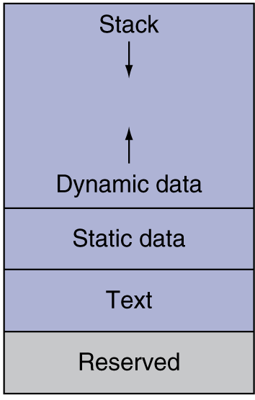
Example: Recursion for 3!
0x000000FC
0x000000F8
0x000000F4
0x000000F0
0x000000EC
0x000000E8
0x000000E4
0x000000E0
0x000000DC
…
$sp
…
$sp
$v0 = 6
$a0 (0x3)
$a0 = 3
$v0 = 3 x 2
factorial: addi $sp, $sp, -8 # make room
sw $a0, 4($sp) # store input (n)
sw $ra, 0($sp) # store return address
addi $t0, $0, 2 # $t0 = 2
slt $t0, $a0, $t0 # n <= 1?
beq $t0, $0, else # no: go to else (recursion)
addi $v0, $0, 1 # yes: return 1
addi $sp, $sp, 8 # restore $sp
jr $ra # return
else: addi $a0, $a0, -1 # n = n -1
jal factorial # recursive call
lw $ra, 0($sp) # restore return address
lw $a0, 4($sp) # restore input
addi $sp, $sp, 8 # restore $sp
mul $v0, $a0, $v0 # n * factorial(n-1)
jr $ra # return
$sp
$ra
$sp
$a0 (0x2)
$sp
$a0 = 2
$v0 = 2 x 1
$ra
$sp
$a0 (0x1)
$v0 = 1
$ra
Compiled machine code

Slide 17
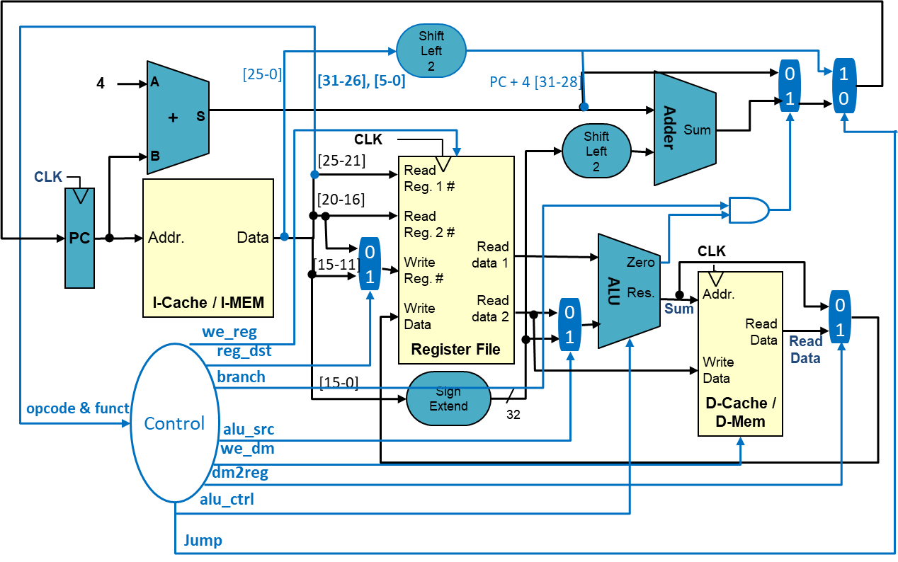
Single-Cycle CPU Performance Analysis
Function Unit | Parameter | Delay (ps)
Register clock-to-Q | T_{pcq_PC} | 30
MUX | T_{MUX} | 25
Sign-extend | T_{s_ext} | 25
ALU | T_{ALU} | 200
Mem read | T_{mem} | 250
Register file read | T_{RFread} | 150
Register file write | T_{RFwrite} | 20
Critical path for LW = T_{pcq_PC} + T_{i-mem} + T_{RFread} + T_{ALU} + T_{d-mem} + T_{MUX} + T_{RFwrite}
= (30 + 250 + 150 + 200 + 250 + 25 + 20) ps
= 925 ps

Slide 18
5-Stage Pipelined CPU
IF/ID
ID/EX
EX/MEM
MEM/WB
4
A
+
Adder
S
Shift Left 2
Sum
B
Register File
0
1
CLK
Read Reg. 1 #
I-Cache / I-MEM
Read Reg. 2 #
PC
Addr.
Data
Read data 1
Write Reg. #
Zero
ALU
Res.
D-Cache /
D-Mem
Write Data
Read data 2
0
1
Addr.
0
1
Read Data
Write Data
Sign Extend
16
32
0
1

Slide 19
Pipelined Timing
Suppose we execute N instructions using a K stage datapath
Total execution cycle: K+N-1 cycles
K cycle for 1st inst + (N-1) cycles for remaining insts
Assume we keep the pipeline full
 | CC1 | CC2 | CC3 | CC4 | CC5 | CC6 | CC7 | CC8 | CC9 | CC10 | CC11
LW | IF | ID | EXE | MEM | WB
ADD |  | IF | ID | EXE | MEM | WB
SUB |  |  | IF | ID | EXE | MEM | WB
SW |  |  |  | IF | ID | EXE | MEM | WB
AND |  |  |  |  | IF | ID | EXE | MEM | WB
OR |  |  |  |  |  | IF | ID | EXE | MEM | WB
XOR |  |  |  |  |  |  | IF | ID | EXE | MEM | WB
7 Instrs. =
11 clocks (5 + 7 – 1)

Slide 20
Data Hazards
Read-After-Write (RAW)
A following instruction reads a result from a previous instruction
Write-After-Read (WAR)
Write-After-Write (WAW)
RAW Example
LW $t1,4($s0)
ADD $t5,$t1,$t4
Initial Conditions:
$s0 = 0x10010000
$t1 = 0x0
00000060
0x10010004
$t4 = 0x24
12345678
0x10010000
$t5 = 0x0
After execution values should be:
$s0 = 0x10010000
$t1 = 0x60
$t4 = 0x24
$t5 = 0x84

Slide 21
Pipeline Latency with Forwarding/Stall
Number of cycles we must stall to execute a dependent instruction:
Instruction that is the dependency source | w/o Forwarding (cycles) | w/ Forwarding (cycles)
LW | 2 | 1
Other instructions that update register file | 2 | 0
Data Hazards Solutions:
- Hardware: stalling & forwarding
- Software: compiler -- code reordering

Slide 22
Forwarding Path
FlushE
IF/ID
ID/EX
EX/MEM
MEM/WB
StallIF
Hazard detection unit
StallID
Control
WB
WB
WB
M
M
EX
0
1
2
Register File
Read Reg. 1 #
I-Cache / I-MEM
Read data 1
Read Reg. 2 #
ForwardAE
ALU
D-Cache /
D-Mem
PC
Addr.
Res.
Addr.
0
1
Data
Write Reg. #
Read data 2
0
1
2
Read Data
en
Write Data
Write Data
ForwardBE
Forwarding Logic
25:21
rsE
20:16
rtE
0
1
rf_waE
rf_waM
rf_waW
15:11
rdE
Note: Logics for sign extensions and next pc calculation are omitted for simplicity

Slide 23
Code Scheduling to Avoid Stalls
Compiler can reorder code to avoid the stalls
C code for A = B + E; C = B + F;
lw $t1, 0($t0)
lw $t2, 4($t0)
add $t3, $t1, $t2
sw $t3, 12($t0)
lw $t4, 8($t0)
add $t5, $t1, $t4
sw $t5, 16($t0)
lw $t1, 0($t0)
lw $t2, 4($t0)
lw $t4, 8($t0)
add $t3, $t1, $t2
sw $t3, 12($t0)
add $t5, $t1, $t4
sw $t5, 16($t0)
stall
stall
Total
execution time
5 cycles for the first inst +
6 cycles for the remaining insts +
2 x 1 stall cycles = 13 cycles
5 cycles for the first inst +
6 cycles for the remaining insts +
0 stall cycles = 11 cycles

Slide 24
Control Hazard
Branch outcomes: Taken (T) or Not-Taken (NT)
Not known until late in the pipeline
Prevents us from fetching future instructions
Rather than stall, we can predict the outcome and keep fetching
We only need to correct the pipeline if we guess wrong
Static Predictions
Predict Taken
Predict Not Taken
T
--- beq L1 L2 --- --- --- --- beq L2 L1 ---
NT
T
NT

Slide 25
Early Branch Determination
Target address can be calculated earlier by moving shift-left-2 and Adder
IF/ID
Adder
ID/EX
EX/MEM
MEM/WB
4
A
Shift Left 2
Sum
+
S
B
Register File
0
1
CLK
Read Reg. 1 #
I-Cache / I-MEM
Read Reg. 2 #
PC
Addr.
Data
Read data 1
Write Reg. #
Zero
=
ALU
Res.
D-Cache /
D-Mem
Write Data
Read data 2
0
1
Addr.
0
1
Read Data
Write Data
Sign Extend
16
32
0
1

Slide 26
Branch Delay Slot
 | CC1 | CC2 | CC3 | CC4 | CC5 | CC6 | CC7 | CC8 | CC9 | CC10
BEQ | IF | ID | EXE | MEM | WB
ADD |  | IF | ID | EXE | MEM | WB
SUB |  |  | IF | ID | EXE | MEM | WB
BNE |  |  |  | IF | ID | EXE | MEM | WB
OR |  |  |  |  | IF | ID | EXE | MEM | WB
ADD |  |  |  |  |  | IF | ID | EXE | MEM | WB
SUB |  |  |  |  |  |  | IF | ID | EXE | MEM
Actual Branch Outcome
No Flush
& Better Performance
BEQ $a0,$a1,L1 (NT)
L2: ADD $s1,$t1,$t2
SUB $t3,$t0,$s0
BNE $a0,$s1,L2 (T)
OR $s0,$t6,$t7
L1: AND $t3,$t6,$t7
SW $t5,0($s1)
LW $s2,0($s5)
Instruction in the
target address (L2)

Slide 27
Early Determination w/ Predict NT
 | CC1 | CC2 | CC3 | CC4 | CC5 | CC6 | CC7 | CC8 | CC9 | CC10
BEQ | IF | ID | EXE | MEM | WB
ADD |  | IF | ID | EXE | MEM | WB
SUB |  |  | IF | ID | EXE | MEM | WB
OR |  |  |  | IF | ID | EXE | MEM | WB
BNE |  |  |  |  | IF | ID | EXE | MEM | WB
AND |  |  |  |  |  | IF
ADD |  |  |  |  |  |  | IF | ID | EXE | MEM
SUB |  |  |  |  |  |  |  | IF | ID | EXE
Actual Branch Outcome
BEQ $a0,$a1,L1 (NT)
L2: ADD $s1,$t1,$t2
SUB $t3,$t0,$s0
OR $s0,$t6,$t7
BNE $a0,$s1,L2 (T)
L1: AND $t3,$t6,$t7
SW $t5,0($s1)
LW $s2,0($s5)
T!
Flush
nop
nop
nop
nop
Instruction in the
target address (L2)

Slide 28
Early Branch Determination: Issues
Target address can be calculated earlier by moving shift-left-2 and Adder
IF/ID
Adder
ID/EX
EX/MEM
MEM/WB
4
A
Shift Left 2
Sum
This may need extra data forwarding and stall
because now the operand value is needed in ID stage (not in EXE stage)
+
S
B
Register File
0
1
CLK
Read Reg. 1 #
I-Cache / I-MEM
Read Reg. 2 #
PC
Addr.
Data
Read data 1
Write Reg. #
Zero
=
ALU
Res.
D-Cache /
D-Mem
Write Data
Read data 2
0
1
Addr.
0
1
Read Data
Write Data
Sign Extend
16
32
0
1

Slide 29
Early Determination w/ Predict NT
If BNE has dependency with its preceding instruction, OR, one cycle stall is required to get the OR’s result value
→ Still better than normal 3 cycle flushing
 | CC1 | CC2 | CC3 | CC4 | CC5 | CC6 | CC7 | CC8 | CC9 | CC10
BEQ | IF | ID | EXE | MEM | WB
ADD |  | IF | ID | EXE | MEM | WB
SUB |  |  | IF | ID | EXE | MEM | WB
OR |  |  |  | IF | ID | EXE | MEM | WB
BNE |  |  |  |  | IF | ID | ID | EXE | MEM | WB
AND |  |  |  |  |  | IF | IF
ADD |  |  |  |  |  |  |  | IF | ID | EXE
SUB |  |  |  |  |  |  |  |  | IF | ID
Actual Branch Outcome
BEQ $a0,$a1,L1 (NT)
L2: ADD $s1,$t1,$t2
SUB $t3,$t0,$s0
OR $s0,$t6,$t7
BNE $s0,$s1,L2 (T)
L1: AND $t3,$t6,$t7
SW $t5,0($s1)
LW $s2,0($s5)
T!
nop
nop
nop
Instruction in the
target address (L2)

Slide 30
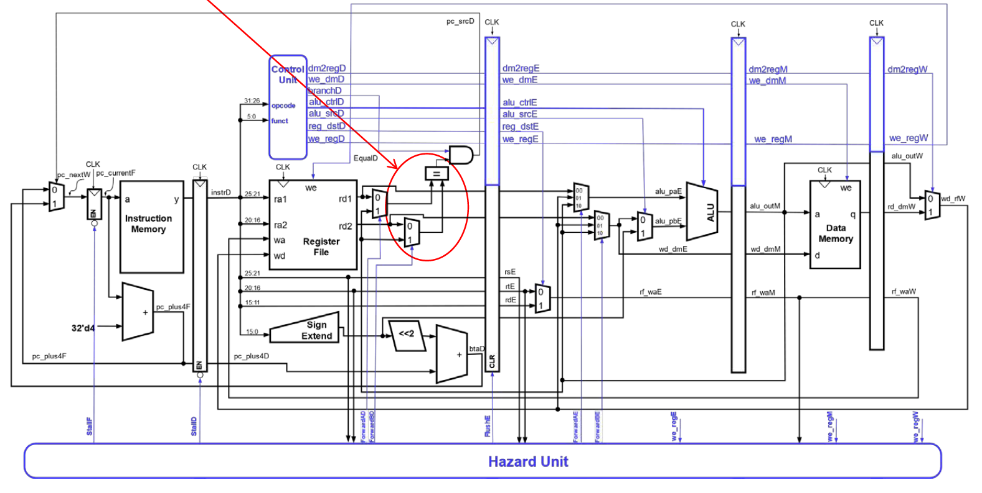
Early Branch Determination
Forwarding logic for early branch determination
ForwardAD = branchD and we_regM and (rsD ≠ 0) and (rf_waM == rsD)
ForwardBD = branchD and we_regM and (rtD ≠ 0) and (rf_waM == rtD)

Slide 31


1-bit Predictor
Each entry of branch prediction buffer is 1-bit (1: Taken, 0: Not Taken)
The entry value is the latest outcome of the branch
Next outcome of the branch is predicted based on current value
Example: Assume that the actual outcomes of the branches at 0xDC04, 0xDC08, and 0xDC20 are untaken, taken, and untaken, respectively
0xDC04 for(i=0;i<10000;i++)
{
0xDC08 if( ( i % 100) == 0 )
tick( );
0xDC20 if( (i % 2) == 0)
even();
}
prediction bit
0
1
0
..
predicted NT
Actual result: NT
0
predicted T
Actual result: NT
1
predicted NT
Actual result: T

Slide 32
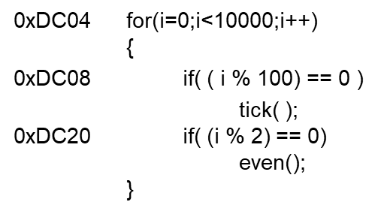
Is 1 bit Enough?
Taken to exit the loop
Not taken and continue to the loop body
NT
TN
DC04: NNNNNNN ... NNNNNNNNNNT
NNNNNNNNN …
10,000 iterations
10,000 iterations …
Mis-predictions for every
first and last iterations
→ 99.998% Correct Prediction
Mis-predictions: 2 / 10,000
DC08: TTTTT ... TNTTTTT … TNTTTTT …
98.0% Correct Prediction
Mis-predictions: 2 / 100
DC20: TNTNTNTNTNTNTNTNTNTNTNTNTNTNT …
0.0% Correct Prediction
Mis-predictions: 2 / 2

Slide 33
Using 2-bit History
2-bit Saturating Counter in each branch prediction buffer entry
Could have more than two bits but two bits cover most patterns (i.e. loops)
Predict NT
Predict T
Transition on T outcome
11
10
Transition on NT outcome
0
1
00
01
FSM for 1-bit
Prediction
FSM for 2-bit
Saturating Counter

Slide 34
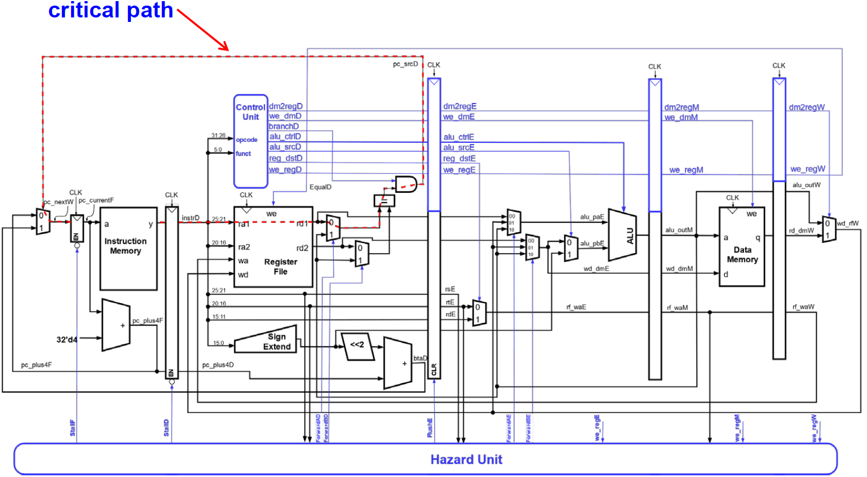
Pipelined CPU Performance Analysis
Function Unit | Parameter | Delay (ps)
Register clock-to-Q | T_{pcq} | 30
Clock setup time | T_{setup} | 20
MUX | T_{MUX} | 25
Sign-extend | T_{s_ext} | 25
ALU | T_{ALU} | 200
Mem read | T_{mem} | 250
AND | T_{AND} | 15
EQ | T_{eq} | 40
Register file read | T_{RFread} | 150
Register file write | T_{RFwrite} | 20
RF write and read need to be finished in the first and second half of each cycle, respectively
Critical path = max {
T_{pcq} + T_{i-mem} + T_{setup},
2 ( T_{RFread} + T_{mux} + T_{eq} + T_{AND} + T_{mux} + T_{setup} ),
T_{pcq} + T_{mux} + T_{mux} + T_{ALU} + T_{setup},
T_{pcq} + T_{memread} + T_{setup},
2 ( T_{pcq} + T_{mux} + T_{RFwrite} )
}

Slide 35

Question: Pipelined CPI
SPECINT2000 benchmark:
25% loads, 10% stores, 11% branches, 2% jumps, 52% R-type
Assume:
40% of loads used by next instruction
25% of branches mispredicted
All jumps flush next instruction
Average CPI calculation:
Load/Branch CPI = 1 when no stalling, 2 when stalling
CPI_{lw} = 1(0.6) + 2(0.4) = 1.4
CPI_{beq} = 1(0.75) + 2(0.25) = 1.25
Overall average CPI = (0.25 x 1.4) + (0.1 x 1) + (0.11 x 1.25) + (0.02 x 2) + (0.52 x 1) = 1.15
Average CPI
= Total Clock Cycles / Total IC
= $\sum{ ICi x CPIi}$ / Total IC
= $\sum{ IRi x CPIi}$

Slide 36
CPU Performance Comparison
For a program with 100 billion instructions executing on the pipelined MIPS processor under discussion, execution time is
CPU time = # instructions x CPI x cycle time
= (100 x 10⁹) x 1.15 x (550 x 10⁻¹² sec)
= 63 seconds
When we ran the same code on a single-cycle processor, CPU time was 92.5 seconds.
Speedup of pipelined architecture = 92.5 / 63 = 1.47x

Slide 37
Other Important Points
You do not have to know everything in the textbook. However, any content we have covered during the lecture so far could appear in the exam. If you have followed all our lectures, your hard work will pay off!
Check the exam related info in the exam Module on Canvas.
Good luck!

Slide 38


