Slide 1
Lecture 0. Introductions
CMPE 200 Computer Architecture & Design
Haonan Wang

Slide 2

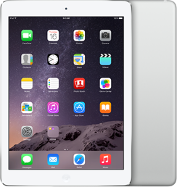
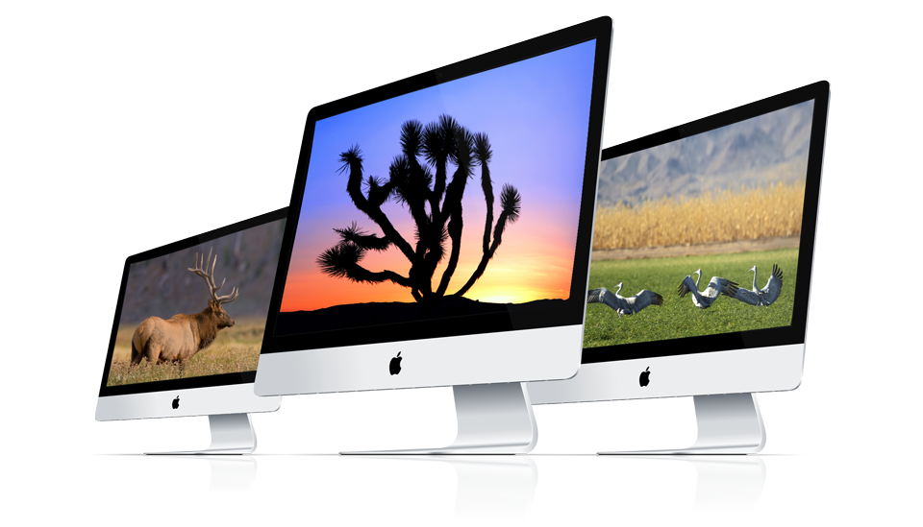


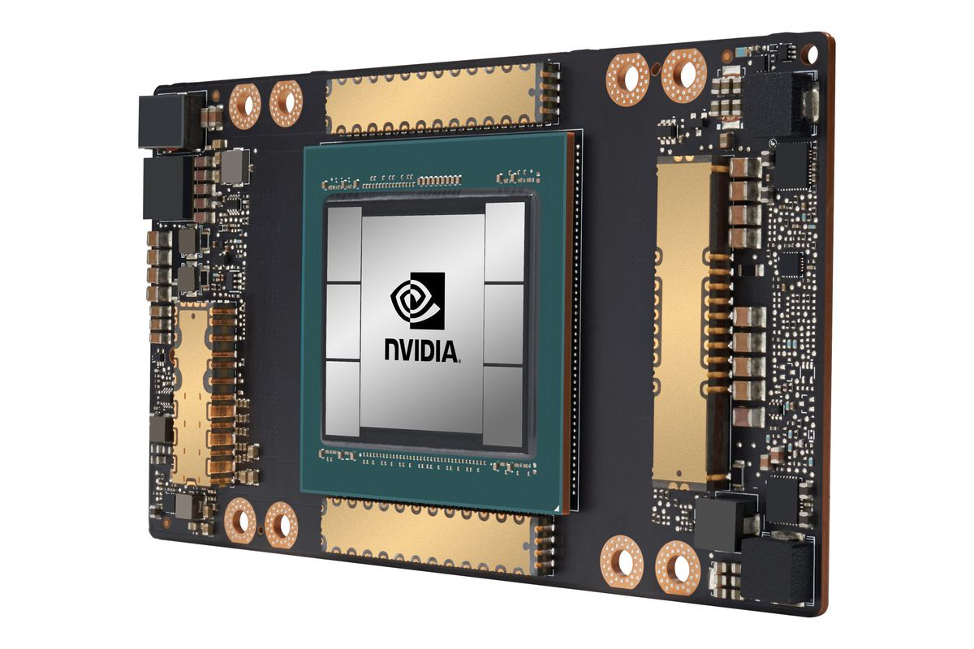
Computer Architecture -- Where?
Computers
Mobile Devices
Data Centers
Accelerators

Slide 3
Computer Architecture -- What?
Software/Applications
Operating System
Compiler
Firmware
CMPE200
Instruction Set
Architecture
Processor
Registers
Cache
Memory
HDD/SSD
Datapath & Control
Digital Design
Circuit Design

Slide 4







Computer Architecture -- Why?
Job opportunities
Research opportunities
Conferences: HPCA, MICRO, ASPLOS, ISCA
Help in many other aspects
Coding
Other courses
Purchasing hardware
…

Slide 5
Learning Goals
1. Have an overall understanding of computing systems from architectural and organizational point of view.
2. Have an in-depth understanding of RISC processor instruction-set architecture and micro-architecture, as well as memory organization.
3. Understand advanced topics such as instruction-level and thread-level parallelism, and multicore/multiprocessor/clustered systems.

Slide 6
Computer Architecture -- How?
Lectures: Mon/Wed 15:00 – 16:15 @ Clark Building 222
Grouped in Canvas modules with assignments, discussions, readings, practices, quizzes, etc.
Slides, announcements, etc. will also be uploaded to Canvas
Textbook
Computer Organization and Design – the Hardware/Software Interface, 5th Edition
Other Readings
Digital Design and Computer Architecture, 2nd Edition
Hennessy and Patterson: Computer Architecture – A Quantitative Approach, 5th Edition
Parallel Computer Organization and Design, 1st Editio
The IEEE Standard 1364-2001 (Verilog Language Reference Manual)
MIPS data card
Google it!
All can be found on Canvas

Slide 7
Grading Information
Assignments 35%: 7 - 8 assignments solo or in 2-student teams
Grade based on completeness, successfulness, and quality of demo & lab reports
Proportion of each assignment (to the final grade) is based on workload
Contribution of each member must be shown (Deserting your teammates is not acceptable)
Almost weekly, check deadlines carefully (No late submissions will be accepted)
Exams 65%: one midterm exam 25% + one final exam 35% + up to four quizzes 5%
Using lockdown browser on Canvas
Extra credit up to 25%:
10% (attendance:6%; asking and answering questions: 4%)
Miscellaneous: 15% (e.g., solving additional questions in assignments and exams)

Slide 8
Tools & Equipments
- EDA Tool (software)
Xilinx Vivado HLx 2019.1 WebPACK edition (https://www.xilinx.com/support/download.html)
- Hardware equipment
Windows and Linux (or virtual machines like WSL) laptops/desktops
- Assemblers and simulators
MIPS: MARS (will be provided in Canvas), MIPSASM
Miscellaneous simulators for process, memory, etc..
Drawing tool (https://www.draw.io/)
Or other professional drawing tools

Slide 9

About Me
Research: Computer Architecture, GPU Architecture
Teaching/learning method: Feynman Technique
My vision of diversity/inclusiveness: the future
- “Our conquest is the sea of stars.”
--- Legend of Galactic Heroes
Contact info
- Email: Haonan.wang@sjsu.edu (add “[CMPE200]” to the subject line)
- Office hours: M/W 16:15-17:15 @ ENG 265
- Join the Slack Channel

Slide 10
Module 0: Assignment 0
1. Introduce yourself in one page (in PDF)
Picture (you should be recognizable by this)
Name / Student ID
A brief self-introduction (background, hobby, special note, something to share, etc.)
What do you know about computer architecture
2. Prerequisite supporting document
Provide a copy of your transcripts, with the grade of CMPE 180D (or equivalent) highlighted
Be careful: You will be dropped if proof is not provided by the due date
3. Honesty pledge
Review carefully and upload signed copy to the Canvas

Slide 11
Module 0: Assignment 0
4. Install Vivado WebPACK Edition.
5. Review the Prerequisite Review: System-level Design Module.
6. Form up 2-student teams for team assignments
Use the People tool on Canvas
You will be randomly assigned a team if you have not joined any team by Sep. 24.
7. Go through the Start Here Module on Canvas.
Orientation Quiz
Respondus Lockdown Browser Practice Quiz
Introductory Discussion-Getting to know you
All contents will be unlocked after finishing the module
Due by Sep. 3 (Sat) 11:59PM

Slide 12
Reference & Special Thanks
CMPE 140, Hyeran Jeon, UC Merced
CMPE 140, Donald Hung, SJSU
CSCI 424, Adwait Jog, W&M

Slide 13


