Slide 1
Lecture 1. Computer Architecture & Design Overview (2)
CMPE 200 Computer Architecture & Design
Haonan Wang

Slide 2
About Prerequisite – What to Submit?
If you have 180D in your admission letter (conditionally classified)
You then need to submit your transcript with 180D highlighted
You cannot take this course before finishing 180D
If you do not have 180D in your admission letter
You then need to submit your admission letter
If you are admitted with classified standing in your admission letter
You then need to submit your admission letter

Slide 3
Relative Performance
Define Performance = 1/Execution Time
“X is n times faster than Y”
Example: time taken to run a program -- 10s on a computer A, 15s on computer B
Execution Time_{B} / Execution Time_{A} = 15s / 10s = 1.5
A is 1.5 times faster than B.

Slide 4
Measuring Execution Time
Elapsed time
Total response time, including all aspects
Processing, I/O, OS overhead, idle time
Determines system performance
CPU time
Time spent processing a given job on CPU
Discounts I/O time, other jobs’ shares
Estimating CPU time is relatively easy based on the number of lines of code and processing speed of the CPU

Slide 5
CPU Clocking
Operation of digital hardware governed by a constant-rate clock
Different system components may have different clock rates
A clock cycle
Clock period
Clock (cycles)
Data transfer and computation
Update state
Clock period: duration of a clock cycle
e.g., 250ps = 0.25ns = 250×10^{–12}s
Clock frequency (rate): cycles per second
e.g., 4.0GHz = 4000MHz = 4.0×10⁹Hz

Slide 6
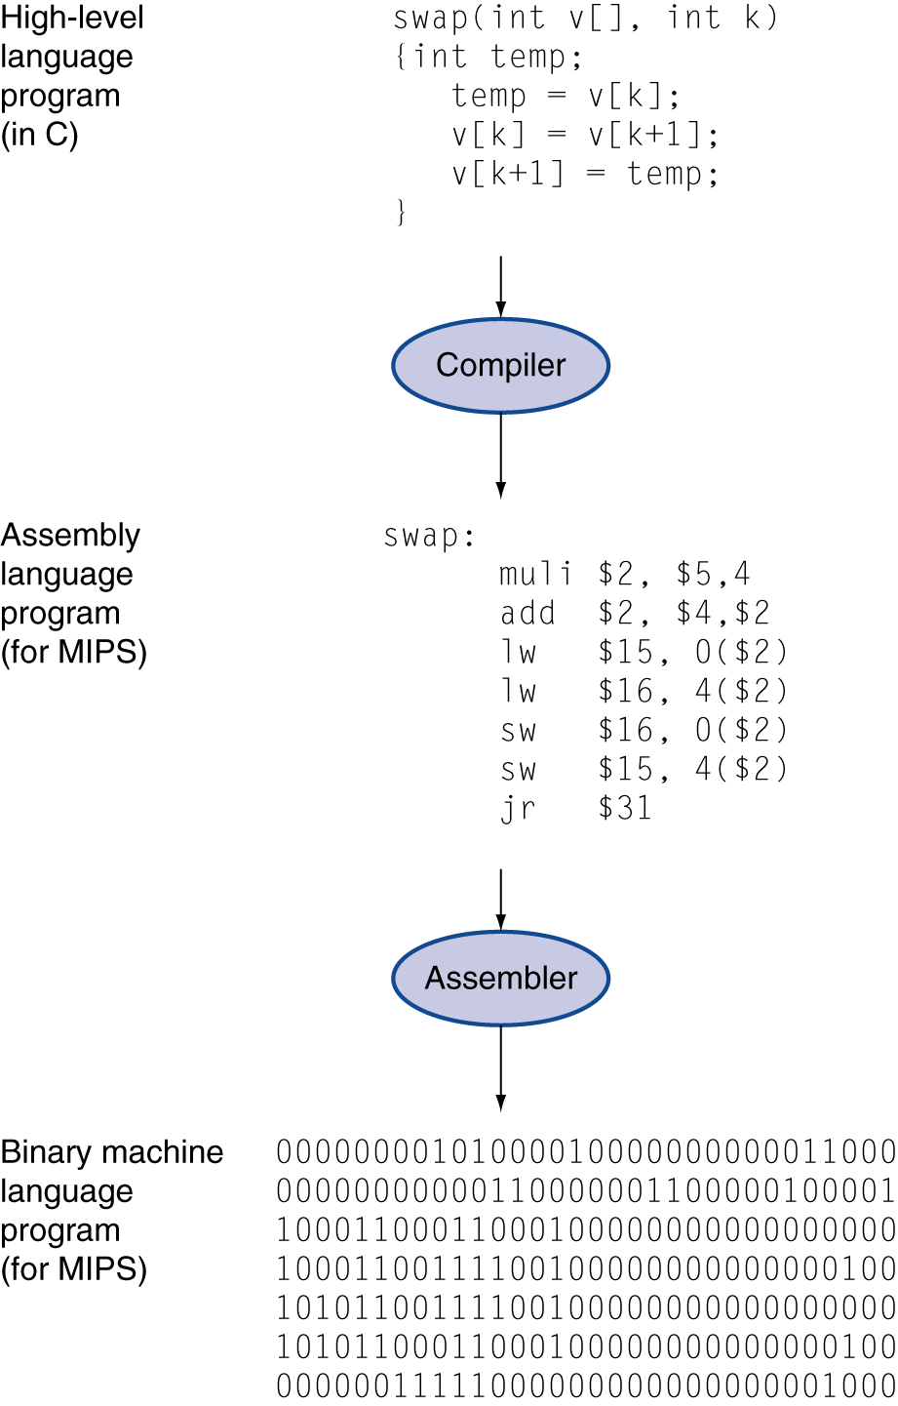
CPU Time Estimation
A code line of high-level language program can be translated to one or multiple assembly code lines
CPU processes a piece of machine code for each assembly code line, one by one
Example: Application A has 1000 assembly lines. CPU has 250 ps clock period.
Clock cycles for Application A
= 1000 cycles
CPU time for Application A
= 1000 cycles x 250 ps = 250×10^{–9}s

Slide 7
CPU Time
CPU Time = Clock Cycles x Clock Period
= Clock Cycles / Clock Frequency

Slide 8
CPU Time Example
Computer A: 2GHz clock, 10s CPU time to run an Application
Designing Computer B
Aim for 6s CPU time for the same Application
Can do faster clock, but causes 1.2 × clock cycles
How fast must Computer B clock be?
CPU Time_{B} = 6 seconds
= Clock Cycles_{B} x Clock Period_{B}
= 1.2 x Clock Cycles_{A} x Clock Period_{B}
= 1.2 x 20 x 10⁹ x Clock Period_{B}
Therefore, Clock Period_{B} = 6 second / (24 x 10⁹)
Clock Frequency_{B} = 4 x 10⁹ = 4GHz
CPU Time_{A} = Clock Cycles_{A} / Clock Frequency_{A}
10 seconds = Clock Cycles_{A} / 2GHz
Clock Cycles_{A} = 10 seconds x 2GHz = 20 x 10⁹ cycles

Slide 9
Instruction Count and CPI
An assembly line is also called one Instruction
In some CPUs, an instruction may take multiple clock cycles
CPU Time equation can be rewritten
Cycles Per Instruction is also called CPI
CPU Time
= Clock Cycles x Clock Period
= Instruction Count x Cycles Per Instruction x Clock Period

Slide 10
CPI Example
A program takes 33 billion instructions to run
CPU processes instructions at 2 cycles per instruction
Clock speed is 3GHz
What is estimated CPU Time for this program?
CPU Time = Instruction Count x CPI x Clock Period
= 33 x 10⁹ x 2 x 1/(3 x 10⁹)
= 22 seconds

Slide 11
CPI Example
Computer A: Cycle Period = 250ps, CPI = 2.0
Computer B: Cycle Period = 500ps, CPI = 1.2
Same number of instructions
Which is faster, and by how much?
CPU Time_{A} = Instruction Count x CPI_{A} x Clock Period_{A}
= Instruction Count x 2.0 x 250 ps
= Instruction Count x 500 ps
CPU Time_{B} = Instruction Count x CPI_{B} x Clock Period_{B}
= Instruction Count x 1.2 x 500 ps
= Instruction Count x 600 ps
Computer A is faster than B by 600ps/500ps = 1.2 times

Slide 12
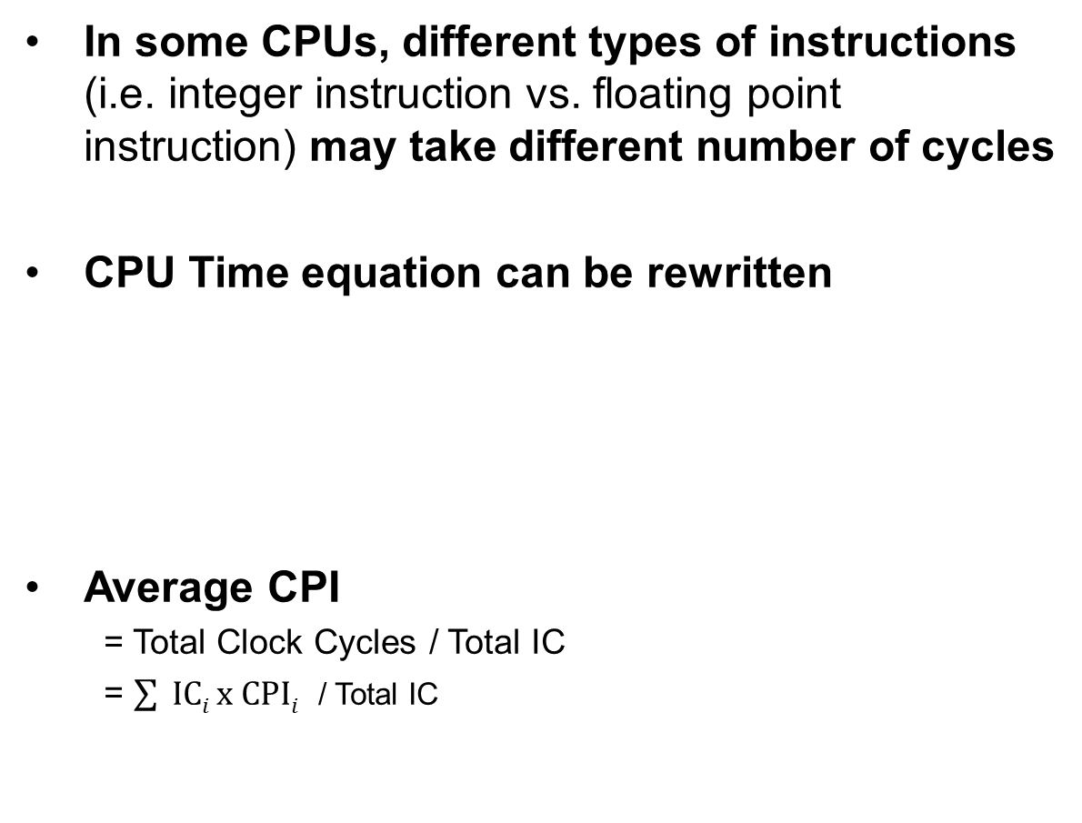
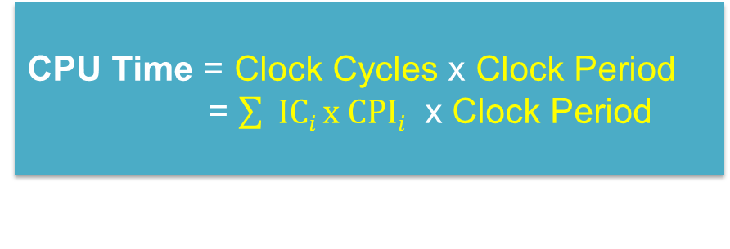
CPI and Average CPI
In some CPUs, different types of instructions (i.e. integer instruction vs. floating point instruction) may take different number of cycles
CPU Time equation can be rewritten
Average CPI
= Total Clock Cycles / Total IC
= $\sum{ ICi x CPIi}$ / Total IC
CPU Time = Clock Cycles x Clock Period
= $\sum{ ICi x CPIi}$ x Clock Period
Sum of (IC of each type instruction x CPI of the type)
(IC = instruction count)

Slide 13
Example: Average CPI
Instruction Type | Integer | Floating point | Branch | Load/ Store
CPI for type | 1 | 2 | 4 | 3
Instruction Count in program A | 50 | 10 | 10 | 10
Instruction Count in program B | 20 | 0 | 10 | 10
Program A: Total Instructions = 80
Clock Cycles = 50×1 + 10×2 + 10×4 + 10x3 = 140
Avg. CPI = 140/80 = 1.75
CPU time (if Clock period = 100 ps)
= 1.75 x 80 x 100ps = 14000 ps = 14ns
Program B: Total Instructions = 40
Clock Cycles = 20×1 + 10×4 + 10×3 = 90
Avg. CPI = 90/40 = 2.25
CPU time (if Clock period = 100 ps)
= 2.25 x 40 x 100ps = 9000 ps = 9ns

Slide 14
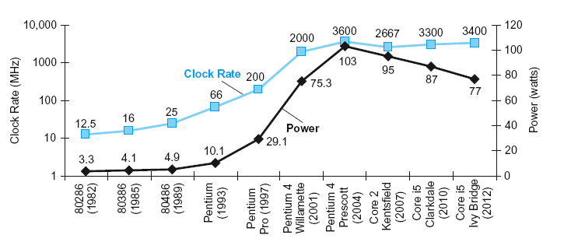
Power and Performance
In CMOS IC technology
Power = Capacitive load x Voltage² x Frequency

Slide 15
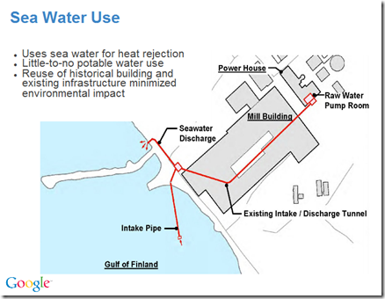
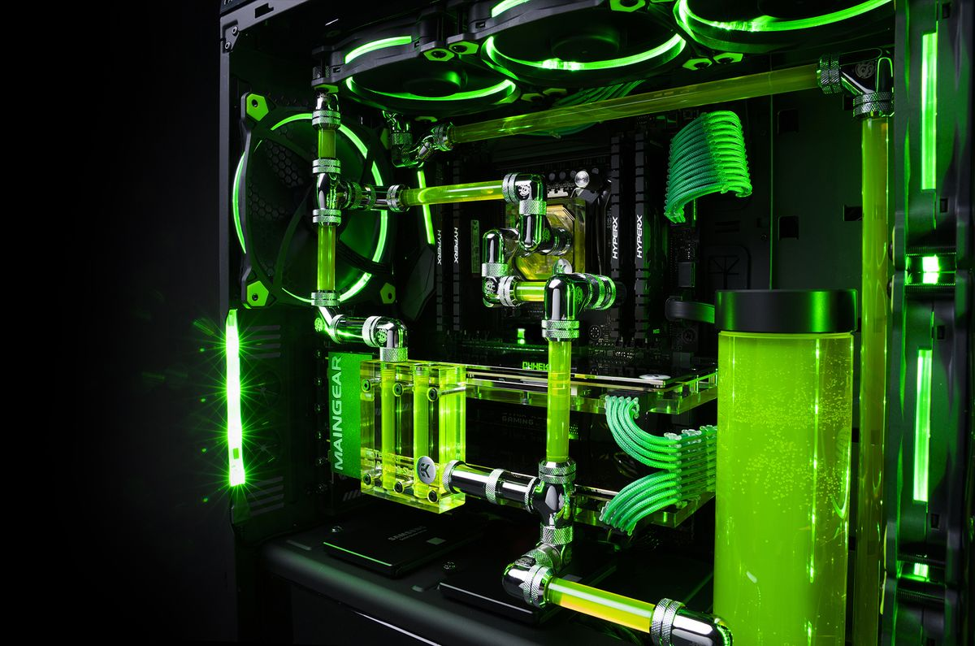
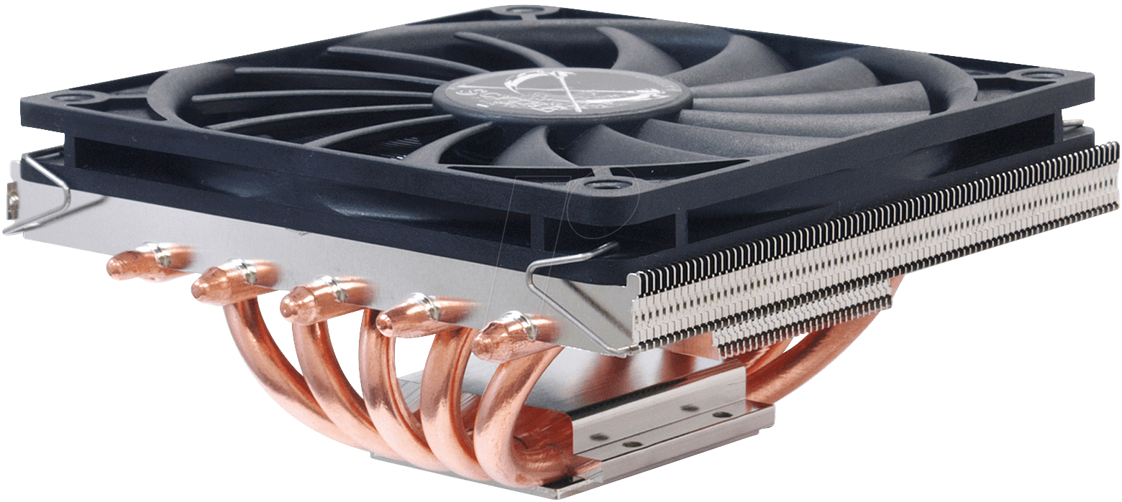
Issue with Power Scaling
Increasing core frequency may burn your processor!
- Almost all energy consumption turns into heat
Cooling is costly
Design more efficient system instead
- Multicore, etc..

Slide 16
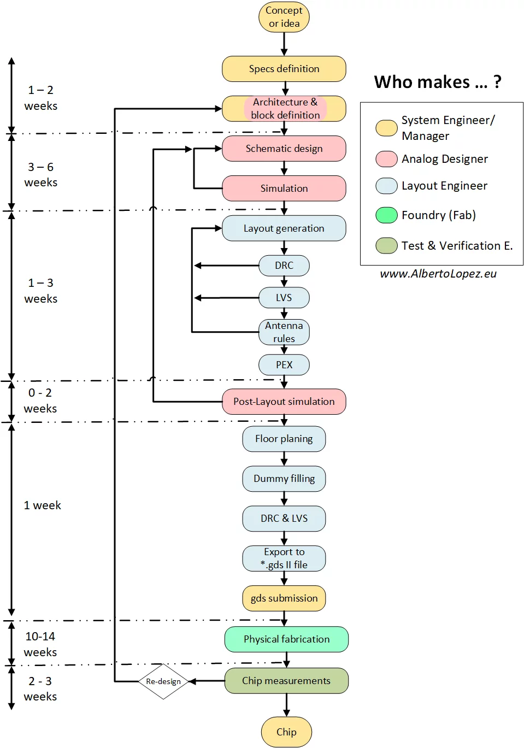
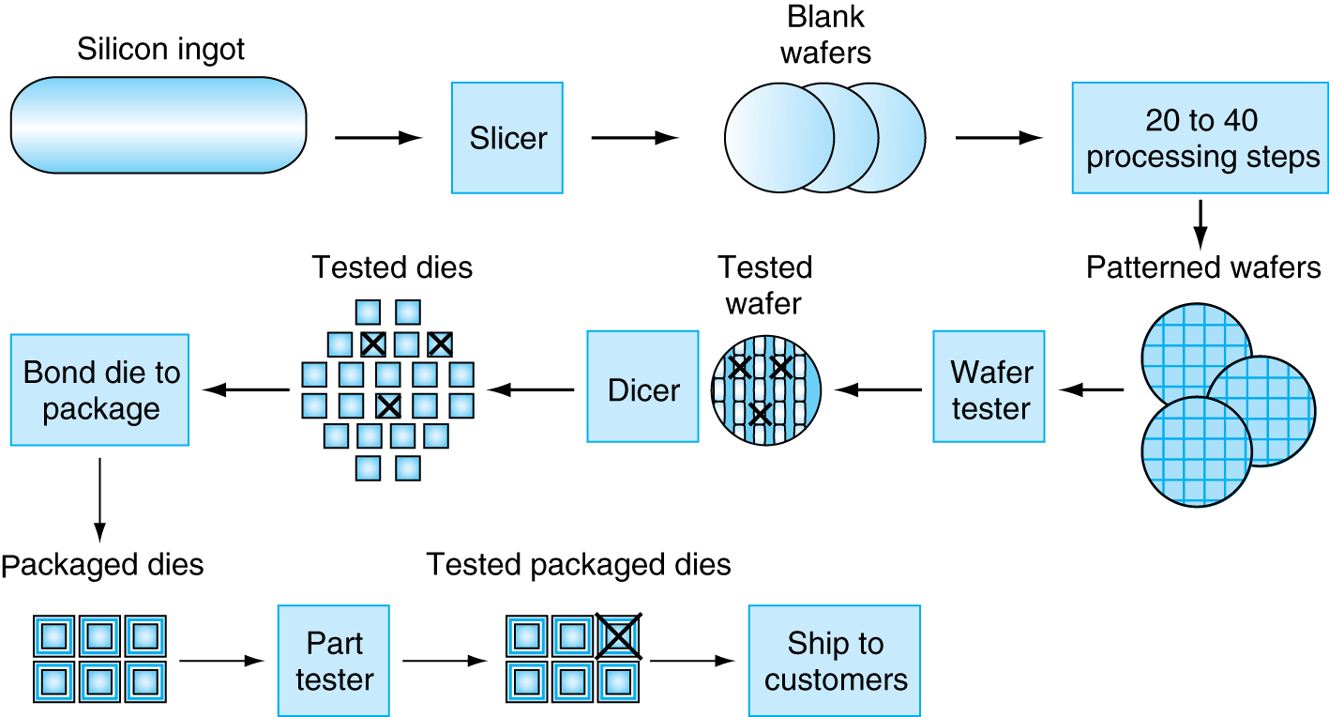
Design and Manufacturing Process

Slide 17
Course Modules
ISA
Processor
Memory
Multicore

Slide 18

Conclusion Time
What is average CPI?
$\sum{ ICi x CPIi}$ / Total IC
What is wrong with increasing power to the system?
Heat
Cost

Slide 19


