Slide 1
Lecture 2. Processor Instruction Set Architecture & Language (1)
CMPE 200 Computer Architecture & Design
Haonan Wang

Slide 2
Instruction Set Architecture & Microarchitecture
Instruction Set Architecture
the programmer’s view of the computer, defined by a set of instructions that each specifies an operation and its operand(s)
Microarchitecture
the way that the ISA is implemented in hardware
Application
Compiler/Libraries
Operating system
Instruction Set (ISA)
Microarchitecture
Circuits
Semiconductor physics

Slide 3
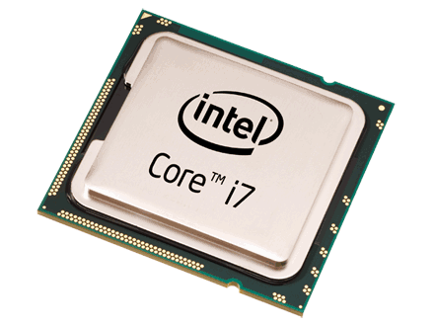
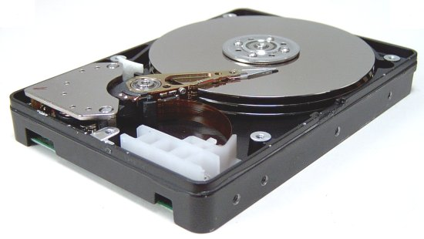
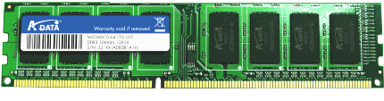
What Does the ISA Deal With Specifically?
Example: a C program that reads
two integer values from “file.txt” file
and prints the sum of them.
Processor
(CPU)
Understands and executes each line of the code.
Uses fast on-chip memories
Memory
(DRAM)
Provides operands to CPU
(*fp, size, sum, numbers[2])
Storage
(HDD)
Provides file inputs and program code
(file.txt)
#include <stdio.h>
#include <string.h>
int numbers[2];
void myfunction(void)
{
FILE *fp;
int size = 2;
int sum = 0;
/* Open file for reading */
fp = fopen(“mynumbers.txt", “r");
/* Read and display data */
fread(numbers, sizeof(int), size, fp);
fclose(fp);
sum = numbers[0] + numbers[1];
printf(“Sum = %d\n”, sum);
}
int main (void) {
myfunction();
return(0);
}

Slide 4
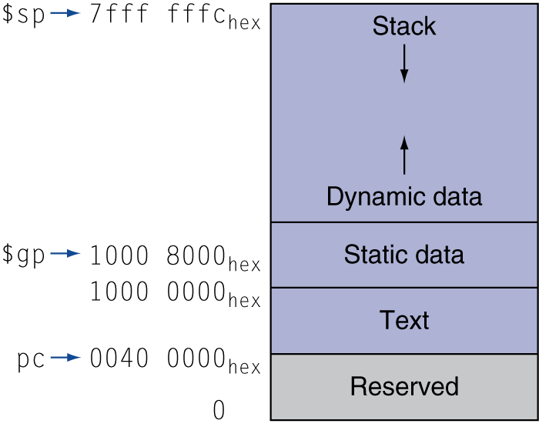
Memory Layout
Address Content
Text: program code
Static data: global variables
e.g., static variables in C, constant arrays and strings
Dynamic data: heap
e.g., malloc in C, new in Java
Grows from bottom (lower address) to top (higher address)
Stack: temporal storage for functions
e.g., return address of sub-functions, local variables
Grows from top to bottom

Slide 5
Memory Layout
#include <stdio.h>
#include <string.h>
int numbers[2];
void myfunction(void)
{
FILE *fp;
int size = 2;
int sum = 0;
/* Open file for reading */
fp = fopen(“mynumbers.txt", “r");
/* Read and display data */
fread(numbers, sizeof(int), size, fp);
fclose(fp);
sum = numbers[0] + numbers[1];
printf(“Sum = %d\n”, sum);
}
int main (void) {
myfunction();
return(0);
}
numbers[1]
numbers[0]
Compiled machine code
Compiled machine code

Slide 6
Memory Layout
#include <stdio.h>
#include <string.h>
int numbers[2];
void myfunction(void)
{
FILE *fp;
int size = 2;
int sum = 0;
/* Open file for reading */
fp = fopen(“mynumbers.txt", “r");
/* Read and display data */
fread(numbers, sizeof(int), size, fp);
fclose(fp);
sum = numbers[0] + numbers[1];
printf(“Sum = %d\n”, sum);
}
int main (void) {
myfunction();
return(0);
}
Return address
Stack region for myfunction
*fp
size
sum
numbers[1]
numbers[0]
Compiled machine code

Slide 7
Memory Layout
#include <stdio.h>
#include <string.h>
int numbers[2];
void myfunction(void)
{
FILE *fp;
int size = 2;
int sum = 0;
/* Open file for reading */
fp = fopen(“mynumbers.txt", “r");
/* Read and display data */
fread(numbers, sizeof(int), size, fp);
fclose(fp);
sum = numbers[0] + numbers[1];
printf(“Sum = %d\n”, sum);
}
int main (void) {
myfunction();
return(0);
}
Return address
Stack region for myfunction
*fp
size
sum
numbers[1]
numbers[0]
Compiled machine code

Slide 8
Memory Access Is Slow
Variables are all stored in Memory, which is outside of CPU
Slow..
How can we execute the operations faster?
Use on-chip memory
Return address
*fp
size
sum
numbers[1]
numbers[0]
Compiled machine code

Slide 9
Register File
Register File
On-chip memory that stores “Registers”
Registers
Temporal space to maintain operand values and calculation results before storing back to memory
Presented with “$” + “register id” in MIPS processor
i.e. $0 : 0th register,
$1 : 1st register
Return address
*fp
size
sum
Register File
$0
$1
$2
numbers[1]
…
numbers[0]
Compiled machine code
$31

Slide 10
Typical Execution Steps
Return address
*fp
Load operand values from memory to registers
Do computation on registers
Move the results from register to memory
size
sum
Register File
$0
$1
$2
numbers[1]
…
numbers[0]
Compiled machine code
$31

Slide 11
Operations in Hardware
Hardware can do one operation at a time
Arithmetic operations
add, sub, mult, div, …
Data movement
move, load data, store data, …
Logical operations
shift, and, or, xor, …
Conditional operations
jump, branch on condition, …
Format of assembly instructions that uses register operands
Command Result, Operand 1, Operand 2
E.g. C = A + B → Add C, A, B (A, B, C should be replaced by register id)

Slide 12
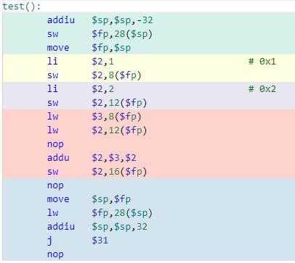
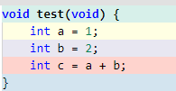
HLL vs. Hardware Operations
HLL are designed to be understood and programmed easily by programmers
A HLL line may be a combination of multiple assembly instructions
Compile

Slide 13
Code Example: Memory & Registers
C code
MIPS Assembly code
Compile
Operations involved:
Value of ‘a’ is loaded from mem to $3
Value of ‘b’ is loaded from mem to $2
Add operation done on $2 and $3
Value of ‘c’ is stored to mem

Slide 14
Code Example: Memory & Registers
C code
Stack region
allocation for test()
Compile
MIPS Assembly code
Register File
$0
executing line
$1
$2
$3
…
Compiled machine code
$31

Slide 15
Code Example: Memory & Registers
C code
a = 1
Compile
MIPS Assembly code
Register File
$0
$1
executing line
$2
$3
…
Compiled machine code
$31

Slide 16
Code Example: Memory & Registers
C code
b = 2
a = 1
Compile
MIPS Assembly code
Register File
$0
$1
$2
$3
executing line
Compiled machine code
…
$31

Slide 17
Code Example: Memory & Registers
C code
b = 2
a = 1
Compile
MIPS Assembly code
Register File
$0
$1
$2
$3
executing line
…
Compiled machine code
$31

Slide 18
Code Example: Memory & Registers
C code
b = 2
a = 1
Compile
MIPS Assembly code
Register File
$0
$1
$2
$3 (1)
…
Compiled machine code
executing line
$31

Slide 19
Code Example: Memory & Registers
C code
b = 2
a = 1
Compile
MIPS Assembly code
Register File
$0
$1
$2 (3)
$2 (2)
$3 (1)
…
Compiled machine code
executing line
$31
+

Slide 20
Code Example: Memory & Registers
C code
c = 3
b = 2
a = 1
Compile
MIPS Assembly code
Register File
$0
$1
$2 (3)
$2 (2)
$3 (1)
…
Compiled machine code
$31
executing line

Slide 21
Registers of MIPS CPUs
Assembler Name | Register Number | Description
$zero | $0 | Constant 0 value
$at | $1 | Assembler temporary
$v0-$v1 | $2-$3 | Function return values
$a0-$a3 | $4-$7 | Function Arguments
$t0-$t7 | $8-$15 | Temporaries
$s0-$s7 | $16-$23 | Saved Temporaries
$t8-$t9 | $24-$25 | Temporaries
$k0-$k1 | $26-$27 | Reserved for OS kernel
$gp | $28 | Global Pointer (Global and static variables/data)
$sp | $29 | Stack Pointer
$fp | $30 | Frame Pointer
$ra | $31 | Return Address

Slide 22
Exercise: Register Reuse
Example:
- Assume g, h, i and j are loaded to registers, $t0, $t1, $t2, $t3
- HLL:
f = (g + h) – (i + j);
- Assembly (with add & sub operations)?
add $t0, $t0, $t1
add $t2, $t2, $t3
sub $t2, $t0, $t2
Register values are maintained unless overwritten

Slide 23
A Brief Review
One line of HLL can involve:
Load operand values from memory to registers
Do computation on registers
Move the results from register to memory
Data load operations
move, load data, …
Arithmetic operations
add, sub, mult, div, …
Logical operations
shift, and, or, xor, …
Conditional operations
jump, branch on condition, …
Data store operations
move, store data, …

Slide 24
Operations of MIPS CPUs
C operator | Assembly Operations | Comments
C = A + B | add C, A, B | Add two values
C = A - B | sub C, A, B | Subtract one from another
C = A * B | mul C, A, B | Multiply two values
C = A & B | and C, A, B | Logical AND operation
C = A | B | or C, A, B | Logical OR operation
C = A ^ B | xor C, A, B | Logical XOR operation
C = A << shamt | sll C, A, shamt | Shift left by shamt
C = A >> shamt | srl C, A, shamt | Shift right by shamt
If (A < B) C = 1 | slt C, A, B | Set if less than
C = Memory | lw C, Memory address | Load value from memory
Memory = C | sw C, Memory address | Store value to memory
If (A == B) go to Addr | beq A, B, address | Jump if A == B
Many more …
Note: A, B, C in the table should be replaced by proper register ids

Slide 25

About MIPS Assembly
CPUs use their own assembly languages
Assembly language of ARM, Pentium, Opteron… are all different
MIPS Assembly Features
Very similar to ARM Assembly
One of the earliest RISC architectures that used pipelined instruction processing
Developed by MIPS Technologies
Now maintained by Wave Computing
Various generations
MIPS I~V
MIPS32 (32-bit processor)
MIPS64 (64-bit processor)
microMIPS..

Slide 26
Two types of Computers
Reduced Instruction Set Computer (RISC): MIPS, ARM, …
- Operands are in registers
- Each instruction can do only one operation: Simple but longer codes
Complex Instruction Set Computer (CISC): Intel, AMD, …
- Operands can be in registers, stacks, accumulators, in memories
- Each instruction can do multiple operations: Complex but shorter codes
- Preferred when memory was very expensive

Slide 27
MIPS Processor Organization
Our Focus
Memory
$0
32 bit
$0
32~64bit
...
Integer
...
Floating
Registers
-point
$31
$31
Registers
Arithmetic Unit
Multiply
Divide
Arithmetic Unit
CPU
Lo
Hi
Coprocessor 1 (FPU)
VAddr
Cause
Status
EPC
Coprocessor 0
(Traps and Memory)

Slide 28
About MIPS32 Processor
Instructions are 32-bit wide
Registers and Computing Logic use 32-bit data
Memory bus is logically 32-bit wide
32 general purpose registers (GPRs) for integer and address values
- A few special ones (i.e. $zero: constant 0, $fp: frame pointer, $sp: stack pointer..)
32 floating point registers for floating point operations (not our focus)

Slide 29
Conclusion Time
What is ISA?
Hardware operation definition
What is Microarchitecture?
ISA implementation
What is Register File?
On-chip memory

Slide 30


