Slide 1
Lecture 2. Processor Instruction Set Architecture & Language (2)
CMPE 200 Computer Architecture & Design
Haonan Wang

Slide 2
MIPS Processor Organization
Our Focus
Memory
$0
32 bit
$0
32~64bit
...
Integer
...
Floating
Registers
-point
$31
$31
Registers
Arithmetic Unit
Multiply
Divide
Arithmetic Unit
CPU
Lo
Hi
Coprocessor 1 (FPU)
VAddr
Cause
Status
EPC
Coprocessor 0
(Traps and Memory)

Slide 3
About MIPS32 Processor
Instructions are 32-bit wide
Registers and Computing Logic use 32-bit data
Memory bus is logically 32-bit wide
32 general purpose registers (GPRs) for integer and address values
- A few special ones (i.e. $zero: constant 0, $fp: frame pointer, $sp: stack pointer..)
32 floating point registers for floating point operations (not our focus)

Slide 4
MIPS Data Sizes
Integer: 3 Sizes Defined
Byte (B)
8-bits
Halfword (H)
16-bits = 2 bytes
Word (W)
32-bits = 4 bytes
Floating-point: 2 Sizes Defined
Single (S)
32-bits = 4 bytes
Double (D)
64-bits = 8 bytes
For a 32-bit data bus, a double needs 2 memory reads

Slide 5
Byte-oriented vs. Word-oriented Memory
Most processors are byte-oriented
Can access a word from any byte address
MIPS: Word-oriented
Words must be aligned to multiples of its size
Still byte-addressable!
Provides some simplicity in design
Logical views can be arranged in rows of 4-bytes for word-oriented memories
Proc
/
32
Mem
A
D
/
32
…
12
0x00002
F3
0x00001
3B
0x00000
Logical Byte-Oriented View of Mem
…
0x00008
8E
47
13
00
0x00004
7C
12
F3
3B
0x00000
Logical Word-Oriented View

Slide 6
Endian-ness
Endian-ness refers to the two alternate methods of ordering the bytes in a larger unit (word, long, etc.)
Big-Endian: IBM, SPARC, Motorola
Most Significant byte (MSB) is put at the
starting (low) address
Little-Endian: Intel, DEC
Least Significant byte (LSB) is put at the
starting (low) address
Supporting both
MIPS, PowerPC, ARM
The longword value:
0 x 1 2 3 4 5 6 7 8
can be stored differently
0x00
12
0x00
78
0x01
34
0x01
56
0x02
56
0x02
34
0x03
78
0x03
12
Big-Endian
Little-Endian

Slide 7
Memory Characteristics & Assumptions
…
0x00008
8E
47
13
00
0x00004
7C
12
F3
3B
0x00000
Logical Word-Oriented View
Half-word and Word data are addressed with lowest byte address among the bytes in the data
Addresses from left to right follows the same order as addresses from top to bottom
We will use Little-Endian for MIPS in this course

Slide 8
Memory Organization Example 1
Example: If the memory layout is given like below
The byte value in address
0x0000 is ( )
0x0001 is ( )
0x0002 is ( )
0x0003 is ( )
0x0006 is ( )
0x3B
…
0x00008
0xF3
8E
47
13
00
0x00004
0x12
7C
12
F3
3B
0x00000
0x7C
Logical Word-Oriented View
0x47

Slide 9
Memory Organization Example 2
Example: If the memory layout in MIPS is given like below
The half-word value in address
0x0000 is ( )
0x0001 is ( )
0x0002 is ( )
The word value in address
0x0002 is ( )
0x0004 is ( )
0xF33B
…
0x00008
Incorrect addressing
8E
47
13
00
0x00004
0x7C12
7C
12
F3
3B
0x00000
Logical Word-Oriented View
Incorrect addressing
0x8E471300

Slide 10
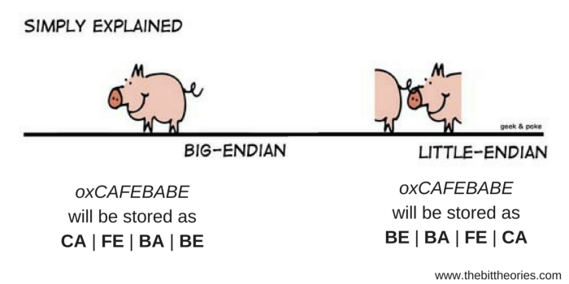
Tips to Remember Endianness
word value:
0 x 1 2 3 4 5 6 7 8
0x03
12
0x00
78
0x02
34
0x01
56
0x01
56
0x02
34
0x00
78
0x03
12
Little-Endian
…
0x00004
12
34
56
78
0x00000
Looks normal (same as writing order) when address is from low to high
Looks strange here
But same as writing order when address is from high to low
Logical Word-Oriented View

Slide 11
Basic Instruction Formats
Example: Format with 3 registers
add Rd, Rs, Rt # Rd = Rs + Rt
Command
(operation)
Source Register 1
(stores first operand value)
Comment
Destination Register
(stores calculation result)
Source Register 2
(stores second operand value)

Slide 12
Basic Instruction Formats
Example: Format with 3 registers
add $4, $3, $2 # $4 = $3 + $2
Register File
$0
If $2 and $3 have integer values 3 and 2 each,
$4 will have ( ) after executing this instruction
$1
5
$2 (3)
$3 (2)
$4 (5)
$4
…
$31

Slide 13
R-Type Instructions
We call the instructions that use three registers as R-type Instructions
2 registers as source, 1 register for result
Examples:
sub Rd, Rs, Rt # Rd = Rs – Rt
mul Rd, Rs, Rt # Rd = Rs * Rt
and Rd, Rs, Rt # Rd = Rs & Rt
or Rd, Rs, Rt # Rd = Rs | Rt
xor Rd, Rs, Rt # Rd = Rs ^ Rt
slt Rd, Rs, Rt # if (Rs < Rt) Rd = 1; else Rd = 0;
many more
Replace Rd, Rs, Rt with actual registers

Slide 14
R-Type Instructions
Exercise:
Assume that the initial state of register file is like below
What is $2 value after executing all three instructions?
sub $4, $2, $3
add $3, $3, $4
slt $2, $3, $4
Register File
# 2 = 10 - 8
$0
# 10 = 8 + 2
$1
$2 (0)
$2 (10)
# (10 < 2)? →No
→ $2 = 0
$3 (8)
$3 (10)
$4 (2)
$4 (4)
…
$31

Slide 15
Instructions Using Immediate Value
What if you want to use an immediate value?
E.g. i = i + 1; // add immediate value 1 to i
addi Rt, Rs, imm # Rt = Rs + imm
Command
(operation)
Source Register
(stores operand value)
Destination Register
(stores calculation result)
Immediate operand
(stores immediate operand value)

Slide 16
Instructions Using Immediate Value
Example: Instruction format with immediate value
addi $4, $3, 1 # $4 = $3 + 1
Register File
$0
If $3 has integer value 2,
$4 will have ( ) after executing this instruction
$1
3
$2 (3)
$3 (2)
$4 (3)
$4
…
$31

Slide 17
I-Type Instructions
We call the instructions that use two registers and one immediate value as I-type Instructions
1 register and 1 immediate value as source, 1 register for result
Examples:
subi Rt, Rs, imm # Rt = Rs – imm
andi Rt, Rs, imm # Rt = Rs & imm
ori Rt, Rs, imm # Rt = Rs | imm
xori Rt, Rs, imm # Rt = Rs ^ imm
beq Rt, Rs, imm # if (Rt == Rs) goto imm; else continue
lw Rt, imm(Rs) # load a word from (imm + Rs) address to Rt
slti Rt, Rs, imm # if (Rs < imm) Rt = 1; else Rt = 0;
many more

Slide 18
I-Type: Branch Instructions
Conditional Branches
Branches only if a particular condition is true
E.g., Compares Rs, Rt. If EQ/NE, branch to label, else continue
Example:
if ( a == b ) {
a++;
}
else {
a--;
}
Check condition of if statement
Upon the condition result,
you execute either a++ or a--
TRUE
FALSE

Slide 19
I-Type: Branch Instructions
Conditional Branches
Branches only if a particular condition is true
E.g., Compares Rs, Rt. If EQ/NE, branch to label, else continue
Example:
sub $4, $2, $3
add $3, $3, $4
slt $2, $3, $4
sub $4, $2, $3
beq $3, $4, Label
slt $2, $3, $4
Label: addi $3, $3, 1
If $3 != $4
If $3 == $4
Without branch,
instructions are executed
sequentially; line by line
Branch instruction checks the condition
and choose either executing next line or
jumping to the specified line

Slide 20
I-Type: Branch Instructions
Conditional Branches
Branch if condition satisfies
beq Rs, Rt, imm # if (Rs == Rt) goto imm; else continue
bne Rs, Rt, imm # if (Rs != Rt) goto imm; else continue
Unconditional Branches
Always branch to label
b imm # goto imm
beq $0, $0, imm # goto imm
Pseudo-instruction
Instruction “b imm” is not actually supported by the hardware.
Assembler replaces “b imm” to “beq $0, $0, imm”
check more pseudo instructions in textbook
Comparing the same
register values
→ always equal

Slide 21
I-Type: Memory Instructions
Memory operations use special format to present memory address
Example:
lw Rt, imm(Rs) # Load a word from address (Rs + imm) to Rt
Command
(operation)
Immediate value
(stores offset value of
the target memory address)
Destination Register
(stores loaded value)
Source operand
(stores base address of
the target memory address)

Slide 22
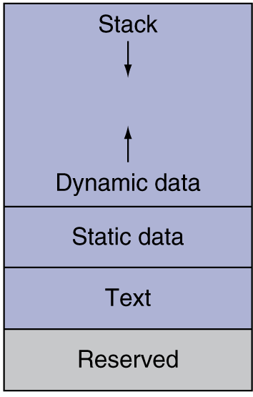
I-Type: Memory Instructions
Memory Instruction Example:
lw $4, 4($3) # $4 = a word data in ($3 + 4)
Register File
Memory
$0
0x7fffffff
If the initial state of register file and memory
is like illustrated,
a word in ( ) will be loaded to $4 so
$4 will have ( ) after executing this instruction
$1
10
0x7004
$2 (3)
512
0x7000
0x7004
10
$3 (0x7000)
$4 (10)
$4
…
$31
0x0

Slide 23
I-Type: Memory Instructions
Load: move data from memory to register file
lb Rt, imm(Rs) # Rt = 1-byte data in (Rs + imm)
lh Rt, imm(Rs) # Rt = 2-byte (half-word) data in (Rs + imm)
lw Rt, imm(Rs) # Rt = 4-byte (word) data in (Rs + imm)
Store: move data from register file to memory
sb Rt, imm(Rs) # (Rs + imm) = 1-byte data in Rt
sh Rt, imm(Rs) # (Rs + imm) = 2-byte (half-word) data in Rt
sw Rt, imm(Rs) # (Rs + imm) = 4-byte (word) data in Rt

Slide 24
I-Type: Memory Instructions
Example:
The initial state of register file and memory are like below
What is $2 value after executing each of the following instructions?
lw $2, 0x40($3)
lb $2, -1($4)
lh $2, -6($4)
# $2 = word in 0x7040
Register File
Memory
# $2 = byte in 0x704B
$0
0x7fffffff
# $2 = 2 bytes in 0x7046
0x7048
$1
0xF8BE97CD
0x7044
0x134982FE
$2
0xFFFFFFF8
0x5A12C5B7
0x7040
0
0x5A12C5B7
0x00001349
Note that when executing lb and lh which loads a signed data which is shorter than 4-byte word, the data should be sign-extended to fill 32-bit space of a register.
$3
0x7000
$4
0x704C
…
$31
0x0

Slide 25
I-Type: Memory Instructions
Example:
The initial state of register file and memory are like below
How the memory is updated?
sw $2, 0x40($3)
sb $2, -5($4)
sh $2, -2($4)
# 0x7040 = word in $2
Register File
Memory
# 0x7047 = byte in $2
$0
0x7fffffff
# 0x704A = 2 bytes in $2
0x89AB97CD
0x7048
$1
0xF8BE97CD
0x7044
0xAB4982FE
0x134982FE
$2
0x123489AB
0x5A12C5B7
0x7040
0x1234589AB
When you store 1- to 2- bytes to memory, other values in the same word should remain unchanged
$3
0x7000
$4
0x704C
…
$31
0x0

Slide 26
Signed vs. Unsigned Instructions
We use sign extension for lb and lh
This is because lb and lh are signed instructions
Unsigned instructions
No need to do sign extension because the values are regarded as positive values always; just fill zeros to the remaining bytes
lbu $2, -1($4) # load byte unsigned
# If lb in the earlier example is lbu,
# $2 will be updated with 0x000000F8
lhu $2, -6($4) # load half-word unsigned
# If lh in the earlier example is lhu,
# $2 will be updated with 0x00001349

Slide 27
Signed vs. Unsigned Instructions
Other instructions also have unsigned versions
addu, addiu, subu, divu, multu, …
Example:
Assume that $2 = 0xFFFFFFFF, $3 = 0x00000001, what is $1 in each instruction?
slt $1, $2, $3 # signed set less than
# -1 < +1 ➔ $1 = 1
sltu $1, $2, $3 # unsigned set less than
# +4,294,967,295 > +1 ➔ $1 = 0

Slide 28
Exercise-1
Translate the given high-level language code to MIPS assembly.
Assume that the address of integer variables x, y, and z are in 0x400, 0x404, and 0x408 in the memory, respectively
$1’s initial value is 0x400
High-level language
MIPS
x = y + z;
lw $2, 4($1)
lw $3, 8($1)
add $2, $2, $3
sw $2, 0($1)
Tasks to do:
Load y value to a register
Load z value to another register
Run add operation
Store the result to memory

Slide 29


