Slide 1
Lecture 3.5. I/O and Interface
CMPE 200 Computer Architecture & Design
Haonan Wang

Slide 2
Computer Architecture Overview
Software/Applications
Operating System
Compiler
Firmware
Instruction Set
Architecture
Processor
ISA & Processor
Registers
I/O Interface
Cache
Memory
Memory Hierarchy
HDD/SSD

Slide 3
Peripheral Devices
Device | Behavior | Partner | Protocol | Data rate (Mb/sec)
Keyboard | input | human | USB, PS/2 | 0.0001
Mouse | input | human | USB, PS/2 | 0.0038
Laser printer | output | human | Parallel Port | 3.20
Graphics display | output | human | DP, HDMI | 8000-80000
Graphics card | accelerator | machine | PCIE | 2000-8000
Network/LAN | input or output | machine | TCP/IP | 10-10000
Magnetic disk | storage | machine | SATA | 240-2560
Solid state drive | storage | machine | SATA, PCIE | 4000-28000
9 orders of magnitude range

Slide 4
I/O Performance Measures
I/O bandwidth (throughput)
How much data can we move through the system in a certain time?
How many I/O operations can we do per unit time?
I/O response time (latency)
The total elapsed time to accomplish an input or output operation
Especially important in real-time systems
Many applications require both high throughput and short response times
Both performance and fairness matters!

Slide 5
A Typical I/O System
Interrupts
Processor
To interface a peripheral device with a processor, an interface wrapper (e.g., controller) is needed
Cache
Memory - I/O Bus
Main
Memory
I/O
Controller
I/O
Controller
I/O
Controller
Important factors:
Performance
Expandability
Resilience
…
Disk
Disk
Graphics
Network

Slide 6
Interface Wrappers
Contains registers to hold signals (control, data, and status) that communicate between the peripheral device and the processor
memory mapped: each interface register can be accessed via an address
The interface wrapper usually contains additional logics (such as address decoder)
If the interface protocol is more complicated, the interface wrapper will also contain control unit (FSM)

Slide 7
Processor Interface Mechanisms
Two ways for processors to access peripheral devices:
Port-mapped I/O (PMIO): isolated I/O, special I/O instructions, separate address spaces, time shared bus
Memory-mapped I/O (MMIO): one address space
MIPS processors use memory-mapped I/O
Use load and store instructions to communicate with peripheral devices
For a MIPS processor that only supports lw and sw, all data transfer will be 32 bits

Slide 8
Processor Interface Mechanisms
Two ways to communicate with CPU:
Polling: The CPU polls the device periodically.
Simple but time consuming
Interrupt: The I/O device calls the CPU actively
Fast but complex: which interrupt has high priority?
Two ways for data transfer between the memory and I/O:
CPU controlled
Direct Memory Access (DMA)

Slide 9
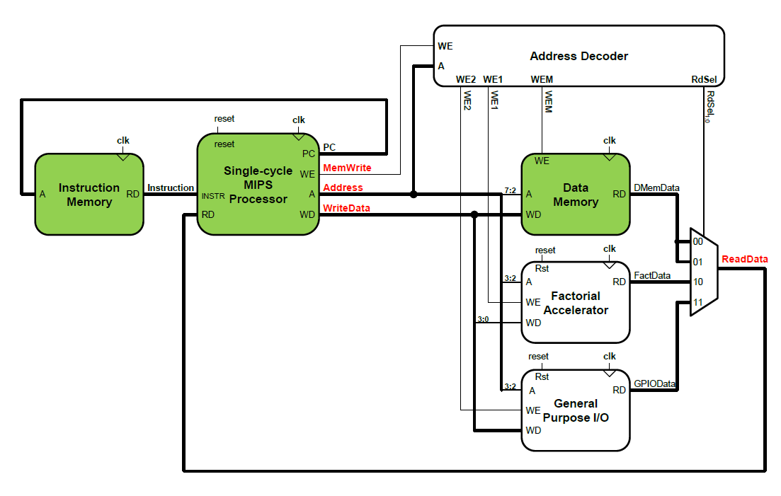
Memory-Mapped I/O Datapath

Slide 10
Memory-Mapped I/O Example
System Integration Memory Map
Base Address | Address Range | R/W | Description
0x00000000 | 0x00 – 0xFC | R/W | Data Memory
0x00000800 | 0x00 – 0x0C | R/W | Device 1
0x00000900 | 0x00 – 0x0C | R/W | Device 2
0xFC = 11111100 → 64 (0x00 – 0x3F) word addresses
0x0C = 00001100 → 4 (0x00 – 0x03) word addresses
Last two bits are byte offsets

Slide 11
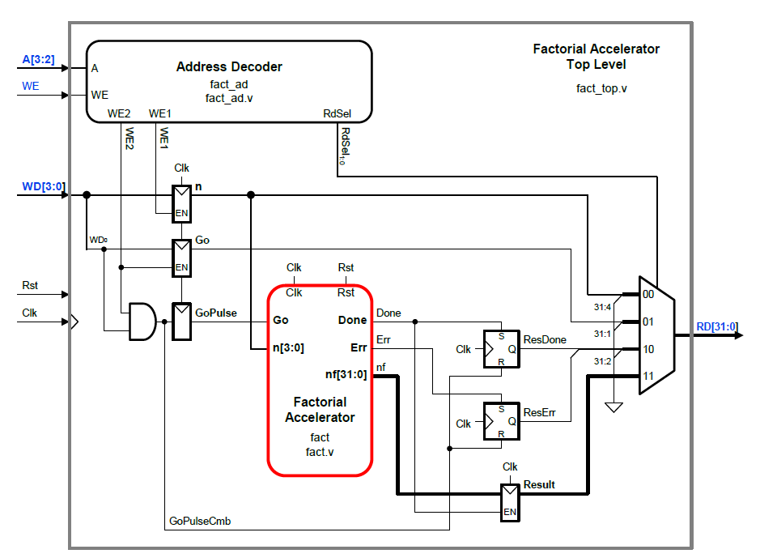
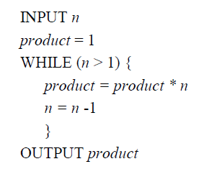
Factorial Accelerator Wrapper
Assignment1

Slide 12
Factorial Accelerator Interface Registers
Address | R/W | Register Name | Bits | Bit Definition
00 | R/W | Data Input (n) | 31:4 | Unused
 |  |  | 3:0 | Input Data, n[3:0]
01 | R/W | Control Input (Go) | 31:1 | Unused
 |  |  | 0 | Go bit
10 | R | Control Output (Done, Err) | 31:2 | Unused
 |  |  | 1 | Err bit
 |  |  | 0 | Done bit
11 | R | Data Output (Result) | 31:0 | Result Data, nf[31:0]

Slide 13
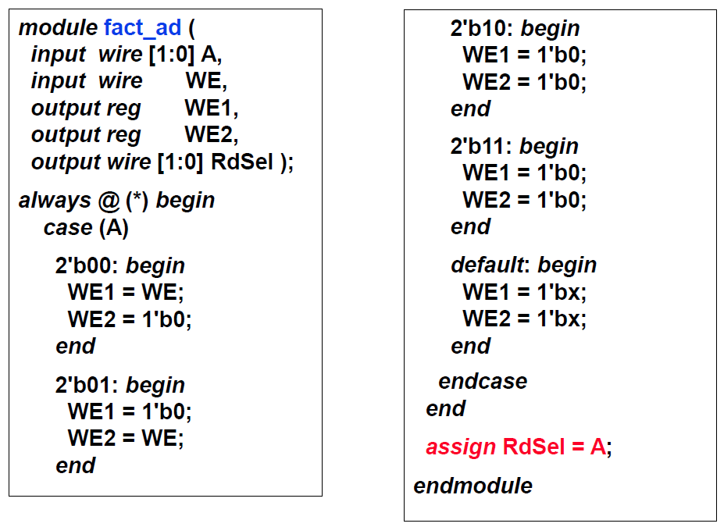
Factorial Accelerator Interface (1)
The factorial accelerator’s local address decoder module:

Slide 14
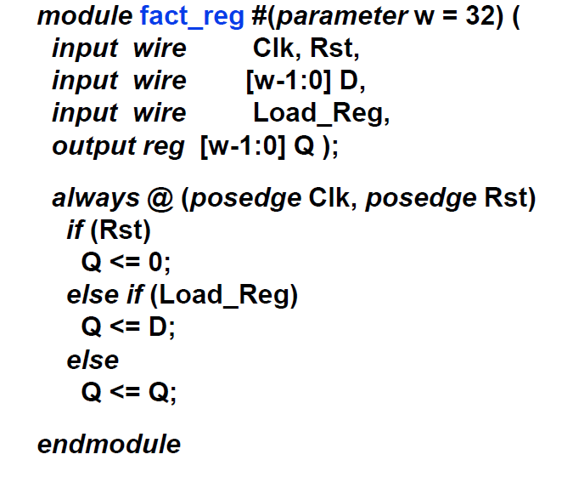
Factorial Accelerator Interface (2)
Registers for inputs n, Go, and output Result:

Slide 15
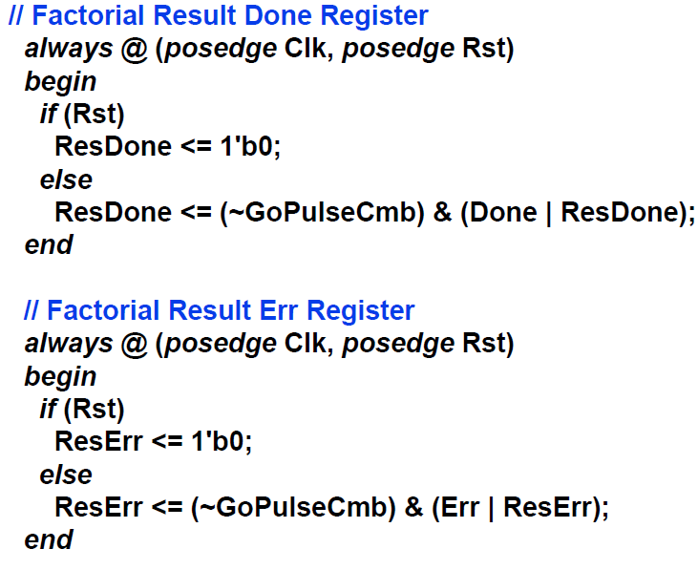
Factorial Accelerator Interface (3)
Registers for status signals Done, and Err:

Slide 16
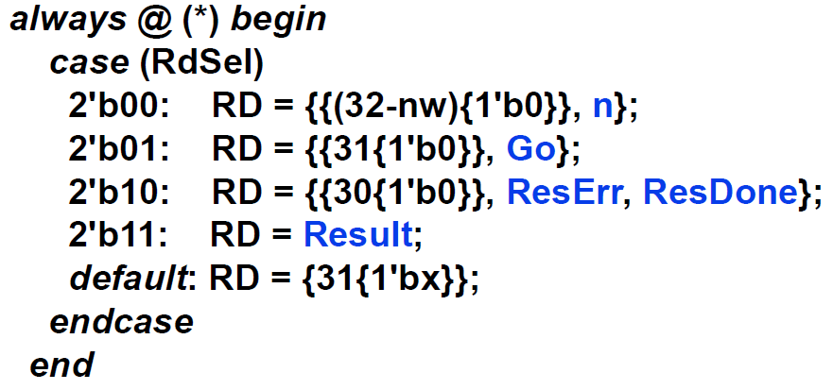
Factorial Accelerator Interface (4)
Read Data Logic (the output MUX):

Slide 17
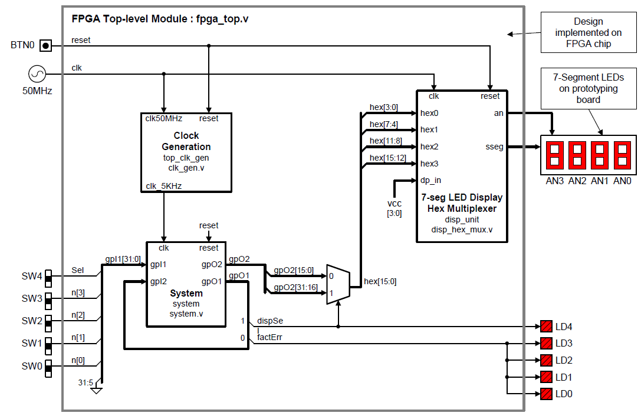
IO Example: FPGA

Slide 18
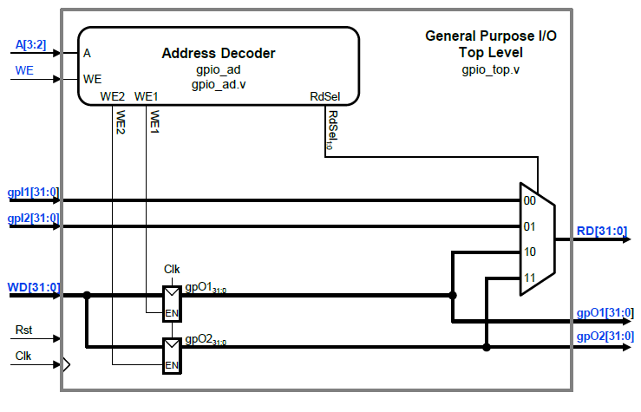
General Purpose I/O (GPIO) Wrapper

Slide 19
GPIO Memory-Mapped Registers
Address | R/W | Register Name | Bits | Bit Definition
00 | R | Input 1 | 31:0 | General Input
01 | R | Input 2 | 31:0 | General Input
10 | R/W | Output 1 | 31:0 | General Output
11 | R/W | Output 2 | 31:0 | General Output

Slide 20
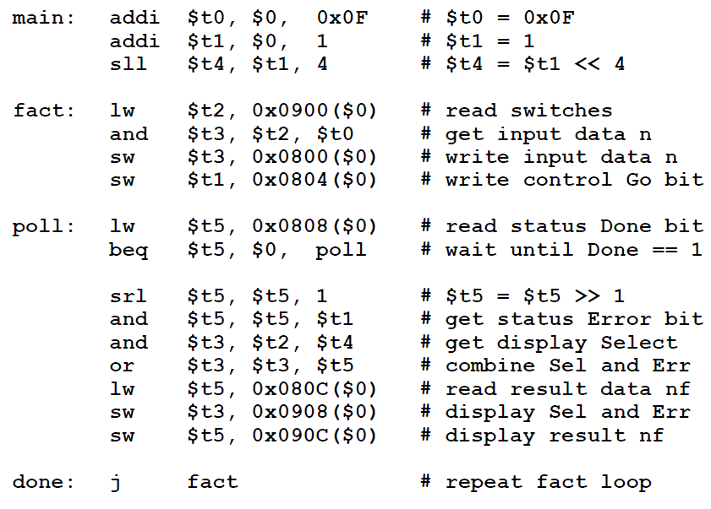
MIPS Driver Code

Slide 21


