Slide 1
Lecture 3. Processor Microarchitecture and Design (1)
CMPE 200 Computer Architecture & Design
Haonan Wang

Slide 2
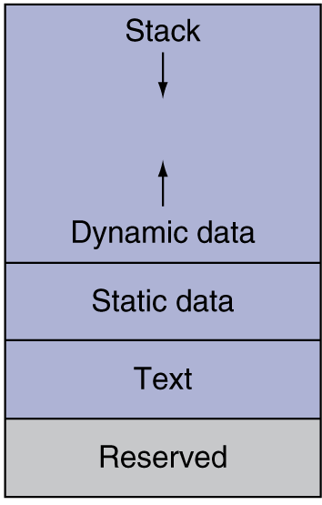
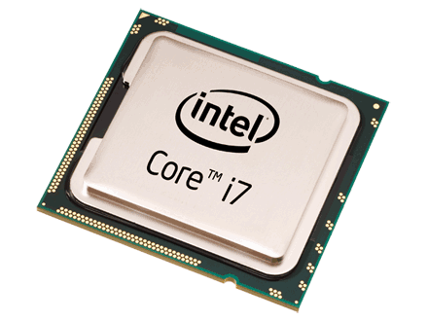

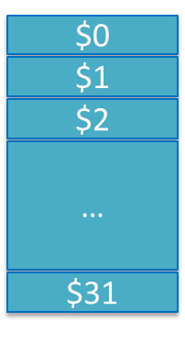
Instruction Processing
Return address
*fp
size
sum
CPU
numbers[1]
add*
numbers[0]
Instruction Processing
Compiled machine code
Decoder
Value of $4
A 32-bit instruction
The instruction is
- Opcode: add
- Rs: $4
- Rt: $3
- Rd: $5
Value of $3
Calculated result
To be stored to $5

Slide 3
Instruction Execution on CPU
To run a software, CPU
Fetches instructions from memory in the right order
Decodes the instruction and Reads the operand values from register file
Executes the computation by using ALU
Loads/store data from/to memory
Writes back the computation results to register file
Instruction Fetch
Decode & Register
Identify opcode & read operands
Execute
Mem
Write Result
Write to
dst register

Slide 4
Implementing a Single-Cycle CPU
All instructions execute in a single clock cycle
Instructions to Implement: LW, SW; ADD, SUB, AND, OR, SLT; BEQ
CPI = 1
Different instructions need different execution times
e.g., LW needs to access memory vs. ADD does not need to access memory
Single-cycle CPU’s clock cycle period should be set to the longest instruction’s execution time

Slide 5
Fetch Components
Required operations
Taking address from PC and reading instruction from memory
Incrementing PC to point at next instruction
Components
PC register
Instruction Memory / Cache
Adder to increment PC value
CLK
I-Cache / I-MEM
/
32
A
From PC
Instruction Word
+
Addr.
/
32
/
32
/
32
Data
/
32
S
/
32
PC
/
32
B
Register
Memory
Adder

Slide 6
Fetch Data Path
4
A
+
“Next” PC = PC + 4
S
B
CLK
I-Cache / I-MEM
Addr.
PC
Data
Current PC / Read Address
Instruction Word

Slide 7
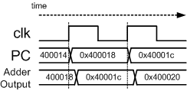
Fetch Data Path
PC value serves as address to instruction memory while also being incremented by 4 using the adder
Instruction word is returned by memory after some delay
New PC value is clocked into PC register at the end of clock cycle
4
A
+
“Next” PC = PC + 4
S
Current PC + 4
B
opcode
rs
rt
rd
shamt
func
CLK
000000
00001
00010
00011
00000
100000
I-Cache / I-MEM
Current PC
Addr.
ADD $3,$1,$2
PC
Data
Current PC / Read Address
Instruction Word

Slide 8
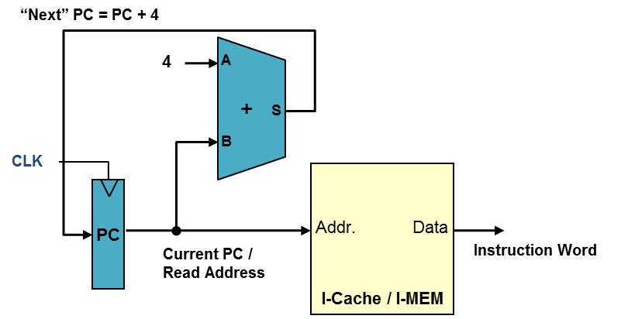
Decode
What is the instruction and operands?
Decode & Register
Identify opcode & read operands
Execute
Mem
Write Result
Write to
dst register

Slide 9
Instruction Formats
different ALU instructions
R-type
0
rs
rt
rd
shamt
funct
31:26
25:21
20:16
15:11
10:6
5:0
Load/ Store
(I-type)
35 or 43
rs
rt
address
31:26
25:21
20:16
15:0
Branch
(I-type)
4
rs
rt
address
31:26
25:21
20:16
15:0
opcode
always read
read, except for load
write for R-type and load
sign-extend and add

Slide 10
Decode Components
Register file is a collection of registers
To support R-type instruction,
4 Input ports: two src register ids, a dst register id and the result value
2 Output ports: two operand values
CLK
/
5
Read Reg. 1 #
Read data 1
/
32
/
5
Read Reg. 2 #
Read data 2
/
32
/
5
Write Reg. #
/
32
Write Data
Register File
RegWrite

Slide 11
Decode Data Path
R-type
Opcode and func. field are decoded to produce control signals
Three register ids are passed to Register file
Control Signals
opcode
CLK
000000
Read Reg. 1 #
Read data 1
Value of $1
1
5
rs
00001
Read Reg. 2 #
Read data 2
Instruction Word
2
Value of $2
5
rt
00010
Write Reg. #
ADD $3,$1,$2
3
5
rd
Write Data
00011
shamt
Register File
00000
func
100000
RegWrite
Control Signals for R-type

Slide 12
Sign Extension Unit
In a ‘LW’ or ‘SW’ instructions with their base register + offset format, the instruction only contains the offset as a 16-bit value
Example: LW $4,-8($1)
Machine Code: 0x8c24fff8
A 16-bit offset must be extended to 32-bits to add to the base register
offset = 0xfff8
Sign Extend
0xfffffff8
LW $4,0xfff8($1)
100011
00001
00100
1111 1111 1111 1000
opcode
rs
rt
offset
16
32

Slide 13
Decode Data Path
I-type
Opcode field is decoded to produce control signals
Two register ids are passed to Register file
Offset is sign extended
Control Signals
opcode
CLK
010111
Read Reg. 1 #
Read data 1
Value of $1
1
5
rs
00001
Read Reg. 2 #
Read data 2
Instruction Word
4
rt
LW $4,0xfff8($1)
00100
Write Reg. #
5
Write Data
offset
Register File
1111 1111 1111 1000
RegWrite
Sign Extend
16
32

Slide 14
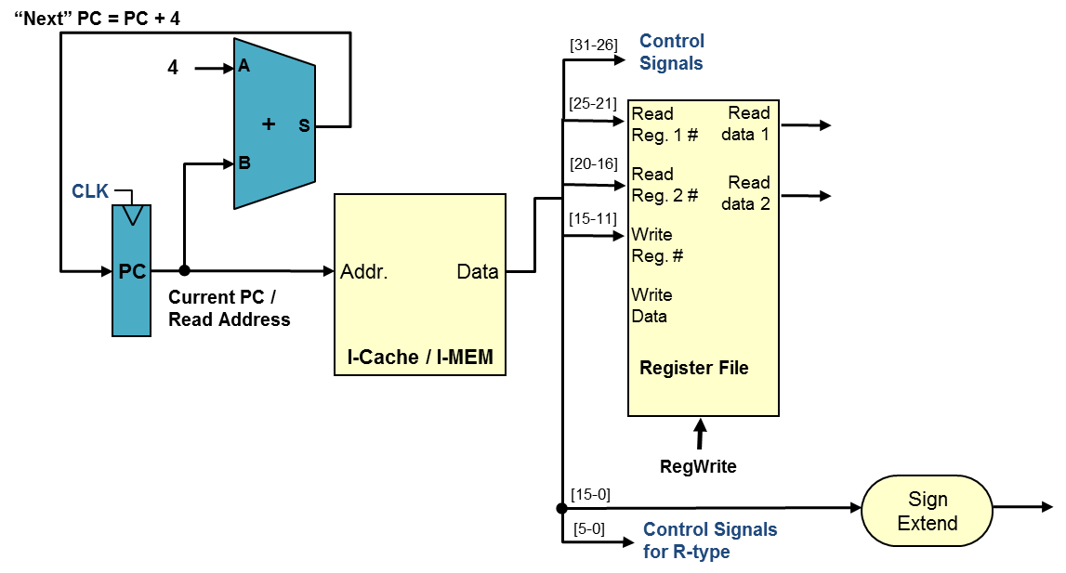
Execution & Write Result
Let’s execute the instruction!
Execute
Mem
Write Result
Write to
dst register

Slide 15
Execution Components
ALU is used for
R-type instructions to operate various arithmetic operations
LW/SW instructions to operate (base address + offset) to generate the target memory address
Branch instructions to compare (subtract) the two operand values
Data Memory for LW/SW instructions
Shift-left-2 and another Adder for Branch instructions to calculate new PC value
CLK
Zero
Read
/
32
ALU
Read Addr.
/
32
ALU Result
PC+4 (incremented PC)
/
32
/
32
Read Data
Adder
Shift Left 2
Sum
/
32
Write Addr.
/
32
/
32
/
32
ALU Operation
Write Data
Write
ALU
Data Memory
Shift-left-2
Adder

Slide 16
Datapath for R-type Instructions
ALU takes inputs from register file and performs the add, sub, and, or, slt, operations
Result is written back to dest. register
ALU Operation is determined by a control logic according to Opcode & Funct
CLK
1
Register File
Read Reg. 1 #
2
ADD
Instruc. word
Read Reg. 2 #
ADD $3,$1,$2
3
Read data 1
$1 value
Write Reg. #
ALU
Read data 2
$2 value
Res.
Sum
Write Data
we_reg

Slide 17
Memory Access Datapath: LW
Operands are read from register file while offset is sign extended
ALU calculates target memory address
Memory access is performed
If LW, read data is written back to register
CLK
1
Register File
Read Reg. 1 #
ADD
Read Reg. 2 #
Read data 1
$1 value
LW $4,0xfff8($1)
4
Write Reg. #
Zero
CLK
ALU
D-Cache /
D-Mem
Read data 2
Res.
Addr.
Write Data
Sum
Read Data
Read Data
Write Data
Sign Extend
0xfff8
32
0xffff fff8

Slide 18
Memory Access Datapath: SW
Operands are read from register file while offset is sign extended
ALU calculates target memory address
If SW, data is written to the memory
CLK
1
Register File
Read Reg. 1 #
3
Read Reg. 2 #
ADD
Read data 1
$1 value
CLK
SW $3,0x1a($1)
Write Reg. #
Zero
ALU
D-Cache /
D-Mem
Read data 2
Res.
Addr.
Write Data
Sum
Read Data
$3 value
Write Data
Sign Extend
Write Data
0x001a
32
0x0000001a
we_dm

Slide 19
Branch Datapath: BEQ
ALU for comparison (examine ‘zero’ output)
Sign extension unit for branch offset
Adder to add PC and offset
PC+4 (incremented PC)
Adder
CLK
Sum
Branch Target Address to PC
Shift Left 2
1
Register File
Read Reg. 1 #
if(zero == 1)
2
SUB
Read Reg. 2 #
BEQ $1,$2,offset
Read data 1
$1 value
PC
Write Reg. #
Zero
ZERO
ALU
Read data 2
$2 value
Res.
Write Data
word offset
Sign Extend
extended word offset

Slide 20
Conclusion Time
What are the stages of single-cycle CPU execution?
Fetch, Decode, Execute, Memory, Writeback
→ IF, ID, EX, MEM, WB
What are the two different ways to calculate addresses in the CPU?
ALU
→ Byte addresses, data access.
Shift-left-2 & Adder
→ Label, PC.

Slide 21


