Slide 1
Lecture 3. Processor Microarchitecture and Design (2)
CMPE 200 Computer Architecture & Design
Haonan Wang

Slide 2
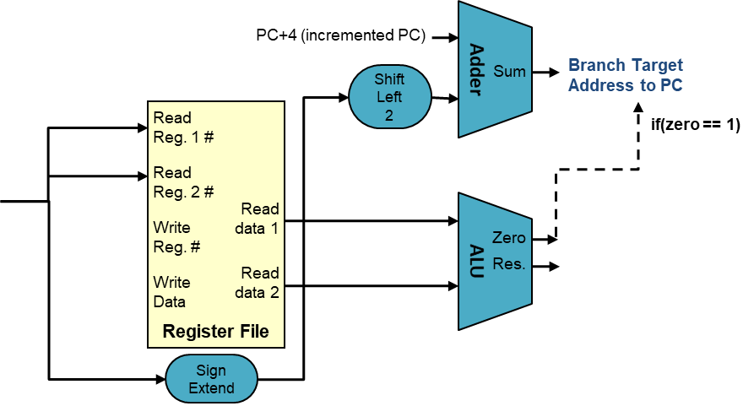
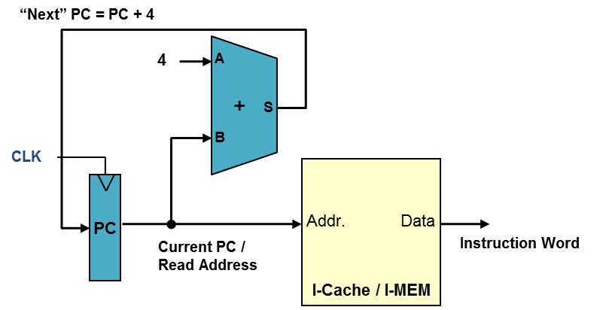
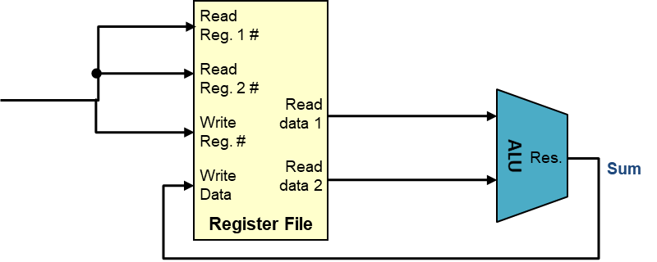
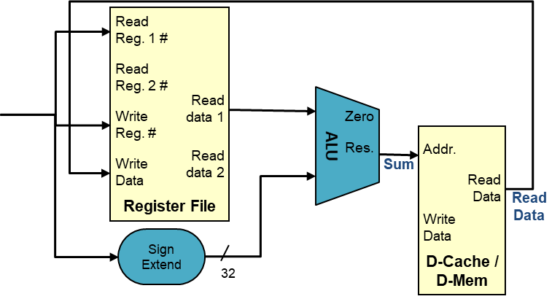
Single-Cycle Datapath
Branch
R-type
Decode to Writeback paths are different for different instruction types
→ Can we merge them?
Memory Operations
2

Slide 3
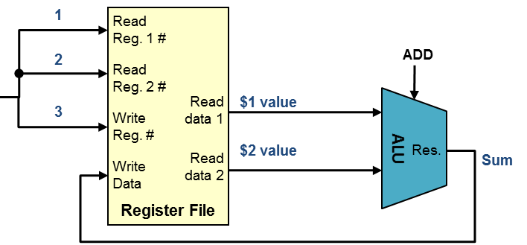
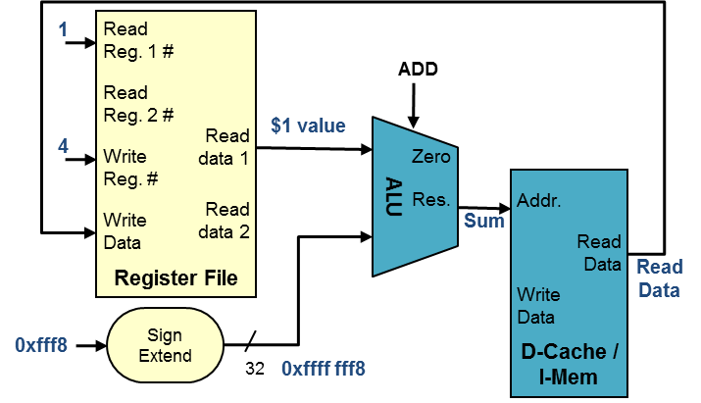
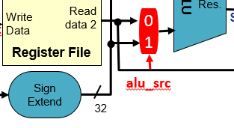
R-Type + LW/SW (1): alu_src Mux
Mux controlling second input to ALU
ALU instruction provides Read Register 2 data to the 2nd input of ALU
LW/SW uses 2nd input of ALU as an offset to form effective address
R-type
Memory operation
D
alu_src | MUX Output
0 | Register output 2
1 | Sign extended data

Slide 4
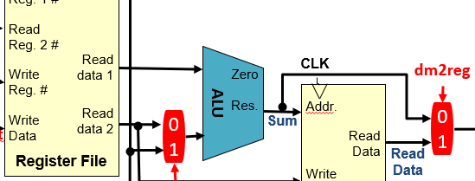
R-Type + LW/SW (2): dm2reg Mux
Mux controlling writeback value to register file
ALU instructions use the result of the ALU
LW uses the read data from data memory
R-type
Memory operation
D
dm2reg | MUX Output
0 | ALU output
1 | Data memory Output

Slide 5
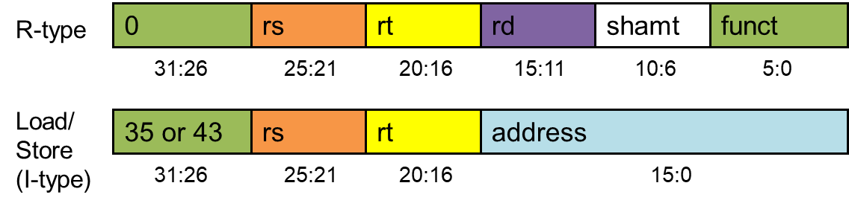
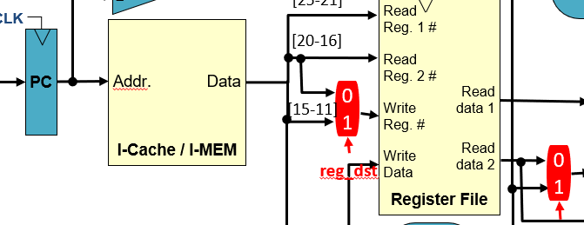
R-Type + LW: reg_dst Mux
Different destination register ID fields for ALU and LW instructions
R-type
Memory operation
instruction[20-16]
instruction[15-11]
reg_dst | MUX Output
0 | instruction [20-16]
1 | instruction [15-11]

Slide 6
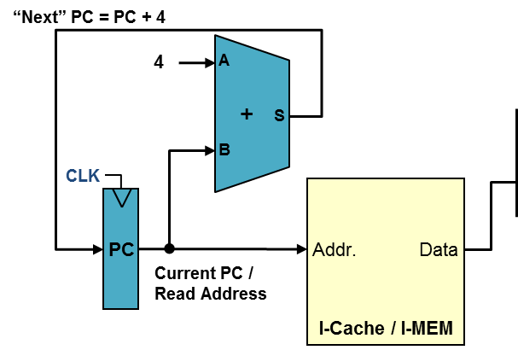
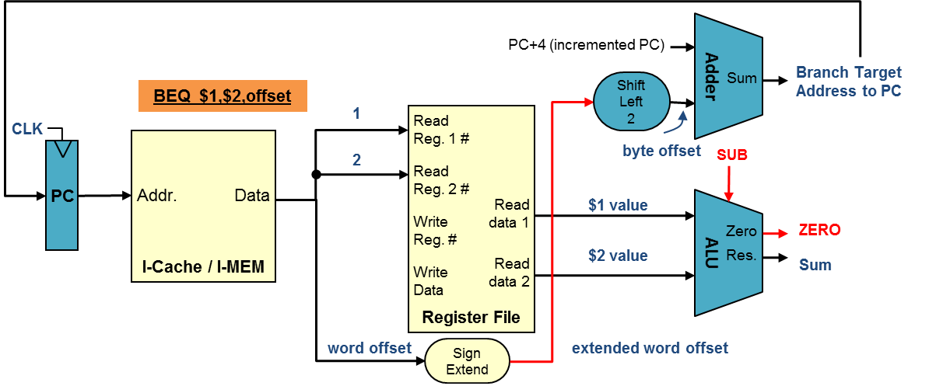
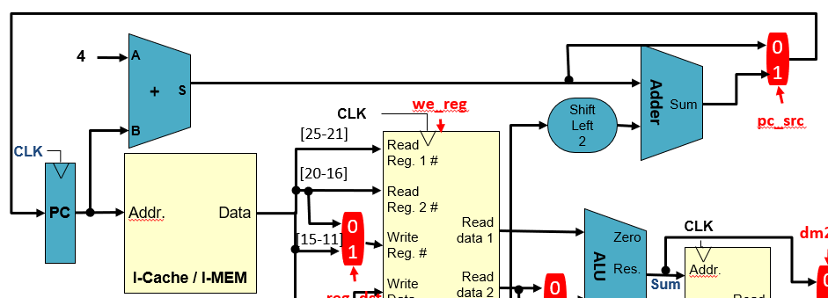
Branch + Others: pc_src Mux
Next instruction can either be at the next sequential address (PC+4) or the branch target address (PC+offset)
Question: where should we apply mux(es)?
Branch
Normal
pc_src | MUX Output
0 | PC+4
1 | Branch target address

Slide 7
Single-cycle CPU Datapath
Taken branch or not
How to decide pc_src?
4
A
0
1
+
Adder
S
we_reg
Sum
CLK
Shift Left 2
pc_src
B
[25-21]
Register File
CLK
Read Reg. 1 #
I-Cache / I-MEM
[20-16]
Read Reg. 2 #
Addr.
PC
Data
Read data 1
dm2reg
0
1
CLK
[15-11]
Write Reg. #
Zero
ALU
D-Cache /
D-Mem
Read data 2
Res.
Addr.
0
1
Write Data
0
1
Sum
reg_dst
Read Data
Read Data
alu_ctrl
Write Data
[15-0]
Sign Extend
alu_src
32
we_dm
7

Slide 8
Single-cycle CPU Datapath
4
A
0
1
+
Adder
S
we_reg
Sum
CLK
Shift Left 2
B
[25-21]
Register File
CLK
Read Reg. 1 #
I-Cache / I-MEM
[20-16]
Branch
Read Reg. 2 #
Addr.
PC
Data
Read data 1
dm2reg
0
1
CLK
[15-11]
Write Reg. #
Zero
ALU
D-Cache /
D-Mem
Read data 2
Res.
Addr.
0
1
Write Data
0
1
Sum
reg_dst
Read Data
Read Data
alu_ctrl
Write Data
[15-0]
Sign Extend
alu_src
32
we_dm
8

Slide 9
Single-cycle CPU Datapath
The Opcode and funct are used for generating selector values
4
A
[31-26], [5-0]
0
1
+
Adder
S
Sum
CLK
Shift Left 2
B
[25-21]
Register File
CLK
Read Reg. 1 #
I-Cache / I-MEM
[20-16]
Read Reg. 2 #
Addr.
PC
Data
Read data 1
0
1
CLK
[15-11]
Write Reg. #
Zero
ALU
D-Cache /
D-Mem
Read data 2
Res.
Addr.
0
1
Write Data
0
1
Sum
we_reg
Read Data
reg_dst
Read Data
Control
Write Data
branch
[15-0]
Sign Extend
opcode & funct
32
alu_src
we_dm
dm2reg
alu_ctrl
9

Slide 10
Single-cycle CPU Control Unit
The control unit is a combinational decoder for the single-cycle CPU
The CU contains
A main decoder for Opcode
An ALU decoder for Funct
Control Unit
Main Decoder
dm2reg
we_dm
Opcode_{5:0}
branch
alu_src
reg_dst
we_reg
alu_op
ALU
Decoder
Funct_{5:0}
alu_ctrl

Slide 11
ALU Usage
Load/Store:
Memory address = Base address + offset → add
Branch:
Branch if two values are equal/not equal → subtract
R-type:
Opcode & Funct field together indicates an ALU operation
These three instruction types can be distinguished by Opcode
R-type
0
rs
rt
rd
shamt
funct
31:26
25:21
20:16
15:11
10:6
5:0

Slide 12
Main Decoder
Main Decoder is used to generate instruction type indicator & mux control
To cover 3 types of instructions, we need a 2-bit indicator, alu_op
alu_op will be the input of ALU Decoder
For R-type instructions, the ALU Decoder will also check the Funct field
Input
Output
Instruction | Opcode | we_reg | reg_dst | alu_src | branch | we_dm | dm2reg | alu_op_{1:0}
R-type | 000000 | 1 | 1 | 0 | 0 | 0 | 0 | 10
lw | 100011 | 1 | 0 | 1 | 0 | 0 | 1 | 00
sw | 101011 | 0 | X | 1 | 0 | 1 | X | 00
beq | 000100 | 0 | X | 0 | 1 | 0 | X | 01

Slide 13
ALU Decoder
Input
Input
Output
opcode | alu_op_{1:0} | Operation | funct | ALU function | alu_ctrl_{2:0}
lw | 00 | load word | XXXXXX | ADD | 010
sw | 00 | store word | XXXXXX | ADD | 010
beq | 01 | branch equal | XXXXXX | SUB | 110
R-type | 10 | ADD | 100000 | ADD | 010
 |  | SUB | 100010 | SUB | 110
 |  | AND | 100100 | AND | 000
 |  | OR | 100101 | OR | 001
 |  | SLT | 101010 | SLT | 111

Slide 14
So Far…
Our design supports the following instructions
Memory Reference Instructions:
LW, SW
Arithmetic and Logic Instructions:
ADD, SUB, AND, OR, SLT
Branch Instructions:
BEQ
How to extend the design to support more MIPS instructions?

Slide 15
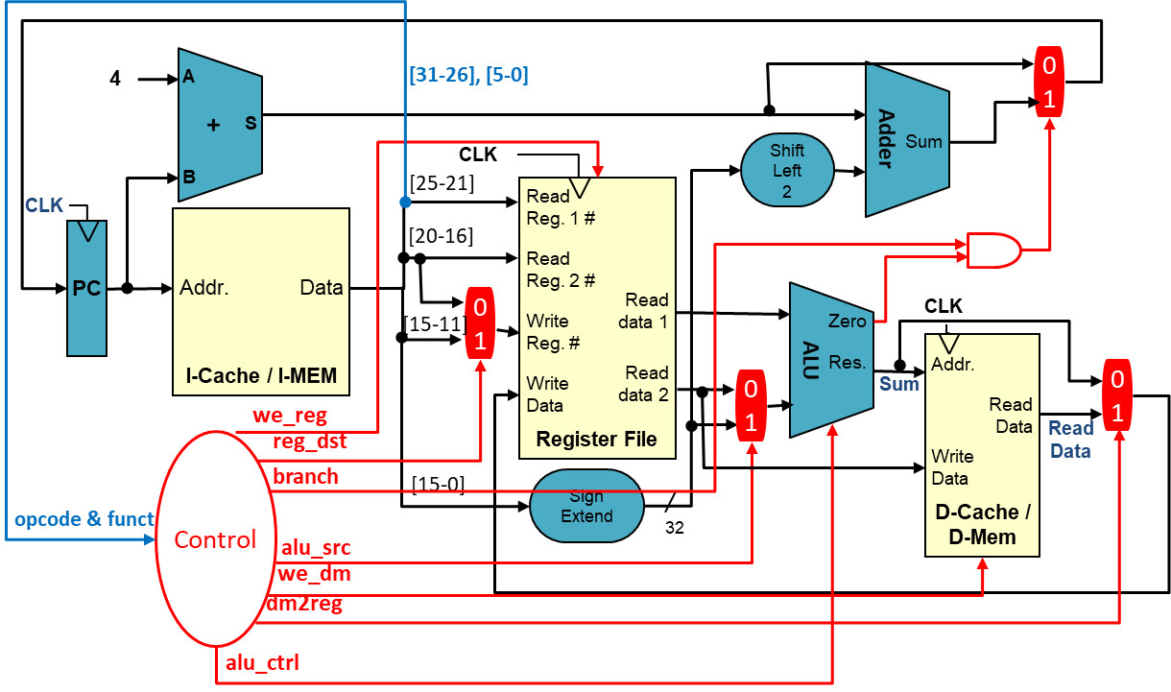
Extension to Support addi
No need to extend the current datapath
Need to extend the control unit, specifically only the Main Decoder
15

Slide 16
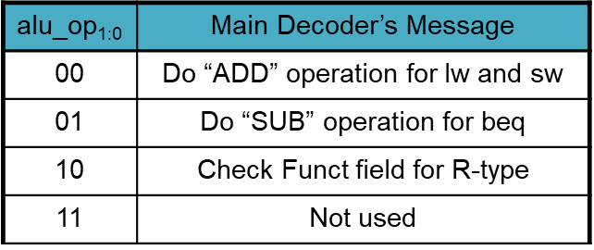
Main Decoder for addi
Instruction | Opcode | we_reg | reg_dst | alu_src | branch | we_dm | dm2reg | alu_op_{1:0}
R-type | 000000 | 1 | 1 | 0 | 0 | 0 | 0 | 10
lw | 100011 | 1 | 0 | 1 | 0 | 0 | 1 | 00
sw | 101011 | 0 | X | 1 | 0 | 1 | X | 00
beq | 000100 | 0 | X | 0 | 1 | 0 | X | 01
addi | 001000 | 1 | 0 | 1 | 0 | 0 | 0 | 00

Slide 17
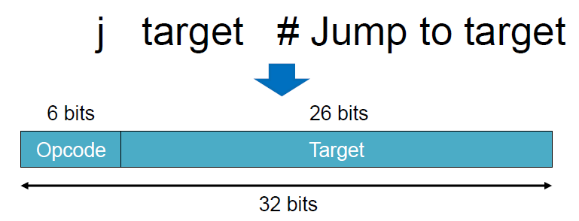
Extension to Support j
?
Can we support j with this datapath?
17

Slide 18
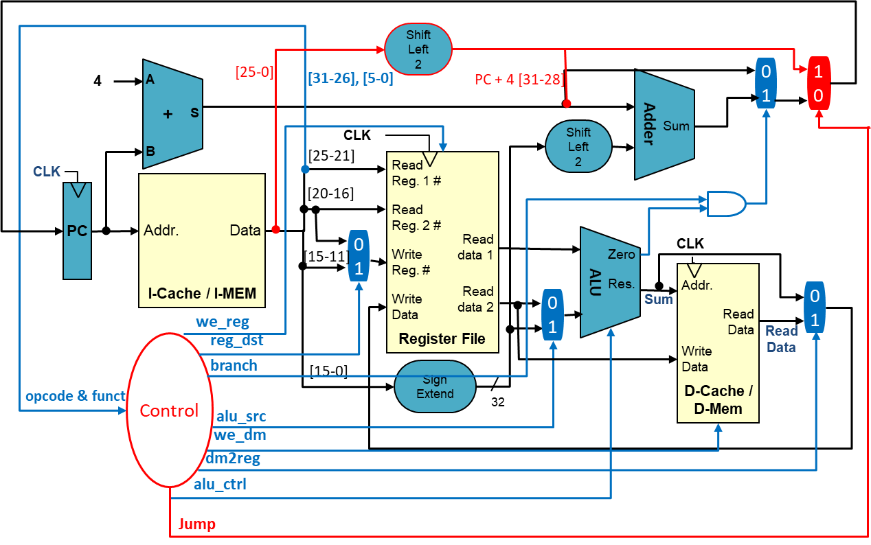
Extension to Support j
Both datapath and control unit (main decoder) need to be extended
18

Slide 19
Main Decoder for j
Instruction | Opcode | we_reg | reg_dst | alu_src | branch | we_dm | dm2reg | alu_op_{1:0} | Jump
R-type | 000000 | 1 | 1 | 0 | 0 | 0 | 0 | 10 | 0
lw | 100011 | 1 | 0 | 1 | 0 | 0 | 1 | 00 | 0
sw | 101011 | 0 | X | 1 | 0 | 1 | X | 00 | 0
beq | 000100 | 0 | X | 0 | 1 | 0 | X | 01 | 0
addi | 001000 | 1 | 0 | 1 | 0 | 0 | 0 | 00 | 0
j | 000010 | 0 | X | X | X | 0 | X | XX | 1

Slide 20
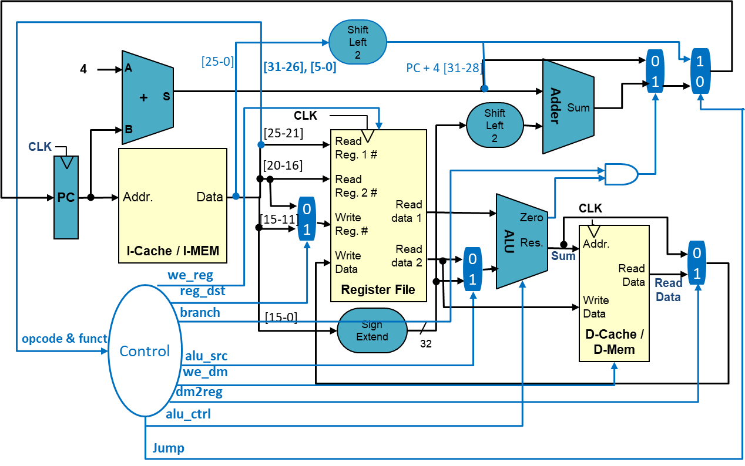
Datapath of LW instruction
There are parallel paths.
The longest path (critical path) decides the execution time of the instruction.

Slide 21
Single-Cycle CPU Performance Analysis
Function Unit | Parameter | Delay (ps)
Register clock-to-Q | T_{pcq_PC} | 30
MUX | T_{MUX} | 25
Sign-extend | T_{s_ext} | 25
ALU | T_{ALU} | 200
Mem read | T_{mem} | 250
Register file read | T_{RFread} | 150
Register file write | T_{RFwrite} | 20
Critical path for LW = T_{pcq_PC} + T_{i-mem} + T_{RFread} + T_{ALU} + T_{d-mem} + T_{MUX} + T_{RFwrite}
= (30 + 250 + 150 + 200 + 250 + 25 + 20) ps
= 925 ps

Slide 22
Single-Cycle CPU Performance Analysis
The longest instruction’s execution time is 925 ps.
If we run 100 billion instructions, what is the total execution time?
The clock cycle period should be set to 925 ps
CPU time = # instructions x CPI x cycle period
= 100 x 10⁹ x 1 x 925 x 10⁻¹²
= 92.5 seconds

Slide 23
Performance Issues
Longest delay determines clock period
Critical path: load instruction
Instruction memory → register file → ALU → data memory → register file
Violates design principle
Making the common case fast
More arithmetic operations than memory operations
Most modern CPUs use multi-cycle processors
Each instruction takes multiple cycles
Multiple instructions can execute concurrently (parallelism → pipelining)

Slide 24




Pipelining Analogy
Laundry tasks
Place one dirty load of clothes in the washer
Place the wet load in the dryer
Place the dry load on a table and fold
Ask your roommate to put the clothes away

Slide 25
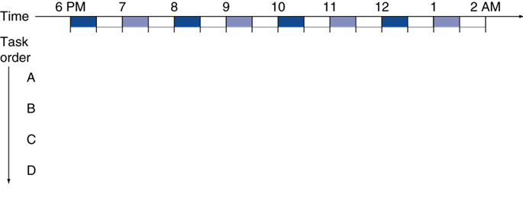

Pipelining Analogy
Lots of dirty clothes -- need to wash them over four separate loads
Assume each task takes 30 minutes
Inefficient!

Slide 26
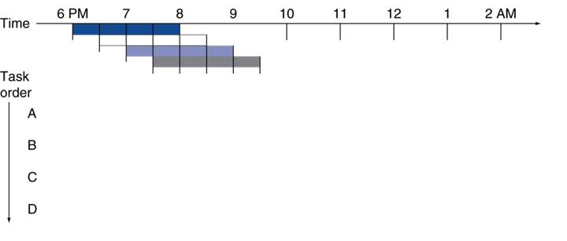




Pipelining Analogy
You can start the next load as soon as the washer finishes washing the previous load
Saved 4.5 hours

Slide 27
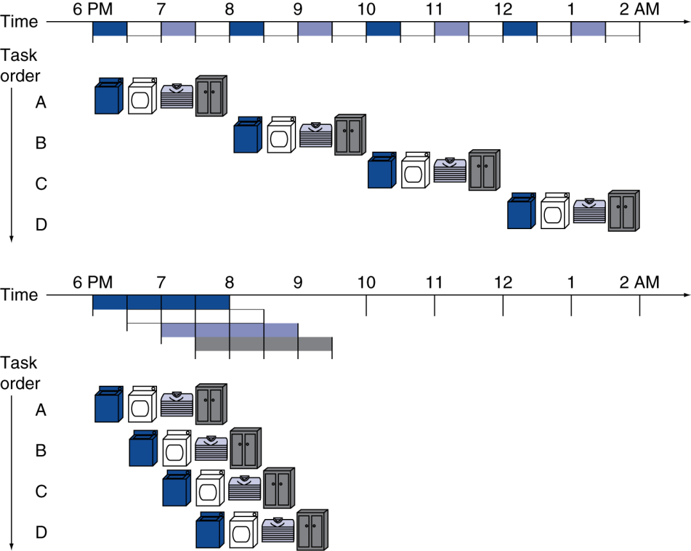
Pipelining Analogy
We can parallelize the single-cycle CPU tasks in a similar way
Pipelined laundry → overlapping execution
Single-cycle CPU
clock cycle period = 2hrs
Pipelined CPU
clock cycle period = 0.5hrs

Slide 28
MIPS Pipeline
5 steps in one cycle for single-cycle CPU design
With each step using separate resources
Instruction Fetch
Decode & Register
Identify opcode & read operands
Execute
Mem
Write Result
Write to
dst register
CLK

Slide 29
MIPS Pipeline
Entire datapath can be broken into five stages
Cycle period is changed to the time taken for a stage
Shorter clock cycle
Higher CPI (e.g., CPI = 5 in MIPS)
Instruction Fetch
Decode & Register
Identify opcode & read operands
Execute
Mem
Write Result
Write to
dst register
CLK

Slide 30
MIPS Pipeline
Entire datapath can be broken into five stages
Cycle period is changed to the time taken for a step
Shorter clock cycle
Higher CPI (e.g., CPI = 5 in MIPS)
System can achieve CPI = 1 by overlapping Multiple Instructions
 | CC1 | CC2 | CC3 | CC4 | CC5 | CC6 | CC7 | CC8 | CC9 | CC10 | CC11
Inst1 | IF | ID | EXE | MEM | WB
Inst2 |  | IF | ID | EXE | MEM | WB
Inst3 |  |  | IF | ID | EXE | MEM | WB
Inst4 |  |  |  | IF | ID | EXE | MEM | WB
Inst5 |  |  |  |  | IF | ID | EXE | MEM | WB
cc: clock cycle
After initial pipeline filling phase,
we can finish an instruction every cycle
Initial pipeline filling phase

Slide 31
Pipeline Performance Example
100ps for register IOs (i.e., decode, writeback); 200ps for other stages
What would be the cycle period in single-cycle and pipelined datapath?
What would be the execution time of lw instruction?
Instr | Instr fetch | Register read | ALU op | Memory access | Register write | Total time
lw | 200ps | 100 ps | 200ps | 200ps | 100 ps | 800ps
sw | 200ps | 100 ps | 200ps | 200ps |  | 700ps
R-type | 200ps | 100 ps | 200ps |  | 100 ps | 600ps
beq | 200ps | 100 ps | 200ps |  |  | 500ps

Slide 32
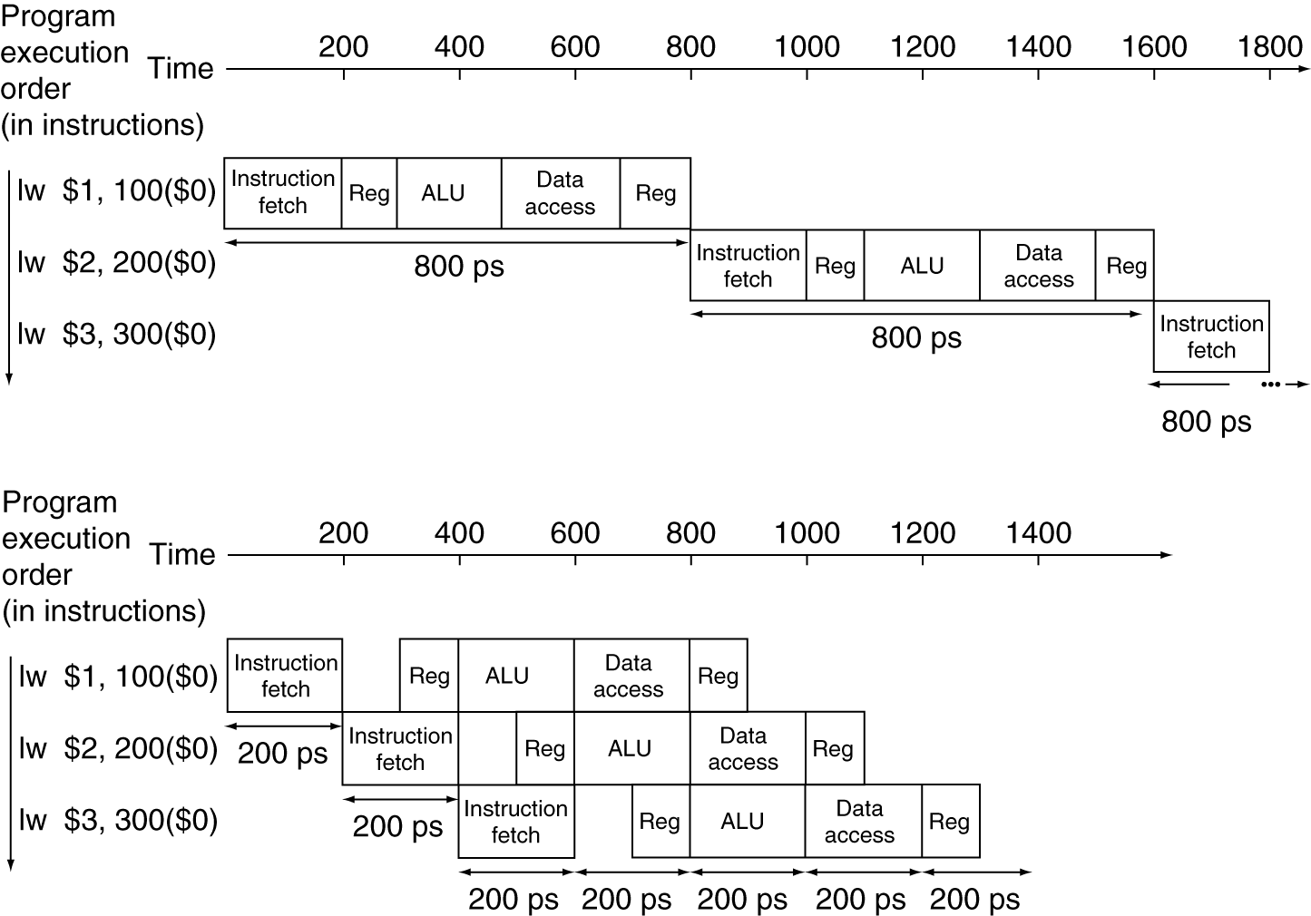
Pipeline Performance Example
Single-cycle (T_{c}= 800ps)
T_{c} = Longest instruction
T_{lw} = 800ps
2 x T_{lw} = 1600ps
…
Pipelined (T_{c}= 200ps)
T_{c} = Longest Stage
T_{lw} = 1000ps
2 x T_{lw} = 1200ps
…

Slide 33
Basic 5 Stage Pipeline
Same structure as single cycle but now broken into 5 stages
IF
(Instruction Fetch)
ID
(Instruction Decode)
EX
(Execute)
MEM
(Memory Access)
WB
(Writeback)
4
A
+
Adder
S
Sum
Shift Left 2
B
Register File
0
1
CLK
Read Reg. 1 #
I-Cache / I-MEM
Read Reg. 2 #
Addr.
PC
Data
0
1
Read data 1
Write Reg. #
Zero
ALU
Res.
D-Cache /
D-Mem
Write Data
Read data 2
0
1
Addr.
0
1
Sum
Read Data
Read Data
Write Data
Sign Extend
16
32

Slide 34
Pipeline Stage Registers
Intermediate results need to be stored to allow stage reuse
IF/ID
ID/EX
EX/MEM
MEM/WB
4
A
+
Adder
S
Shift Left 2
Sum
B
Register File
0
1
CLK
Read Reg. 1 #
I-Cache / I-MEM
Read Reg. 2 #
PC
Addr.
Data
0
1
Read data 1
Write Reg. #
Zero
ALU
Res.
D-Cache /
D-Mem
Write Data
Read data 2
0
1
Addr.
0
1
Read Data
Write Data
Sign Extend
16
32

Slide 35
Pipeline Example: LW $t1, 4($s0)
Fetch instr. and increment PC
IF/ID
ID/EX
EX/MEM
MEM/WB
4
A
+
Adder
S
Shift Left 2
Sum
B
Register File
0
1
CLK
Read Reg. 1 #
I-Cache / I-MEM
Read Reg. 2 #
PC
Addr.
Data
0
1
Read data 1
Write Reg. #
Zero
ALU
Res.
D-Cache /
D-Mem
Write Data
Read data 2
0
1
Addr.
0
1
Read Data
Write Data
Sign Extend
16
32

Slide 36
Pipeline Example: LW $t1, 4($s0)
Read $s0 values
IF/ID
ID/EX
EX/MEM
MEM/WB
4
A
+
Adder
S
Shift Left 2
Sum
B
Register File
0
1
CLK
Read Reg. 1 #
I-Cache / I-MEM
Read Reg. 2 #
PC
Addr.
Data
0
1
Read data 1
LW $t1,4($s0) machine code
Write Reg. #
Zero
ALU
Res.
D-Cache /
D-Mem
Write Data
Read data 2
0
1
Addr.
0
1
Read Data
Write Data
Sign Extend
16
32

Slide 37
Pipeline Example: LW $t1, 4($s0)
Calculate memory address
IF/ID
ID/EX
EX/MEM
MEM/WB
4
A
+
Adder
S
Shift Left 2
Sum
B
Register File
0
1
CLK
Read Reg. 1 #
I-Cache / I-MEM
Read Reg. 2 #
PC
Addr.
Data
0
1
Read data 1
Write Reg. #
Zero
Offset=0x00000004 / $s0 value
ALU
Res.
D-Cache /
D-Mem
Write Data
Read data 2
0
1
Addr.
0
1
Read Data
Write Data
Sign Extend
16
32

Slide 38
Pipeline Example: LW $t1, 4($s0)
Read data from memory
IF/ID
ID/EX
EX/MEM
MEM/WB
4
A
+
Adder
S
Shift Left 2
Sum
B
Register File
0
1
CLK
Read Reg. 1 #
I-Cache / I-MEM
Read Reg. 2 #
PC
Addr.
Data
0
1
Read data 1
Write Reg. #
Zero
ALU
Memory Address
Res.
D-Cache /
D-Mem
Write Data
Read data 2
0
1
Addr.
0
1
Read Data
Write Data
Sign Extend
16
32

Slide 39
Pipeline Example: LW $t1, 4($s0)
Store data to register file
IF/ID
ID/EX
EX/MEM
MEM/WB
4
A
+
Adder
S
Shift Left 2
Sum
B
Register File
0
1
CLK
Read Reg. 1 #
I-Cache / I-MEM
Read Reg. 2 #
PC
Addr.
Data
0
1
Read data 1
Write Reg. #
Zero
Data read from memory
ALU
Res.
D-Cache /
D-Mem
Write Data
Read data 2
0
1
Addr.
0
1
Read Data
Write Data
Sign Extend
16
32

Slide 40
Pipeline Example: LW $t1, 4($s0)
Store data to register file
IF/ID
ID/EX
EX/MEM
MEM/WB
4
A
+
Adder
S
Shift Left 2
Sum
B
Is this $t1 (LW’s dest. reg)?
Register File
0
1
CLK
Read Reg. 1 #
I-Cache / I-MEM
Read Reg. 2 #
PC
Addr.
Data
0
1
Read data 1
Write Reg. #
Zero
Data read from memory
ALU
Res.
D-Cache /
D-Mem
Write Data
Read data 2
0
1
Addr.
0
1
Read Data
Write Data
Sign Extend
16
32

Slide 41
Revised Datapath
Dest. register number should be stored in the pipeline registers
The dest. register number is passed together with data during writeback
IF/ID
ID/EX
EX/MEM
MEM/WB
4
A
+
Adder
S
Shift Left 2
Sum
B
Register File
0
1
CLK
Read Reg. 1 #
I-Cache / I-MEM
Read Reg. 2 #
PC
Addr.
Data
Read data 1
Write Reg. #
Zero
ALU
Res.
D-Cache /
D-Mem
Write Data
Read data 2
0
1
Addr.
0
1
Read Data
Write Data
Sign Extend
16
32
0
1

Slide 42
Conclusion Time
What are the two components of the CPU control unit?
Main decoder & ALU decoder
Why are both J and Branch instructions based on the next PC?
Add 4 is already applied
Do we have subi in MIPS? Why?
Not needed and complex

Slide 43
Conclusion Time
What is the main issue of single-cycle CPU?
Long clock period
What is the key idea behind pipelined CPUs?
Parallelism

Slide 44


